Slide 1
Women In Security (not insecurity) Point your browser to pollev.com/cherylodell452

Slide 2
Women In Security (not insecurity)
Andrea Childress
University of Nebraska ITS, Executive Directory, Cybersecurity Governance, Risk and Compliance
Cheryl O’Dell
University of Nebraska ITS, Security Awareness & Incident Response Manager
Leilani Lauger
University of Chicago, Chief Information Security Officer
Renee Peters
Northeast Community College, Director of Technology Risk & Service Management

Slide 3
Notes:
What do you want to learn from this presentation? https://www.polleverywhere.com/discourses/TJQLU3OAYxljOsagRBuMt

Slide 4
By the way – this is the correct ratio of women to men in cybersecurity as of July 2018*
*https://cybersecurityventures.com/women-in-cybersecurity/

Slide 5
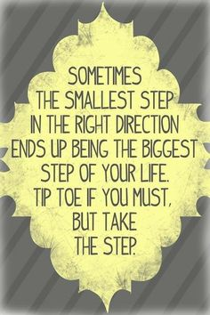

Slide 6
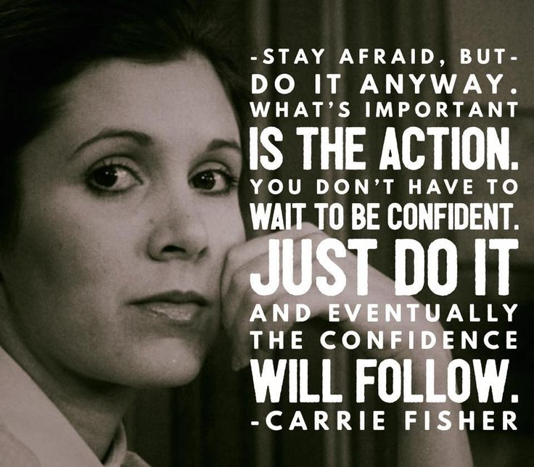

Slide 7
I don’t need an education!
Cheryl O’Dell, CISSP(2010), GIAC Certified Forensic Examiner (2017), MBA (Dec 2019)
1980 1983 ~1986 ~1992 1994 2005 2010 2014 2017 2028?

Slide 8
Notes:
How diverse is your security team? https://www.polleverywhere.com/multiple_choice_polls/WXtKAzTXOuxHgzXukWwmR

Slide 9
Leilani Lauger
Started IT career volunteering for a position on a helpdesk
Worked my way up through desktop support, server administration
Volunteered to take on the work no one else wanted …security!
Key quotes from my peers:
“Security has no future.”
“No one is ever going to care about security.”
“You will never get any funding.”
Executive Director, and Chief Information Security Officer, University of Chicago

Slide 10
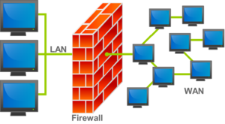
Renee Peters
Director of Technology Risk & Service Management Northeast Community College, Norfolk NE
www.linkedin.com/in/reneepeters1
?

Slide 11
Notes:
Why do you work in cyber security? https://www.polleverywhere.com/discourses/cpNkAlzcGRgYbrLQdNQAZ

Slide 12
What skills do we need in a security professional? Do security personnel need to be technical?
How can an IT department remove unconscious bias when recruiting/interviewing/hiring?
What was THE reason you started in IT, in security, and stayed in IT and/or Security?
How can we recruit more women into Security?
What would you say to someone wanting to start a career in cyber security?

Slide 13
Women Advance IT Conference
November 5-6, 2019 Lincoln, Nebraska
Proposals due May 31, 2019
https://its.unl.edu/conference/
https://www.wicys.net/
http://nebraskawhel.wixsite.com/nwhel/about1-cmfe
https://www.meetup.com/witheartland
https://ghc.anitab.org/
https://www.educause.edu/community/women-in-it-constituent-group

Slide 14
Women In Security (not insecurity)
Andrea Childress
achildress@nebraska.edu
Cheryl O’Dell
codell@nebraska.edu
Leilani Lauger
leilani@uchicago.edu
Renee Peters
renee@northeast.edu

Slide 15
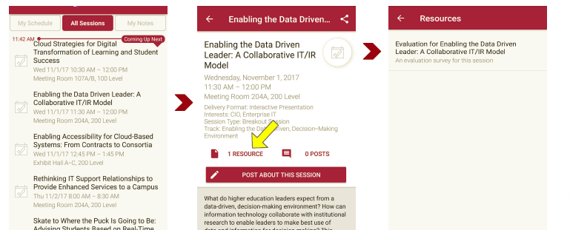
Session Evaluations There are two ways to access the session and presenter evaluations:
1
2
In the online agenda, click on the “Evaluate Session” link
From the mobile app, click on the session you want from the schedule > then click the associated resources > and the evaluation will pop up in the list

