Slide 1
Machine Learning For SecOPS
A Gentle Introduction
By: Louw Smith (Boston College)
…you say robot uprising like it’s a bad thing.

Slide 2




whoami
Currently: BC Security Analyst
Past: UC San Francisco, NASA
E: louw.smith@bc.edu
Twitter: @louws

Slide 3
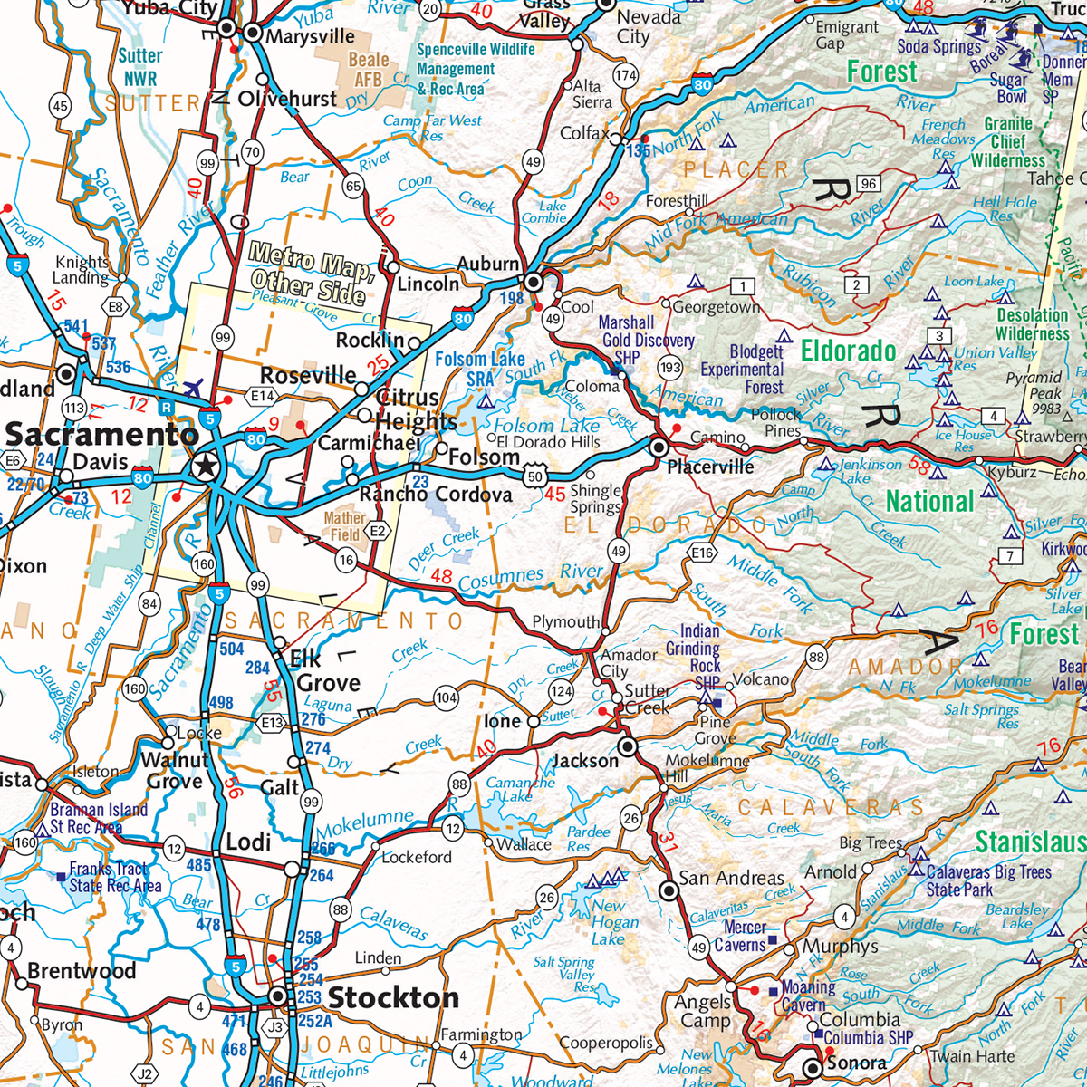
Roadmap
Introduction
How to get into ML
Selecting your project
ML Basics
ML not so basics
Our Project -The Nitty Gritty
About those Results…
Resources
Questions?

Slide 4




How to Get into Machine Learning
Piles of data
OR

Slide 5
Three Desired Competencies
If you’re:
Statistics Oriented:
  Start with R/Matlab, move into Numpy.
  Familiarize yourself with coding
Computer Science Oriented:
  Start with your language of choice; Python or Java are great
  Familiarize yourself with basics of statistics
If you’re an Expert in a topic:
  Prototype with Weka
  Familiarize yourself with coding (Python is a great start)

Slide 6

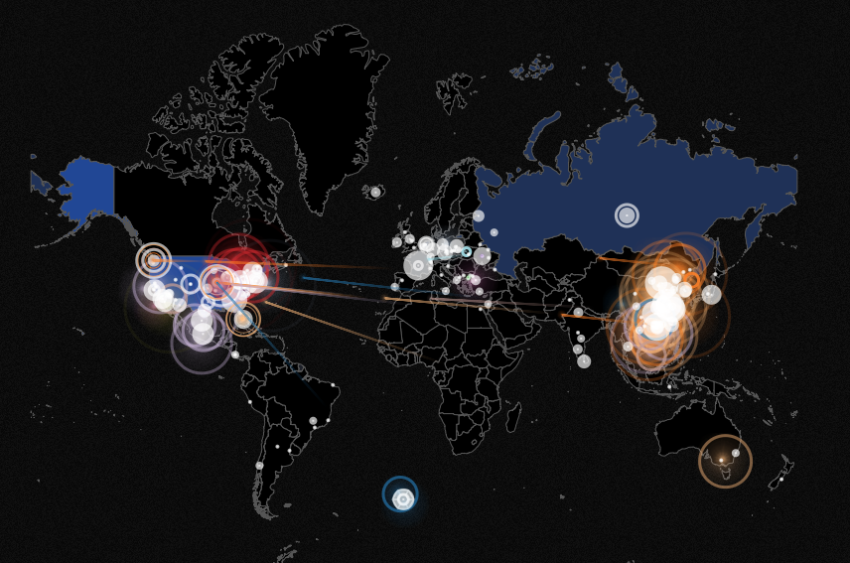
Our Projects
PolyMorphism in Malware
(Security Camp 2017)
Detecting DGA Malware
pew-pew

Slide 7
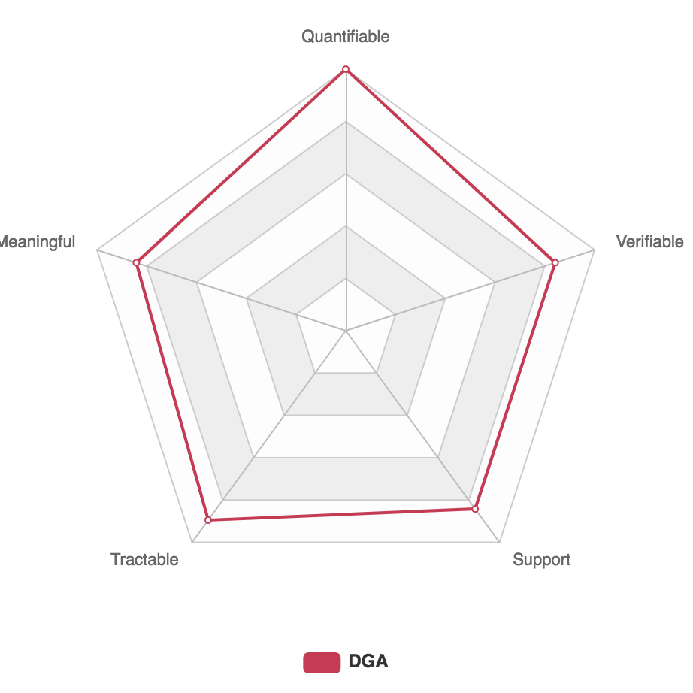
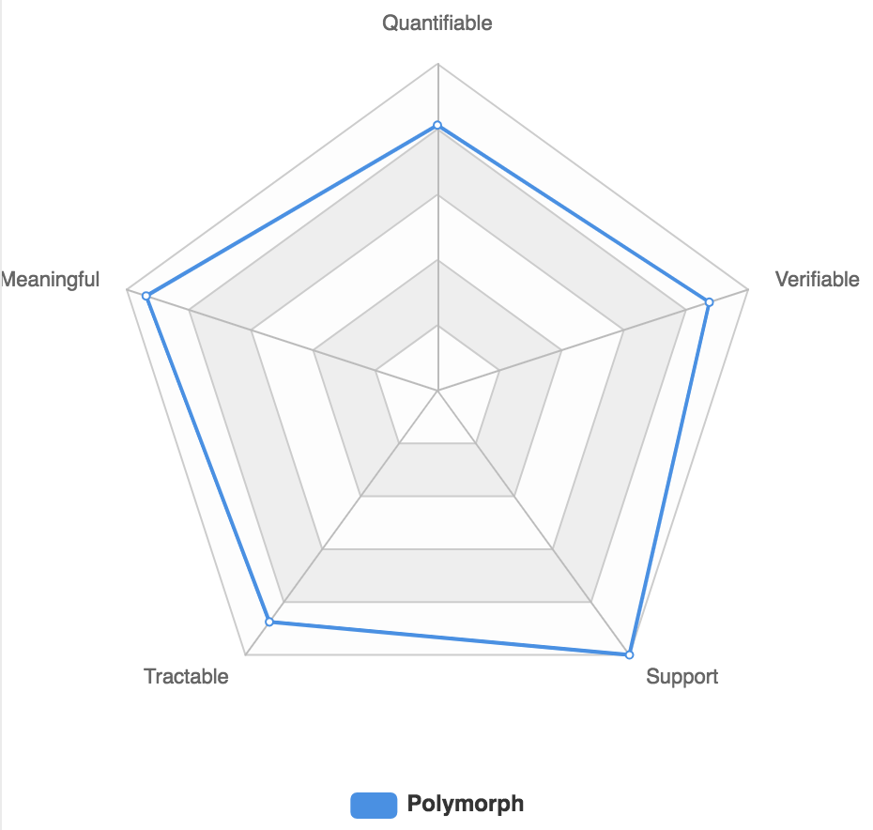
Aspects of a Machine Learning Project
ML projects should be:
  Quantifiable – Is the problem measurable?
  Verifiable – Can we verify the results? The learning?
  Reinforce our intuition, or at least have rock solid evidence for changing our understanding of a problem
  Tractable – Before we moonwalk lets make sure we first can first mooncrawl(?)

Slide 8
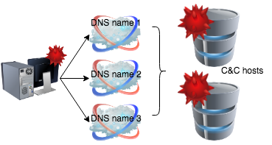
Domain Generating Algorithm
Some Neat Facts:
First seen used by Kraken malware
Guest star in the Conficker worm
What it does:
Allows attackers to launch a malware campaign with a persistent C&C presence. The ”presence” is a domain known to the malware where it can receive instructions. Domains are dynamically generated and hard to detect
How it works:
User’s machine is infected
Malware knows which domains to contact to receive instructions
C&C Server maintains a constant contact
1
2
3

Slide 9
Example: Banjori
Step 1: Begin with a seed word:
Step 2: Apply a few rounds of
transformations/permutations
Step 3: Profit!

Slide 10
What can we do?
Challenges
Domains are algorithmically generated, normal threat intel is not overly helpful
Domains are generated quickly and as needed
Domain information itself doesn’t indicate malicious purposes (ie there is no “.evil” domain)
Malware reversing does not give us a secret list of available domains.
Responses:
We can try to look for binaries, droppers, evidence of the malware itself.
Keep refreshing threat intel
We can try to look for weird looking DNS requests. (Ok weirder that normal) and block them

Slide 11
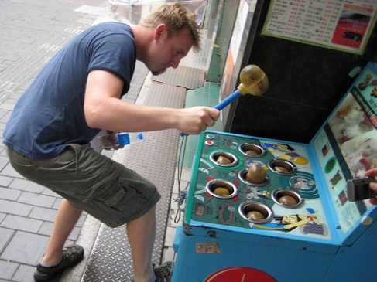
From Security’s Point of View

Slide 12
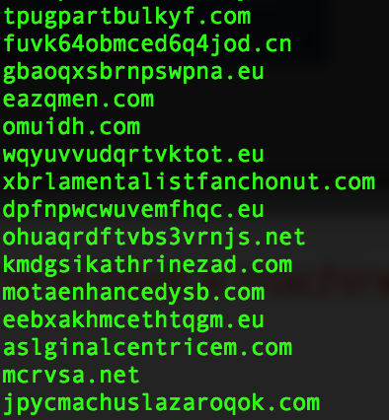
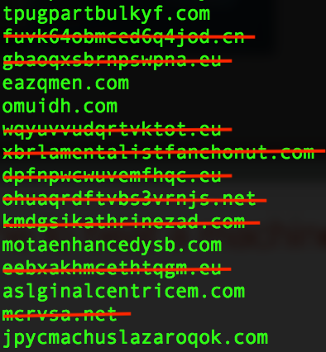
It takes a machine to beat a machine
Can do we take domains like this
And do this ?
… oh and please don’t block any legitimate sites

Slide 13
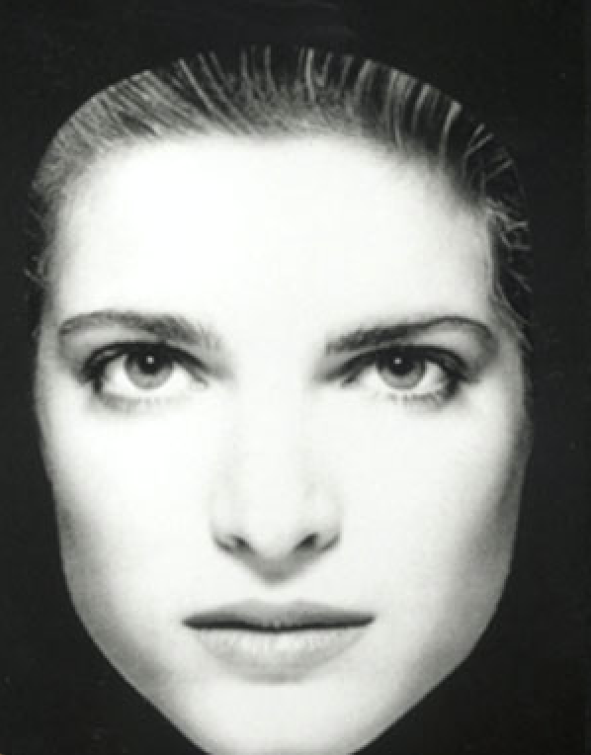
Machine Learning in 5 minutes or less (or your money back!)
We begin with well known objects/instances. In this case faces

Slide 14
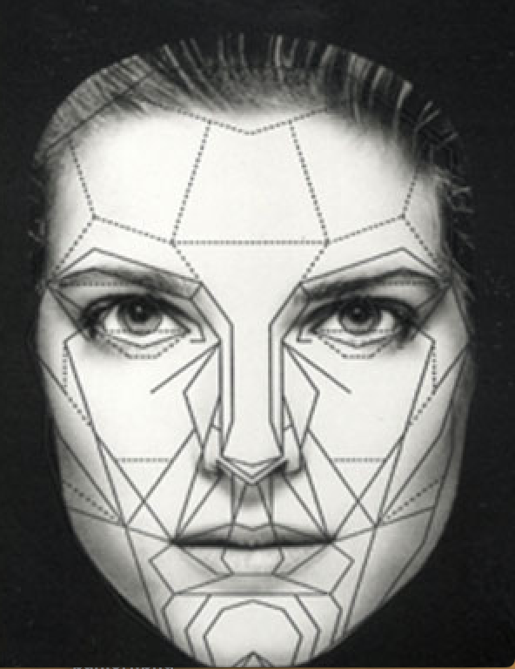
Machine Learning Step2
We collect ”features” or metrics of the specific instance
Gender: Female
Age: 35
Hobbies: Juggling
mountain biking
Occupation: Journalist
Notes:
The more features the more correlations we can make. But also the harder the computation and the higher the noise.

Slide 15
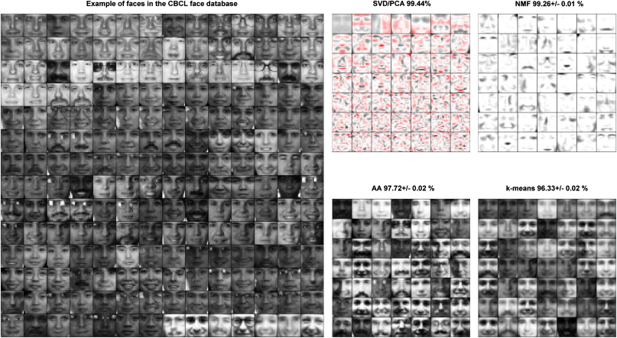
Repeat 100’s, 1000’s of times (at least more than 50)

Slide 16
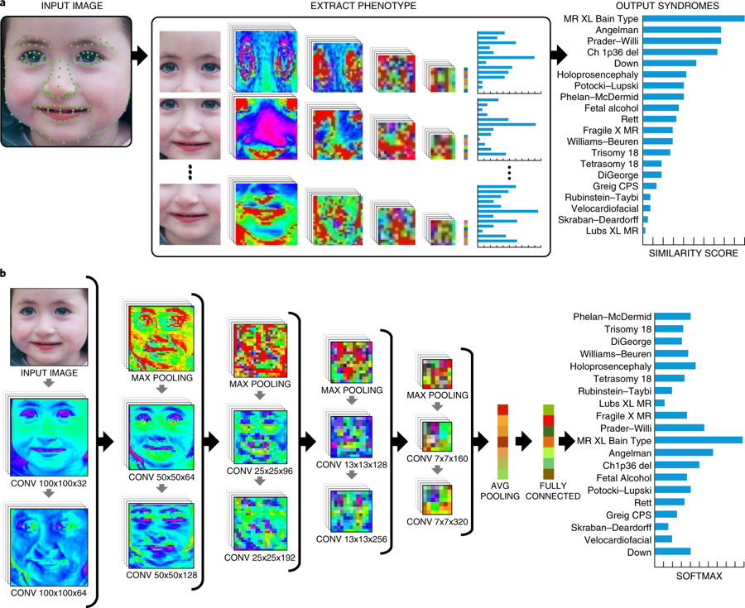
Apply Statistical Learning Algorithms to Instance/Feature pairs to find correlations

Slide 17
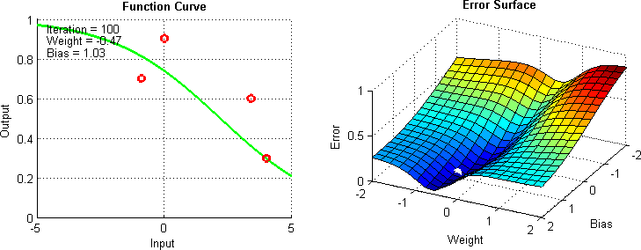
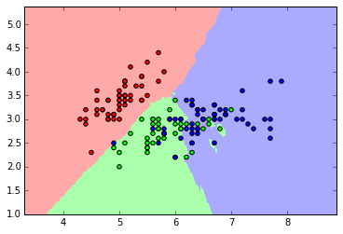
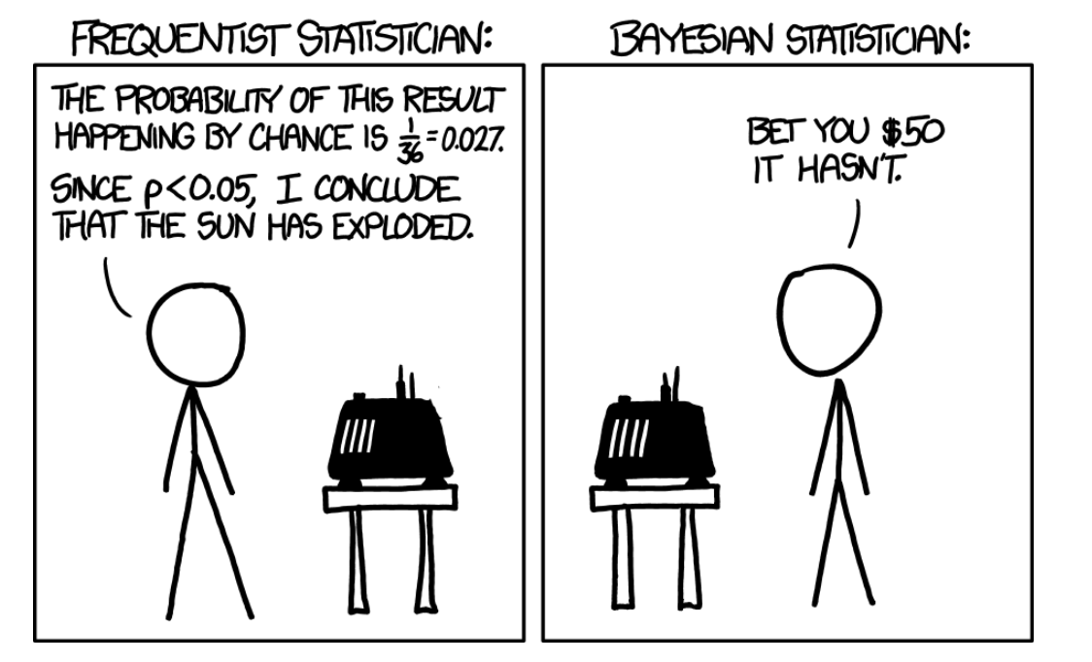
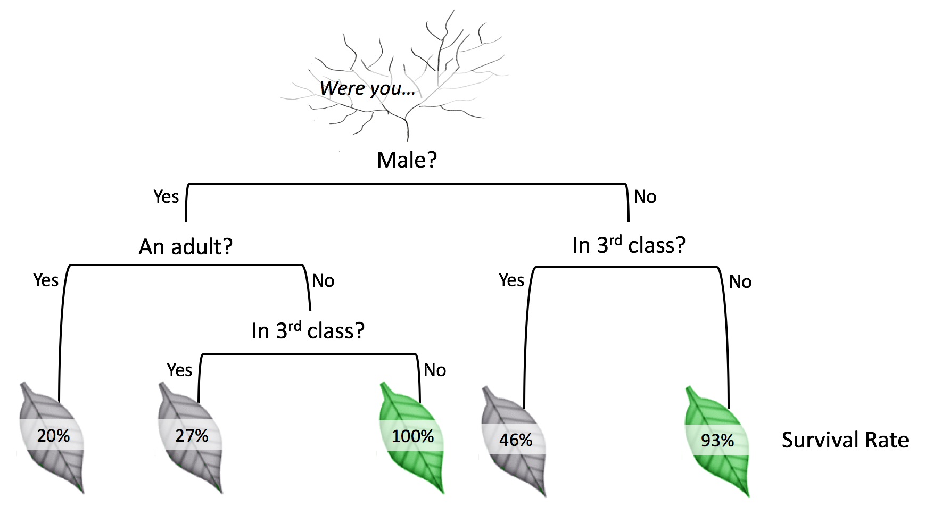
Some Common ”Algorithms” - Classifiers
Stochastic Gradient Descent
K Nearest Neighbors
*source: https://towardsdatascience.com/
Source: https://dsdeepdive.blogspot.com
Bayesian
Decision-Tree
*source:XKCD
Source: https://www.kdnuggets.com/

Slide 18
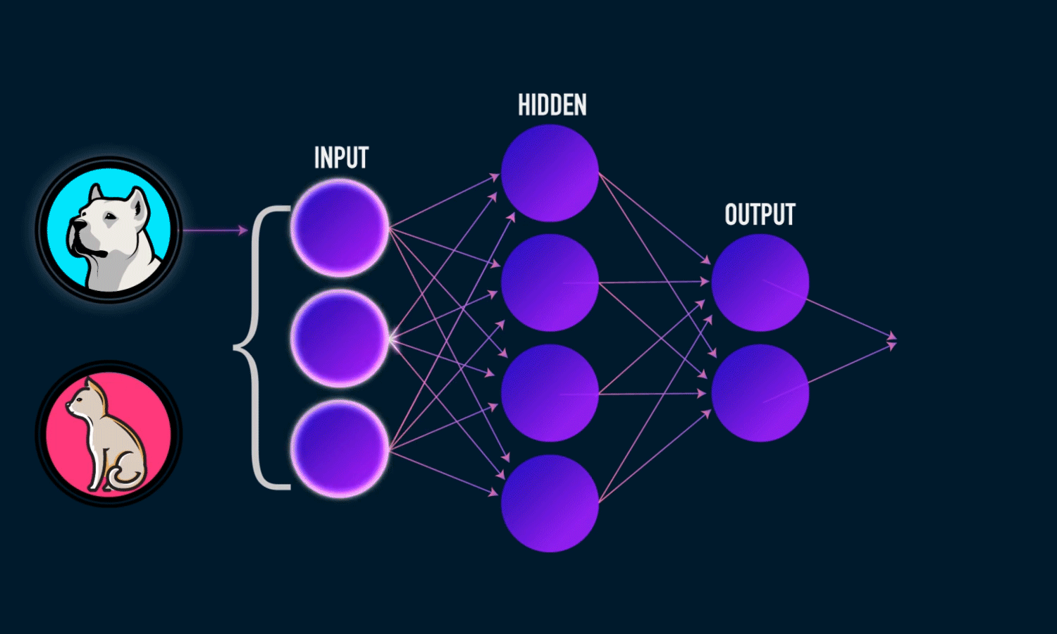
Another type: Neural Networks
*Source: https://www.analyticsindiamag.com/

Slide 19
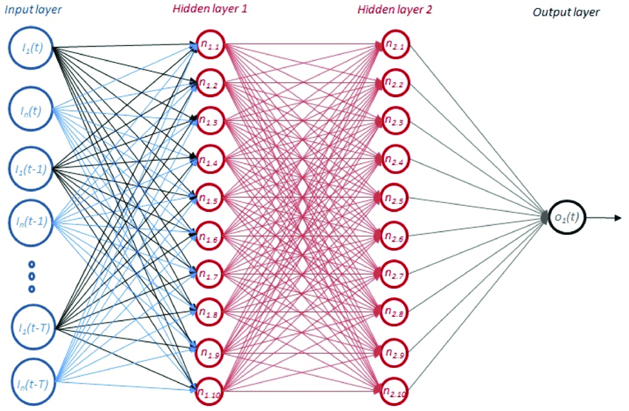
It can get complex quickly
*source: https://www.researchgate.net/

Slide 20
Hidden Layers transfer information
We use Recurrent Neural Net (RRN) to incorporate what we learn from prior inputs
Input prior
Output
Input new
Chain them together we can ‘remember’ prior information as we feed new information to a cell

Slide 21


Except when…
If your initial learning factor is too small...
You get a vanishing gradient problem and no learning occurs (convergence => 0)
But if your learning factor is too big…
You get an exploding gradient problem (convergence tends to $∞$)

Slide 22
Long Short Term Memory to the Rescue!
Long Short Term Memory
LSTMS
function better than RNNs as it uses a
number of gates and forget states to
hone in the most relevant information
and through various sigmoid
and
tanh functions prevents the issue of either
exploding or vanishing gradients. Additionally it has a robust mechanism that
carries over learned information from previous cells

Slide 23

To Begin: The Data We have
It turns out some fantastic malware researchers found the algorithms to some of the common DGA campaigns. We were able to generate thousands of domains similar to the following campaigns:
*Approximately 10,000 for each campaign.
Additionally we also added:
Alexa’s top million sites for known “good” sites
All of BC’s sites
Additional malware sources including Bambenek’s lists and Malware Domains

Slide 24
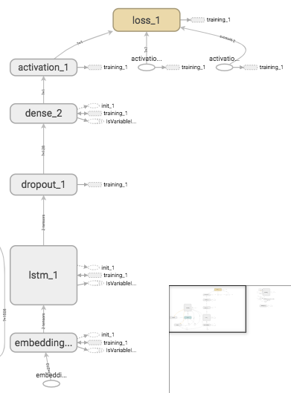
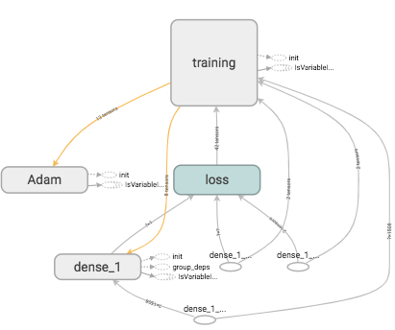
Remember those cells?
This is what our learning graph looks like at a very high level
Who is Adam and what is he doing in my neural net?!

Slide 25
The Learning Observed
Step1:We start with a list of domains that are labeled
xewokii.com:malware
forum-media.hu:ok
bc.edu:ok
hovione.com:ok
tbhwrm.info:malware
gvxerpxbdediyvkv.la:necurs
gater.eu:simda
mingmen.com:banjori
satoment.com:banjori

Slide 26
Learning Continued
Step 2: We encode the letters (turn them into vectors)
xewokii.com:malware
X
E
W
O
K
I
I
.
C
O
M
1
[v1]
[v2]
[v3]
[v4]
[v5]
[v6]x2
[v7]
[v4]
[v8]
[0,1]
bc.edu:ok
B
C
.
E
D
U
0
[v10]
[v7]
[v2]
[v11]
[v12]
[0,0]

Slide 27
Learning Continued
Step 3: We start making some correlations
xewokii.com:malware
X
E
W
O
K
I
I
.
C
O
M
1
bc.edu:ok
B
C
.
E
D
U
0

Slide 28
How to evaluate your ML results.
There are fundamentally 4 types of results we can achieve
Actual Value
True
False
TP
FP
True
Predicted Value
FN
TN
False

Slide 29
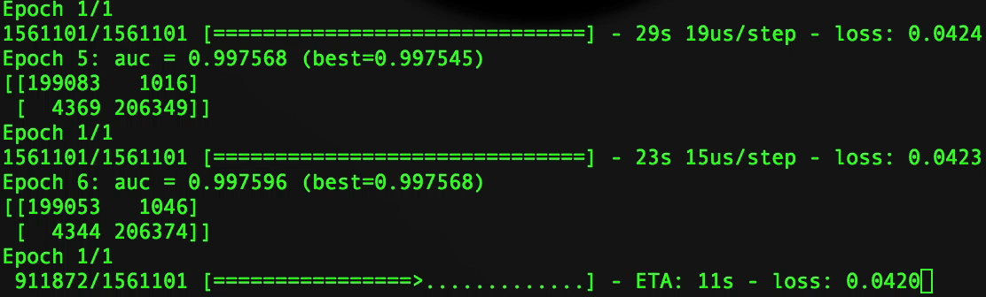
Go Classifier Go!
Epochs: A new training instance. With neural nets we carry over some information
from prior epochs to hopefully enhance learning
Confusion matrix: Every epoch witll have a combination for FPs TPs FNs and TNs
AUC: Area under the curve. A metric for how robust our model is. Values closer
to 1 typically mean better performance
Loss: Roughly a measure how well (or poorly) our guesses are

Slide 30
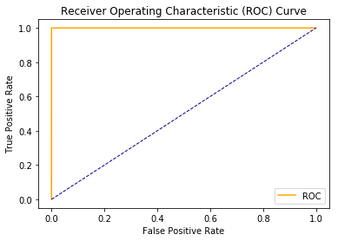
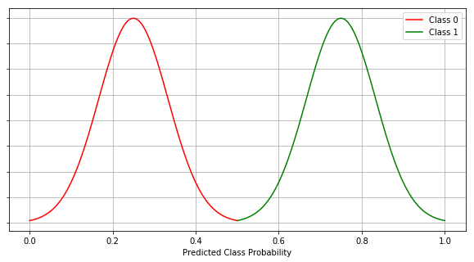
Learn like a ROC…star
Plotting our rates of True Positives to False positives we get a ROC plot (Receive
Operator Curve). It is a measure of how well we captured TPs and FPs compared
to each other
Rember that AUC number from
Before? Well it is the area under
The yellow line. The maximum being 1.

Slide 31
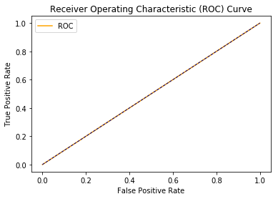
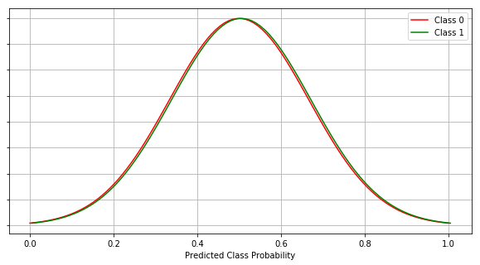
When your classifier is not so great…
If your TP rate is the same as your FP rate then your predictions are no better
than chance

Slide 32
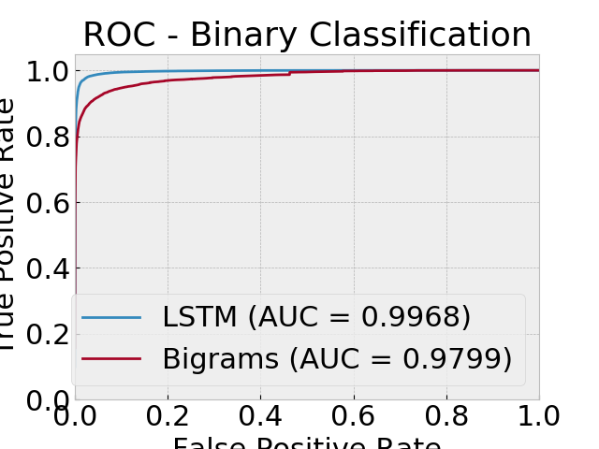
How did we do?
We got nearly there
With an AUC of 0.9968
**We compared it with
another classifier for
A speed comparison

Slide 33

But how well did we really do?
Real world test:
  50 Known DGA sites
    49 classified as malware
    1 classified as non-malware
  50 published malware sites,
    45 Classified as malware
    5 Classified as non-malware
  50 Alexa sites:
    14 Classified as malware
    36 Classified as non-malware
  50 sites from traffic on campus
    12 classified malware
    38 classified as non-malware

Slide 34
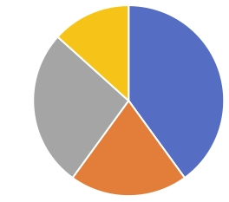
What’s happening here?
Some of the misclassified sites caught by the classifier were:
Lessons:
Alexa ranks traffic not safety
A lot of malware still uses ‘adult’ topic matter
The balance of campaigns veer towards China/Russian efforts
Takeaways:
We’re good at detecting DGA’s
We need more work on False positives
Other
Adult Sites
Chinese Sites
Russian Sites

Slide 35

Can you beat a machine?
Malware or Not? (1 of 3)
bsda3clq7s5e.com

Slide 36
Malware or Not? (2 of 3)
almostpeople.com

Slide 37

Malware or Not? (3 of 3)
appboycdn.com

Slide 38

Next Steps
Enrich our training data with actual DNS metrics
  Query type (A,PTR,NS)
  Response type (NOERROR, NXDOMAIN)
  TTLs etc.
Enroll additional campaigns
Move away from ‘name’ recognition and move into behaviorial recognition
  Previous efforts suggest this work is promising

Slide 39






Wrapping up
With some of the theory in mind we used the following tools to run

Slide 40
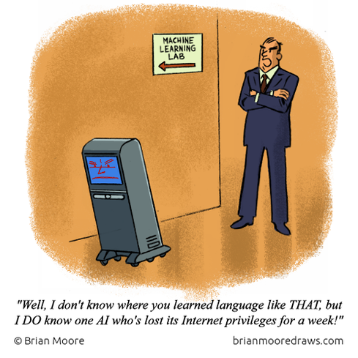

Slide 41

Questions?
Source: XKCD

Slide 42

Thank you
No really. Thank you
Special thanks to my colleagues
David Escalante
Phil Deneault
David Millar
Patrick Cain

