Slide 1
Practice to Prevent
Creating and Delivering IR Table Top Exercises
Richard Sparrow
The Office of Information Security
The Pennsylvania State University

Slide 3
The Aha Moment
Routine incident?
01
Suspicious network traffic quickly escalated when Mimikatz was discovered.
Missing team members
02
Key team members were not available through a combination of illness and family matters.
Collaboration challenges
03
Working with unit IT proved to be challenging at first. They were completely unfamiliar with our plan and approach.
Stress caused problems and delays
04
The scale of the response created stress. This led to time wasting mistakes, duplicated task, and failed communication.

Slide 4
Committed to Improving

Slide 5
Honest Assessment
Plan
It was clear that not everyone was aware we had a plan.
Resilience
People were not prepared to step into other roles.
Static
We had grown used to handling volume, not complexity
Unit IT
Unit IT had high expectations, we could not fall short

Slide 6
Embracing Continuous Improvement
Face the hard truth
We needed to get better in all aspects of communication, collaboration, and organization. We had become over-reliant on key players and did not prepare others to take over when needed.
Seek ways to improve
We needed to find ways to improve without relying on lessons learned from major events.
Focus on process and people
We need to build teams that understood the value of processes and consistency. Processes needed to be useful. Outcomes needed to be consistent.
Result: We would design a test of our incident response plan that would challenge our weaknesses and expose gaps. We would incorporate lessons learned and seek to improve with every test.

Slide 7
Exercise Criteria
Practice Makes Perfect
Outside Unit Participation
Everyone helps design
Table tops needed to be repeatable. Exercises are scheduled months in advance.
Units would be recruited to participate in planning and exercise management.
Exercises are designed and executed by different team members.
Find Gaps
Assess the Exercise
Work the process
Need to create a safe place. Set the tone that the test is designed to show gaps.
We will grade exercise performance. Spend time on learning lessons.
Consistency is valued. Trust the process.
Expect the Unexpected
Incorporate Improvements
Use the time wisely
Team members need to be ready to step in. There is always a red herring.
Constantly look for ways to improve the table top exercises.
Exercises need to be engaging for participants. Find value add activities to fill the gaps.

Slide 8
What incident response scenario
keeps you up at night?

Slide 9
Penn State’s Approach

Slide 11
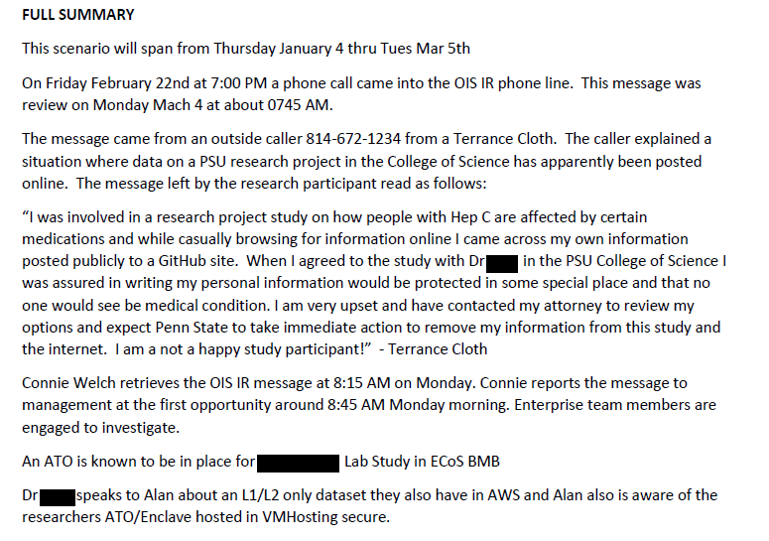
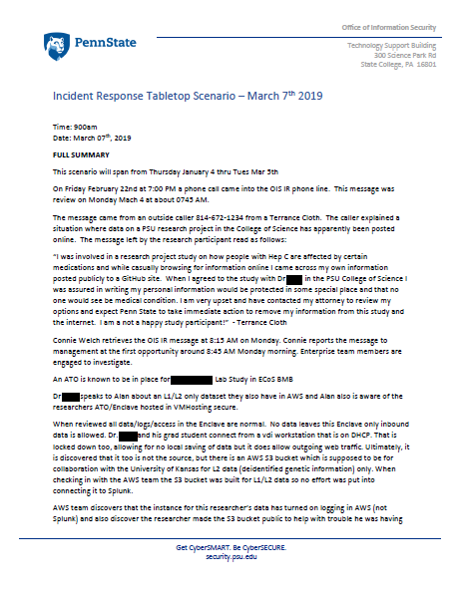
What Really Happened

Slide 12
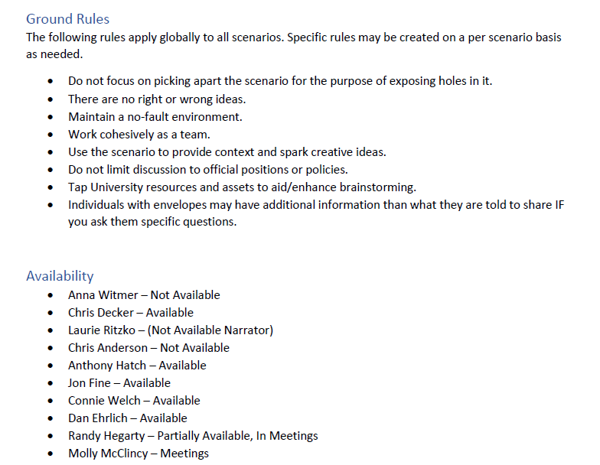
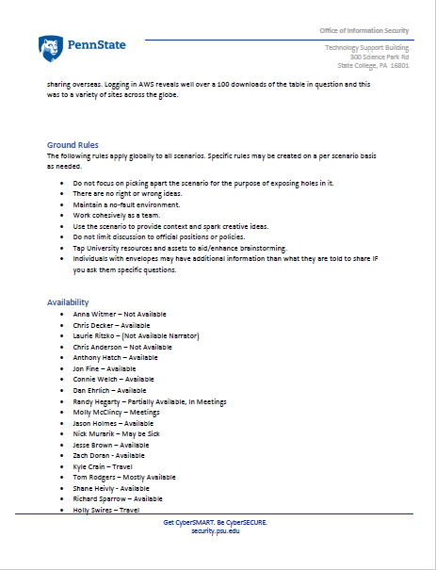
Setting the Stage

Slide 13
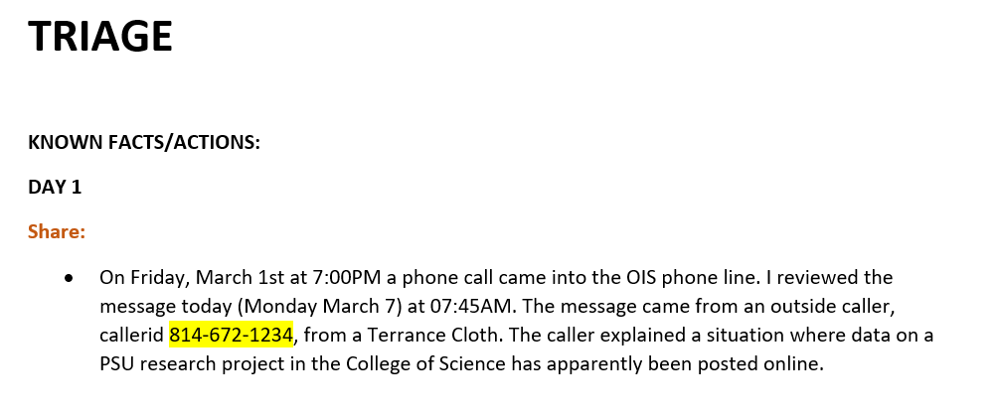
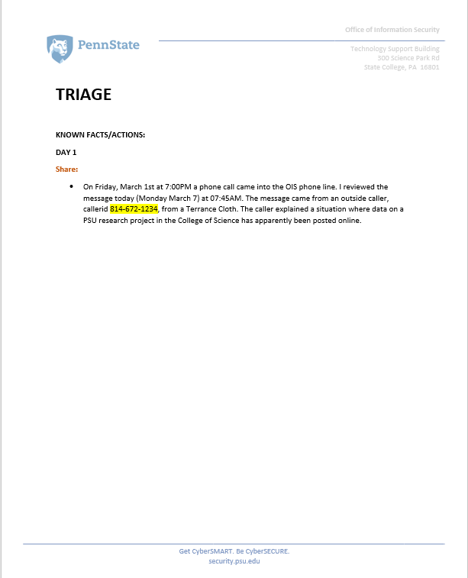
Getting Started

Slide 14
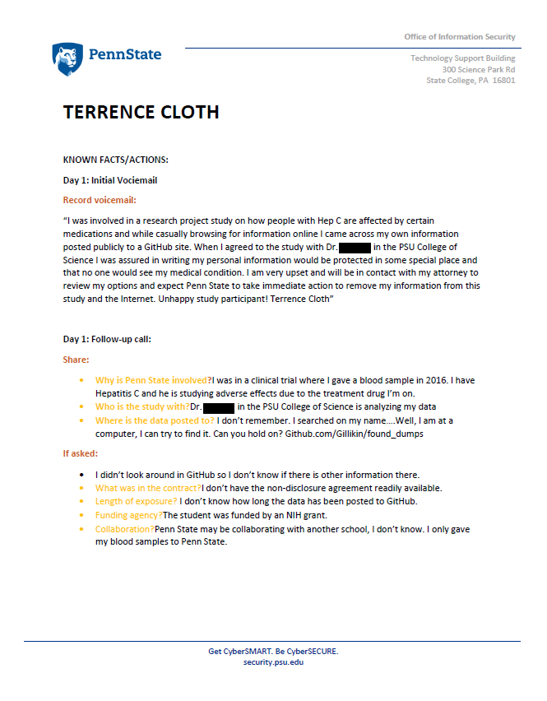
First Interview

Slide 15
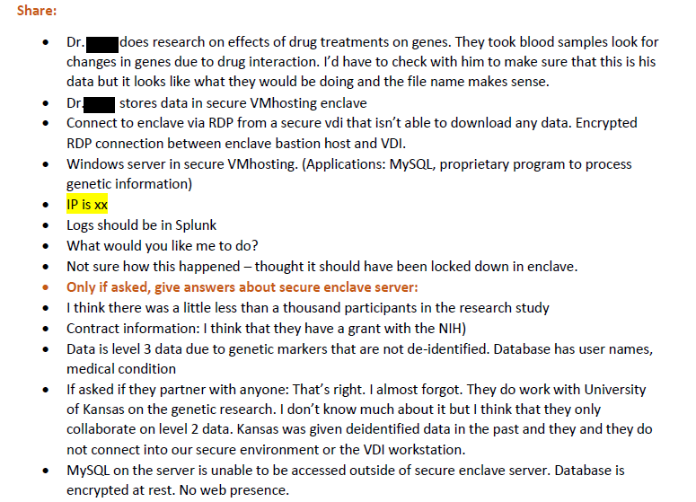
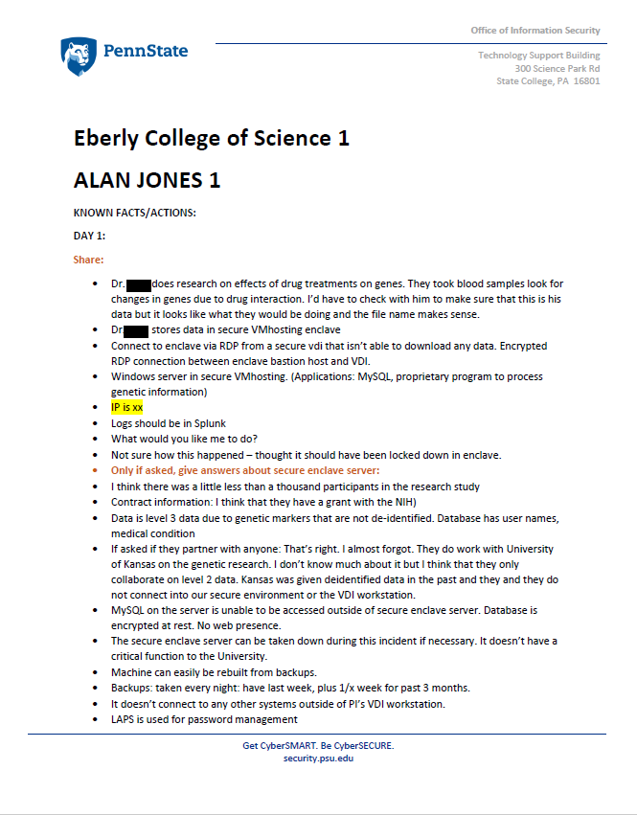
Working with Unit IT

Slide 16
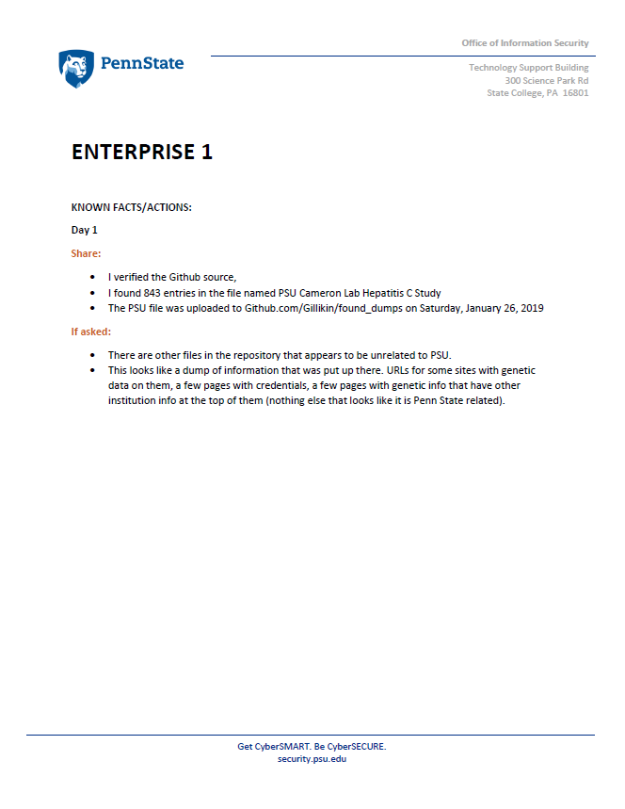
Analyst Work

Slide 17
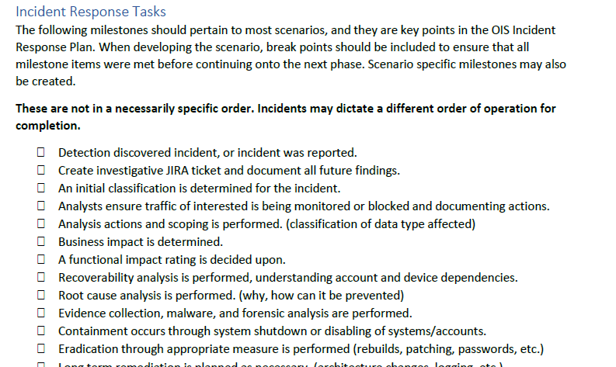
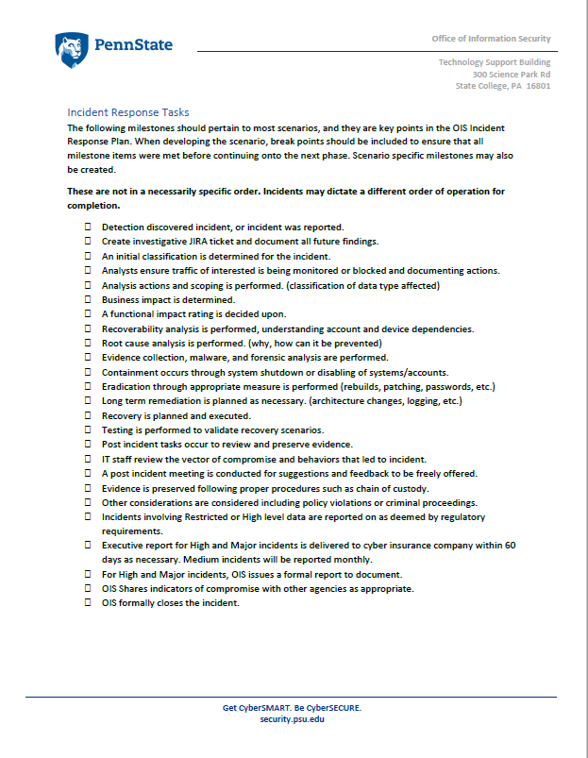
Assessing Progress

Slide 18
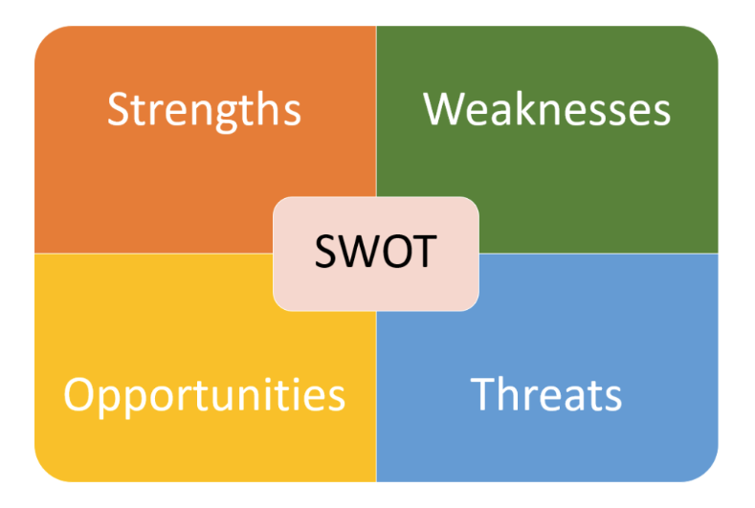
Wrapping it All Up
Solicit feedback
Make sure everyone’s voice is heard. Be prepared to expand dialog with questions. Work for good feedback.
Plus / Delta or SWOT Exercises
Conduct exercises that give the team time to digest and articulate things that went well or things that should be improved. Document the positive and the negative.
Plan for Improvement
Create plans to incorporate ideas for improvement. Be thoughtful and deliberate. Create action items.

Slide 19
Past Scenarios
OIS detects a compromised workstation with a mapped drive that contains medical information.
An outside agency reports suspicious activity related to APT18. The server in question is an orphan.
Amazon IaaS is found to be compromised.
Unit IT reported that AV detected malware on a system belonging to a faculty member who was traveling abroad. Compliance issues are discovered.
Several Penn State computers participate in a DDOS attack. Investigation leads to a researcher who just returned from travel.
FBI sends a report on a suspicious IP. The IP is correlated to a WorkDay contractor.

Slide 20
Exercise Phases
Create a planning team
Pull together a cross functional from OIS and unit IT
Build out the exercise
Use lessons learned and exercise artifacts to build out exercise
01
02
Six Steps
Process
Incorporate lessons learned into operations
Fix documentation and process gaps, train people where needed
06
03
Hold the exercise
Execute and manage the exercise
05
04
Conduct lessons learned exercise
Review the assessment scorecard, conduct a SWOT
Assess exercise performance
Use the scenario scorecard to track milestones

Slide 21
Things We Learned Along the Way
Communication Really Matters
01
Change with interview format allowed the team to focus on the quality of the information they received and transmitted.
Need to have engaging Activities
02
Key participant evidence gathering and interviews provide a good time for brainstorming activities to keep people engaged.
A need to keep the clock moving
03
Use PowerPoint slides to give participants a sense of time. Example: Day is ending, what are the wrap up task.
Consistency increased
04
The team made significant strides. New members to the IR process could perform adequate triage.
Unit IT realized value
05
Without exception, unit IT came to value the experience.

Slide 22
What is one step you can take to prepare your school?

Slide 23
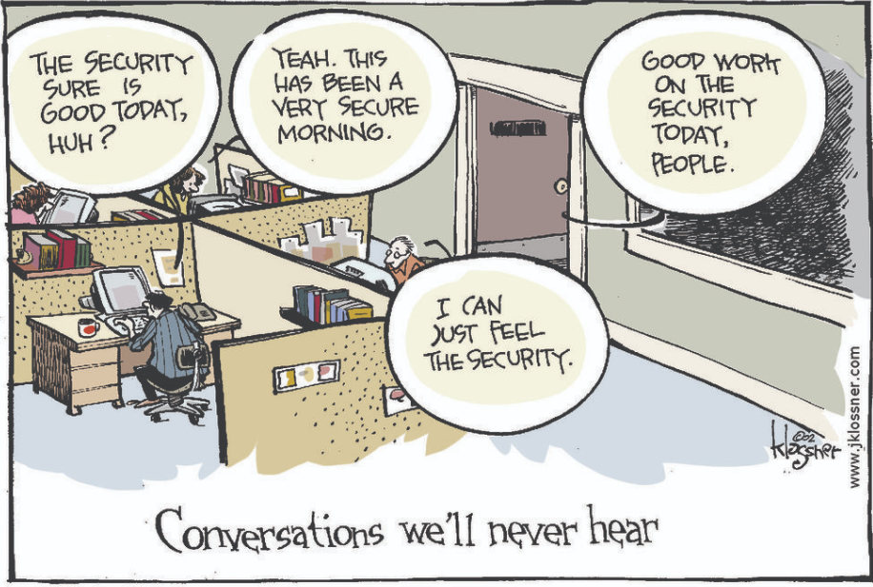
Q & A

Slide 24
The Office of Information Security
Contact Information
EMAIL
richard.sparrow@psu.edu
website
www.security.psu.edu

