Slide 1
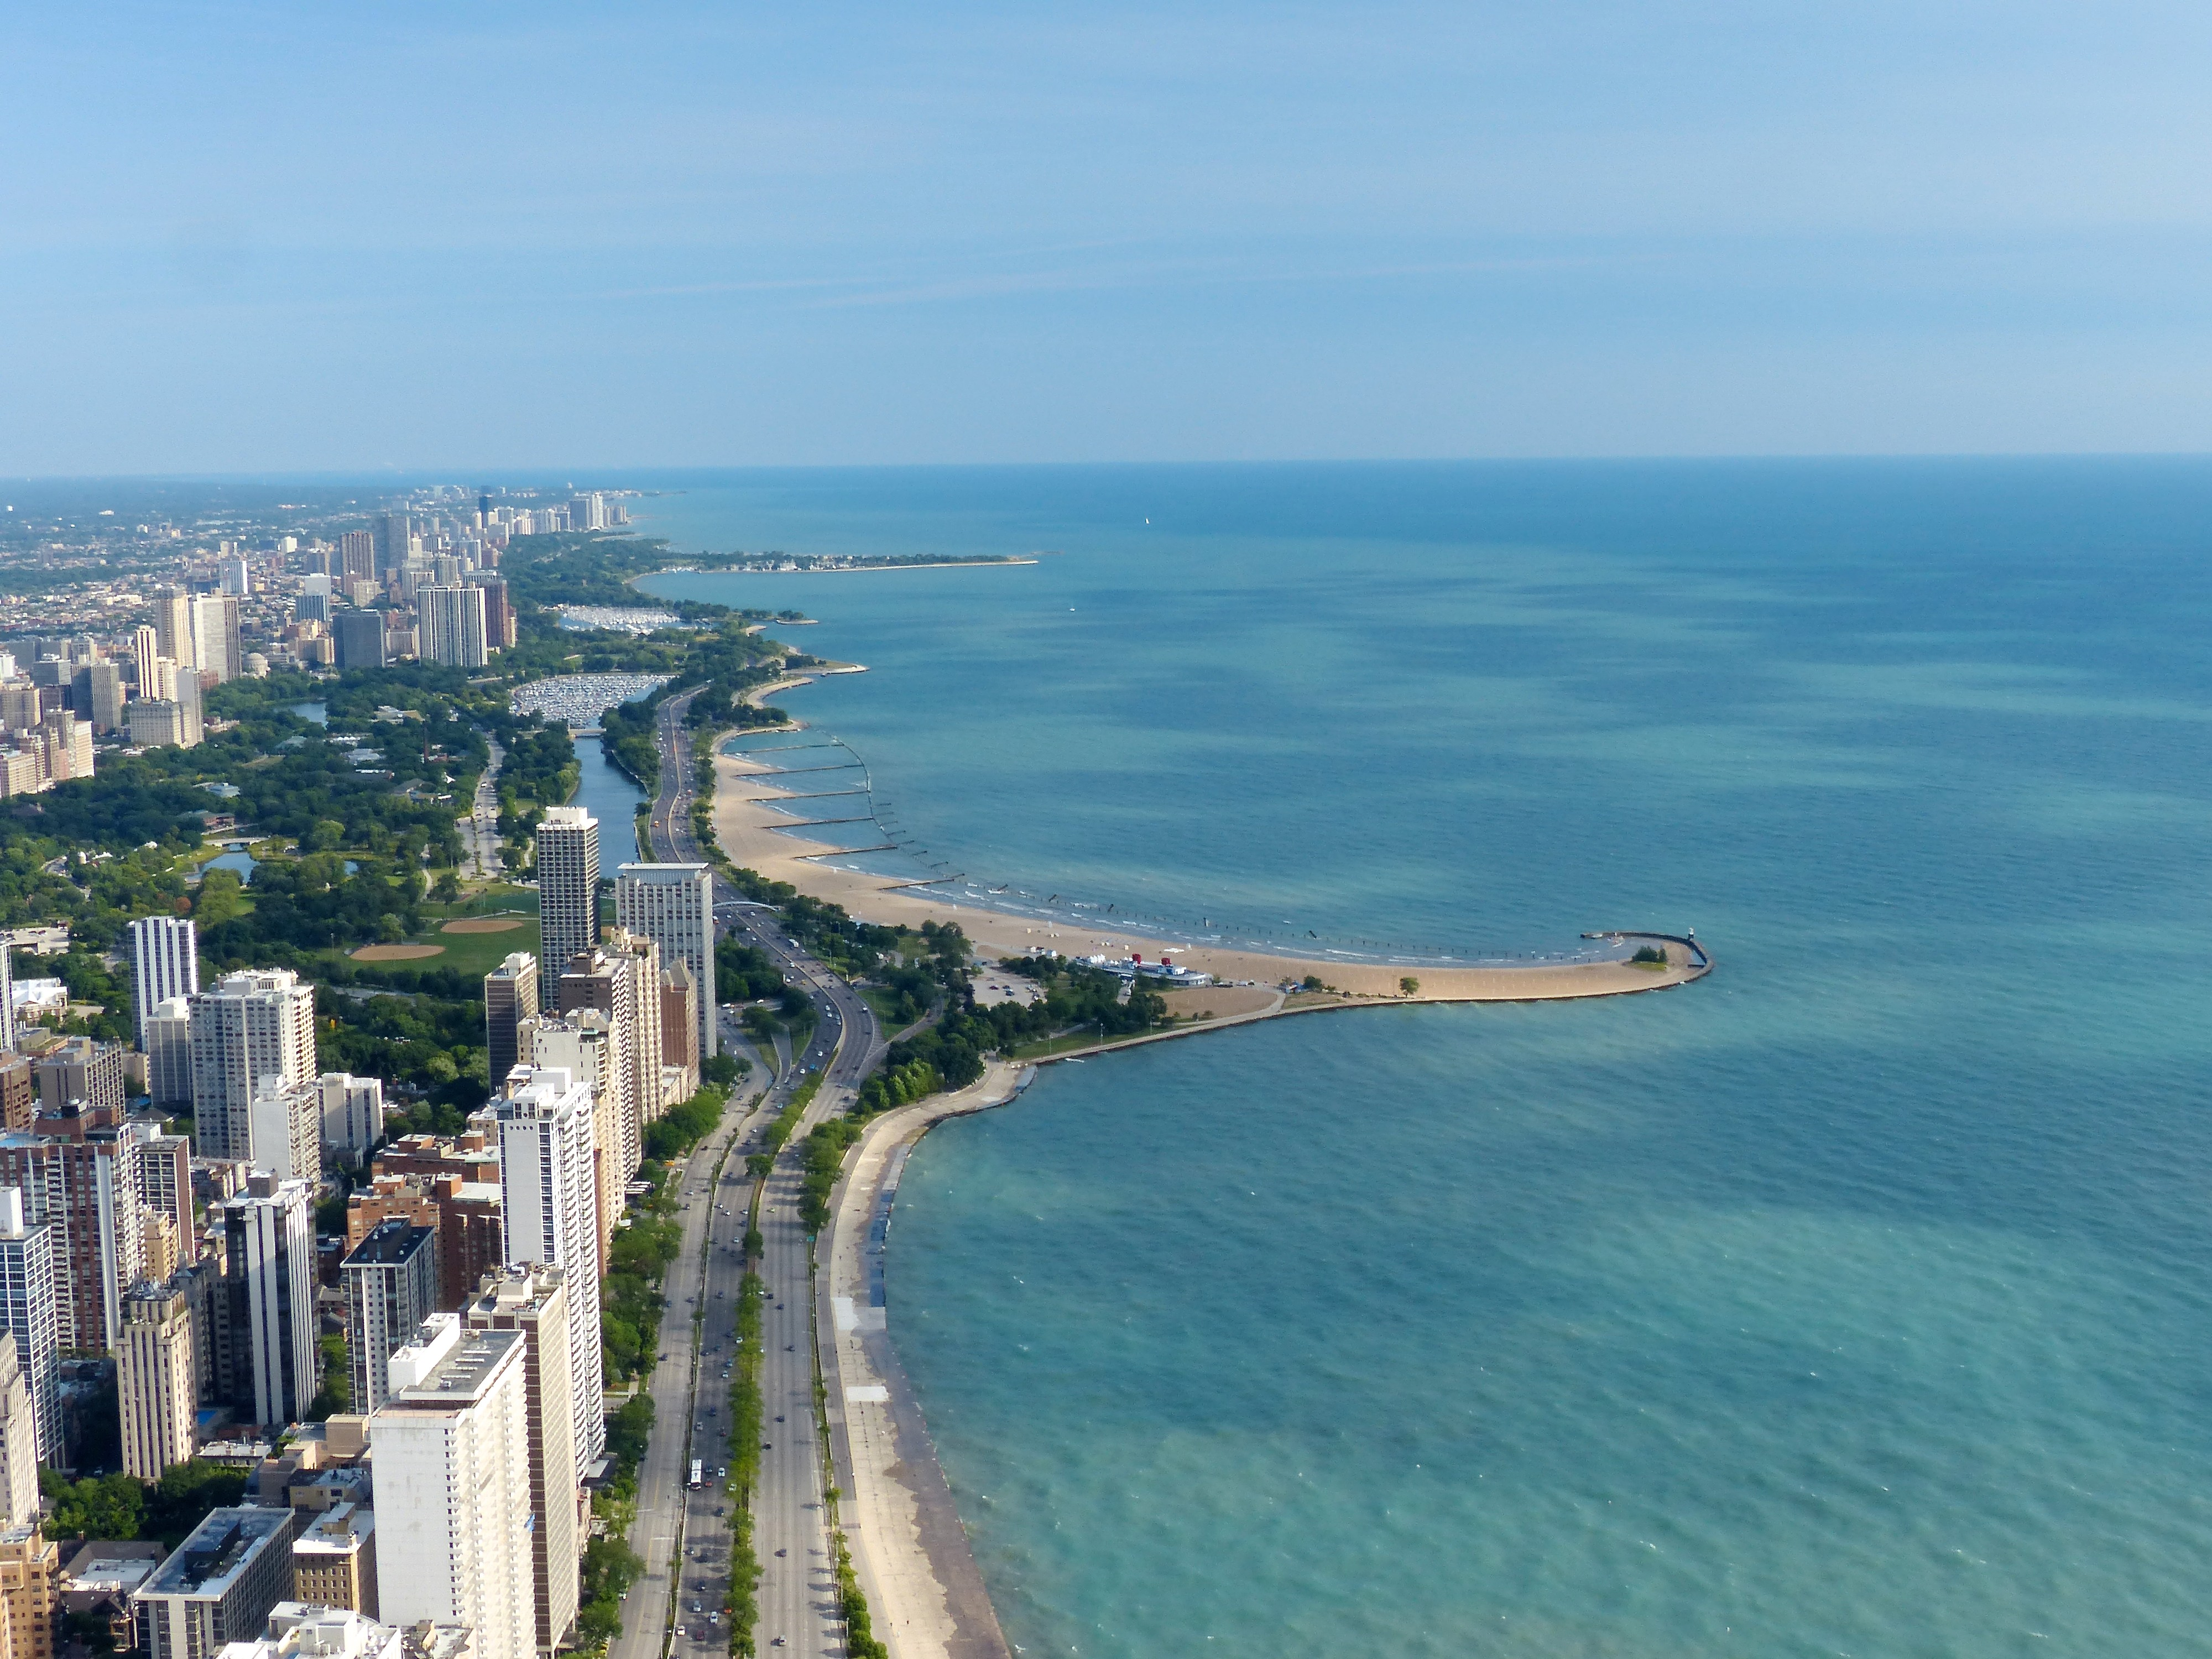
Bringing a
Security Data
Lake into View
Philip Kobezak
Randy Marchany
Security Professionals
Conference 2019
Lake Michigan at Chicago by Roman Boed is licensed under CC BY-SA

Slide 2
Enable Research,
Responsibly
Lake Michigan at Chicago by Roman Boed is licensed under CC BY-SA

Slide 3
Agenda
Data Lake Concept
Poll #1 (pollev.com/philipk241)
Virginia Tech Approach
Poll #2
Research Examples
Other Approaches
Audience Discussion
Lake Michigan at Chicago by Roman Boed is licensed under CC BY-SA

Slide 4
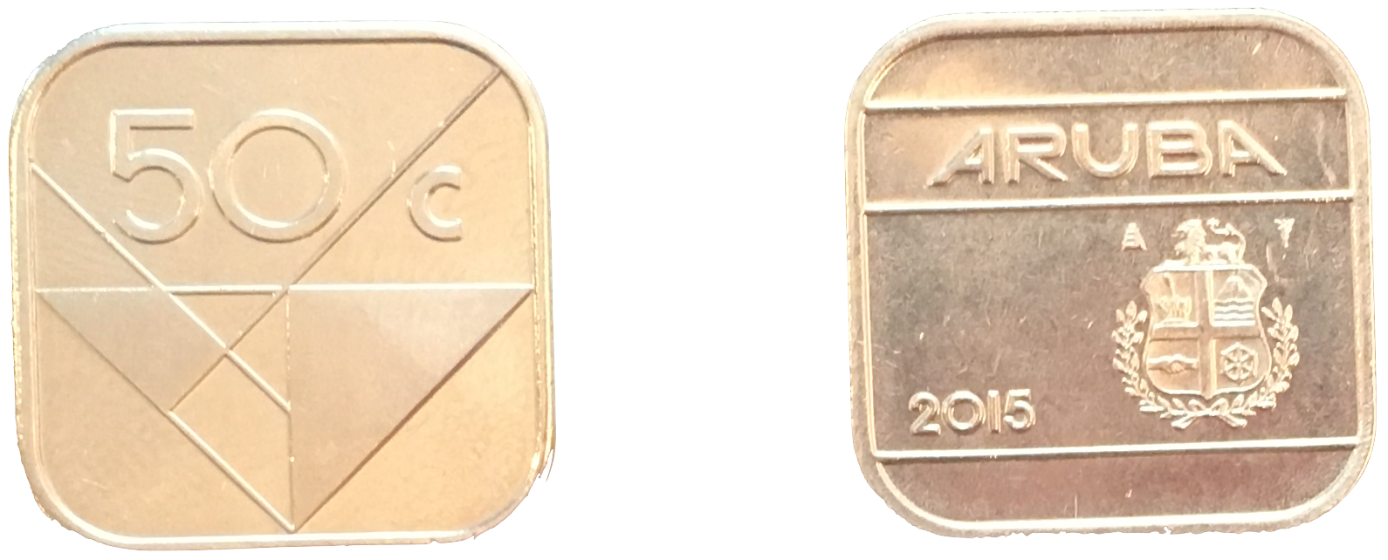
But First…
Security and Privacy – two sides of the same coin

Slide 5
Data Lake Concept
We define a data lake as
Many sources in one place
Flexible query tools
Data democratization
Developed out of business needs
for administrative and learning mgmt. data

Slide 6
Data Lake Concept
VT Data Lake Pilot
Started as a “sandbox effort” – now a pilot
Involves Provost’s Office
AWS account using S3 storage and Glue
S3 is economical
Glue catalogs for Athena (SQL access)
Customers built web apps and RDBs

Slide 7
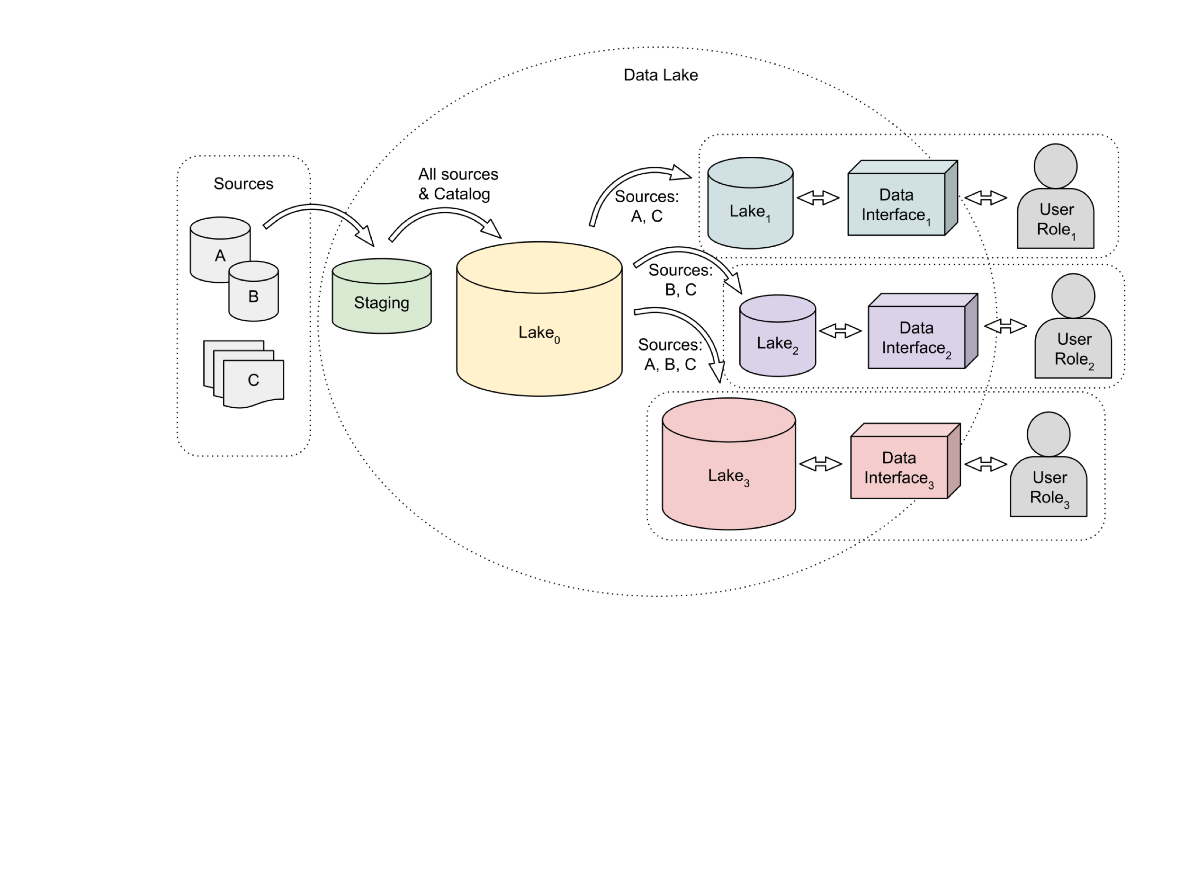

Slide 8
Data Lake Concept
To Summarize:
More data accessible by more people
Consistent data catalog
Derived copies refreshed as required
Data lakes may very slightly in implementation
This is an evolving concept

Slide 9
Poll # 1: Data Lake and Enterprise Data
PollEv.com/philipk241
We have four questions, we’ll ask one at a time

Slide 10
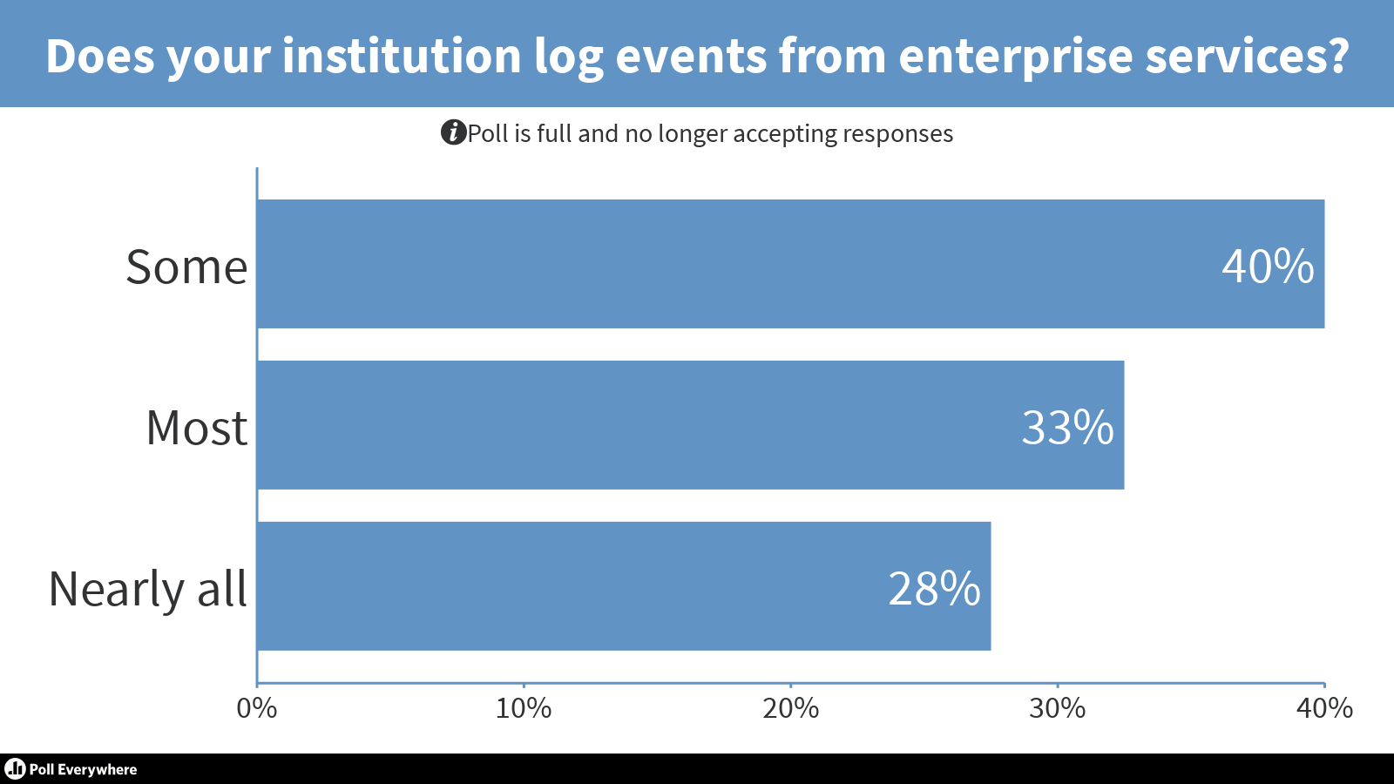

Slide 12
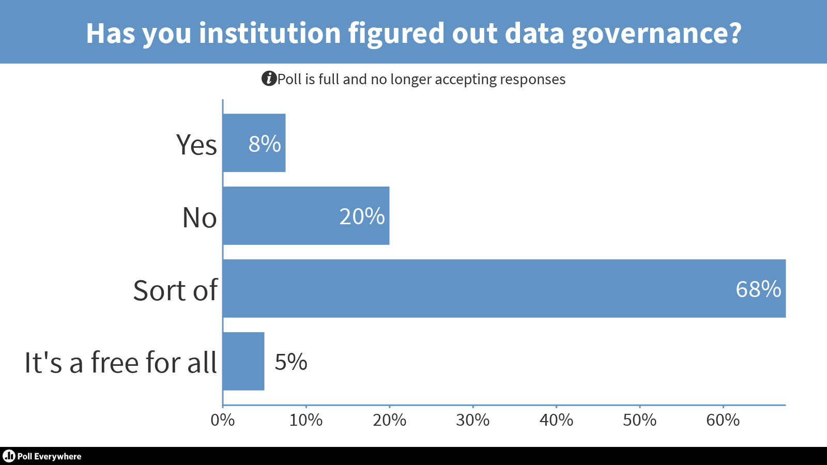

Slide 14
Virginia Tech Approach
Big initiative in 2015: Log Archiving and Analysis
Supports central IT, distributed IT, compliance efforts
Deployed ELK + Kafka for several thousand sources
Supports SOC and IT service operations
More than 100 people with access
Successful but need more tools and better data access

Slide 15
Virginia Tech Approach
Evolution of log analysis
Local Files
& Review
Centralized
(Syslog)
SIEM
(RDBMS)
Scalable & Flexible
(Splunk, ELK)
Security
Data Lake

Slide 16
Virginia Tech Approach
PaaS (AWS S3, Kinesis, Lambda, Glue, Athena)
Serverless allows minimal operational overhead
Mirror Data Lake pilot and eventually merge
On-prem and cloud originating logs
Stream both to AWS

Slide 17
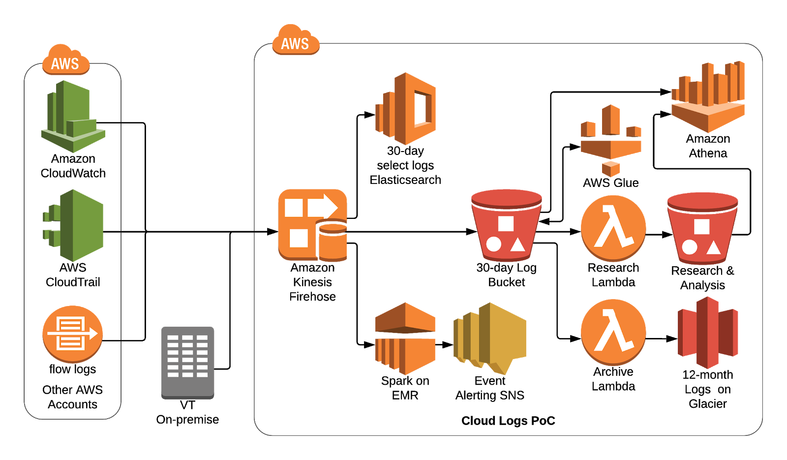

Slide 18
Virginia Tech Approach
Privacy considerations and research
University and ITSL students
Operational research
De-identification of events

Slide 19
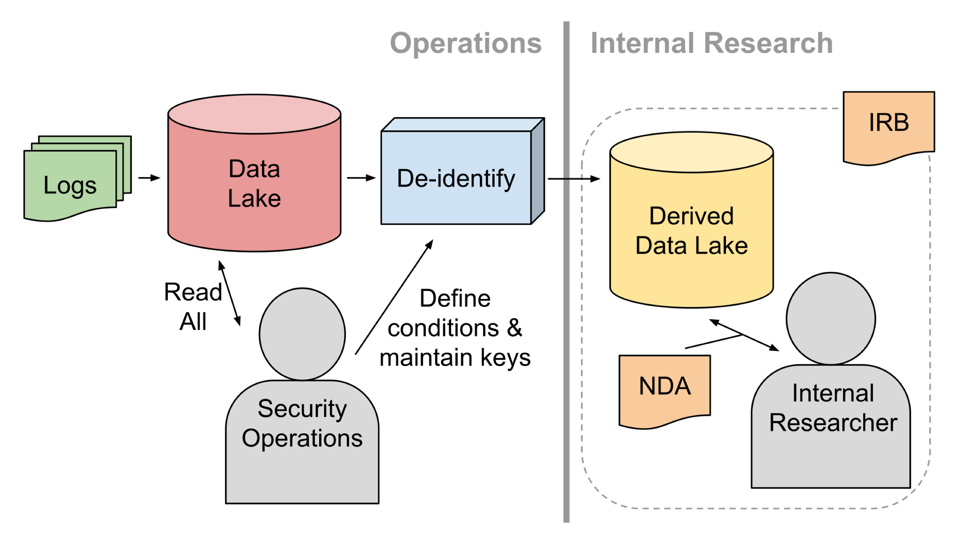

Slide 20
Poll #2: Security Data Analysis
PollEv.com/philipk241
We have four questions, we’ll ask one at a time

Slide 22
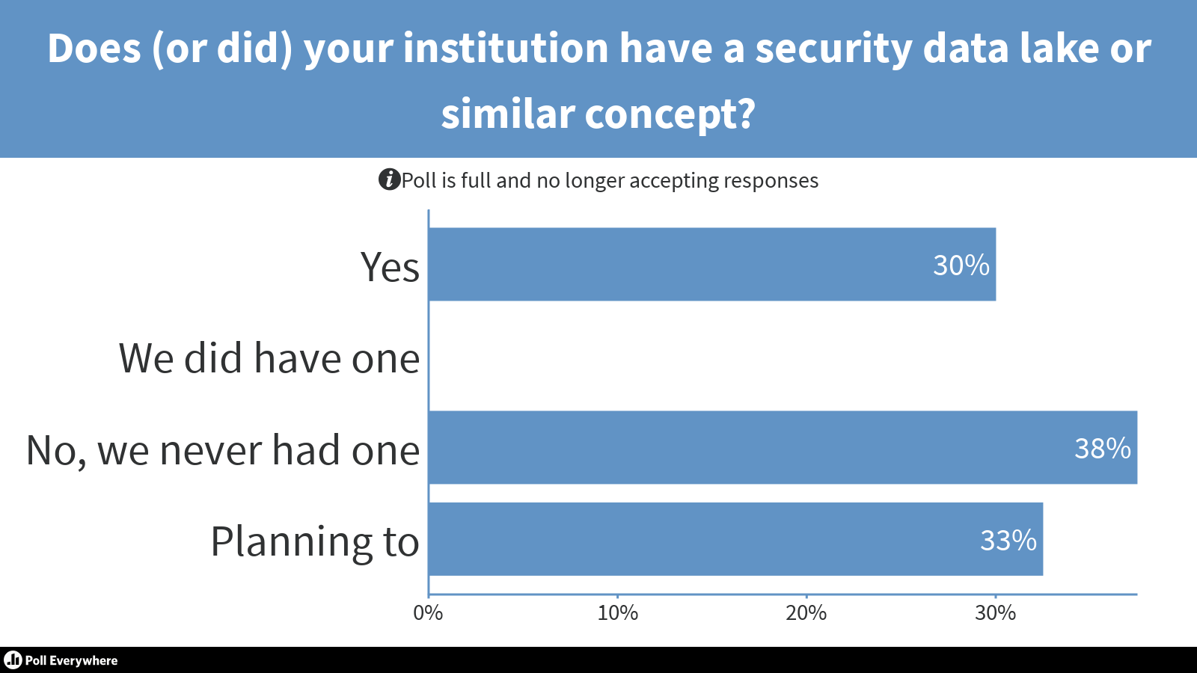

Slide 24
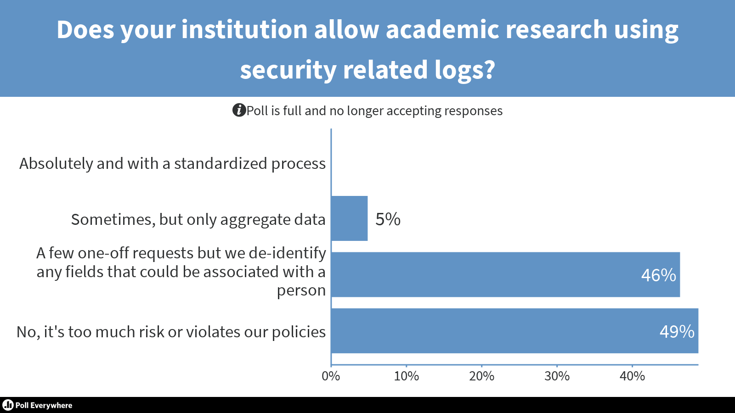

Slide 25
Research Examples
Select examples of research projects

Slide 26
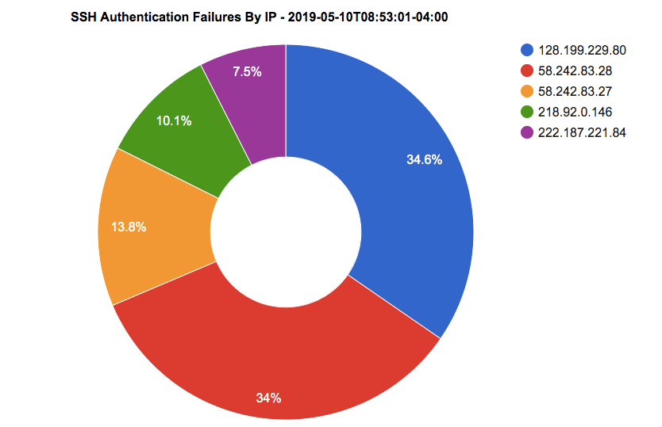

Slide 27
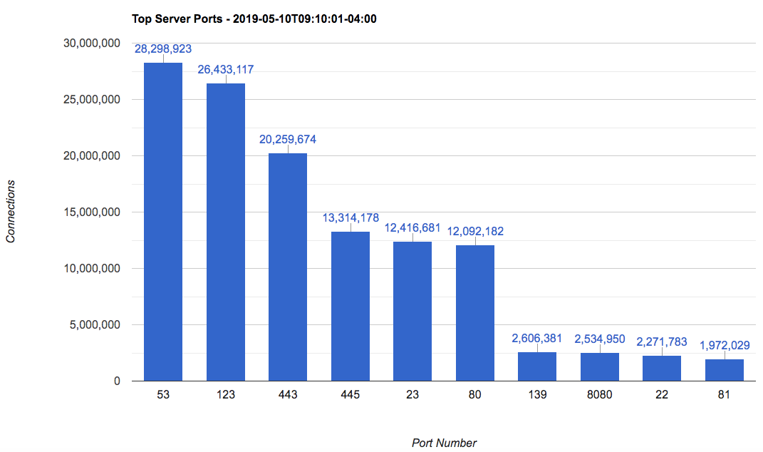

Slide 28
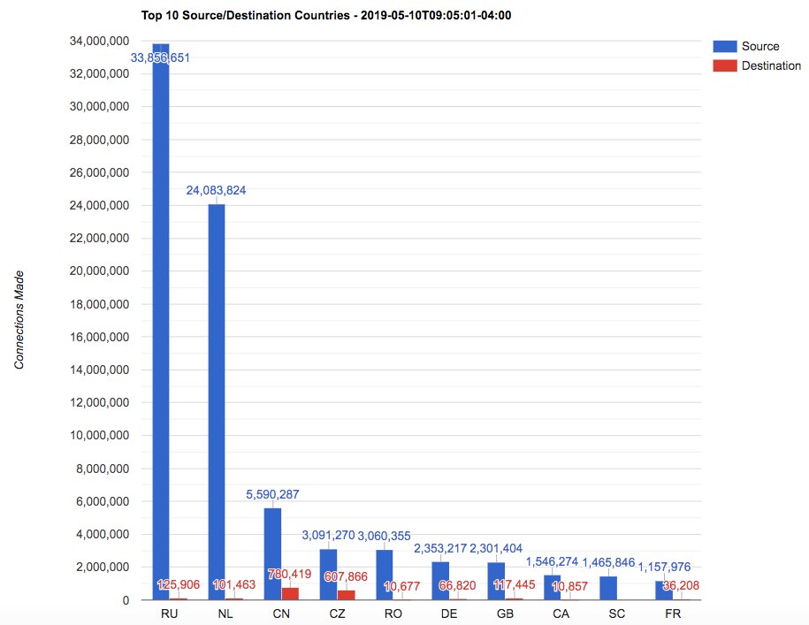

Slide 29
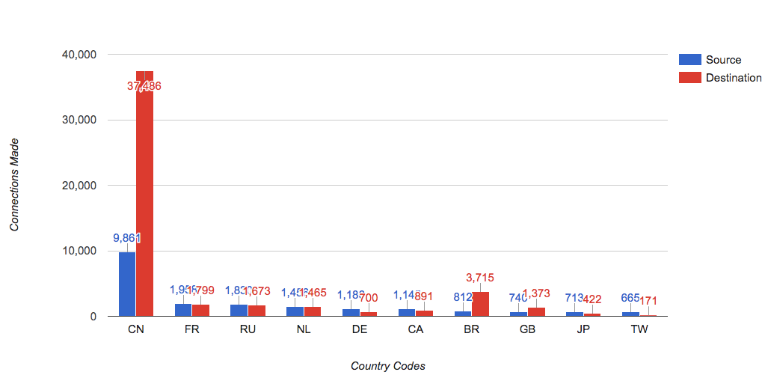

Slide 30
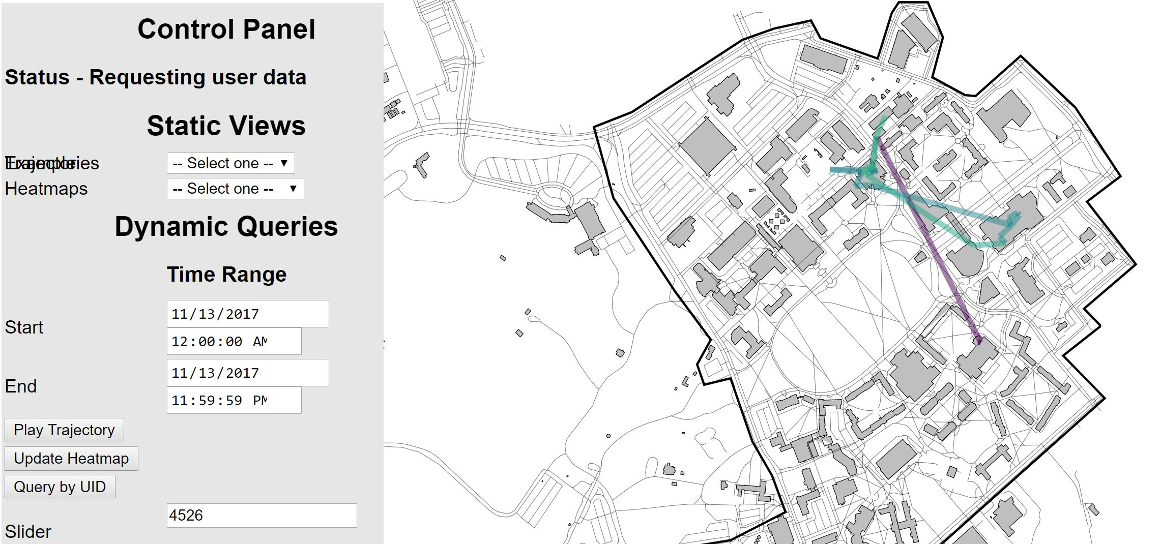

Slide 32
Other Approaches
Duke
Open architecture - Apache Spark
Python & SQL queries
Jupyter notebooks, JupyterLab dashboards
University of Michigan
PrivaScope
its.umich.edu/academics-research/research/privascope

Slide 33
Audience Discussion
What are you doing for security data analysis?
Successes or failures?
How can we enable research using this data and maintain privacy?

Slide 34
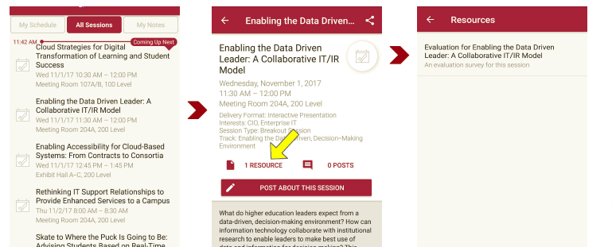
Session Evaluations There are two ways to access the session and presenter evaluations:
1
2
In the online agenda, click on the “Evaluate Session” link
From the mobile app, click on the session you want from the schedule > then click the associated resources > and the evaluation will pop up in the list

