Slide 2
Our Journey to the Cloud
Security by Design Approach

Slide 3
Agenda
Why make the journey
Initial cloud approach – Acceleration
Instill a Security by Design culture
Understand Shared Security Responsibility
Built-in Extensible Security Capabilities
Compliance
Disaster Recovery
Special Situations
Key Take-Aways

Slide 4
Aging data center

Slide 5
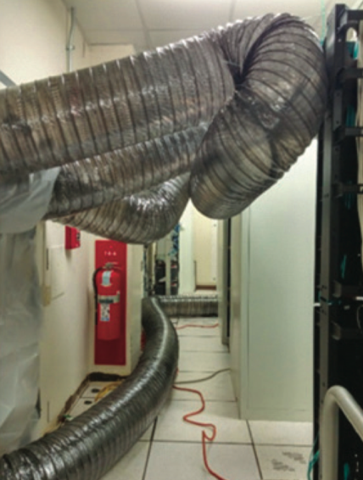
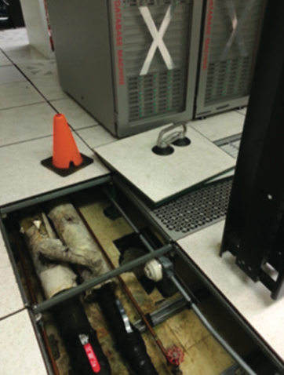
Aging infrastructure

Slide 6
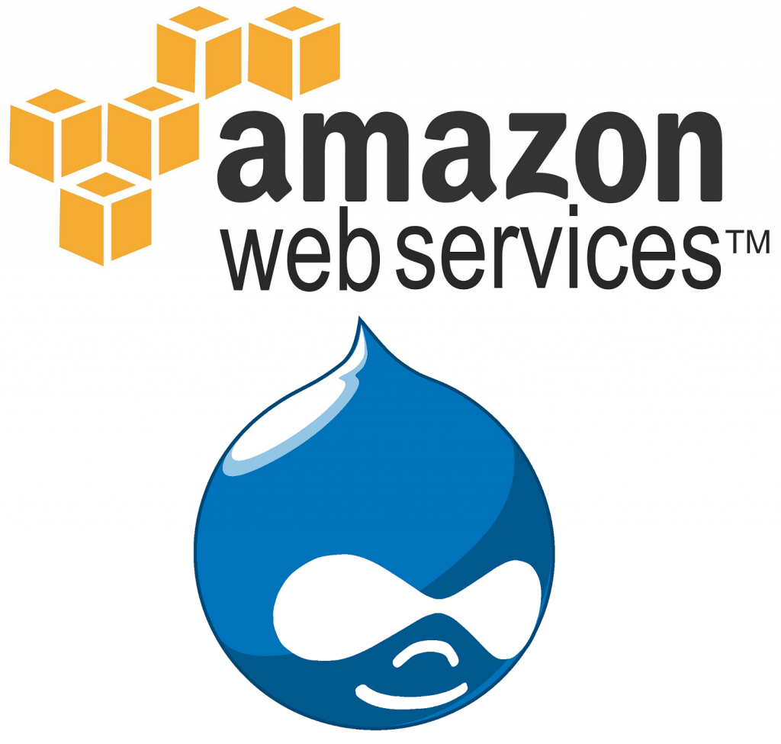
A starting point
150 enterprise applications running in our data center
1-20+ years old
750 servers (on-premise)
120 central IT staff
80 distributed IT
Drupal web environment in AWS since 2013
List of unmet demands

Slide 7
Accelerate into the cloud

Slide 8
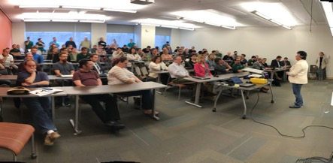
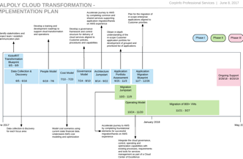
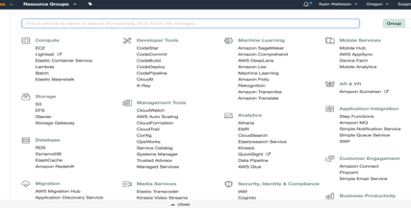
People Process Tools
What is “All-In” on Cloud?

Slide 9
All In (for Cal Poly) – Guiding Principles
Flexible and open
Native tools wherever possible
Minimum viable solution
Be agile
Create efficient, scalable, & automated solutions
Combined efforts
Transparent decisions
Take calculated (intelligent) risks
Fail Fast

Slide 10
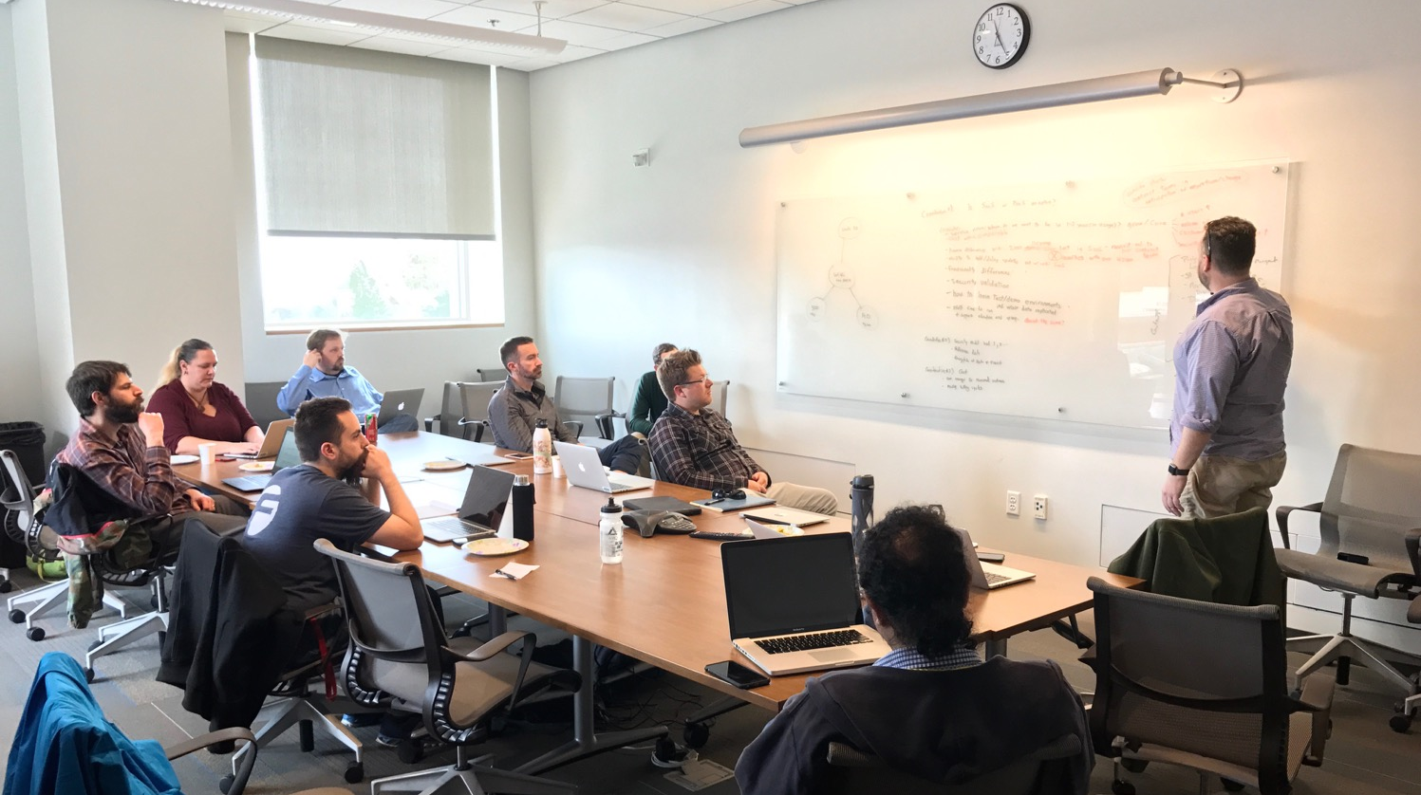
Cloud Acceleration Team
People will grow
Leaders will emerge
You may be surprised
Peer-to-peer is powerful

Slide 11
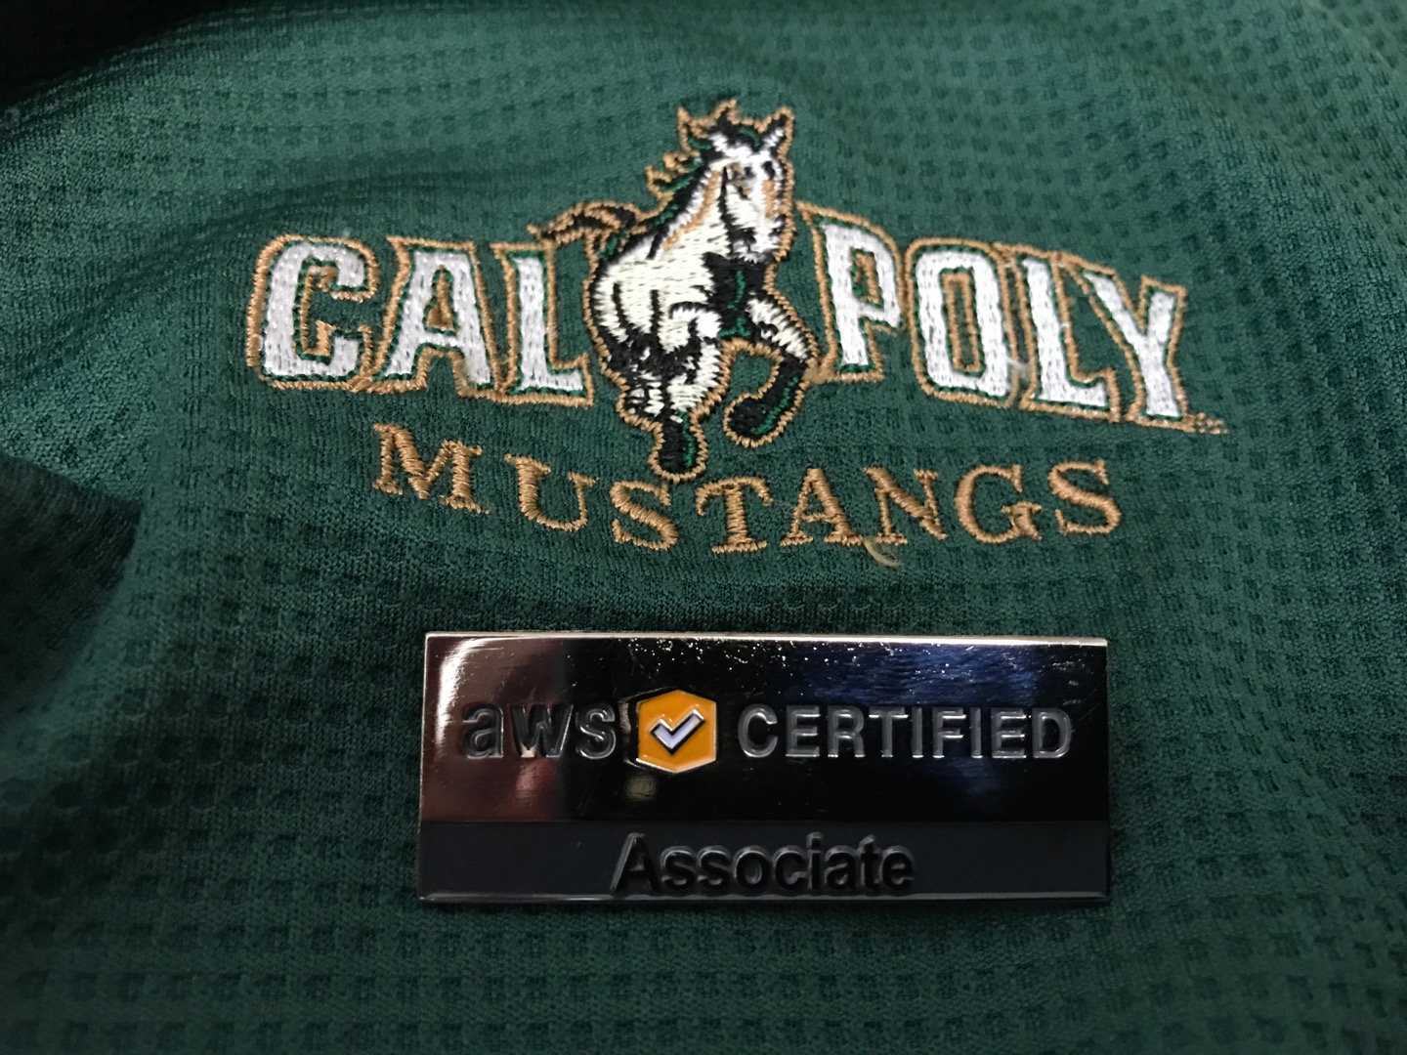
Use every avenue
Excitement spreads
60+ staff trained
23 certified

Slide 12
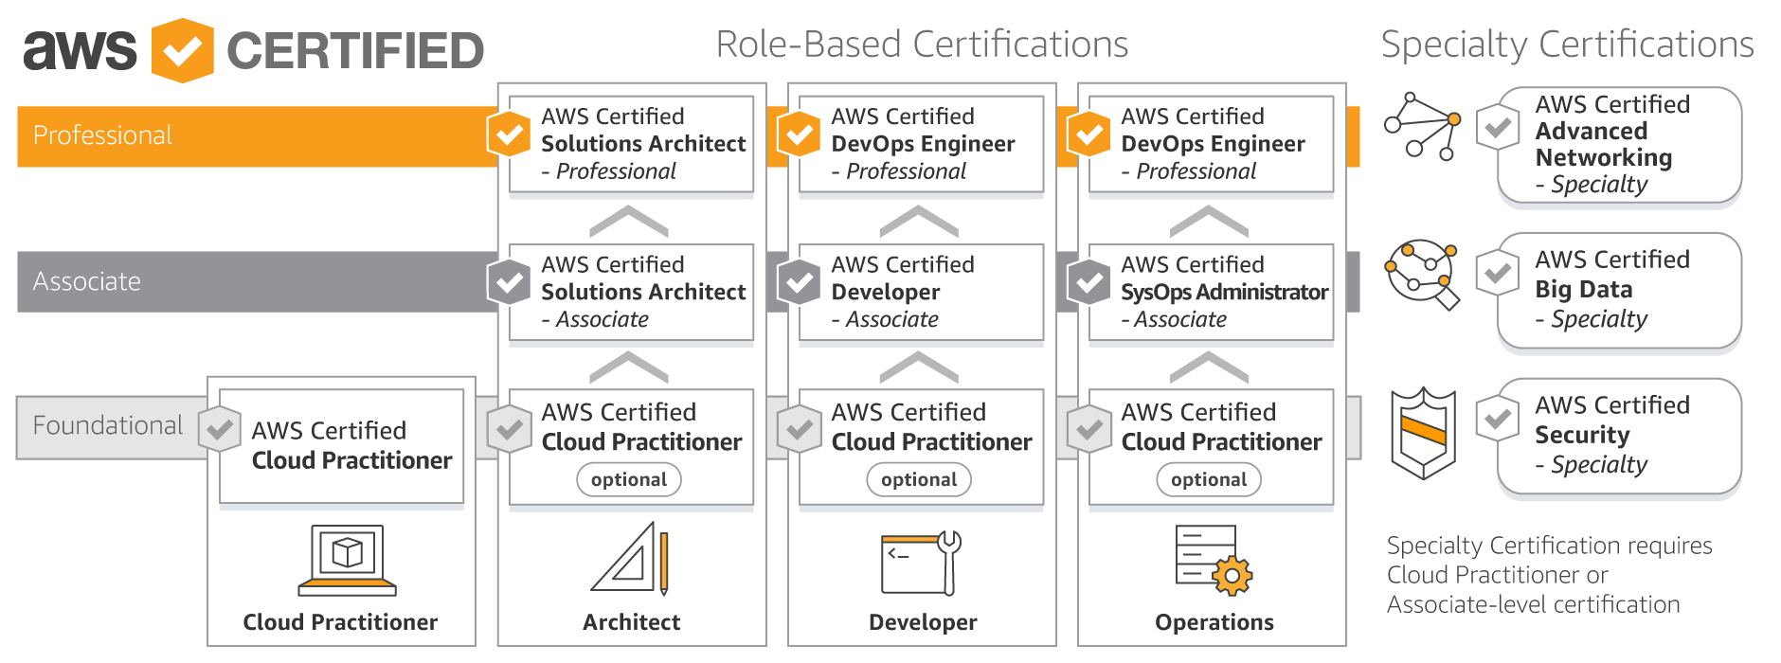

Slide 13
Instill a Security by Design culture
Top-down leadership direction
Build from ground up versus “bolted on”
Trends we’re keeping an eye on:
Account compromise – Vulnerability management
Container management – Account audits
Template enforcement
Shared security responsibility model
Notes:
Builders (not just InfoSec)
Security as code.

Slide 14
Shared security responsibility model
Security “in” the cloud
Security “of” the cloud
Bottom line: You’re still running software and software can have vulnerabilities

Slide 15
Security Layers

Slide 16
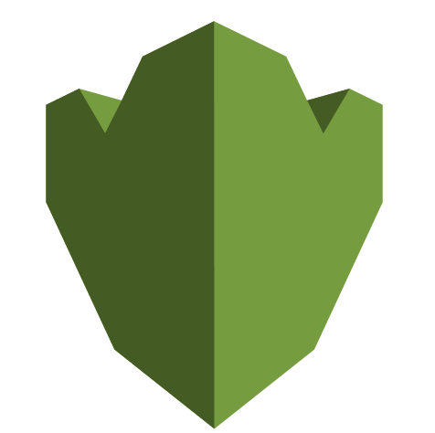
Built-in security capabilities
Secrets Manager/Secure Parameter Store
Secrets service allows secure storage of secret variables
Credentials/Private Keys
Not hard-code into application configs
Key Management Service
Key Management allows for encryption
Control access through IAM / least privilege
Notes:
Parameter Store

Slide 17
Built-in security capabilities
Amazon Virtual Private Cloud
Isolate services on the network to improve security
Allow passing of data between org and AWS
VPN or Direct Connect

Slide 18
Built-in security capabilities
Firewall Services
Control what network traffic is allowed in/out
Security Groups
Replace host-based firewalls
All network traffic must be defined via security group
Network Access Control Lists
Stateless firewall – Enforce Public/Private/Protected zones
Control traffic flow between subnets
Notes:
VPC

Slide 19
Built-in security capabilities
Systems Manager / Patch Manager
Patching strategy
EC2 - Long-lived servers
Receive in-place updates
EC2 - Ephemeral servers
CloudWatch events are dispatched
Apps trigger patching cycle

Slide 20
Built-in security capabilities
Amazon CloudWatch
Log Collection
Monitor networking resources
Metrics
Dashboard
Service health
VPN Tunnel status
Configure alerts

Slide 21
Built-in security capabilities
AWS Config
Evaluate AWS resource configurations for desired settings
Snapshot of current configurations
Retrieve configurations of resources within account
Receive notification when resource is created/modified/deleted
View relationships between resources

Slide 22
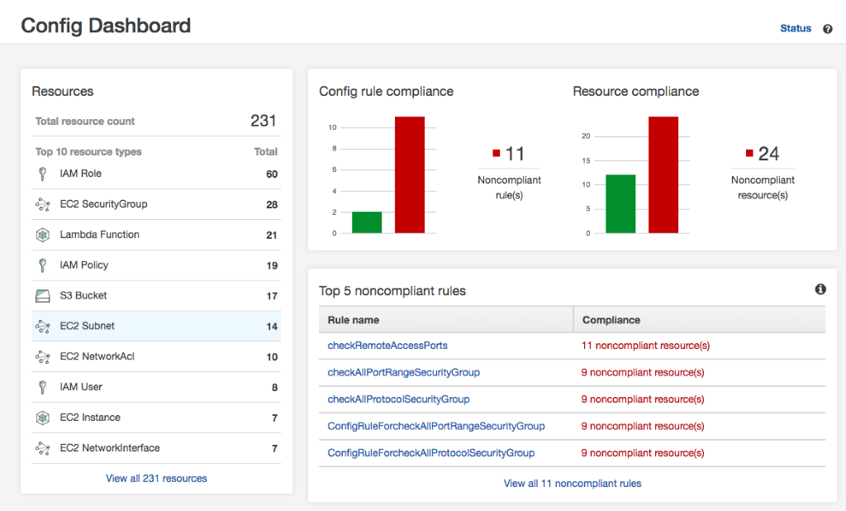
AWS Config and Lambda Examples

Slide 23
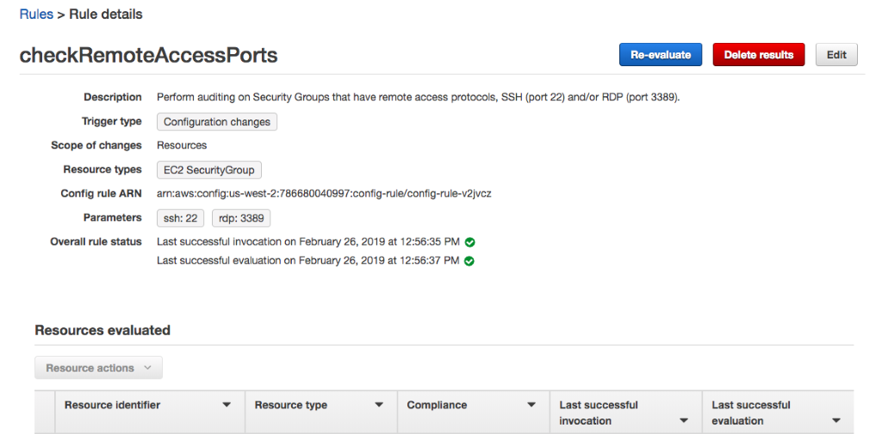
AWS Config and Lambda Examples
Auditing security groups w/ Remote access port(s) open

Slide 24
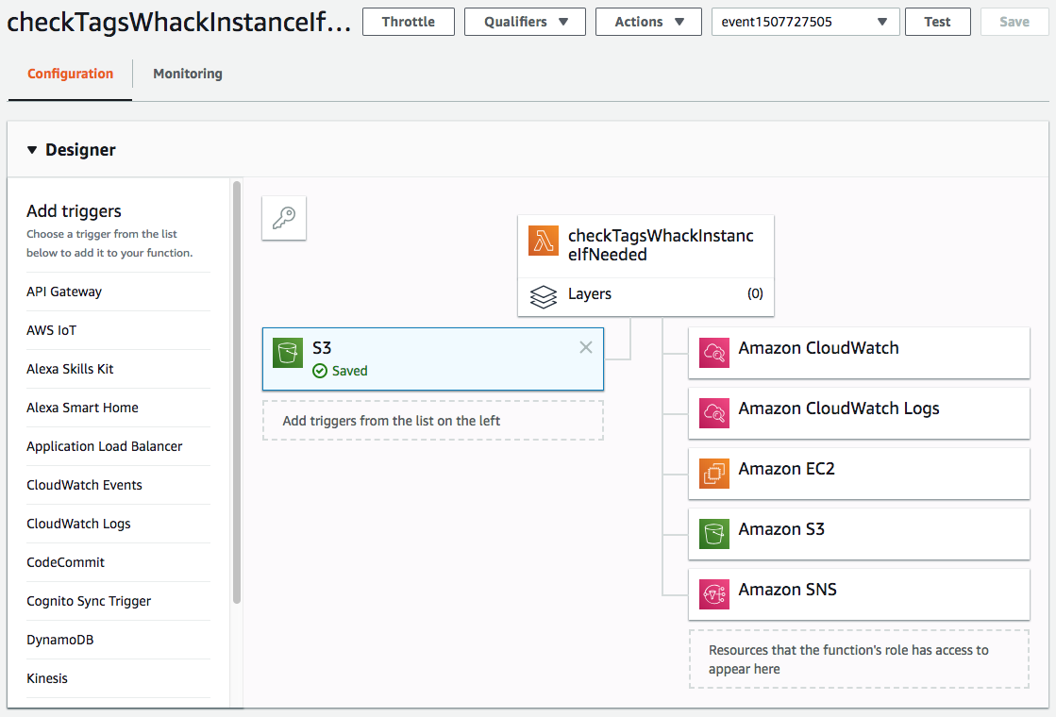
AWS Config and Lambda Examples
Automated response scenario

Slide 25
3rd Party Tools
Logging Service
Data stored in S3 or CloudWatch logs
“ELK Stack”
ElasticSearch
Analytics engine provides index for log data
Logstash
Pulls log data & sends transformed data to ElasticSearch
Kibana
Web interface for visualizing data
Notes:
Logstash gets data into
Elastic search is the Engine, keys,
Kibana is the visualization tool

Slide 26
3rd Party Tools
Web Application Firewall
Extra layer on top of Security Groups
Provides protection at the application layer
Toolset facilitates ability to write custom rules sets
Detect and/or block app traffic
Our standard is a WAF is used to protect any of our publicly exposed Web Apps or websites

Slide 27
3rd Party Tools
Cloud Workload Protection Platform – Trend Micro
Facilitates network level protection, per instance
Scales seamlessly with workloads
Integrates directly with AWS for auditing and validation that instances are protected properly

Slide 28
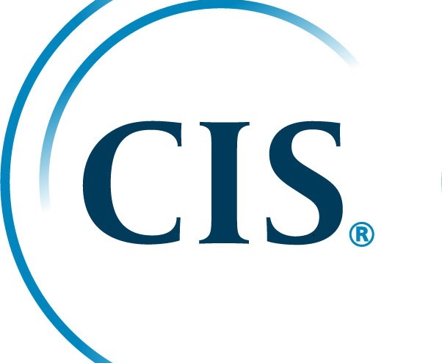
Compliance
InfoSec Framework based on NIST 800-53
Audit recommendations
Operating System Hardening
Data center physical security
Encryption of data at rest/in-transit

Slide 29
Disaster Recovery
Timely and effective restoration of services
Off-premise storage of data
Various Regions and Availability Zones
Long-term storage of data backups

Slide 30
Special situations
Government research and protection of data
International Trade and Arms Regulation (ITAR) and Controlled Unclassified Information (CUI)
NIST 800-171
AWS GovCloud
Use the same templates we’ve created for our normal workloads -- different environment

Slide 31
Key Take-Aways
Partnership
Partnership between IT and Security
Pick the right cloud provider for your organization’s needs
Learn the built-in Security capabilities and utilize them
Learn how to extend the built-in security capabilities to suit your organization’s needs
Pick the right Third-Party Security solutions that integrate well with your Cloud

Slide 32
Questions?
Contact info:
Douglas Lomsdalen Kyle Gustafson
Information Security Officer Senior Security Engineer
dlomsdal@calpoly.edu kygustaf@calpoly.edu

