Slide 1
From the Bottom Up: Diversity Perspectives from a Security Engineer

Slide 2
Presenter Information Tyrone Smith, CISSP University of Delaware Security Engineer

Slide 3
Disclaimers
The opinions expressed in this presentation are mine. They do not represent the University of Delaware or any entity which I have been or am now affiliated.
These are my opinions. Take what you like and leave the rest
This presentation leaves copyright of the content to the presenter. Unless otherwise noted in the materials, uploaded content carries the Creative Commons Attribution 4.0 International (CC BY 4.0), which grants usage to the general public, with appropriate credit to the author.

Slide 4
Agenda
About …
My MFA journey – a few stories
Chasing a “Grand Unified” Theory
Top Down Diversity
Bottom Up Diversity
Summary

Slide 5
About this Presentation
How did this happen?
Did you read the disclaimers?
I am not an expert in Diversity and Inclusion programs

Slide 6
About the Presenter
Something I know
Deep dish pizza is a casserole
https://www.geniuskitchen.com/recipe/deep-dish-pizza-casserole-56451
Something I have
Self administered tracking device … if I do anything of interest
Something I am
A tall Black guy with glasses

Slide 7
About my job – Security Engineer
Transferred from financial services (Citi)
Member of our four person IT - Security Operations team
Responsibilities include regular security stuff AND “Other duties as required”

Slide 8
About you
Why are you here?
Need 2-3 questions to answer at the end of the presentation

Slide 9
About the University of Delaware
Around 7,000 staff
Around 25,000 students
And it is a terrific place to work
https://www.udel.edu/
https://en.wikipedia.org/wiki/University_of_Delaware

Slide 10
About MFA at the University of Delaware
The program is labeled 2FA instead of MFA
Over 49052 accounts configured for 2FA
Includes some exceptions but covers the majority of staff, students, and faculty
Changed phishing and account compromise remediations from daily to ad-hoc

Slide 11
My MFA journey
When I joined the project, all of the fun decisions and coding were complete.
Secrets storage complete
Directory and database integration
Development of opt out functions

Slide 12
My MFA journey
“Other duties as required”
Scheduling deployments including students
Handling feedback on the expense of tokens
Present 2FA to clients
I was not comfortable handling “non-technical” tasks
I leveraged a framework I created/learned during my previous job to help

Slide 13
Situational Awareness
Communication-Evaluation-Execution (CEE)
Steps | Testing prompts
Communication (Goals) | What do I want? Did I ask for it? Can I ask for it?
Evaluation (Deciding) | Will this improve outcomes? Will this make things worse? Do I need more information?
Execution (Doing) | Can this be done? Should this be done? When do I need to finish?

Slide 14
Situational Awareness
Other frameworks
Rotary 4 way test
Observe–Orient–Decide–Act (OODA Loop)
Plan-Do-Check-Act (Deming cycle)
To reduce the impact of personal bias, it has been helpful to me to use a framework to evaluate ideas and tasks
The framework selected should align with the project and team goals

Slide 15
Scheduling deployments
Scheduling deployment of 2FA (including students)
Challenges
I was the only African-American in the meeting
I did not recognize my biases and assumption as roadblocks. I held multiple assumptions. These included:
Leadership is not technical
I need to make an impact move the project forward

Slide 16
Situational Awareness
Steps | Testing prompts
Communication (Goals) | To be respected as a key team member To complete 2FA deployment
Evaluation (Deciding) | Political, technical and logistical issue were being introduced along with plans to remediate each The team including a manager that I believed was not technical who demonstrated deeper skills than I have
Execution (Doing) | Do not interfere with success Participate as requested

Slide 17
Scheduling deployments
Lessons learned:
Find out or ask about the skills of team members. Assumptions are not facts
I felt the need to prove my competence. It is ok to sit back and learn if the core project needs are met
A diverse team will usually defy expectations in ways you do not expect due to your own biases. The biases prevent fair evaluation of team capabilities

Slide 18
Token costs
Handling feedback on the expense of phones as tokens
Challenges
During a follow-up conversation with a staff member, I heard “I would expect you to be concerned about high initial costs”
I did not expect my emotional reaction later that day
I was a low income student with work study job and debt
Is this coming up due to bias?

Slide 19
Situational Awareness
Steps | Testing prompts
Communication (Goals) | To be respected as a key team member To complete 2FA deployment
Evaluation (Deciding) | Need to clearly analyze the options for lower income students and ensure the options are reasonable
Execution (Doing) | Technical options were already in place I worked to improve the documentation of the process to ensure alternatives were clear

Slide 20
Token Costs
Lessons learned
Clear communication in diverse teams is difficult
I am not sure if “what I heard” was “what was said” however my personal boundaries were not crossed
An important set of stakeholders were considered which improved the rollout for everyone

Slide 21
Present 2FA to clients
Offering presentations that communicate effectively while reducing the impact of biases
Challenges
Why me?
Handling my biases
Handling the biases of others

Slide 22
Situational Awareness
Steps | Testing prompts
Communication (Goals) | To be respected as a key team member To complete 2FA deployment
Evaluation (Deciding) | These presentations are important to client adoption and improving client security practices I have life skills and can leverage privilege I do have to make this happen
Execution (Doing) | Move forward. Don’t allow my preferences and biases to stand in the way of the goals

Slide 23
Present 2FA to clients
Lessons learned
Code switching is a useful life skill
This is a life skill developed by most members of minority groups
Adjusting a message to the audience
Dress code
My glasses, a proclivity to business casual, and collared shirts should not matter
However, it does help
Offering personal experience
I hate dislike giving insight into my personal life
It is a powerful rapport builder

Slide 24
Present 2FA to clients

Slide 25
So what?
Each project brings together a team of people. Each person brings skills, perspectives, and biases to a project
I learned new things through each experience and brought unique skills to each issue
But something is missing…

Slide 26
A Grand Unified Theory
An understanding of why diversity is beneficial
A snappy, short, slogan to summarize this understanding
To establish diverse teams and reap the benefits …

Slide 27
Slogan 1
Step 1
Implement diverse teams
Step 3
Profit

Slide 28
But …
Step 2 is always a problem
The writers from South Park may sue

Slide 29
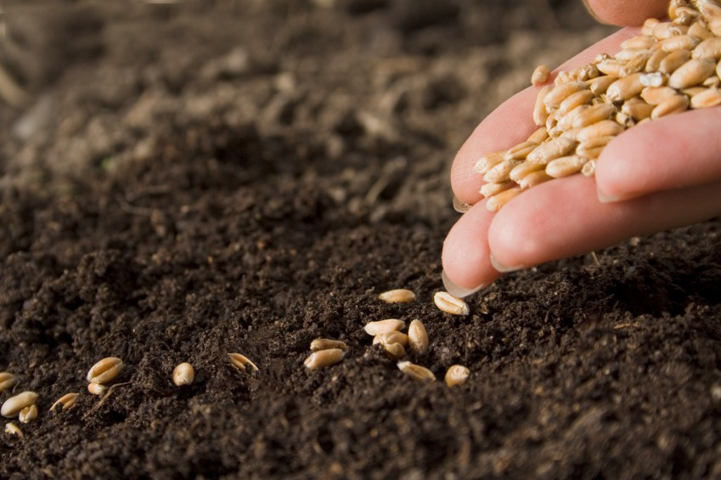
Slogan 2 - Plant the seeds

Slide 30
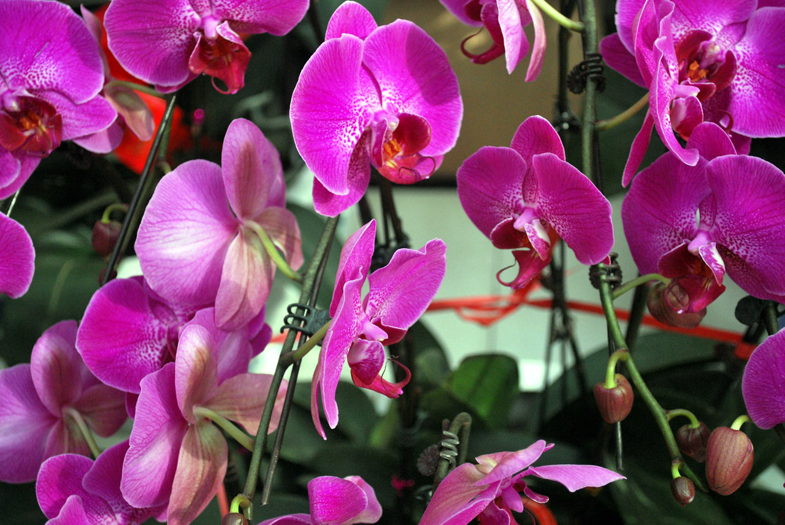
… Let them grow

Slide 31
But …
The analogy may be off looking at my current garden (of weeds)
Each part of this oversimplified formula doesn’t provide enough direction or context

Slide 32
Set the scope and definitions
Scope
Complex team projects and tasks
Diversity
A complex topic with multiple definitions
There are more opinions of what diversity means than definitions
Documenting what I mean may help form a slogan

Slide 33
What is diversity? – Definition 1
“… the inclusion of different types of people (such as people of different races or cultures) in a group or organization”
https://www.merriam-webster.com/dictionary/diversity

Slide 34
What is diversity? – Definition 2
“… being composed of differing elements or qualities…”
https://www.merriam-webster.com/dictionary/diversity

Slide 35
What is a diverse team?
A union of unique attributes of the individuals in the team including temperament, current skills, and other attributes

Slide 36
How do label unique attributes?
Types of human diversity
Racial
Gender
Religious
… continued …

Slide 37
How do label unique attributes?
Types of human diversity
Cultural
Includes cultural and ethnic groups
Functional
Includes physical disabilities and impairments
Neurodiversity
Includes neurological differences such as learning disabilities and the autism spectrum
And many more …

Slide 38
Slogan 3
Build diverse teams because humans are diverse

Slide 39
But …
It’s too long
A statement of truth is not a great slogan
If it can be easily followed by a sarcastic “Yes, Captain Obvious”, it is not great slogan

Slide 40
Why is diversity needed in teams?
When teams are built with a majority of people with common experiences and skills, the methodology and output of the team is more likely to stay the same
If nothing changes, nothing changes

Slide 41
Who is impacted by diverse teams?
Management
Teams
Individuals

Slide 42
Top Down Diversity
What does this mean
Management provides resources and guidance to create and maintain diverse teams

Slide 43
Top Down Diversity
What is the work required for management to realize the benefits of diverse teams?
Communication
Tolerance
Leadership

Slide 44
Top Down Diversity
How do organizations build diverse teams?
This is a widely studied problem
Because this is primarily a management responsibility, I will skip my opinions on this critical part of creating diverse teams
[Find new team members can explain why something is a bad idea, this ability shows more advanced communications skills]

Slide 45
Bottom Up Diversity
What does this mean
Individuals leverage their unique talents to expand their skills, extend the capabilities of their teams, and deliver better outcomes
Team goals are met in unique ways providing additional paths to team success

Slide 46
Bottom Up Diversity
What is the work required for teams to realize the benefits of diverse teams?
Communication
Maintain Situational Awareness
Tolerance
Teamwork

Slide 47
Bottom Up Diversity
How do we (team members) drive creation of diverse teams ?
Mindfulness?
What is the sound of one hand clapping?
Communication

Slide 48
Slogan 4 - Plant the seeds

Slide 49
Add the work

Slide 50
Let them grow

Slide 51
Summary – Slogan
(To establish diverse teams and reap the benefits)
Plant the seeds,
Add the work,
Let them grow

Slide 52
Summary – My Experience
MFA is awesome. Implement it as soon as possible. Implementing MFA has been my favorite project
Situation awareness is key to processing challenges and growing from them

Slide 53
Summary – Almost the last slide
Diversity + Work = Growth
Growth is required to address management requests for innovation and handle the pace of change in cybersecurity
Growth in both Top Down and Bottom Up efforts are required for better outcomes

Slide 54
Questions? Comments? Concerns?
?
?
?

Slide 55
If you did not like this presentation, …
Elwood : Try not to be so negative all the time. Why don't you offer a little... constructive criticism?

Slide 56
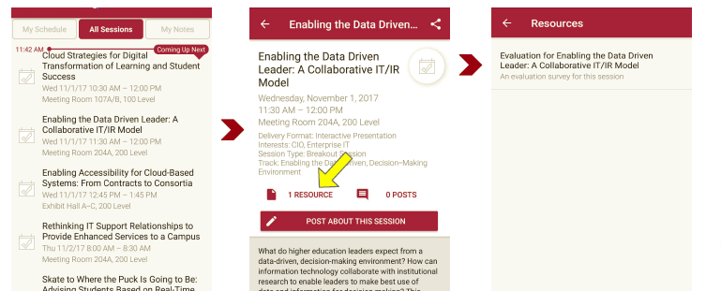
Session Evaluations There are two ways to access the session and presenter evaluations:
1
2
In the online agenda, click on the “Evaluate Session” link
From the mobile app, click on the session you want from the schedule > then click the associated resources > and the evaluation will pop up in the list

Slide 57
Some references
These pages items include articles and media inspiring the presentation but may or may not be directly referenced. Copyright and usage is governed by the content owners.
Schoolhouse Rock - 3 Is A Magic Number - YouTube
James Brown I Don't Want Nobody To Give Me Nothing MDS 1969 ...
Blues Brothers graphic provided by Vectezy

Slide 58
Some references
https://www.educause.edu/about/diversity-equity-and-inclusion/resources - Excellent resource
https://www.udel.edu/2fa
https://er.educause.edu/blogs/2019/4/cds-spotlight-campus-mfa-practices
https://www.inc.com/shama-hyder/creating-a-diverse-team-is-harder-than-it-looks-heres-how-to-fix-it.html
https://open.nytimes.com/diversity-inclusion-and-culture-steps-for-building-great-teams-ca157bd98c07
https://hbr.org/2008/02/three-keys-to-effective-execut

Slide 59
Some references
https://www.commondreams.org/views/2013/11/02/gmo-mumbo-jumbo - Just needed the picture
https://www.publicdomainpictures.net/en/view-image.php?image=11672&picture=purple-orchids
https://www.publicdomainpictures.net/en/view-image.php?image=76001&picture=we-can-do-it-poster
https://en.wikipedia.org/wiki/Diversity
https://www.merriam-webster.com/dictionary/diversity

