Slide 1
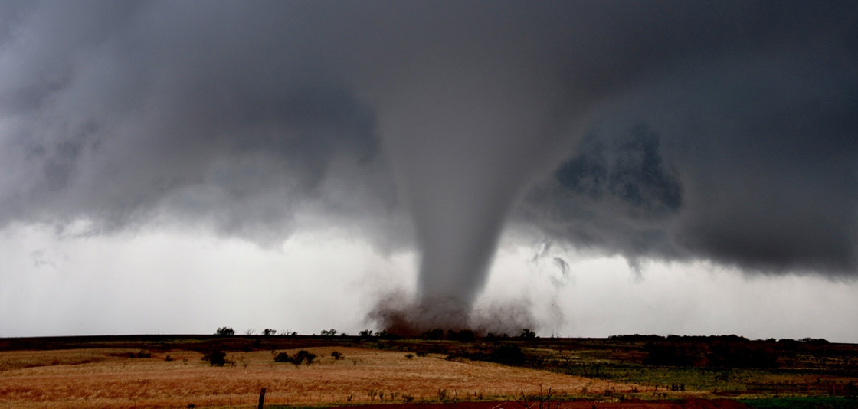
Building a Shelter for Sensitive Data
Cal Frye, Mike Warfe, Brian Christian
© 2019 by Cal Frye, Mike Warfe, and Brian Christian under a Creative Commons Attribution 4.0 International (CC BY 4.0), which grants usage to the general public, with appropriate credit to the author.

Slide 2
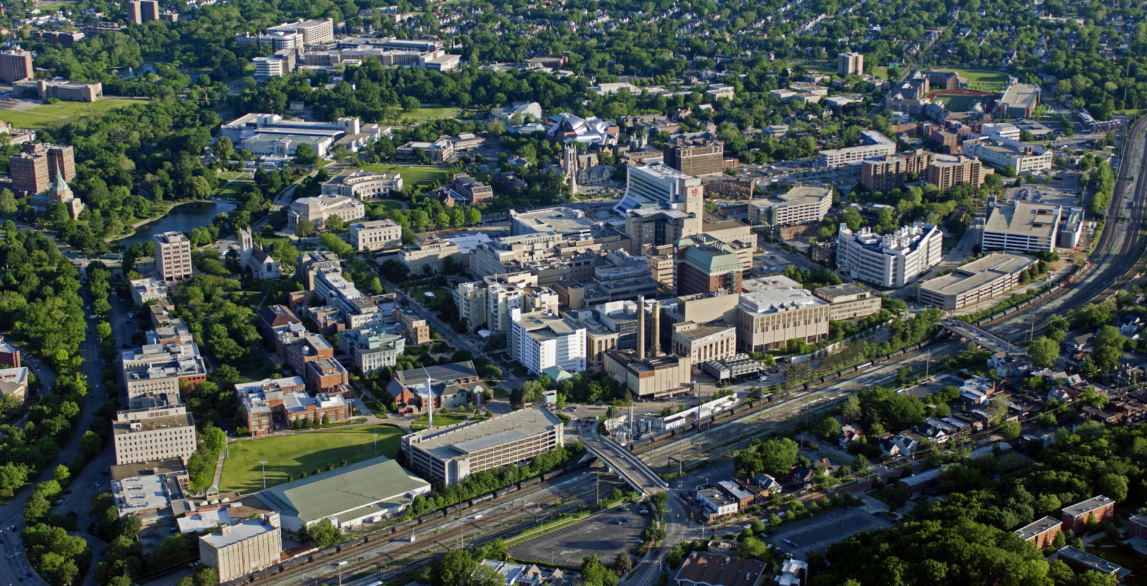
Notes:
Greetings from Case Western Reserve University, the funny-named institution that is the “University” in the Cleveland neighborhood of University Circle. In addition to our campus visible in this photo, you can also see the Cleveland Museums of Art, Modern Art, and Natural History, along with the Cleveland Institute of Art, the Cleveland Institute of Music, as well as other educational and cultural institutions and more than a couple hospitals.

Slide 3

Background and History
Founded 1826 and 1880, federated 1967.
5150 Undergraduates, 6674 Graduates, 3501 full-time faculty.
Among the top 20 private institutions receiving federal R&D expenditures.
think beyond the possible…
Notes:
Our marching band prides itself on delivering “the longest cheer in college football,” “Gimme a C, gimme an A, gimme an S” and so on. At homecoming they include the street address as well.
Our logo suggests thinking outside of the box, but our motto twould have us go beyond the possible…

Slide 4
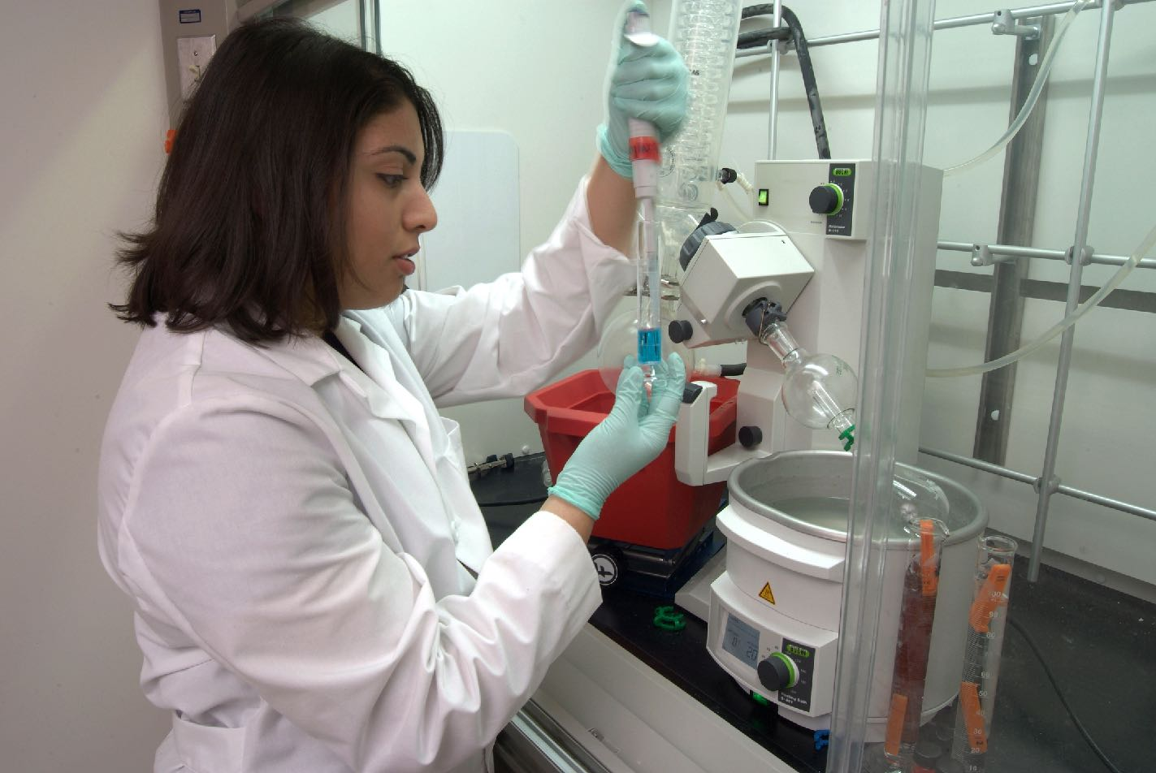
Diverse fields of scholarship and research
Case School of Engineering
College of Arts and Sciences
Frances Payne Bolton School of Nursing
Jack, Joseph and Morton Mandel School of Applied Social Sciences
School of Dental Medicine
School of Graduate Studies
School of Law
School of Medicine
Weatherhead School of Management

Slide 5
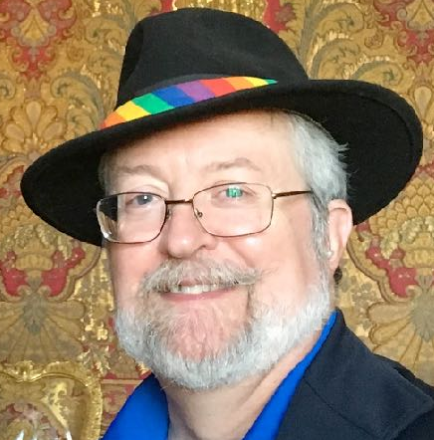
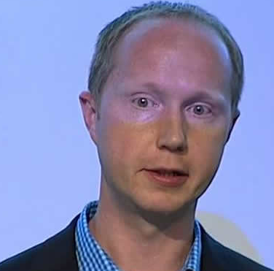

Who are we?
Cal Frye, Compliance Technologist, RCCI and Information Security
Mike Warfe, Asst. Director, Research Computing and Cyberinfrastructure
Brian Christian, IT Engineer, RCCI

Slide 6

Outline
The problem: Where to put it?
Deciding on a solution
Implementation, security framework
Risk Assessment
Remaining Problems

Slide 7

Restricted Data
In CWRU parlance, this means PII, PHI, PCI, and the like, along with legal and other records
HR and student data, not our problem
Research data can include PHI or PII for social work
Notes:
Personally Identified Information, Protected Health Information, Payment Card Information, anything including Social Security numbers or even a description of a health condition along with enough information a third party could possibly identify the person described.
Tenure discussions, HR records, legal matters, and student records are kept elsewhere; I am speaking today about research data that meets the criteria. In addition to more typical medical research. Credit card information can appear here if payments or reimbursements are made.

Slide 8

Collaboration is the key
Collaboration is historically difficult
Data wants to be shared, or at least assembled
  NIH All of Us Program (1,000,000+ people)
  VA Million Veteran Program
  NCI Cancer Moonshot
Notes:
IT struggles to keep up with security, data movement, and data analysis resources at the scale of these initiatives. It’s a difficult balancing act, and very hard to stay out in front.

Slide 9
If you build it, they will come
Improve healthcare through the analysis of Big Data
The Case Comprehensive Cancer Center needed something better
Electronic Health Records
Genomics and other analyses
Stored securely, shared safely
Notes:
Nearly all major medical centers now have EHRs recording thousands of events daily. As biomedical data becomes digitized, the opportunity for analysis grows apace. Our partners in the Case Comprehensive Cancer Center needed better tools and better security than we had been offering them. The ICB was founded to manage this project and to improve healthcare by accumulating a large body of medical records and use this Big Data pool for further analyses involving thousands of individual outcomes.
Cleveland has both the opportunity and the challenge of combining EHR from at least three major medical centers, direct competitors, into one large dataset, and the ICB is the center and driver of this effort. Projects include the study of Alzheimer’s and Prion diseases, brain cancer research, as well as a better understanding of public health outcomes across our region.

Slide 10
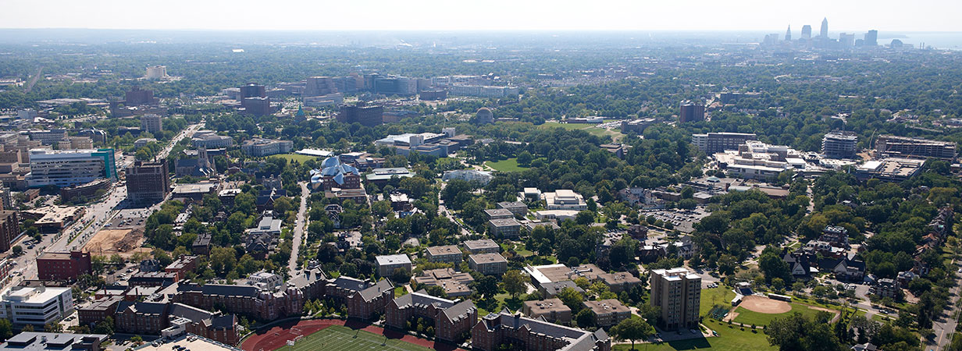

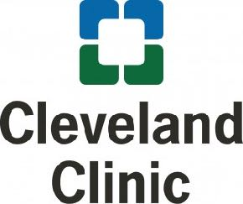




Notes:
The ICB and the School of Medicine have partnerships with the three hospital systems shown here, University Hospitals, the Cleveland Clinic, and Metro Health. In addition, we have projects with the regional VA medical center and hope to work more closely with this center in the future.

Slide 11
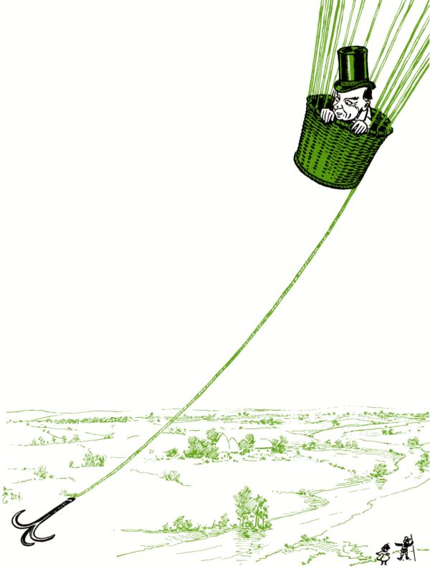
How to share data safely
… without getting carried away …
Google? Dropbox? Box?
Smart folks are clever DIY-ers
Put Restricted Data in a safe place, and bring researchers to the data instead
Notes:
Google and Dropbox are about sharing, not so much on security. We do have a Business Associate Agreement with Google for managing HIPAA data, as our Dental Clinic is a covered entity. But we use this in a very managed way, and our policies are that Restricted data should not be sent in email or stored on Google Drive. We also have a BAA with box.com, as Box is more security conscious, and importantly offers end-to-end encryption for data stored there. We make use of Box for transfer of Restricted data when that serves the need.
DIYers often run off and adopt or invent their own approaches to solving a perceived problem, usually before University Technology becomes aware of their need. Sometimes this “solution” is an old laptop hiding underneath a desk somewhere. That device may even be encrypted. But whole disk encryption does not solve the need to share data with collaborators.
What if we built a Safely Held Electronic Data Platform (SHED) where such data could be kept?

Slide 12
Deployment lessons learned
Consultation and service advertisement is the key to adoption
Understand the organization (Strategic, Cultural, and Political) - get allies
Be willing to leave some things out of scope and allow others to own the solution
Learn the language of research (IRB, DUA, Subject Consenting, etc)
Pitch the value (collaborations, grant awards/requirements, publications, curing diseases, discovering something novel, etc.)
Notes:
You’re in sales and marketing, whether you want to be or not. Unless you have a digital twister heading for your campus, and even then you can’t get everyone to see it if they don’t want to. You do have a chance to sell them on the idea that you have a better service available, ‘cause it’s always going to be something of an inconvenience for them.
Of course, you’re taking on the upkeep, patching, and other security tasks they don’t want to be doing, but perhaps they’re not doing them anyhow, so what’s to gain?

Slide 13
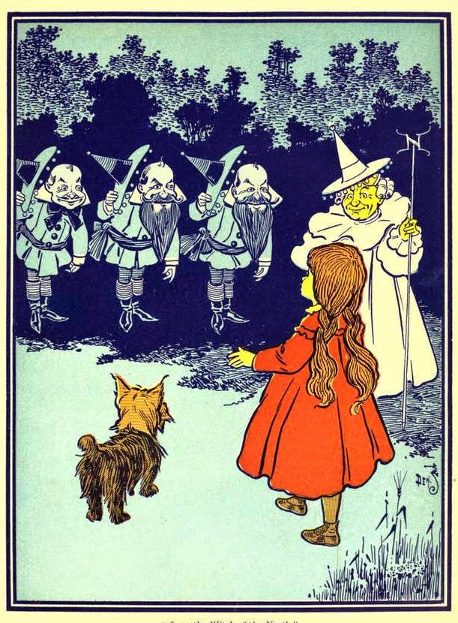
Researchers are your partners
bring them in early…
Other partners are the IRB and data owners
One way to get out in front of the process
Notes:
The Institutional Review Board and in turn the original data owners, whether Medicare, the National Institutes of Health, local healthcare, or whomever, can be the stick to go along with your carrots. They collectively are being more careful in their requirements for sheltering data safely in your hands. I now have researchers coming to me for assistance in reviewing Data Use Agreements and crafting their Data Security Plans as part of the review process and for grant applications. This is a great help in placing the data in the environment most appropriate for its classification and the researchers’ needs.

Slide 14
Deciding the build the SHED
Spearheaded by the Institute for Computational Biology
A service of Research Computing and Cyberinfrastructure
Went live in July, 2015
Fee-for-service model, first two years were free
Notes:
The distinction is important, this is not yet another departmental project but intended to be a service offered University-wide. At first the service was called the Safely Held Electronic Data platform, or SHED. Well, now we’re calling it the Secure Research Environment, as data storage is only a part of its function.
A sliding scale of user fees was implemented to ease projects into the SRE even after grants had been awarded. The goal was to protect the data, not to buy new toys. The first two years were offered free of charge, to aid migrating existing projects into the new service.

Slide 15
Choosing Standards
HIPAA
SANS
HIPAA was our main focus
SANS 20 Critical Controls our framework
FISMA / NIST 800-53
Ending on NIST 800-171
FISMA
ISO
COBIT
NIST
Notes:
Our aim from the beginning was to align our environment with appropriate agency controls. Which ones? We crossmapped Federal Information Security Management Act (2002) FISMA controls with the SANS Critical 20 and interpreted this within the HIPAA framework as needed. At first we settled on viewing the NIST 800-53 controls through the SANS 20 lens, as many parts of 800-53 were a poor fit for our environment.

Slide 16
NIST 800-53 or 800-171?
“the tailoring criteria, …derived from FIPS Publication 200 and the moderate security control baseline in NIST Special Publication 800-53 and are based on the CUI regulation (32 CFR Part 2002, Controlled Unclassified Information) … focuses on the protection of CUI from unauthorized disclosure in nonfederal systems and organizations.”
NIST Special Publication 800-171 rev. 1, 2016, Introduction, Cautionary Note
Notes:
With time and experience, we first re-evaluated our efforts in terms of the NIST 800-53 standard of 2005, but that is both intended for Government internal systems and is a hulking, complex beast.
The later publication of NIST 800-171 in 2015 was designed for government contractors and addresses policies as well as practices in a way that is more appropriate for our implementation and coincidently by design easier to understand and apply.

Slide 17

Research (the “R) within the SRE
Applications in support of researchers across the country
Center On Urban Poverty And Community Development
National Prion Disease Pathology Surveillance Center
Case Comprehensive Cancer Center (CWRU, UH, and CC)
And many more that could be added…
Notes:
We’ve come to call our model the Secure Research Environment, or SRE, rather than “the SHED,” as our emphasis has shifted to viewing it as an entire environment, and not just a place to store data. Sure, we’ll put the data in there, and we’ll bring you into the protected space as well, so all the work remains secured within.
Forte OnCore Enterprise Research is a data management tool allowing for longitudinal tracking of study subjects (including disease profiles and outcomes) and storage of versioned IRB protocols, subject consent forms, and clinical findings.
Biofortis Labmatrix provides the capability for complete biospecimen tracking (annotations, locations, chains of custody, barcodes), cell and cell lines annotation, and reporting.
Oracle Application Express (APEX) is a framework for designing custom interactive applications tailored to the specific needs of a project.
REDCap is a secure web application for building and managing online surveys and databases, originated at Vanderbilt (thanks, guys!) and maintained by a consortium of users and developers. It is specifically geared to support online or offline data capture for research studies and operations, including patient or client surveys and data input.
Contributors are located country-wide. We hold data on hundreds of thousands of lab specimens, with several dozen individual projects and nearly 500 users.

Slide 18
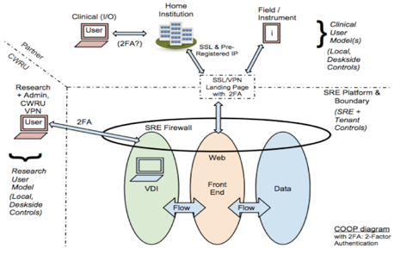
The “E” in the SRE
Not shown:
Campus firewall, DMZ
Management tools
Proxy Server
Notes:
Describe the diagram:
The SRE is located off-campus in a commercial Tier III datacenter facility. The network is not tied to case.edu infrastructure. The build was auditable by design.
Communications are encrypted and limited to those needing access, our researchers and our partner hospitals and institutions.
Access is protected with two-factor authentication.
Not shown is the extra layer of protection offered by campus firewalls. Portals to the SRE are located within our DMZ.
Within the SRE, the firewall not only protects the applications and desktops, but it is heavily segmented so tenants are isolated from each other.
Firewall migration is taking place as we speak. The SRE’s firewall is Checkpoint, but Fortinet is the current firewall of choice for the campus; this migration will bring us into alignment with the rest of the shop, as well as increasing our connectivity to 100Gb/s.

Slide 19
The “E” in the SRE
Managed File Transfer used to import data and export results
Tenant Coordinators manage users, file transfers, etc.
VMWare Virtual Desktops provided to bring researchers to the data
SAS, SPSS, R, other tools provided as requested
Virtual Machines also provided for application servers
Notes:
Serv-U is the application we use to provide logged file transfer services to the environment.
If each project is considered a tenant of the environment, each tenant has a coordinator who manages users and their needs. Our system administrators don’t know the users, we depend on the tenant coordinators to be that interface.

Slide 20
Secure Research Environment, the “S” bit
Users are added upon request of their Tenant Coordinators
Users must hold current CITI/CREC or SANS StH training
User accounts expire annually and must be kept fresh
Logins are granted with Duo 2FA
Session timeouts, locks, used but adjusted as required
Notes:
Securing the least secure part of the environment, the users. We require security training, either SANS Securing the Human or the more comprehensive Collaborative IRB Training Initiative continuing education courses we and our hospital partners offer to clinicians.
Duo two-factor authentication is required to access the SRE or the web applications housed within it. CWRU is actively expanding the scope of our Duo implementation, with the ultimate goal of bringing Duo to every single signon application.
You will encounter conflicts between security’s desire to close out idle sessions and those long-running statistical jobs that want to run overnight. Depending on your implementation, your mileage may vary on how to reconcile these demands. Be mindful, we wish you well.

Slide 21
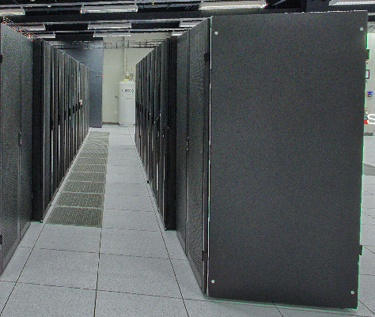
Physical access to the SRE
Two racks in an offsite data center, with redundant cooling and power
24hr live monitoring of personnel access and events
Network monitors report on rack access, power, temperature events, including photos of immediate area
Notes:
You know what a data center looks like. Ours on campus is open to many more people than we liked, so we contracted with a local hosting service (Expedient). Their secure data centers offer more redundancy and physical security than available on campus. Netbotz alert on rack door opening, etc. etc, As this is a colocation site, we do not send motion activated photos of the aisle spaces every time someone walks by our rack.

Slide 22
Monitoring events in the SRE
Solarwinds and logs exported to Splunk or ELK, some produce alerts
Duo authentication failures generate email alerts
Centrally managed Symantec Endpoint Protection
File access monitoring is a costly option
Notes:
We looked at a product (Varonis, if asked) which records file access and make analysis of file and directory permissions easier. That costs some serious money. Alternatively, all the information you need is in Windows, just scattered between event logs and the directory tree, so costly in terms of time and effort. Linux even worse.

Slide 23
Application security
Not easy. We rely on the skills of the developers
Commercial applications
All the various R modules
Best alternative is to religiously patch on schedule
No email, no user-installed software, very limited web access
Notes:
Is anyone doing this to their satisfaction? I didn’t think so.
HECVAT is a good start, but there’s so much yet to do. Let me also put in a plug for the Dorkbot service from our friends at the University of Texas in Austin, we’re happy customers. That said,
For commercial applications we’re really at their mercy to do the right thing. Open source products are more than I and my admins are equipped to handle. There are so many R modules! The best alternative is to be religious in our patch schedule. CWRU policy is to apply patches within 30 days of release, and after Change Advisory Board review. We do have test/development environments for our major applications, and patches can be briefly tested to see what breaks before we go ahead and place them in production. Whether patches fix the vulnerability on the other hand…
We do rest easier knowing that here we’re providing a tightly restricted environment. Patches come from a local SCCM or Satellite server. There is no email, no user-installed software, and users have no web access from within the environment. Our developers are not entirely happy with us…

Slide 24
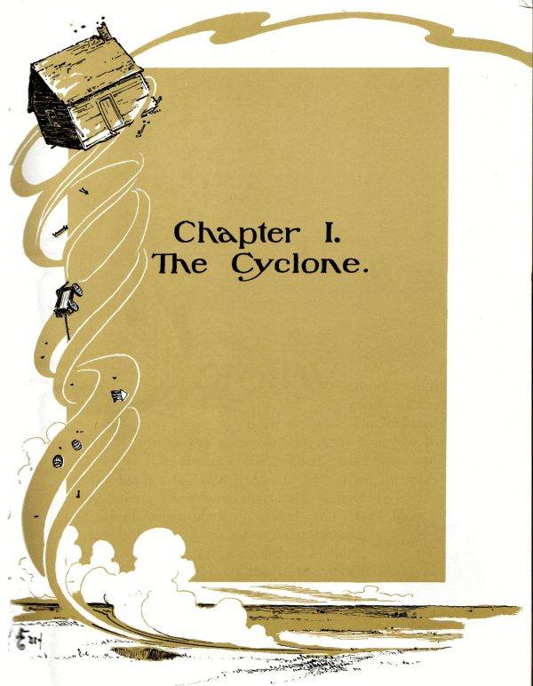

How did we do?
In July-August 2018, RSM’s Cleveland office was engaged to perform a risk assessment of our environment
Baseline was NIST 800-171 controls, as scoped in our agreement
Both Web application and internal VDI penetration testing were authorized
Interesting and useful things were observed
Notes:
In July and August last year, RSM’s Cleveland office was engaged to perform a risk assessment of our environment. The baseline chosen was the NIST 800-171 controls, as scoped in our agreement. Besides a review of our firewall configuration and policies and procedures, both Web application and internal virtual desktop penetration testing were authorized.
Interesting and useful things were observed

Slide 25
How did we do?
Overall, we met 91% of our goals
Data isolation is a strength, exports tightly controlled
Access controls are strong
Vendors do not have persistent access to the environment
The system is actively managed
Patch management and change controls are good
Notes:
Overall, we did rather well.
We hit the mark on data isolation and access controls. We keep vendors at arms’ length for the most part. And our environment is actively managed, monitored, and maintained. All good things, and all that take continuing effort.

Slide 26
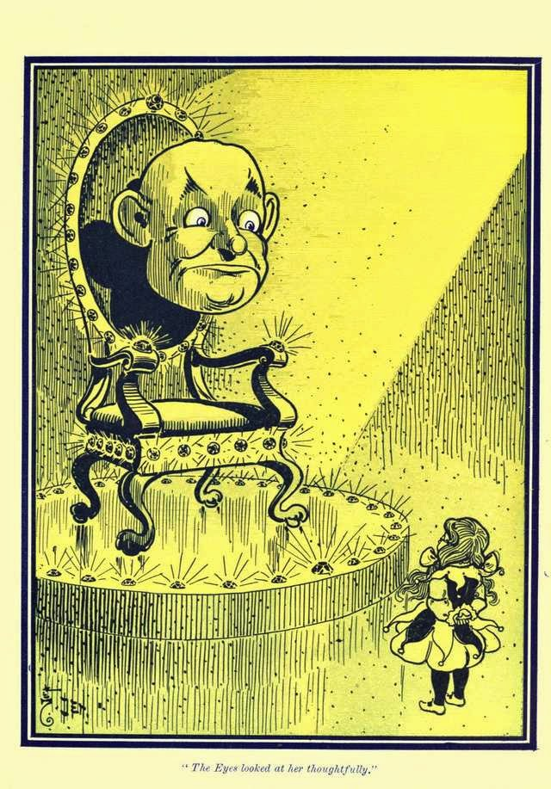
Scary results (sorta)
Most users use web interfaces native to the applications hosted in the SRE
A few dozen have VDI access
So we gave our tester insider access
Surprize! It worked…
Notes:
Web pen testing revealed a few places where cross-site scripting was possible, and a couple areas where we needed to tighten up our SSL/TLS requirements on individual servers. Not entirely minor, but easily fixed. It was the internal access that was interesting. Our monitoring did alert us to what was going on, but we’d instructed the system administrators to note without comment and allow the exercise to proceed. We got dinged on that in the report, but we were curious…

Slide 27
Scary results (sorta)
Well, they caught us
A folder in the path was writable by users
DLL hijacking was successful
So was restarting the virtual desktop
Local admin privileges were obtained!

Slide 28
A brief anatomy of the attack
The IKEEXT service was set to run at startup (used for IPSec, unneeded here)
The service looked for the wlbsctrl.dll file, which was missing
A third-party application had added its directory to the path
This directory was writeable
Paste an executable into Notepad, save it in the directory as a DLL
Notes:
The IKEEXT service was set to run at startup, a service used for IPSec, which we don’t need.
The service looked for the wlbsctrl.dll file, which is missing (and Microsoft doesn’t appear to want to fix it).
A third-party application had added its directory to the path, at the start of the path, as one does, ‘cause that’s easy.
This directory was writeable by mere users, including our pen tester, of course.
Available tools were slight, but he was able to paste an executable into Notepad, and save it in the directory as the missing DLL.

Slide 29
DLL hijack attack, continued
Reboot the system (thought to have been disabled)
IKEEXT finds the bogus DLL, loads it, and Viola! We have admin rights
Policies and the Registry could then be altered
Attempts to gain Domain Admin rights were unsuccessful
Local admin could grant self rights to exfiltrate data, however
Notes:
To load the DLL, our guy had to restart the system. We had thought we’d disabled this feature, but there are many ways to do the trick, and we hadn’t stopped them all. We watched as the system rebooted.
Bang! the IKEEXT service found the new DLL, loaded it, and VIOLA, the user was escalated to local Administrator.
All sorts of things were now possible, but because we had other controls in place, our diligent tester was unable to gain Domain admin rights. Certainly he had enough to break the policy objects preventing the export of data, but as we still controlled the horizontal AND the vertical, any such attempt would have been alerted and observed, if his next steps had been successful. Still, though, it was interesting and useful to see…

Slide 30
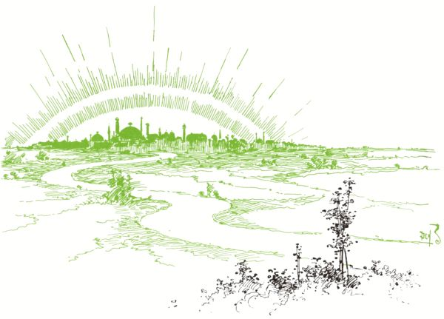
Approaching the Emerald City
Notes:
Lessons learned:
We thought we were in pretty good shape, but improvements can always be made. Most of the operational weaknesses found in the overall assessment have already been remediated, and we’re working on improving our administrative practices. The journey was certainly very useful, and reassuring. We’ll do it again sometime, for sure.

Slide 31
Words for the wise
Be mindful of application installation and updates!
Pay attention when alerts are thrown
Centralize the source of patches and updates as you can
Stay on top of user training, including student workers
Policies and procedures should be reviewed and updated routinely

Slide 32
Special attention: BC/DR
What is the appropriate service level agreement?
To what extent is daily work being done in your environment?
These requirements tend to change over time
Restore services to redundant data center, or cloud service?
Notes:
Finally, the more segmented and locked away you make your environment, the harder it is to replicate in the case of a physical disaster. Our initial thought was that we were serving a research function, so we assumed a restore time measured as a week or three might be sufficient. But as the SRE has become popular and more services have been hosted there, we find there are folks out there whose work would be halted if we were to indeed lose the SRE.
As Case Western Reserve expands its use of cloud services, we consider one alternative to be to migrate the environment into AWS with S3. As it turns out, it’s fairly simple to restore the virtual machines into AWS, that’s even becoming a feature of backup software solutions like Veem. But the network structure, all those VLANS, and all those firewall rules, those don’t have as easy a migration path. We are in the midst of this discussion now. Whether we choose to restore the SRE into a backup data center, either on campus or in another hosted location, or restore the entire shebang into AWS or Azure, we will need to begin by replicating the network framework before we can consider the easy part of moving VMs. Laying that groundwork will take time, and additional funds, as is always the case.

Slide 33

Questions?

Slide 34
Acknowledgements
Erin Fogarty, Mark Herron, Rich Sparrow
Roger Bielefeld - Sr. Director, UTech
Tom Siu - Chief Information Security Officer, UTech
Jeff Gumpf - Chief IT Architect, UTech
Sue Workman - Chief Information Officer, UTech
Artech - Technology Partners
University Hospitals Cleveland Medical Center
Cleveland Clinic Foundation
CWRU faculty, students, and staff
Photos courtesy of NOAA, CWRU
Drawings in the public domain by Wm W Denslow, for “The Wonderful Wizard of Oz”
Notes:
Erin and Mark and RSM Rich Sparrow (Penn State)

