Slide 1
Kansas City University
How to Successfully Survive a Phishing Attack
Lance Huggins – IT Director
Notes:
1) First, save this template to your folder –
In the PowerPoint Menu, go to File > Save As…
A screen comes up. Title your layout at the top of the screen. Save layout to your folder.
2) To insert a new slide
On the Home tab, in the Slides group, click Layout, and then click the new layout that you want.
3) Format slides with your content
All page elements can be edited in the regular slide mode or moved/deleted off the page if you choose not to use elements.
Master page elements can be accessed through View > Master > Slide Master
Other Notes: Primary Font: Georgia, Secondary Font: Verdana

Slide 2
Kansas City University Background
Who are we?
  Health Sciences University
    College of Osteopathic Medicine
    College of Biosciences
  Private not for profit
  Enrollment is ~1,500
  450 Employees
  Campuses located in Kansas City and Joplin MO
Notes:
1) First, save this template to your folder –
In the PowerPoint Menu, go to File > Save As…
A screen comes up. Title your layout at the top of the screen. Save layout to your folder.
2) To insert a new slide
On the Home tab, in the Slides group, click Layout, and then click the new layout that you want.
3) Format slides with your content
All page elements can be edited in the regular slide mode or moved/deleted off the page if you choose not to use elements.
Master page elements can be accessed through View > Master > Slide Master
Other Notes: Primary Font: Georgia, Secondary Font: Verdana

Slide 3
Our Story – What Happened?
One employee received phishing email from dropbox about an invoice
Employee enters credentials into a landing page
Actor uses employee’s login to send internally authenticated email to all employees except IT from their address book
Actor gets 15 more credentials and starts logging into ERP and changing direct deposit information
Employee alerts HR their direct deposit information was changed
Notes:
1) First, save this template to your folder –
In the PowerPoint Menu, go to File > Save As…
A screen comes up. Title your layout at the top of the screen. Save layout to your folder.
2) To insert a new slide
On the Home tab, in the Slides group, click Layout, and then click the new layout that you want.
3) Format slides with your content
All page elements can be edited in the regular slide mode or moved/deleted off the page if you choose not to use elements.
Master page elements can be accessed through View > Master > Slide Master
Other Notes: Primary Font: Georgia, Secondary Font: Verdana

Slide 4
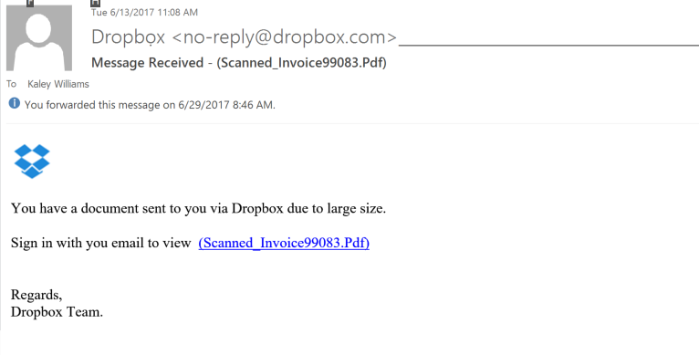
Email Sent to Employee
Email response was masked
Hyperlink went to hoteldefrenso.com

Slide 5
Our Story – How did we respond (short term)?
Created task force to include HR, Compliance, Finance, and IT
  CFO lead the response getting all parties together
Compliance officer put our insurance on notice
  Follow up on this later with forensics
IT reset all employee passwords
KCU HR notified impacted employees and worked with them for identity protection
KCU notified payroll vendor to stop all payments for impacted employees
Notes:
1) First, save this template to your folder –
In the PowerPoint Menu, go to File > Save As…
A screen comes up. Title your layout at the top of the screen. Save layout to your folder.
2) To insert a new slide
On the Home tab, in the Slides group, click Layout, and then click the new layout that you want.
3) Format slides with your content
All page elements can be edited in the regular slide mode or moved/deleted off the page if you choose not to use elements.
Master page elements can be accessed through View > Master > Slide Master
Other Notes: Primary Font: Georgia, Secondary Font: Verdana

Slide 6
Our Story – How did we respond (longer term)?
IT and Compliance worked with insurance and legal counsel on forensics report
  This included all logs from O365, ERP, authentication activity, etc.
  IT Security vendor created overall report from forensics information
HR Implemented improved direct deposit notification and additional approval flow
IT implemented Proofpoint email security and multifactor authentication
Notes:
1) First, save this template to your folder –
In the PowerPoint Menu, go to File > Save As…
A screen comes up. Title your layout at the top of the screen. Save layout to your folder.
2) To insert a new slide
On the Home tab, in the Slides group, click Layout, and then click the new layout that you want.
3) Format slides with your content
All page elements can be edited in the regular slide mode or moved/deleted off the page if you choose not to use elements.
Master page elements can be accessed through View > Master > Slide Master
Other Notes: Primary Font: Georgia, Secondary Font: Verdana

Slide 7
Lessons Learned
Implementation of multi-factor authentication would have prevented this
Proofpoint opened our eyes to exactly what is going on in our email with more controls
Better logging tools like Splunk would have helped in our forensics
Employees need enormous amounts of awareness and it needs support from the top
Notes:
1) First, save this template to your folder –
In the PowerPoint Menu, go to File > Save As…
A screen comes up. Title your layout at the top of the screen. Save layout to your folder.
2) To insert a new slide
On the Home tab, in the Slides group, click Layout, and then click the new layout that you want.
3) Format slides with your content
All page elements can be edited in the regular slide mode or moved/deleted off the page if you choose not to use elements.
Master page elements can be accessed through View > Master > Slide Master
Other Notes: Primary Font: Georgia, Secondary Font: Verdana

Slide 8
Questions?
Lance Huggins – lhuggins@kcumb.edu

