Slide 1
NIST 800-63-3b Password Vetting Changes
At Virginia Tech
Brad Tilley, rtilley@vt.edu
Randy Marchany, marchany@vt.edu

Slide 2
Drastic Changes in NIST 800-63-3b
When processing requests to establish and change memorized secrets, verifiers SHALL compare the prospective secrets against a list that contains values known to be commonly-used, expected, or compromised.
If the chosen secret is found in the list, the verifier SHALL advise the subscriber that they need to select a different secret.
Verifiers SHOULD NOT impose other composition rules (e.g., requiring mixtures of different character types or prohibiting consecutively repeated characters) for memorized secrets.

Slide 3
Background - How We Got Here
Password Composition Policies do not work.
Frustrating, Confusing, Inconsistent for users
Policy may require special characters but not allow some special characters
No standard for password policies (every org is different)
Easily Circumvented/Gamed by users – Password2019!
Policies actual weaken passwords. Opposite outcome of intent.
Technologists have seen this epic failure first-hand for many years.
NIST finally said enough is enough, let us stop this madness.

Slide 4
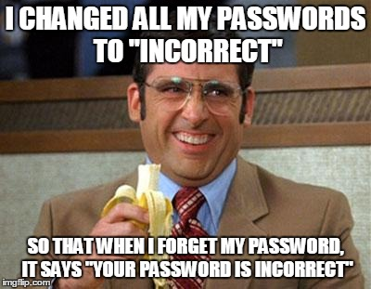
It’s been a joke for years.

Slide 5
Academics Noticed Too
Password Policies Do Not Work!

Slide 6
Weir et al. - 2010
Matt Weir, Sudhir Aggarwal, Michael Collins, and Henry Stern. 2010. Testing Metrics for Password Creation Policies by Attacking Large Sets of Revealed Passwords. In Proceedings of the 17th ACM Conference on Computer and Communications Security (CCS ’10).
“However, these policy mechanisms are hampered by an ill-defined understanding of their actual effectiveness against real attack techniques, and by circumvention strategies employed by the users. For example, a policy mandating that a user include at least three digits in a password will often result in the user simply appending "123" on the end of an insecure password”

Slide 7
Helkala - 2011
Kirsi Helkala. 2011. Password Education Based on Guidelines Tailored to Different Password Categories. JOURNAL OF COMPUTERS 6 (05 2011), 969–975.
“However, even if a system uses password policy, stating which character sets to use and what the minimum length of a password is, passwords might end up being predictable”
“From the user perspective the general instructions [within password policies] are often too broad to be useful. One remembers best meaningful passwords, some like numbers and special characters while others recall best patterns from the keyboard, etc. The general instructions such as ’Minimum length of 8, use all character sets’ do not support all users in their password generation process”

Slide 8
NIST Took Action - 2017
Introduced 800-63-3B
Requires changes at all levels
Management, policy makers and auditors must embrace
Technologists and users must embrace
Everyone may be reluctant to let go of old ways
Even though password composition policies are seriously flawed, we are accustomed to them (the devil we know)

Slide 9
Technological Challenge
There are about 520 million unique compromised passwords publicly available as of Oct 2018
Probably more than this on criminal/hacker underground
NIST says orgs should compare user passwords to these
Orgs should not allow users to set known compromised passwords
How to do this without using composition policies
How to do this efficiently each time account created or password changed?
At Virginia Tech, we solved this using a Bloom Filter.

Slide 10
Bloom Filters - 50 year old idea
Represent items as a few bits rather than the items themselves
HIBP compromised password list is 22GB in size
Bloom Filter of the same list is 860MB
If test for item fails, 100% positive that item is not present
If test for item succeeds, we’re pretty sure the item is present
Have user select new password
Pros: Small size. Constant lookup and insertion times O(1)
Cons: Small chance of false positive, cannot remove items
Summary: A Bloom Filter can efficiently solve the new NIST comparison requirement.

Slide 11
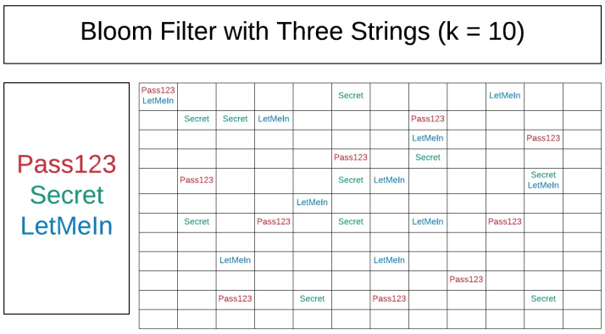
What a Bloom Filter Looks Like

Slide 12
Demo - Background
Small Docker container running in AWS Fargate
Uses 2GB of RAM
Simple Web Service written in Go
Returns 200 if hash was found
Returns 400 on bad requests
Returns 404 if hash not found
Backed by Bloom Filter built from the HIBP list
Note: Only uses first 16 Hex chars (never send a full hash to anyone)

Slide 13
Demo - Links
200 - https://check.aws.cloud.iso.vt.edu/hashes/sha1/F7C3BC1D808E0473
400 - https://check.aws.cloud.iso.vt.edu/hashes/sha1/Password
404 - https://check.aws.cloud.iso.vt.edu/hashes/sha1/1234567812345678
Example Source Code
https://github.com/w8rbt/bp

Slide 14
Conclusion
NIST 800-63-3b brought much needed change but also introduced some challenges.
The technical challenges (effectively and efficiently) met by using bloom filters to comprehensively test massive sets of exposed passwords during account creation and password resets.
Hard part will be the organizational change… convincing auditors, managers and users to move in this direction, but it is the right thing to do.

