Slide 1
ACTI-CCI Draft Feedback on the NSF ACCI Task Force Reports
ACTI / Common Solutions Group Joint Meeting
Stanford University
10 January 2012

Slide 2
Emergence of net@edu CCI WG: Campus Cyberinfrastructure
July 2008: Workshop (with CASC) on “… Cyberinfrastructure from Local Campus to National Facilities”
2009: NSF ACCI forms six Task Forces
spring 2011: Tasks Forces Issue Reports
Campus Bridging Task Force very active
ACTI CCI WG (re)organized; studies these reports in context of Campus CI
summer 2011: XSEDE announced as successor to the TeraGrid

Slide 3
1: Grand Challenge Task Force
Fundamental claim: Cyber Science and Engineering (CS&E) deserves a permanent programmatic place at NSF
Examples:
Climate Change and Human Activity
Macromolecular structure and complexes
Hazard Analysis and Management
Virtual product design for Manufacturing

Slide 4
Grand Challenges require …
Computational models, methods, algorithms
HPC (including exascale)
Software
Data and Visualization (critical of current data infrastructure)
Education, Training, and Workforce Development
Grand Challenge Communities and Virtual Organizations

Slide 5
Two weaknesses …
Fails to emphasize the potential role for CCI
The authors are very good leaders in this area, and thus have excellent access to national centers
Pessimistic about impact of large data
Fails to emphasize the consequent need for end-to-end data networking capacity

Slide 6
Impact on CCI
This report is very positive about CS&E generally and we should absolutely embrace it in its positive statements
The report reminds us that CCI is often off the radar. Better integration of CCI, as with several XSEDE directions and with better bulk data movement, would help.

Slide 7
2: Cyberlearning and Workforce Development Task Force
redesign entire approach to education from scratch exploiting C⁴: the Continuous Collaborative Computational Cloud that has already formed and continues to develop

Slide 8
What is C⁴?
Notes:
This figure from the report is not a recommendation for what NSF should be trying to do. It is an effort to visualize what has been happening to our society and how education needs to evolve in response. Take a look at the Motivating Issues to the lower left, and the NSF responsibilities to the lower right. Next slide is going to call out some of the report’s assumptions about the direction of change in C4.

Slide 9
Key points of critique …
Positive: the emphasis of the report on impact on broader society (rather than training more MPI coders, say) is very good
Gentle criticisms:
perhaps too prescriptive, e.g., with C⁴
too optimistic about K12 teachers being prepared to execute the vision
But will stress CCI in some positive ways!

Slide 10
3: Data and Visualization Task Force
Points of Agreement to be Stressed:
Data Infrastructure / Services: Essential research assets for today¹s science
Culture and Sociological Change: Reinforce expectations and encourage data sharing
Responsibility for data stewardship is shared among Principal Investigators, research centers, libraries and archives, agencies, and commercial providers
Need for proven “best practices”

Slide 11
Gentle Critique
In many ways, the Grand Challenge report makes a more forceful case for Data Infrastructure and for Visualization than does the Data and Visualization Task Force Report
But on those areas that the report touches, it makes solid points from serious data professionals
Note history and makeup of the Task Force

Slide 12
Specific Shortcomings
Report does not identify specific "grand challenge areas" in either data management or visualization
Need to address the issue of sustaining collections of irreproducible data
Need means to declare / use trust relationships in access control across large time / space dimensions
Specific problems of “big data” (e.g., networking, storage, data analysis) only touched on
Need for better “Big Data Analytics”
Visualization explicitly left out

Slide 13
Impact on CCI
CCI will have a natural role in
Data Stewardship
Big Data Analytics
CCI and the National centers will need to work together to achieve a positive Remote Visualization outcome
We expect XSEDE to contribute here together with CCI

Slide 14
4: High Performance Computing Task Force
Very thin: Three Areas of focus
Cyberinfrastructure sustainability
Exascale computing
Broader impact
We concur with these positive statements, and note that they are less obvious than they may appear

Slide 15
Weaknesses
Focuses solely on the highest end capability systems
How might campus layer dovetail?
Role for high-throughput computing?
Need for large data flows?
Didn’t address campus level HPC work and bridging
Will the national centers be Fortresses or sources of synergy and leadership?

Slide 16
5: Software for Science and Engineering Task Force
Software identified as critical success factor
Tension between “organically” developed codes and the need for rigorous software engineering and validation for sustainability
Noted importance of compilers etc. that can leverage modern processors (incl. MICs and GPUs and multi/many-core)
Did not stress issues required for O(10^6) elements

Slide 17
Kinds of Software noted:
Operating and grid software
Compilers and other tools
Robust applications
Comments:
History of downplaying importance and difficulty of software
Our community is often “in denial” about how hard this is to do right

Slide 18
6: Campus Bridging Task Force
At least two major interpretations of “bridging”:
bridging “from” campus to “national CI”
bridging “among” campus CI and national CI resources

Slide 19
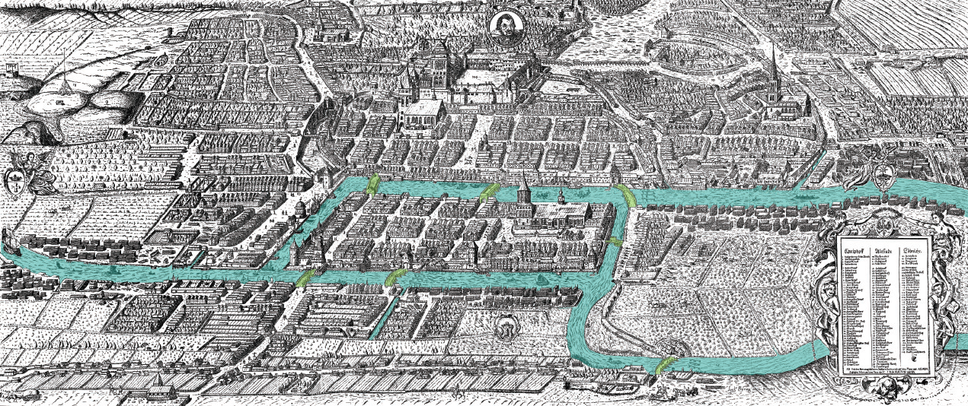

Slide 20
Recommendations to NSF
encourage the use of the InCommon Federation global federated system by using it in services
establish a blueprint for a National Cyberinfrastructure
create a new program funding high-speed connections from campuses to the nearest landing point for a national network backbone

Slide 21
Recommendations to NSF (cont’d)
fund national facilities for data storage and management to support collaboration, scientific workflows, etc.
continue research, development, and delivery of new networking technologies
fund Cyberinfrastructure activities through careful analyses of needs and outcomes

Slide 22
Recommendations to Higher Ed
invest in university, state, and regional cyberinfrastructure –including the needed skilled FTEs
have a strategic plan to establish a coherent cyberinfrastructure maximizing value and minimizing global environmental impact
adopt criteria for tenure and promotion that reward the range of contributions (data sets, scholarly services, software, etc.)

Slide 23
Recommendations for Commercial Providers
work with the US open research community to reduce barriers to use of their facilities:
quality of connectivity
business model issues such as transport costs
policy issues such as the control of geographic location of data

Slide 24
How Should CCI Respond?
Can we (campus CI staff):
leverage XSEDE
do better alignment with regional and national CI providers?
contribute to controlling cost of infrastructure and services for research computing?
directly support faculty use of CI at any distance?
promote more interoperability?

Slide 25
Thanks to specific contributors
Grand Challenges (Guy Almes, Jill Gemmill)
Cyberlearning (Raj Bose and Sally Jackson)
Data and Visualization (Jill Gemmill, Rick McMullen)
HPC (Vijay Agarwala, Curt Hillegas)
Software for Science and Engineering (Rick McMullen, and Jill Gemmill)
Campus Bridging (Sally Jackson, Rick McMullen, Thomas Hauser, Guy Almes)

Slide 26
Questions?

