Slide 1
Virtualization Across The Enterprise
Rob Lowden
Director, Enterprise Infrastructure
Indiana University
23 May 2007
Notes:
Rob Lowden
Director, Enterprise Infrastructure
University Information Technology Systems
Indiana University
rlowden@iu.edu

Slide 2
Topics
Virtualization across your data center
Strategy and Vision
Benefits and Opportunities
Questions and Discussion

Slide 3
Gartner Symposium ITXPO 2006 (8-13 October 2006 Orlando Florida)
“Virtualization is the most impactful trend in infrastructure and operations through 2008”
Data centers can realize up to 80% reduction in x86 servers
90% of Fortune 1,000 companies will use VM by 2008
The single largest benefit of virtualization is reduced downtime and faster responses to changing demands

Slide 4
Gartner Symposium ITXPO 2006 (8-13 October 2006 Orlando Florida)
“You would be crazy not to use virtualization.”
Notes:
OK, not a quote from Gartner, but you get the message. If you have not heard about or are not leveraging the advantages of virtualization, you need to pay attention to this technology.

Slide 5
The Changing Expense Profile
Source: IDC Survey Data, 2002-2004
Original Source IBM Presentation Feb 2007
Notes:
Because software expenses represent such a large portion of IT spending, any ability to reduce the amount of software licenses can have a substantial financial impact as can economies of scale from consolidation / standardization and their impact on staff reduction.

Slide 6
Server Management and Administration Costs
Source: IDC Survey Data, 2002-2004
Original Source IBM Presentation Feb 2007
Notes:
Initial system and software deployment, migrations, planning for Upgrades, expansion and capacity as well as system monitoring can be over 50% of your costs in terms of server management and administration costs. Reductions here can be significant and impact your IT budget.

Slide 7
Virtualization
Where did this “brand new” term originate?
The abstraction of computer resources…
One physical resource, multiple logical resources…
The hiding of technical detail through encapsulation…
Notes:
Source, http://en.wikipedia.org/wiki/Virtualization

Slide 8
Virtualization
Notes:
Enable doing more with less.
Images represent server/CPU utilization.
Images can also represent physical rack space utilized due to data center policies and practices

Slide 9
Suggested P2V Approach
Identify service demands
Servers at or near capacity
Servers out of warranty/maint./ lifecycle
Servers out of standard build
Applications that lend themselves to VM
Notes:
Does the application or service being supported by the physical service lend itself to a Virtual platform? Does it have high IO demands that are better suited for a dedicated system? Does the software running on the device require a physical adapter that can be virtualized?
Does the current physical device consume all available CPU, memory or other resources?
Will you soon be extending the maintenance or purchasing new equipment?
Does the server represent a model or vendor that you have consolidated from or no longer prefer to support?
After reviewing the first questions, even if it does not meet all of the criteria, does the application or service being provided by that machine lend itself well to VM? Does the vendor support their application on a virtualized platform?

Slide 10
Storage Virtualization
“Where should the intelligence be hosted to handle storage virtualization?"
Three approaches:
Array Based
System Based
Switch Based
Notes:
Storage Virtualization has recently hit the mainstream in the industry. Combining a server virtualization strategy with a storage virtualization strategy is a powerful combination.

Slide 11
Pros and Cons
Source: Joe Clabby, Clabby Analytics
04/11/2006

Slide 12
Storage Virtualization
No added complexity
Not limited to SAN connection
Virtualization is done at the Controller level
Existing Controller functions are mapped across external storage
No new standards or APIs required
Preserves end-to-end security

Slide 13
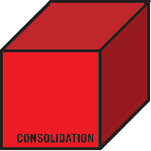
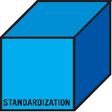
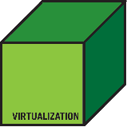
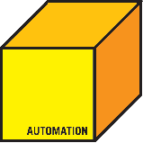
Vision
Utilize consolidation, standardization, virtualization and automation as a foundation to deliver key infrastructure services.

Slide 14
Strategy

Slide 15
Tiered Storage
High End Disk
Mid Range Disk
SATA
Tape
Notes:
IU had an existing install base of storage and backup devices. By introducing virtualized storage, we created a single pane of glass view into a heterogeneous environment allowing us to leverage tiered storage solutions and simplify storage management.

Slide 16
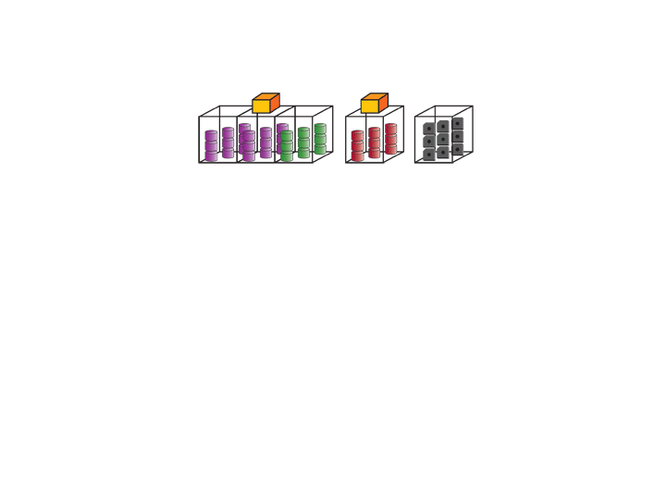
Storage Consolidation
Notes:
A pretty slide on how it can be done. ;)

Slide 17
Virtualization / Consolidation Benefits
Increased disk / CPU utilization
Deferring disk / server procurements
TB per administrator improvement
Reduce data center rack/floor space
Reduce tape library procurement
New DR capabilities
Online recoverability options
Improved data path availability
Reduce general purpose x86 servers
Improve network performance via FC
Reduce / eliminate backup servers
Reduce / eliminate batch and backup windows
Storage / server resources on demand!

Slide 18
Campus Services
For fee services available
Currently in pilot mode
Four models currently offered:
Backups
Virtual Server
System Administration
Full Service Package

Slide 19
Quiz
What percentage of respondents in a recent AFCOM study regarding disaster recovery sited in-sourcing as their primary disaster recovery strategy?
A. 25%
B. 52%
C. 58%
D. 72%

Slide 20
Backup and Recovery
Notes:
Install a common data backup and restore service
Replicate Bloomington backups across geographic distrance
Leverage and expand ATL’s/tape media at both sites
Leverage “Dark Fiber” between core campuses

Slide 21
IT Systems Environment
Original Source IBM Presentation Feb 2007

Slide 22
Questions and Discussion
Notes:
Rob Lowden
University Information Systems Director
University Information Technology Systems
Indiana University
rlowden@iu.edu

Slide 23
Virtualization Across The Enterprise
Rob Lowden
Director, Enterprise Infrastructure
Indiana University
23 May 2007
Notes:
Rob Lowden
Director, Enterprise Infrastructure
Indiana University
rlowden@iu.edu

Slide 24
Copyright
Copyright Rob Lowden, 2007. This work is the intellectual property of the author. Permission is granted for this material to be shared for non-commercial, educational purposes, provided that this copyright statement appears on the reproduced materials and notice is given that the copying is by permission of the author. To disseminate otherwise or to republish requires written permission from the author.

