Slide 1
Presentation of
Millersville University
Analytics of Per Credit
Tuition Model

Slide 2
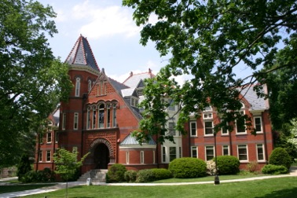
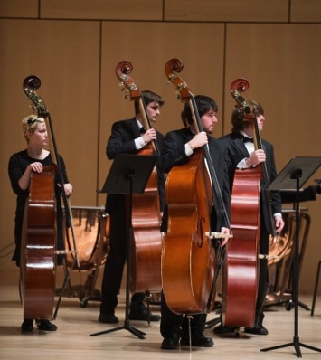
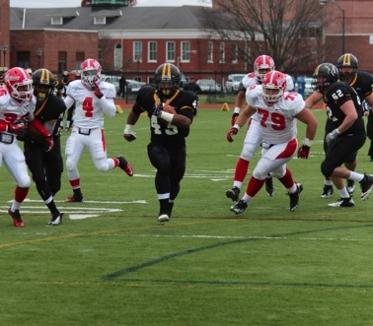
Problem
Structural Budget Deficit of $8.1 million

Slide 3
Old Tuition Model
Full-time rate is based on 12 credit hours
You pay for 12 credits but you can take up to 18 credits with no additional cost.
So you buy four three credit courses and you get one or more FREE.
No longer affordable
We wanted a consumption model.
You pay for what you buy.
We need a new model

Slide 4
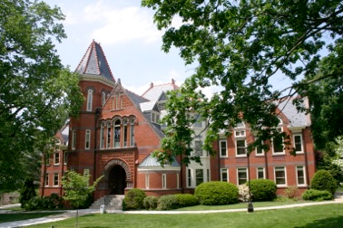
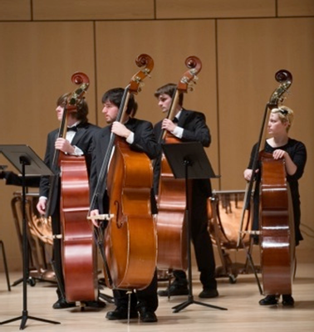
Building a Team
We need three teams:
A development team to create the model
Implementation team to execute the model
An evaluation team to monitor result

Slide 5
Development Team
Vice President for Administration and Finance Office
Budget Office
Assessment and Planning
Institutional Research
Bursar
Enrollment Management
Admissions
Financial Aid
The President’s Cabinet was the Steering Committee.

Slide 6
Implementation Team
Vice President for Administration and Finance Office
Budget Office
Bursar
Enrollment Management
Admissions
Financial Aid
Marketing and Social Media
Information Technology
Website
Banner

Slide 7
Evaluation Team
Vice President for Administration and Finance Office
Budget Office
Assessment and Planning
Institutional Research
Bursar
Enrollment Management
Admissions
Financial Aid

Slide 8
Basic Concept
Develop a scenario which impacts the least number of students
Generate additional revenue

Slide 9
Impact of Alternative Per Credit Rates
Assumed a BOG tuition increase of 3%
PASSHE full-time in-state rate of $3,410
Calculated the per credit charge based on # of credits
Used trial and error and kept the percentages whole

Slide 10
Student Impact

Slide 11
Unmet Financial Needs
In the fall of 2013, 1,957 in-state undergraduate students who filed a FAFSA and were taking more than 13 credits had unmet need.
How much would it cost to cover 2 credits for each of these students?
The additional revenue generated made it possible to provide an additional $1.1 MILLION in aid to our students.

Slide 12
A Successful Model

Slide 13
Estimated Tuition Rates 2014-15 through 2017-18
Assumes PASSHE approves a 3% tuition increase each year.

Slide 14
Communication Plan
Spokesperson and Incoming Calls
Print
Website
Frequently Asked Questions developed
Press Release
Article in The Exchange
Social Media

Slide 15
Internal Implementation Challenges
Financial Aid Packaging
Refunds
Financial aid disbursement date is delayed
Payment Plans
Many individuals in the tuition payment plan program had miscalculated their budgets due to late notice of the change
Assessing Fees and Waivers
There is no longer a full-time rate on which to base calculations and assess charges
Impacted General/Technology/STEM Fees, Exchange Program, and Waivers

Slide 16
Impact of Undergraduate In-State Per Credit Tuition

Slide 17
Impact of Undergraduate In-State Per Credit Tuition

Slide 18
Lessons Learned
Timing and Communication
Should have brought Marketing and Communication in earlier
Impact to other external programs
Data Availability
Data-Driven Mind Set
Talent - Financial Aid needed a consultant

Slide 19
Thank You!

