Slide 1
Describing the Solution Patterns and Real-World Examples
Tom Barton, University of Chicago
Steven Carmody, Brown University
Cal Racey, Newcastle University
Liz Salley, University of Michigan

Slide 2
Design Patterns
From the Yahoo Design Pattern Library:
Patterns are optimal solutions to common problems. As common problems are tossed around a community and are resolved, common solutions often spontaneously emerge. Eventually, the best of these rise above the din and self-identify and become refined until they reach the status of a Design Pattern.

Slide 3
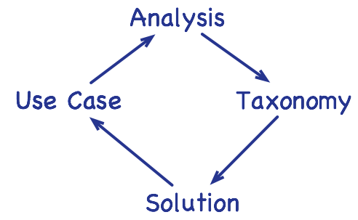
Design Patterns

Slide 4
Design Patterns
Academic Case #5
Authority rests with the Registrar (business role)
Grantor is self-identified but constrained by authoritative source (only students may exert FERPA rights)
Depending on IAM implementation, could be algorithmic (eg., by eduPersonAffiliation) or more ad hoc (Registrar may provide a list of covered students)
Constraint: grantees must be identify (in some unspecified fashion) an academic need for information
Business Case #4
Authority rests with HR department (business role)
Grantor and grantee are the same, self-identified but constrained by authoritative source (only staff and faculty)
Depending on IAM implementation, could be algorithmic (eg., by eduPersonAffiliation) or more ad hoc (HR provides eligible “staff” and “faculty” lists)
Constraint: the grantee must accept terms and conditions of the program before being enrolled.

Slide 5
Access Management Solution Patterns
At first glance, many of our use cases appear to be unique challenges.
As we break each use case down into component parts, we begin to see similarities.
We can now think about building solutions around the patterns rather than the use cases.
Are there solutions that have been tossed around the community enough to emerge as design patterns?

Slide 6
Access Management Solution Patterns
Application Access Roles-Multiple Registrars for a Service
Official Source with White and Black Lists
Ad-hoc Lists
Managing Hierarchies
Proxy and Delegation Access
Access to Internal Resource Granted to External Parties
Time-restricted Access

Slide 7
Application Access Roles
Problem
Individuals need to be specifically authorized to use a service.
They are locally-identified, in that the organization does not track who belongs to each group. Only they know who they are.
Typically, someone in authority assigns individuals to the appropriate group.

Slide 8
Application Access Roles
Variants
Single registrar grants and removes privileges for the entire organization.
Multiple registrars, each responsible for a department or team, grant and remove access for their team.
Multiple registrars, each responsible for different privileges within the service.

Slide 9
Application Access Roles
Solution
Create a group with a membership of the people authorized to use the service.
If there is a need to support different privileges within the service, create multiple groups that map to the various Roles within the application.
If there are multiple Registrars, give all of them the authority to manage group membership, or create separate groups for each of them to manage.

Slide 10
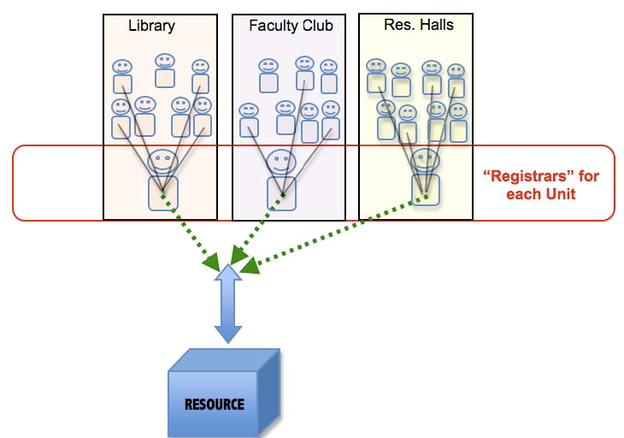
Example: Multiple Registrars for Campus Wireless Access

Slide 11
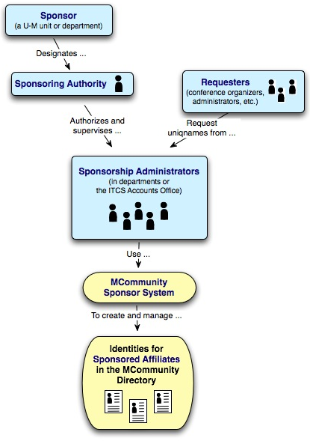
Example: Multiple Registrars for University Affiliates
Any University of Michigan school, college, or department can sponsor and manage affiliates in our IAM system (known as MCommunity).
Each sponsoring unit is a registrar responsible for managing affiliates within their area. Each unit can name one or more local administrators.
http://www.itcs.umich.edu/itcsdocs/r1458/

Slide 12
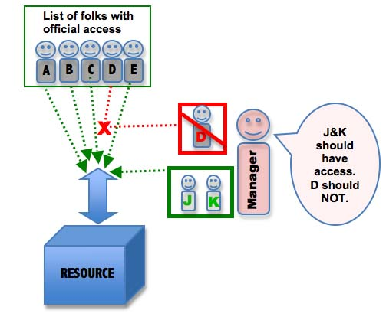
Official Source with White and Black Lists

Slide 13
Some motivating situations
Greg Jackson
Student testing
Graceful account closure
From “Use Cases Organized by Area of Interest”
Travel reimbursement approval
Trustee conflict of interest
Terminating Access for a Disgruntled Employee
Adding a lab assistant
Adding TA Access to Course Dropbox
Pre-hire affiliation
Notes:
Greg Jackson, CIO & VP for IT, is not “officially” part of the IT unit from a payroll perspective. He’s gotta be whitelisted in to a number of IT-restricted resources.
The Alumni Relations & Development Office want some students to try out their new portal. The portal is shib-protected and configured to only let alums in. They can be whitelisted, and the shib IdP configured to supply the appropriate “this guy’s an alum” attribute for whitelisted people. Management of that whitelist can be given to the ARD people so they can handle the testing themselves.
An account is normally closed over a 45-day period during which the user is notified. Mid-way, access to some services is removed, just to be sure we’ve got their attention - in case something’s wrong, we really shouldn’t permanently delete their resources. In effect, they’re added to a blacklist observed by those services.
The power of using official sources, whitelists , & blacklists together is seen in an aspect of a more hierarchical and workflow-oriented use case, Travel Reimbursement Approval. Who are the Approvees for a given Approver? Because work is supervised independently of how people are paid, they’re not exactly the people paid on a given account, but that’s close. The official list of who’s paid from a given account can be “tweaked”, i.e., have a few manually entered whitelist people added and manually entered blacklist people removed, to arrive at the correct list of Approvees. This minimizes manual entry and ensures that at least most Approvees are automatically assigned to a new Approver when they move to a different job at the University.

Slide 14
Ad Hoc Lists

Slide 15
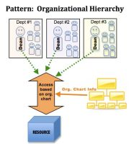

Slide 16
Hierarchy examples
HR organisational structure
School of engineering
Chemical engineering
Process engineering group
HR chain of command staff hierarchy
Dean
Professor
Principle investigator
minions
Physical Location hierarchy
Campus
Building
floor
Course Hierarchy
Business school
Accountancy specialism
Auditing module

Slide 17
Using hierarchies
What hierarchies does an institute have
Where hierarchies are kept
How to capture them
Dealing with change
Systems of record are imperfect
Perfection enemy of progress

Slide 18
