Slide 1
Glimpses of our IT Future: What’s Green, Mobile, and Regulated All Over?
2008 EDUCAUSE
Evolving Technologies Committee

Slide 2
Welcome!
Presentations
  Green Enterprise Computing
  Location Aware Computing
  Virtual Worlds in Education
  Business Process Management
  Regulatory Compliance
Overview paper in EDUCAUSE Review, Nov/Dec 2008 issue, full papers on website
Questions, Comments, Suggestions for Next Year following presentations
Notes:
No, it’s not a corny joke your six-year-old might tell. “What’s green, mobile, and regulated all over?” is a fairly succinct description of today’s evolving IT environment. More than ever, we find we are dealing with a new interpretation of Moore’s Law. As technical capabilities continue to double regularly, energy, economic, and regulatory constraints on those capabilities are increasing exponentially as well. This year’s EDUCAUSE Evolving Technologies Committee has attempted to capture a glimpse of the collective future for IT professionals in higher education, anticipating not only the evolving technologies but also ways to address the ever-evolving constraints placed on our ability to provide the technologies that our institutions have come to expect.

Slide 3
Green Enterprise Computing
Tina Meier
Oklahoma State University System
John S. Moses
University of Chicago

Slide 4
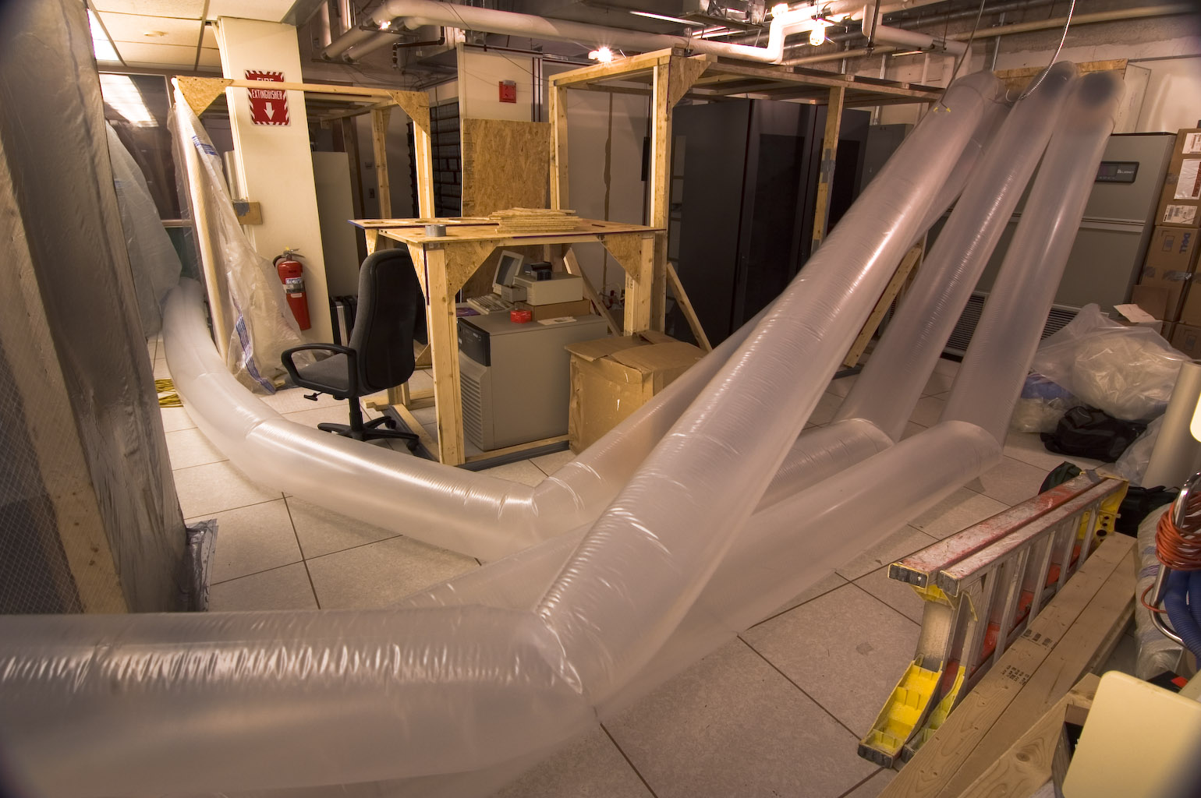
Does This Look Like Your Data Center?

Slide 5
Why Go Green?
Economics – Save $$$
Improve Environmental Impact
Better stewards of resources
Politics

Slide 6
How To Go Green?
Energy Surveys
  Work done at OSU
    Policy – adopted in August 2007
    Green Campaign
    Implement tools for measurement
    Reports to the Board & the Public
  Workstations
    How much will you save by turning them off?
  Labs
    How much will you save by putting them to sleep?
  Data Center
    Power, Cooling and Virtualization

Slide 7
How To Go Green?
Workstation Savings
  Turn Off at Night – savings of 100 hours of energy
  Upgrade older models
    Dell OptiPlex GX620 to Dell Optiplex 745
      Save ~ $75.20 per desktop in energy
      500 x $75 = $36,500 annual energy savings

Slide 8
Data Center Upgrades
OSU Data Center Upgrade
Focus on Power & Cooling
Resources
Futures
  Automate Server Shutdowns
  Cooling on Demand

Slide 9
Virtualization
Most server utilization sits at 10 to 30%
Tools available to examine server usage
OSU Example – VMWare Tool TCO
  4 month ROI; 3 year payback
  $250,000 on power/cooling
  $800,000 on hardware costs
  $57,000 on network costs

Slide 10
Location Aware Computing
Sue Lewis
University of Illinois at Urbana-Champaign
Anthony Conto
University of Maryland
A. Michael Berman
Art Center College of Design

Slide 11
What is it?
Systems that sense location of user and change behavior based on that location
Underlying technologies
  Mobile-phone triangulation
  WiFi triangulation
  GPS
  RFID
Standalone or embedded e.g. cell phone

Slide 12
Available Services
"friend finders"
Smart-guide systems
Security systems
Rich-media systems
Traffic management
Simulation games
Surveillance systems
Notes:
Friend Finders
Xxx
Smart-guide Systems
Dartmouth Library (Guide by Cell)
http://www.dartmouth.edu/~vox/0708/1105/tours.html
Security Systems
Rave Wireless provides Rave Guardian to a number of colleges and universities (e.g., Montclair State University)
http://cit.duke.edu/tools/mobile/index.html
Mobile Devices in Education
Students in the "Methods Primate Field Ecology" course use a Global Positioning System (GPS) unit and accelerometer unit to track primates at the Duke University Lemur Center. (http://cit.duke.edu/ideas/projects/2007/05/04/visualizing-movement/)
Rich Media Systems
Under the direction of Trudi Abel, students are gathering audio, digital photographs, and GPS data to enrich historical maps available via the Digital Durham web project. (http://cit.duke.edu/ideas/projects/2007/05/04/visualizing-durham/)
Pat Halpin from NSOE loaded Geographic Information System(GIS) software onto a set of Pocket PCs (palm-sized computers), which were then made available to students in his courses to take into the field. Paired with portable Global Positioning System (GPS) devices, the Pocket PCs enabled students to verify and collect environmental geospatial data.
(http://cit.duke.edu/showcase/2002/program.html)
Traffic Management
TeleNav Traffic
http://www.telenav.com/products/tn/traffic.html
Bus Systems
e.g. Montclair University (Rave Transit)- a number of universities use the Rave System
University of Illinois Golf Course Management
http://courses.ece.uiuc.edu/ece445/projects/spring2004/project16_presentation.ppt#259,2,Overview

Slide 13
Concerns
Privacy - who has access to information about individuals?
Technology typically not built for security, e.g. weak encryption in RFID
Electromagnetic radiation

Slide 14

“On The Map” concept by Shawn Randall, Graduate Media Design,
Art Center College of Design
Notes:
Mscape tools from HP, based on work by HP Labs Bristol, the University of Bristol, and Appliance Studio
Examples of Mediascape tours (http://www.mscapers.com/make-a-mediascape) available for
Menlo College
Miami University
San Jose State University
University of Massachusetts

Slide 15
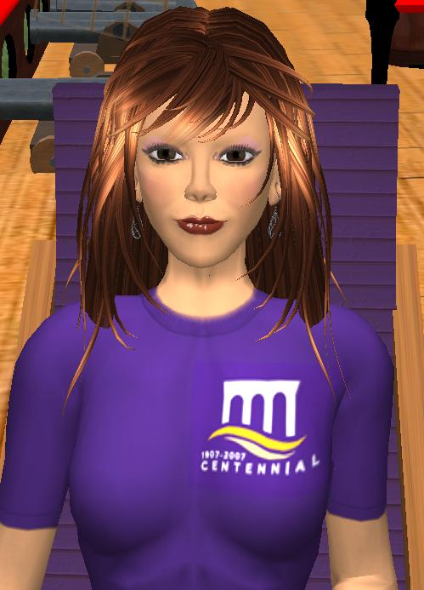
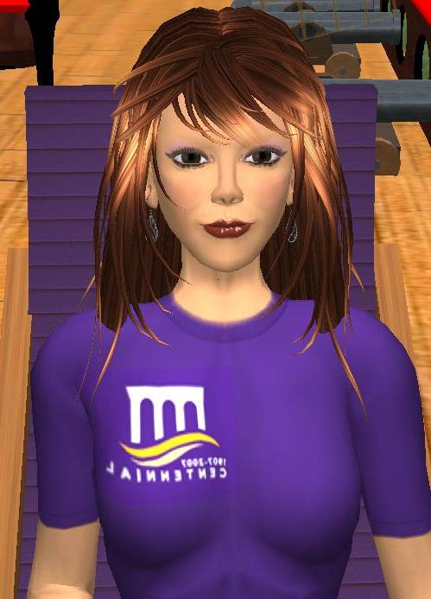
Virtual Worlds in Education
Lets Ride the Freight Train
Sharon Collins
East Carolina University
Kelvin Bently
Northampton Community College
Anthony Conto
University of Maryland

Slide 16
Characteristics and Uses
Virtual Worlds
  3-D computer based simulated environments
  Ability to create an avatar
    Replica of self
    Imaginable alter-ego
  Educational, professional, and military training
  Socialization and gaming
  Emulates experiences and objects from real life

Slide 17

Why Virtual Worlds for Education?
Fulfill the social networking presence requirements of the Net-Gens, Generation X, and Y
What do we know?
  These individuals will drive the technology needs of the future
  Demand innovation and connectivity
  Easily bored – we must engage
  Compelling user experience
Where do we go?
  One world and one space

Slide 18
Types of Virtual Worlds
Social Networking Tools - Engage - Learning a New Language - Images - 3-D Objects - Links to Websites - Dynamic Learning Hubs -
Second Life
Active Worlds
Google Lively
Virtual
Worlds
Wonderland
Croquet

Slide 19
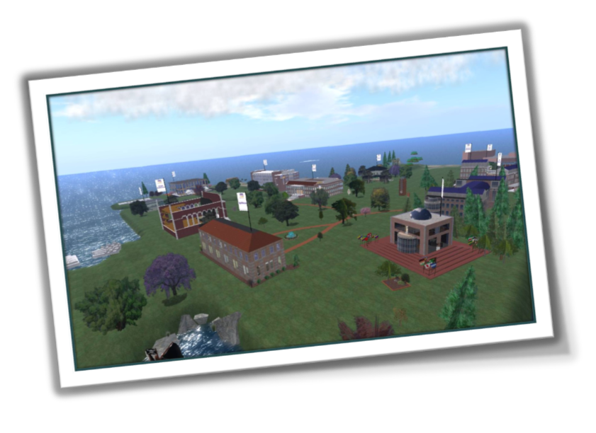
Virtual Worlds in Education
East Carolina University Second Life Campus

Slide 20
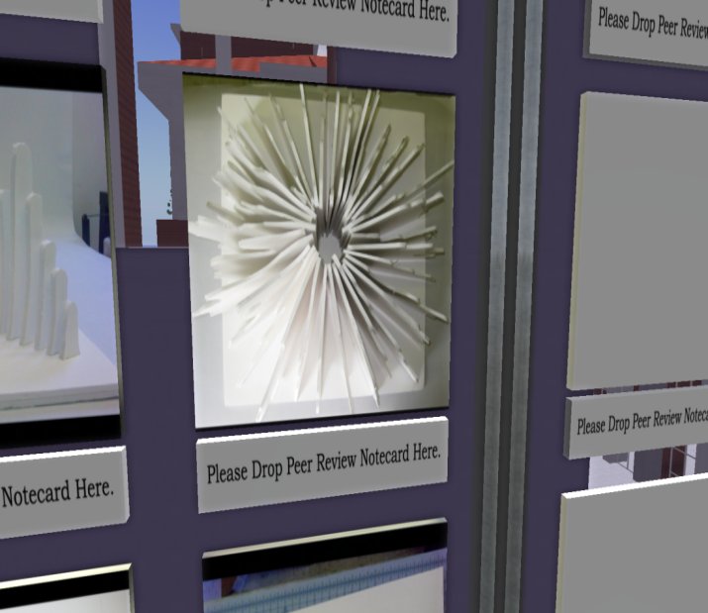
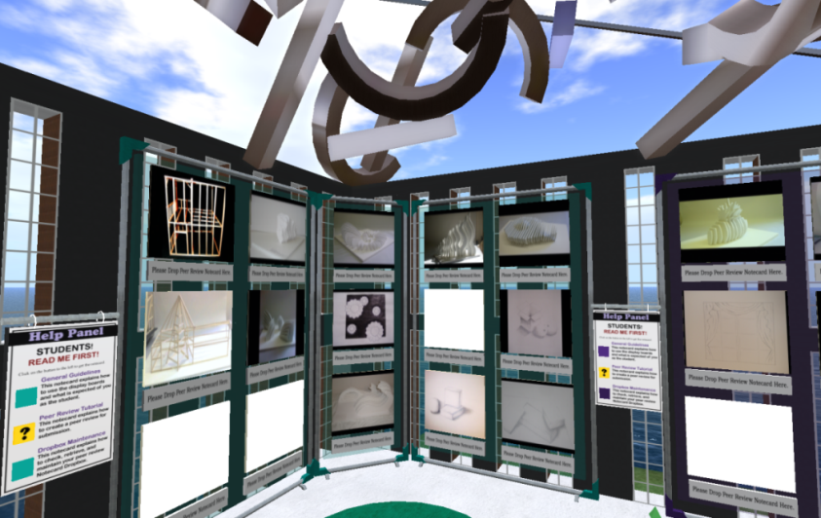
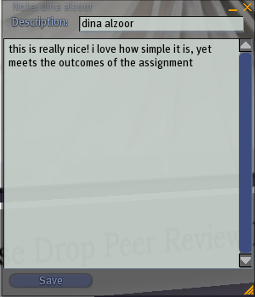
Concept to Inception: Peer-Reviews
Concept to Inception: Peer-Reviews
Began with an idea of collaboration and review
  Students design projects by hand
    Snapshot Uploaded
  Students peer-review
    Drop note cards

Slide 21
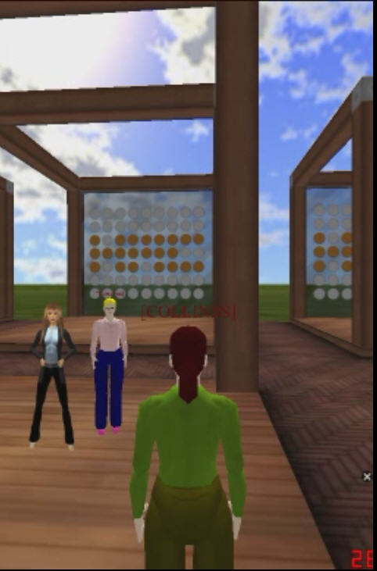
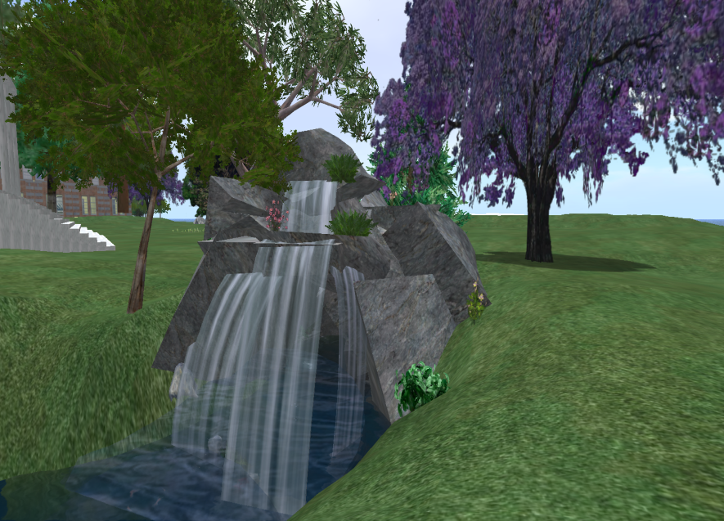
Mobility of People & Learning
Join us in a new dimension

Slide 22

Capabilities of Virtual Worlds
Presentations
Site Tours – New Lands
Gaming
Open Forum Discussion
Scavenger Hunt
Simulations & Role Playing
Discovery Learning – Culture & Diversity
Ecommerce, Business & Economics

Slide 23
Virtual Worlds - Gaming
Microsoft
  X-Box 360 - Launched on October 19 a 3D Virtual World
    Geared toward social chat, music and video sharing
Sony
  PlayStation Home
    Allowing users to create custom personal spaces and invite others into those spaces

Slide 24
Open Source Virtual Worlds
Wonderland
  Open source toolkit for creating 3D virtual worlds
  Improving the usability of virtual worlds
      200 simultaneous users in a world in several rooms
      Security, improved live application sharing, recording video in-world, private voice chat, and placing 3D models in world
Croquet
  Runs on local machine
  Interaction between players is sent over the network and then executed on fast local virtual machines

Slide 25
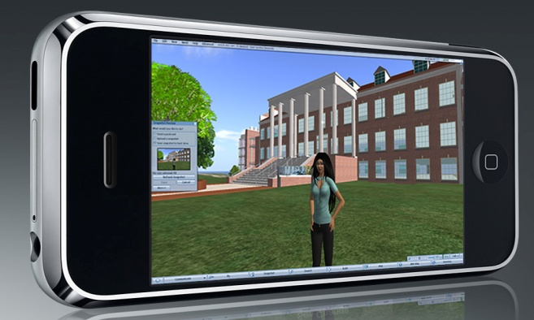
Calling Second Life…..
Vollee Mobile Access
  70 handsets
  3G or WiFi enabled handsets
  Fly or teleport, Chat, IM

Slide 26
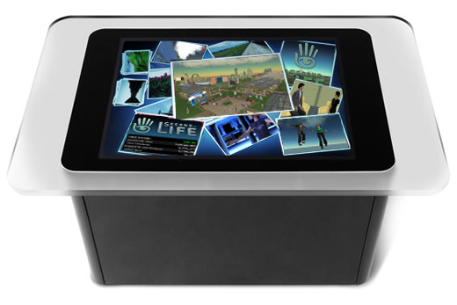
Future, Is Anything Possible?
Microsoft Surface Applicability
  Enabling hands-free movement on a tabletop
  Exponential viewing

Slide 27
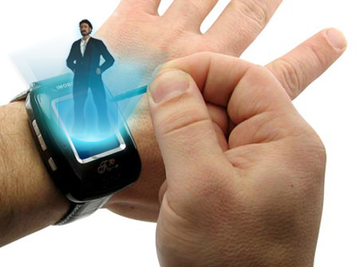
Mobility
007 Virtual Worlds

Slide 28
Additional Mobility
Augmented Reality
  Avatars and environments integrated with real-life images using a 3-D camera
Hands Free Navigation
  No mouse, no keyboard
    Camera to capture movement

Slide 29
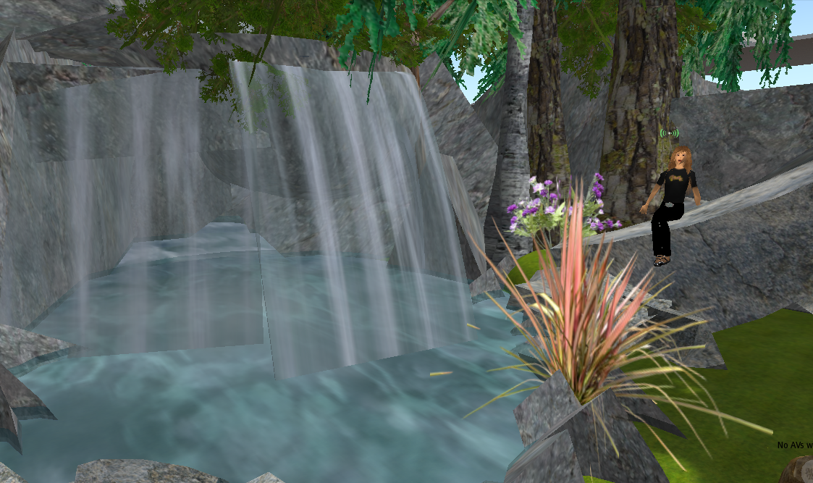
One World
Notes:
Lessons can be taken "out of the classroom" and into in real life such as
World museums where real world art is replicated. Revitalization of course content in an environment that is engaging, interactive, entertaining, and challenging is the essence of Virtual Worlds.
The static chalkboard, much as we hate to admit, is fading. Virtual Worlds bring a new dimension to face-to-face teaching as well as distance education.

Slide 30
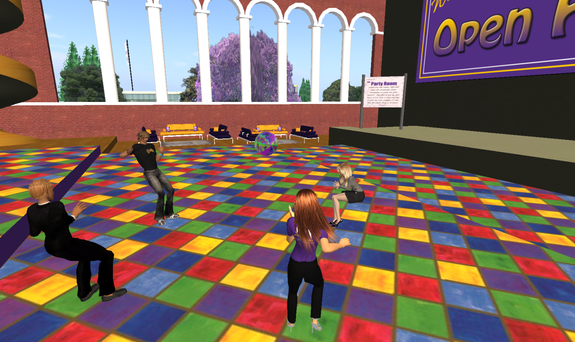


So Long, Farewell

Slide 31
Questions, Comments?
Full Committee Papers Available at: http://www.educause.edu/EvolvingTechnologiesReports
Evolving Technologies Committee – 2008 Membership
Beth Forrest Warner, Committee Chair
Officer for Grants, Research Support, & Library Assessment
University of Kansas
Kelvin William Bentley
Director of Online Learning
Northampton Community College
A. Michael Berman
Senior Vice President/Chief Technology Officer
Art Center College of Design
Sharon Collins
Project Manager
East Carolina University
Anthony D. Conto
Office of Information Technology
University of Maryland
Susan M. Lewis
Special Assistant to the Dean
University of Illinois at Urbana-Champaign
John W. McGuthry
CIO
Armstrong Atlantic State University
Mary Christine McMahon
Manager, Research Application Development
Saint Louis University
Tina Meier
Director, Server Administration
Oklahoma State University
John S. Moses
Director, Technology Planning, Biological Sciences
University of Chicago

Slide 33
Business Process Management
John W. McGuthry
Armstrong Atlantic State University

Slide 34
What is it?
Software solution that models business processes
  Inputs
  Outputs
  Statistics
  Reports

Slide 35
Available Solutions
Pegasis Systems
Savvion
Lombardi
Oracle
IBM
Appain
Sofware AG
Notes:
Friend Finders
Xxx
Smart-guide Systems
Dartmouth Library (Guide by Cell)
http://www.dartmouth.edu/~vox/0708/1105/tours.html
Security Systems
Rave Wireless provides Rave Guardian to a number of colleges and universities (e.g., Montclair State University)
http://cit.duke.edu/tools/mobile/index.html
Mobile Devices in Education
Students in the "Methods Primate Field Ecology" course use a Global Positioning System (GPS) unit and accelerometer unit to track primates at the Duke University Lemur Center. (http://cit.duke.edu/ideas/projects/2007/05/04/visualizing-movement/)
Rich Media Systems
Under the direction of Trudi Abel, students are gathering audio, digital photographs, and GPS data to enrich historical maps available via the Digital Durham web project. (http://cit.duke.edu/ideas/projects/2007/05/04/visualizing-durham/)
Pat Halpin from NSOE loaded Geographic Information System(GIS) software onto a set of Pocket PCs (palm-sized computers), which were then made available to students in his courses to take into the field. Paired with portable Global Positioning System (GPS) devices, the Pocket PCs enabled students to verify and collect environmental geospatial data.
(http://cit.duke.edu/showcase/2002/program.html)
Traffic Management
TeleNav Traffic
http://www.telenav.com/products/tn/traffic.html
Bus Systems
e.g. Montclair University (Rave Transit)- a number of universities use the Rave System
University of Illinois Golf Course Management
http://courses.ece.uiuc.edu/ece445/projects/spring2004/project16_presentation.ppt#259,2,Overview

Slide 36
Conclusion
Identify gaps in business processes
Assist in the development of new and improved processes

Slide 37
Regulatory Compliance
M. Christine McMahon
Saint Louis University

Slide 38
Regulatory Compliance
Compliance generally indicates the observance of norms on the part of an organization (Gasser and Haueusermann 2007)

Slide 39
Regulatory Compliance
Information Technology organizations seek to quantify the impact of regulatory evolution
These factors exert influence on the collection and use of data within the institution
Seeking transparency

Slide 40
Regulatory Compliance
How do we achieve actionable intelligence to prepare for regulatory impacts
Define the compliance situation and assess risk.
Apply proper control measures (fixing the gap)
Governance (eliminate the root cause of the failure).

