Slide 1
Collaboration is Strategy
Brad Wheeler
Indiana University bwheeler@indiana.edu
© Brad Wheeler, Creative Commons Attribution 3.0

Slide 2
What is Strategy?

Slide 3
Seeking Competitive Advantage

Slide 4
Michael E. Porter
Operational effectiveness is not strategy
Strategy rests on unique activities
Inter-relatedness of activities can be inimitable
Trade-offs are essential
Porter, “What is Strategy?” HBR, 1996.

Slide 5
Activities
Buying equipment
Pricing choices
Shipping an order
Choosing partners
Sales channel choices
Product design
Product rollouts
Avoiding features
Labor policies
Choosing store locations
Packaging
Execution with Partners
Paying an invoice
Support policies
Handling a return
Adding features

Slide 6
“The essence of strategy is choosing to perform activities differently than rivals do.”
Porter, HBR, 1996, p. 64

Slide 7
“…to achieve sustainable competitive advantage by preserving what is distinctive about a company.
It means performing different activities from rivals, or performing similar activities in different ways.”
Porter, 1996

Slide 8
But….

Slide 9
Sustainable Competitive Advantage? …Higher Ed?

Slide 10
Education and Research
Our industry is different… but is our behavior?

Slide 11
Competitive Strategy: “The essence of strategy is choosing to perform activities differently than rivals do.”
The essence of collaboration as strategy is choosing to perform activities similarly to partners …and driving down costs via leverage.

Slide 12
What is Collaboration?

Slide 13
An Unnatural Act

Slide 14
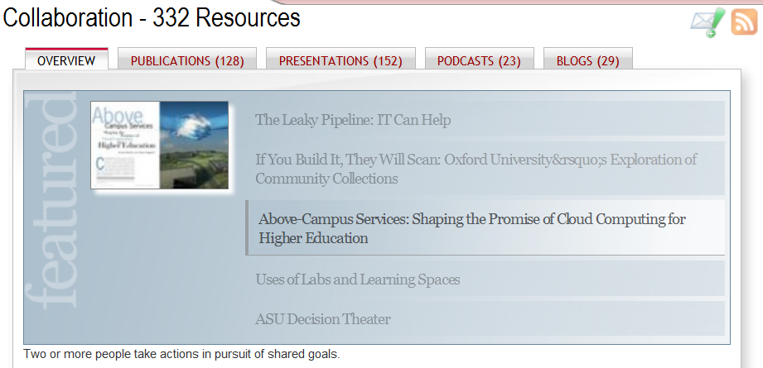
EDUCAUSE members are prolific writers regarding collaboration

Slide 15
“Collaboration is not he same as cooperation. Collaboration requires alignment around a common goal. Collaboration is about doing something together. Collaboration only lasts as long as the alignment around common purpose lasts.”
James Hilton, U. of Virginia

Slide 16
To “co – labor”

Slide 17
Domains for Collaboration
Challenge
Value $$
Slope of Retreat
Individuals Departments Schools Campuses Institutions

Slide 18
Experience Yields Improvement
Challenge
Value $$
Individuals Departments Schools Campuses Institutions

Slide 19
Why Collaborate?

Slide 20
“Our academic leadership is increasingly embracing the notion of coordinating business objectives and leveraging resources with other institutions and within our own university.
The maturity of community source governance, the stream of Kuali deliverables, and the stature of the community members all contribute to this. It really does represent a breakthrough, not just for Kuali, but as a way of thinking…”
Ted Dodds, University of British Columbia

Slide 21
In the process of [HathiTrust] collaboration, participants are forced to solidify their own institutional goals… Bringing UC point of view to the table has involved examining our own goals.
Heather Christenson, U. of California

Slide 22
The New Normal

Slide 23
Essential Tool for the New Normal
Achieve more…
Serve our mission…
Favorable economics (over time)…
Align institution to external environment…

Slide 24
Leverage
$
$
$
$

Slide 25
2 + 2 = 3 ? 2 + 2 + 2 + 2 = 5 ?
Collaboration Math
John Norman, U. of Cambridge

Slide 26
“HathiTrust partners = tons of expertise. A richness of talent at the individual level that we can tap into -- Diversity of opinions and healthy debate leads to more robust processes.
Finding the appropriate level of standardization versus customization is a true challenge (especially in technical matters)”
Heather Christenson, U. of California

Slide 27
“The aspect of the Kuali Community that Colorado State University is perhaps most grateful for is the team of exceptional technical folks who assist one another with problems and issues, on what seems almost a 24x7 schedule.
We are MUCH stronger together than apart, and we have observed the expertise of the group steadily spiral upward as a result.”
Patrick Burns, Colorado State U.

Slide 28
Main Reason to Collaborate…
It serves our mission

Slide 29
Co-Laboring towards the Meta-university

Slide 30
Charles M. Vest
President Emeritus, MIT
“…we are seeing the early emergence of a meta-university – a transcendent, accessible, empowering, dynamic, communally constructed framework of open materials and platforms on which much of higher education worldwide can be constructed or enhanced.”
EDUCAUSE Review, May/June 2006, p. 30.

Slide 31
Meta-university Collaborations
c
c
c
c
c
PUBLIC KNOWLEDGE
PROJECT
Library Books
Journals
Textbooks
Learning
Administrative
(Just to name a few…)

Slide 32
Charles M. Vest
President Emeritus, MIT
“The meta-university will enable, not replace, residential campuses, especially in wealthier regions. It will bring cost-efficiencies to institutions through the shared development of educational materials. It will be adaptive, not prescriptive.”
EDUCAUSE Review, May/June 2006, p. 30.

Slide 33
Working in the Collaborative Era

Slide 34
Higher Ed Ecosystem
Academic and Commercial

Slide 35
Kuali Commercial Affiliates
Notes:
We have two new Commercial Affiliates: Sciquest and VivanTech. Sciquest brings expertise in eprocurement and plan on assisting the KFS project with creating linkages between KFS and shopping carts within Sciquest. VivanTech brings expertise in developing custom financial information systems, and has been assisting some of the Kuali partners in their implementation planning for KFS. We welcome these 2 new CA’s.

Slide 36
Personal Observations

Slide 37
“Overcoming local DIY culture is a constant struggle, though the degree seems to vary according to institutional profile (we could use more Delta Colleges!).
I’m not sure the penny has quite dropped in that majority of minds that it is far preferable to align local efforts with those of our partners than to stray back into purely local solutions.”
Unattributed

Slide 38
“A key part of our strategy is knowing when and where we should be collaborating, and when and where should be competing [striving for differentiation] - it isn't usually real competition anyway).
And, in today's world, the line is moving quickly in such a way that we need to collaborate more than we compete.”
Kevin Morooney, Penn State University

Slide 39
“This release is the culmination of everything (and more!) we set out to deliver back in 2005 when the functional and development teams first formed. At times, it seemed like we would never get here.
The amazing thing to me is the incredible number of people from our institutions that have had a hand in this accomplishment. …It certainly wasn’t easy. No one promised it would be a walk in the park. The fact remains that we all persevered and made it.”
Jim Thomas, Kuali Financials Project Manager

Slide 40
My Observations

Slide 41
Collaboration Essentials
Goal alignment
Values alignment
Temporal alignment
Talent alignment
Governance clarity (input/decision rights)
Problem solving alignment

Slide 42
Collaborations are fundamentally dynamic. Unlike cooperation, I would argue that collaboration can never be a permanent default condition. It requires constant explicit attention.
You can pledge to be nice forever (I.e., cooperate), but not to collaborate forever.
James Hilton, U. of Virginia

Slide 43
Many Ways to Collaborate
Design, Comment, Code, Test, Document, Educate…

Slide 44
Collaborative Capability
Can’t be bought Must be grown via experience
…Trust?

Slide 45
“Life’s a dance you learn as you go
Sometimes you lead, sometimes you follow
Don’t worry ‘bout what you don’t know
Life’s a dance you learn as you go”
Allen Shamblin, Steve Seskin
Sung by Michael Montgomery

Slide 46
The Collaborative IT Agenda

Slide 49
1. Federated Identity…now!

Slide 50
2. Clouds
X
X
X
X
X

Slide 51
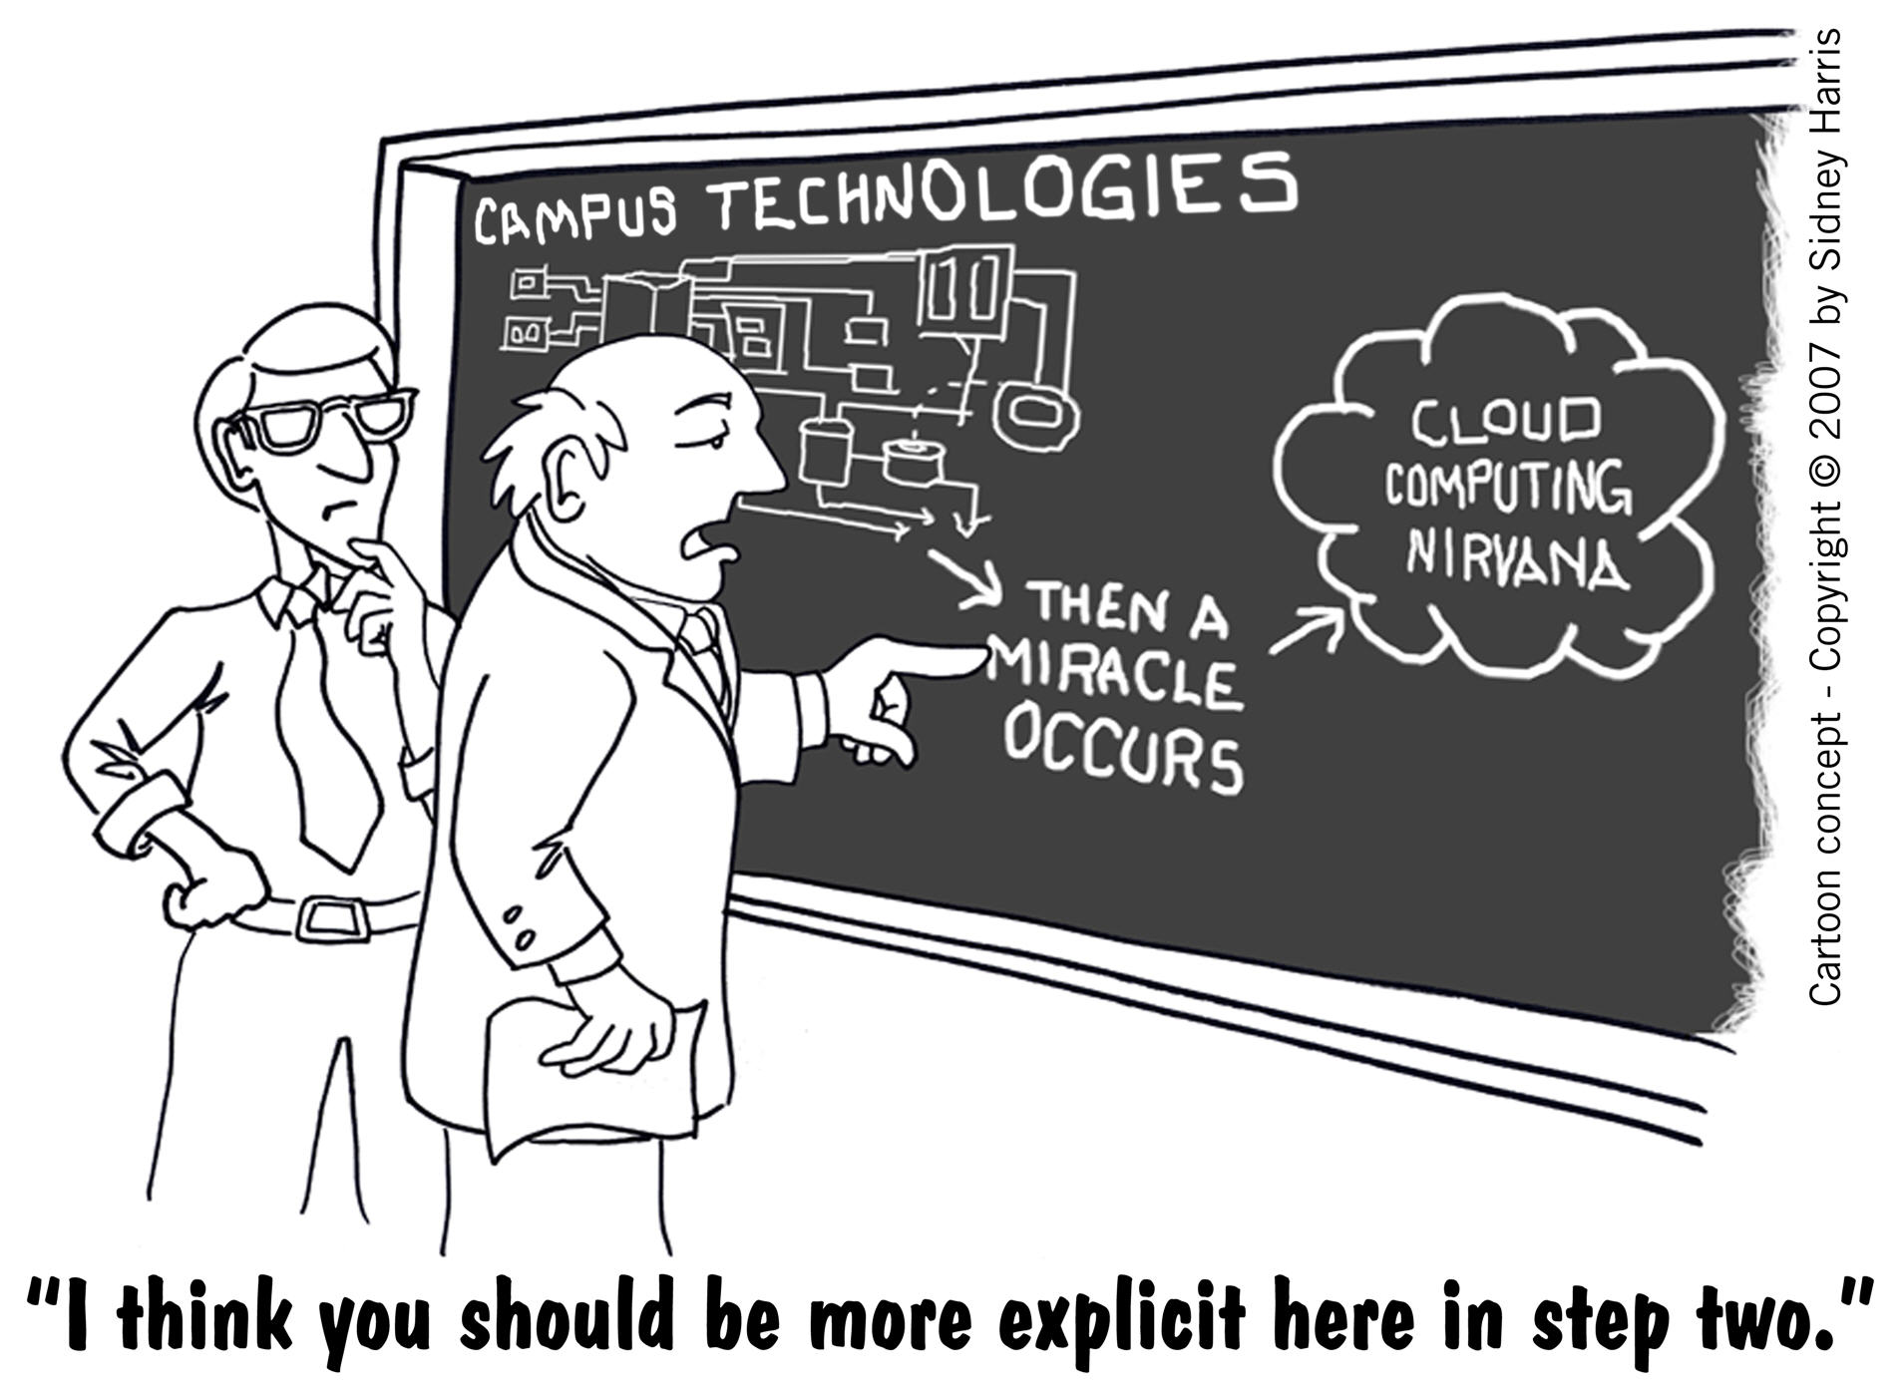

Slide 52
Above Campus Services Shaping the Promise of Cloud Computing for Higher Education by Brad Wheeler and Shelton Waggener
Illustration by Randy Lyhus ©2009
EDUCAUSE Review, Nov/Dec 2009

Slide 53
Sourcing Models
Above Campus Services:
Commercial Sourcing
Institutional Sourcing
Consortium Sourcing

Slide 54
Collaboration is Strategy

Slide 55
Back to Porter…

Slide 56
Competitive Strategy: “The essence of strategy is choosing to perform activities differently than rivals do.”
The essence of collaboration as strategy is choosing to perform activities similarly to partners …and driving down costs via leverage.

Slide 57
Collaborating is an Activity

Slide 58
Assessing Collaboration as Strategy
Operational effectiveness is not strategy
Strategy rests on unique activities
Inter-relatedness of activities can be inimitable
Trade-offs are essential
Porter, “What is Strategy?” HBR, 1996.

Slide 59
“Consistent with this statement of policy, throughout my years of responsibility for administration I have been motivated by a strong belief that the resources of higher education are so insufficient and the opportunities and responsibilities so vast, the only sensible course is to attempt in every way to avoid unnecessary duplication among or with institutions.”
Herman B Wells, Being Lucky, 1980, p. 135 President of Indiana University, 1938-1962

Slide 60
Collaboration is Strategy
Brad Wheeler
Indiana University bwheeler@indiana.edu
© Brad Wheeler, Creative Commons Attribution 3.0

Slide 61
Collaboration is Strategy
Session Abstract: As open content, "above campus" economies of scale, and cloud services shape the environment for education and research, effective collaboration becomes an essential tool for IT leaders and leading institutions. Collaboration is more than guarded partnerships or money—it requires a cohesive vision, new attitudes, principled trust, and execution to achieve valued outcomes for institutional goals. Collaborative capabilities cannot be bought; they are developed through behavior.

