Slide 1
"TRANSFORMING TO A VIRTUAL ENVIRONMENT"
Dr. Michael Hoadley
John Henderson
Ted Genders
Michael McBride
Eastern Illinois University
November 4, 2009

Slide 2
OVERVIEW
Transformation to the virtual environment in higher education
Planning is paramount
Key factors: security, costs, technical support, and management
Uniqueness of academic setting

Slide 3
EIU VISION FOR PROJECT
Deliver applications to faculty, staff, and students desktops
Lower disk capacity/utilization
Reduce overall costs
Effectively manage services

Slide 4
PROJECT EXPECTATIONS
Simplified deployment and management of applications
Best means in which to provide faculty, staff, and students of EIU simple, fast, and efficient application access.
High availability and redundancy to ensure an “always on” environment
Lower costs to deploy, manage, and support an enterprise that will deliver a myriad of applications

Slide 5
PROJECT EXPECTATIONS
Consolidated universal print driver which creates a much more manageable print environment
Strict control on who can access, what they can access, and when they can access
Capability to centrally monitor and manage the server farm, with real-time graphing and alerting, capacity planning, and reporting
Ability to easily expand capacity without affecting performance

Slide 6
PROJECT REALIZATION
Major investment needed for upgrade to virtualization
Minimal disruption to EIU community
Limited technical expertise at EIU relative to Citrix implementation and support
Need for contractual services with external group for transformation to virtual environment

Slide 7
VIRTUAL CONSULTING METHODOLOGY
Vision
Discover Phase
Design Phase
Delivery Phase
Management

Slide 8
DISCOVER PHASE

Slide 9
EIU HISTORICAL TIMELINE
2001:
  Review costs for computer lab upgrades on campus
  Various versions of software available
2002:
  Two English labs scheduled for upgrade (50 computers @ $1800, not including software)
  Thin clients at $600/unit and $240/seat for Citrix
  Software applications and keyboard interface

Slide 10
EIU HISTORICAL TIMELINE
2002:
  EIU purchased 180 Citrix licenses to accommodate English Students (about 2,000 per semester)
2003:
  School of Business wanted more access to computers, but not increase the number of labs
  30 laptops on cart purchased
  60 more Citrix licenses purchased

Slide 11
EIU HISTORICAL TIMELINE
2004 to 2006:
  Citrix system in-place with 9 servers spread out across three farms (English, Business, and Triad)
  Opportunity for EIU staff to gain valuable experience with Citrix
  Ongoing feedback from campus to identify strengths and issues of concern about Citrix use
2007:
  Decision made to explore virtualization options

Slide 12
PROBLEMS EXPERIENCED @ EIU
Students not allowed in Active Directory by ITS due to security concerns and cost of licenses
LDAP was ITS solution, but it never worked properly
Philosophy that as usage increased, more servers should be added
  More management required
  Potential for more mechanical failures

Slide 13
PROBLEMS EXPERIENCED @ EIU
Loading and access to particular software applications
Other issues:
  Saving work on thumb drives
  Remote access
  Installing the Citrix client
  Wi-fi access
  Off-campus students needed to logon twice

Slide 14
DESIGN AND DELIVER PHASES

Slide 15
CONSULTANT PERSPECTIVE
Key Questions:
  What interested you the most about taking on this project?
  How would you describe the process of converting a legacy Citrix environment into a Dynamic Delivery Center?

Slide 16


Slide 17
WHAT IS SERVER VIRTUALIZATION?
Fundamentally, virtualization is the decoupling of logical computing resources from the physical hardware
Enables 1 physical server to support multiple workloads in simultaneously running virtual machines

Slide 18



What is a Workload?
Operating System Application Set + Configurations
Server Workload

Slide 19
What is citrix xenserver?
XenServer is Citrix’s version of server virtualization and dynamic workload delivery management software that includes two important elements of virtualization:
  Isolation – running multiple workloads safely and securely on a single computing platform
  Workload Portability – moving the workload across different physical computing platforms

Slide 20
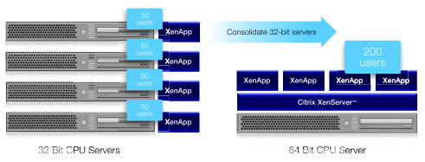
HOW DID WE TRANSITION FROM OUR OLD ENVIRONMENT TO A VIRTUAL ENVIRONMENT?
Consolidation

Slide 21
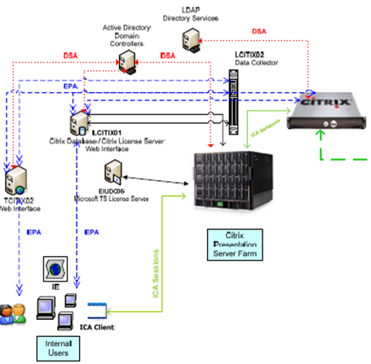
transition from legacy system

Slide 22
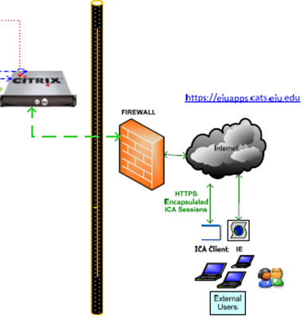
transition from legacy system

Slide 23
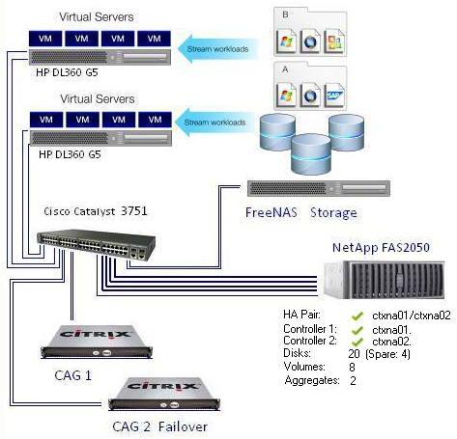
transition to a virtual environment

Slide 24
VIRTUAL SERVER IMPLEMENTATION
SQL Server
License server (Utility Server)
Web Interface Servers (redundant)
Provisioning Server
XenApp Servers (Production Servers)

Slide 25
Delivering software as a service
SaaS – The separation of software from an operating system
Application Virtualization through the Citrix Streaming Profiler packages apps to a net share.
AMC – Access Management Console publishes apps to specific users to be streamed to specific XenApp servers
Active directory allows access to Faculty & Staff
CCA – Citrix Class Accounts are created for students who authenticate through LDAP.

Slide 26
MANAGEMENT PHASE

Slide 27
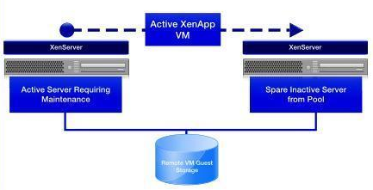
Advantages of citrix virtualization
Rapid Transition from one Virtual Server to Another for Maintenance

Slide 28
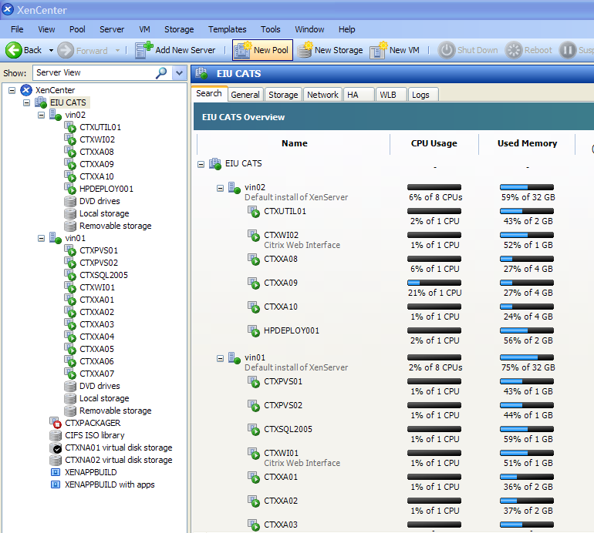
Advantages of citrix virtualization
Anywhere access to XenCenter Management Console

Slide 29
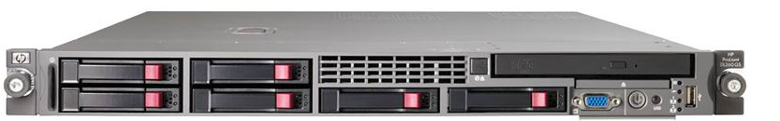
Virtual Infrastructure components
Hardware/Software Components
2 HP DL360 G5 Servers
32GB RAM
Dual Intel Quad‐Core Xeon 5450 Processors
Two 73GB 15K RPM internal SAS drives
Six Gigabit NICs
HP 3yr, 4hr 24x7 support
SOFTWARE
2 Citrix XenServer Platinum –Embedded Edition for HP
1 Citrix Access Gateway –Standard Edition 2010

Slide 30
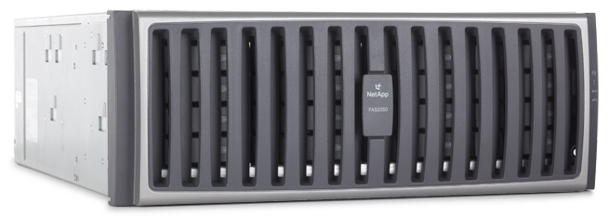
Virtual Infrastructure components
Storage Management Hardware
NetApp FAS2050
2 Controllers
10 Disks and 2 Spares Each
SAS 268.4GB 15k RPM
Total ~5.4 TB
Usable ~ 4.3 TB

Slide 31
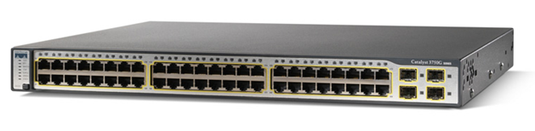
Virtual Infrastructure components
Cisco Catalyst 3750 - next generation energy-efficient Layer 3 Fast Ethernet stackable switch.
Allows port teaming configurations to double the bandwidth used in streaming applications from the storage appliance to the production servers.

Slide 32
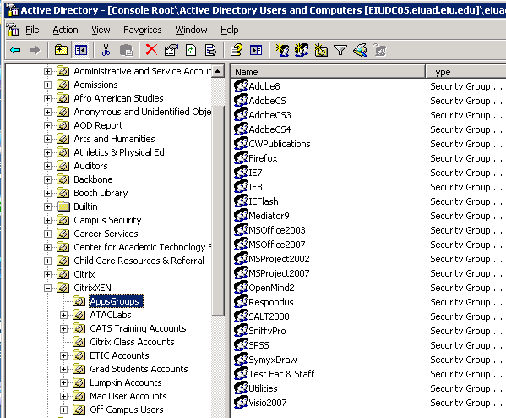
User authentication
LDAP
AD
AD Structure

Slide 33
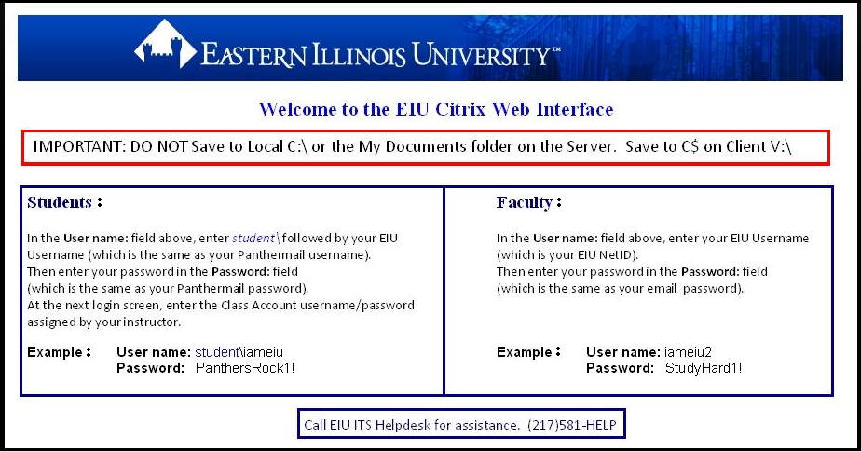
Web Authentication options

Slide 34
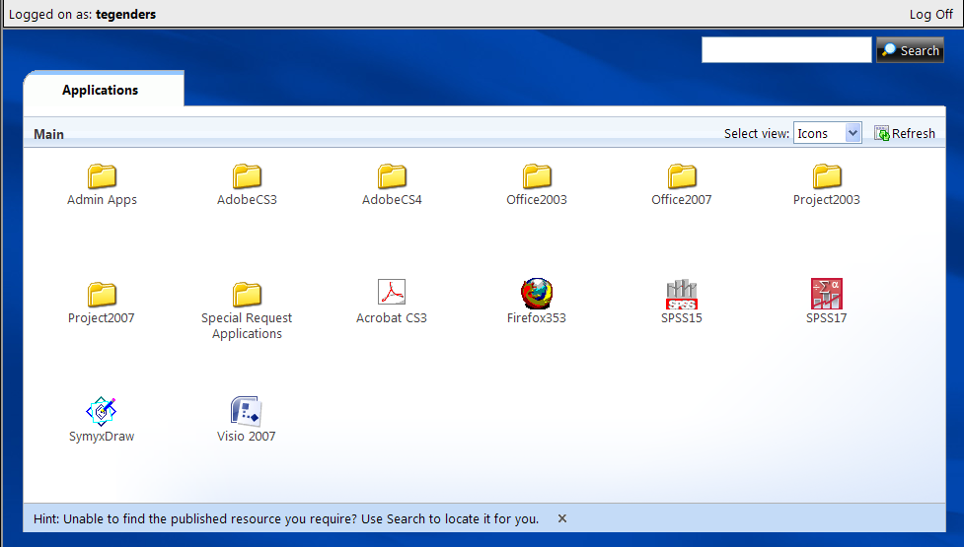
Software applications on citrix

Slide 35
Virtualization Project costs hardware & software
Citrix XenServer Platinum Embedded –Hardware & Software $24,500 Citrix Access Gateway –Hardware $ 2,800
NetApp FAS2050 Storage Appliance $40,000
Total $67,300
NOTE: Storage Repository was not part of the original quote.
Notes:
Ted

Slide 36
Virtualization Project costs professional fees
Citrix Access Gateway ‐Configuration $ 200
XenServer Install & Configuration $4,500 XenApp Install & Configuration $3,300
PVS Server Install & Configuration $2,500
Application Packaging $5,000 Project Documentation $4,000
TOTAL $19,500
VIRTUAL INFRASTRUCTURE PROJECT
TOTAL $86,800
Notes:
John & Michael present

Slide 37
CONSULTANT PERSPECTIVE
Key Questions:
  How scalable is our current environment for future demand without adding significant cost?
  How do you see EIU leveraging this infrastructure for the future?
Notes:
Ted leading into video 3&4
37

Slide 39
SUMMARY

Slide 40
Challenges for University setting
Difference between academic needs and technical perspective
Large annual turnover of new users (i.e., classes and employees)
Dealing with University schedule of classes and the need to maintain current service during transition

Slide 41
COSTS
Start-up costs are high
  Citrix software and hardware initially
  Professional services
Ongoing costs
  $18,000 for software maintenance and upgrades
  $20,000 for consulting services
  Not all software applications can be loaded and used on Citrix, so other alternatives must be in-place to address diverse curricular and program needs

Slide 42
EDUCATING THE CAMPUS
More info about Citrix and how to use it
  Training faculty one-on-one
  Group workshops
  Presentations in classes
Provide online resources
  TECnet developed training and information videos
  (no video resources available from Citrix)

Slide 43
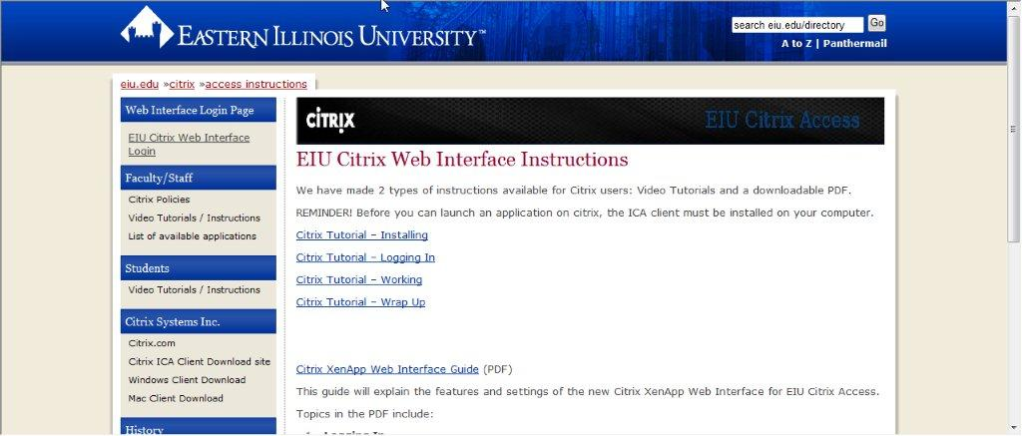

Slide 44


Slide 45
WORKING WITH EXTERNAL GROUPS
Vendor and consultants do not really understand the University model and its needs (compared to business model)
Constant communication is necessary in order to accomplish academic goals in a timely manner, while still making the technology transparent

Slide 46
BENEFITS WITH CITRIX @ EIU
Never maxed out number of concurrent users (currently 300 Citrix concurrent license seats, but more will be added)
Latest versions of software available to faculty, staff and students (on- and off-campus)
Support for software loaded on Citrix
As part of integrative learning opportunities at EIU, students are able to experience a balance in transition from “education to workforce” to help prepare them for the future

Slide 47
CITRIX TEAM @ EIU
Ted Genders
  tegenders@eiu.edu
  217-581-7021
Michael McBride
  mlmcbride@eiu.edu
  217-581-7632
  Visit: http://www.eiu.edu/~cats/citrix/

Slide 48
What did you think about this session?
Your input is important to us!
Click on “Evaluate This Session” on the conference program page.

