Slide 1
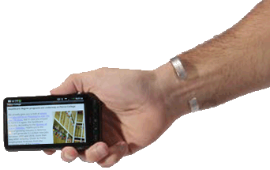
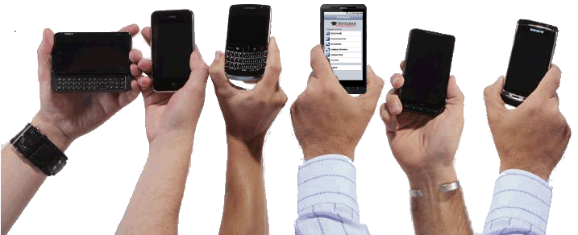
Mobility in the Student Information System
Christopher Duffy, CISSP & Sam Burgio
Peirce College Jenzabar

Slide 2
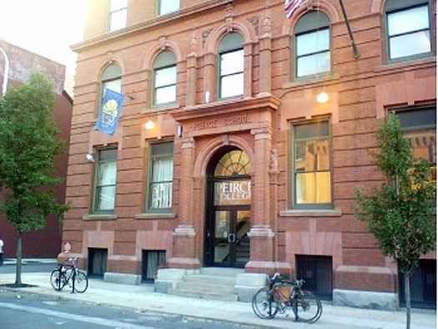
Peirce Background
Founded In 1865
Urban Campus
Moved To Online In 2001
2200 Students In 43 states & 13 countries
Rolling Admissions
Focused on Adult Working Learning
Average age dropping from 34

Slide 3
Catch The Wave
Managers must beware of ignoring new technologies that don't initially meet the needs of their mainstream customers.
Disruptive Technologies: Catching the Wave
by Joseph L. Bower and Clayton M. Christensen

Slide 4
A disruptive innovation is an innovation that disrupts an existing market. The term is used in business and technology literature to describe innovations that improve a product or service in ways that the market does not expect, typically by lowering price or designing for a different set of consumers.

Slide 5
Disruptive Technologies
Starts Small
Customer or Consumer Driven*
Can Be Ignored (To Start)
Novelty Approach
Need to Divert Resources
Not Planned
Not Budgeted
Not Understood!
* Technology IS Disruptive Innovations

Slide 6
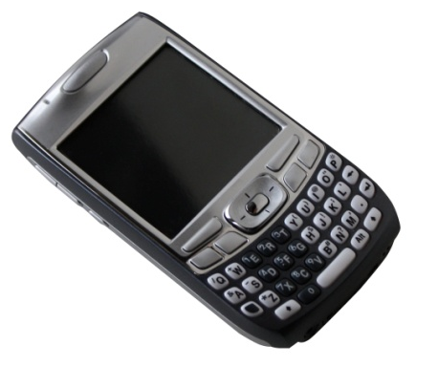
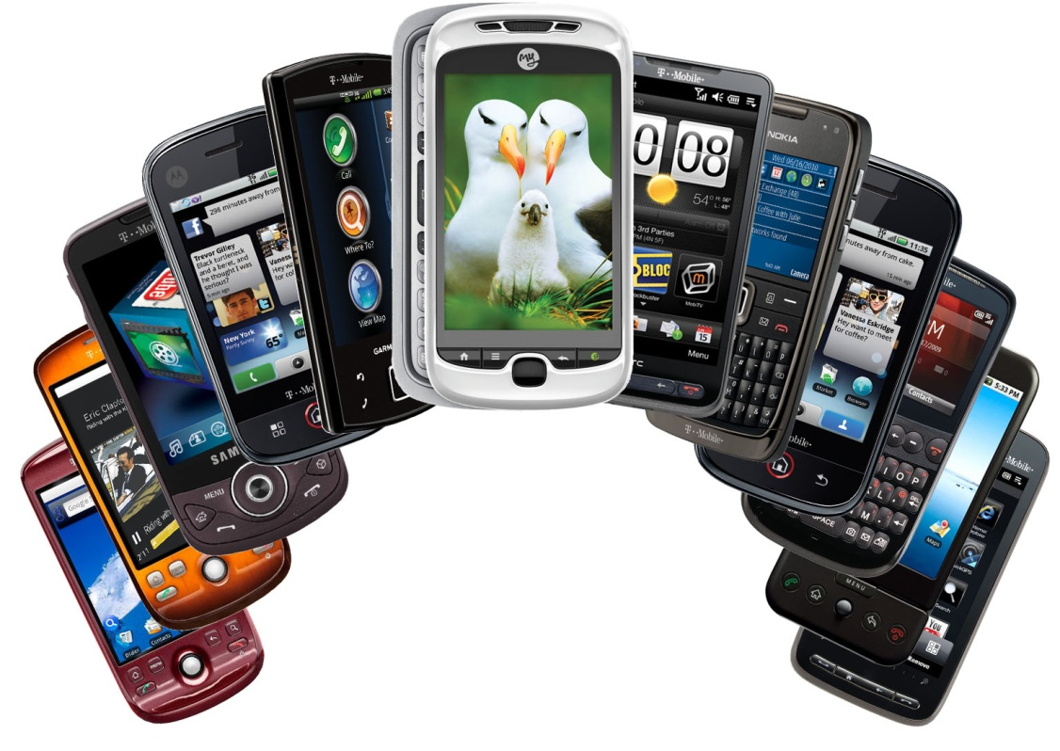
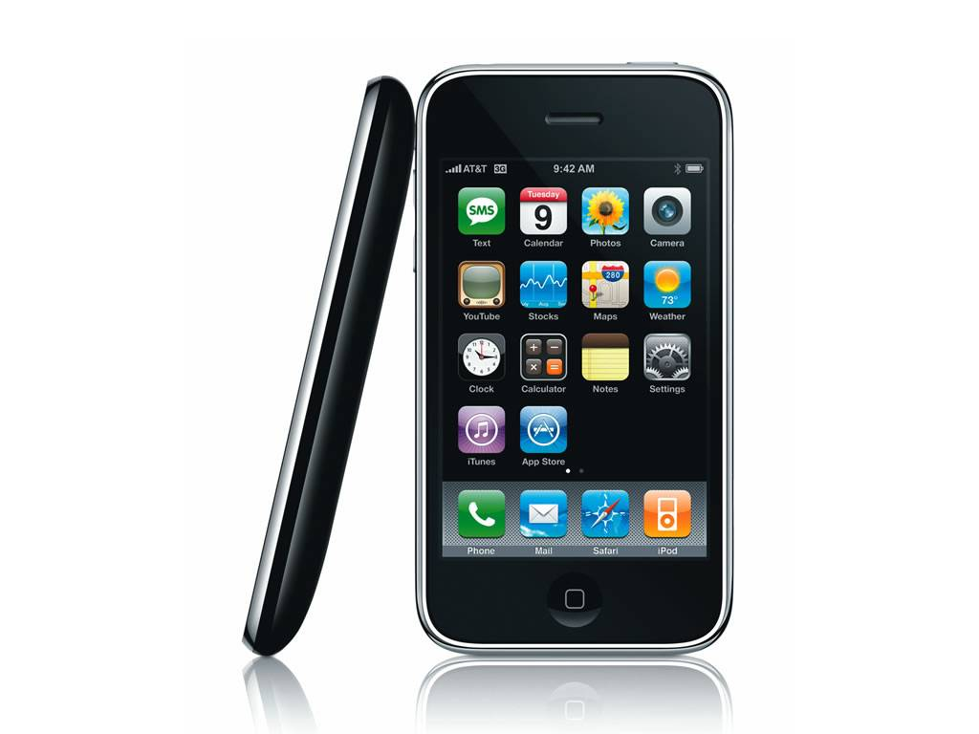
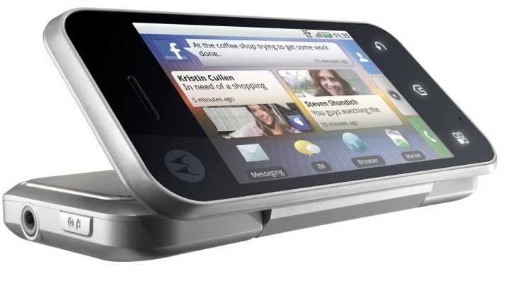
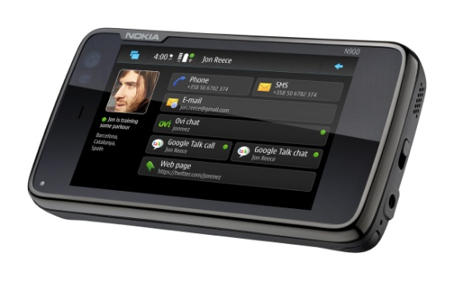
DISRUPTIVE?

Slide 7
Early Alerts
Visibility in:
Labs
Cafeteria
Library
Classrooms
On Wireless Network

Slide 8
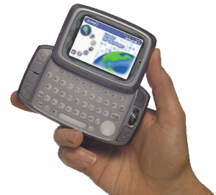
Changing Landscape
Peirce Website Analytics for Mobile Devices
Jan 1-March 31, 2010
April 1, June 30, 2010
Hiptop= TMobile Sidekick

Slide 10
Student Portal
Average 2500+ Visits Per Day
Single Sign On:
LMS
Library
Student Email
Financial Aid
Customized Based on Student Needs

Slide 11
Student Portal Mobile Traffic
Jan 1-March 31, 2010
April 1, June 30, 2010

Slide 12
Speaking to The Numbers
Website Yearly Traffic Growth for Mobile:
2009: .04% 2010: 2.6%
Student Portal Mobile Growth
2009: 1.1% 2010: 4.5%
Average Student:
Spends 5m:39s on Smartphone Browser
Visits 4.71 pages per visit

Slide 13
Skunkworks
The Skunk Works® Was Formed in June 1943 in Burbank, Ca by Engineer Clarence Kelly Johnson with Lockheed.
Team was Successful Due to Unconventional Organizational Approach, Breaking Rules and Challenging System That Stifled Innovation

Slide 14
Peirce Skunkworks
Application Development Team “Pet Project”
Small Consulting Budget
Self Oversight
Minimize Development Across Platforms
Fixed Timeframe
Open Solution

Slide 15
Affirmation
Survey Sent to Current Student to Identify Mobile Planning, Growth & Demand
Over 100 Respondents in 5 Minutes
3 Core Mobility Questions
100+ Responses per Open Ended Question

Slide 16
Snapshot of What Students Own

Slide 17
Snapshot of What Students Want

Slide 18
App Dev Team Planned Delivery
Prospective & Current
Peirce Blog
Directions
Current Student
Faculty & Staff Directory
Class List

Slide 19
Expanding the Universe
“Disruptive Technology” Education for:
Marketing & Communications
Administration
FACULTY!
Create Vision &Understanding
Build Excitement
Collaboration
Planned Deployment

Slide 20
Development Terminology
Presentation Layer
How the Data is Displayed “Look & Feel”
Business Logic
Controlling the Data for Input & Output
Class Search ACC * = Input
Match= Output
Web Server
“Middleware” between Database & Device

Slide 21
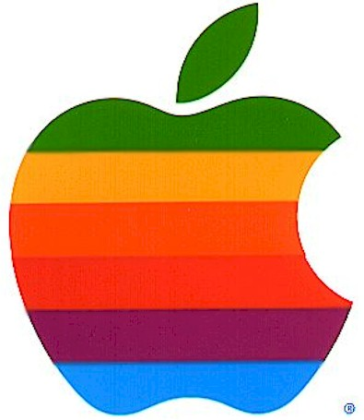
Conventional Development Infrastructure
Interface
Interface
Database
Interface

Slide 22
Additional Development Terminology
Application Server
Houses the Business Logic
Produces “Generic” Web Services
Handles I/O:
JavaScript Object Notation (JSON)
A way to represent data as an object in JavaScript.
Primarily for client-side scripting; useful for sending/retrieving data via AJAX
eXtensible Markup Language (XML)
A way to describe data through element tags and attributes to be used across a wide range of applications and programming languages.
ORM
Object Relational Model :
A programming layer that allows you to access and manipulate data from the database using object notation rather than data readers and dictionary keys.

Slide 23
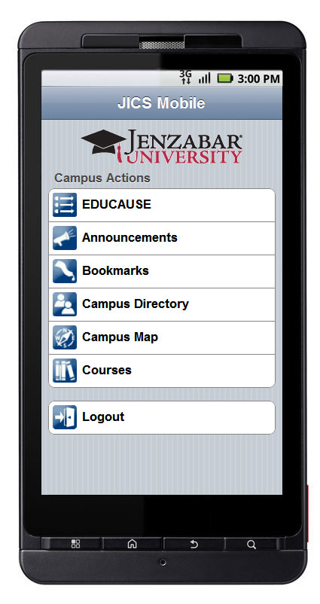
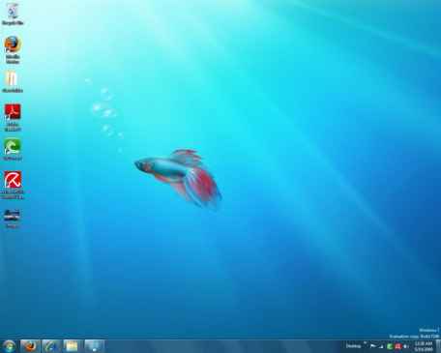
Skunkworks Development Infrastructure
CRM
Mobile website
XML/JSON
producing Web Services
Database
Application Server
(hosts business logic)
Smart phones
ORM
Desktop Applets
App server hosts all business logic, interacting with DB’s via ORM
Outside applications interact with app server via web services
Web applications, mobile applications etc. consumer web services and handle only presentation

Slide 24
Mobile Apps Version 1.0

Slide 25
Lessons Learned
Programming in Objective-C language
Less intuitive than C# or Java
Apple’s App Store process is slow, while the potential for applications to be rejected without too detailed a reason why is high.
As with many open source solutions, Android lacks the control, refinement and intuitive tools that a closed source OS would have out of the box.

Slide 26
Lessons Learned
Android applications are written in Java with the primary IDE being Eclipse with an Android plugin. Eclipse can be cumbersome and clunky taking up a lot of memory.
Android’s marketplace is not as robustly built as the iPhone’s.
Standard UI controls are sometimes ugly and limited.
As with many open source solutions, Android lacks the control, refinement and intuitive tools that a closed source OS would have out of the box.

Slide 27
Cross Platform 3rd Party Tools
Unity 3D :Games Development Engine Supporting JavaScript, C# and Boo Programming Languages and targeting iOS, Android, Mac, Windows
MonoTouch – Application Development Supporting C# & Targeting the iOS.
Appcelerator Titanium – Application Development Supporting JavaScript & Targeting iOS and Android.
PhoneGap – Application Development in HTML, CSS & JavaScript Targeting iOS, Android, Blackberry, Symbian and WebOS.

Slide 28
Resources
Harvard Business Review: Disruptive Technologies
Apple iOS Dev Center:
http://developer.apple.com/devcenter/ios/index.action
Apple App Store Review Guidelines:
http://www.appleinsider.com/articles/10/09/09
Android Developer Resources:
http://developer.android.com/index.html
Eclipse with the Android Developer Tools:
http://developer.android.com/guide
Blackberry 6:
http://na.blackberry.com/eng/developers/blackberry6/

Slide 29
Christopher Duffy
cduffy@peirce.edu

