Slide 1
how we make
Matt Harp
mharp@asu.edu
Anali Perry
anali.perry@asu.edu
with contributions by
Mimmo Bonanni
Notes:
Hello and introduce ourselves (mimmo/matt)
We will give you brief over the process and elements of making our series of short subject videos promoting the library which includes our library minute.
So what is the library minute? It may be best to just show you?

Slide 2
Minute 20: Get it @ ASU
View on YouTube
Notes:
Give brief intro: this is a video about our open linker url service.

Slide 3
Minute 22: Printing
View on YouTube
Notes:
Brief intro: this video is an example the library working with partners. We were asked by ASU Police to inform our patrons of theft.

Slide 4
the library channel
Notes:
Where did it come from?
Wanted to make our resources known to non-librarians in a language understandable to our targeted to student community.
History:
Began 5 years ago in 2005
Library website evolved from static HTML pages to dynamic content platforms.
Library Minute is a part of the Library Channel. Our audio, video, and news information hub.
Accessible through our website, digital signage, ASU TV.
It is discoverable in popular social networking tools like YouTube, and twitter, and it is also available discoverable though iTunes.

Slide 5
production cycle
Notes:
It is a 5 step process.
Fairly Linear process
Let’s go into a bit more detail

Slide 6
planning
ideas
talking points
Notes:
How do we get our ideas?
Anali use to come up with the early topics on her own.
Began working collaboratively with Marketing Director and…
Ask a Librarian – Faculty and most importantly student questions
Staff – what needs do think need to be address (example: printing and security)
Archivist send us exhibits and events info
We even get special requests from library departments and units within the University
The trick is nailing down the ideas to snippets (not brochure length dialogue) forming a brief narrative (talking points) hardest part in planning
NO SCRIPT

Slide 7
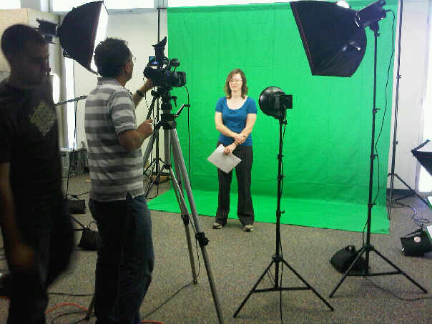
recording
bring it to life
Notes:
Gathering your material
Recording within our cube farm
Have to work within the environment we are given
Noise issues always a problem…lighting not optimal
Things to consider:
Lighting
Audio
Equipment
Talent energy and focus

Slide 8
editing
refine till it’s right
Notes:
Most cyclic of process
Multi staged
Assemble
Refine
Reorganize
Add graphics and text
Re shoot or record additional audio if necessary

Slide 9
Minute 27: Top 5 Resources For Online Students
Before
View Rough Cut
After
View YouTube Final
rough vs. final
Notes:
This best illustrates the process of editing from a rough draft that could technically be released but does not meet the needs of our audience
Here’s why
Compile
Evaluate
Mix
Evaluate
Re-Mix
Evaluate
Soundtrack
Final Eval

Slide 10
finally…
distribute disseminate
and make accessible
Notes:
Plan compression
Must if at all possible think about accessibility
Closed or Open captions necessary for hearing impaired
Side benefit is YouTube Auto Translation (fans in Netherlands)

Slide 11
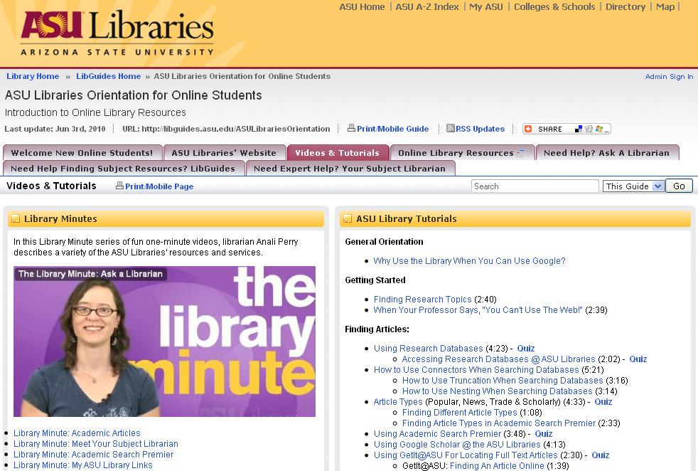
discover
share
use
Notes:
What do we do with them … this drives production
The need to be discoverable
We need to allowing sharing and exchange
Not only on the web and signage but embedded in Libguides, Blackboard, and used in the classroom
FeedbacK? Has been great not only from our librarians but the students as well.
Awesome
Instructors…. Students (via twitter) laugh in right place and remember things (instant feedback)

Slide 12
what does it take to make a library minute?
vision
people
time
enthusiasm
and yes, equipment…
Notes:
Vision: need to clearly know for whom and why like target our students… and scope: work within time limit for LM for a topic – don’t want to cram too much.
People: Have to have the resources to make it happen not a one person process (could be but better results with distribution of roles)
Time: Not just time to record but edit, review, improve, compress, and distribute
Budget: allocated staff time to make the videos. We do purchase equipment business scope.
Enthusiasm: We have to have fun, creative, and have support. We need to respond to our users and adapt organically

Slide 13
lib.asu.edu/librarychannel
thanks
@librarychannel

