Slide 1
A Sampling of IT Compliance in Higher Education – 2010
Phyllis Bernt
Professor of Information and Telecommunication Systems
Scripps College of Communication
Ohio University
Matthew Dalton
Information Security Officer
Office of Information Technology
Ohio University

Slide 2
Some stats about the survey
Number of responses 160
States represented 38
Carnegie Classifications 14
Dates of the Survey
May 13, 2010 –
June 14, 2010

Slide 3
Who completed the survey?
Assistant Dean - 2
Assistant Director - 3
Associate Provost - 4
Associate Vice President - 4
Chief Financial Officer - 1
Chief Information Officer - 53
Chief Information Security Officer - 4
Chief Information Technology Officer - 2
Chief Privacy Officer - 1
Chief Technology Officer - 4
Compliance Coordinator - 1
Consultant - 1
Coordinator - 1
Dean - 4
Director - 38
Enterprise Architect - 1
Executive Director - 8
Information Security Officer - 4
Information Technology Policy Officer - 1
Manager - 2
Professor - 2
Senior Director - 3
Special Assistant - 1
Vice Chancellor - 4
Vice President - 18
Vice Provost - 1

Slide 4
When was your compliance effort started?

Slide 5
What triggered your compliance initiative?

Slide 6
Current Compliance Practices

Slide 7
Compliance Staff (FTE) by Carnegie

Slide 8
Who supports compliance efforts?

Slide 9
IT Compliance is assigned to:

Slide 10
Compliance Demands and Response

Slide 11
Standards used in Compliance Efforts

Slide 12
Methods for Addressing Compliance

Slide 13
Challenges in Compliance

Slide 14
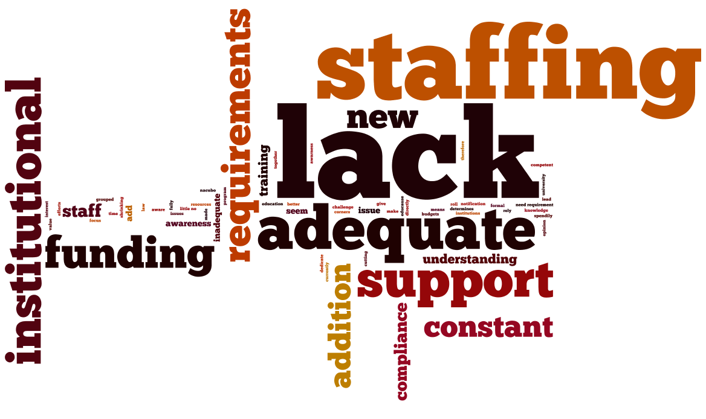
What is the biggest challenge?

Slide 15
“We have had state and system requirements for compliance and auditing for many years. The role of compliance has grown exponentially, however, over the past 10 years.”
“security awareness programs are difficult to sell when limited resources are constantly being chopped at by other ‘more important’ projects.”
[IT compliance environment is] “getting better but need to work with community more, challenge [is we] must work on more communications and public relations.”
“one of the challenges we face now is that there is uncertainty regarding which laws and contractual obligations we, as a college, must comply with.”
Challenge – ‘Balancing IT security practices and academic freedom.’

Slide 16
“IT personnel need to be reminded occasionally and told that they cannot function without ensuring that the campus is aware of what is being done. It is as constant battle to keep them from reverting back to making changes on the fly in a production system.”
“I think the college must recognize that Information Security can be implemented within higher education without affecting the ‘open’ environment often associated with it. Information security is not always saying ‘No,’ it is more about adapting industry standard best practices to fit within the institution.”
“My biggest success has been to gain the respect of key decision makers and ‘influencers’ throughout the campus. Mainly the respect was earned through listening, responding thoughtfully and having a plan ready before the need for the plan surfaced.”

Slide 17
“We have had state and system requirements for compliance and auditing for many years. The role of compliance has grown exponentially, however, over the past 10 years.”
Challenges – “Too few compliance staff people who really understand IT; the ever-increasing complexities of providing a safe IT environment; lack of understanding of the issues at the executive level.”
“The fiscal realities of our college, system, and state have made it difficult to hire new or additional staff.”
“I look at compliance with an eye toward enabling safe academic freedom and research. This means instead of restricting activity or data sharing, supporting activity and data sharing within a framework that protects key data, but does not arbitrarily establish end-user constraints.”

Slide 18
Challenges
“Too few compliance staff people who really understand IT; the ever-increasing complexities of providing a safe IT environment; lack of understanding of the issues at the executive level.”
“Faculty, staff, and administration spend time developing methods to improve and enhance the learning environment and I try to work with them instead of against them.”
“Currently, compliance is no one’s primary responsibility. It is one of many ‘add on’ responsibilities for a number of folks.”
“It [current IT compliance environment] grew out of the questions and reports our auditors began asking about four years ago.”
“security awareness programs are difficult to sell when limited resources are constantly being chopped at by other ‘more important’ projects.”

