Slide 1
Seminar 03P
Improving Accessibility for All:
Using Universal Design for Media, Mobile Devices, and the Web
Jon Gunderson | October 12th, 2010

Slide 2
PART 1: AccessIBLE Learning OBJECTS
Jon Gunderson, Ph.D.
University of Illinois at Urbana/Champaign

Slide 3
TYpes of disability

Slide 4
DisabiLity By Age

Slide 5
Web Accessibility Survey

Slide 6
Disability Simulation
Keyboard
Colors
Size
Fonts
Assistive Technology

Slide 7
STEPS to Accessibility
Awareness
Standards/Practices
Auditing and Administrative Controls

Slide 8
Awareness
People assume accessible
Feedback on accessibility
Automated Tools

Slide 9
Standards/Practices
Accessible Repair vs. Accessible Design
Practices
Planning
Authoring Environments and Tools

Slide 10
Accessible design
Contrast with Accessible Repair
  No or low cost to accessible design
  Systematic improvement and maintainability
Benefit all users
  Users with disabilities
  Users without disabilities
  Developers
  Integration with mobile strategies

Slide 11
Practices
Choosing accessible technologies
Use best practices
Training staff
User support groups
Authoring Tools
  Accessibility by default
  Making tools readily available

Slide 12
PlaNNING
Focus on new development
What has the biggest impact
Where are the opportunities
Working with vendors on accessibility features

Slide 13
Auditing
Measuring success
Insuring progress
Getting input form people with disabilities

Slide 14
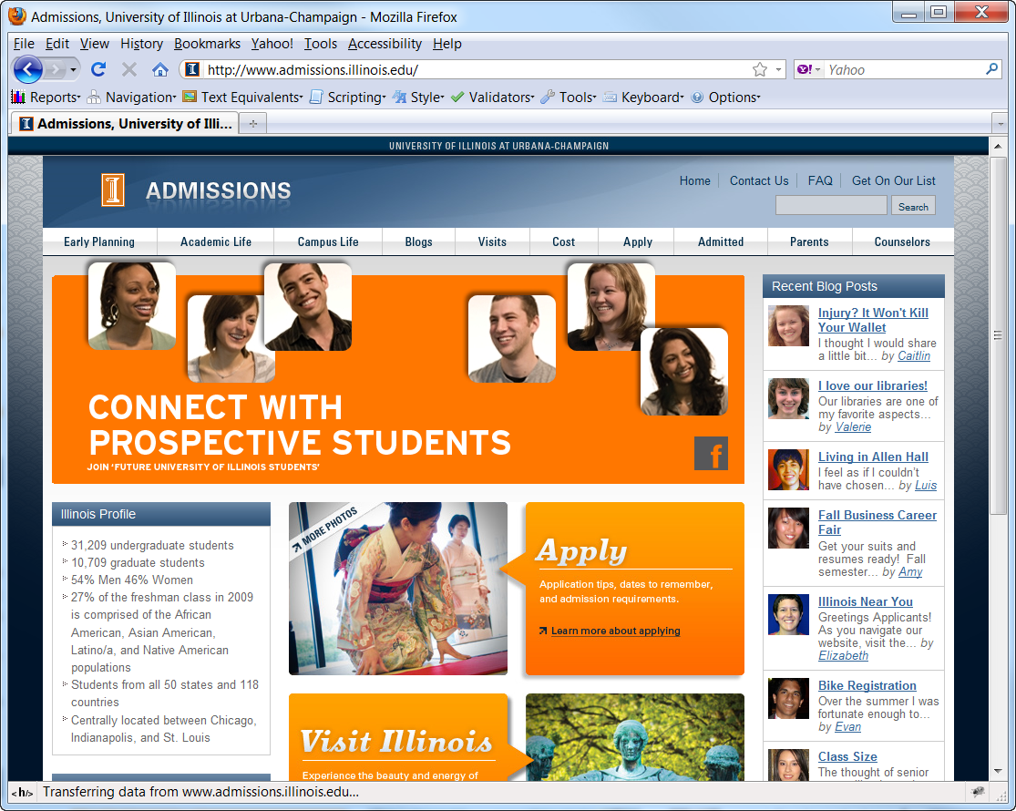
Accessible Web Design Example
http://www.admissions.illinois.edu/

Slide 15
Accessibility Features
H1 and TITLE for titling
H2 elements for marking lists of links
H2 for main topics
  H3 for sub topics
Form labels
ALT text for images
CSS for styling
Issues: Multimedia

Slide 16
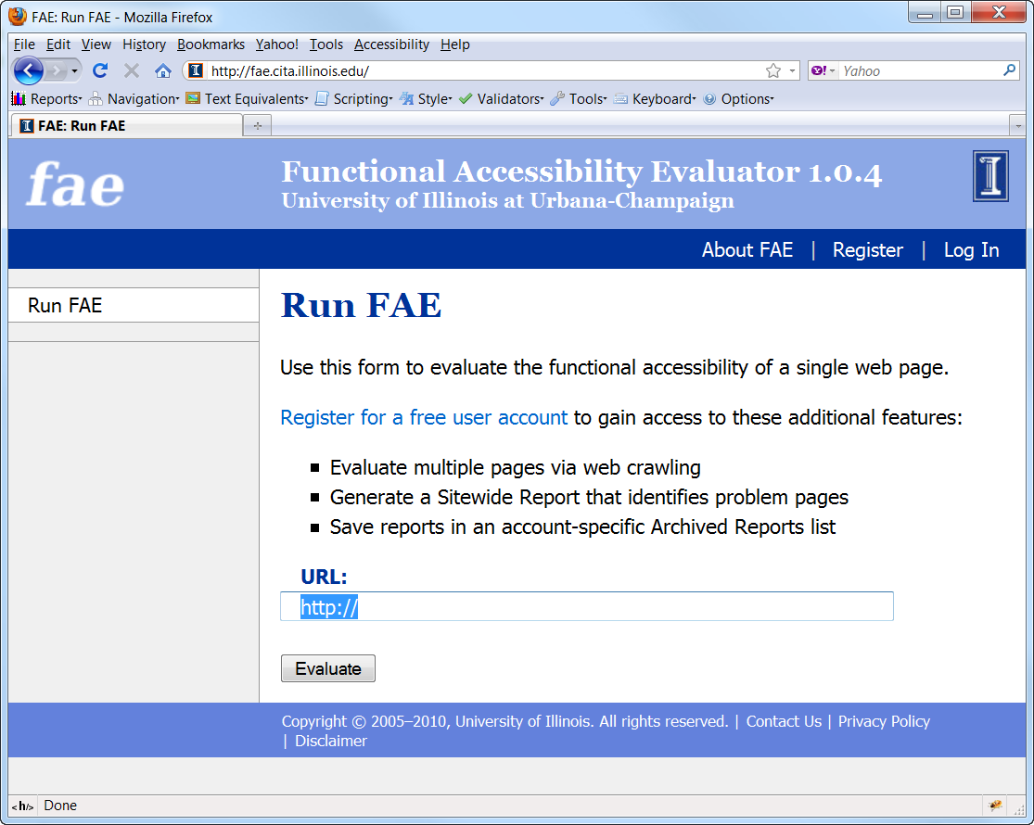
Functional Accessibility Evaluator
http://fae.cita.illinois.edu

Slide 17
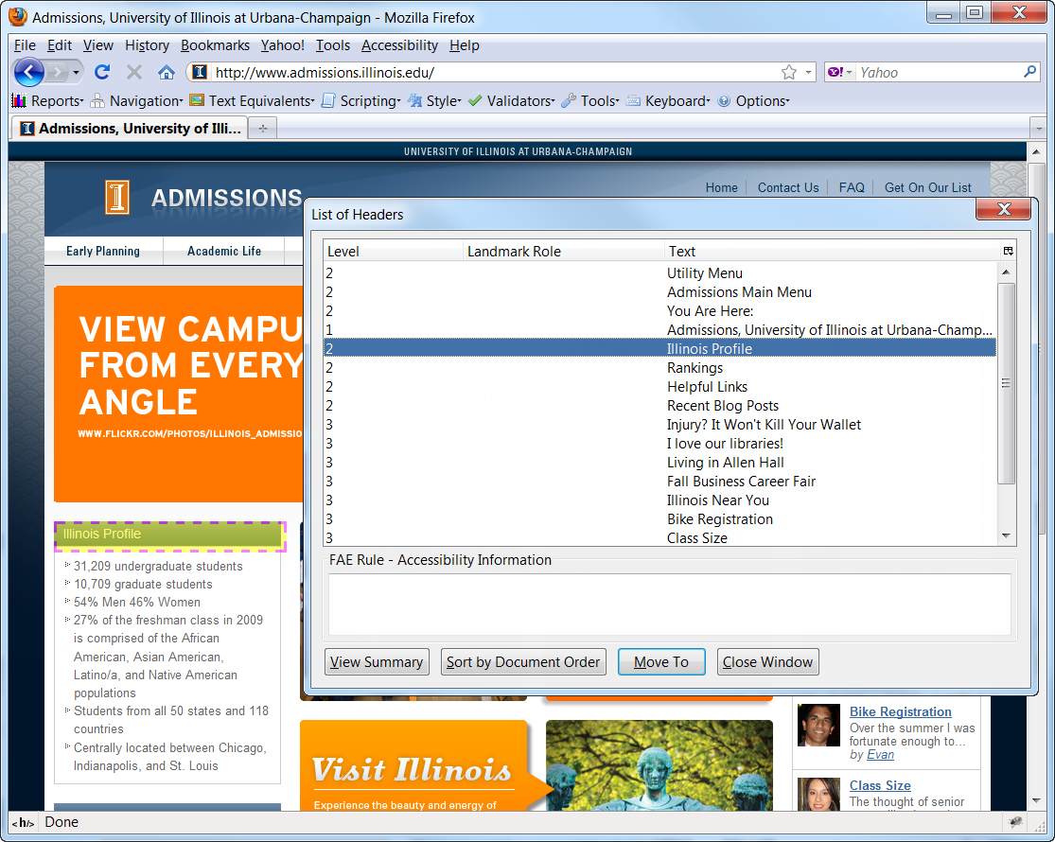
Firefox Accessibility Extension
https://addons.mozilla.org/en-US/firefox/addon/5809/

Slide 18
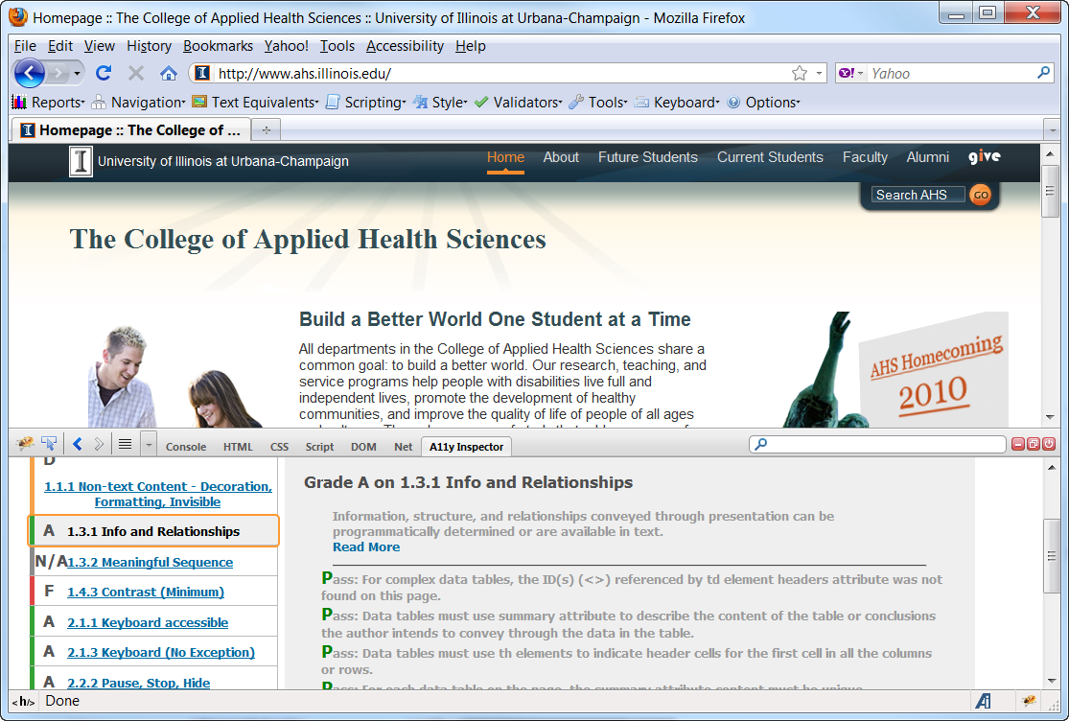
Firebug Accessibility Inspector
http://code.google.com/p/ainspector

Slide 19
Problems of Using Automated ToolS
Automated tools look for coding patterns
  ALT text for images
  LABELs for form controls
  H1-H6 for section headers
Some issue
  Cannot determine if captions available for media
  Cannot determine if markup represents the structure and organization
Developers design to satisfy automated tool instead of the accessibility feature

Slide 20
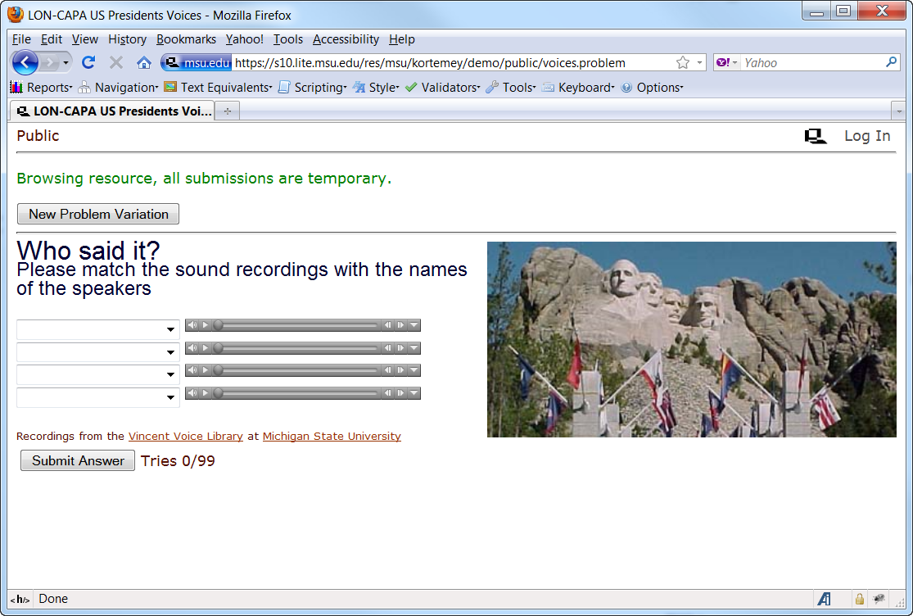
Learning OJECT Example
http://www.lon-capa.org/demo.html

Slide 21
Accessibility Issues
Keyboard support
Form labeling
Instructions
Audio
Feedback

Slide 22
How would we access accessibility?

Slide 23
What would the Issue be for Mobile Technologies?

Slide 24
Accessible and Mobile version
Keyboard support
Text transcripts
Form labeling
Headings
Text descriptions
Media format and player

Slide 25
Learning Management and Delivery SYSTEMS
Blackboard
Desire2Learn
Elluminate
Adobe Connect
etc…

Slide 26
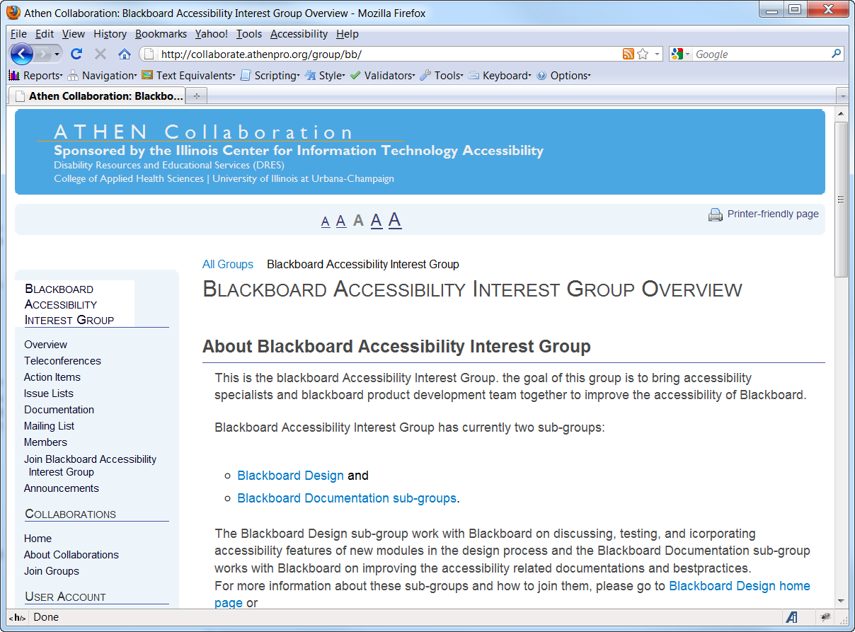
Collaboration
http://collaborate.athenpro.org

Slide 27
PART 2: UNIVERSAL DESIGN USING DOCUMENT MARKUP
Norman Coombs, Ph.D.
Professor Emeritus
Rochester Institute of Technology
EASI Equal Access to Software and Information
http://easi.cc

Slide 28
THIS PRESENTATION WILL COVER
Organize: plan before creating content
Modularize: use chunking
Layout: use content display to reflect meaning
Structure: design using document markup
Markup: benefits and importance of markup

Slide 29
WHAT THIS TOPIC MEANS TO ME
Braille in contrast to print & electronic documents does not display structure clearly. It consists of patterns of raised dots of an identical shape and size making document navigation difficult
Electronic documents and assistive software:
Changed my life
Pushed me into online teaching
Changed how I author books

Slide 30
UNIVERSAL DESIGN AND COMMUNICATION
Today’s students come with a broad spectrum of experiences, interests, motivations and abilities
Universal design does not mean aiming at the lowest denominator
The challenge of universal design is to create content that will communicate effectively to the broadest spectrum of students possible.
Also, such clear communication is the most important tool to support students with special needs

Slide 31
ORGANIZE: PLAN BEFORE CREATING CONTENT
Clear, simple organization of content springs from a clear and thorough understanding of the content
Clear, simple organization of content better enables the learner to understand its meaning
Rambling presentations frequently reflect either an inadequate grasp of the content or inadequate preparation and puts an extra burden on the learner

Slide 32
MODULARIZE: USE DOCUMENT CHUNKING
Segment online lessons for all learners so that they can be completed in short chunks.
Chunking implies not only that the document is modularized but also that it is well organized.
Using meaningful headings will enable users to navigate quickly through the document
Skimming a page looking for the next section is a common practice. But for users of some assistive technologies such as screen readers, this is only possible when the document uses properly constructed headers that interact with assistive applications

Slide 33
DOCUMENT STRUCTURE AND MEANING 1
New York
Albany
Rochester
Washington
Spokane
Seattle
Notes:
33

Slide 34
DOCUMENT STRUCTURE AND MEANING 2
New York
Albany
Rochester
Washington
Spokane
Seattle
Notes:
34

Slide 35
DOCUMENT STRUCTURE AND MEANING 3
New York
Albany
Rochester
Washington
Spokane
Seattle
Notes:
35

Slide 36
DIFFERENT WAYS TO CREATE LAYOUT
Create layout and appearance using font type, font size etc.
Create the same appearance using markup
If these look the same, why care?
If the application understands the layout it can help you
If the application understands the meaning of the layout, it can better interact with user agents

Slide 37
UNIVERSAL DESIGN IN DOCUMENT CREATION
Universal design means using the markup features in document creation whether Word, PDF, or Web pages
Providing the application with markup information enables the application to help you with your structure and organization
Markup almost guarantees that when you repurpose a document into another document format that its basic structure will travel with it maintaining its meaning and integrity

Slide 38
USE OF COLOR
Use good contrast between background and foreground colors
Avoid heavily patterned background
Avoid conveying information by color alone but always use a redundant method of communication

Slide 39
HEADER NAVIGATION IN WORD PROCESSORS
Scrolling was for the Middle Ages
Books permitted document navigation
Headers make navigation of electronic documents possible provided the application supports it
Modern assistive applications provide header navigation which is unusually beneficial for users with disabilities

Slide 40
CREATING HEADERS IN WORD
Highlight the text to be a header
Select the icon for the desired header and click on it
Headers can also be accessed by keystrokes:
alt + control + 1 for header 1 and 2 ,3,etc. for other headers
(This will be spelled out in detail later)

Slide 41
HEADER CODE FOR NAVIGATION IN WEB PAGES
<h1> (text goes here </h1>
<h2> (text goes here </h2>
Other attributes such as font and color are best defined for each header in an associated cascading style sheet

Slide 42
WHAT IS A STYLE?
A style is a set of commands saved with your document that govern the display of the entire document in contrast to specific commands that only control specific items in the document
You can change the entire document appearance by changing the style
(This is true for word processor documents and for Web pages)

Slide 43
HOW CAN STYLES HELP YOU?
You can make and save several styles for different types of documents
Styles make it easier to create more accessible content
Styles help you keep your document’s structure consistent
Styles make it simpler to collaborate with someone else

Slide 44
PLANNING A STYLE
Creating a style is nothing more than making a template for the structure of your documents
You will decide on font type and size and you can modify line and margin settings
Plan for the appearance of body text and for the appearance of different header levels
(this true both for a Word document style and for a Web cascading style sheet)

Slide 45
CREATING STYLES IN 2007
In Word 2007 go to the style ribbon and click on the arrow in the bottom right of the label
Click on the icon at the bottom for new style

Slide 46
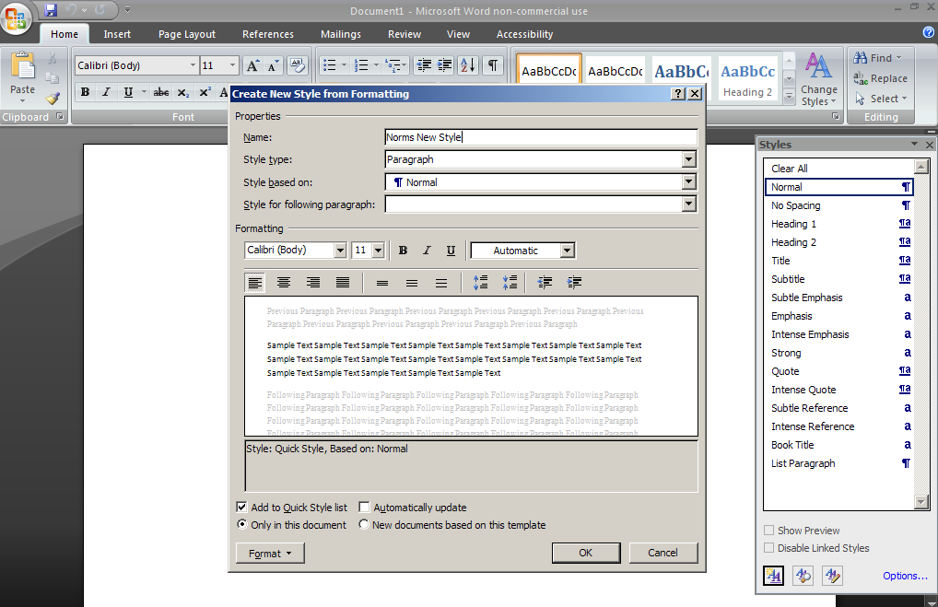
SCREENSHOT OF STYLE IN WORD 2007

Slide 47
USING A TABLE OF CONTENTS FOR NAVIGATION
An application that can jump from header to header greatly enhances navigation in all documents
In longer documents, having a table of contents at the beginning permits even more efficient navigation
It also gives an overview of the document providing another aid to the reader’s understanding

Slide 48
MAKING A TOC IN WORD 2007
  First make a blank line at the place you want the contents. It will probably be at the top or maybe just after the title and author
From the references tab, select Table Of Contents
In seconds, the TOC will appear

Slide 49
MAKING A TOC IN HTML
The table of contents in Web pages requires 2 parts: the item in the contents and the target further down the Web page or the point that the contents point to
<a href="#p1"> Student introduction </a>
<a name="p1" id="p1"> Student introduction</a>
WYSYSIWYG Web editors will help you do it

Slide 50
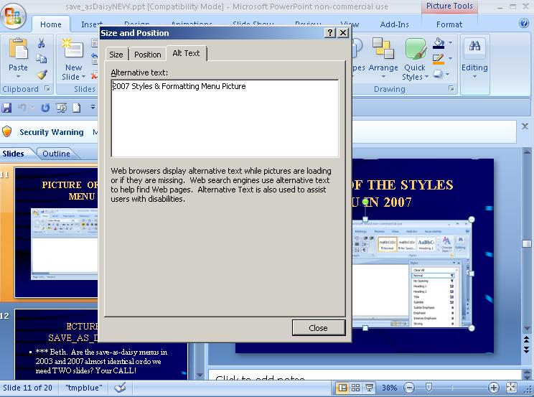
ADDING ALT TEXT TO A PICTURE IN WORD 2007

Slide 51
CODE TO ADD TEXT TO AN IMAGE IN HTML
<IMG src="coombs.jpg" alt="Picture of Coombs">
Any modern professional WYSIWYG HTML editor will put in the code for the image and then will provide a text box where you can put its description
Types of images for descriptions:
Purely decorative
Informative
Complex image requiring longer description

Slide 52
UNIVERSAL DESIGN AND USERS WITH DISABILITIES
Content organization, modularizing, page layout and the use of markup all provide special advantages for users with a variety of disabilities:
Motor impairments
Learning disabilities
Low vision
Blind
Deaf and hearing impaired

Slide 53
UNIVERSAL DESIGN AND CAPTIONS
Captions and/or transcriptions are necessary for the hard of hearing person
They provide dual sensory input for hearing users enhancing their learning
They also assist non-English speakers
They also facilitate search engines
They also facilitate printing content for study and annotation

Slide 54
REPURPOSING BETWEEN DOCUMENT FORMATS
Documents created in one format using markup and clear layout will usually convert into other formats and retain basic structure which is especially if the document is not too complex
Word processor documents can frequently be exported to PDF and Web pages and retain basic features including their accessibility features
Exporting from Word to HTML works best using filtered Web HTML
Word has an add-in for exporting to PDF as does Acrobat

Slide 55
A WORD ABOUT POWERPOINT
PowerPoint’s native ‘ppt’ or ‘pptx’ formats can be made reasonably accessible with good contrast, good font type and size
Images still require alt text
Transitions and animations can be a problem and do not repurpose well for the Web
There are 2 accessible wizards to output accessible Web content
LecShare.com
Virtual508.com

Slide 56
A WORD ABOUT EXCEL
Tables and spreadsheets make sense when each cell can be seen in context meaning related to row and column headers
Because screen readers and screen enlargement software lose this crucial context:
Provide an overview of the spreadsheet
Inform the user of which row and column contain the headers because the user can configure the adaptive software to interact meaningfully with the headers

Slide 57
RESOURCES
EASI: Equal Access to Software and Information:
http://easi.cc
Illinois HTML Best Practices:
http://html.cita.illinois.edu
Making Online Teaching Accessible
Coombs published by Jossey Bass (2010)

Slide 59
PART 3: UNIVERSAL DESIGN AND ACCESSIBLE MEDIA
John Foliot
Program Manager
Stanford Online Accessibility Program
Co-chair - W3C HTML5 Accessibility Task Force (Media)
jfoliot@stanford.edu

Slide 60
Multi-Media in the learning environment
Multi-Media = Multi-Modal
Audio
Visual
Interactive
Cognitive
Technologies

Slide 61
Interactive content with Flash
Benefits
  Mature & Robust Development Platform
  Large developer community with experience
  “Portable” (Web, CD Rom, etc.)
  Secure (digital rights, etc.)
Issues
  Proprietary
  Difficult to impossible to ensure Universal Access
  The “iProblem” (iPhone, iPad)

Slide 62
Using Video & Audio IN the .EDU Environment
Benefits
  Distance Learning
  Research & review
  Improving Comprehension
Issues
  Asset Management
  Compliance Issues (Sec. 508, 504, etc.)
  Production requirements
  Cost

Slide 63
Planning for Accessible Media
Workflow – inserting accessibility into a project
  Video capture
  Captions / transcripts
  Described audio/text
  Sign Language
Production Tools
Manual Methods
  MAGpie
  World Caption
  MovCaptioner
  Subtitle Workshop
  Express Scribe
Outsourcing
  3PlayMedia
  Automatic Synch
  Check your local market

Slide 64
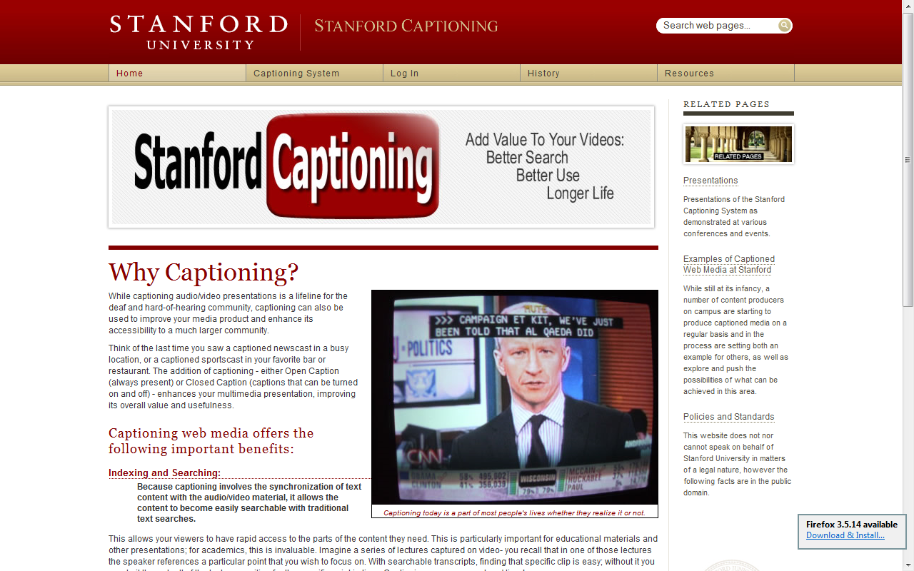
Case study – Captioning Videos

Slide 65
Emergent Technologies (HTML5)
Canvas
SVG
<video>
Deploying for mobile

Slide 66
Resources
Compliance requirements:
Section 508:
"b) Equivalent alternatives for any multimedia presentation shall be synchronized with the presentation."
- http://section508.gov/index.cfm?FuseAction=Content&ID=12#Web
Section 504:
Suggests that pedagogical materials must be made available to all students regardless of any disability.
- http://www.ed.gov/about/offices/list/ocr/504faq.html
WCAG 2:
- http://www.w3.org/TR/WCAG20/#media-equiv
Captioning:
Manual
MAGpie- http://ncam.wgbh.org/webaccess/magpie/
World Caption - http://lss.wisc.edu/node/276
MovCaptioner - http://www.synchrimedia.com/
Subtitle Workshop - http://www.urusoft.net/products.php?cat=sw&lang=1
Express Scribe - http://www.nch.com.au/scribe/
Outsourcing
3PlayMedia - http://www.3playmedia.com/
Automatic Synch - http://www.automaticsync.com/captionsync/

Slide 67
What You Can do
Ask for vendors for accessibility features
Ask vendors to demonstrate accessibility features
Ask vendors to demonstrate accessible authoring
Assign accessibility responsibilities to IT staff
Use accessible design best practices when creating new campus resources
Partner with disability services and campus disability communities to prioritize accessibility intiatives

Slide 68
Questions?

