Slide 1
Understanding Open Source KFS
Dave Lyons, rSmart
Kymber Horn, University of Arizona
Keiko Takahashi, rSmart
October 12, 2010
Copyright David Lyons , Keiko Takahashi and Kymber Horn. This work is the intellectual property of the authors. Permission is granted for this material to be shared for non-commercial, educational purposes, provided that this copyright statement appears on the reproduced materials and notice is given that the copying is by permission of the author. To disseminate otherwise or to republish requires written permission from the authors.

Slide 2
Overview of KFS
Dave Lyons| October 12, 2010

Slide 3
KFS History
NACUBO Sponsored Meeting 2004
Mellon Foundation Planning Grant 2004
Original University Investment Partners
Major Mellon Foundation Grant for Development 2005

Slide 4
Kuali Today 2010
Kuali Financial System
Kuali Coeus
Kuali Student
Kuali Rice
Kuali Ole
Kuali Ready
Incubation Projects

Slide 5
Kuali Proposed Projects
Kuali HR/Payroll
Travel & Expense Management (KFS)
Contract & Grant Billing (KFS)
Kuali Materials Management (KFS)

Slide 6
The Kuali Foundation
Non-Profit Foundation
Funded by Participating Members
Board of Directors Elected by Members
Coordinates Efforts of Partners
Protects Intellectual Property
Legal Services

Slide 7
The Kuali Foundation (cont.)
Quality Assurance
Licensing
Collaboration Infrastructure
Event Management
Public Relations
Website

Slide 8
KFS Partners
Colorado State
Cornell University
Indiana University
Michigan State
University of Arizona
University of Connecticut

Slide 9
KFS Partners (cont.)
U of California/President’s Office, Davis, Irvine & Santa Barbara
University of Hawaii
University of Maryland
University of Southern California
rSmart

Slide 10
Other KFS Implementers
Strathmore University
San Joaquin Delta College
Naval Postgraduate School
Iowa State University
Stevens Institute of Technology

Slide 11
KFS Modules
Release 1.0 – October 2006
Chart of Accounts
Financial Transactions/General Ledger
Release 2.0 – November 2007
Purchasing/Accounts Payable
Labor Ledger
Contracts & Grants

Slide 12
KFS Modules (cont.)
Release 3.0 – November, 2009
Accounts Receivable
Budget Construction
Capital Assets
Release 4.0 – Late 2010
Kuali Coeus/KFS Integration
Kuali Endowment Management
Enhancements

Slide 13
Indiana University FIS
13 Years of Operations
7 Campuses of Various Sizes
$2.4 Billion Annual Expenditures
Flexible Chart of Accounts
Needed New Technology Environment

Slide 14
KFS Features
Some Modules are Optional
Workflow
Import/Export Capabilities
Electronic Document Attachments
Chart of Accounts/Attributes
Sub-Accounts/Sub-Object Codes

Slide 15
KFS Features (cont.)
Transaction Audit Trail
Business Rules/Parameters/Configurable
Automated Entries at Each Update
Real Time Access to Pending Entries
24/7 Access to Balances
Developed by and for Higher Education
Sustained by Higher Education

Slide 16
Chart of Accounts
Account is Simple Identification Number
Attribute Structure Higher Ed Specific
Accounts, Organizations, Object Codes may all Have Attributes
New Attributes can Be Added
Multiple Charts if Needed

Slide 17
Business Rules
Maintained by Parameter Tables
Configurable
Institutions Can Customize Based Upon Their Policies

Slide 18
Workflow
Routing Engine for Validated Transactions
Can be Used for Legacy Systems
Highly Customizable
Different Organizations can Configure as Desired

Slide 19
Automated Entries
Cash Offsets
Capitalization of Assets
Plant Indebtedness
Cost Share
Indirect Cost Recovery
Automatic Journal Entries

Slide 20
Tour of KFS
Kymber Horn, University of Arizona
October 12, 2010

Slide 21
The KFS Hierarchies
Chart, Organization, Accounts and Sub-Accounts
Facilitates multiple charts of accounts under a single Institutional/System reporting system
Object Codes
Facilitates grouping of object codes for high level reporting, drill down, reporting, routing and business rules (parameters)
Documents
Facilitates easy establishment and management of permissions, responsibilities, parameters using inheritance. Custom Searches.

Slide 22
Chart Conceptual Model

Slide 23
Chart Conceptual Model

Slide 24
Charts, Orgs, Accounts and Sub-Accounts
UA (c)
MC (c)
VPBus (o)
FSO (o)
Admin (o)
FM (o)
2113010 (a)
2172000 (a)
OPFNDS (s)
NONOP (s)

Slide 25
Object Code Hierarchy
Consolidation:
GENX-General Expense
Level:
ADV-Advertising
Level:
S&E-SUPPLIES & EXPENSE
4159-Marketing Fee
4100-Office Supplies
4502-Advertising
5000-Supplies & Exp

Slide 26
Document Hierarchy
Kuali Documents
Rice eDocs
KFS (All KFS eDocs)
KFSM (Complex Maint eDocs)
FSO
KFST (Transactional eDocs)
FP (Financial Processing eDocs)
DV (Disbursement Voucher)

Slide 27
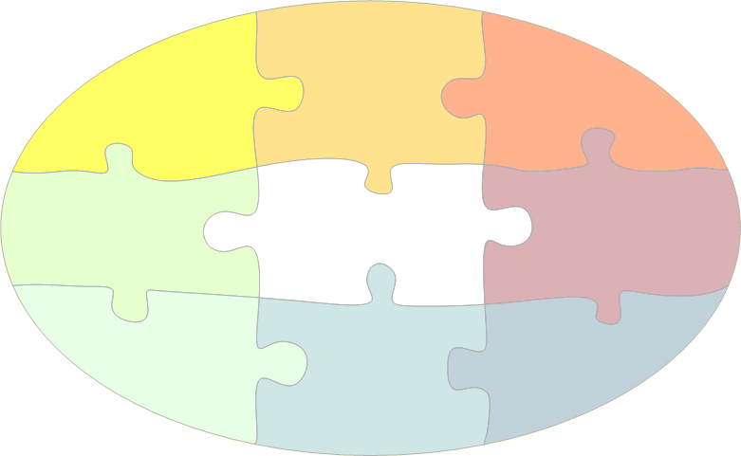
Kuali Financial System Modules
Capital
Assets
Purchasing/
Accounts
Payable
Budget
Construction
Accounts
Receivable
Labor
Ledger
CORE
Contracts
& Grants
(KCRA)
Effort
Certification
Endowment
Notes:
What we want to achieve in the 1 hour session today:
<Read from slide>

Slide 28
Contribution
Keiko Takahashi, rSmart | October 12, 2010

Slide 29
Kuali Foundation’s Mission
Kuali Foundation supports collaboration and community building around the Kuali administrative systems application framework(s) and associated tools of components.
Kuali Foundation establishes a process to foster the sharing of Kuali-related assets among community members and adopters, even if a Kuali project development team did not produce them.

Slide 30
Contribution Model
Gated Community
Formal Contribution Process
https://wiki.kuali.org/display/KULFOUND/Contribution+Model
Notes:
The contribution must
-not compromise financial data integrity
-the design must be in sync with the rest of the modules
-must accommodate options for private, public, and research institutions using the parameters or reference tables (no hard-coding)

Slide 31
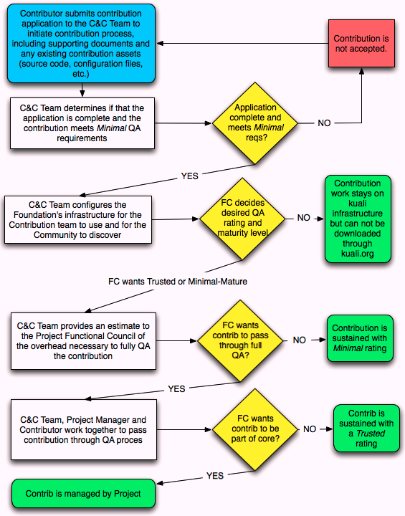
Contribution process
Notes:
-The contribution application must be made to the Collaboration and Communication Team
-The contribution must be submitted with source code, configuration file and documentation
The C&C team must asses the maturity level and QA requirement
The Functional Council must approve the functionality
The code must be merged to the base code by the sustaining team and must pass the QA process

Slide 32
How contributions are fostered
Bug fixes and enhancements
Collaboration by “like” Institutions
Contribution from Commercial Affiliates
Contribution from individual schools
New projects by soliciting partners (investors)
http://kuali.org/kis/contribs/
Notes:
KFSMI-5925 Default Chart Code

Slide 33
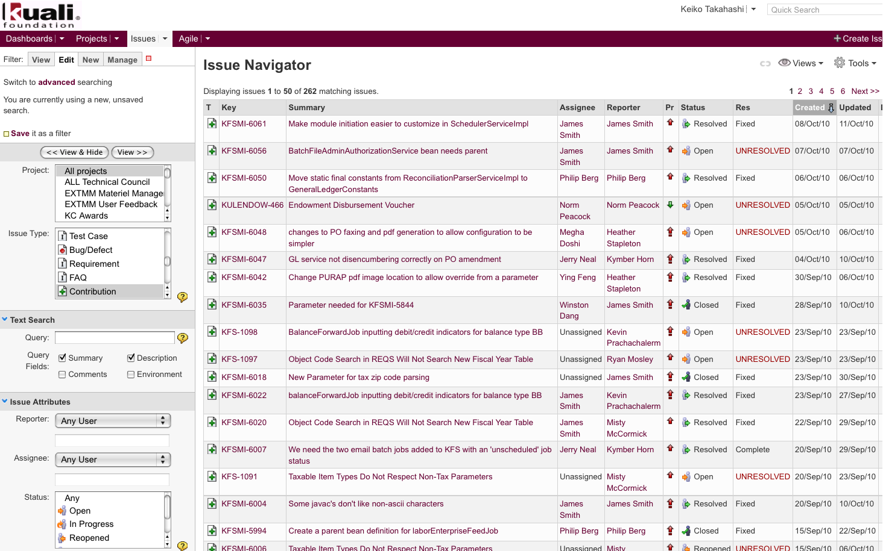
Contribution jira tickets

Slide 34
Collaboration by early adopters
Form 1099 Process
Extracts vendors and payments from PDP
Provides the 1099 document to edit payees and payments
Produces IRS Submission File and 1099 Forms
1099 Module
Vendor
PDP

Slide 35
Collaboration by early adopters
Check Reconciliation Process
Reconciles the checks produced by PDP to the cleared check records from the bank. This is accomplished by matching the check file sent from the bank against the PDP records by the check number, date, and amount
PDP Check Records
Bank File

Slide 36
Collaboration by early adopters
Automated Journal Vouchers
Eliminates the need to enter manual postings by the accounting office for recurring, predictable transactions by defining the distribution rules in the tables.
Balance Table
Rule Table
Transactions

Slide 37
Collaboration by early adopters
Procurement Cardholder Maintenance Document
Procurement Card Administrators to maintain the default account number and the reconciler information so that the PCDO e-doc can be loaded with the default account number and routed to the reconciler.
PCDO Document
pcardholder
Procurement card transactions

Slide 38
Collaboration by early adopters
Purchase Order Batch Upload
Converts approved open purchase orders from external systems during migrations to KFS
Feeds completed purchase orders from the external systems on an on-going basis so that the AP can pay invoices against the POs.
PO.XML
Upload
PO Document

Slide 39
Collaboration by early adopters
Disbursement Voucher Batch Upload
Enables a batch feed of disbursement vouchers from the external systems (such as Library).
Pushes the DV documents and routes them to approvers
DV.XML
Upload
DV Document

Slide 40
Contribution from commercial affiliate
Access Security (Granular Security)
Integrated with KIM, this module provides infrastructure to configure granular restrictions to accesses financial data based on institution-defined attributes.
Front-end maintenance documents to Kuali Identify Management (KIM)
Locks down data by attributes (attribute value based security)

Slide 41
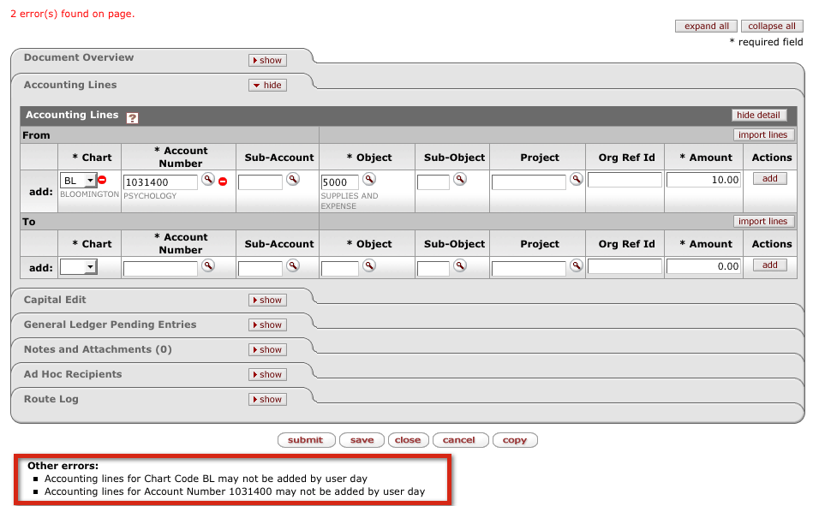
Access security

Slide 42
Contribution by INVESTING partners
Travel Project
Travel Request (authorization) document, Travel Reimbursement document, tracking of travel advances.
Traveler profile, corporate card data import
Relocation expenses

Slide 43
Contribution by INVESTING partners
Contracts & Grants Billing
Sponsor, Project Profile
Invoice Templates
Invoice Preview and Edit, and creation
Collection
Integration with KC and AR

Slide 44
Integration between KC and KFS
Kuali Coeus and Kuali Financial System Integration
https://wiki.kuali.org/display/KULRICE/KFS-KC+Integration+Project
Integrating two systems over the service bus
Use of standalone Rice
Notes:
http://kra.testdrive.kuali.org/kra-ptd/portal.jsp

Slide 45
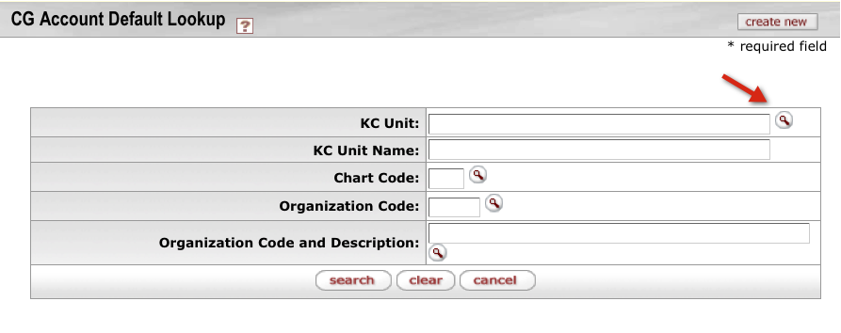
Looking up KC from KFS

Slide 46
For more information, please contact swarren@rsmart.com

