Slide 1

Implementing Kuali Identity Management at Your Institution
Eric Westfall – Indiana University
Dan Seibert – University of California San Diego
EDUCAUSE 2010
Notes:
Identity Management
Access control / access management
Especially at a university, it’s more complex than it would first appear.
Institutions vary on IT Resources. Seems that the more you try to provide, the more complex it gets.
A lot of different, individual solutions in a wide range of technologies.
Still, Universities working on their own solutions to common problems.
Common problems – not exactly the same, but similar
Also, Expectations and Demands Evolved to expect Enterprise Level
it’s expensive to build top of the line, professional quality software
Budget issues have changed the way we can do business.
Collaborative Higher Ed Communties
Kuali Foundation - common higher ed applications
Your institution must be heading down this road. Ask guests if they are using kuali apps.
We’re going to look into Kuali Rice, and how it handles identity / access management

Slide 2
Welcome! Outline for today’s session…
What is KIM?
Terminology
End-User Functionality
User Interface
Services and Architecture
Break
Implementation Options
Integration with other IdM Solutions
Institutional Use Cases
Notes:
Kuali Rice via the KIM module provides a common, centralized identity management services to be use by not only Kuali applications (KFS, KC, Student, and others, OLE, …) but other products thru the Rice framework
Outline of today’s session – just run down the bullet points.

Slide 3
What is KIM?
Kuali Identity Management (KIM) is a module of the Kuali Rice middleware framework
Provides a common contract and service layer for Identity and Access Management
Includes an integrated Reference Implementation
Ships with a set of User Interfaces
Acts as an “integration platform” for identity and access management services within Kuali
Despite the name, KIM is not just Identity Management, it’s also Access Management!
Notes:
There are many different identity and role management systems out there.
A lot of home-grown systems developed over the years.
- Gabe’s vision my first day at UCSD. 7 years ago, a lot accomplished, still a long way off
Several commercial products Either way very expensive
What is KIM? - a module Kuali Rice
Common API / Service layer
For the Kuali applications, and any applications developed on top of the Rice framework, it provides a layer of abstraction to insulate the application from needing to know the details of those systems.
Avoids duplication of effort for application developers.
allows the implementation of the identity, group, and role definitions, permisssions…. All to be handled, maintained and managed outside of the application.
TO the developer, changed out without code changes on the part of the application.
To the end user institutions commonality, eases configuration and maintenance, …
With the KIM service layer, you can leave the data in your system-of-record.
Includes reference implementations. Designed to be easily overridden.
SOA architecture Architecture makes it easier to integrate with institutions existing systems.
Provides - Varying hybrid approaches
KIM also provides a set of user interfaces.
These are mainly useful when using the reference implementation although some aspects of the main person UI have been designed to work with external systems.

Slide 4
What KIM is Not
A Full-Fledged Identity Management System
It does not provide built-in services for:
  Provisioning
  Identity Aggregation
  Duplication Management
  Strongly secured account and password management
  Authentication
    Typically provided by CAS, Shibboleth, or something institution-specific
  Directory services
    Typically provided by 3rd party LDAP solutions
Notes:
Ching!!! KIM’s the answer to everything!!!! Well… no
It’s still a big, complex issue.
KIM’s default implementation is more of a data storage system than a provisioning system. It does not have any built-in code to scan other systems for identity/role information. Those hooks would have to be built by your institutions.
KIM is not an identity aggregation system.
One of the things that some other systems (like the proposed JA-SIG Open Registry and Microsoft’s Identity Lifecycle Management) provide tools for aggregating identity data from multiple sources (HR system, Student system, etc.).

Slide 5
Motivations for the creation of KIM
Expansion of Kuali
  Kuali Financial System
  Kuali Coeus
  Kuali Student
  Kuali OLE
  More to come…!
Shared Identity Management API
Consistent Authorization Implementation
Notes:
When Kuali started, single focus: KFS. About two years in, the KRA component started and we realized that we had build an infrastructure upon which we could build multiple systems but that infrastructure was embedded in KFS. From that, the Rice project was created and extracted. User maintenance was part of rice, but not in a way which would be usable between multiple enterprise-level systems.
members from the Kuali projects met to discuss what would be needed for the projects to be able to use the Rice framework as a core going forward.
From those discussions, it was decided that a unified identity/roles/permissions system would be needed to prevent every Kuali application from going their own way as well as to simplify the implementation of multiple Kuali applications within a single institution.
Consistent, Centralized, yet flexible.
SOA Architecture – integrate with several types of systems

Slide 6
What we did not want
KFS
KC
IDM
IDM
IDM
KS
Notes:
This is what has evolved in the past generations of software.
From isolated solutions
Hard to maintain, keep current, scattered,
duplication of effort to both developers and users
To a common, integrated IDM solution.

Slide 7

What we did want
KFS
KC
KIM
KS
Notes:
Enterprise Level
SOA
Get the advantages: scalable, available, pluggable, replaceable …

Slide 8
Design Considerations
Kuali applications need to be deployed in disparate environments throughout higher education
  Legacy and Pre-existing Implementations
  Existence of Other IdM Solutions
Service independence
Pluggable and Replaceable Services
Service Bus integration
Maintenance GUIs
Workflow engine integration
Notes:
When KIM was being designed, it was recognized that there were other entries in the market, many of which had been around for some time and had robust feature sets. We also knew that many institutions would not adopt a system which would require a change to their user maintenance infrastructure.
So, KIM was defined as a set of services with fairly well delineated boundaries. This would allow institutions to use or override coherent portions of the system without having to understand the whole of KIM.

Slide 9
KIM Terminology
Namespace
Entity
Principal
  Principal ID
  Principal Name
Person
Entity Type
Group
Role
  Qualifier
Permission / Permission Template
Responsibility / Responsibility Template

Slide 10
Namespace
Prevent Naming Conflicts
Allow for Permissions to be Segmented
Examples:
  KR-KNS
  KR-WRKFLW
  KFS-SYS
  KFS-AP
  KC-SYS
Notes:
Namespace
Most items in KIM have namespaces. Namespaces are what allow KIM to function as a repository for multiple applications. For any of the main items of KIM which have user-visible names, the namespace is part of the unique key. To a large degree, this allows for applications connected to KIM to not have to worry about affecting the others. That’s not to say that you can not link elements across namespaces, but it would require a user with the appropriate permissions to do so.

Slide 11
Entity
Principal
  Principal ID
  Principal Name
Entity Type
Names
Addresses
Phone Numbers
Email Addresses
Affiliations
Notes:
Principal
Primary object used by the application. This represents a handle which a person has that identifies them to the system. It maintains two important pieces of information: The principal name and principal ID. The principal name is the publicly visible identifier of that person, such as their user ID. (Like the ID they would type when logging in via CAS.) The principal ID is an internal identifier which is (should be) an unchangeable reference in the system for that user. All roles and permissions are linked to the principal ID. The principal name could change for various reasons, but the principal ID will stay the same.
Entity An entity is a higher level element which represents a person, system, vendor, etc… The idea here is that a given person may have multiple principals or aspects to their relationship with the institution. The Entity ID is an identifier that joins all that information together. For example, a person may have a relationship with the university both as an employee (PERSON) and as a vendor. These would be different entity types. However, since they share the same entity ID (managing this is outside the current function of KIM), your system can recognize that they are one and the same when necessary.
Person
The person object is an abstraction and simplification of the KIM data model for use by the core KNS components. Most usage of person/entity data is covered by the data attributes on the person object. It takes the default information from the Entity/Principal and mostly flattens it into a simpler object. Within the KNS, in most cases, only the Person object is used.

Slide 12
Person
Person is a simplified representation of a Principal and it’s related Entity
Includes only the “default” values for various entity attributes, including:
  Default name
  Default email address
  Default phone number
  Default affiliation
  Etc.
It exists to provide a more streamlined representation of the Entity and Principal data model for API clients to work with
Notes:
Principal
Primary object used by the application. This represents a handle which a person has that identifies them to the system. It maintains two important pieces of information: The principal name and principal ID. The principal name is the publicly visible identifier of that person, such as their user ID. (Like the ID they would type when logging in via CAS.) The principal ID is an internal identifier which is (should be) an unchangeable reference in the system for that user. All roles and permissions are linked to the principal ID. The principal name could change for various reasons, but the principal ID will stay the same.
Entity An entity is a higher level element which represents a person, system, vendor, etc… The idea here is that a given person may have multiple principals or aspects to their relationship with the institution. The Entity ID is an identifier that joins all that information together. For example, a person may have a relationship with the university both as an employee (PERSON) and as a vendor. These would be different entity types. However, since they share the same entity ID (managing this is outside the current function of KIM), your system can recognize that they are one and the same when necessary.
Person
The person object is an abstraction and simplification of the KIM data model for use by the core KNS components. Most usage of person/entity data is covered by the data attributes on the person object. It takes the default information from the Entity/Principal and mostly flattens it into a simpler object. Within the KNS, in most cases, only the Person object is used.

Slide 13
Group
Namespace
Name
Group Type
Attributes
Members
  Principals
  Nested groups
Membership is effective dated
Notes:
Group
Just a collection of principals and/or other groups. Groups may have attributes associated with them. KFS uses organization attributes to allow groups to be modified by departments and then pass through appropriate routing.

Slide 14
Role
Namespace
Name
Role Type
Members
  Principals
  Groups
  Nested roles
Membership can be “qualified”
Notes:
Role
The core of KIM. Roles are intended to be functional, business roles. All permissions and responsibilities (for workflow) are linked to roles. Like groups, roles can be nested and contain principals and groups. In addition, roles can be “qualified.” Qualifications are attributes which you attach to each role membership (that is, the association of the role with a principal, group, or another role) which specify *in what context* the user has that role. One attribute in Rice is the campus code. By attaching a campus code as a needed qualification to a role, you effectively state that the user only has that role when they are operating on an object belonging to that campus.
Role qualifiers are one of the more powerful features of KIM, especially when coupled with the Role Type Services which we will talk about later.

Slide 15
Role
Permissions – granted to roles
Responsibilities – assigned to roles
Delegations
  Primary
  Secondary
Role Type Services
  Derived roles
Notes:
Role
The core of KIM. Roles are intended to be functional, business roles. All permissions and responsibilities (for workflow) are linked to roles. Like groups, roles can be nested and contain principals and groups. In addition, roles can be “qualified.” Qualifications are attributes which you attach to each role membership (that is, the association of the role with a principal, group, or another role) which specify *in what context* the user has that role. One attribute in Rice is the campus code. By attaching a campus code as a needed qualification to a role, you effectively state that the user only has that role when they are operating on an object belonging to that campus.
Role qualifiers are one of the more powerful features of KIM, especially when coupled with the Role Type Services which we will talk about later.

Slide 16
Permission / Permission Template
Permission Template
Permission
Permission Details
Permission Type Service
  Implement custom permission matching logic
Assigned to Roles
Notes:
Permission
Used by rice-based applications to determine what you can do at any given time. Each permission may have details about it’s context. (As in, the “Initiate Document” permission will have a detail which specifies *what* document type it applies to. All permissions are connected to roles. When you perform an authorization check, the system first finds the applicable permissions for the current situation and then resolves whether the user has a role which confers that permission.

Slide 17
Responsibility / Responsibility Template
Responsibility Template
  Review
  Resolve Exception
Responsibility
Responsibility Details
Responsibility Actions
  Define workflow requests generated for responsibility
Assigned to Roles
Notes:
Responsibility
Responsibilities are almost identical in structure to permissions. However, responsibilities are used by the KEW workflow engine to determine who *needs* to take an action at a given point in routing. Like Permissions, KIM first finds the applicable responsibilities. But then, it queries to find all the principals and groups of roles which have those responsibilities.

Slide 18
End-User Functionality
KIM provides various GUI screens which can be used for:
  Searching for identity data (groups, roles, permissions, etc.)
  Finding out more information about a particular piece of identity data
  Creating new identity data
  Editing existing data
KIM maintenance functions provide integration with Kuali Enterprise Workflow for approval of changes
Authorization to perform maintenance functions in KIM is also handled by KIM permissions
  Typically partitioned by namespace

Slide 19
User Interface – We will look at
Persons
Groups
Roles
Permissions

Slide 20
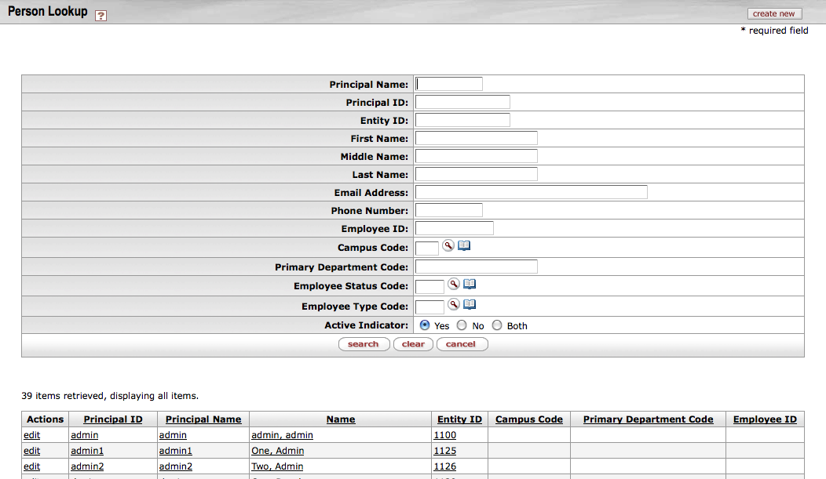
Person Lookup

Slide 21
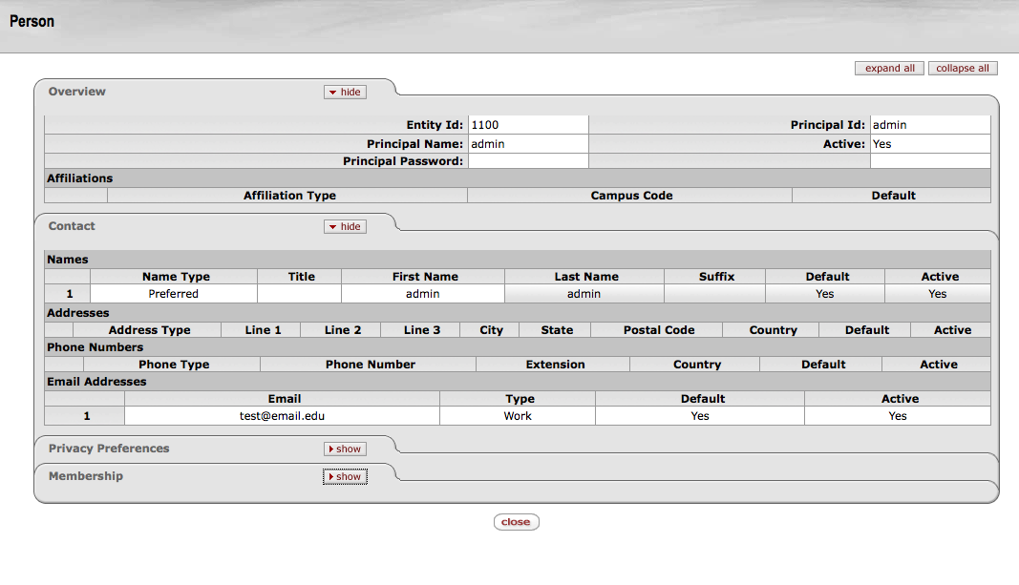
Person Inquiry

Slide 22
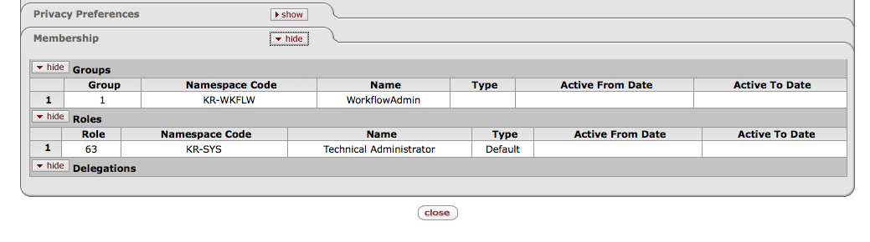
Person Inquiry - Membership

Slide 23
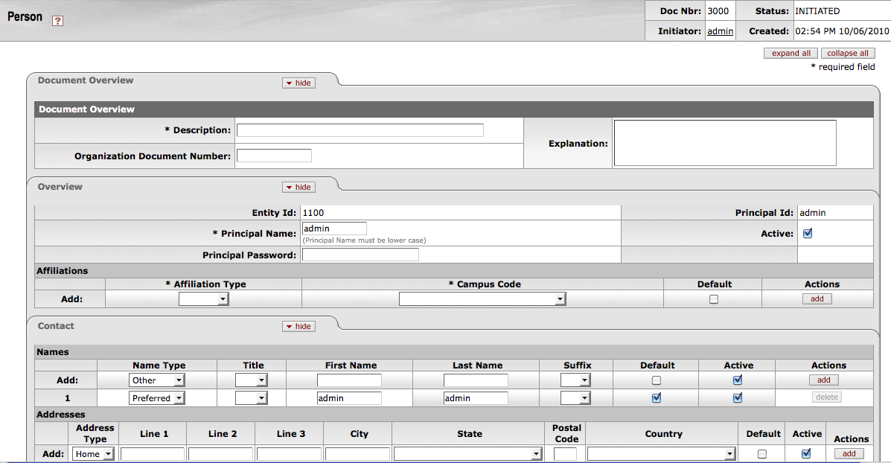
Person Maintenance

Slide 24
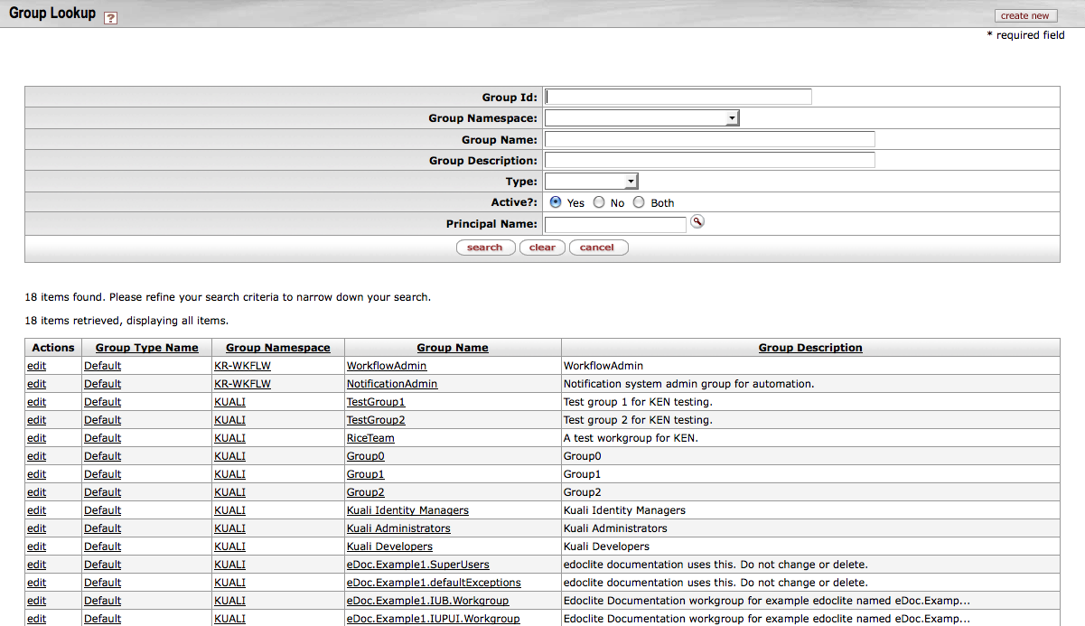
Group Lookup

Slide 25
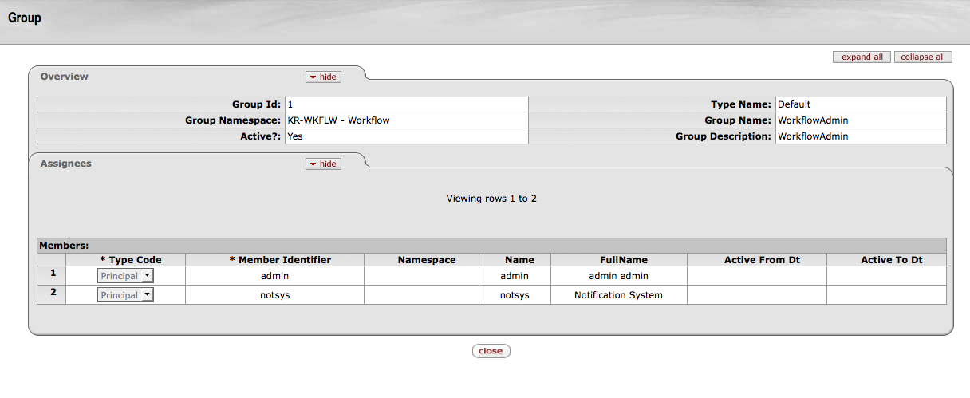
Group Inquiry

Slide 26
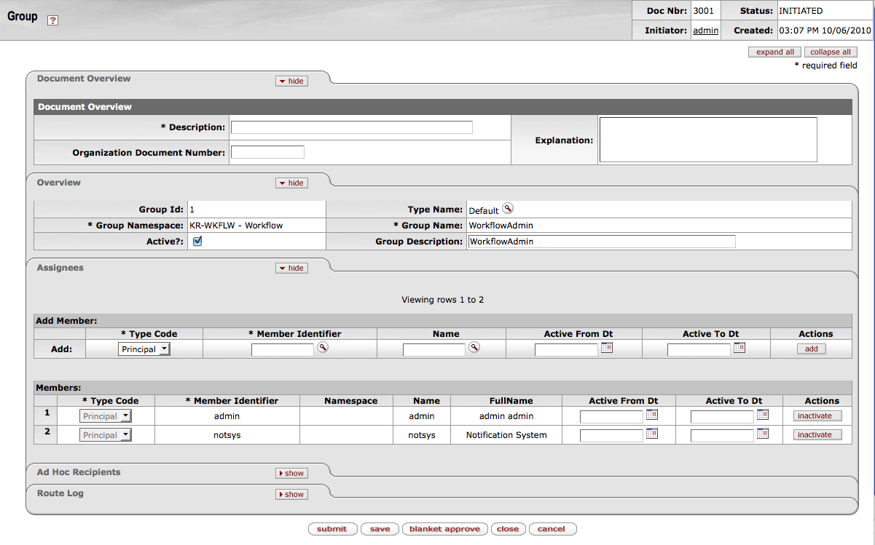
Group Maintenance

Slide 27
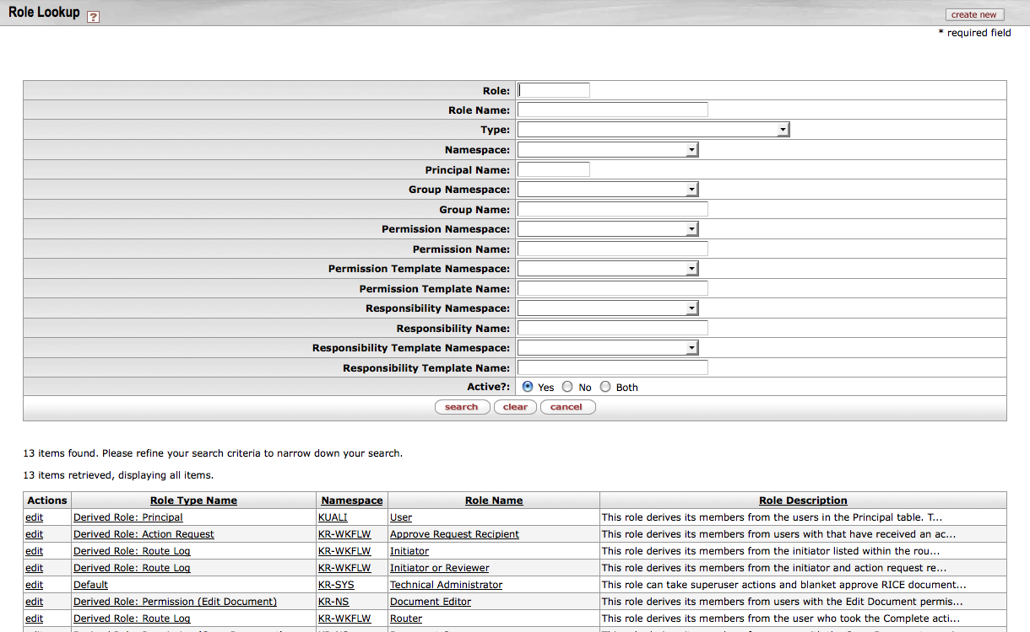
Role Lookup

Slide 28
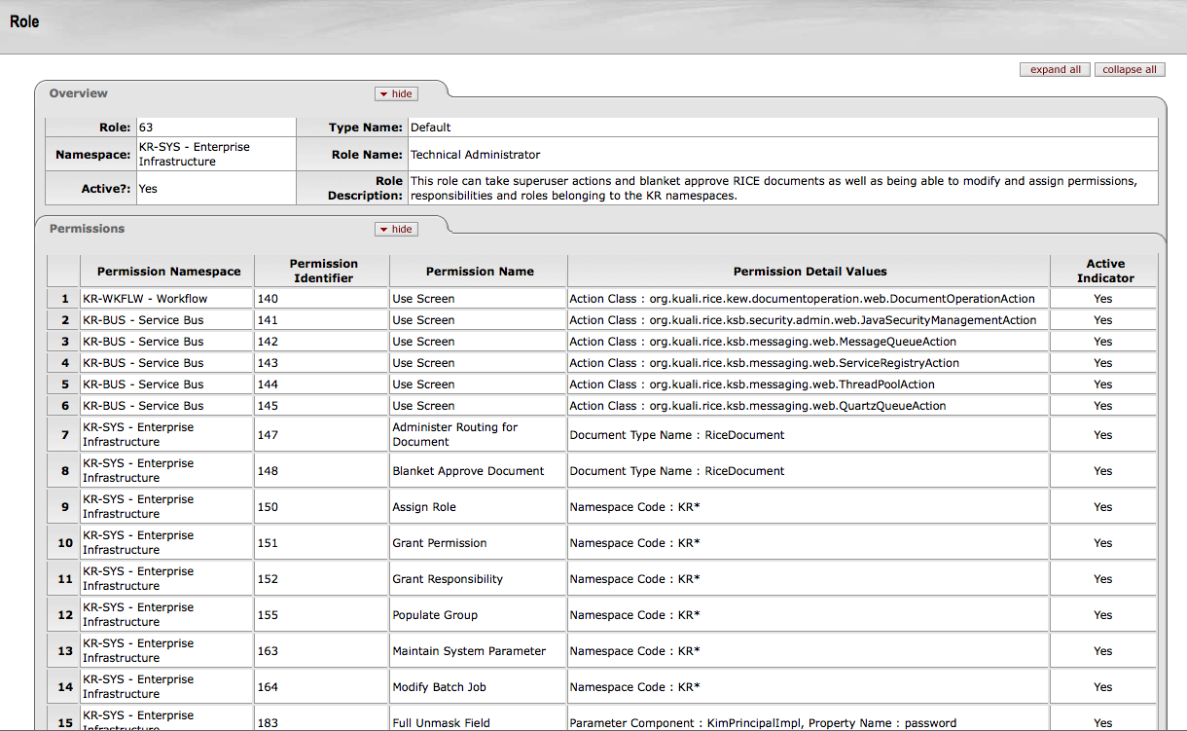
Role Inquiry – Simple Role

Slide 29
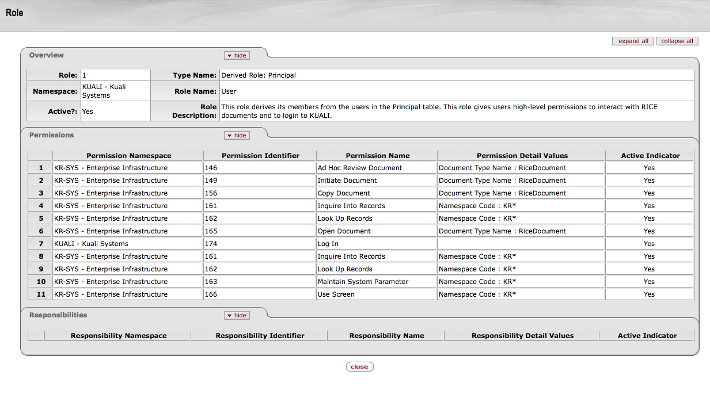
Role Inquiry – Derived Role

Slide 30
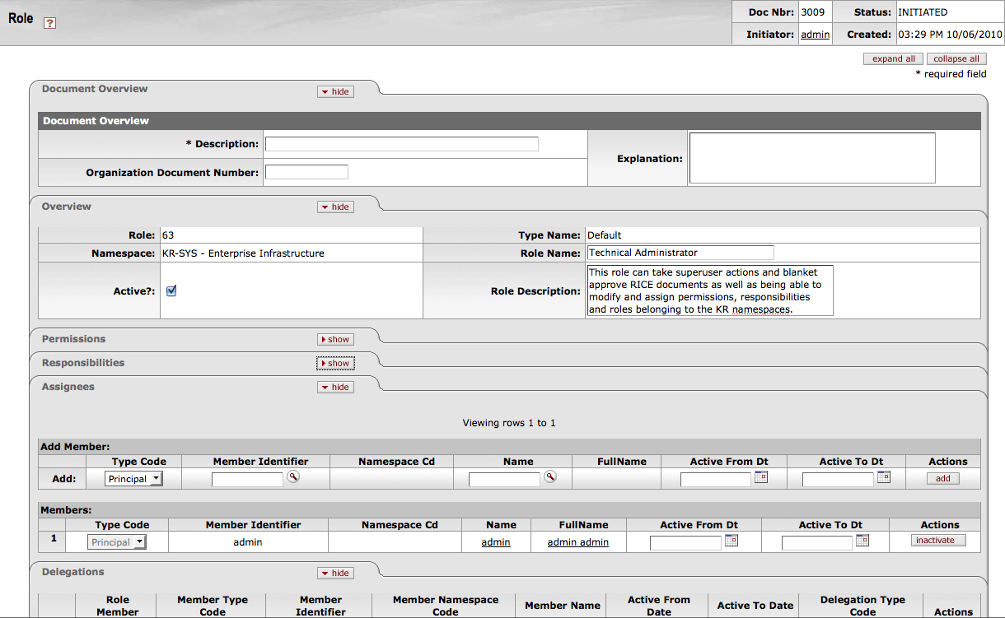
Role Maintenance

Slide 31
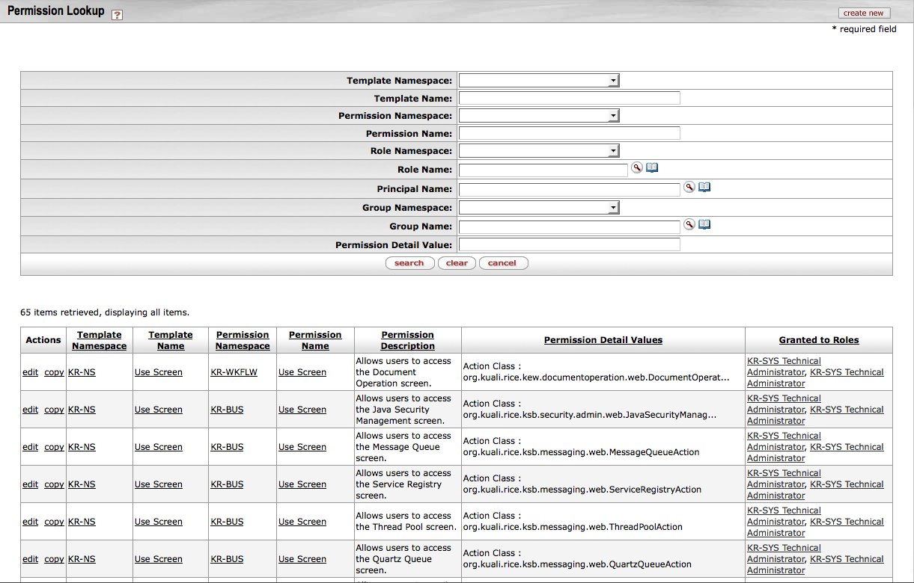
Permission Lookup

Slide 32
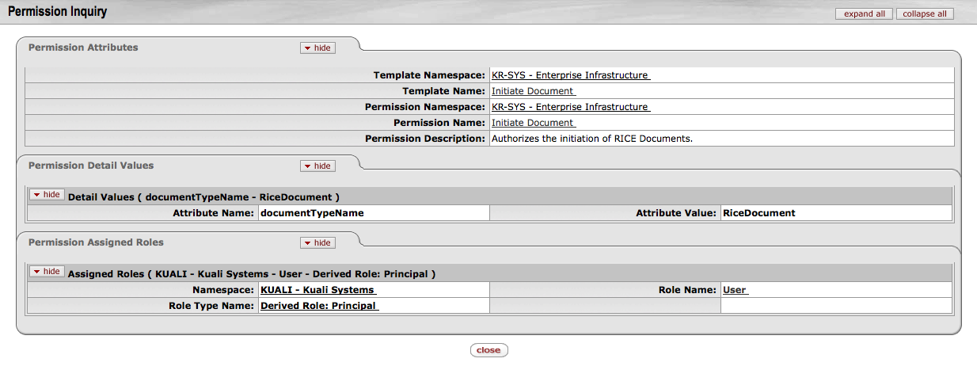
Permission Inquiry

Slide 33
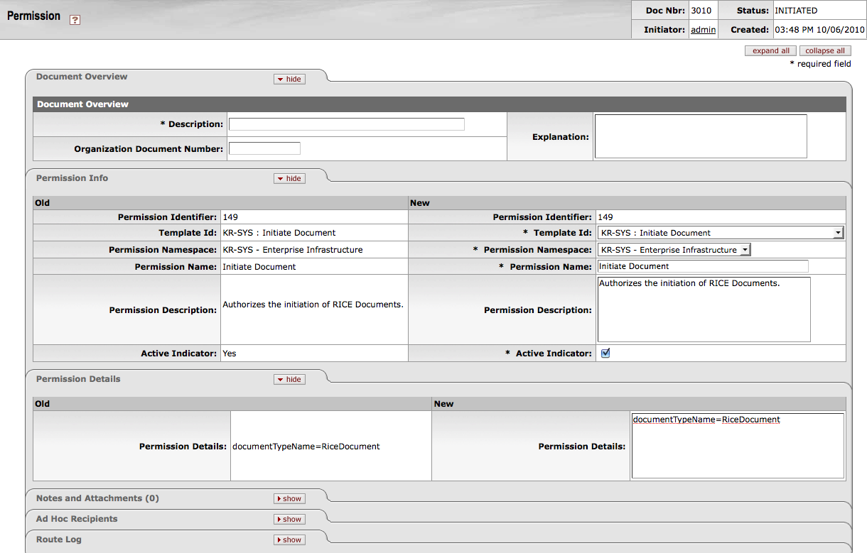
Permission Maintenance

Slide 34
Recall the main components of KIM
Functional User Interfaces
  We just looked at these
Reference Implementation
  We will talk about these later
Service Interface API
  Let’s take a look at the service architecture for Kuali Identity Management
Notes:
KIM consists of a set of service definitions, available over the Kuali Service Bus, or more generically through SOAP web service calls for non-Kuali applications.
A default implementation using the capabilities of the Kuali Nervous system for data persistence and UIs.

Slide 35
Main KIM Services
Identity Service
Group Service
Role Service
Permission Service
Responsibility Service
Notes:
Authentication Service
Extremely simple client-only service. This service will never be remoted on the KSB. Just returns the principal name from the authentication system. Default works for most authentication systems that use the REMOTE_USER header. You may want to override this if you need to perform some translation on what your authentication method returns if it is not what you use in your identity system.
Identity Service
This service is responsible for nothing more than the lookup and retrieval of entity information. It’s unaware of any of the other services. All the other services use this one for retrieval of entity/principal information when needed.
Group Service
Role Service
This one is not often used directly. All the checking within the application is done in terms of permissions. The permissions are then linked to roles which the permission service accesses.
Permission Service
This is the most heavily used service in the KNS. It’s API methods are centered around running authorization checks.
Responsibility Service
Used almost exclusively by the workflow engine for determination of routing.

Slide 36
Identity Service
Responsible for Principals and Entities
Principals have a “name” which is intended to be the user name they use to authenticate
All principals are associated with an entity
There can be different types of entities, including Person and System
Notes:
Authentication Service
Extremely simple client-only service. This service will never be remoted on the KSB. Just returns the principal name from the authentication system. Default works for most authentication systems that use the REMOTE_USER header. You may want to override this if you need to perform some translation on what your authentication method returns if it is not what you use in your identity system.
Identity Service
This service is responsible for nothing more than the lookup and retrieval of entity information. It’s unaware of any of the other services. All the other services use this one for retrieval of entity/principal information when needed.
Group Service
Role Service
This one is not often used directly. All the checking within the application is done in terms of permissions. The permissions are then linked to roles which the permission service accesses.
Permission Service
This is the most heavily used service in the KNS. It’s API methods are centered around running authorization checks.
Responsibility Service
Used almost exclusively by the workflow engine for determination of routing.

Slide 37
Identity Service
Numerous pieces of data can be stored about an entity including: names, affiliations, external ids, employment information, address, phone, email, privacy preferences (FERPA), etc.
Example Service Operations:
  Get principal by id
  Get principal by principal name
  Get entity info by id
  Get entity info by principal id
  Get entity privacy preferences
Notes:
Authentication Service
Extremely simple client-only service. This service will never be remoted on the KSB. Just returns the principal name from the authentication system. Default works for most authentication systems that use the REMOTE_USER header. You may want to override this if you need to perform some translation on what your authentication method returns if it is not what you use in your identity system.
Identity Service
This service is responsible for nothing more than the lookup and retrieval of entity information. It’s unaware of any of the other services. All the other services use this one for retrieval of entity/principal information when needed.
Group Service
Role Service
This one is not often used directly. All the checking within the application is done in terms of permissions. The permissions are then linked to roles which the permission service accesses.
Permission Service
This is the most heavily used service in the KNS. It’s API methods are centered around running authorization checks.
Responsibility Service
Used almost exclusively by the workflow engine for determination of routing.

Slide 38
Group Service
All groups identified uniquely by id or namespace + name
Supports nested groups
Example Service Operations:
  Get group by id
  Get group by name
  Get groups for principal
  Is member of group
  Get member group ids
Notes:
Authentication Service
Extremely simple client-only service. This service will never be remoted on the KSB. Just returns the principal name from the authentication system. Default works for most authentication systems that use the REMOTE_USER header. You may want to override this if you need to perform some translation on what your authentication method returns if it is not what you use in your identity system.
Identity Service
This service is responsible for nothing more than the lookup and retrieval of entity information. It’s unaware of any of the other services. All the other services use this one for retrieval of entity/principal information when needed.
Group Service
Role Service
This one is not often used directly. All the checking within the application is done in terms of permissions. The permissions are then linked to roles which the permission service accesses.
Permission Service
This is the most heavily used service in the KNS. It’s API methods are centered around running authorization checks.
Responsibility Service
Used almost exclusively by the workflow engine for determination of routing.

Slide 39
Role Service
Roles can have members that are principals, groups or even other roles
All members assigned to a role will be granted any permissions or responsibilities that are associated with the role
Role membership can optionally be qualified
Example Service Operations:
  Get role by name
  Get role qualifiers for principal
  Get role members
Notes:
Authentication Service
Extremely simple client-only service. This service will never be remoted on the KSB. Just returns the principal name from the authentication system. Default works for most authentication systems that use the REMOTE_USER header. You may want to override this if you need to perform some translation on what your authentication method returns if it is not what you use in your identity system.
Identity Service
This service is responsible for nothing more than the lookup and retrieval of entity information. It’s unaware of any of the other services. All the other services use this one for retrieval of entity/principal information when needed.
Group Service
Role Service
This one is not often used directly. All the checking within the application is done in terms of permissions. The permissions are then linked to roles which the permission service accesses.
Permission Service
This is the most heavily used service in the KNS. It’s API methods are centered around running authorization checks.
Responsibility Service
Used almost exclusively by the workflow engine for determination of routing.

Slide 40
Permission Service
KIM has the concepts of Permission Templates and Permissions
Permission Template represents some course-grained permission
  Use Screen, Initiate Document, Maintain Records, etc.
A Permission is created from a template and has more specific information identified on it’s permission details
  for example “Initiate Document” of type “Transfer of Funds”
Notes:
Authentication Service
Extremely simple client-only service. This service will never be remoted on the KSB. Just returns the principal name from the authentication system. Default works for most authentication systems that use the REMOTE_USER header. You may want to override this if you need to perform some translation on what your authentication method returns if it is not what you use in your identity system.
Identity Service
This service is responsible for nothing more than the lookup and retrieval of entity information. It’s unaware of any of the other services. All the other services use this one for retrieval of entity/principal information when needed.
Group Service
Role Service
This one is not often used directly. All the checking within the application is done in terms of permissions. The permissions are then linked to roles which the permission service accesses.
Permission Service
This is the most heavily used service in the KNS. It’s API methods are centered around running authorization checks.
Responsibility Service
Used almost exclusively by the workflow engine for determination of routing.

Slide 41
Permission Service
Evaluation of permissions is handled by the permission service. KIM provides plug points for implementing custom logic for permission checking
  Example: permission checks based on hierarchical data
  This is referred to as a “PermissionTypeService”
Example Service Operations:
  Is principal authorized by permission name with details
  Is principal authorized by permission template name with details
  Get assignees for permission
  Get authorized permissions for principal
  Get ids of roles that have given permission
Notes:
Authentication Service
Extremely simple client-only service. This service will never be remoted on the KSB. Just returns the principal name from the authentication system. Default works for most authentication systems that use the REMOTE_USER header. You may want to override this if you need to perform some translation on what your authentication method returns if it is not what you use in your identity system.
Identity Service
This service is responsible for nothing more than the lookup and retrieval of entity information. It’s unaware of any of the other services. All the other services use this one for retrieval of entity/principal information when needed.
Group Service
Role Service
This one is not often used directly. All the checking within the application is done in terms of permissions. The permissions are then linked to roles which the permission service accesses.
Permission Service
This is the most heavily used service in the KNS. It’s API methods are centered around running authorization checks.
Responsibility Service
Used almost exclusively by the workflow engine for determination of routing.

Slide 42
Responsibility Service
Provides integration of KIM with workflow engine via Responsibility Actions
These define what actions the principal needs to take (i.e. approve, acknowledge, fyi) on workflow processes
Responsibility details identity when these actions are applied during the routing process
Responsibility Actions also provide delegation support (for both routing and permission delegation)
Example Service Operations:
  Get responsibilities by name
  Get responsibility actions
  Get responsibility actions by responsibility template
  Does principal have responsibility
Notes:
Authentication Service
Extremely simple client-only service. This service will never be remoted on the KSB. Just returns the principal name from the authentication system. Default works for most authentication systems that use the REMOTE_USER header. You may want to override this if you need to perform some translation on what your authentication method returns if it is not what you use in your identity system.
Identity Service
This service is responsible for nothing more than the lookup and retrieval of entity information. It’s unaware of any of the other services. All the other services use this one for retrieval of entity/principal information when needed.
Group Service
Role Service
This one is not often used directly. All the checking within the application is done in terms of permissions. The permissions are then linked to roles which the permission service accesses.
Permission Service
This is the most heavily used service in the KNS. It’s API methods are centered around running authorization checks.
Responsibility Service
Used almost exclusively by the workflow engine for determination of routing.

Slide 43
Additional KIM Services
Type Services
Authentication Service
Identity Management Service
Role Management Service
Person Service
Identity Archive Service
Notes:
Authentication Service
Extremely simple client-only service. This service will never be remoted on the KSB. Just returns the principal name from the authentication system. Default works for most authentication systems that use the REMOTE_USER header. You may want to override this if you need to perform some translation on what your authentication method returns if it is not what you use in your identity system.
Identity Service
This service is responsible for nothing more than the lookup and retrieval of entity information. It’s unaware of any of the other services. All the other services use this one for retrieval of entity/principal information when needed.
Group Service
Role Service
This one is not often used directly. All the checking within the application is done in terms of permissions. The permissions are then linked to roles which the permission service accesses.
Permission Service
This is the most heavily used service in the KNS. It’s API methods are centered around running authorization checks.
Responsibility Service
Used almost exclusively by the workflow engine for determination of routing.

Slide 44
Kim “Types” and Type Services
In KIM, certain pieces of data are “typed”
Types can be used as an organizational tool
Also used to customize behavior via “Type Services”
Types can be associated with a service which KIM delegates to for certain operations
Note that Kim Type Services are not part of the “public” API for KIM, but rather are used behind some of the reference service implementations
Notes:
Authentication Service
Extremely simple client-only service. This service will never be remoted on the KSB. Just returns the principal name from the authentication system. Default works for most authentication systems that use the REMOTE_USER header. You may want to override this if you need to perform some translation on what your authentication method returns if it is not what you use in your identity system.
Identity Service
This service is responsible for nothing more than the lookup and retrieval of entity information. It’s unaware of any of the other services. All the other services use this one for retrieval of entity/principal information when needed.
Group Service
Role Service
This one is not often used directly. All the checking within the application is done in terms of permissions. The permissions are then linked to roles which the permission service accesses.
Permission Service
This is the most heavily used service in the KNS. It’s API methods are centered around running authorization checks.
Responsibility Service
Used almost exclusively by the workflow engine for determination of routing.

Slide 45
Support KIM Type Services
Supported Type Services include:
  KimRoleTypeService
  KimPermissionTypeService
  KimGroupTypeService
  KimResponsibilityTypeService
  KimDelegationTypeService
Let’s look at a couple of these in more detail
Notes:
Authentication Service
Extremely simple client-only service. This service will never be remoted on the KSB. Just returns the principal name from the authentication system. Default works for most authentication systems that use the REMOTE_USER header. You may want to override this if you need to perform some translation on what your authentication method returns if it is not what you use in your identity system.
Identity Service
This service is responsible for nothing more than the lookup and retrieval of entity information. It’s unaware of any of the other services. All the other services use this one for retrieval of entity/principal information when needed.
Group Service
Role Service
This one is not often used directly. All the checking within the application is done in terms of permissions. The permissions are then linked to roles which the permission service accesses.
Permission Service
This is the most heavily used service in the KNS. It’s API methods are centered around running authorization checks.
Responsibility Service
Used almost exclusively by the workflow engine for determination of routing.

Slide 46
Role Type Services
To customize Role behavior you can implement a custom “RoleTypeService”
This can provide for the following features:
  Qualifier Matching
  Validation (through UI)
  Derived Roles
  Qualifier conversion for nested Roles
Notes:
So, what does a role type service do:
* Helps with Qualifier matching
* Validates Qualifiers when assigned through the built-in UIs
* Provides the membership for Derived/Application Roles

Slide 47
Role Qualifier Matching
RoleService delegates to two API methods on RoleTypeService
  doesRoleQualifierMatchQualification
  doRoleQualifiersMatchQualification
Takes a set of incoming qualifiers and compares them with qualifiers on each role membership
  Return true if they “match”
These operations are essentially the same, except the second one allows for checking multiple Role Qualifiers at once
Notes:
These methods are used by the KIM RoleService when checking the qualifiers attached to a principal, group, or other role’s membership in the role.
In addition, since you do not always know where your roles will be called from or what data will be passed, (Although, that is an important consideration to make when designing your roles.) Where possible, you will want to implement the last method here to handle any other qualifiers you expect may be passed to this role. The default implementation just returns the original list.
An example of this comes from the KFS data model. In KFS, we have an organization hierarchy. Some of the roles are qualified by the campus. Each organization has a campus code associated with it. But the documents from which the role may be tested will only pass the organization information. This method is your chance to perform any conversions you may need to make

Slide 48
Role Qualifier Matching
Default implementation just does a straight equality comparison of “incoming qualifiers” and “role member qualifiers”
Can implement custom qualification matching logic by creating a custom RoleTypeService
Examples:
  Hierarchy-based check
  Other comparisons that may need to interact with data or services external to KIM
Notes:
These methods are used by the KIM RoleService when checking the qualifiers attached to a principal, group, or other role’s membership in the role.
In addition, since you do not always know where your roles will be called from or what data will be passed, (Although, that is an important consideration to make when designing your roles.) Where possible, you will want to implement the last method here to handle any other qualifiers you expect may be passed to this role. The default implementation just returns the original list.
An example of this comes from the KFS data model. In KFS, we have an organization hierarchy. Some of the roles are qualified by the campus. Each organization has a campus code associated with it. But the documents from which the role may be tested will only pass the organization information. This method is your chance to perform any conversions you may need to make

Slide 49
Role Derivation
As discussed previously, in some cases Role membership cannot be defined statically
Typically used for situations where roles are defined in other systems external to KIM
Examples:
  “All Users of the System” – derive the role based on the KIM principal table
  “All students” – derive the role based on information stored in an external Student Information System
Notes:
Now, another of the features of the KIM roles is the application, or derived, role. These are roles whose members are not known to KIM. Either because they are maintained by an external system (which might just be a Rice client application) or they are too dynamic to store in the KIM database.
For these services, you must implement these methods to provide the principals and/or groups who have the role. The service will be passed the role name and the same qualification set a built-in role would have so that it can return different sets of users based on the context.
The base class for derived roles defines these methods. Strictly speaking, the hasApplicationRole() method does not need to be implemented. The base implementation will simply perform the contains check between the principalId against the results of the getRoleMembers… method. However, depending on how expensive the check is to make, you will probably want to implement both so you can short circuit the enumeration of all members of the role.
You may note that the method signatures take the namespace and role name. This allows a single service to be used for multiple application role types. Use this feature as it makes sense to reduce duplication and the number of services exposed on the bus.

Slide 50
Role Derivation
RoleService delegates to three operations on RoleTypeService:
  isApplicationRoleType
  hasApplicationRole
  getRoleMembersFromApplicationRole
Note that the term “application role” and “derived role” mean the same thing in this context
Essentially, isApplicationRoleType and hasApplicationRoleType are used to determine if the type implements a derived role
getRoleMembersFromApplicationRole is responsible for resolving the derived members
Notes:
Now, another of the features of the KIM roles is the application, or derived, role. These are roles whose members are not known to KIM. Either because they are maintained by an external system (which might just be a Rice client application) or they are too dynamic to store in the KIM database.
For these services, you must implement these methods to provide the principals and/or groups who have the role. The service will be passed the role name and the same qualification set a built-in role would have so that it can return different sets of users based on the context.
The base class for derived roles defines these methods. Strictly speaking, the hasApplicationRole() method does not need to be implemented. The base implementation will simply perform the contains check between the principalId against the results of the getRoleMembers… method. However, depending on how expensive the check is to make, you will probably want to implement both so you can short circuit the enumeration of all members of the role.
You may note that the method signatures take the namespace and role name. This allows a single service to be used for multiple application role types. Use this feature as it makes sense to reduce duplication and the number of services exposed on the bus.

Slide 51
Permission Type Service
To customize Permission behavior you can implement a custom “PermissionTypeService”
This can be used to implement custom matching logic for permission details
  getMatchingPermissions
Default implementation just does a straight equality comparison of incoming details against a list of possible permission candidates, returning the ones that “match”
Custom logic can be implemented here for things like hierarchy-based checks or checks against external systems
Notes:
Like role qualifiers, permissions have details which are checked in much the same way. The base permission type service behaves the same as the base role type service, performing an exact match on the details.
However, for the base types which are aware of the document hierarchy, the behavior is a bit different. For ease of permission definition in the system, the permissions use the priority matching I described in the role type section of this presentation. The service implementation looks for the *most specific* document type which applies of all the available permissions. Once it finds one, it will only use permissions with that document type. This allows for permissive permissions to be defined at a high level and then overridden selectively. This greatly reduces the number of permissions you need to create to manage base behaviors in the application.

Slide 52
Authentication Service
Extracts information on who the current authenticated principal is
  Typically from the HttpServletRequest
Informs the application of the principal name that has authenticated
Default implementation simply reads the “remote user” on the HTTP request
Notes:
Authentication Service
Extremely simple client-only service. This service will never be remoted on the KSB. Just returns the principal name from the authentication system. Default works for most authentication systems that use the REMOTE_USER header. You may want to override this if you need to perform some translation on what your authentication method returns if it is not what you use in your identity system.
Identity Service
This service is responsible for nothing more than the lookup and retrieval of entity information. It’s unaware of any of the other services. All the other services use this one for retrieval of entity/principal information when needed.
Group Service
Role Service
This one is not often used directly. All the checking within the application is done in terms of permissions. The permissions are then linked to roles which the permission service accesses.
Permission Service
This is the most heavily used service in the KNS. It’s API methods are centered around running authorization checks.
Responsibility Service
Used almost exclusively by the workflow engine for determination of routing.

Slide 53
Identity Management Service
Client-side façade that sits on top of most of the KIM services
  Identity Service
  Group Service
  Permission Service
  Responsibility Service
Provides caching functionality
Notes:
Identity Management Service
This service is a wrapper around the identity, group, permission, and responsibility services. It is intended to run locally within the Rice client application. It will access the other services off the Kuali Service Bus as needed. It provides caching of results locally to prevent expensive network access. It also has some API methods to purge portions of the cache as needed.
Roles are not in this service mainly to enforce the nature of permission checks. (Previously, many “permission” checks were done by checking the user’s membership in a group (pre-KIM). This separation was made so that explicit role checks must be a conscious decision on the part of the developer.
Role Management Service
This service is to roles what the IdM service is to the other four services.
Person Service
The person service provides an abstraction and simplification of the KIM data model for use by the core KNS components. Most usage of person/entity data is covered by the data attributes on the person object. It takes the default information from the Entity/Principal and mostly flattens it into a simpler object. Within the KNS, in most cases, only the Person object is used.
Identity Archive Service
This optional service sits behind the identity service. It’s purpose is to archive a very limited subset of the most current data on each principal that it sees. If the user is ever removed from the identity management system completely, the data will be pulled from this service so that information like principal name, entity name, and email address can still be displayed on old document route logs.

Slide 54
Role Management Service
Client-side façade for the KIM Role Service
Provides caching functionality
Separate from IdentityManagementService
  Performing authorization checks based on permissions is best practice
  Because of this, role membership should not be checked directly in most cases
Notes:
Identity Management Service
This service is a wrapper around the identity, group, permission, and responsibility services. It is intended to run locally within the Rice client application. It will access the other services off the Kuali Service Bus as needed. It provides caching of results locally to prevent expensive network access. It also has some API methods to purge portions of the cache as needed.
Roles are not in this service mainly to enforce the nature of permission checks. (Previously, many “permission” checks were done by checking the user’s membership in a group (pre-KIM). This separation was made so that explicit role checks must be a conscious decision on the part of the developer.
Role Management Service
This service is to roles what the IdM service is to the other four services.
Person Service
The person service provides an abstraction and simplification of the KIM data model for use by the core KNS components. Most usage of person/entity data is covered by the data attributes on the person object. It takes the default information from the Entity/Principal and mostly flattens it into a simpler object. Within the KNS, in most cases, only the Person object is used.
Identity Archive Service
This optional service sits behind the identity service. It’s purpose is to archive a very limited subset of the most current data on each principal that it sees. If the user is ever removed from the identity management system completely, the data will be pulled from this service so that information like principal name, entity name, and email address can still be displayed on old document route logs.

Slide 55
Person Service
Provides an API for working with simplified Person data model
Person data model includes
  Default entity data
  Principal data for the entity
Implements caching functionality
Notes:
Identity Management Service
This service is a wrapper around the identity, group, permission, and responsibility services. It is intended to run locally within the Rice client application. It will access the other services off the Kuali Service Bus as needed. It provides caching of results locally to prevent expensive network access. It also has some API methods to purge portions of the cache as needed.
Roles are not in this service mainly to enforce the nature of permission checks. (Previously, many “permission” checks were done by checking the user’s membership in a group (pre-KIM). This separation was made so that explicit role checks must be a conscious decision on the part of the developer.
Role Management Service
This service is to roles what the IdM service is to the other four services.
Person Service
The person service provides an abstraction and simplification of the KIM data model for use by the core KNS components. Most usage of person/entity data is covered by the data attributes on the person object. It takes the default information from the Entity/Principal and mostly flattens it into a simpler object. Within the KNS, in most cases, only the Person object is used.
Identity Archive Service
This optional service sits behind the identity service. It’s purpose is to archive a very limited subset of the most current data on each principal that it sees. If the user is ever removed from the identity management system completely, the data will be pulled from this service so that information like principal name, entity name, and email address can still be displayed on old document route logs.

Slide 56
Identity Archive Service
Handles archiving of identity data to provide important attributes as backup in the case of identity removal
Sits behind the main IdentityService
This comes into play depending on an institution’s retention policy on identities
Some applications may store references to principal ids for long periods of time
If the backend of the identity service fails to resolve a particular principal id, it will be searched for in the identity archive
Notes:
Identity Management Service
This service is a wrapper around the identity, group, permission, and responsibility services. It is intended to run locally within the Rice client application. It will access the other services off the Kuali Service Bus as needed. It provides caching of results locally to prevent expensive network access. It also has some API methods to purge portions of the cache as needed.
Roles are not in this service mainly to enforce the nature of permission checks. (Previously, many “permission” checks were done by checking the user’s membership in a group (pre-KIM). This separation was made so that explicit role checks must be a conscious decision on the part of the developer.
Role Management Service
This service is to roles what the IdM service is to the other four services.
Person Service
The person service provides an abstraction and simplification of the KIM data model for use by the core KNS components. Most usage of person/entity data is covered by the data attributes on the person object. It takes the default information from the Entity/Principal and mostly flattens it into a simpler object. Within the KNS, in most cases, only the Person object is used.
Identity Archive Service
This optional service sits behind the identity service. It’s purpose is to archive a very limited subset of the most current data on each principal that it sees. If the user is ever removed from the identity management system completely, the data will be pulled from this service so that information like principal name, entity name, and email address can still be displayed on old document route logs.

Slide 57
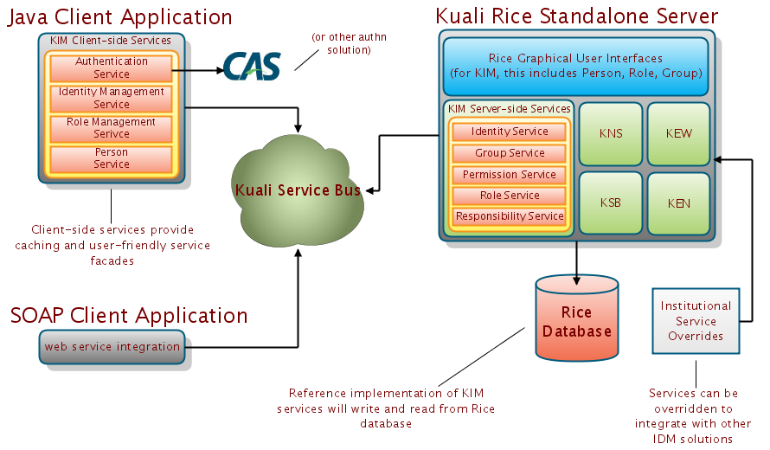
KIM Service Architecture
Notes:
Identity Management Service
This service is a wrapper around the identity, group, permission, and responsibility services. It is intended to run locally within the Rice client application. It will access the other services off the Kuali Service Bus as needed. It provides caching of results locally to prevent expensive network access. It also has some API methods to purge portions of the cache as needed.
Roles are not in this service mainly to enforce the nature of permission checks. (Previously, many “permission” checks were done by checking the user’s membership in a group (pre-KIM). This separation was made so that explicit role checks must be a conscious decision on the part of the developer.
Role Management Service
This service is to roles what the IdM service is to the other four services.
Person Service
The person service provides an abstraction and simplification of the KIM data model for use by the core KNS components. Most usage of person/entity data is covered by the data attributes on the person object. It takes the default information from the Entity/Principal and mostly flattens it into a simpler object. Within the KNS, in most cases, only the Person object is used.
Identity Archive Service
This optional service sits behind the identity service. It’s purpose is to archive a very limited subset of the most current data on each principal that it sees. If the user is ever removed from the identity management system completely, the data will be pulled from this service so that information like principal name, entity name, and email address can still be displayed on old document route logs.

Slide 58
Intermission
30-minute break
Notes:
Identity Management Service
This service is a wrapper around the identity, group, permission, and responsibility services. It is intended to run locally within the Rice client application. It will access the other services off the Kuali Service Bus as needed. It provides caching of results locally to prevent expensive network access. It also has some API methods to purge portions of the cache as needed.
Roles are not in this service mainly to enforce the nature of permission checks. (Previously, many “permission” checks were done by checking the user’s membership in a group (pre-KIM). This separation was made so that explicit role checks must be a conscious decision on the part of the developer.
Role Management Service
This service is to roles what the IdM service is to the other four services.
Person Service
The person service provides an abstraction and simplification of the KIM data model for use by the core KNS components. Most usage of person/entity data is covered by the data attributes on the person object. It takes the default information from the Entity/Principal and mostly flattens it into a simpler object. Within the KNS, in most cases, only the Person object is used.
Identity Archive Service
This optional service sits behind the identity service. It’s purpose is to archive a very limited subset of the most current data on each principal that it sees. If the user is ever removed from the identity management system completely, the data will be pulled from this service so that information like principal name, entity name, and email address can still be displayed on old document route logs.

Slide 59
Implementation Options
Out-of-the-box (no changes)
Data feeds into KIM database
Service Customization
Hybrid of the Strategies above

Slide 60
Out-of-the-box
Use the delivered KIM service reference implementations
Use the delivered KIM database tables
Create Persons, Groups, Roles manually via the GUI
  May do an initial load of person data
Set of identities available will likely be small
Only feasible for small applications on a Kuali Rice infrastructure that’s not institution-wide

Slide 61
Data feeds into KIM database
Use the delivered KIM service reference implementations
Use the delivered KIM database tables
Use batch or external processes to periodically populate KIM database with identity data
Allows for KIM identity data set to match that available at institution
No need to maintain data separately
Care must be taken to ensure data parity and prevent stale data

Slide 62
Service Customization
Override or replace the reference implementations for the various KIM services
Each of the services in KIM can be customized individually
Example: LDAP integration
Has implications on the KIM user interface screens

Slide 63
KIM Services
Authentication Service – likely to override
Identity Service – likely to override
Group Service – might override
Permission Service – unlikely to override
Role Service – unlikely to override
Identity Archive Service – unlikely to override
Both Permission and Role Service have an extra abstraction layer behind them that allows for customization without overriding

Slide 64
Hybrid Solutions
In practice, many implementations will use a hybrid of these various options
For example:
  Load entity and principal data periodically into KIM database, use reference IdentityService implementation
  Use standard out-of-the-box GroupService implementation (no external integration)
  Customize the IdentityArchiveService to read historical identity data from an external source
  Use reference Permission and Role services

Slide 65
Choosing the option that’s right for you!
Might depend on:
  which external systems or data sources you want to integrate with KIM
  size of your KIM implementation (amount of data)
  performance considerations
  expected usage of the KIM GUI screens
  the role that KIM will play at your institution
Notes:
Very important to start by making a plan

Slide 66
Integration with other IdM Solutions
Remember…
The primary goal of KIM was to build a service-oriented abstraction layer for Identity and Access Management
Integration with other IDM services was acknowledged, expected, and designed for!

Slide 67







KIM Integration
Integration with various Identity Management Components
Notes:
However, they are using multiple authentication mechanisms – native Active Directory, Shibboleth, and Central Authentication Service. In order to implement KIM, even in this relatively simple but non-Kuali case, custom connectors will have to be written to pull data from PeopleSoft. Additional work will need to be done on the Active Directory side. Fortunately, Indiana has already completed or is in the process of completing most of this work. Eric will talk about this in more detail when we get to the case studies near the end of the workshop.

Slide 68

KIM Integration
KIM Service Layer
Identity Service
Group Service
Role Service
Permission Service
Responsibility Service
Rice Database
Reference Implementations

Slide 69

KIM integration with
CAS – Authentication system for Single Sign On (SSO)
Two ways to integrate:
  CAS Server
  Rice Client Application
Integration with Rice Client application will be the most likely integration scenario

Slide 70
CAS – Server Integration
Implement a custom CAS AuthenticationHandler which interfaces with the KIM services or database
Kuali already provides such an implementation in it’s Subversion repository
kuali-cas project

Slide 71
CAS – Rice Client Integration
Integrate the CAS client with:
  Kuali Rice Standalone Server
  A Kuali Rice client application
KIM provides an “AuthenticationService” which is used to inform the Rice framework about the authenticated principal
Default implementation simply reads REMOTE_USER
  Sufficient for CAS integration

Slide 72
CAS – Setup
Simply configure the standard CAS servlet filters in your web.xml as you would normally
  AuthenticationFilter
  Cas20ProxyReceivingTicketValidationFilter
  HttpServletRequestWrapperFilter
The usernames entered into the CAS login must match the principal names in your KIM implementation

Slide 73

KIM integration with
Microsoft Active Directory provides “LDAP-like” directory services among other network services
We will concentrate on groups defined in ADS and how they can be integrated with the KIM GroupService
This particular usage has been implemented at Indiana University

Slide 74
ADS – KIM Group Requirements
Should be able to use ADS groups in addition to the out-of-the-box KIM group store
Groups must have a unique ID
Groups are also uniquely identified by a combination of Namespace and Name
Group membership can be nested

Slide 75
ADS Group Integration – Implementation
ADS groups are assigned a namespace of “ADS” which allows the GroupService to determine how to load the Group
ADS groups have an ID assigned to them consisting of “ADS” and the group name
  i.e. ADS:MyAdsGroupName

Slide 76
ADS Group Integration – GroupService
Override the GroupService so that it loads groups from both ADS (via LDAP) and the KIM database
  IF - id starts with “ADS” or namespace equals “ADS”, query ADS
  ELSE - delegate to reference implementation
Various operations need to be customized including operations to load GroupInfo objects as well as checking Group membership
Also customize the Group Lookup screen so that it can search for Groups in ADS

Slide 77
Integrating KIM with LDAP
LDAP Integration Efforts
  University of Arizona
  San Joaquin Delta College
  UC Davis
  Naval Post Graduate School
  Others…
Using CAS to connect to LDAP
Will be included as a standard feature in a future version of Kuali Rice
Notes:
It’s also possible to integrate Kim with your institutions LDAP server.
A few institutions have already done this.
Including UofA, SJDC, and UCDavis.
Another approach would be to use CAS and configure CAS to connect to LDAP datasource
Let’s take a closer look as UofA’s implementation

Slide 78
KIM with LDAP
Identity information is available in UA’s Enterprise Directory Service (EDS)
Uses Spring LDAP as an adapter layer between Spring and LDAP datasource
Uses KIM ParameterService to map between KIM and LDAP attributes
Implement / Override KIM IdentityService
In order to use the KIM GUI’s properly, the UIDocumentService is also overridden
Notes:
To ease their implementation, they chose to use the Spring LDAP module.
Spring LDAP is an adapter layer between Spring and LDAP datasources.
The LdapTemplate class encapsulates all the plumbing work involved in traditional LDAP programming
In addition, they used the Kim parameter service to map between KIM and their EDS system.
By using these tools, most of the work is a configuration task.
Some programming is still required: To implement and override the KIM Identity service
In addition, they still wanted to use the Rice UI screens to add and update principals in the system, so they also overrode the UIDocumentService.
This service is a layer below, the services we’ve discussed so far.

Slide 79
KIM with LDAP
Setup Spring LDAP module
  <bean id=”contextSource” …
  <bean id=”authenticationSource” …
  <bean id=”springSecurityAuthenticationSource ” …
  <bean id=”ldapTemplate ” …
Notes:
Modifications to the edu/arizona/kfs/sys/spring-sys.xml
Modify the spring config files to define the following beans

Slide 80
KIM with LDAP
Rice ParameterService maps EDS attributes to KIM
KIM Class | Attribute Name | EDS Attribute Name
KimPrincipalInfo | principalId | uaid
KimPrincipalInfo | entityId | uaid
KimPrincipalInfo | principalName | uid
KimEntityNameInfo | lastName | sn
KimEntityNameInfo | firstName | givenName
KimEntityEmployementInformationInfo | employeeId | employeeId
KimEntityEmployementInformationInfo | email | employeeEmail
…
Notes:
Modifications to the edu/arizona/kfs/sys/spring-sys.xml

Slide 81
KIM with LDAP
The Spring LDAP integration and Kuali Rice ParameterService are injected into the EdsPrincipalDaoImpl instance.
<bean id=”edsPrincipalDao”
class=”edu.arizona.kim.dataaccess.impl.EdsPrincipalDaoImpl”>
<property name=”ldapTemplate” ref=”ldapTemplate ” />
<property name=”parameterService” ref=”parameterService”/>
<property name=”kimConstants” ref=”azKimConstants ” />
</bean>
The EdsPrincipalDaoImpl is an implementation of PrincipalDao which
connects to EDS and maps the principal and entity information into KIM
domain objects.
Notes:
Spring LDAP is an adapter layer between Spring and LDAP datasources.
The LdapTemplate class encapsulates all the plumbing work involved in traditional LDAP programming
Setup Spring LDAP
Implement/Override

Slide 82
KIM with LDAP
Implement and Override KIM Services
kimIdentityService
  getPrincipal()
  getPrincipalByPrincipalName()
  lookupEntities()
  getEntityDefaultInfo()
  …
UiDocumentService
  loadEntityToPersonDoc()
  saveEntityPerson()
Notes:
loadEntityToPersonDoc is used to populate the IdentityManagementPersonDocument
when the page loads from “edit” or “create new”. Even though entity
information is not being stored in the database, it still needs to be
present on persons.
saveEntityPerson is used to store the information and actually update the
person. It needed to modified to take into consider the check for the
“Modify Entity” permission. Normally, even if the permission isn’t
present, the document will try to save entity information. By checking
for this permission, the desired behavior takes place which is entities

Slide 83
KIM integration with
Intra-campus Web SSO
Federated Access to a Rice application
KIM as an Identity Provider (IdP)
Using Shibboleth Attributes for KIM authorization
Notes:
Shibboleth can be used a few different ways to provide authentication and authorization functionality across or within institution boundaries. It allows sites to make informed auth decisions for protecting online resources. Some ways that Shibboleth could be used with a Kuali Rice application are: …

Slide 84
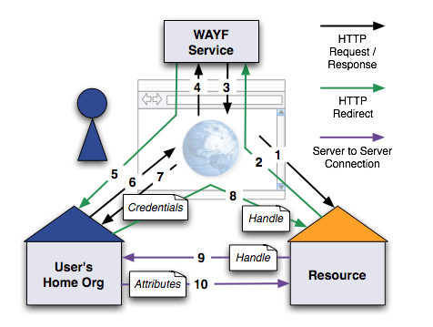
Federated Authentication
Shibboleth Login Process
Notes:
This slide illustrates the flow of a typical federated logic process using Shibboleth. I won’t go into too much detail here, but the process involves:
- User attempt to access a Shibboleth protected site. The user is re-directed to a service which determines where the user is from, and then redirects them again to their home institutions authentication service. Once the user is authenticated, they are redirected back to their original site, there login credentials are passed to the site along with the request. The site then knows that the user has authenticated with a trusted resource, and can access the credential attributes to make authorization decisions.

Slide 85
Federated Authentication
Protecting a Rice application as a Service Provider (SP)
A web server and openssl must be available first
Add Shibboleth filters to the web server.
Metadata defines the attributes to be passed between the Identity Provider and Service Provider.
Override KIM Authentication Service
Notes:
Shib filters: for apache:
mod_shib,
mod_proxy_ajp - forwards HTTP request from the web server to the servlet container (tomcat)
Shib config file: shibboleth2.xml
<RequestMap>
<Session Initiator>
<WAYF>
<ERRORS>
Config settings: set behavior of filter – Auth Type, require,
Implement AuthenticationService to retrieve the Shibboleth attributes and authenticate the user. You may need to implement some logic =

Slide 86
Federated Authentication
Metadata Example:
<AttributeRule
Name=“urn:mace:dir:attribute-def:eduPersonPrincipalName”
Header=“REMOTE_USER”
Alias=“eppn”>
<AnySite>
<AnyValue/>
</AnySite>
</AttributeRule>
Notes:
Name is the attribute name as provided by the identity provider
Header is the name of the HTTP header, that will carry the attribute value
Alias is a more convenient shorter name to be used in Apache configuration (see below)
It is also possible, by using proper <SiteRule> and <Value> elements to restrict attributes to some origins (identity providers) or values only.

Slide 87
KIM as an Identity Provider
Prerequisites: SSL certificate, source of SAML Metadata
Install Shibboleth IdP
Load SAML Metadata
Configure KIM as the User Authentication Mechanism
Implement kimAuthenticationService to authenticate the user and provide the appropriate attributes.
Notes:
A different scenario is to use your KIM module to authenticate users for other applications.

Slide 88
Authorization Attributes
Using Shibboleth Attributes for KIM Authorization
Entity Attributes
Group
Roles
Permissions / Responsibilities

Slide 89
KIM integration with
In collaboration with Kuali Rice, the Internet2 Grouper team created a connector from the KIM GroupService to Grouper
This connector was released and is available in Grouper 1.6
Notes:
We are all here, as representatives of educational institutions and their commercial affiliates, to address common problems related to computing services in higher education. Several communities and consortiums have developed various open source solutions.
Kuali Rice and Internet2’s Grouper are examples of these.
An interesting progression now, is how to take some of these solutions and use them together to create something richer than each provides on its own.
Recently, the Kuali Rice team and the Internet2 Grouper team met and collaborated on how to delegate from Kuali Rice to Internet2 Grouper. Specifically, Chris Hyzer of University of Pennsylvania worked with the Kuali Rice Team to develop adaptors that integrate the Rice KIM module with Grouper.

Slide 90
Adapter Overview
Custom Implementation of KIM Services using Grouper Client API
    GroupService
    GroupUpdateService
    IdentityService
Notes:
Rice offers pluggable service interfaces.
Grouper provides a thin client for remote communication.
This project implements the Rice group services to delegate to the Grouper client.

Slide 91
Installation
grouperClient.jar
grouperKimConnector.jar
grouper.client.properties
Override kimGroupService and kimIdentityService
Notes:
Installation of the KIM/Grouper Adaptors is relatively simple, if you already have a Kuali Rice application and Grouper installed.
Copy jars to the rice applications library directory. kr-dev/WEB-INF/lib
copy the properties file to webapp directory …/WEB-INF/classes
Edit the properties file to set the WS connect string to the Grouper WS at your institution. Also customize the grouperKIMConnector settings
- Override the kim group and Identity services

Slide 92
How to override a KIM service
<beans xmlns=http://www.springframework.org/schema/beans
…
<bean id="kimGroupService" class="edu.internet2.middleware.grouperKimConnector.group.GrouperKimGroupServiceImpl"/>
</beans>
Notes:
To override a KIM service, simply modify the appropriate spring config file to create a new bean with the ID, and class.
Collaborative efforts are what make Internet2 and Kuali work. Within higher education, many of the problems we each face are similar, both technical and financial. Collaborative efforts such as these, are vital to providing enterprise level software solutions to our institutions.

Slide 93
KIM integration with
Recall…
  Earlier we stated that KIM is NOT an identity aggregator or provisioning tool
  However, Microsoft Identity Lifecycle Manager (ILM) has this functionality
Current branding of this tool is Forefront Identity Manager
Indiana University has used this tool as part of it’s Kuali Identity Management implementation
Essentially synchronizes identities from multiple sources into our KIM database
Will talk about this more in the IU case study
Notes:
Current branding of this tool is “Forefront Identity Manager”

Slide 94
Case Studies
Indiana University
University of Maryland
Colorado State University
San Joaquin Delta College
University of Arizona
University of Washington

Slide 95

Case Study: Indiana University

Slide 96
Indiana University
Implemented Rice 1.0.1.1 in May 2010
Kuali Financial System - partial implementation – May 2010
Implementation of KIM includes a hybrid of data loading into KIM database tables and service overrides
KIM provides the primary IdM services for many of our enterprise software applications
Notes:
KFS implementation dependent on rice upgrade
- we have a lot of systems that are already based on Kuali Rice at IU, so they will sort of “automatically” switch over to using it as part of the upgrade

Slide 97
Identity Data
Indiana University uses a tool from Microsoft called Identity Lifecycle Management (ILM)
ILM aggregates identity data from various sources – HR, PeopleSoft, etc.
It can then feed that data in close to real time to other systems
At IU, Kuali Identity Management is one of those systems
Built a web service that sits on top of KIM that implements CRUD operations for identity data
Notes:
- Close to real time = 10 minutes

Slide 98
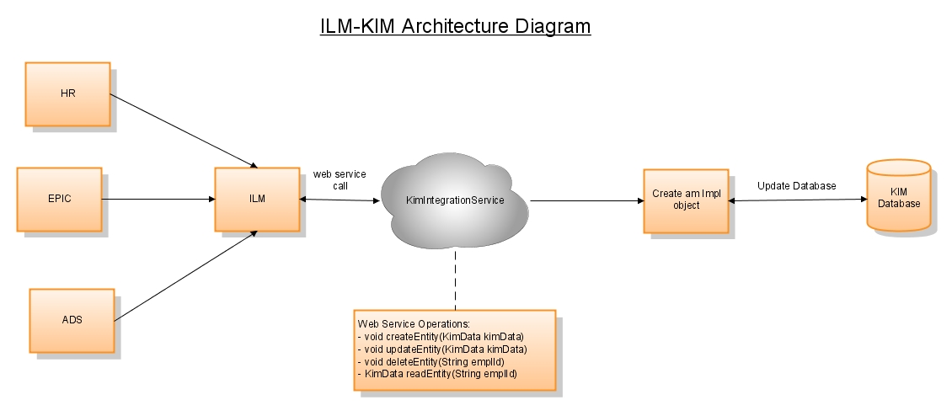
ILM-KIM Architecture
Notes:
- ILM aggregates ID data from HR, SIS, Peoplesoft
Pushes out to active directory
- web service invocations to our KIM Integrate Service
- on the backend we essentially process that incoming request and persist to database
- We do various pieces of logic in that service, including transforming employee status and type codes

Slide 99
Principal ID and Principal Name
In KIM the Principal ID must be unique across the implementation
At IU we are using our Peoplesoft “Employee ID” for both our principal and entity ids
We are using the user’s “network id” for their principal name

Slide 100
Historical Data
IU has a large historical data set of users
Many of these could have participated in workflow transactions as long as 7 years ago
KIM has the “IdentityArchiveService” that can be used to retrieve historical entity data
  A subset of the full entity data
We pull this historical data into the designated KIM table from an external source when it is requested

Slide 101
Groups and Active Directory
IU has a large Microsoft Active Directory implementation
Contains many, many groups that customers want to use for role assignment and routing
We override the GroupService so that it pulls from both the KIM database and from ADS (via LDAP)
We identify ADS groups by giving them an “ADS” namespace
Generate group ID based on ADS group name

Slide 102
Authentication
Use a customized version of CAS
Override the default AuthenticationService implementation
Pulls authenticated principal name from our custom CAS filter which we use for Java applications

Slide 103
User Interfaces
Person – isn’t used to maintain person data, but does permit role/group assignment
Group – can be used to create and edit groups unless their namespace is “ADS”
  Accomplished using permissions
Role –using out-of-the-box implementation

Slide 104
Future Plans
Upgrade to Rice 1.0.3 – early 2011
Kuali Coeus 3.0 – coming July 2011
Kuali Financial System – full implementation – Q4 2012
Integrate Role assignment with our HR system at time of hire or position change
Integrate KIM roles and permissions with our Decision Support and reporting environments
Begin modeling more Roles at IU using KIM to facilitate authz and role-based routing

Slide 105

Case Study: University of Maryland

Slide 106
UMD KIM Implementation
Used out of the box implementations of
  Authorization Services
  Group Services
Implemented Institutional versions of
  Identity Service
  SSO
Customized some screens

Slide 107
UMD Identity Data Source
University Person System (UPS)
  In House Identity system
  Contains student and employee Bio-Demographic data
  Database backed system
  UID’s from LDAP fed into UPS nightly

Slide 108
UMD Implementation
Created a custom module and bundled it into our standalone Rice deployment
  IdentityService implementation which connects directly to the database for UPS
  Mapped our Unit Hierarchy as a KNS Business Object for use as Role Qualifiers and for workflow routing
  Used JPA for persistence layer

Slide 109
UMD Data Mapping
UMD does not use multiple principals for an Entity so we mapped:
  KIM Entity Id, KIM Principal Id : UPS Person Id
  KIM Principal Name : LDAP UID
Name, Address, Phone, Email all mapped easily
We didn’t tackle Affiliation, which caused Person screens to be uneditable (for assigning roles)

Slide 110
UMD Additional Institutional Data
Created System User kr in institutional identity systems
  Added kr to LDAP to reserve principal name, user cannot login
  Added kr to UPS system

Slide 111
UMD Additional Rice Data
Created Namespace UMD-RICE for all additional Rice Roles and Permissions
Created Namespaces, Roles, and Permissions for clients to administer their own authorization
Assigned Technical Administrator Role via database insert to initial administrators
  All other authorization to be done via screens to maintain audit trail

Slide 112
UMD Person Lookup Modifications
Principal Name is our LDAP UID which is referred to as Directory ID
Employee ID maps to our Entity ID and is referred to as UID
Added dropdown control populated by our unit hierarchy for Primary Department
Removed unnecessary fields

Slide 113
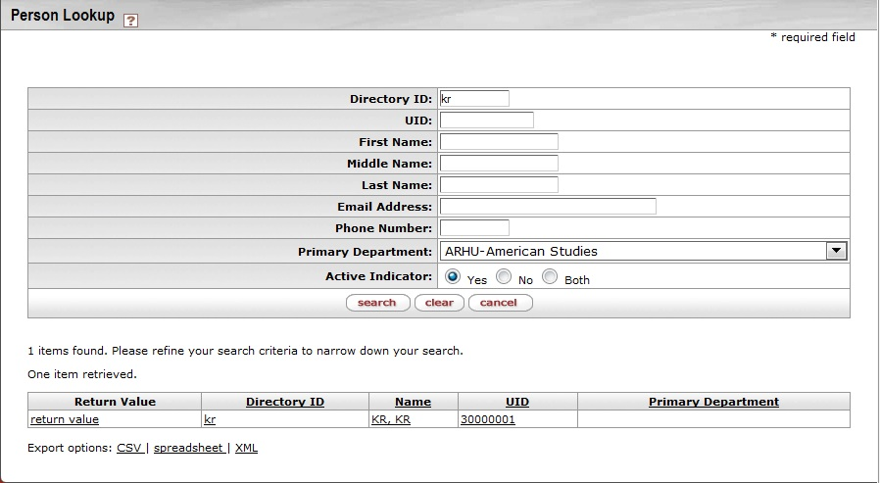
UMD Person Lookup Screen

Slide 114
Case Study: Colorado State University

Slide 115
Colorado State University
Implemented KFS in July 2009
Load HR data into KIM with a nightly batch
Nightly comparison of HR data with KIM data to maintain consistency
Deactivate – update the principal and set to inactive
Report produced showing people deactivated that are in KFS approval roles so new principals can be assigned

Slide 116
Colorado State University
KFS users use the KIM screens for creating roles and assigning permissions and responsibilities
EID used for principal name
Banner CSU id as employee id

Slide 117
Future Plans
Plan to continue nightly batch synchronization as KIM implementation strategy
  HR
  Banner Student
Planning to implement Kuali Coeus
At that point will unbundle Kuali Rice from KFS so both use a single standalone Rice instance

Slide 118

Case Study: San Joaquin Delta College

Slide 119
San Joaquin Delta College
Implemented KFS in July 2009
Use a hybrid approach for identity data
  Principal id and entity id are populated with “College Id” the unique id at SJDC
  Have basic KIM records for this in KRIM_PRNCPL_T and KRIM_ENTITY_T
  Store system users in the KIM database
  Other users are pulled from LDAP via an overridden Identity Service
Do not use KIM GUI screens
  Manually manage tables because of small number of users

Slide 120
Future Plans
For next release of KFS implementation, plan on switching to a model more similar to CSU
Would like to make KIM the “master” for data and duplicate from KIM to LDAP system

Slide 121

Case Study: The University of Arizona

Slide 122
The University of Arizona
Working on a KFS implementation
UA netid is used for authentication
Identity information is available in UA’s Enterprise Directory Service (EDS)
Connect to EDS using Spring LDAP and overriding the KIM IdentityService
  This is the LDAP integration that we discussed earlier
In order to use the KIM GUI’s properly, the UIDocumentService is also overridden

Slide 123

Case Study: University of Washington
Notes:
Two week proof of concept with rSmart team this past spring

Slide 124
The University of Washington
Integration with .NET
Completed a proof of concept
Future plans for Rice, KFS, Kuali Student
Existing Homegrown systems
Several integration points
Notes:
UW has been a .NET shop for several years. Some local influence ☺
In April / May of 2010 – 2 week proof of concept. rSmart worked with Washington .Net devs.
UW has developed tools, Homegrown systems Astra roles system has a very nice user interface that the users are very happy with.
Have several other systems in place, and wanted to integrate to keep look and feel and to avoid duplication of code or data.
UW has been a strong Kuali partner for quite some time, contributing to Rice and Kuali Student development.
UW looking toward a Long term strategy, where Rice will be a core component for workflow, identity management, and potentially roles and responsibilities.

Slide 125
The University of Washington
LDAP integration
KIM integration with home-grown system
Hybrid solution
Secure web services
Source control and build process
Notes:
UW Team was very experienced with .NET but not Java.
1-week of training on Rice KIM and workflow
From the proof of concept, they wanted to have usable results. Not- throw away work.
Requirements. Needed into integrate 3 primary systems.
. LDAP - entitities
. Astra - Groups and Roles system.
. Workflow – Advanced Budget Request system.

Slide 126

The University of Washington
UW Entity Service
LDAP
UW Security Handler
Astra
Kuali App Server
UW KIM Group Service
Business Users
UW KIM Role Service
KIM RoleType Service
UW Org WS
SAGE
UW Workflow Service
SAGE Post Processor
End Users
End Users
Kuali Rice Portal UI
Devs
Notes:
Requirements. Needed into integrate 3 primary systems.
. LDAP - entitities
. Astra - Groups and Roles system.
. Workflow – Advanced Budget Request system.
LDAP integration contributed back to Kuali Rice

Slide 127
LDAP Integration
Spring LDAP & Spring Security Modules
Encryption
Configuration
  Spring
  System parameters
  Mapping
Notes:
Tools taken advantage of Spring LDAP module and security modules.
Rice heavily leverages Spring Framework, so this is just using an additional Spring Module.
Most of the work to be done was not coding, but configuration.
Mapping of attributes from legacy systems to KIM.
LDAP integration took about 2 days.

Slide 128
Roles and Groups Integration
JAX-WS used to generate Java classes
Roles
  Mapped directly to ASTRA roles using convention
  ASTRA “span of control” mapped to KIM qualifiers
Groups
  Mapped to specific roles within ASTRA
Notes:
JAX-WS queries .NET service to determine
Creates a service that can automatically talk to it.
Made it very simple to talk to the .NET service
Override roles service.
There is a direct mapping between Kuali Roles and Astra Roles.
Effort was fairly easy. While Roles API has 12 or more services, really needed to
KIM roles are very flexible. With qualifiers and templates, allows the ability to finely define roles.
For groups, groups mapped to Atra Roles.

Slide 129
Workflow Integration
SimpleDocumentService
  Routing calls (create, route, approve, etc)
Post Processor
  Callbacks through web services
  Notification to external system
    Route status changes (saved, initiated, enroute, final, etc)
    Route node changes (who has responsibility now)
Qualifiers
Notes:
Just a couple of steps to integrate workflow.
With Java, .Net, Ruby, etc.
1st task is to use SimpleDocumentService (already exposed via KSB)
On .NET side of the … there is a tool which inspects a service and automates
2nd task is to implement a PostProcessor. Call back notification when a document has a route change or a status change.
Override Action List with their own UI. Had to expose a couple of internal Rice services on the service bus.
Qualifiers, used to determine who to route a document to and what action to be performed.
(org code, rule name, document type, etc)

Slide 130
Outcome and Future Plans
Highly functional
All major integration points completed
Code contributions
Team confidence
What’s Next?
Notes:
Making use of Kuali contribution model to add the LDAP integration module into Rice
Experienced 80-20 rule.
Minimal changes/optimizations were necessary to the Rice code.
The Rice KIM service override modal was very effective in making things easy.
Need recent updates regarding any new work since proof of concept, and schedule for putting this into production.

Slide 131
Questions?
Finding out more about Kuali Identity Management and Kuali Rice in general
  http://rice.kuali.org
Join the mailing list – rice.collab@kuali.org

