Slide 1
Deploying an Internal Cloud: Offering Infrastructure as a Service to the Campus Community
Dennis Cromwell
October 13, 2010
Copyright Dennis Cromwell, 2010. This work is the intellectual property of the author. Permission is granted for this material to be shared for non-commercial, educational purposes, provided that this copyright statement appears on the reproduced materials and notice is given that the copying is by permission of the author. To disseminate otherwise or to republish requires written permission from the author.
Notes:
Copyright Dennis Cromwell, 2010. This work is the intellectual property of the author. Permission is granted for this material to be shared for non-commercial, educational purposes, provided that this copyright statement appears on the reproduced materials and notice is given that the copying is by permission of the author. To disseminate otherwise or to republish requires written permission from the author.

Slide 2
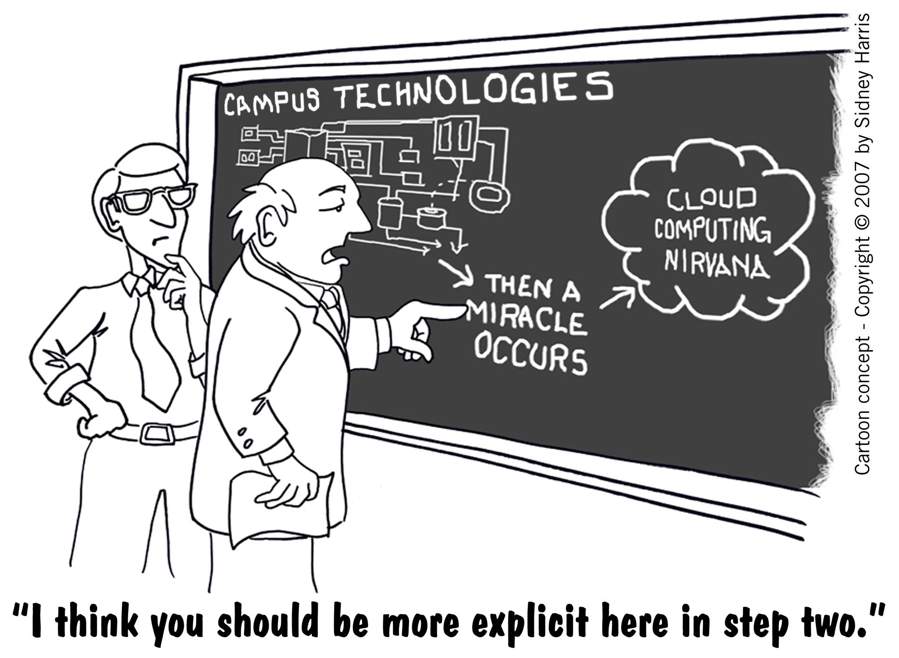
Notes:
Hype or Reality?

Slide 3
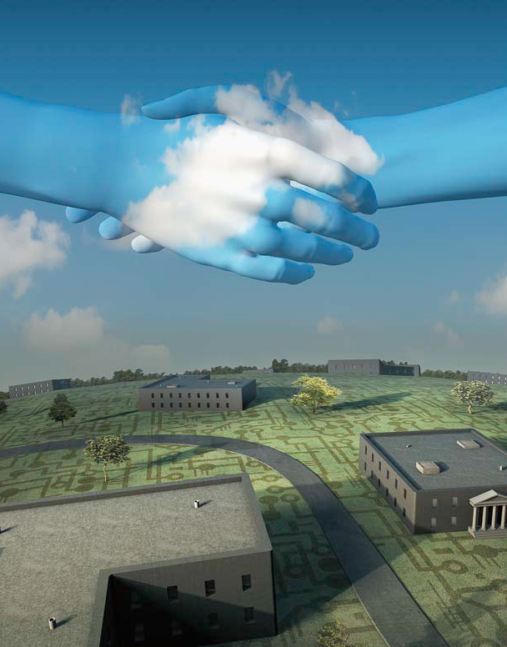
Above-Campus Services
Shaping the Promise of Cloud Computing for Higher Education by Brad Wheeler and Shelton Waggener
Illustration by Randy Lyhus ©2009
EDUCAUSE Review, Nov/Dec 2009
Notes:
The cloud term is often confusing and people will debate the characteristics of a service that are needed for it to be called a cloud. We like the Above-Campus Services term to describe the type of services supported through data center virtualization. Wheeler and Waggener say “Just as atmospheric clouds can obscure the sun, the current discussion of cloud computing by the IT industry and the media may be obscuring a far more strategic conversation for colleges and universities.”
One key aspect to keep in mind is abstraction. Each “layer” of the architectural model needs to be sufficiently abstract to allow the lower layer to be upgraded, moved, etc, without impacting the other aspects. Example, we can swap out an entire set of servers without impacting any applications.
“From the moment an IT organization virtualizes its first server, it is
laying the groundwork for the cloud. Abstraction--the first main
advantage of virtualization--is the foundation of cloud computing. By
separating operating systems and applications from the underlying
hardware platform, virtualization frees them to move from server to
server, cluster to cluster or even across data centers.”
From: How Virtualization Enhances Cloud Computing
by Vittorio Viarengo , Vice president of desktop products for VMware.
Forbes
August 24, 2010, 12:00PM ET

Slide 4
Above-Campus Sourcing Models
Commercial Sourcing
Institutional Sourcing
Consortium Sourcing
AKA – Commercial Cloud, Internal Cloud, Cooperative Cloud
Notes:
Commercial – Amazon, Rackspace, Google, Microsoft.
Email, office, storage, computing, development platforms
Institutional – This is the virtualized data center. The steps to delivering a cloud model.
Consortium – Starting from the virtualized data center, like-minded institutions can collaborate to deliver services beyond their University and even to higer-ed in general

Slide 5
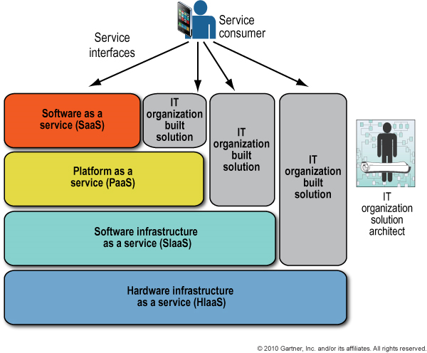
Services in Three (or four) forms
Notes:
Infrastructure as a Service (IaaS)
Hardware IaaS
Software IaaS
Platform as a Service (PaaS)
Software as a Service (SaaS)
A very traditional look at cloud computing. All of these models have value. The virtualized data center is primarily looking at the bottom layers of this stack. They key is that it enables the top layers of the stack.

Slide 6
Virtualized Data Center
The Burton Group defines an “internal cloud” as “an IT capability offered as a service by an IT organization to its business”
VM Software
Virtual Storage
Virtual Networks
Notes:
The presentation will not discuss VDI – Many aspects of the virtual datacenter apply to VDI deployment or virtualized applications. However, the focus of this presentation is on the data center components.

Slide 7
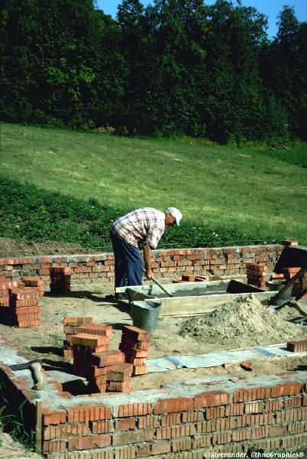
VM Software
Foundation of the Virtual Data Center
Virtual servers or host-based server virtualization
Layer of abstraction between hardware and OS
Primary commercial players
  VMWare (vSphere)
    VI 3.5 Update 3 was the first hypervisor to satisfy
    Burton Groups (Now Gartner) production class
    Hypervisor Evaluation
  Microsoft (Hyper-V)
  Citrix (Xen Server)
  Virtual Iron (Oracle OVM)
Notes:
Key concepts:
Support multiple guest operating systems
Support movement of virtual server across physical server without interruption
Level of automation for management and monitoring

Slide 8
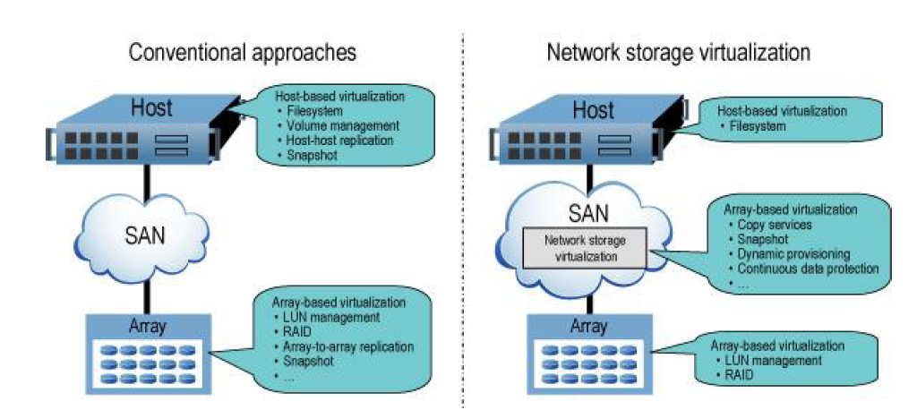
Virtual Storage
Source: The Burton Group (Gartner)
Notes:
Attributes:
Volume Management – dynamic to allow growth
Improved I/O performance (caching, hot spot management, etc)
Replication – Synch, asynch, snapshot
Thin Provisioning
Storage pooling
Tiered storage support
NAS support (CIFS, NFS)

Slide 9
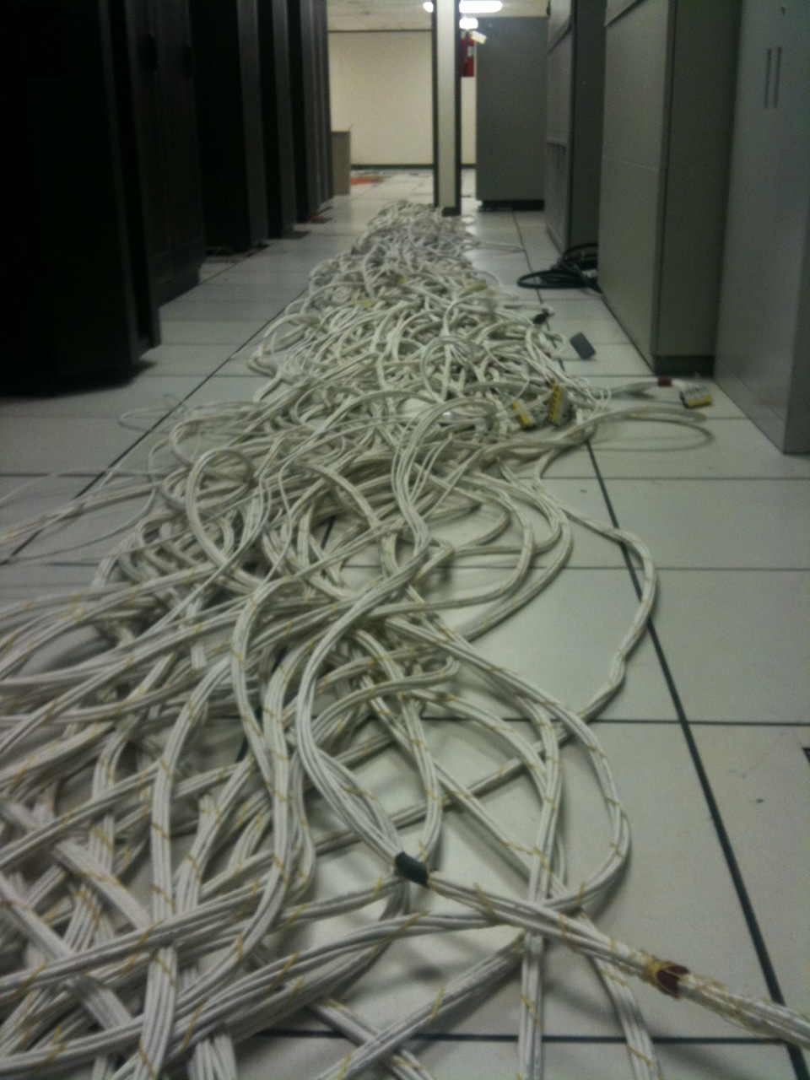
The virtual network

Slide 10
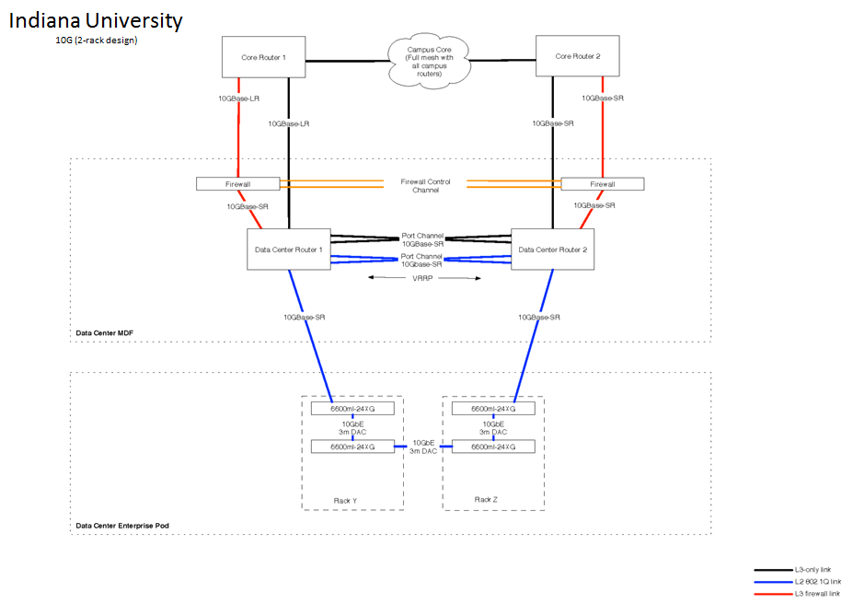
Virtual Network
Notes:
Virtual Ethernet switches
Virtual Ethernet MAC addresses
Integrated switching/unified fabrics: Permit Ethernet local area networks (LANs) to take the place of separate (mostly Fibre Channel) SANs
Use the same Ethernet switches and backbone for standard Internet Protocol (IP) traffic and for Fibre Channel over Ethernet (FCoE) or Internet Small Computer Systems Interface (iSCSI) storage traffic
Flatter switched networks with fewer switching tiers
New top-of-rack Ethernet switching products
Converged Enhanced Ethernet (CEE) and integrated switching as a substitute for separate Fibre Channel SANs (i.e., running SAN traffic over the switched Ethernet network)
Server links to top-of-rack Ethernet switches via 10 Gigabit Ethernet (10GbE) virtual LAN (VLAN) trunks
Security based on logical rather than physical network perimeters
Abstraction of multiple virtual and physical Ethernet switches into a single logical switch for purposes of management and operation.
Source: The Burton Group (Gartner)

Slide 11
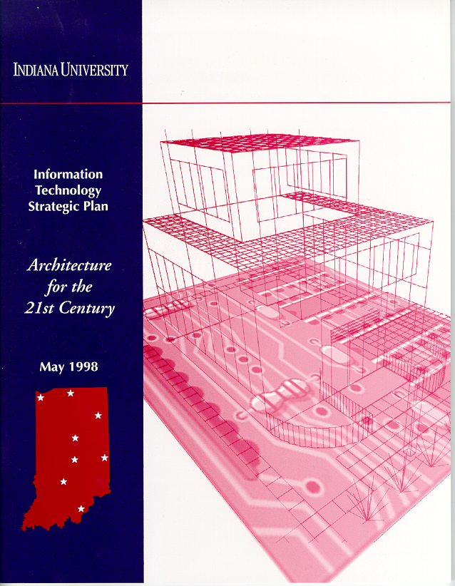
IU’s Journey
IU First IT Strategic Plan
10 Year Strategy
Virtualization Groundwork

Slide 12
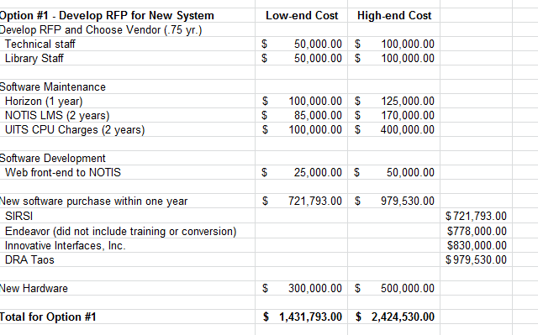
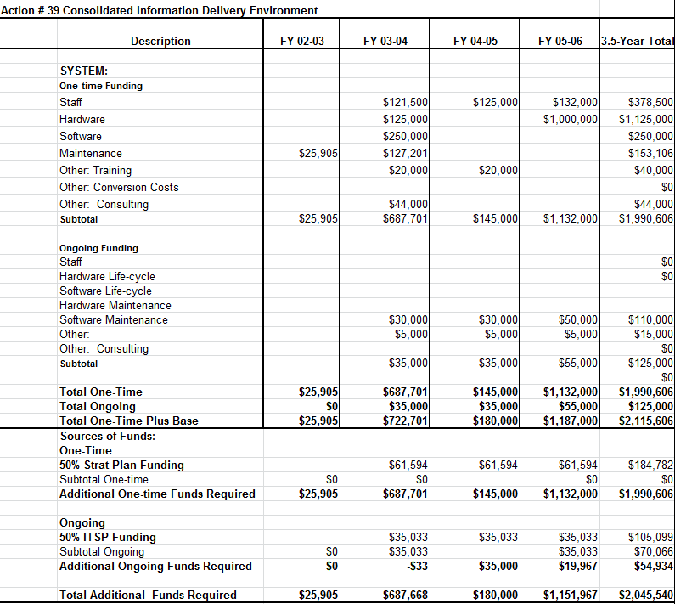
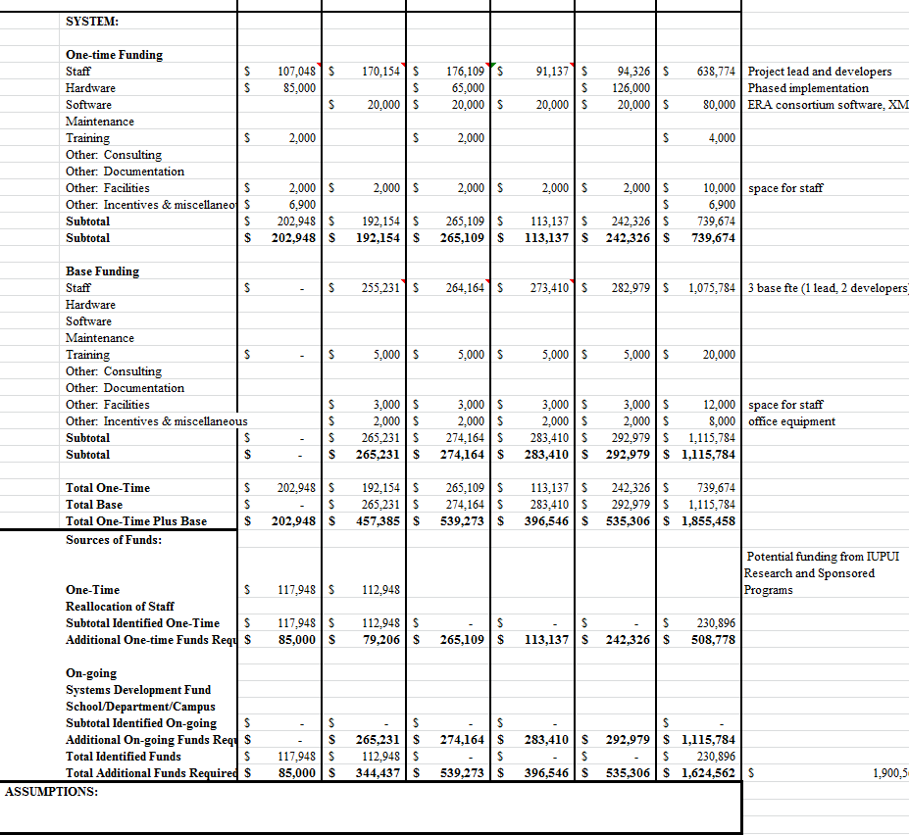
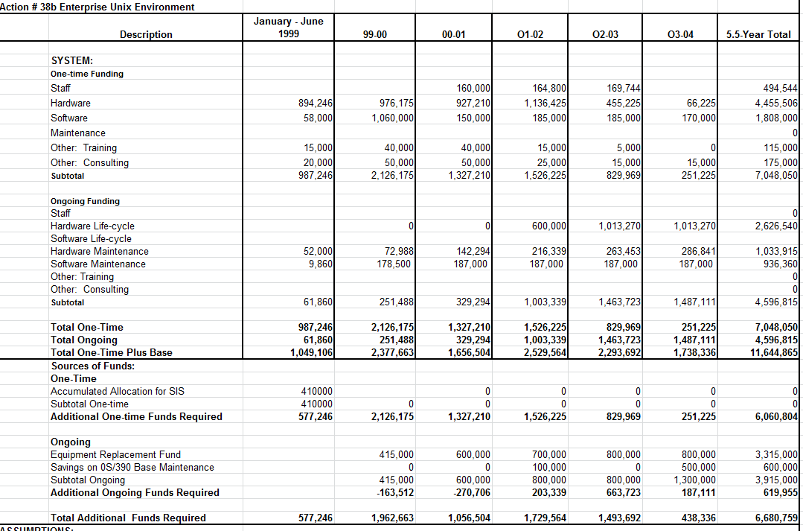
Establishing a common
Infrastructure Budget
Consolidate infrastructure budgets from projects
Create fungible resources
Manage capacity to need

Slide 13
Benefit to Budget Consolidation
Standardize technology
Choose technology for greater good
Invest in tools that no single project could fund
  Storage and server virtualization

Slide 14
And so the investment in the tools of the cloud begins…..
Needed for a specific cases in 2003
Began in earnest in 2006
Virtualize 100% of x86 business systems
Standardize Supporting Architecture
Consolidate Storage
Improve HA
Maximize Cost Savings $$$$
Initially 40:1 Consolidation Ratio

Slide 15
IT as a Service Phase
IU’s Intelligent Infrastructure (2007)
Improved flexibility, BC, HA, and DR
Reduced power/cooling consumption (Green) (< 40KW to power)
Removed Traditional Conflict of Interest Situation
Demonstrated Confidence / Savings
Web enabled provisioning and workflow
Drive the Enzo Ferrari for the cost of a Yugo

Slide 16
IT as a Service Phase
Standard x86 boxes across the entire platform
One vendor, one chip set, one solution
960Total CPU’s/Cores
7,680 Total GB RAM
Hypervisor Virtualization Booting from SAN
30-40 VM’s per physical box average
3 year life cycle replacement

Slide 17
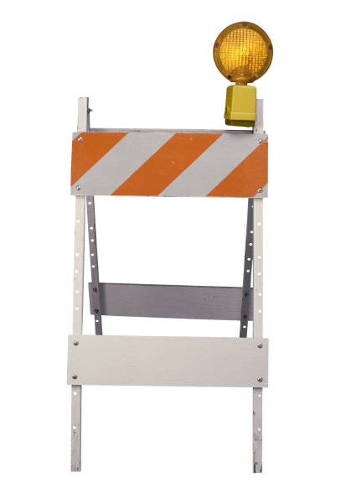
What are the inhibitors?

Slide 18
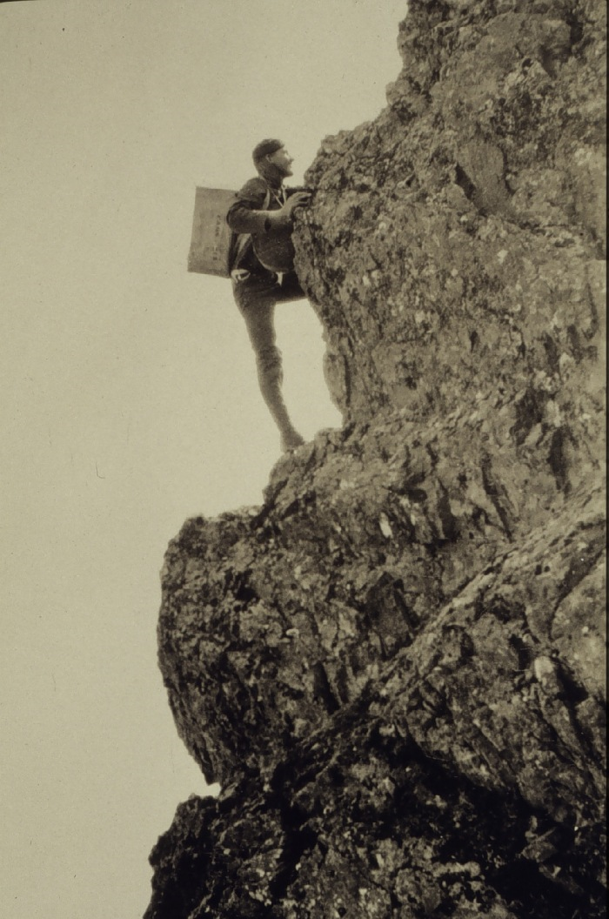
Or ….Why this is seems so hard
Notes:
It is worthwhile to revisit a few key reasons why the creation of a common virtual data center seems so difficult to achieve.

Slide 19
Virtual Data Center Requires Investment
Servers
Network
Storage
Tools
In House Expertise (Staff)
Backup Strategy

Slide 20

Cultural Issues
Budgeting in higher ed does not always look at true TCO
Expenses
Electricity costs
Building costs
How much is space worth?
Saving a fraction of an FTE is not really a savings
CapEx vs. OpEx
Notes:
Budget -> Where is the budget, and where are the expenses
Staff depth (Small shops may only have a single jack of all trades and not true technical depth / redundancy)

Slide 21
Control is a perception
Trust is hard
Vs.
Notes:
Sometimes there are valid reasons a unit does not want to give up “control”
Generally the level of control is not an real issue, but a perceived one.
The issue is really one of trust

Slide 22
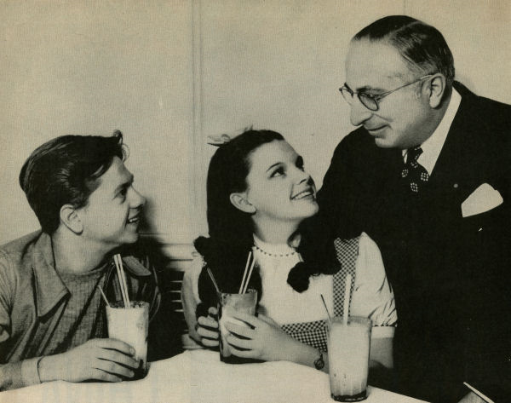
“Hey kids! let’s Build an Internal Cloud”
Notes:
There are considerations on how you organize to support the virtual data center. It may not be the same way we are organized now. Certainly have to consider the roles and responsibilities in different ways

Slide 23

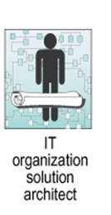
Personnel organization in the New Data center
Networks
Switches and Routers
FC and/or Ethernet
Server Hardware
Racks
Bare Metal
Operating Systems
Patching
Storage
Middleware
Database
Web/application servers
Email, unicom, etc
Firewall and load balancers
Linux, windows…
Volume management
Replication
FC Fabric
Notes:
This makes it very complex.
Who does your storage and virtualization?
Who manages the OS?
Do you have system administration across a number of management teams?
Is your organization too small for specialization?
Who designs and runs your network in the data center?
Are parties comfortable with the virtual aspects of hardware, storage and networks?

Slide 24
Should I consider Co Location of Servers instead of the Internal Cloud
Departments struggle with server room space
Greening IT = fewer, more efficient data centers
Physical security and stability difficult to achieve at the edge
Data center (server room) space is expensive
Space is always a premium
Notes:
Drivers that force us looking at Co-Lo. They are compelling. Departments are starting to realize that there is a cost for those servers.

Slide 25
Co-Lo or No Co-LO
Pros
Cons
Better use of IT resources
Safer environment
Opportunity to standardize best practices
Supports sustainability
Begin a trust relationship
Economies of scale
Simplified management
Access to center – are you going to treat departmental staff the same as your org?
Planning for everything is tough
Life cycle management or how to get the junk out?
Common backup, storage, tougher to offer

Slide 26
Co-Lo Considerations
Standard Racks
Placement within Rack (they don’t get their own)
Firewall and security scanning requirements
Common HR practice for departmental staff access
  Background checks
  Certification
MOU / SLA
No stand alone UPS

Slide 27
References
theb1856, NOAA's Historic Coast & Geodetic Survey (C&GS) Collection http://www.photolib.noaa.gov/700s/theb1856.jpg
Publicity still released by MGM of Mickey Rooney, Judy Garland, and Louis B. Mayer http://upload.wikimedia.org/wikipedia/commons/e/ec/Judygarland_mickeyrooney_louisbmayer_mgmpublicitystill.jpg
Wheeler and Waggener. Above-Campus Services: Shaping the Promise of Cloud Computing for Higher Education http://www.educause.edu/EDUCAUSE+Review/EDUCAUSEReviewMagazineVolume44/AboveCampusServicesShapingtheP/185222
Simpson. Network Storage Virtualization: Technology Overview http://www.burtongroup.com/Client/Research/Document.aspx?cid=1134
Blakley and Reeves. Defining Cloud Computing http://www.burtongroup.com/Client/Research/Document.aspx?cid=1951
Armbrust, Fox, et al. Above the Clouds: A Berkeley View of Cloud Computing http://www.eecs.berkeley.edu/Pubs/TechRpts/2009/EECS-2009-28.pdf

Slide 28
THANK YOU

