Slide 1
The Horizon Report in Action: Deploying Innovation Locally
EDUCAUSE Advisory Committee for
Teaching and Learning
October 2010

Slide 2
Why (how) innovation
The Horizon Report
Student engagement (and innovation)
Deploying Innovation Locally (ER Sept/Oct 10)
http://www.educause.edu/EDUCAUSE+Review/EDUCAUSEReviewMagazineVolume45/DeployingInnovationLocally/213926
In the spirit of engagement ☺
http://tinyurl.com/e10tech (Google Moderator)
Don’t forget to take the session survey

Slide 3
Open Content
David Starrett, Southeast Missouri State University
Pat Kohrman, The Pennsylvania State University

Slide 4
Open Content a Philosophy
Notes:
Open Content is more a philosophy than a technology. Is Education or ,at least knowledge, a communal common good? Why pursue? "As higher education works to increase educational opportunities and student success, even as budgets shrink, an increasingly common approach is open education--the notion that education should be freely and easily available to anyone seeking it." The Future of HE: Beyond the Campus

Slide 5
Perfect Storm
Notes:
Perfect storm of opportunity
(Do we hunker down in our storm cellars or embrace the opportunities and fly our kite like Ben Franklin?)

Slide 6
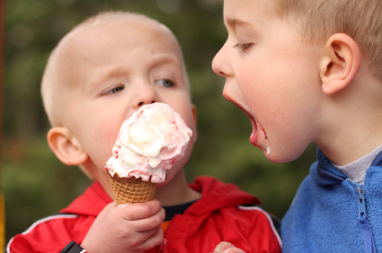
Culture of Sharing
Notes:
Requires culture of sharing and collaboration. Open content community is diffuse and distributed.

Slide 7
Why pursue Open Content?
Social Responsibility
Expand access to knowledge
Reduce costs of learning
Collective Wisdom
Accountability
Notes:
Expands resources available to faculty and learners. Wide variety of resources, depositories. Open content takes advantage of Internet as 'dissemination platform' for collective knowledge and wisdom and design learning experiences. (Horizon report)
Quote from Cape Town Open Education Declaration. Open education and the people who develop OER create "a world where each and every person on earth can access and contribute to the sum of all human knowledge.“Content producers moved from authoritative repositories to content being free and ubiquitous and a social responsibility(response to demands for HE to be more open and accountable).

Slide 8
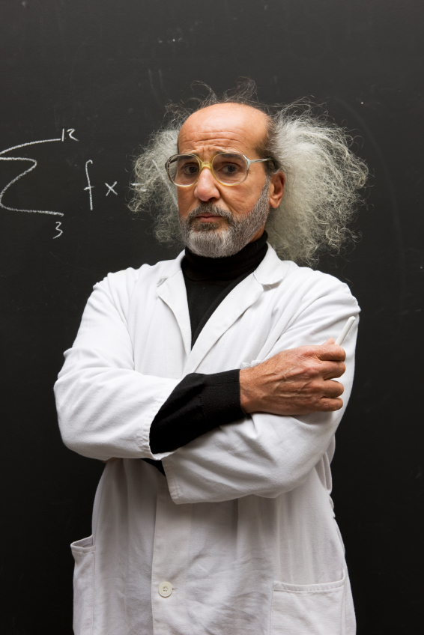
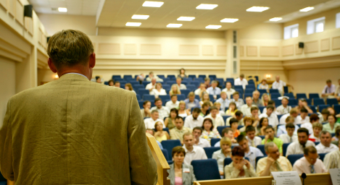
Old Model
Notes:
Relationship between instructor and learner has the potential to change and be enriched.
Learners become collaborators and develop skills for finding, assessing quality of resources, repurposing for learning and research. Instructor now a facilitator or guide to learning and also a collaborator with learners.

Slide 9
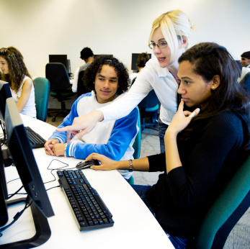
New Relationships

Slide 10
Challenges
Sharing, repurposing, reusing scholarly works
Intellectual property, copyright, ownership
Student-to-student collaboration and privacy
Sources, quality, oversight of resources vary
Accessibility issues
Access to required technology
Notes:
Issues in developing or using open content:
Challenges of sharing, repurposing, reusing scholarly works
Intellectual property, copyright, student-to-student collaboration and privacy
Sources and oversight of resources vary widely
Quality can be uneven
Accessibility issues
Access to required technology (Is it a valid assumption that all learners have access to technology and the Web?)

Slide 11
Getting Started
Structured initiatives
Small diffuse initiatives
Notes:
Open Content types:
Highly structured initiatives: require institutional support, financial resources, staff, technology, commitment of academic staff
Small diffuse initiatives: Require interest and commitment of instructor, investment of time, some support with design and/or technology.
Open content community is diffuse and distributed

Slide 12
Open Content Repositories
Notes:
Examples: MIT, Yale, Carnegie-Mellon, Merlot, Looking for Whitman, Connexions by Rice University, Otter by University of Leicester, OpenLearn

Slide 13
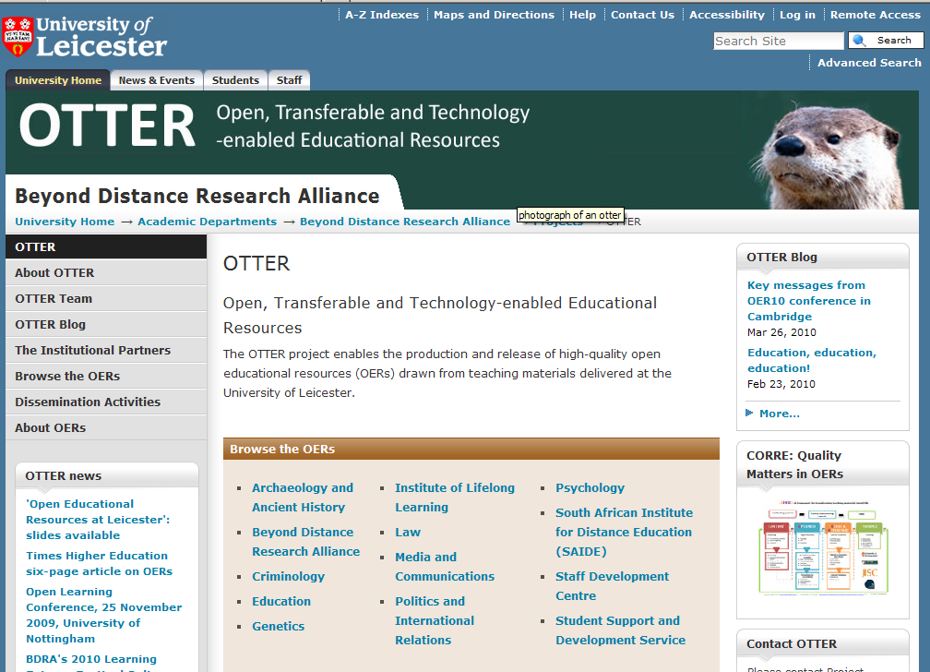
Screen Shot Example (OTTER)
Notes:
Accessed September 23, 2010

Slide 14
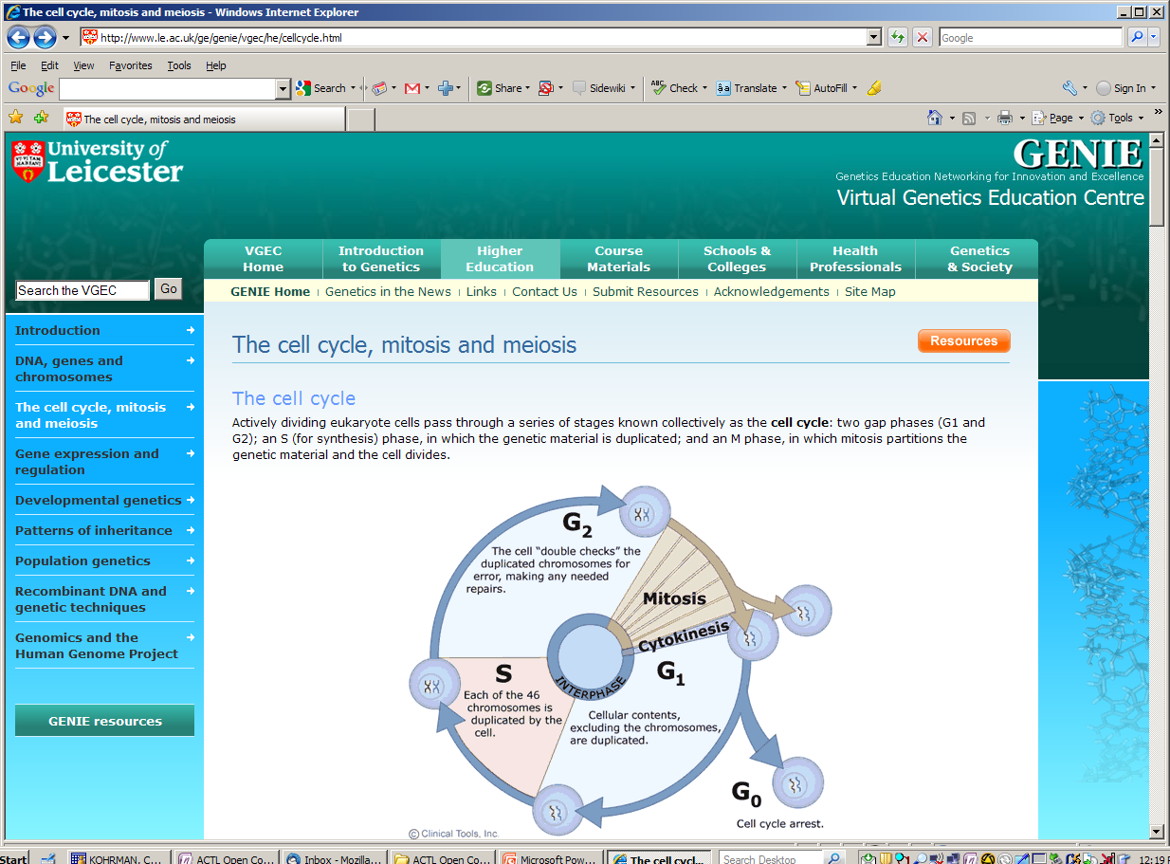
Notes:
http://www.le.ac.uk/ge/genie/vgec/he/cellcycle.html accessed September 23, 2010

Slide 15
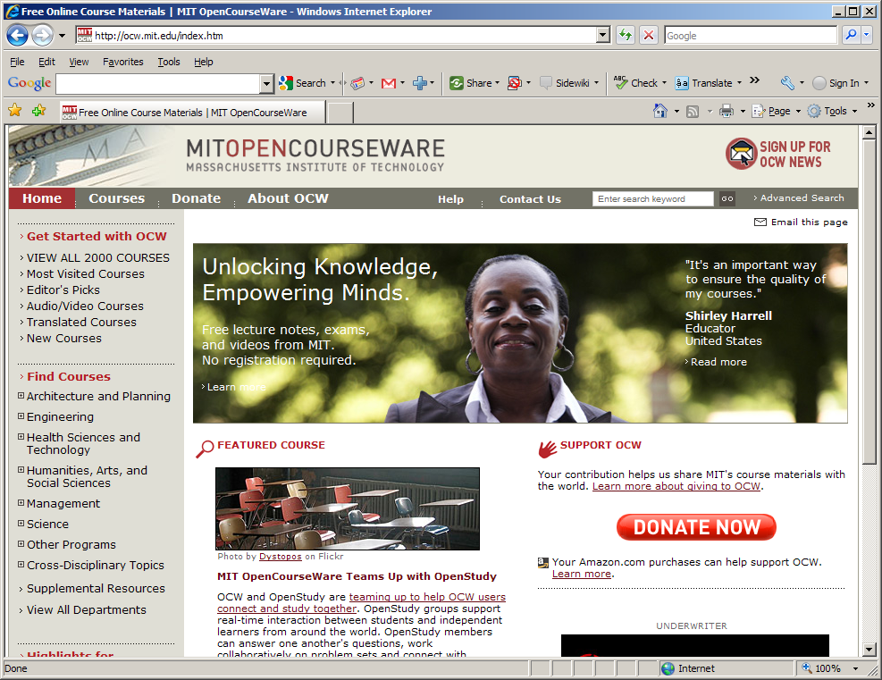
Screen Shot example
Notes:
Accessed September 23, 2010

Slide 16
Notes:
http://ocw.mit.edu/courses/mathematics/18-06-linear-algebra-spring-2010/video-lectures/lecture01/ accessed September 23, 2010.

Slide 17
The Future
Notes:
Current and future generations may question why we would not have an environment of openness.

Slide 18
Mobile computing
Deborah Keyek-Franssen, CU at Boulder
Barron Koralesky, Macalester College

Slide 19
What Is Mobile Computing?
tool
non-fixed location
status quo
Notes:
use of a tool
small, light, portable
robust connectivity
robust application options
in a non-fixed location
restless, moving, affording change
tools like smart phones, tablets, netbooks
mobile computing is the new status quo
preferred by students
82% of adults in U.S. have cell phones, 43% with apps (Pew)
iMovie, Evernote, GIS, Facebook

Slide 20
Why Mobile Computing?
student learning and engagement
across distance
Chickering & Gamson would
give it two thumbs up
Notes:
Supports pedagogies and modes of learning that promote student engagement
Using mobile technology, sometimes further away can be closer

Slide 21
Mobility vs. Chickering & Gamson’s 7 Principles
for good practice in undergraduate education
encourages contact between students and faculty
develops reciprocity and cooperation among students,
encourages active learning,
gives prompt feedback,
emphasizes time on task
communicates high expectations, and
respects diverse talents and ways of learning.

Slide 22
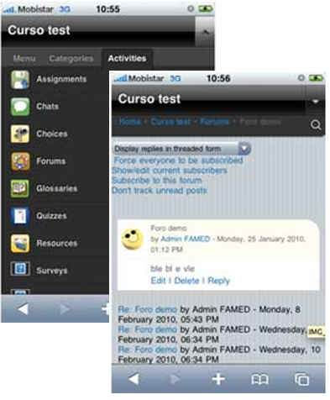
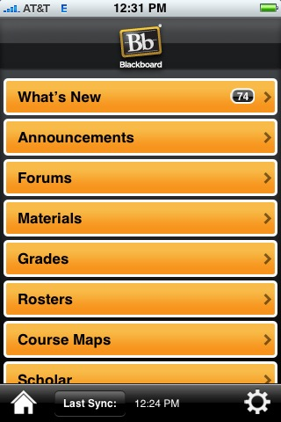
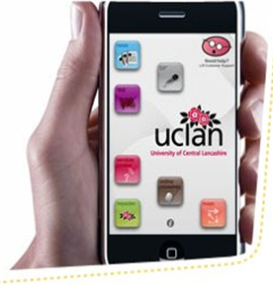
Rapid & Constant Connection
Notes:
If we consider the course and the cohort to be the primary structure of higher education learning, then mobile computing brings course information, resources, and messages to wherever the student is, connecting students with faculty, peers, and the administrative and student services of the institution.

Slide 23
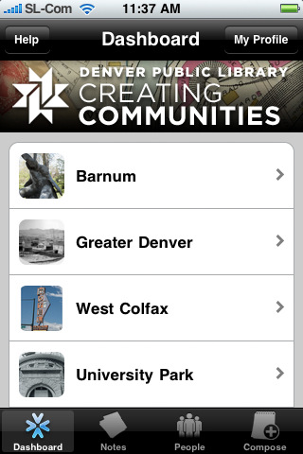
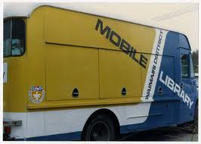
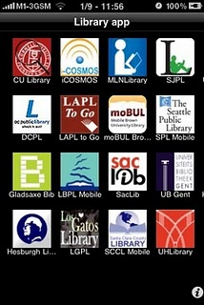
Ubiquitous Access to Content
Notes:
all digital, all the time
lifelong learning
access to information when/where they need it

Slide 24
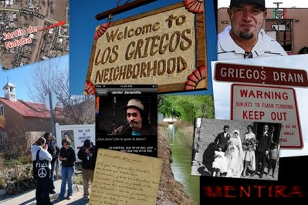
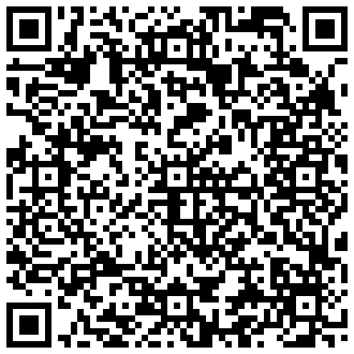
Local Interactions & Connections
Notes:
If we consider the course and the cohort to be the primary structure of higher education learning, then mobile computing brings course information, resources, and messages to wherever the student is, connecting students with faculty, peers, and the administrative and student services of the institution.

Slide 25
Mobility vs. Chickering & Gamson’s 7 Principles
for good practice in undergraduate education
☑ encourages contact between students and faculty
☑ develops reciprocity and cooperation among students
☑ encourages active learning
☑ gives prompt feedback
☑ emphasizes time on task
communicates high expectations, and
☑ respects diverse talents and ways of learning

Slide 26
Discussion Ideas...
What can we do to enable mobile learning for students, given that our faculty skills/time may not be there?
How do IT departments support these devices when we don't own them and new ones come to campus every day?
Given the current (high) expense of mobile devices and data plans, how can we minimize economic divide among students as mobile computing becomes more pervasive?

Slide 27
IMAGE CITATIONS
RAPID & CONSTANT CONNECTION
http://www.nus.org.uk/en/Student-Life/Student-Lifestyle/First-university-iPhone-app-launched/
www.moodletouch.com (MTOUCH)
UBIQUITOUS ACCESS TO CONTENT
http://commonplace.net/2010/03/mobile-library-services/
http://musingsaboutlibrarianship.blogspot.com/2010/09/library-mobile-apps-vs-web-apps-some.html
CREATING COMMUNITIES: http://creatingcommunities.denverlibrary.org/
LOCAL INTERACTIONS AND CONNECTIONS
HTTP://ITUNES.APPLE.COM/US/APP/ARIS/ID371788434?MT=8
HTTPS://SITES.GOOGLE.COM/A/MENTIRA.ORG/TRIAL/

Slide 28
eBooks → eTextbooks
Barron Koralesky, Macalester College
Jeffrey Trzeciak, McMaster University

Slide 29
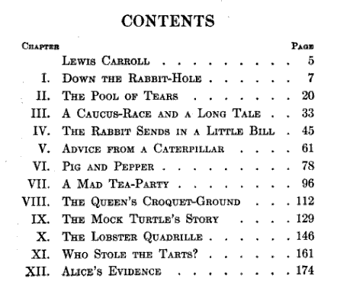
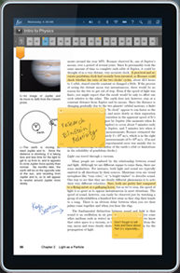
What is an eBook?
Format
ePub, mobi, HTML
Kindle, text, PDF
Proprietary…
Open…
???

Slide 30
eBook Trends – The Future is Here
Format
ePub, mobi, HTML
Kindle, text, PDF
Proprietary…
Open…
???

Slide 31
eTextbook Initiatives
eReader hardware pilots everywhere, on all scales!
IT and libraries bring the campus together

Slide 32
Advantages
Challenges
Cost
Accessibility
Student Engagement
Search
Interaction
Integration
Sharing
Legal
Accessibility
ADA
Cost
Availability
Formats…

Slide 33
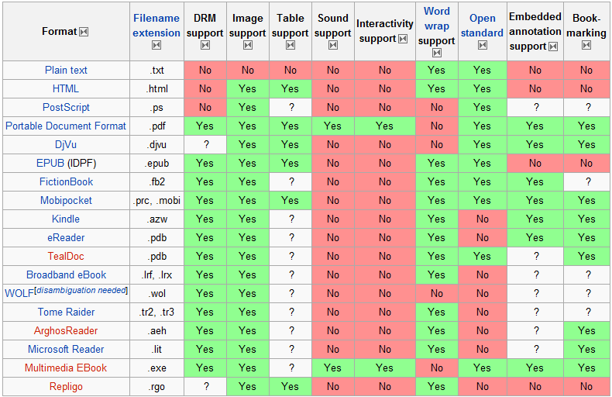
Challenges -- Formats
http://en.wikipedia.org/wiki/Comparison_of_e-book_formats

Slide 34
Advantages for Education
Teachers
Architect your own Textbook
Student Engagement…

Slide 35
eBooks vs. Chickering & Gamson’s 7 Principles
for good practice in undergraduate education
☑ encourages contact between students and faculty
☑ develops reciprocity and cooperation among students
☑ encourages active learning
☑ gives prompt feedback
emphasizes time on task
communicates high expectations, and
☑ respects diverse talents and ways of learning

Slide 36
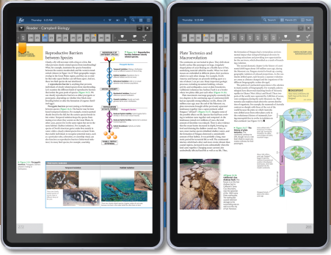
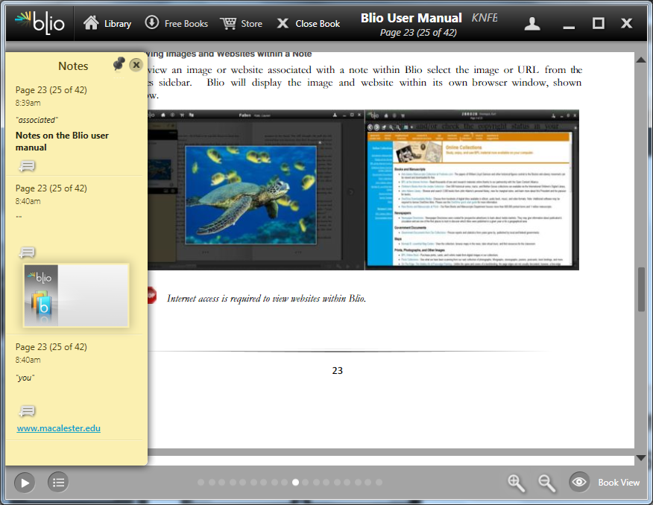
The Future Future
Advantage
knowledge
construction
Notes =

Slide 37
Closing Thought
IT and Libraries can bring their campuses together
to get the most from eTextbooks

Slide 38
References
Jairam, D., & Kiewra, K. A. (2010). Helping students soar to success on computers: An investigation of the SOAR study method for computer-based learning. Journal of Educational Psychology, 102(3), 601-614.
Brahier, B. (2006). Teachers’ uses of students’ digital annotations: Implications for the formative assessment of reading comprehension. Minneapolis, MN: University of Minnesota Center for Reading Research.
Kiewra, K. A. (2009). Teaching how to learn : the teacher's guide to student success. Thousand Oaks, Calif.: Corwin Press.
Reed Kindle Pilot - http://web.reed.edu/cis/about/kindle_pilot/
Kno - http://kno.com/
Blio - http://blio.com/
http://www.flatworldknowledge.com/
http://connect.mcgraw-hill.com
http://www.coursesmart.com/
http://www.dynamicbooks.com/
http://www.symtext.com/
Thanks to Brad Belbas, Angi Faiks, & Dave Collins

Slide 39
Discuss at your table and on google moderator: http://tinyurl.com/e10tech

Slide 40
Questions and answers

Slide 41
Next steps for innovation
2011 Horizon Report (EDUCAUSE Learning Initiative and New Media Consortium) Horizon
2010 Horizon Report
ELI Webinar: Horizon Report 2010--Projects in E-Books, Open Content, Mobile Learning, and Augmented Reality

Slide 42
resources
Open Content Examples
ELI Mobile Learning Focus Session
Mobile Learning Examples
Horizon Project wiki
E-Book Examples
2010 Horizon Report Delicious Tags
Past Horizon Reports

Slide 43
Copyright EDUCAUSE, ACTL, 2010. This work is the intellectual property of the author. Permission is granted for this material to be shared for non-commercial, educational purposes, provided that this copyright statement appears on the reproduced materials and notice is given that the copying is by permission of the author. To disseminate otherwise or to republish requires written permission from the author.

