Slide 1
Enforcing Copyright on Campus Networks:
Lessons Learned, Next Steps
Steve Worona, EDUCAUSE
Ken Pflueger, Pomona College
Kent Wada, UCLA
October 13, 2010

Slide 2
HEOA History
Signed August, 2008
  2 years ago
  Drafting started 3 years ago
“Negotiated Rulemaking”: March-October, 2009
  Because this is an Education law, not a Copyright law
  Penalties: Think FERPA
Compliance deadline: July 1, 2010
  Likewise

Slide 3
HEOA Overview: 3 Requirements
Have & implement a plan to “effectively combat infringement”
  Using 1 or more “technology-based deterrents”
    Bandwidth shaping
    Traffic monitoring to identify the largest bandwidth users
    A vigorous program of accepting and responding to Digital Millennium Copyright Act (DMCA) notices
    A variety of commercial products designed to reduce or block illegal file sharing
  Periodically re-evaluated using “relevant assessment criteria”
“Offer” legal alternatives
  OK to point to list
Regularly inform community of key copyright facts
  Local policies
  Federal law

Slide 4
Despite what you may have heard,
HEOA does not require you to…
Count DMCA notices
Reduce DMCA notices
Reduce infringement to zero
Have less infringement every year
File plans with Department of Education
“Detect”
“Prevent”
“Monitor”
“License”

Slide 5
P2P at Pomona College
Ken Pflueger | 13 October 2010

Slide 6
The Pomona Environment
Small, Residential Liberal Arts College
Policy Adverse
IT does not monitor content of network traffic
Assert rights under copyright law as well as responsibilities

Slide 7
Factors FoR Success
  Personalize Approach
  Collaborate with Dean of Students
  Consult with ASPC
  Integrate enforcement with existing policies/procedures
  IT not the enforcer

Slide 8
So What did we Do to Comply?
Annual Disclosure that Informs Students:
  Joint letter from Dean of Students and CIO
  Publish policy and procedures in Student Handbook
  Include compliance in Acceptable Use Policy
  Quick link on main ITS Website (http://its.pomona.edu)

Slide 9
So What did we Do to Comply?
Certify Plans are in place:
  Two levels of bandwidth shaping
  Automatically generated report alerts IT staff of excessive bandwidth usage (outbound traffic)
  Clearly articulated policy and process worked out with Dean of Students
  Educate students one-on-one

Slide 10
So What did we Do to Comply?
Offer Legal Alternatives
  Not in our institutional culture to pay for such services for students
  IT maintains website that provides links to resources for legal downloads

Slide 11
So What did we Do to Comply?
Policy/Procedure Review
  Reviewed Annually
  Review based on analysis and comparisons of previous years’ data:
    Number of DMCA Notices: Up/Down/Static?
    Frequency of excessive bandwidth usage infractions
  Any increases would cause further investigation, but has not been necessary so far.

Slide 12
THE UCLA APPROACH (P2P.UCLA.EDU)
Kent Wada | October 13, 2010

Slide 13
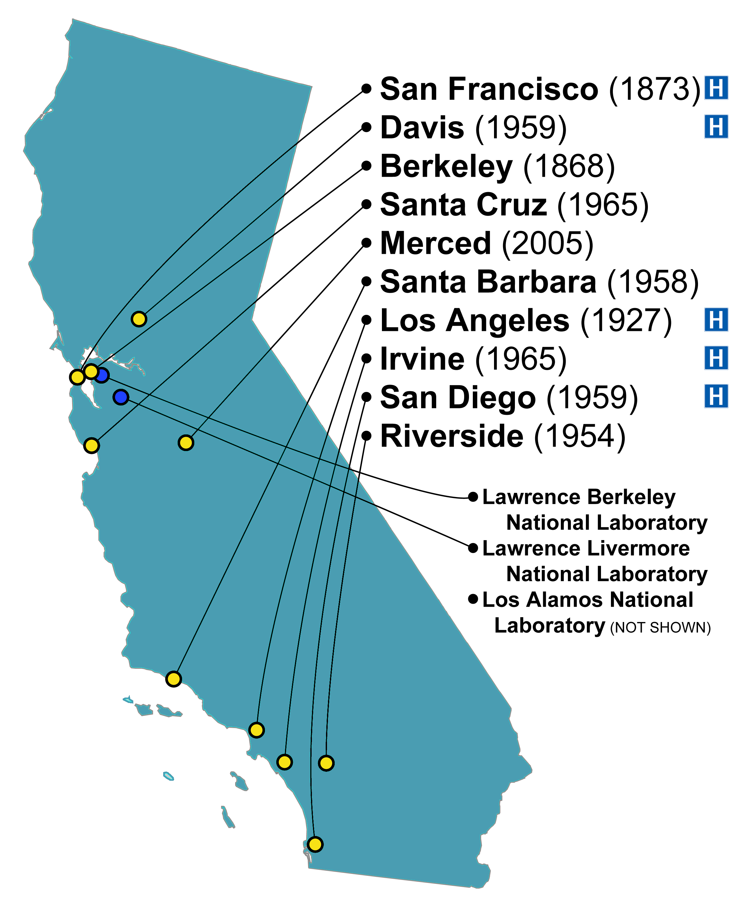

26,600 undergrad, 12,000 grad, 1,400 interns/residents
4.37 GPA average for 2010 incoming freshman class
4,000 faculty/teaching staff
5 Nobel laureates, 10 National Medal of Science winners,
3 Presidential Medal of Freedom winners, 3 Pulitzer Prize winners
Ranked in the top 5 hospitals nationally by US N&WR
106 NCAA team championships
$4.7B (9% state funding)
$1.1B competitive grants funding awarded in 2009-10
225,000 students
170,000 faculty and staff
$20.1B
base image credit: wikimedia commons

Slide 14
Focusing on the uncommon
Orientation
Informational web sites
Information workshops
Promotional activities
Annual letter
Policies
Information workshops
  Workshops covering all aspects of file sharing and alternatives are offered nine times per quarter by the Office of the Dean of Students.
  These workshops are mandatory for first-time recipients of a DMCA infringement claim, but are open to all.
Technology-based deterrents
Community education and annual disclosure to students
Legal alternatives to illegal file sharing
Campus procedures for handling unauthorized distribution of copyright
Periodic review of plan and assessment criteria

Slide 15
Focusing on the uncommon
Community education and annual disclosure to students
Legal alternatives to illegal file sharing
Periodic review of plan and assessment criteria
Recidivism
Continual, incremental “tweaking”
Joint study
Joint study
  In 2008, a joint study commissioned by UCLA and the MPAA produced a gold mine of insight into student beliefs and attitudes about digital entertainment media and illegal file sharing.
  UCLA intends to repeat a similar study in 2010-11 as part of its assessment efforts, and if appropriate, on an ongoing longitudinal basis.

Slide 16
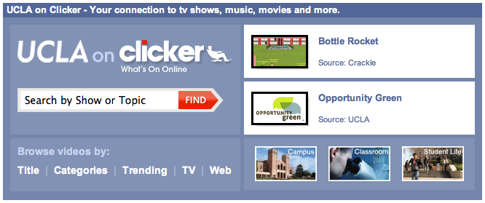
Focusing on the uncommon
UCLA on Clicker provides a search and index capability that integrates Clicker’s existing guide to Internet television with a way to showcase UCLA content.
A two-year pilot project launched in February 2010 in partnership with Clicker Media.
Community education and annual disclosure to students
Legal alternatives to illegal file sharing
Periodic review of plan and assessment criteria

Slide 17
Much of the campus anti-infringement program is about making it difficult to do the wrong thing.
UCLA on Clicker is about making it easy to do the right thing.

Slide 18
The Future of Copyright Enforcement

Slide 19
The Future
New player: Victoria Espinel, IPEC
  Ongoing series of notices of inquiry
  More interest and energy in general
Focus moving from P2P to for-profit Web sites
  FBI’s “Operation In Our Sites” (June 30, 2010)
  S.3804: COICA (Combating Online Infringement & Counterfeiting Act)
Focus moving from legal safe harbors to technology choke-points
  Good news: Takes the spotlight off campuses
  Bad news: We’re ISPs, too

