Slide 1
Portal
Rethinking the Modern-Day Campus
Copyright Ithaca College, 2010. This work is the intellectual property of the author. Permission is granted for this material to be shared for non-commercial, educational purposes, provided that this copyright statement appears on the reproduced materials and notice is given that the copying is by permission of the author. To disseminate otherwise or to republish requires written permission from the author.

Slide 2
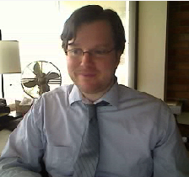
Welcome
David Weil
Director, Enterprise Application Services, Ithaca College - dweil@ithaca.edu
Other Contributors:
Benjamin Costello
Manager, Web & eMedia Development
bcostello@ithaca.edu
Matthew Modrowski
Web & eMedia Developer
mmodrowski@ithaca.edu

Slide 3
For More information
Email us
Visit: www.ithaca.edu/myhome
Copy of presentation is on the EDUCAUSE Conference Site
Interacting
Tweet hash tag #E10_SESS072

Slide 4
Session Goals
Present ways in which we might re-think the campus portal
Provide examples
Generate ideas & thoughts
Note: while the presentation will rely heavily on what we’ve done at Ithaca, not everything described is something we’ve actually implemented. The focus is intended to be on the concepts being described, not a particular implementation.

Slide 5
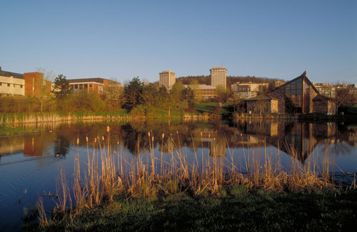
Ithaca College
Private, residential undergraduate liberal arts college in upstate New York
Comprehensive, masters one institution
5 schools, over 100 degree programs
Faculty | 463 FT / 216 PT
Staff | 800 FT / 190 PT
Student FTE
Undergraduate | 6,000
Graduate | 400

Slide 6
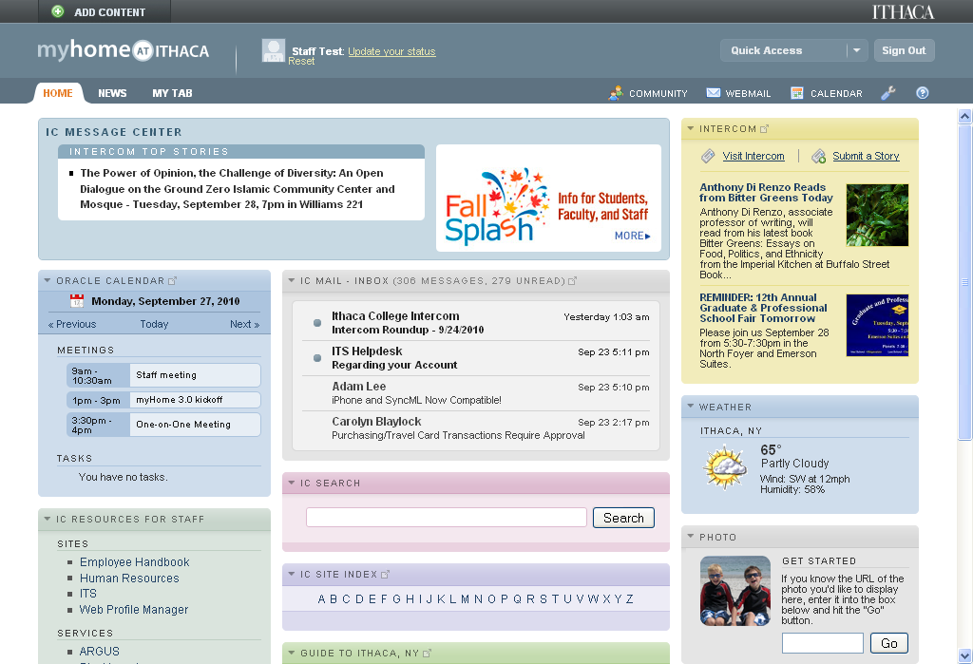
myhome@ithaca Web Portal
Deployed Fall 2008
Major upgrade Spring 2010
Developed in-house
Blends traditional portal w/social networking, other tools

Slide 7
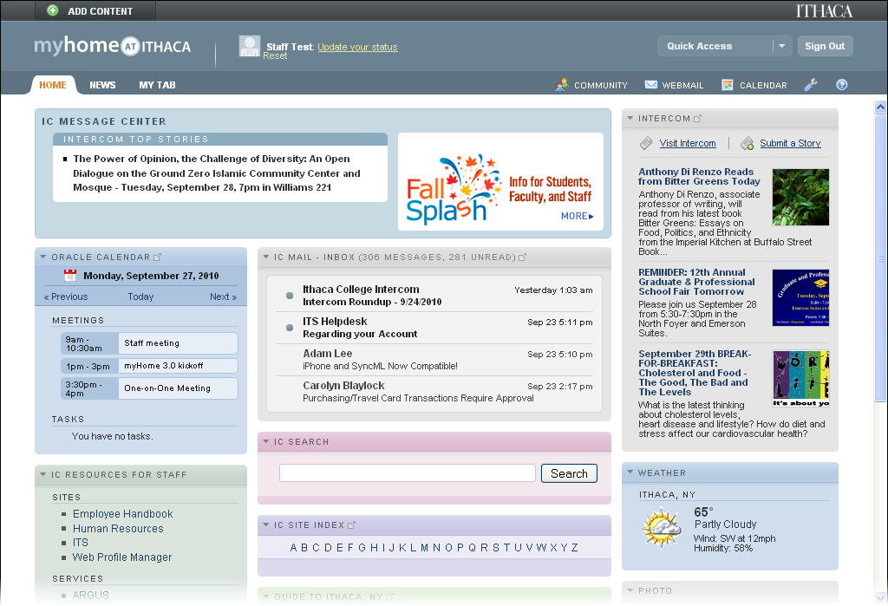

Slide 8
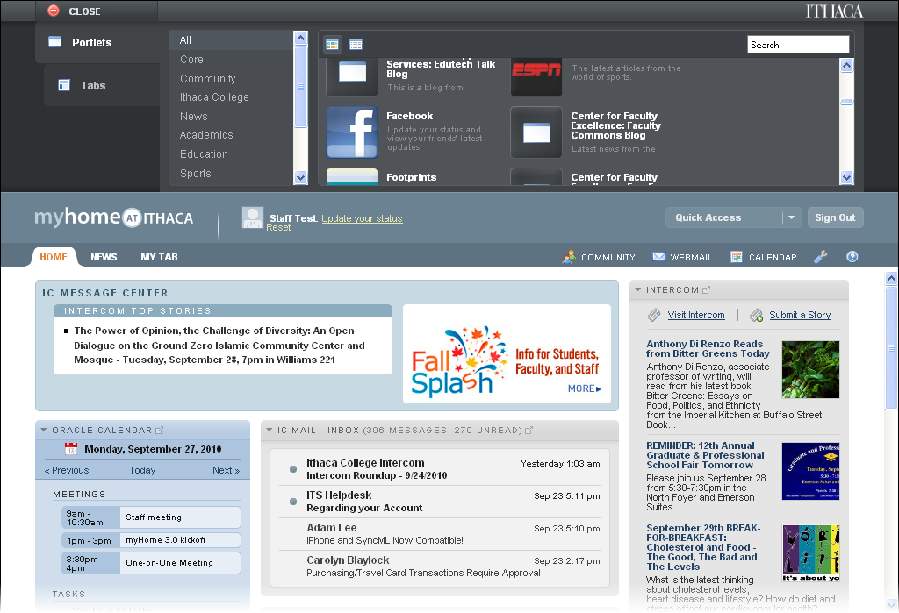

Slide 9
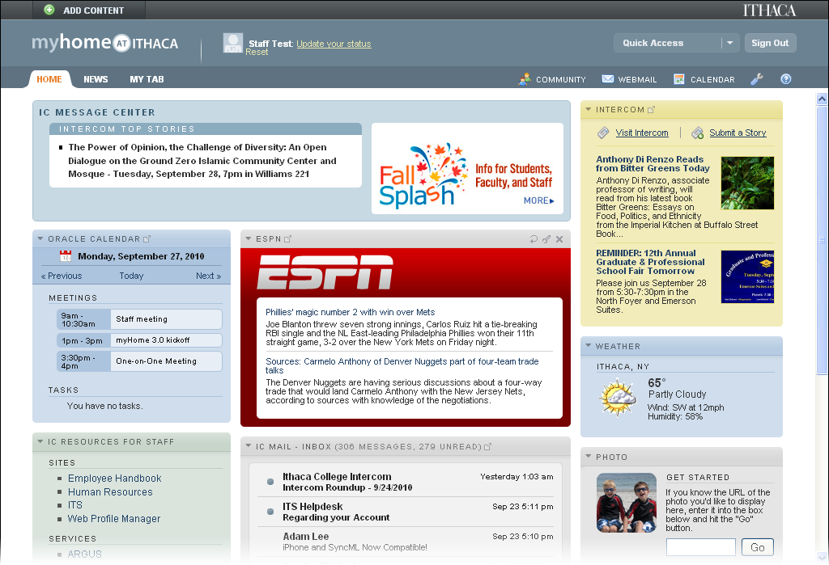

Slide 10
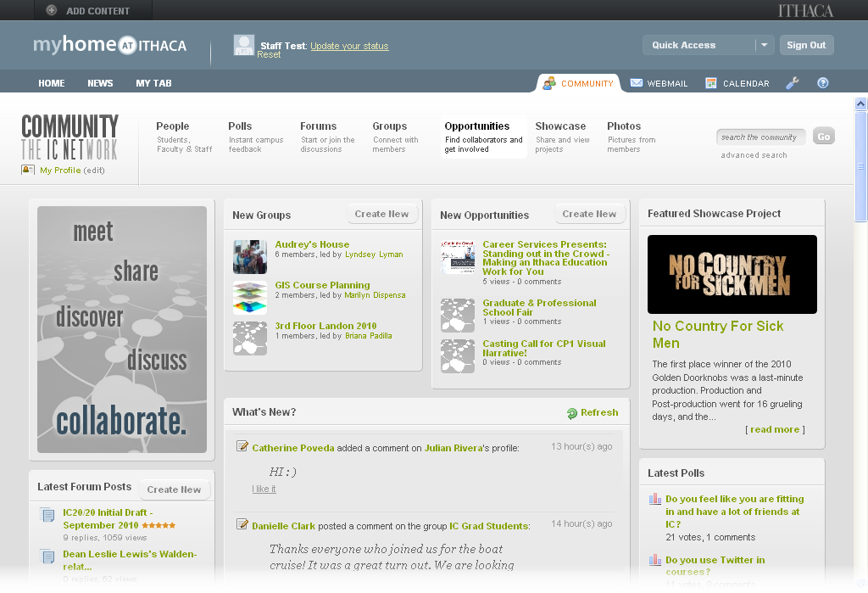

Slide 11
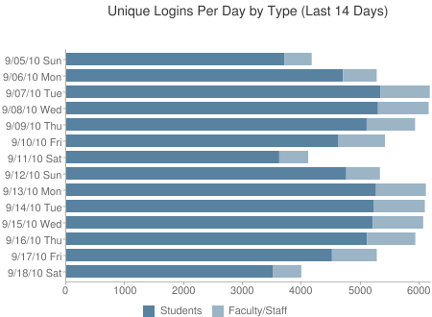
80%
Of the total IC campus population logs into myHome at least once per day

Slide 12
That makes the home page of the portal very, very, valuable.
There is no other place, virtual or physical, that 80% of our campus population goes / sees every day.

Slide 13
Some typical components of a campus portal
Push/Pull Messaging
Online Campus Services
Calendaring
eMail
Dashboards
Self Service
Applications
User Customization

Slide 14
Rethinking the Campus Portal

Slide 15
Rethinking the Campus Portal
Blend On- and Off- Campus Worlds
Streamline Content Delivery
Unify the Campus
Provide a Rich Web / Mobile Experience
Build Community
Increase Security

Slide 16
Rethinking the Campus Portal
Blend On- and Off- Campus Worlds
Streamline Content Delivery
Unify the Campus
Provide a Rich Web / Mobile Experience
Build Community
Increase Security

Slide 17
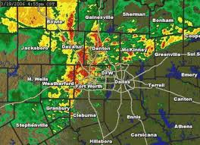
Blend On- and Off- Campus Worlds

Slide 18
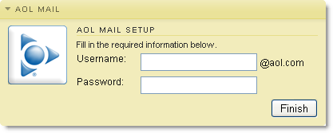
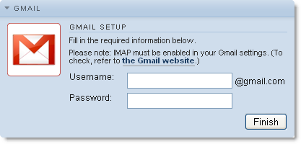
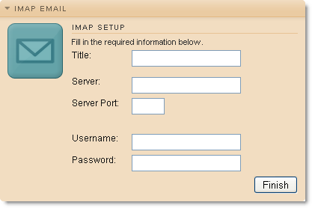
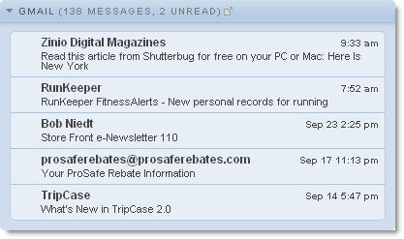
eMail Portlets
Premade & Generic

Slide 19
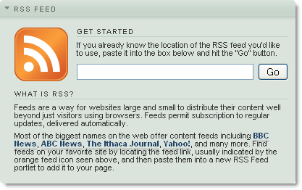
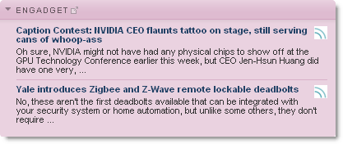
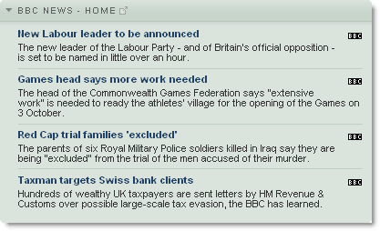
External Content
RSS Feeds

Slide 20
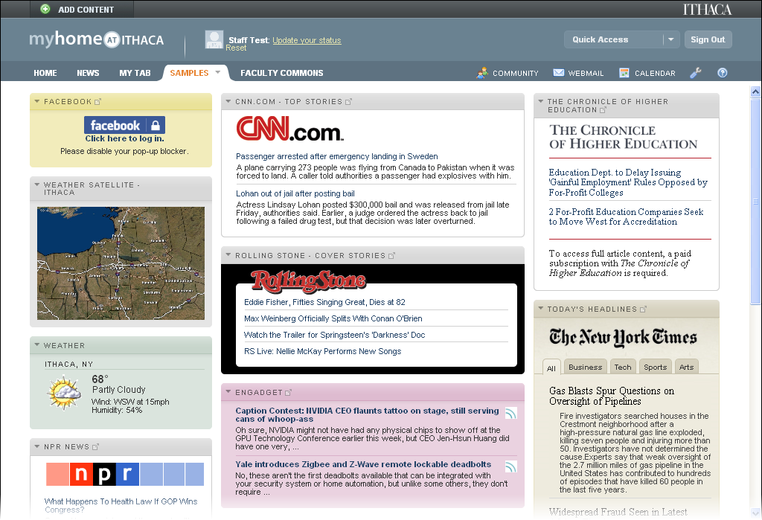
Custom External Content Portlets

Slide 21
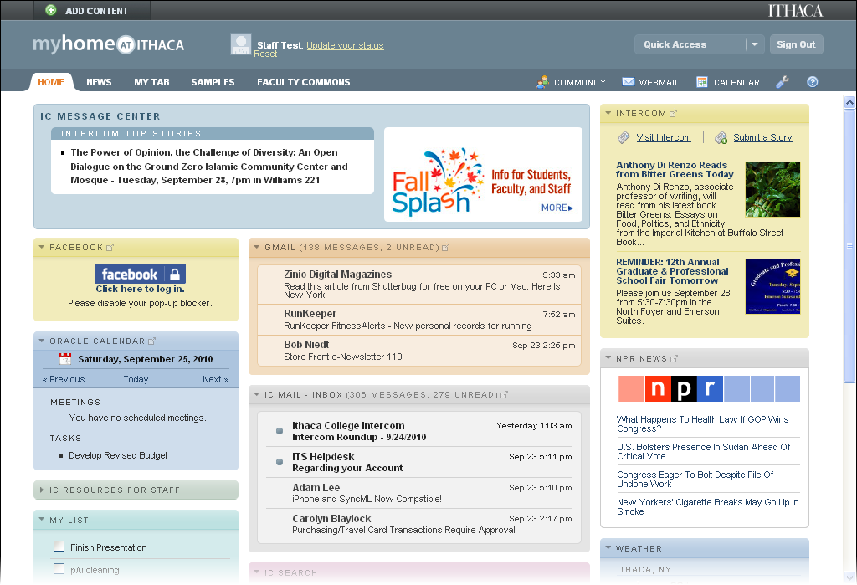
Bringing it all together in one place…

Slide 22
Rethinking the Campus Portal
Blend On- and Off- Campus Worlds
Streamline Content Delivery
Unify the Campus
Provide a Rich Web / Mobile Experience
Build Community
Increase Security

Slide 23
Provide a Rich Web / Mobile Experience
Web 2.0
Mobile
One-point of entry
Location aware

Slide 24
Provide a Rich Web / Mobile Experience
Web 2.0
Mobile
One-point of entry
Location aware

Slide 25
Web 2.0 Experience
Drag & Drop
Customization
Inline content refresh
“Application-like” experience

Slide 26
User Customization
Leverage API’s & Services

Slide 27
Provide a Rich Web / Mobile Experience
Web 2.0
Mobile
One-point of entry
Location aware

Slide 28
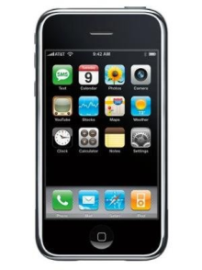
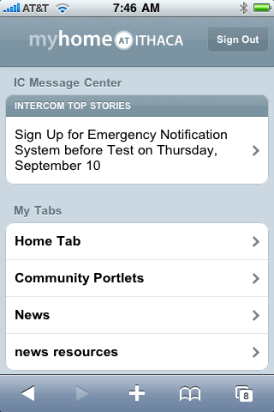
Mobile
Device specific apps
Mobile Optimized Web site

Slide 29
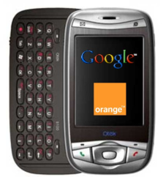
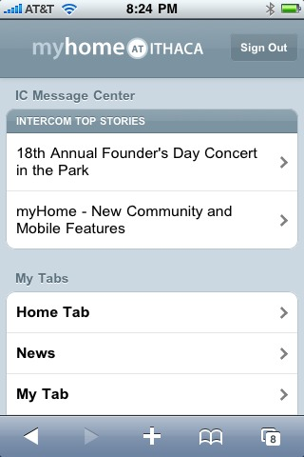
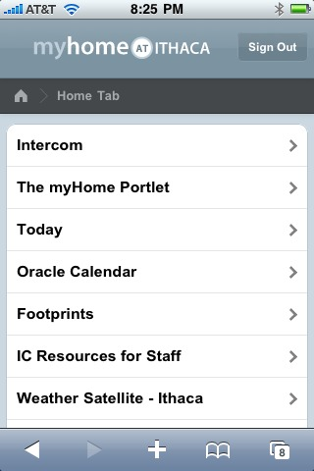
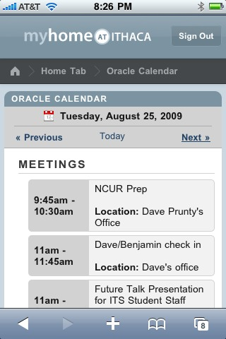
Mobile Website
Use a mobile interface wrapped around selected portlets to provide mobile access

Slide 30
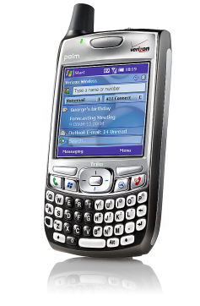
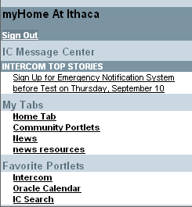
Automatically format for your device
Devices with more limited mobile browsers
iPhone, Palm Pre, etc.

Slide 31
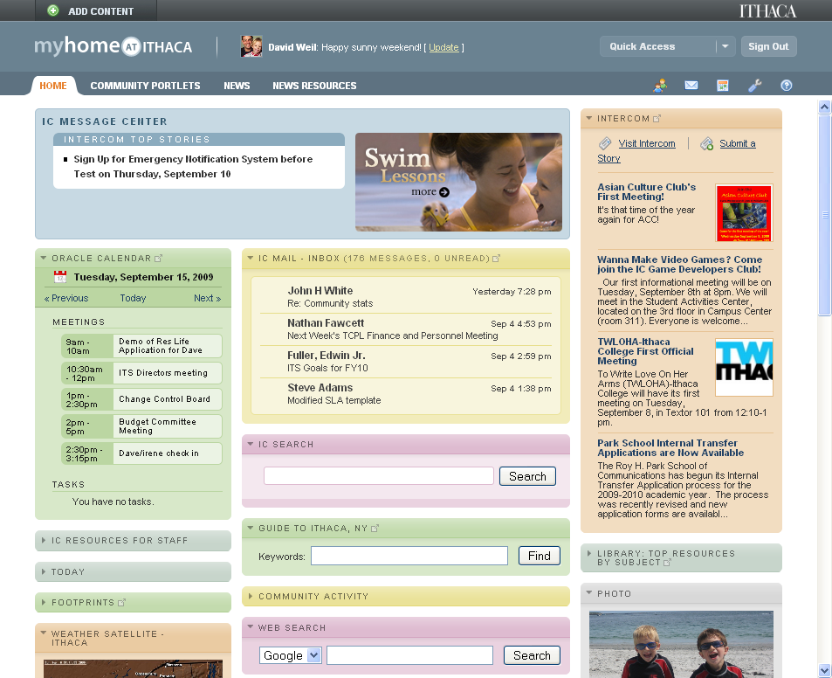
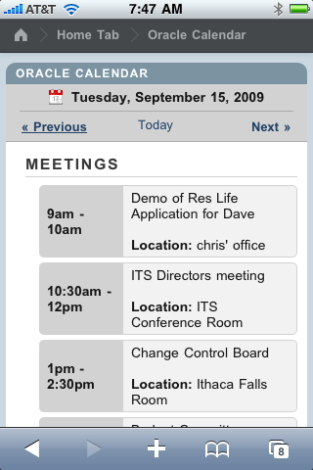
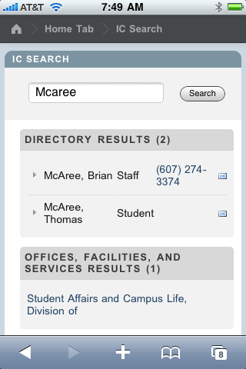
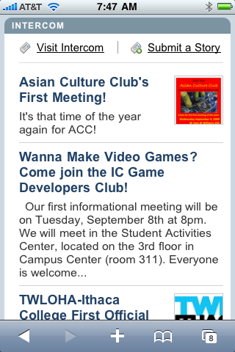
Mobile Menu
Oracle Calendar
IC Search
Intercom

Slide 32
Provide a Rich Web / Mobile Experience
Web 2.0
Mobile
One-point of entry
Location aware

Slide 33
One point of entry…
Log in once, then use the portal as your gateway to other information via:
Portlets
Framed content
Quick Access (Brokered)
Links

Slide 34
Service Tabs
Portlets
Links

Slide 35
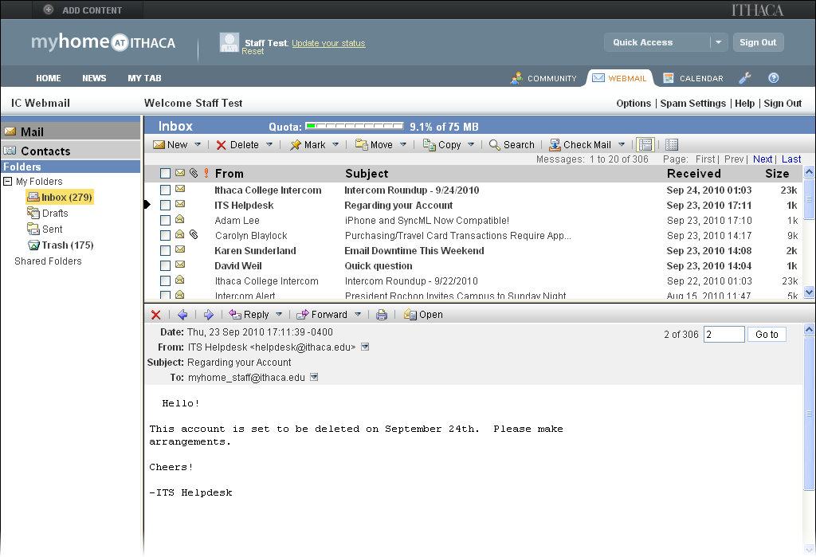
Framed Content

Slide 36
Quick Access Menu

Slide 37
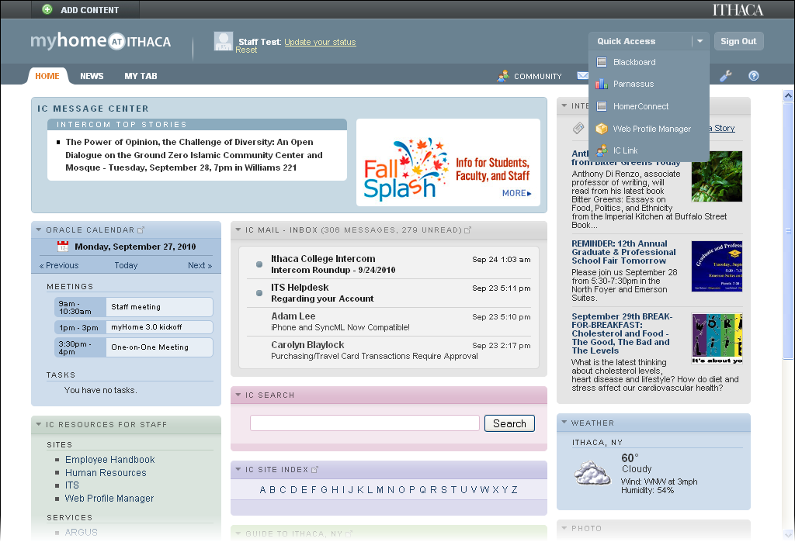
Quick Access Menu
Brokered access to services
Opens in a new window

Slide 38
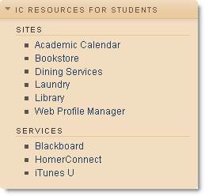
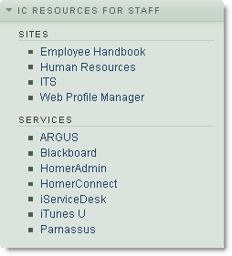
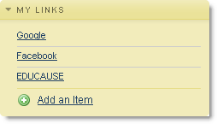
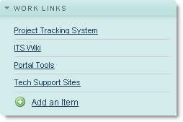
Links
Pre-defined by cohort
User defined links

Slide 39
Provide a Rich Web / Mobile Experience
Web 2.0
Mobile
One-point of entry
Location aware

Slide 40
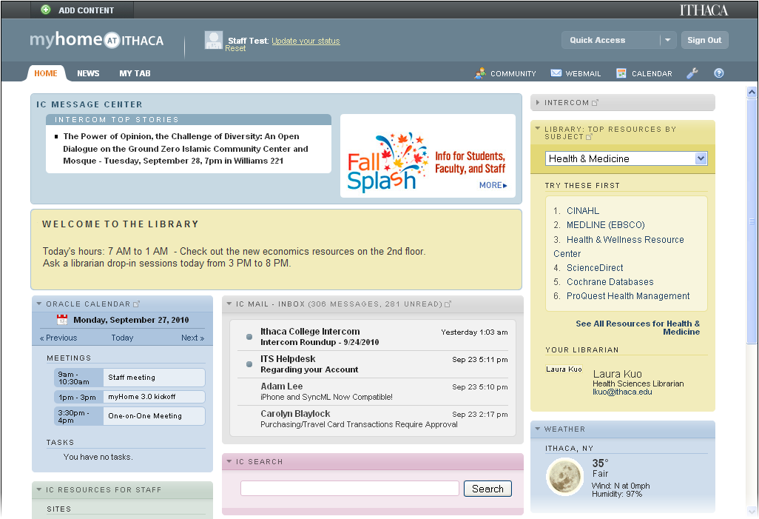
Location Awareness
Provide different information depending on where you are
Mobile
Desktop

Slide 41
Rethinking the Campus Portal
Blend On- and Off- Campus Worlds
Streamline Content Delivery
Unify the Campus
Provide a Rich Web / Mobile Experience
Build Community
Increase Security

Slide 42
Build Community
Integrated Social Networking Tools
“Collaboration Classifieds”

Slide 43
Build Community
Integrated Social Networking Tools
“Collaboration Classifieds”

Slide 44
Integrated Community Tools
Profiles / People
Friends
Groups
Wall
Polls
Photos
Other functions

Slide 46
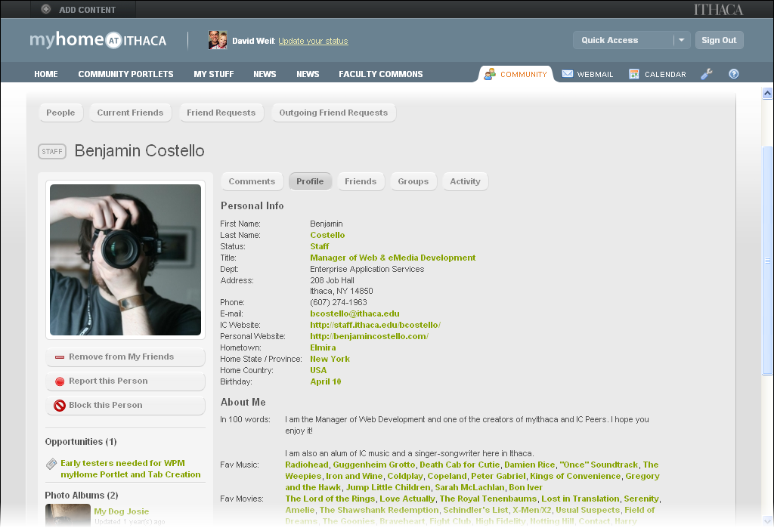

Slide 47
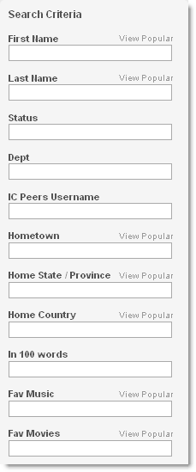
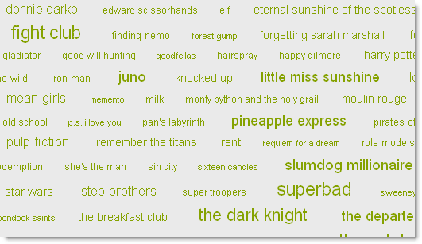
Use of tag clouds to find people with similar interests

Slide 48
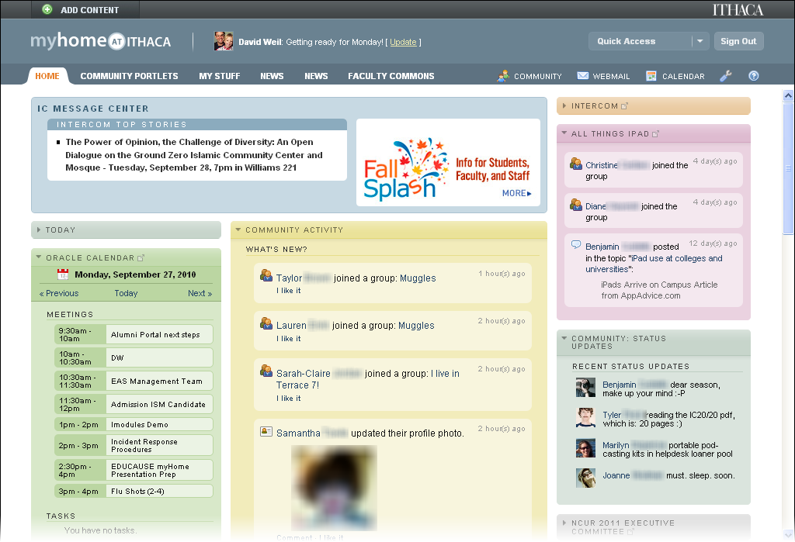
Update your status
Group Activity
Monitor Community Activity

Slide 49
Build Community
Integrated Social Networking Tools
“Collaboration Classifieds”

Slide 50
Opportunities
Classifieds-like system
Focus is on collaboration and making connections

Slide 51
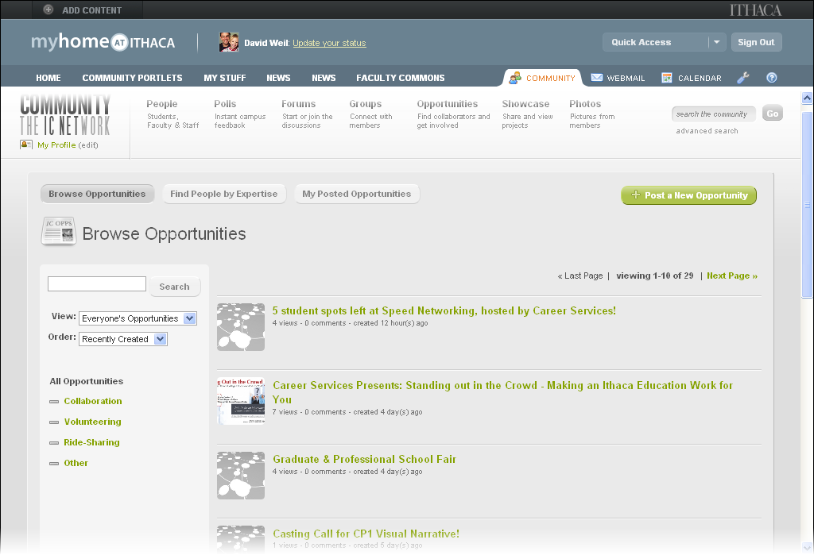

Slide 52
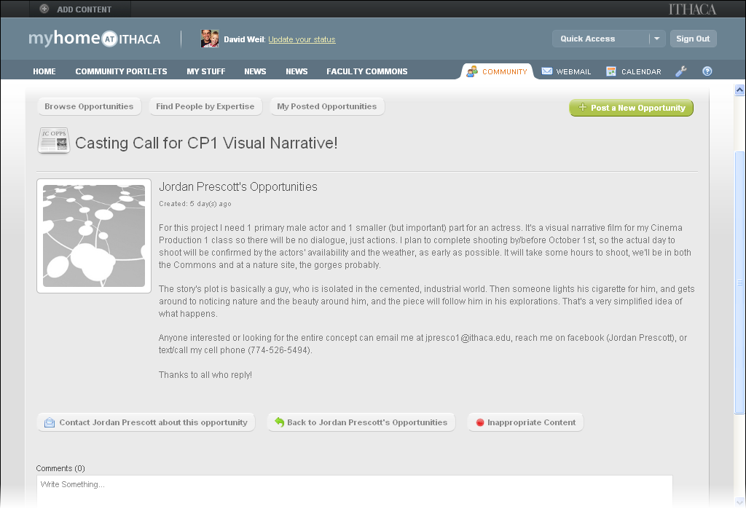

Slide 53
Rethinking the Campus Portal
Blend On- and Off- Campus Worlds
Streamline Content Delivery
Unify the Campus
Provide a Rich Web / Mobile Experience
Build Community
Increase Security

Slide 54
Increase Security
“Front Door” for Web-services
Role-based access

Slide 55
Increase Security
“Front Door” for Web-services
Role-based access

Slide 56
Portal is the front door
Internet
Traffic must pass through the portal
Network layer controls
Portal
SiS
LMS
HR
Files

Slide 57
Increase Security
“Front Door” for Web-services
Role-based access

Slide 58
Role Based Control
Default layouts
What portlets you can add / view
QuickAccess menu items
Targeted messages

Slide 59
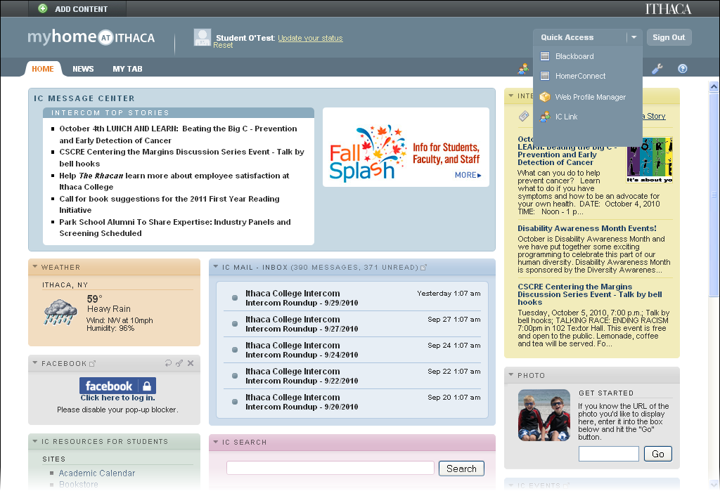
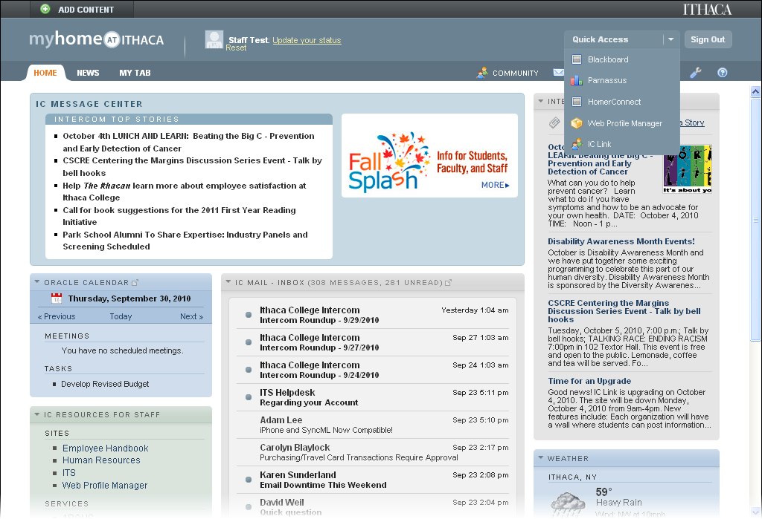
Student Role
Different Portlets
Staff Role
Different QuickAccess Menu Options

Slide 60
Rethinking the Campus Portal
Blend On- and Off- Campus Worlds
Streamline Content Delivery
Unify the Campus
Provide a Rich Web / Mobile Experience
Build Community
Increase Security

Slide 61
Streamline Content Delivery
Leveraging content management system
Publishing pre-defined content sets

Slide 62
Streamline Content Delivery
Leveraging content management system
Publishing pre-defined content sets

Slide 63
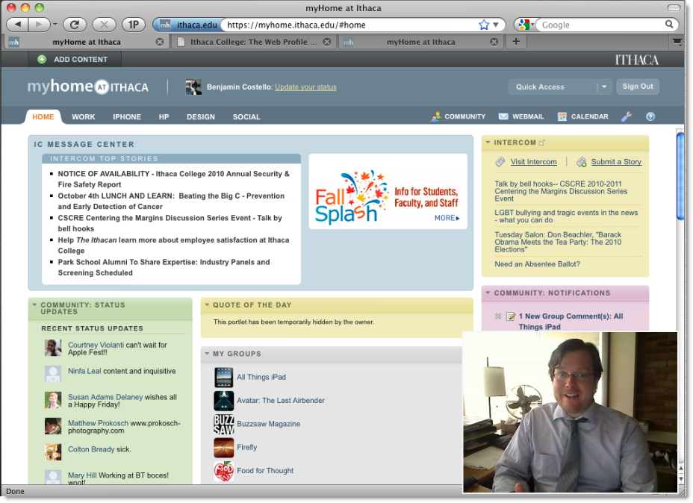
Using a content management system to allow distributed content creators to publish portlets
Benjamin Costello
Manager, Web & eMedia Development
bcostello@ithaca.edu

Slide 64
Streamline Content Delivery
Leveraging content management system
Publishing pre-defined content sets

Slide 65
Pre-packaged “Tabs”
Publish a pre-configured set of portlets
Can be refreshed centrally

Slide 66
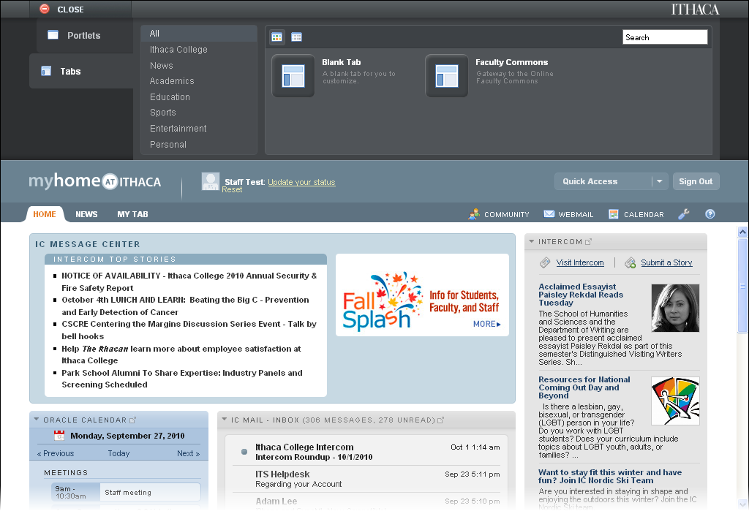

Slide 67
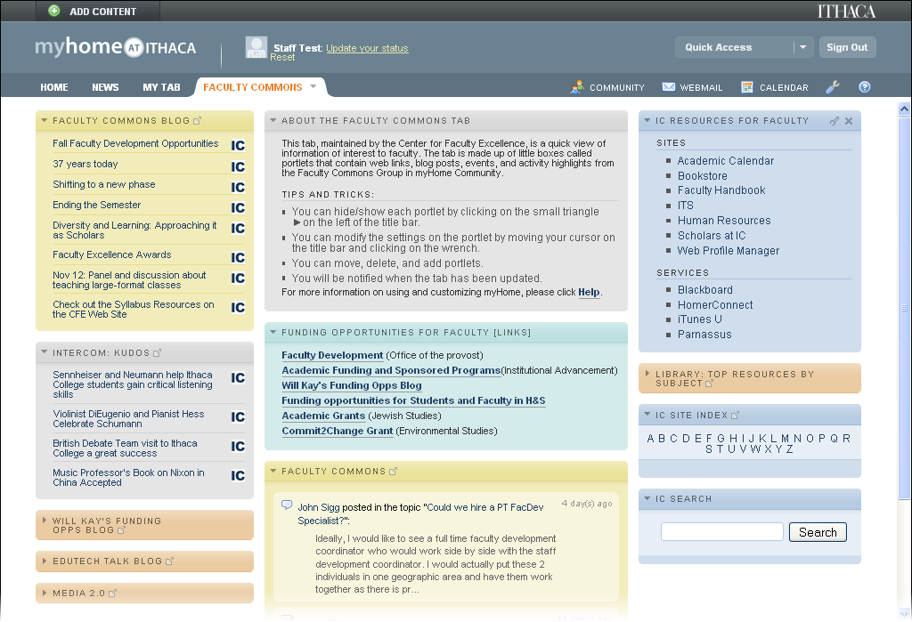

Slide 68
Rethinking the Campus Portal
Blend On- and Off- Campus Worlds
Streamline Content Delivery
Unify the Campus
Provide a Rich Web / Mobile Experience
Build Community
Increase Security

Slide 69
Unify the Campus
Central place for official information
Provide collaboration and discussion spaces
Share what’s going on

Slide 70
Unify the Campus
Central place for official information
Provide collaboration and discussion spaces
Share what’s going on

Slide 71
IC Message Center
Highlight important campus information
Role-based
Situational information

Slide 72
Balancing Official and Personal Information

Slide 73
IC Message Center
Highlights Official college information
Cannot be removed, moved, or collapsed
myHome always starts on “Home” tab
General Campus Alerts (Intercom Alerts)
Public Safety Alerts

Slide 74
Campus Newsletter

Slide 75
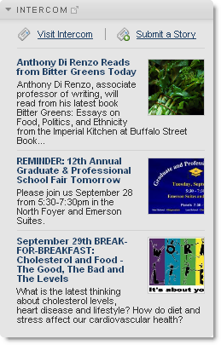
Intercom – College Newsletter
Internal college newsletter
Events, information for faculty, staff, students
Cannot be deleted
Can be streamlined, collapsed

Slide 76
Campus Newsletter

Slide 77
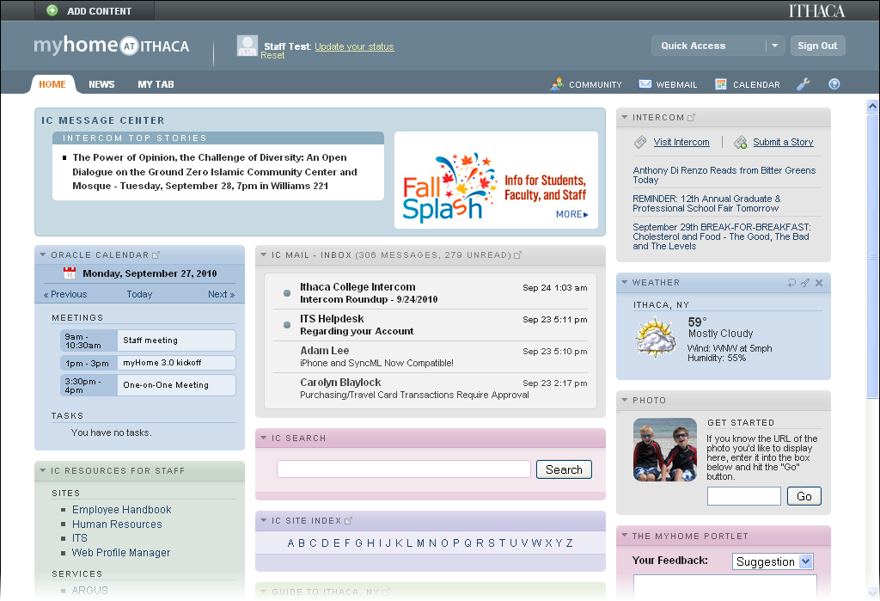
Campus Newsletter

Slide 78
Campus Newsletter

Slide 79
A slightly different approach that provides more flexibility for users

Slide 83
Unify the Campus
Central place for official information
Provide collaboration and discussion spaces
Share what’s going on

Slide 84
Collaboration and Discussion
Groups
Public
Private
Discussion Forums
General
By Role

Slide 89
Unify the Campus
Central place for official information
Provide collaboration and discussion spaces
Share what’s going on

Slide 90
Showcase
View projects from across campus
Anyone can create a new project
Each project can have:
Description
Photos
List of collaborators
Wall/Feedback
Collaboration Opportunities
Mailing list

Slide 93
Rethinking the Campus Portal
Blend On- and Off- Campus Worlds
Streamline Content Delivery
Unify the Campus
Provide a Rich Web / Mobile Experience
Build Community
Increase Security

Slide 94
Conceptual model of a different type of portal interface
Matthew Modrowski
Web & eMedia Developer
mmodrowski@ithaca.edu

Slide 95
Thanks!
Rethinking the Campus Portal
Blend On- and Off- Campus Worlds
Streamline Content Delivery
Unify the Campus
Provide a Rich Web / Mobile Experience
Build Community
Increase Security
David Weil
dweil@ithaca.edu or myhome@ithaca.edu
Information site: www.ithaca.edu/myhome
Presentation is on the EDUCAUSE Conference Site

