Slide 1
A Survey of Video Streaming Practice and Aspirations in Academic Libraries
Mark Notess
Jon Dunn
EDUCAUSE 2010
October 14, 2010

Slide 2
Survey Context: Variations on Video

Slide 3
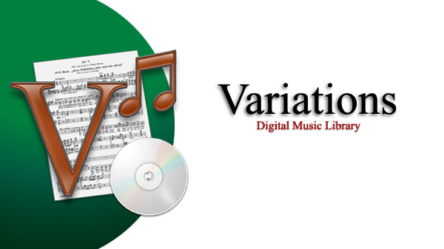
Open source digital music library system
Used at a dozen institutions, mainly for streaming audio course reserves
@IU, current version online since 2005, now with ~20,000 digitized albums; in heavy daily use

Slide 4
What’s in the box
Includes
Server software
Client construction kits for Windows and Mac
Sample content: 2 recordings and scores
Various utilities for authentication, authorization & encoding
Web applications for audio playback & authorization mgmt
Just add
A Linux/Unix server
MySQL, Apple Darwin SS, Java, Quicktime, Perl, Tomcat, Apache
Your content
Nutrition Facts
Open source BSD license
Album- not track-based
Online access to streaming audio and scanned score images
Flexible access control
Teaching & learning tools for annotation & analysis
See variations.sourceforge.net for more information.

Slide 5
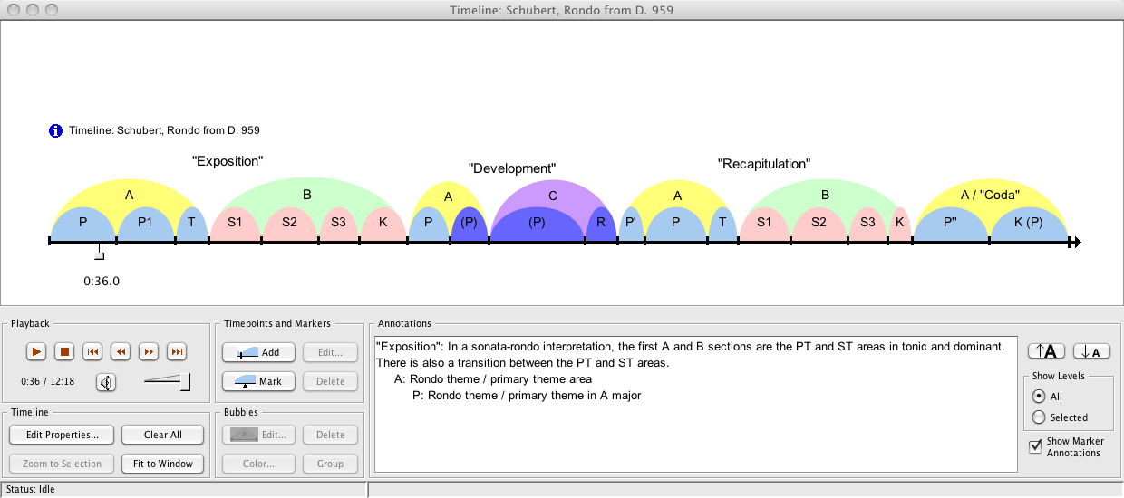
Variations: Pedagogical Tools

Slide 6
Variations on Video
Add online video access capabilities to Variations, providing equivalent access, annotation, and analysis tools to support teaching and learning.
Initial planning grant, Aug 2010 – Jan 2011 from the Institute of Museum and Library Services
IU & Northwestern are lead institutions
Funding multi-institutional collaboration on functional and technical requirements
Goal: Submit full implementation grant proposal to IMLS in Feb 2011

Slide 7
Motivators for Variations on Video
Demand from Variations implementers
Increased video digitization locally at IU
IU Media Preservation Initiative
IU IT strategic plan: Empowering People
History of involvement in open and community source software
Desire to create a sustainable foundation for Variations development and maintenance

Slide 8
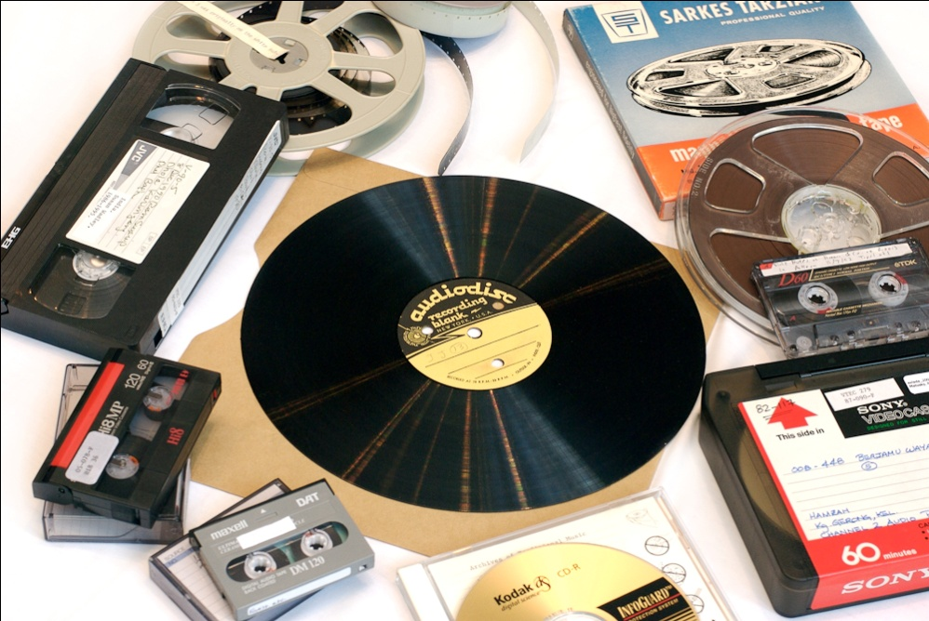

Slide 9
Variations on Video: Scope
Access to managed collections
Video, audio
Focus on libraries, archives
Research, teaching, and learning use
Variety of access control requirements
Integration with preservation repository services
Ad-hoc faculty/student uploads ☒
Classroom capture ☒
Live streaming ☒
Working digital assets – media production ☒

Slide 10
Variations on Video: Content
Video digitized from library collections
Live Performances
University produced video
Feature Films
Research-
related
Video
Archival collections
TV shows
Files with purchased or licensed streaming rights
Lecture
Series
Faculty-produced video
Field Recordings
Documentaries

Slide 11
Variations on Video Grant Objectives
Identify functional and technical requirements and define scope based on input from:
Librarians and technologists
Faculty and students
Technical investigation and gap analysis
Develop high-level technical architecture and development plan
Form partnership for development and ongoing maintenance
Submit IMLS National Leadership Grant proposal (February 2011)

Slide 12
Survey Results
Spring 2010

Slide 13
Overview
Survey conducted online April 29 - June 5, 2010
Invitations sent to
MLA-L
Code4lib
Some Variations lists
DLF-L
SYSLIB-L
VIDEOLIB
AMIA-L
Approximately 150 respondents completed the survey, though most questions were optional so response numbers vary
Of these, ~90 reported currently streaming video

Slide 14
Primary Institutional Role
Who were the survey respondents? (N = 136)
Other:
Media Specialists (3)
Archivists (2)
Digital Services Librarian (2)
Programmer, Metadata Librarian, Faculty, Developer….
Notes:
Survey Question 28

Slide 15
Those Currently streaming Video
~90 respondents

Slide 16
What are the main kinds of video content you stream? Check all that apply (N=94)
Notes:
Question 2

Slide 17
What streaming server do you use? Check all that apply (N=88)
Other: includes Wowza, YouTube, iTunes, VideoFurnace, Apple H.264 ….
Notes:
Question 3

Slide 18
What method do you use to restrict access to your streaming video? Check all that apply (N=91)
Other: Some materials are open, some are not; on-campus only; it depends….
Notes:
Question 4

Slide 19
Which organization has primary responsibility for managing your video streaming server technology? (N=92)
Library (47%)
Campus IT Department (27%)
Consortium of which we are a member (7%)
A commercial third-party to whom we outsource (4%)
Other (15%) – Most of these responses were multiple servers run by multiple organizations
Notes:
Question 5

Slide 20
What do you like about your current video streaming solution? (N=66)
(open responses categorized by topic, ranked highest to lowest by count)
Reliability
Broader/easier access
Tools: Clips can be created by faculty for courses, videos can be embedded, access can be controlled at several levels by admin.
Easy to use and set up
High praise from faculty and students
Video stream is high-quality
Security and password protection
Conversion of obsolete formats
Support for a variety of formats
Notes:
Question 6

Slide 21
What needs are not well met by your current solution? (N=57)
(open responses categorized by topic, ranked highest to lowest by count)
Rights management
Ability to control authentication or restrict access
Lacking clip creation, Blackboard embed, clip portability, collaboration, bookmarking
Workflow is time-consuming, labor-intensive
Off-campus access, mobile access
Metadata production
Limited file support
Platform limitations (only vendor products can be used)
Statistical data gathering
Notes:
Question 7

Slide 22
Those NOT Currently streaming Video
~60 respondents

Slide 23
What statement best describes your library’s plans for streaming video? (N=66)
Notes:
Question 8

Slide 24
If you have already decided which video streaming server to use (or have a leading candidate), indicate which one you have chosen (N=24)
Other: Wowza (2), Flash (2), RealMedia,
CONTENTdm, Video Furnace, Kaltura, SAFARI Montage
Notes:
Question 9

Slide 25
What main types of video content would you like to stream? Check all that apply (N=64)
Notes:
Question 10

Slide 26
Both groups of respondents
~150 respondents

Slide 27
What is important in a video streaming solution?
(The following selected answers show high ‘must have’ responses)
 | Must Have | Would Like | Not Sure | Don’t Need
Users can adjust playback location precisely (within a second of the desired location) | 48 | 55 | 22 | 5
Users can mark a particular location in a video for future immediate access (bookmarking) | 33 | 73 | 17 | 9
Users can create a playlist of segments from different videos for future reference | 27 | 77 | 15 | 12
Videos can be accompanied by transcripts | 28 | 70 | 22 | 10
Video content can be delivered to mobile devices | 21 | 70 | 30 | 11
Notes:
Questions 12-23

Slide 28
Interactive, end-user features wanted in a video streaming solution
(open responses categorized by topic, ranked highest to lowest by count)
Clips can be downloaded for use in other applications
Closed and Soft Captioning
Search by indexed transcript
Tools for creating learning objects for integration into online classes
Re-purposing of content for student use (annotation, bookmarking, remixing)
Remote Access
Statistics on use (overall, by school, by staff member)
Notes:
Survey Question 24

Slide 29
Which of the following repositories or digital asset management systems are you currently running? Check all that apply (N=107)
Other includes Digital Commons, bepress, DigiTool, Symposia, custom in-house systems….
Notes:
Question 25

Slide 30
If you are running a repository or digital asset management system, check any that you use to store video assets (N=68)
Other: In-house or custom (6), bepress (2), Digital Commons (2), various….
Notes:
Question 26

Slide 31
Additional Comments
(open responses categorized by topic, ranked highest to lowest by count)
Issues
Opportunities
Copyright barriers
Cost of licensing
No coherent policy on fair use in this ‘Wild West DRM frontier’
Conflicts between needs of Library and IT
Storage costs
Faculty and students love their streaming video solution
Increased collaboration
Notes:
Question 27

Slide 32
Variations on Video Project Participant Meeting
Held October 5-6, 2010, at IU
Institutions contributed usage scenarios to surface user requirements
Analyzed scenarios and developed functional & technical requirements

Slide 33
Variations on Video: Other Planning Phase Participants

Slide 34
Preliminary directions
More likely to focus on ingest, management and delivery than on sophisticated analysis and annotation, at least initially
Tending towards a modular approach
Investigating opportunities to leverage work of other projects where possible, such as Opencast Matterhorn and Kaltura

Slide 35
Initial Module List (tentative)
Ingest/transcoding
Media delivery server
Basic player interface
Simple metadata storage and management search
Access control (with or without rights), with authentication piece
Ability to import metadata from other systems

Slide 36
Basic Player
Navigational metadata (i.e., chapters/tracks)
Precise, responsive time positioning
Embeddable
Browser- or mobile-based
Bookmarks
Clip and playlist creation

Slide 37
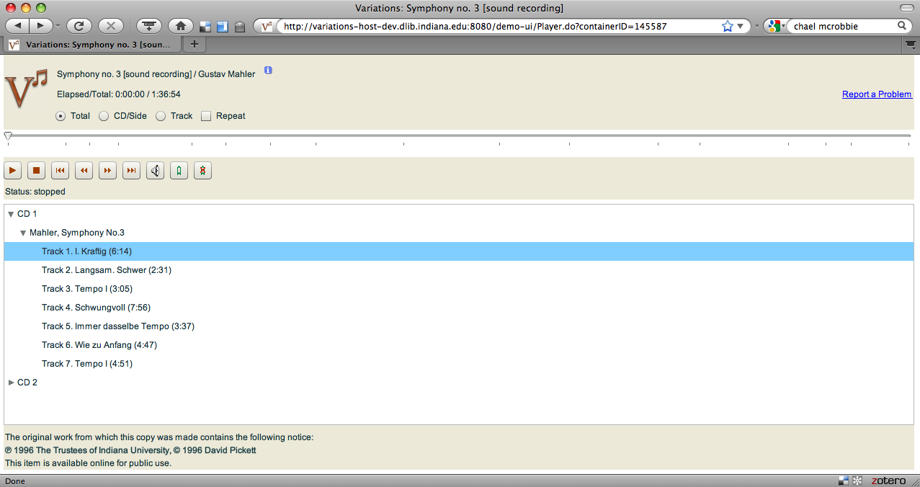
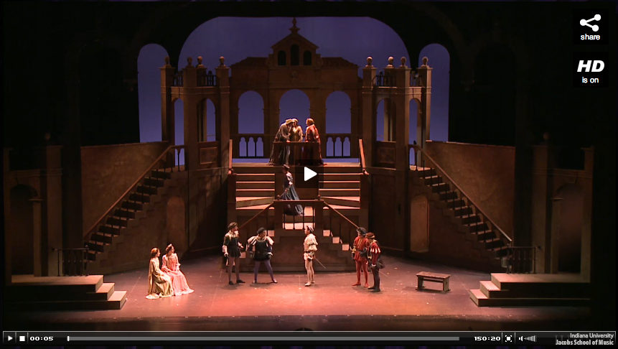
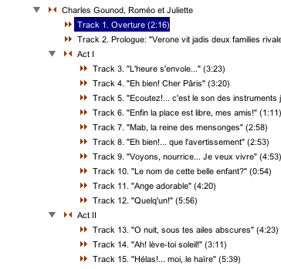
Player Concept
Roméo et Juliette / Charles Gounod
Elapsed/Total: 0:00:05 / 150:20:03
View IUCAT Record
Logged in as mnotess :: Logout
My Bookmarks

Slide 38
Interested?
We are looking for partners
Visit our project page: http://www.dlib.indiana.edu/projects/vov
Survey writeup will be posted on VoV site
Follow us on Facebook or Twitter
BOF this afternoon, 4:30-5:20 in 207A

