Slide 1
Building a Cyberinfrastructure Culture: IT as a Partner in Research
EDUCAUSE 2010
Curt Hillegas
Director of Research Computing
Princeton University
Notes:
My name is Curt Hillegas, and as Director of Research Computing at Princeton University I’m going to talk to you today about how you can build a successful cyberinfrastructure program into your university’s culture (and notice I said successful).
Having been on multiple sides of the coin over my 20 years at Princeton, first as a researcher while I earned my Ph.D. in Chemistry, then moving on to my IT career where in the early stages I did everything from system administration and designing email systems, to building large storage systems, then moving on to the management side on which I have been managing and leading teams for 10 years, one of the key principles I’ve learned through all of this is that if you do not build partnerships you will not be successful.
By the end of our time together today, you’ll clearly understand why partnerships play such an important role in building and maintaining a successful cyberinfrastructure program.
I’m also going to give you some specific examples of approaches that have worked for us and that perhaps you can successfully apply to your own program if it makes sense at your institution.
Before we get started I would like to set the context.

Slide 2
Cyberinfrastructure
Cyberinfrastructure consists of computational systems, data and information management, advanced instruments, visualization environments, and people, all linked together by software and advanced networks to improve scholarly productivity and enable knowledge breakthroughs and discoveries not otherwise possible.
Developing a Coherent Cyberinfrastructure from Local Campus to National Facilities: Challenges and Strategies A Workshop Report and Recommendations
Notes:
*** Research is driven by the faculty ***
Partnerships involve two or more parties coming to the table recognizing each other’s strengths and finding ways to solve problems by maximizing the combined knowledge, experience and skills of all involved.
Having set the context for the topic, let’s look at an overview of what we’ll discuss.

Slide 3
Contents
Building a CI Program
Current Successes and Challenges
Opportunities for Continued Growth
Summary
Notes:
Let’s start at the beginning, building a ci program

Slide 4
The Beginning
CSES: Computational Science and Engineering Support group - OIT, Academic Services
PICSciE: Princeton Institute for Computational Science and Engineering
RCAG: Research Computing Advisory Group
Notes:
Now that we had a support and governance structure, we needed to take the first major step.

Slide 5
Building Trust
AdrOIT – small Beowulf cluster
Princeton Software Repository
University Internet connectivity
Maintenance of old systems
Elders image – rebuilt RHEL distribution
Notes:
As we began to gain the trust of the faculty and departments, it was time to reach out and develop relationships.
*** Trust ***

Slide 6
Building Relationships
Hire new faculty
1st annual RCAG Presentation
Wow!!!
Let’s buy something big together
Collaborative selection process
Cobble together funding
Notes:
*** Relationships ***
But as we can see from the faculty member’s reaction at our presentation, relationships are not enough.

Slide 7
Building Partnerships
64 processor SGI Altix BX2, Hecate
1024 node IBM BlueGene/L, Orangena
Faculty
OIT
Development
Facilities
Collaborative administration (without fees)
Housed in central Data Center (without fees)
256 node Dell Beowulf cluster, Della
HPC Steering Committee
Notes:
*** Partnerships ***
We had now built a successful program, but we are still learning lessons.

Slide 8
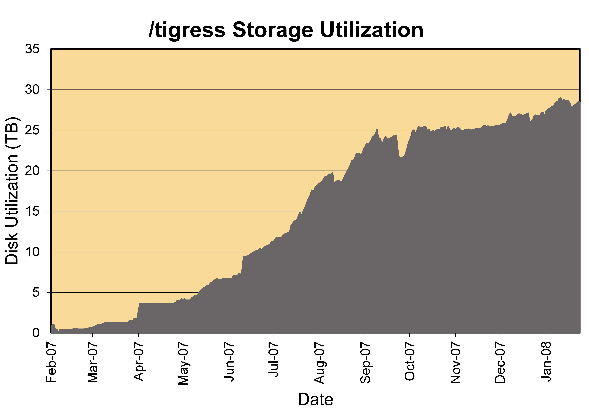
Storage
Hire a pair of junior faculty
35 TB GPFS Storage System
96 node SGI Altix ICE, Artemis
RCAG – Need a scalable storage system that provides appropriate performance and availability for aging data
Hierarchical Storage Management System
Notes:
*** Avoid fees ***
Of course it never get’s easy

Slide 9
Success Brings New Challenges
Senior faculty hire
448 node Dell cluster
New scheduling policies
(Supercomputing|Scientific Computing) Administrators Meeting – SCAM
DataSpace
Notes:
*** Change is constant ***
Having shown you how we’ve arrived where we are today, I’d like to highlight some of our current measures of success and new challenges.

Slide 10
Cyberinfrastructure at Princeton
Programming Support
Research Computing Base
Software
HPC Hardware
Infrastructure
Collaboration
Visualization
Storage
Infrastructure
Notes:
Let’s get a brief overview of our current hardware.

Slide 11
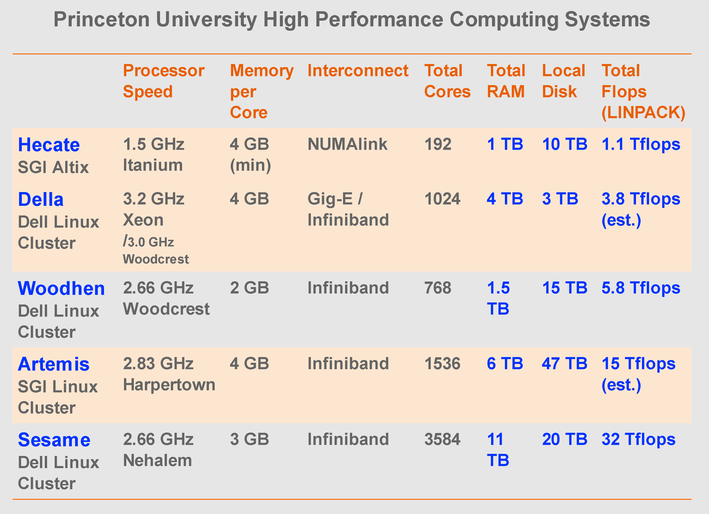
HPC Hardware
Programming Support
Research Computing Base
Software
HPC Hardware
Infrastructure
Collaboration
Visualization
Storage
Infrastructure
Notes:
Moving on to visualization

Slide 12
Visualization
Visualization Expert
Sony SRX-S110 Projector
8,847,360 pixels (4096x2160)
Rear projection ultra wide angle fabric screen
9’3” (H) X 16’6” (W)
Open Source and Proprietary software
Programming Support
Research Computing Base
Software
HPC Hardware
Infrastructure
Collaboration
Visualization
Storage
Infrastructure
Notes:
Perhaps our most exciting current activity is our new High Performance Computing Research Center.

Slide 13
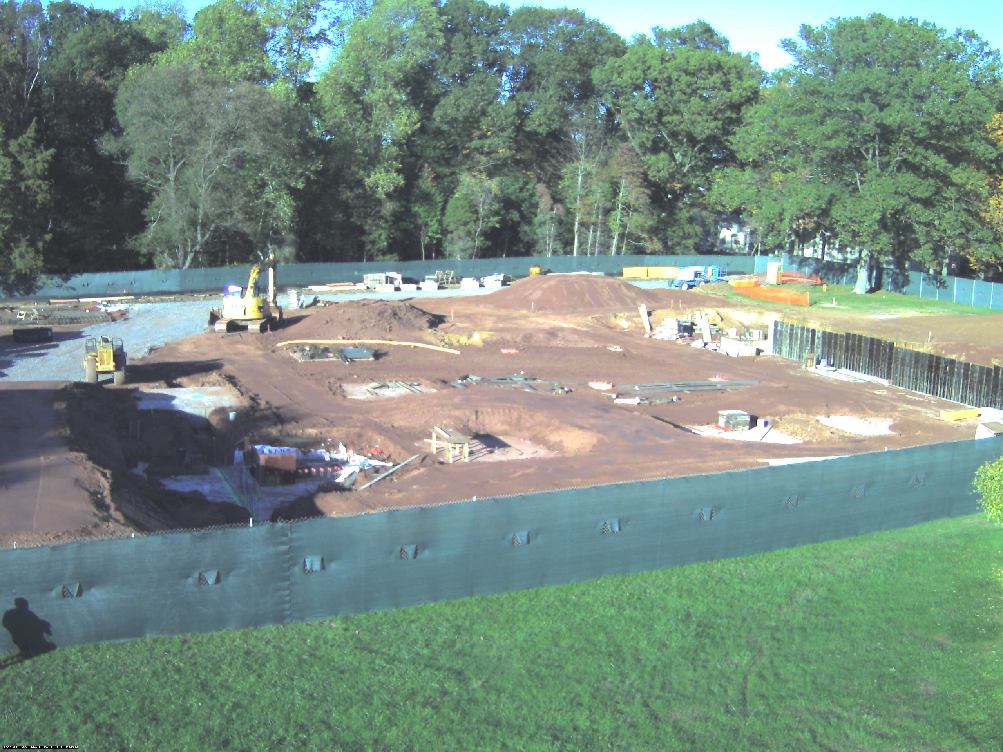
HPCRC
High Performance Computing Research Center
OIT
PICSciE
Provost
Facilities
RCAG
Programming Support
Research Computing Base
Software
HPC Hardware
Infrastructure
Collaboration
Visualization
Storage
Infrastructure
Notes:
All of this has not just been enabled by, but it has been driven by the collaborative environment we have built.

Slide 14
Collaboration
PICSciE
RCAG
TIGRESS Steering Committee
TIGRESS Users
SCAM
PLUG
Programming Support
Research Computing Base
Software
HPC Hardware
Infrastructure
Collaboration
Visualization
Storage
Infrastructure
Notes:
Those are some of the highlights from today, but where do we need to go from here?

Slide 15
Future
Coordinated supervision of departmental scientific/Linux system administrators
Collaboration with the Library
Lifecycle management
New technologies
GPGPU
Power7
X86_64 based single image
Participation in Virtual Organizations
Notes:
Finally let’s sum up with some of the lessons we’ve learned building our program.

Slide 16
Summary
Research is driven by the faculty
Trust, relationships, and partnerships are essential to success
Research computing relies on the complete cyberinfrastructure of the University
Avoid fees
Change is a constant
Start small, do things well, and growth will follow
It’s all about the people

