Slide 1
Core Data Service 2009 Annual Summary Report
Pam Arroway, Eric Davenport, Guangning Xu
and
Dan Updegrove

Slide 2
EDUCAUSE Core Data Service (CDS)
Annual survey instrument
currently being redesigned for 2011
Web-based interactive database
currently being redesigned for 2011
Annual, publicly available summary report based on data collected from the survey
2009 Fiscal Year (2008-2009)
Redesign well underway (Dan Updegrove)
OPEN HOUSE—2:45-4:15pm in 201 B/C

Slide 3
Underlying Principles
Data are identifiable by institution
Only campuses that participate have access to the data
Appropriate Use Policy

Slide 4
Methodology
All EDUCAUSE members (US and outside of the US) are invited to participate
In addition, non-members may be invited to participate
Multicampus systems and community college districts
System offices can not enter data directly
Component campuses enter data
If 40% of campuses in a system complete the survey, system office gains access

Slide 5
Respondents
Nearly 900 respondents
Data can still be submitted until December 31, 2010!
Location | Respondents
US | 790
Outside US | 90

Slide 6
Methodology (cont)
All data are captured electronically
And available electronically
Embedded in the survey
Numerous pop-ups and help links
Navigation to a glossary
Other aids
Some basic data auditing is done in real time

Slide 7
CDS Survey
IT Organization, Staffing and Planning
IT Financing and Management
Faculty and Student Computing
Networking and Security
Information Systems

Slide 8
Use of IPEDS Data
Integrated Postsecondary Education Data Service (IPEDS) collects institutional data from campuses
Some variables from IPEDS are included in the CDS and the analysis
Student enrollment FTEs
Type of institutional control (public vs. private)
Carnegie classification***

Slide 9
Carnegie Classification
Analyses make extensive use of the “Basic Classification”
Doctoral Extensive (DR EXT)
Doctoral Intensive (DR INT)
Master’s Institutions I (MA I)
Master’s Institutions II (MA II)
Baccalaureate Colleges—Liberal Arts (BA LA)
Baccalaureate Colleges—General (BA GEN)
Associate’s Colleges (AA)

Slide 10
Carnegie Classification
Doctoral Extensive (DR EXT) 50+ PhDs/yr
Doctoral Intensive (DR INT) 20+ PhDs/yr
Master’s Institutions I (MA I) 40+ MRs/yr
Master’s Institutions II (MA II) 20+ MRs/yr
Baccalaureate Colleges—Liberal Arts (BA LA)
At least half of Bachelor’s degrees in liberal arts
Baccalaureate Colleges—General (BA GEN)
Less than half of Bachelor’s degrees in liberal arts
Associate’s Colleges (AA)
Offer Associate’s degrees, but typically no BA degrees

Slide 11
Respondents by Carnegie Class
Class | Resp.
DR EXT | 108
DR INT | 57
MA I | 200
MA II | 36
BA LA | 113
BA GEN | 73
AA | 144

Slide 12
Data Presentation
Toward graphics and away from tables
Summary report, coarsely sliced
Allows users of the report to see big picture
More details available from CDS
Time trends over five years
Using all respondents in each year
CDS currently only offers two years of data
Quartiles
Rather than mean or median, quartiles give a fuller picture of the distribution

Slide 13
CDS Survey
IT Organization, Staffing and Planning
IT Financing and Management
Faculty and Student Computing
Networking and Security
Information Systems

Slide 14
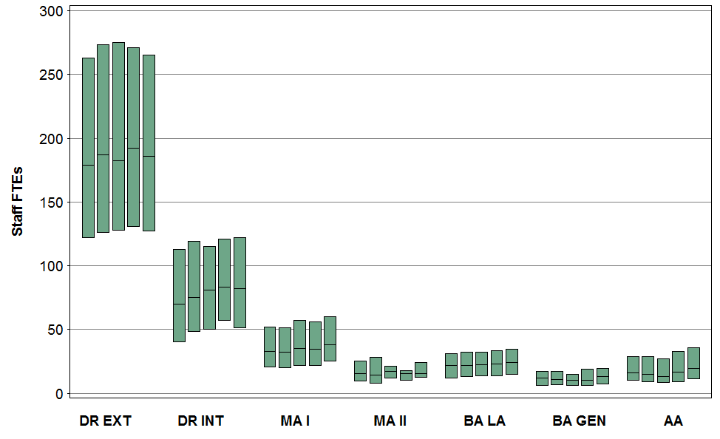
Centralized IT Staff FTEs
1 IT Organization, Staffing and Planning
Notes:
Here is an example of one of our quartile plots (or boxplots) you may remember from statistics class.

Slide 15
Centralized IT Staff FTEs
25% of data up here
75th percentile
25% of data in here
1 IT Organization, Staffing and Planning
Median
25% of data in here
25th percentile
25% of data down here
Notes:
This quartile plot allows the user to see not only the middle (median) of the distribution, but also the first and third quartiles. The top of the box represents the 75th percentile: only 25% of respondents are above this value. The bottom of the box represents the 25th percentile: only 25% of respondents are below this value. Thus the box covers the middle 50% of the distribution.

Slide 16
Centralized IT Staff FTEs
1 IT Organization, Staffing and Planning
Notes:
Predictably DR EXT universities have the most Staff FTEs. The distribution has moved only slightly across years, likely due to sampling error not real trends. Notice that the MA II distribution bounces around a bit more, likely due to smaller sample sizes (36 in 2009).

Slide 17
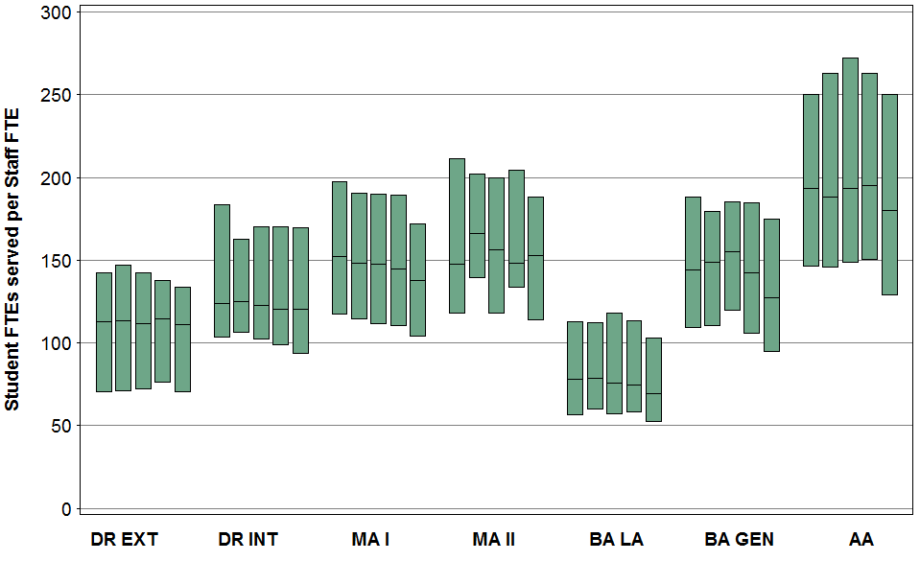
Student FTEs served by Centralized IT Staff FTEs
1 IT Organization, Staffing and Planning
Notes:
Much of the differences across classes may be accounted for by enrollment. This graphic shows the distribution of student FTEs (IPEDS enrollment data) per centralized IT Staff FTEs. The distributions are narrower (smaller range), but also more consistent over time. While LA Institutions have the most centralized staff per student, doctoral institutions also tend to have more IT staff that are distributed to units.

Slide 18
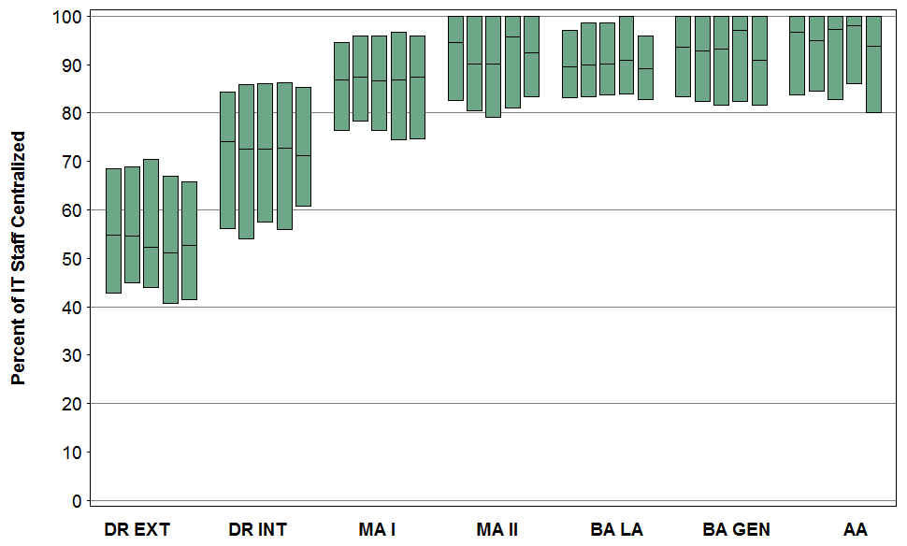
Centralized Staff / Total IT Staff
1 IT Organization, Staffing and Planning
Notes:
About half of DR EXT campuses report that only about half of their IT staff is in the central IT organization. While at liberal arts schools, the median is around 90%. One aspect of the redesign is to get more information about distributed IT staff and services.

Slide 19
Functional Areas
Enterprise Information Systems
DR EXT: median=37 FTEs or 22% of FTEs, other medians are 17 or below.
Not such a gap in other classes, but still at or near top.
User Support (across all classes)
Varies by class
Instructional Technology
Network Infrastructure
IT Organization/Planning
Identity Management
Data Center
Notes:
What are these staff doing?

Slide 20
CDS Survey
IT Organization, Staffing and Planning
IT Financing and Management
Faculty and Student Computing
Networking and Security
Information Systems

Slide 21
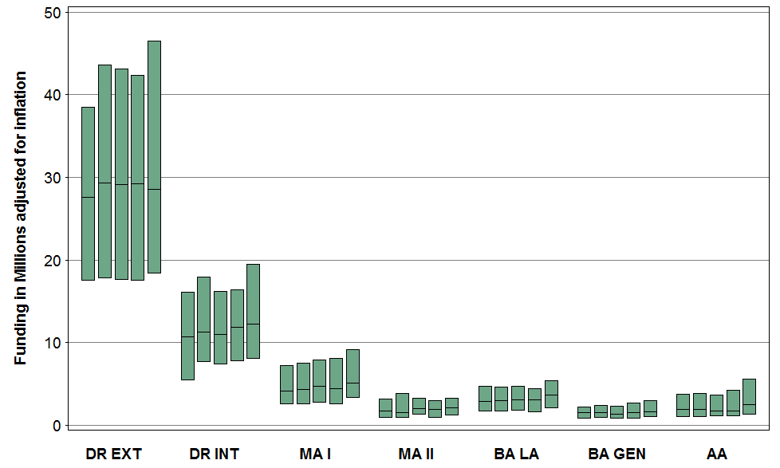
Centralized IT funding
2 IT Financing and Management
Notes:
After adjusting for inflation, centralized IT funding has not changed too much. In each class, we see a slight up tick in the upper end of the distribution (some campuses stretching up a bit here).

Slide 22
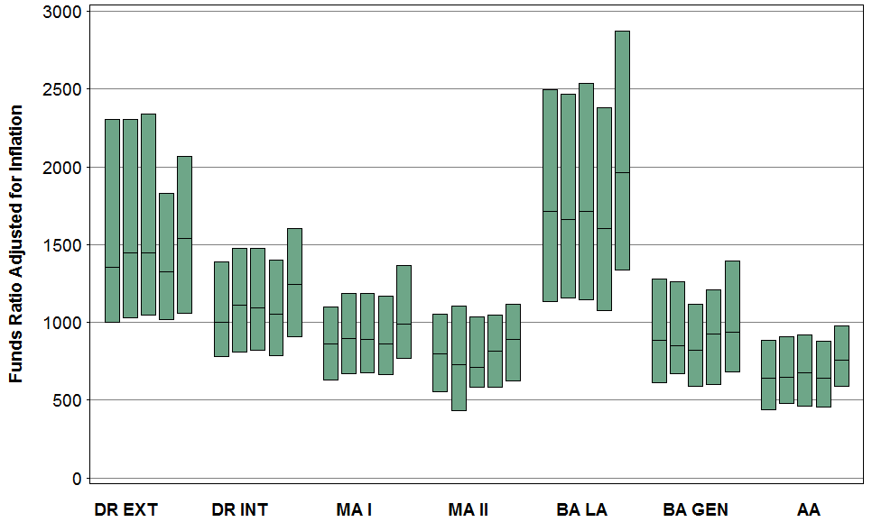
IT funding per student FTE
2 IT Financing and Management
Notes:
This figure shows that changes in funding have mostly kept pace with enrollment, maybe even outpacing enrollment a bit in 2009.

Slide 23
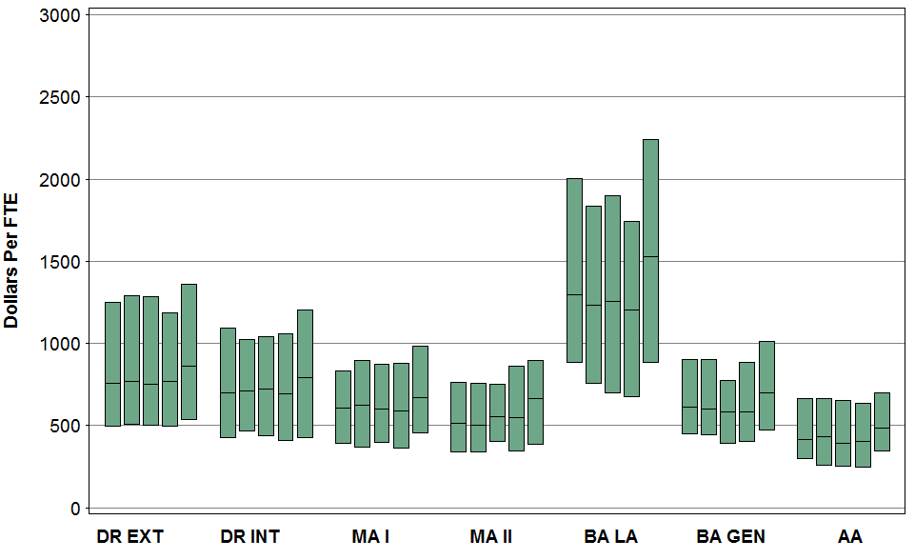
Operating appropriation per student FTE
2 IT Financing and Management
Notes:
Operating appropriation drives the shape of these distributions, and shows similar trends.

Slide 24
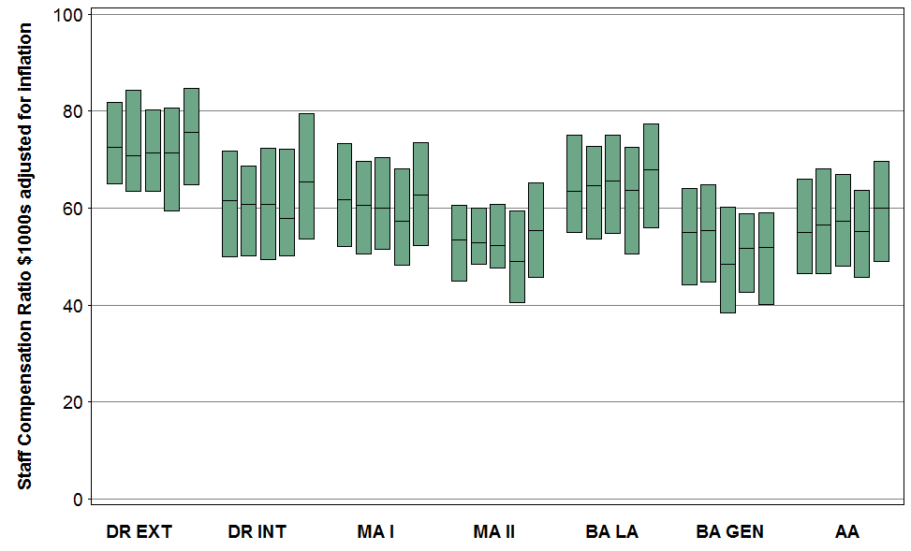
Staff Compensation per FTE
2 IT Financing and Management
Notes:
Compensation for staff, including benefits, has not changed dramatically over the last 5 years. Though, again, we see an uptick in distributions in 2009 (after adjusting for inflation)

Slide 25
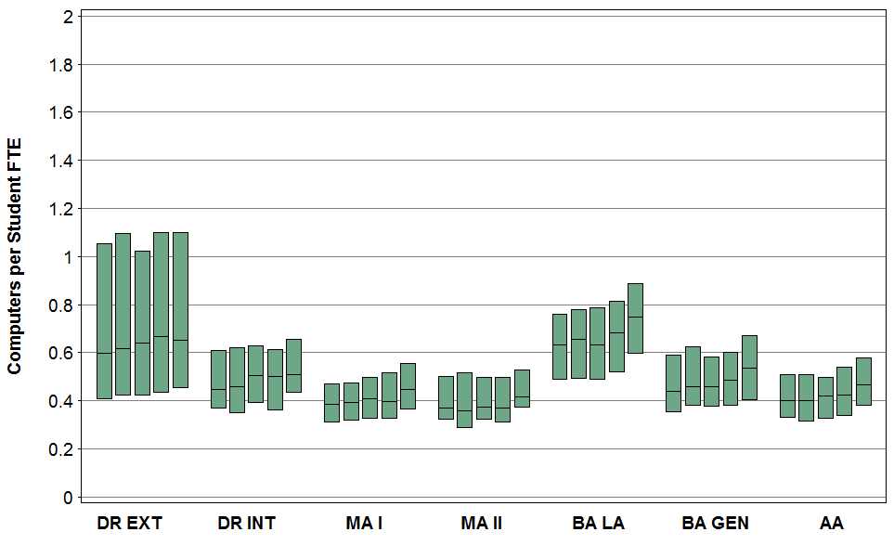
Computers per student FTE
2 IT Financing and Management
Notes:
Turning to equipment, we see some predictable differences across classes with LA institutions having, in general, more computers per student FTE. This distribution appears to be shifting upward over time. DR EXT campuses are more variable than other classes in this respect. And about 25% of these campuses have just over one computer per student FTE.

Slide 26
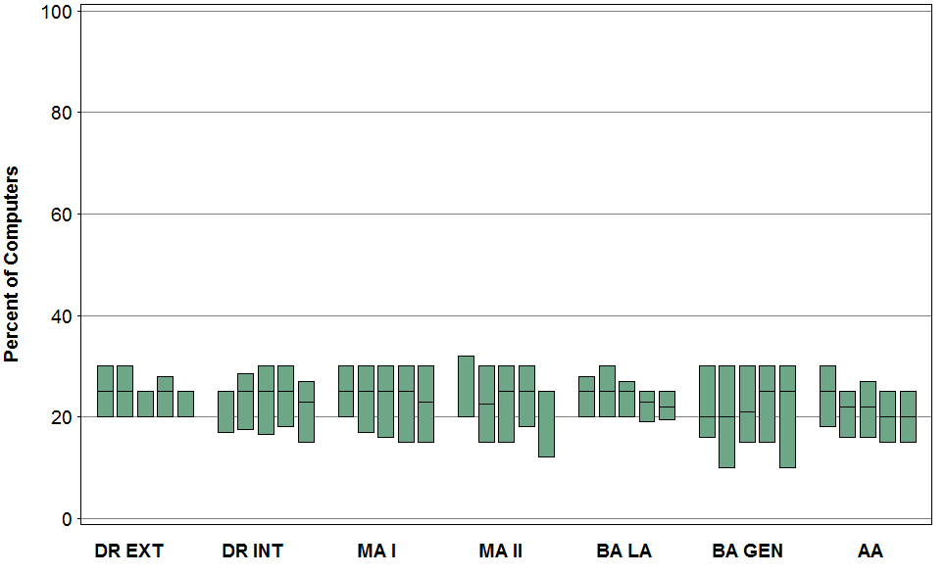
Computers replaced
2 IT Financing and Management
Notes:
It is challenging for IT managers to assure that this equipment is replaced in a timely fashion. CDS collected data on plans and funding for computer replacement. This graphic shows actual percentage of computers that were replaced in a given year. Most medians are in the 20-25% range.

Slide 27
CDS Survey
IT Organization, Staffing and Planning
IT Financing and Management
Faculty and Student Computing
Networking and Security
Information Systems

Slide 28
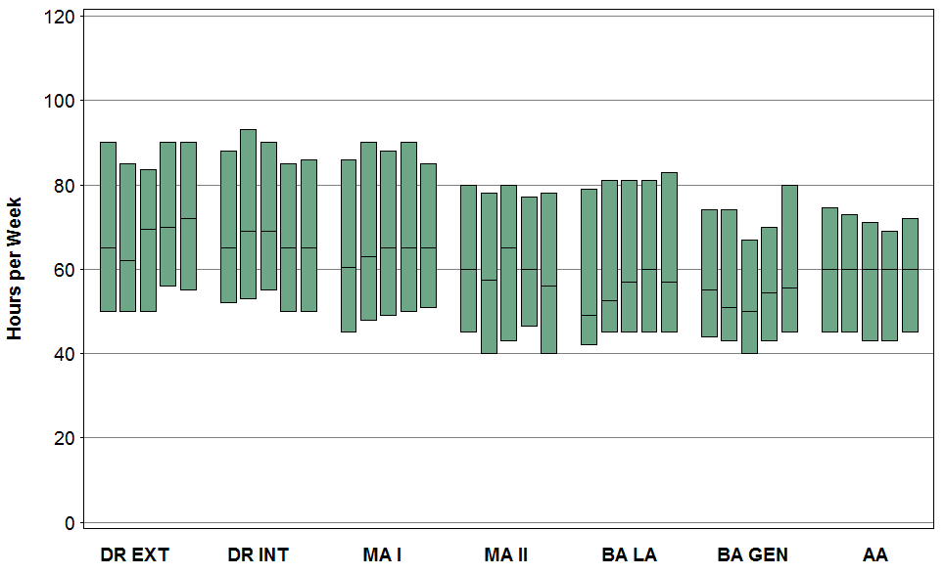
Help Desk Hours
24x7 = 168 hours
3 Faculty and Student Computing
Notes:
Nearly all institutions provide a central help desk. The number of hours the help desk is open varies considerably across campuses. Note that very few campuses report 24x7 service. Most campuses are offering 80 hours per week or less.

Slide 29
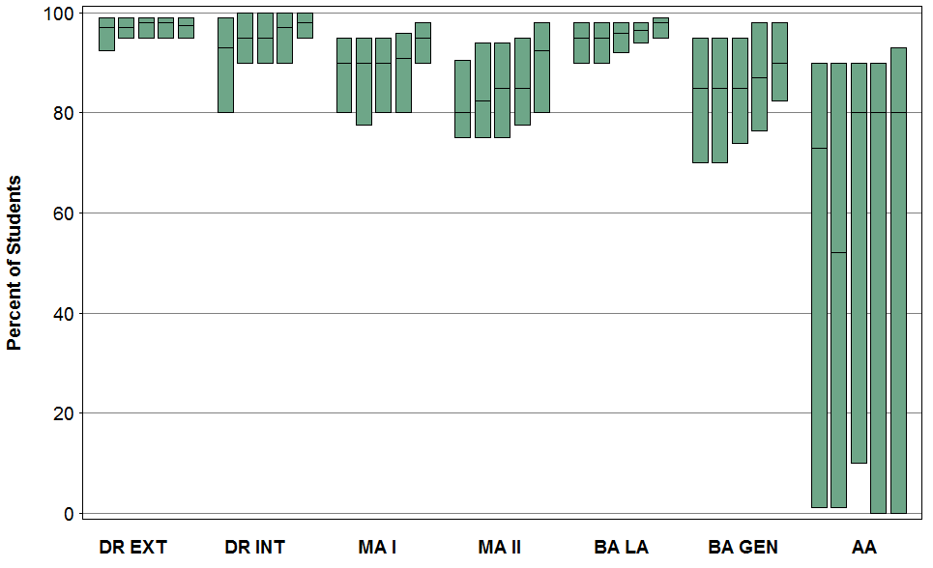
Student PC Ownership
n=19
n=3
Private Only
3 Student and Faculty Computing
Notes:
More and more students are coming to private institutions with their own computers. The graphic seems to show a lot of variability, but the sample size here is only 3 respondents in 2009, so it should be ignored. The sample size in DR INT is also a bit on the small side.

Slide 30
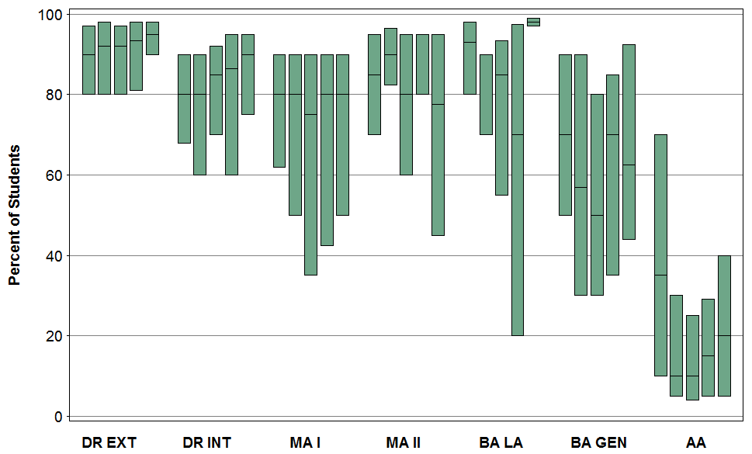
Student PC Ownership
n=8
n=5
n=12
3 Student and Faculty Computing
Public Only
Notes:
Predictably, percentages are lower for public institutions.

Slide 31
Student PC Ownership
3 Student and Faculty Computing
Private
Public

Slide 32
Connection Speed (res halls)
3 Student and Faculty Computing
Notes:
Internet service in residence halls is nearly ubiquitous, with a growing percentage of institutions deploying wireless for this purpose. Speeds have been increasing across time in all classes (see the creeping grey at the top of the graph and downward shift in all colors). About 50-60% of institutions are offering 100 Mbps or higher. (blue + grey)

Slide 33
Issuing Student Email Accounts
3 Student and Faculty Computing
Notes:
Actual usage of university-provided email address varies widely, and was not capture in this survey. However, we can see that some institutions have discontinued issuing email or are considering the prospect. This percentage has gone up in the past 5 years.

Slide 34
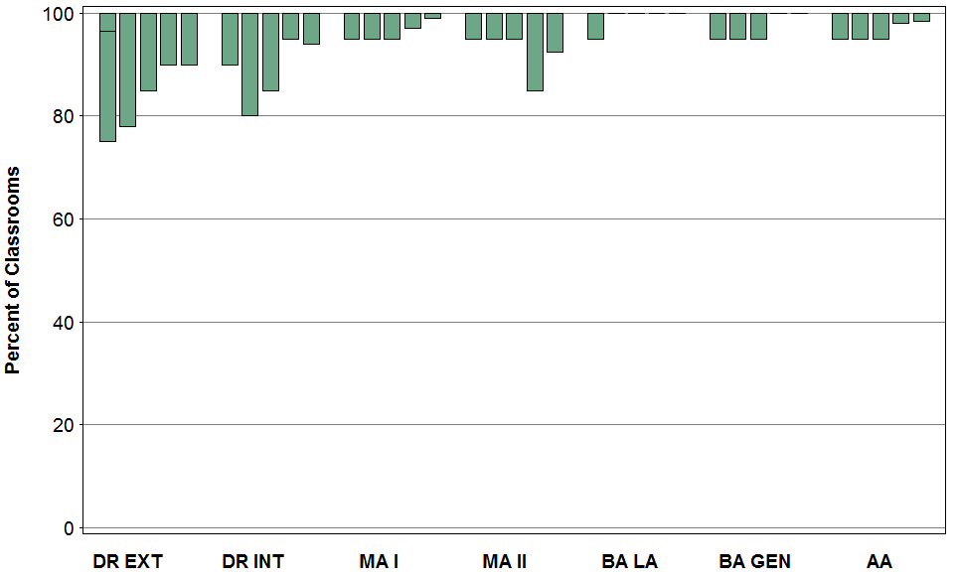
Wired Internet in Classrooms
3 Student and Faculty Computing
Notes:
Not surprisingly, most classrooms have wired connections, though the survey does not distinguish between a single connection for instructor use or multiple connections available for student use. These “hanging” box plots mean that the distribution is so stacked up at 100%, that it is the maximum, 75th percentile and median in many classes. In LA institutions, the boxes have slipped off the graphic, showing that almost all institutions report 100% availability of wired internet connections.

Slide 35
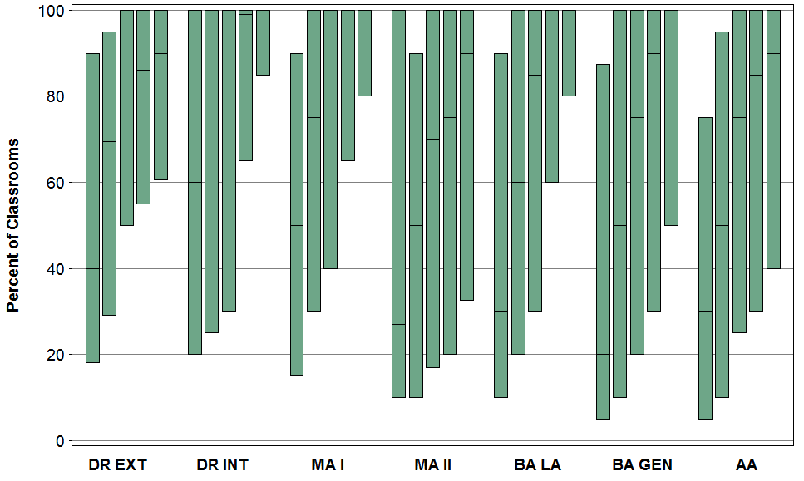
Wireless Internet in Classrooms
3 Student and Faculty Computing
Notes:
These distributions are much lower than the wired connection plots. However, clear increasing trends can be seen in all classes. Most dramatically, LA campuses are now at the point where about ¾ report 80% of classrooms or more have wireless access.

Slide 36
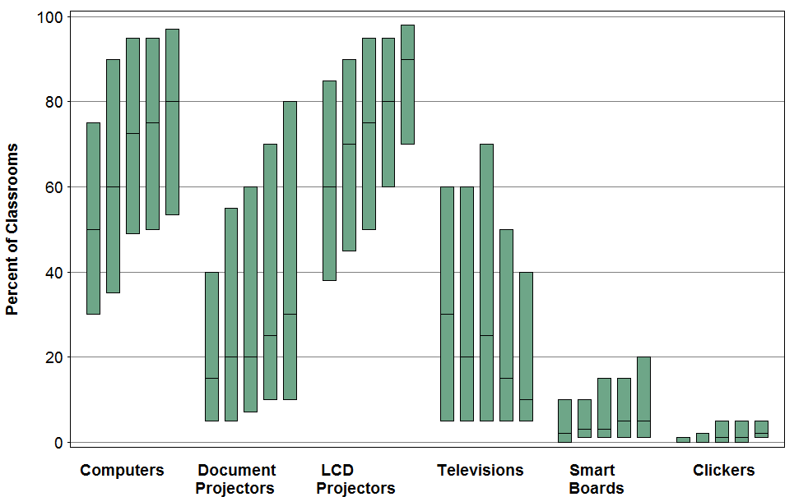
Technology in Classrooms
AA Only
3 Student and Faculty Computing
Notes:
For each of the 7 Carnegie classes, the annual summary report provides a graphic similar to this one. This is for AA institutions. The patterns are generally the same for each class: increasing availability of computers, doc projectors and LCD projectors; decreasing availability of televisions. Smart Boards and Clickers are increasing, but still nowhere near ubiquitous.

Slide 37
CDS Survey
IT Organization, Staffing and Planning
IT Financing and Management
Faculty and Student Computing
Networking and Security
Information Systems

Slide 38
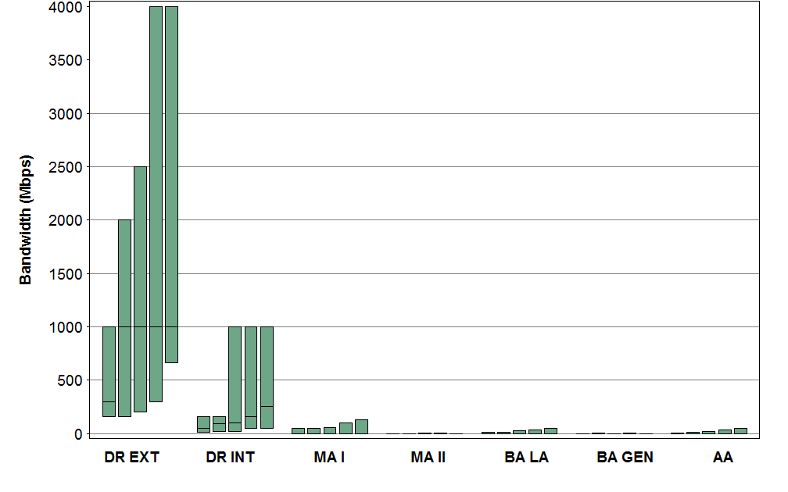
Bandwidth to Commodity Internet
4 Networking and Security
Notes:
Not surprisingly, DR EXT institutions dominate in this category, but increases can be seen in all classes.

Slide 39
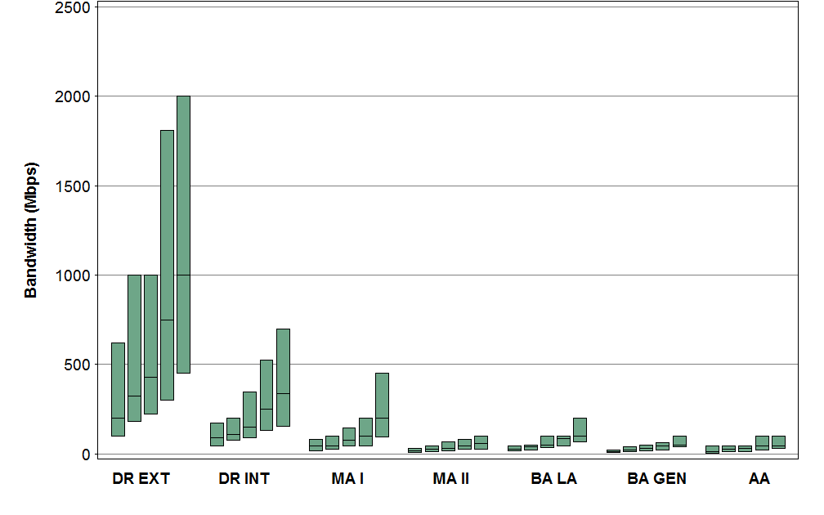
Bandwidth to High-Performance
4 Networking and Security
Notes:
Again, doctoral institutions are the dominant subscribers to high-performance networks. However, these networks have, in recent years, added commodity Internet transit and peering to their offerings, so this and the previous figure may have some ambiguity. This will be handled differently in the redesigned CDS.

Slide 40
Bandwidth to High-Performance
4 Networking and Security
Notes:
Again, doctoral institutions are the dominant subscribers to high-performance networks, such as Internet2 and National Lambda-Rail. However, these networks have, in recent years, added commodity Internet transit and peering to their offerings, so this and the previous figure may have some ambiguity. This will be handled differently in the redesigned CDS.

Slide 41
Wireless access on campus
BA LA Only
4 Networking and Security
Notes:
The survey asked about penetration for seven types of campus facilities and open spaces. Graphics are provided for each Carnegie class. These are for LA institutions. The green represents campuses who reported less than 25% of that type of facility has wireless access. Yellow is 25-50%; blue 50-75%; grey is over 75%. The downward shift in the colors represents increasing penetration. For example, in residence halls in 2005, about 50% of LA schools reported less than 25% of the area in the student union had wireless access. In 2009, the percentage is less than 20%. Many more campuses are now reporting 75% or more of the residence halls have wireless access.

Slide 42
Wireless access on campus
BA LA Only
4 Networking and Security
Notes:
Across classes, we generally see that wireless access is least likely in residence halls and open spaces, but nearly ubiquitous in libraries. Availability in research facilities varies greatly depending on the institution type, as we would expect.

Slide 43
Security Technologies
DR EXT Only
4 Networking and Security
Notes:
This graphic is available for each Carnegie class. This one is for DR EXT. The green shows the percentage of institutions who have already deployed this technology. A color shift up represents an increase in deployment of these technologies. Anti-spam and anti-virus software are givens Antispyware is catching up.

Slide 44
Network Service Technologies
DR EXT Only
4 Networking and Security
Notes:
Emergency notification was only added to the survey in 2007, but since then we see use of this technology increasing dramatically in all classes.

Slide 45
Identity Management Technologies
4 Networking and Security
DR EXT Only
Notes:
There is a lot more variability in use of Identity management technologies

Slide 46
Use of Firewalls
BA GEN Only
4 Networking and Security
Notes:
Firewalls are an important component of institutional security. (Less than 1% of respondents said that no firewalls have been deployed.) But one firewall is not adequate. This graphic shows use of firewalls for BA GEN only. But trends are similar in other classes. Notice on the right side of the graph, the institutions who plan to implement additional firewalls.

Slide 47
CDS Survey
IT Organization, Staffing and Planning
IT Financing and Management
Faculty and Student Computing
Networking and Security
Information Systems

Slide 48
Information System Solutions
MA I Only
5 Information Systems
Notes:
Most campuses are using vendors for most systems. This graphic shows the breakout by type of system for MA I institutions only. This is typical of most classes, that most campuses are using vendors, but there are yellow “tips” in most categories indicating the use of “homegrown” solutions. In course management systems, we see blue tips instead of yellow tips indicating use of open source solutions for course management systems. LA institutions are leading the charge here with 60% of campuses reporting use of open source course management systems.

Slide 49
Course Management Systems
5 Information Systems
Notes:
Most campuses are using vendors for most systems. This graphic shows the breakout by type of system for MA I institutions only. This is typical of most classes, that most campuses are using vendors, but there are yellow “tips” in most categories indicating the use of “homegrown” solutions. In course management systems, we see blue tips instead of yellow tips indicating use of open source solutions for course management systems. LA institutions are leading the charge here with 60% of campuses reporting use of open source course management systems.

Slide 50
Enterprise Resource Planning
5 Information Systems
Notes:
Enterprise Resource Planning systems are becoming more common as replacements for legacy, stand-alone information systems. ERPs integrate a suite of systems based on a common database and user interface. This figure shows the status of ERPs at campuses. The green indicates those who have already implemented systems, and the yellow ones are in process. A growing number of institutions reported having completed their ERP implementations with a large number in process.

Slide 51
Web Portals
5 Information Systems
Notes:
While not a traditional “information system”, web portals are becoming ubiquitous. Green shows those implemented with blue showing planning or in process. LA schools are the least willing here, with current implementation around a little over 50% and about 20% of campuses reporting no plans to implement web portals.

Slide 52
Web Portal Strategies
5 Information Systems
Notes:
Of those who have already implemented or are planning web portals, commercial vendors (green) is the most common strategy, with open source and homegrown solutions being used at less than 1/3 of institutions.

Slide 53
Use of CDS
This presentation gives only a flavor of the report
The report gives only a taste of what you can do with CDS
User-defined peer groups
More data
Respondents still welcome if you’d like to have access to these data
Open House 2:45-4:15 201 B/C

