Slide 1
Smart design for distance learning environments
Linda A. Gedemer, LEED AP, CTS
Senior Consultant – Systems Group

Slide 2
What we will cover:
Jargon
Room Attributes
Acoustics
Lighting
Millwork & Furniture
Equipment Planning

Slide 3
Distance learning Jargon
Near End : The site where you are
Far End : The site where the other participants are.
Point-to-Point : A normal two-party video or audio conference
Multi-Point : A video or audio call with more than two parties connected
Casting (i.e. multicasting, webcasting) : a one way call where the communication has low or no interactivity.

Slide 4
Room Attributes
What makes for good distance learning?
Eye Contact
Camera layout
Seating layout
High Quality Audio
Microphone placement
Background noise
Adjacencies & isolation
Reverberation control
High-Quality Video
Lighting & interior finishes

Slide 5
Room Attributes
What makes a good distance learning space?
Appropriate Room Dimensions
Seating & Sightlines
Lighting
Acoustics
Technology

Slide 6
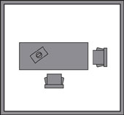
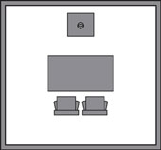
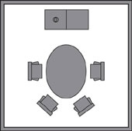
Small Conference Rooms
1 participant
1-2 participants
3-4 participants
Highly interactive:
1 microphone
Typically not many video,
audio, or acoustical issues

Slide 7
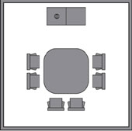
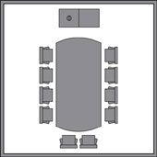
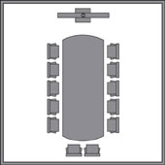
Medium Conference Rooms
4-6 participants
6-10 participants
8-12 participants
Fairly interactive:
1 to 3 microphones
Some video and audio issues
Acoustical issues begin to appear

Slide 8
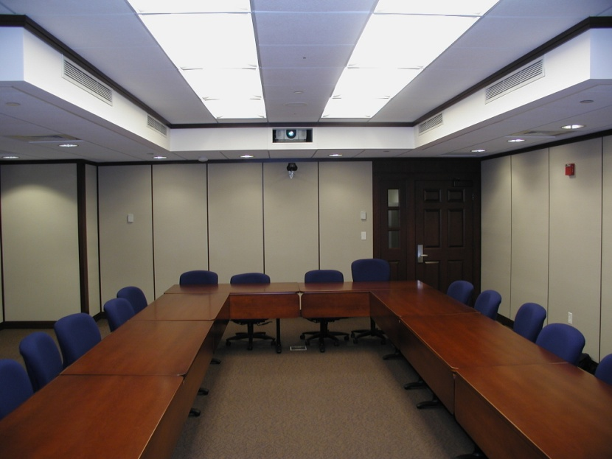
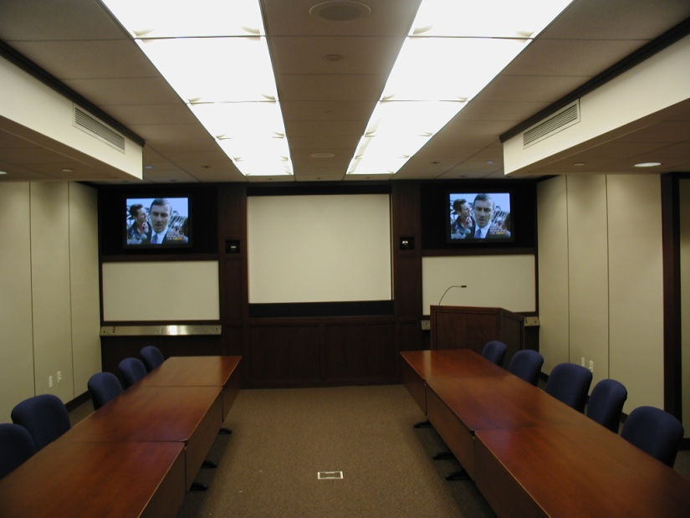
Large Conference Rooms
10-30 participants
Limited interactivity:
3 to 12 microphones
Many video and audio issues
Acoustical issues are paramount

Slide 9
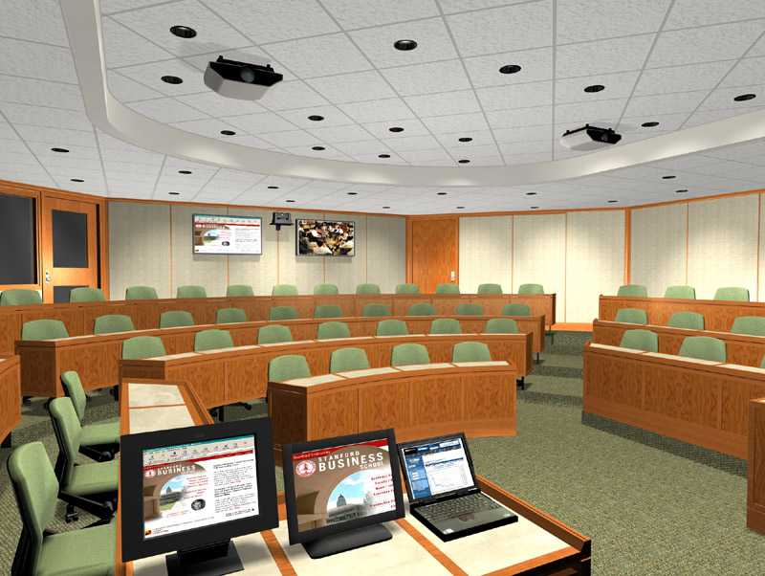
Large Group Rooms
30-60 participants
Interactivity limited by room design,
technology and technical support:
Multiple cameras
Control booth required
Technician support required
12-30 microphones
Many video and audio issues
Acoustical issues are
paramount
Lighting for video is key

Slide 10
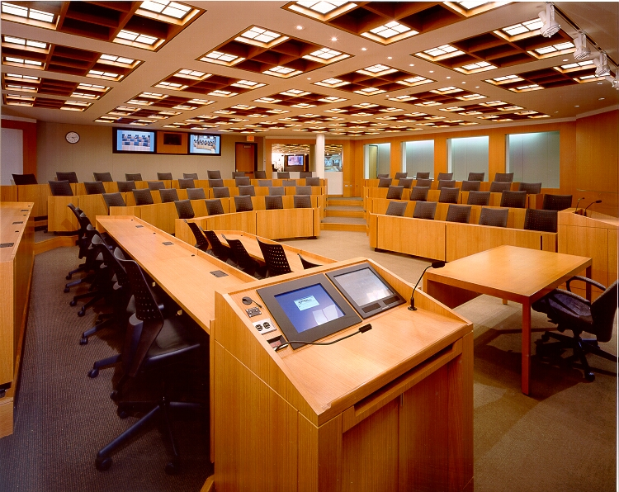
Very Large Group Rooms
60-90 participants
Interactivity limited by room design, equipment and technical support:
Multiple cameras
Control booth required
Technician support required
30-48 microphones
Many video and audio issues
Acoustical issues are
paramount
Lighting for video is key
Infrastructure is intensive

Slide 11
Videoconferencing versus Distance Learning
Distance learning can take many forms:
Correspondence courses by mail
Web-based courses
Live web streaming
Live interactive video conferencing
“Distance Learning” classroom refers to a facility where the instructor faces the audience.

Slide 12
Dimensions & Seating
Is 100% interactivity expected?
Does everyone need to be seen clearly?
Does everyone need to be heard clearly?
Will some participants be passive?
Will some participants be moderators?

Slide 13
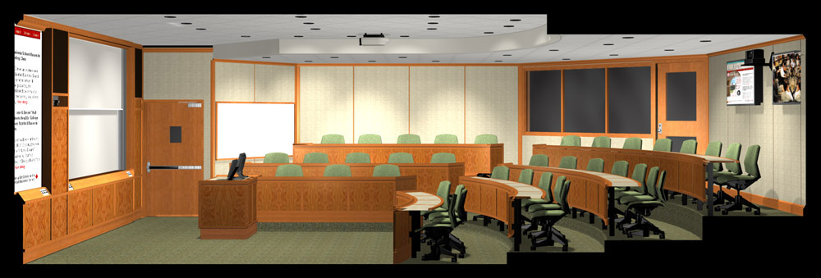
Sight-line Considerations
Both the people and the cameras need to clearly see.

Slide 14
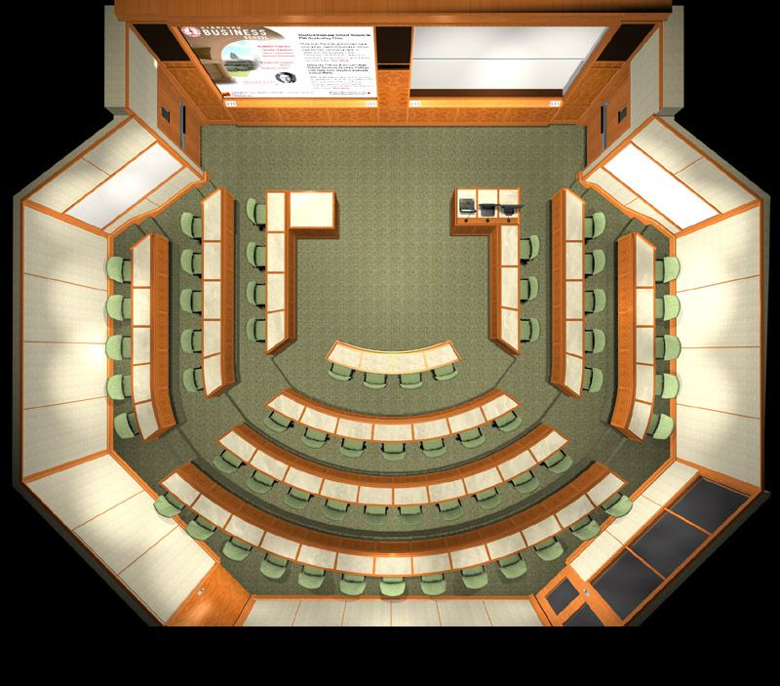
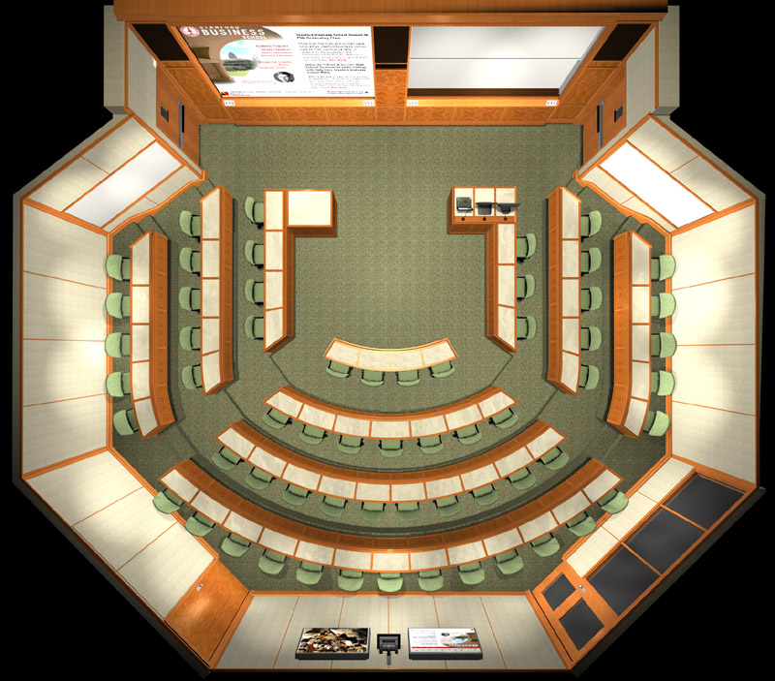
INSTRUCTOR
STUDENT

Slide 15
INSTRUCTOR
STUDENT
TECHNICIAN

Slide 16
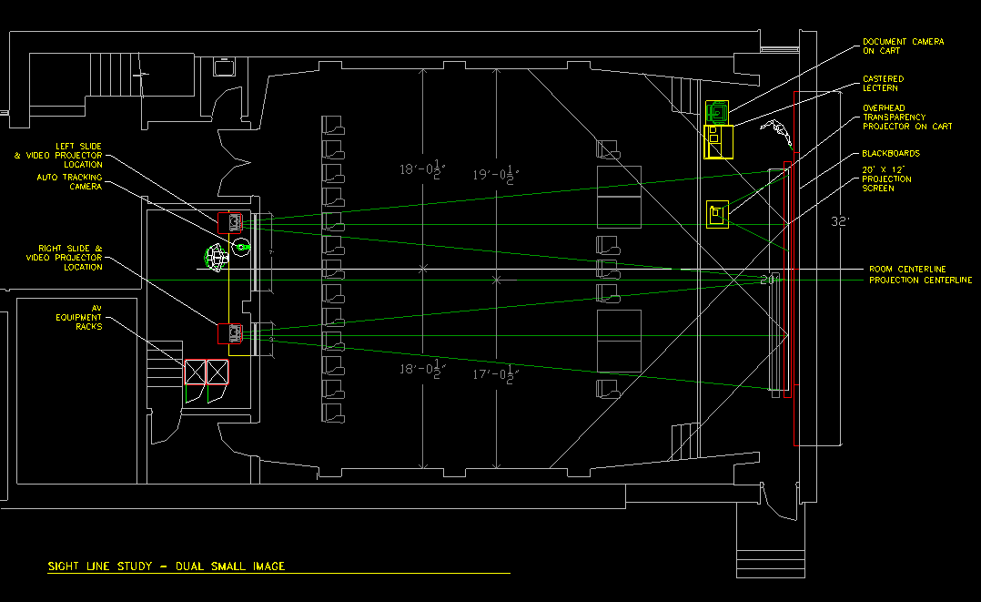

Slide 17
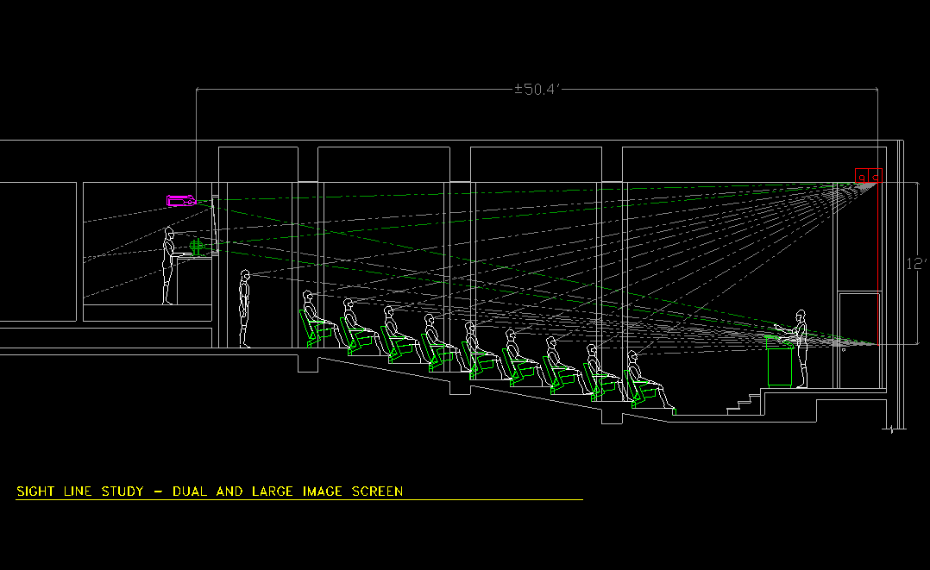

Slide 18
Acoustical Design for Presentation Spaces:
Easy as A - B - C:
“A” = Absorption:
Reverberation Control
“B” = Background:
Building Systems Noise Control
“C” = Construction:
Sound Isolation

Slide 19
“A” = Absorption: Reverberation Control Recommendations
Acoustical Ceiling
Soffits, Borders
Wall Surfaces
Flooring

Slide 20
“B” = Background Sound: Building Systems Noise Control Basics
Lights, Motors
GRDs
Fans, VAVs
Noise Intrusion

Slide 21
“C” = Constructions: Sound Isolation Suggestions
Ceiling Styles
Ductwork /
Soffits
Partition Types
Door Gaskets
Floor Types

Slide 22
Sound Absorptive Materials: Porous fill or surface that absorbs sound
Glass Fiber (1” thick)
Cellulose (1” thick, spray-on)
Mineral Wool (1” thick)
Open-cell Foam (1/2” thick)
Fabric drapes (light to heavy)
Carpet

Slide 23
Sound Transparent Facings: Common absorptive fill liners or covers
Open Weave Cloth
Perforated Vinyl
Perforated Metal
“Wood” (slats, multi-layer arrays, perforated panels)

Slide 24
Lighting Considerations
The million dollar question:
Multi-media room or dedicated
distance learning room?
Two audiences:
The folks in the room and the folks
on the “box”.
Seating:
Flexible or fixed seating?

Slide 25
Lighting Considerations
Glare: both light in eyes and veiling
reflections off the projection machine
Room finishes / reflectance:
walls 40-60% reflectance
ceiling 70-80% reflectance
Contrast ratio, environment to people:
front wall = 4-5:1,
side/back walls = 3-4:1

Slide 26
Lighting Considerations
How bright? Staying in focus (depth of field)
The more light the more depth of field
Start with well designed lighting layout
Teleconference: 45-75 vertical footcandles
Distance learning: 40-55 vertical footcandles

Slide 27
Lighting Considerations
Key lighting: main front lights, focused at a 40 degree angle below horizontal, should not be dimmed.
Fill lighting: front lights focused at a 15 degree angle below horizontal, removes shadows around the eyes and neck, should not be dimmed.
Back (hair) lighting: rear lights focused at a 45 degree angle below horizontal, helps to give some depth of field to the video image, may be on a dimming circuit.
Wall lighting: room lights that illuminate the walls to separate the persons being shot from the background, should be dimmed to below the reflected light level of the face which reflects about 45% of light falling on it.
Modeling (top) lighting: a point source light used to create a three dimensional effect achieved through the perception of form and depth, can be dimmed.

Slide 28
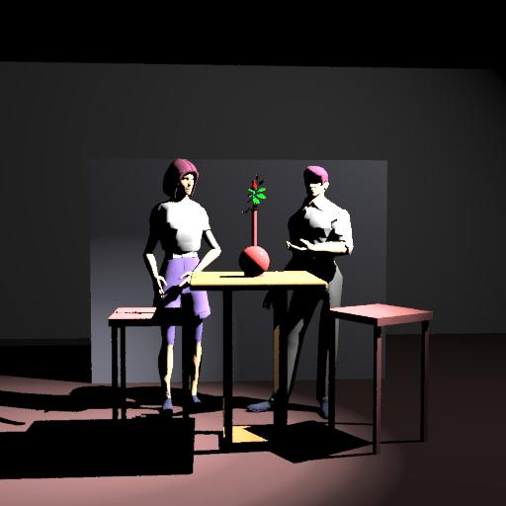
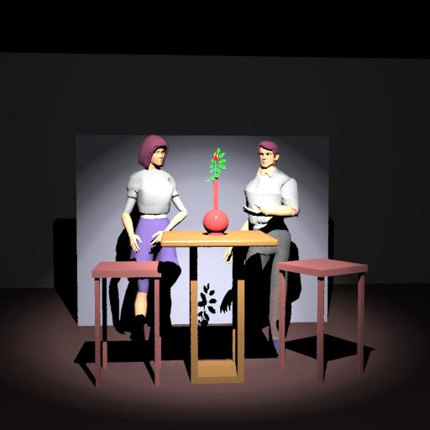
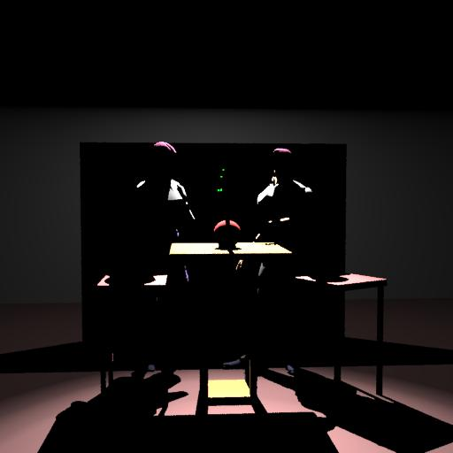
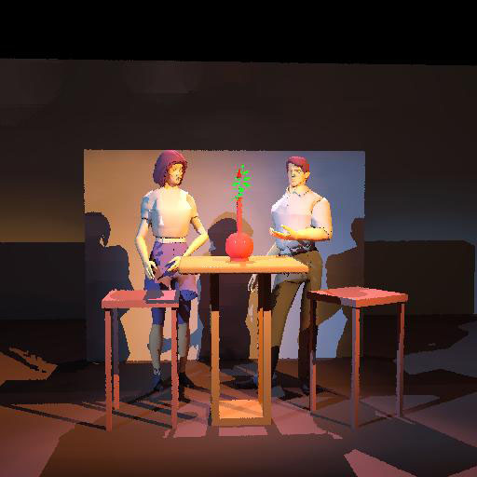
Perceiving 3D Form in a 2D Medium
Key
Fill
Back (hair)
Modeling (top)

Slide 29
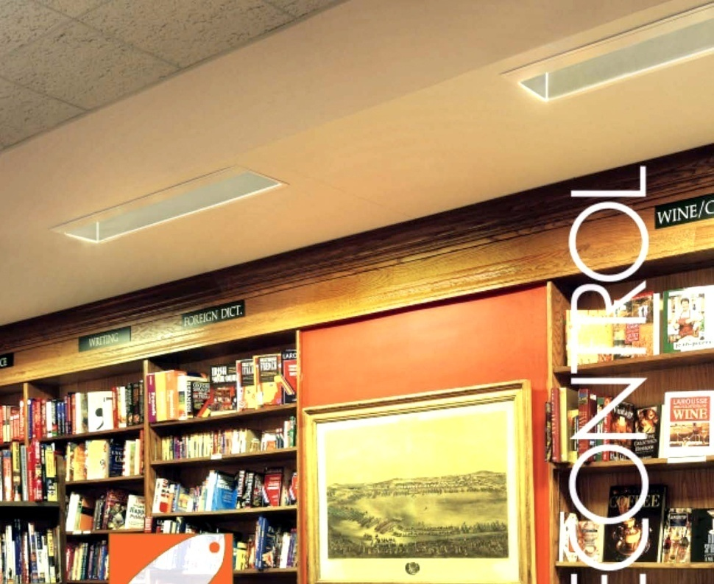
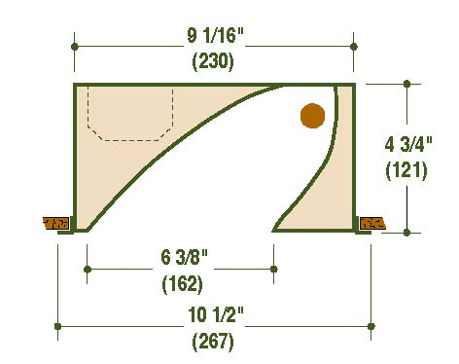
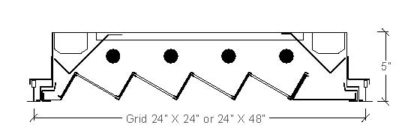
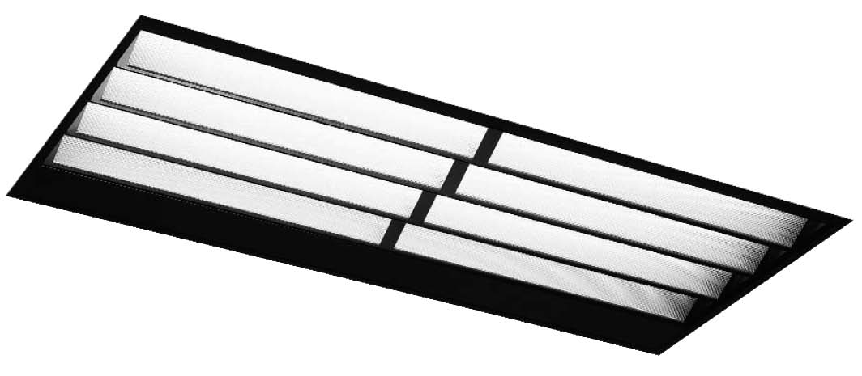
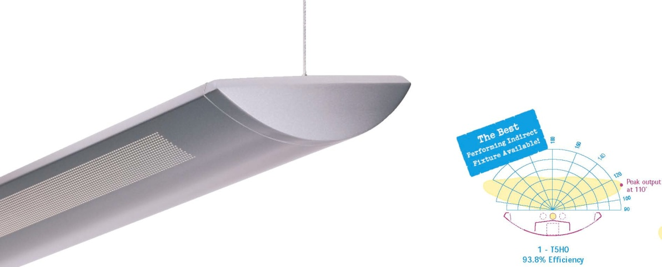
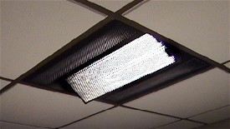
Wall Washing
Fill
Key

Slide 30
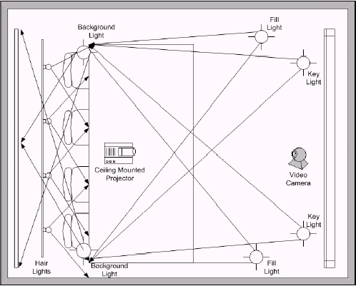
Lighting Layout

Slide 31
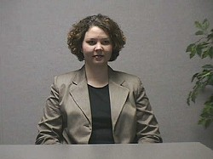
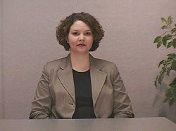
Standard Room Lighting
Videoconference Lighting

Slide 32
Furniture and Millwork Considerations
AV-equipped lecterns, desks, tables, & credenzas FF&E or special equipment?
Desk millwork may include custom modifications and cable management for microphones, laptop network connections and AC power.
Front wall millwork coordination - boards, screens, loudspeakers, infrared emitters, cameras
Projection booth counters, windows, and ergonomics

Slide 33
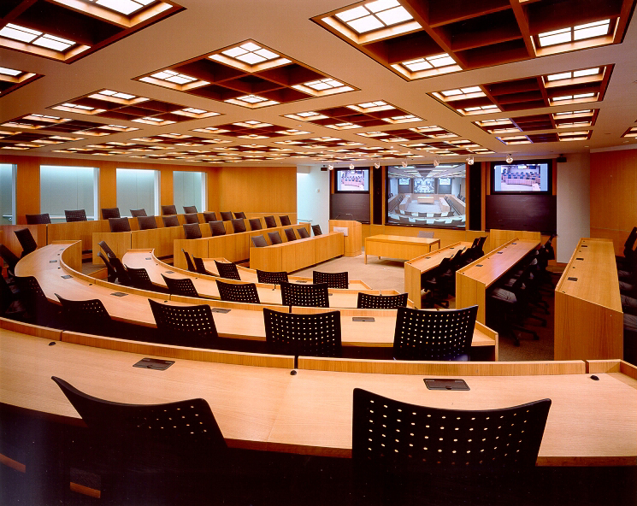

Slide 34
Equipment Planning
Microphones
Lecturer
Students / Participants
Speakers
Ceiling
Media / Stereo
Cameras
Control Panels
Projectors, screen, displays

Slide 35
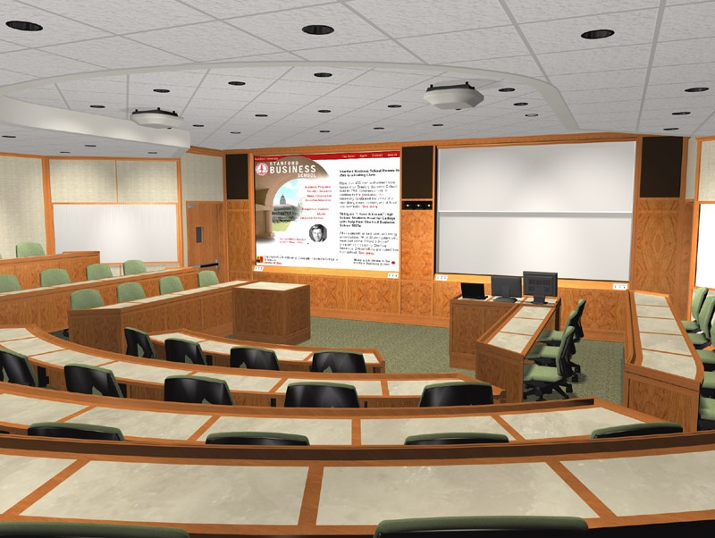
Utility Niches for Loudspeakers & Assistive Listening Devices
Dual Projectors
Dual Display Wall
Cameras
Lights, Ceiling Loudspeakers, & Microphones
Portable Lectern
Fixed Lectern w/ AV Control and Source Devices
Equipment Planning

Slide 36
Instructor’s Confidence Monitors
Instructor’s Camera
Power & Dimming Panels, HVAC Closet
Technician’s Booth
Computer Monitor, Laptop, AV Control Panel
Fixed Lectern w/ Add’l AV Equipment Below
Equipment Planning

Slide 37
Microphone and Speaker Placement
Distance Learning Microphone Placement Choices:
Ceiling - Poor
Flush in desk/table surface - Good
Wireless lapel - Good
Gooseneck - Excellent
Head-worn - Excellent, but usually impractical
Notes:
SPL - 0dB SPL = threshold of hearing 140dB SPL = irreparable hearing damage.
inverse square law - doubling the distance quarters the sound energy

Slide 38
Microphone and Speaker Placement
To minimize echo, microphones must be located closer to the talker’s mouth than the loudspeaker(s).
Signal-to-noise, echo cancellation, and feedback suppression are the critical factors
Notes:
SPL - 0dB SPL = threshold of hearing 140dB SPL = irreparable hearing damage.
inverse square law - doubling the distance quarters the sound energy

Slide 39
59 Seats
37 Wired
Microphones
4 Ceiling
4 Wireless
4 Wired Panel
Microphones
Add’l Microphone Jacks
Total of 53 Permanently installed Microphones

Slide 40
Echo Cancellation & Feedback Suppression
Overcoming the “vicious circle”
Loud
speaker
Mixing & Signal Processing
Compression (CODEC)
ISDN or IP
Decompression (CODEC)
Processing & Amplification

Slide 41
Rooms You’ll Need Room For
Rear Projection Room
Equipment Rack Room
Technician Control Booth
Each will have its own unique requirements for:
Lighting
Temperature and Humidity Control
Dust / dirt control
Security

Slide 42
Design Coordination
Microphone and camera placements are key - flexible seating is problematic
Cable pathways, conduit, receptacle backboxes, floor boxes and access panels require significant coordination
Selection of materials and finishes for wall panels, ceilings, and furniture must be video-friendly to avoid moiré effect and reflective glare.

Slide 43
General Physical Considerations
Visual
Can seating tiers be used?
Can an AV soffit be incorporated?
Will slab penetrations for floor boxes be possible?
Aural
Can the ceiling accommodate large ducts, special lighting, loudspeakers, microphones, and sprinklers?
Can multiple microphones be employed
Architectural
Will the desks be fixed or movable?
Will interior finishes be appropriate for video?
Codes
What about ADA access and hard-of-hearing support?

Slide 44
Existing Physical Constraints
Ceiling too low for planned group size
Displays too small or too low - poor legibility
Near site audience not visible to far site
Existing HVAC noise too loud
Microphones not audible
Poor speech intelligibility
Existing lighting not appropriate
Near site audience has “raccoon eyes”
Body language difficult to interpret

Slide 45
Design Coordination
Not all rooms are ideal for distance learning!
Low background noise (NC25) often requires low velocity, high capacity HVAC design
Isolation from external noise may require specialized wall constructions, window and door gasketing
Exterior windows are problematic for light control
Specialized VTC lighting may require specialized ceiling design
Tiered seating may be required in larger venues for proper viewing

Slide 46
Ideal Room Attributes
Quiet, well-isolated space
Few or no windows
Controllable lighting, preferably designed for videoconferencing
High volume, low velocity HVAC
Gasketed doors or vestibules
Technician’s booth with separate entrance
(if large group venue)
Individual temperature controls for booth room,
rear projection room (if any)
Penetrable floor
Fixed desks or tables

Slide 47
How Can an Consultant Help?
Start Early in Planning and Design!
Present case-studies, review prior projects of similar nature.
Adjacencies, location and types of doors, vestibules, windows, AV closets, etc.
Seating configurations, slopes, ramps, stage dimensions, etc.
Sight line studies and preliminary equipment location plans. Indications of potential conflicts, ADA issues, user and maintenance ergonomics.
Room Shaping / Acoustic considerations

Slide 48
Summary
Room attributes are critical:
Unobstructed sightlines
Unobstructed camera angles
Lighting specifically for distance learning
Appropriate finishes
User ergonomics
Acoustics are critical:
Background Noise - NC25
Isolation from adjacent noise sources
Reverberation - <1s (wall & ceiling treatments)

Slide 49
THANK YOU!!
www.acentech.com
lgedemer@acentech.com

