Slide 1
MPortfolio University of Michigan
Noah Botimer, Technical Lead
Urmila Venkatesh, Instructional Designer

Slide 2
Overview
Project began in 2004 with support from DSA and Provost
Two models developed out of different needs from different units
First model: flexible and expressive
Second model: structured and based on competencies and assessment

Slide 3
Expressive Portfolio: What is it?
What is an expressive portfolio?
A collection of reflections that demonstrate the knowledge, skills, and values a learner has developed from all areas of life.

Slide 4
Expressive Portfolio: What’s the process?
Learning and portfolio goals in each phase:
Notes:
This process developed by Dr. Melissa Peet and Dr. Tiffany Marra during pilot work with Social Work and Psychology. This is the model specific to Michigan, and each pilot has autonomy to change the model, the pages included, and the default text that prompts students to write.
Phase 1: Although many of their important learning experiences did not occur in a classroom, those experiences are still directly applicable to their learning within their academic courses.
Phase 2: Create a Work Showcase: knowledge, skills, insights a learner has gained from work
Phase 3: Analyze skills and knowledge to find underlying influences, what motivates and inspires students, including the personal strengths and moral commitments that influence their decision‐making and problem‐solving. Philosophy Statement: articulated values and beliefs underlying work and Goals: overarching direction or purpose, and specific plans, for future
Phase 4: Consider ramifications of creating content for public consumption, craft relationship between text and image, and consider audience; Welcome: introduces the portfolio creatively and succinctly

Slide 5
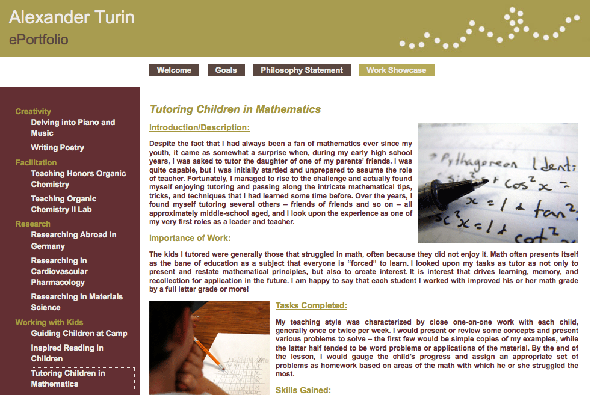
Work Showcase example

Slide 6

Work Showcase example (continued)

Slide 7
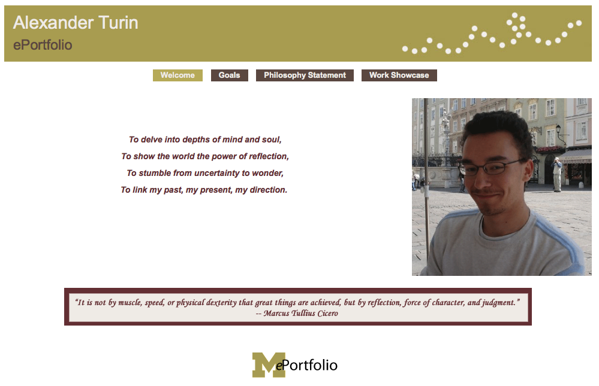
Welcome Page Sample

Slide 8
Structured Portfolios
Dental Hygiene and Sociocultural Portfolio, Medical School:
Scale – rather small and intensive
Adaptive – structure and implementation can evolve readily
Assessment – based on quality of reflection – quality of work is handled in the courses
Curricular change – assessment providing new information in support of adjustments to curriculum

Slide 9
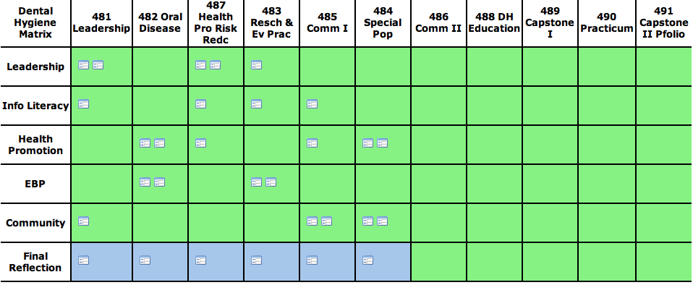
Dental Hygiene Program

Slide 10
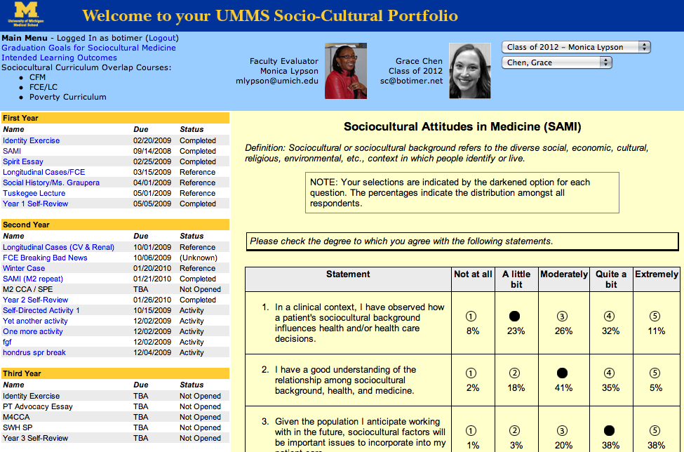
Sociocultural Portfolio

Slide 11
Learner and Educator Support
Expressive Model
For learners:
Open Studio
Learning Modules
Beginning Trainings
Advanced Workshops
Campus Partnerships
For educators:
Individual Consultations
Two-day Trainings

Slide 12
Learner and Educator Support
Structured Models
For learners:
In-house Staff
Beginning Trainings
Integrated Instruction
For educators:
Implementation Consultation
Workshops on Feedback
Training for Tools

Slide 13
Accreditation
Primary focus on internal assessment (for curricular, other purposes) rather than external structured review
We are looking into how portfolios fit into an external review process

Slide 14
Success Factors
Gradual growth
Strong leadership within programs
Ample support for educators and program alignment
Content and methodology driving technology

Slide 15
Summary
Encourages learners to reflect on curriculum and recognize their learning and development over time
Encourages educators to realign curriculum based on learner feedback
Makes educators more aware of knowledge, skills, and perspectives that learners bring to the educational environment
Provides institutions another mechanism for collecting data about student learning

Slide 16
ePortfolio Adoption at Virginia Tech
Marc Zaldivar, Director, ePortfolio Initiatives
Jennifer Sparrow, Director, Innovation Space

Slide 17
Overview
Brief History and Background
ePortfolios at Virginia Tech
Learning
Professional Development
Assessment
Putting it all together
Supporting and nurturing the adoption
Collaboration with other units
Engaging Students
Faculty Development
“Portfolio-aware” activities: the Innovation Space

Slide 18
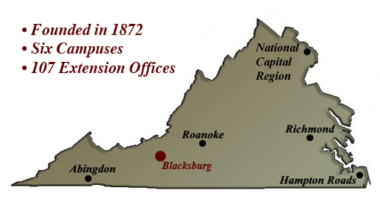
Overview of Virginia Tech
Comprehensive, Research I Institution
Land grant
60 bachelor's degree programs
140 master's and doctoral degree programs
~28,000 total FTE
~1,700 full-time teaching faculty

Slide 19
Brief History of eP @ VT
“Getting Organized”
2008
VT ePI office opens within Learning Technologies.
Hires 2 FTE and 1 GA to work with existing development team and faculty support but to focus on eP tools.
By 2009, grew from 7 to 25 projects.
SACS visit due in 2009-2010.

Slide 20
Brief History of eP @ VT
“Where are we?”
2010
Hired 3rd full time position, and now have 2 GAs and 1 undergraduate intern.
Have more than 70 projects across all 7 colleges, balanced across grad and undergrad programs, courses and program-wide programs.
~4000 students currently working with some form of portfolio project.

Slide 21
Brief History of eP @ VT
“What’s next?”
2011 and beyond….
First-year experiences
Exploring a four-year portfolio
Teaching and other faculty portfolios
Administrative Assessment

Slide 22
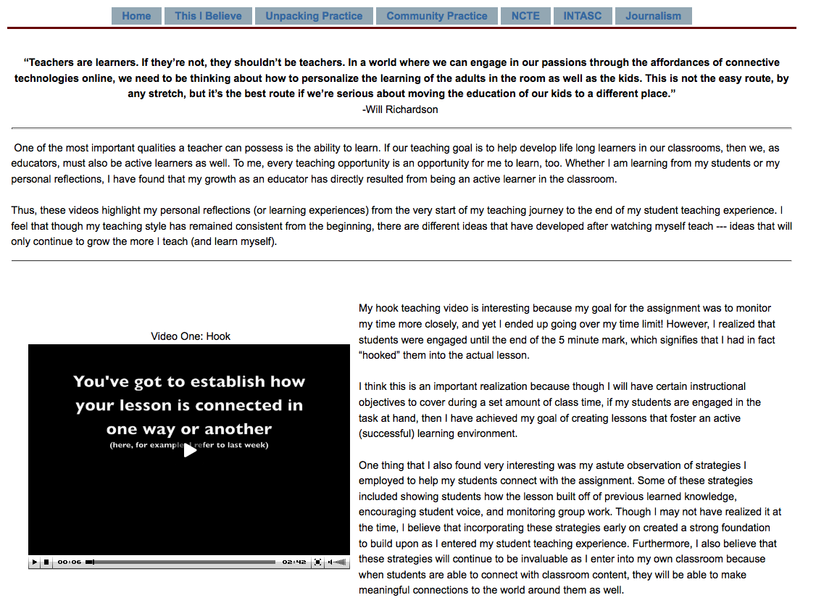
eP @ VT: Learning

Slide 23
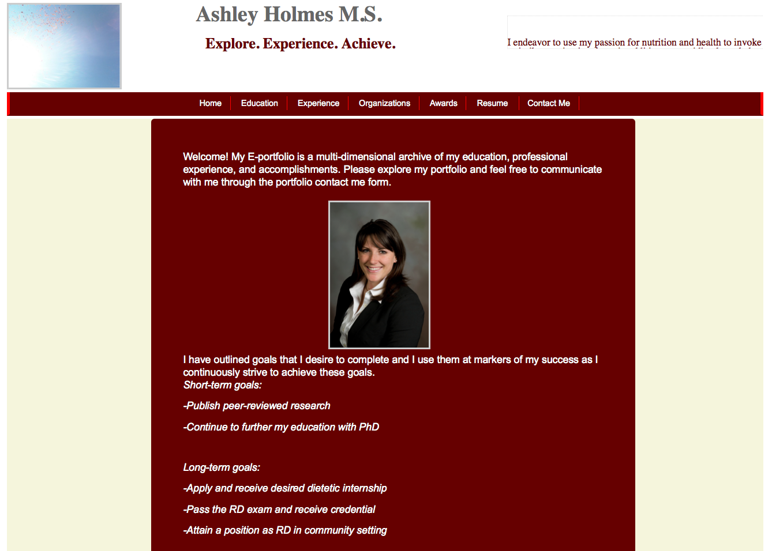
eP @ VT: Professional Development

Slide 24
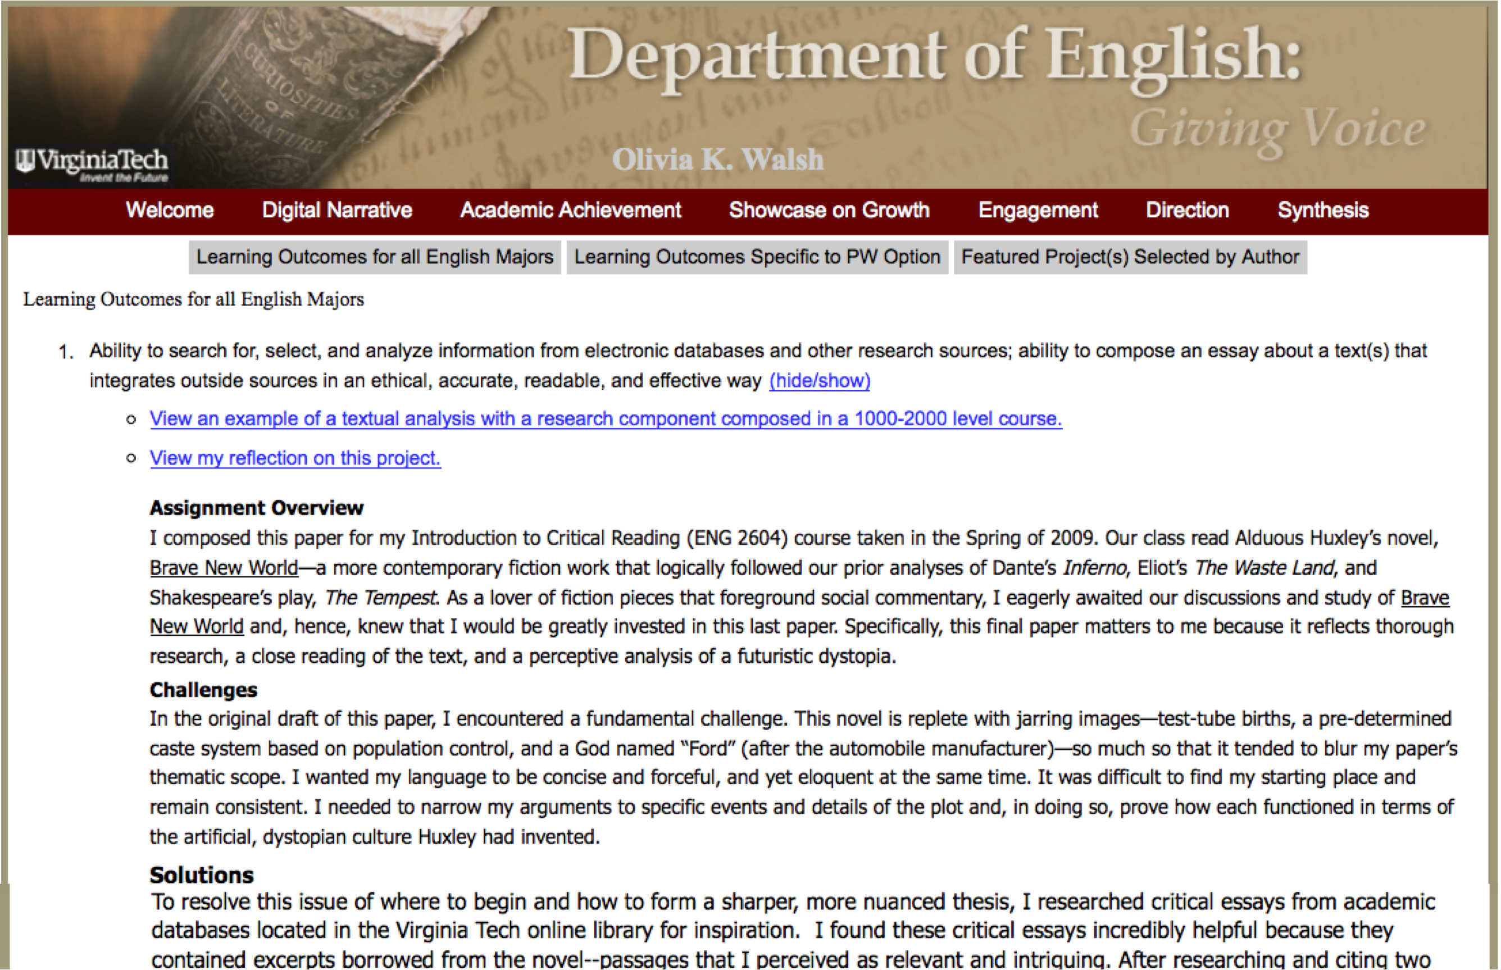
eP @ VT: Assessment

Slide 25
Putting it all together
Learning Portfolios
Learning
Academic Accreditation
VTeP
Professional Development
Assessment
Departmental Development

Slide 26
The First-Year Experience ePortfolio
Relies on two tools within Scholar’s ePortfolio suite:
Portfolio templates (for self/programmatic reflection)
Matrix/Forms (for high-level assessment)
Tools can be added to existing course site(s) or put in a specially-dedicated ePortfolio site.

Slide 27
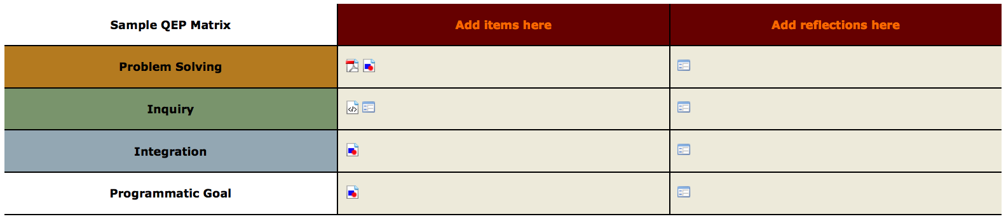
The Matrix: High-level assessment
Students choose (“are guided to choose”) what goes here, as the term/year progresses
Students reflect, on the “big” level, about each of the FYE goals at the end of the term/year.
Goals can be customized to include programmatic goals for each program. You can design your reflection prompts, also.

Slide 28
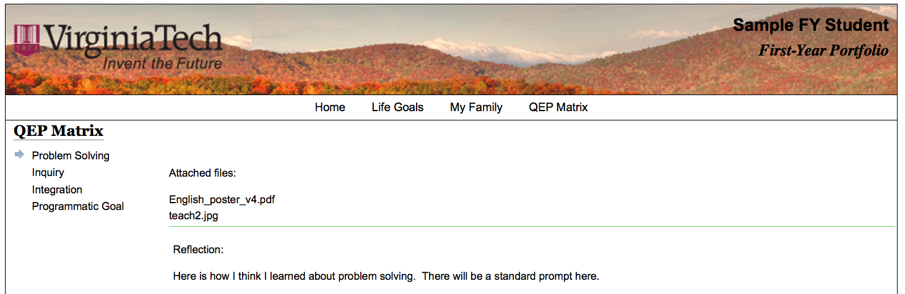
The Portfolio Template
Student-centered
Program-customized
Flexible
Sharable: Public or private?

Slide 29
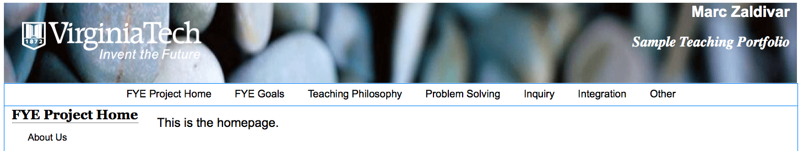
FYE Teaching Portfolio
Practice what you preach
Place to store history of ideas for project
Supplemental data and reflection for self-assessment
Each project should create at least one, assumedly the PI’s
Each project can optionally ask all instructors to do this activity

Slide 30
Supporting the Effort: Working with Others
Within Learning Technologies
Innovation Space
Faculty Development
Online Learning and Collaboration Services
Graduate Education Development Initiative

Slide 31
Supporting the Effort: Working with Others
Within Virginia Tech
Office of Academic Assessment
Center for Instructional Design and Educational Research
Office of First-Year Experiences
Office of Student Engagement and Community Partnerships
Residential Life

Slide 32
Supporting the Effort: Working with Others
Within the larger community
Sakai / Open-Source Portfolio
International Coalition for ePortfolio Research
Association for Authentic, Experiential, and Evidence-Based Learning
ePortfolio Action Committee

Slide 33

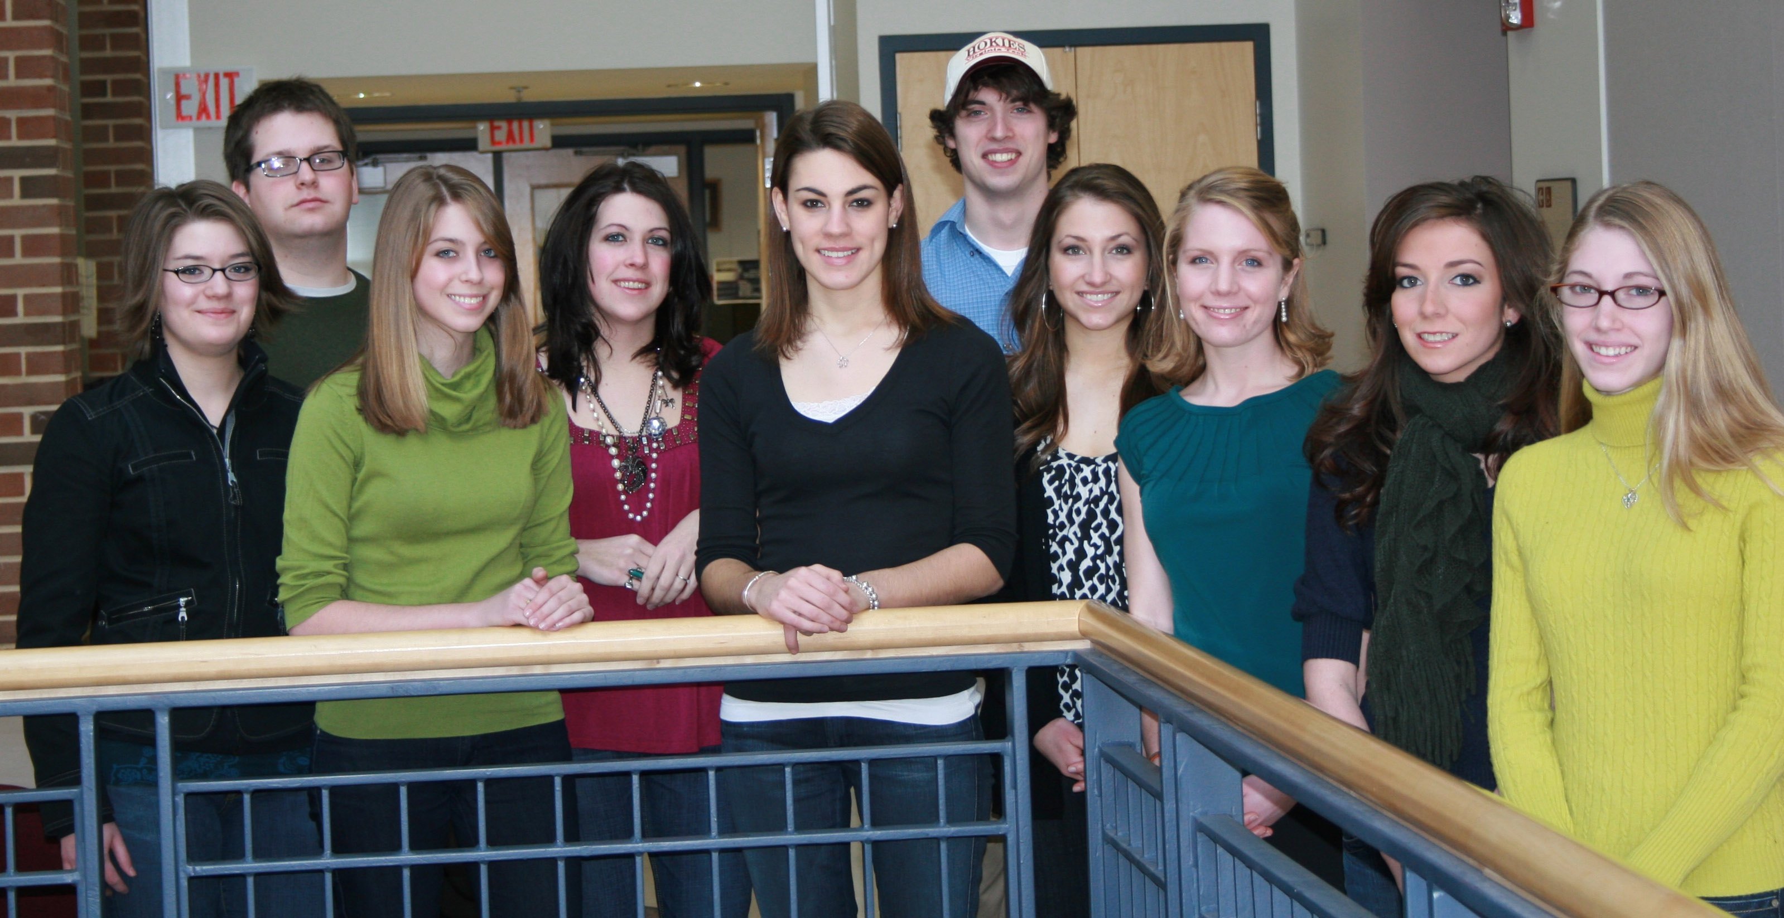
Supporting the Effort: Engaging Students
“ePortfolio Leadership” teams
English
Dietetics

Slide 34
Supporting the Effort: Faculty Development
Workshops focused on
Technology
Pedagogy
Assessment
Engaging Students
Workshops offered via
Faculty Development Institute
Center for Instructional Design and Educational Research
Office of Academic Assessment
Office of First-Year Experiences

Slide 35
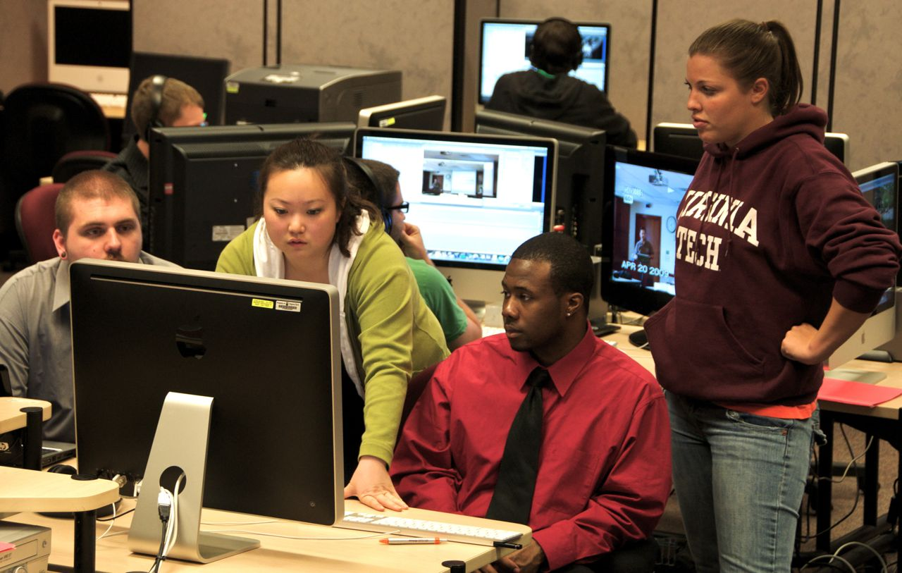
Supporting the effort: InnovationSpace
Multimedia development
Training needs
Resources
Training and support
Student staff
SpaceCamp

Slide 36
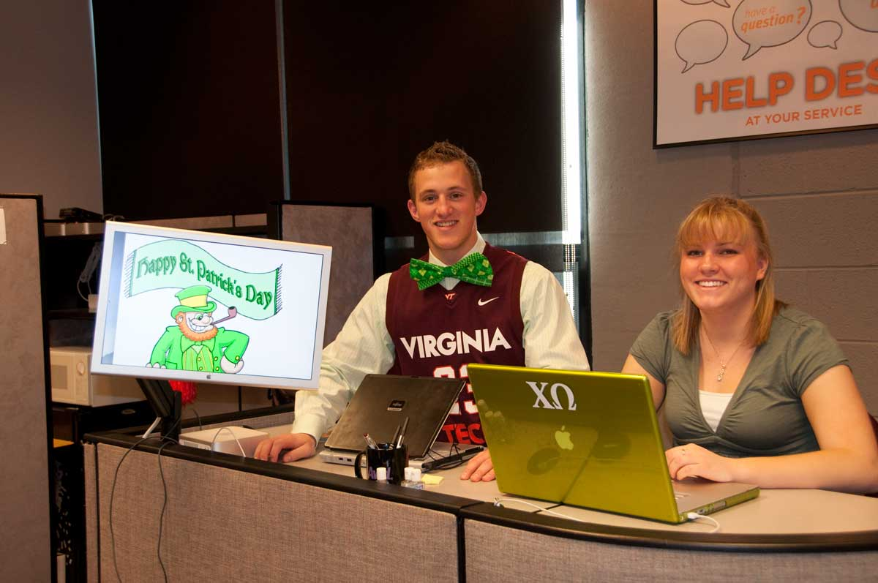
Student Feedback
Formal
Tasks Completed
Resources
Difficulties
Plan
Informal
Numbers, times, questions

Slide 37
Conclusions
Grass-root effort
Engaging all stakeholders
Powerful functionality for learning, professional development, and assessment
Sakai provides a very open, flexible environment for us to face this challenging task of instructional and technological transformation.

