Slide 1
Overview of the Information Security Guide: Leveraging the Knowledge and Skills of Your Colleagues
Cedric Bennett, Emeritus Director, Information Security Services, Stanford University
Mary B. Dunker, Director, Secure Enterprise Technology Initiatives, Virginia Tech

Slide 3
Overview of the Information Security Guide:
Leveraging the Knowledge and Skills of Your Colleagues
October 13, 2010 – 9:45 AM – 10:15 AM

Slide 4
Agenda
Introduction
Structure of the Guide
Finding information in the Guide
Contributing to the Guide
Questions and Answers
Here’s where you can find the Guide
www.educause.edu/security/guide

Slide 5
Higher Education Information Security Council
Established in 2002 by EDUCAUSE and Internet2
HEISC formerly called the Security Task Force
Works to improve information security and privacy programs across the higher education sector
through its community members and focused partnerships with government, industry, and other academic organizations
Actively develops and promotes awareness and understanding, effective practices and policies, and solutions for the protection of critical IT assets and infrastructures

Slide 6
Information Security Guide
A major initiative and key publication of HEISC
A compendium of information providing guidance on effective approaches to the application of information security at institutions of higher education
Content managed by the Editorial Board
Represents a broad cross-section of higher education community
Input comes from
Editorial Board members
Other HEISC working groups
Conference presentations and published articles
Information security practioners from a wide variety of institutions

Slide 7
Structure of the Guide
Recently reorganized to follow ISO 27002 topics
But it is NOT an implementation toolkit for ISO 27002
ISO 27002 was selected as the organizing principle of the Guide because it is a widely accepted international standard – and because…
ISO 27002 is concerned with the security of information assets (i.e., the actual information)
ISO 27002 focuses on information security controls within a framework of enterprise security topics

Slide 8
Structure of the Guide
Every topic page includes:
Linked Table of Contents
Overview description of general intent of the ISO topic
Cross-reference to other common standards
Information Security categories appropriate to that ISO topic
ISO objective for each category of the topic
Explanations, links to articles, links to presentations, links to institutional examples, and other materials
Linked references to other topic relevant materials
“Bread-crumb” trail at the top of the page, (e.g.)

Slide 9
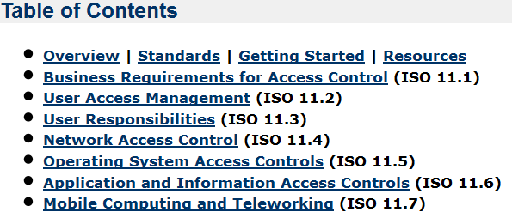
Table of Contents - Examples
Access Control (ISO 11)

Slide 10
Table of Contents - Examples
Access Control (ISO 11)
Security Policy (ISO 5)

Slide 11
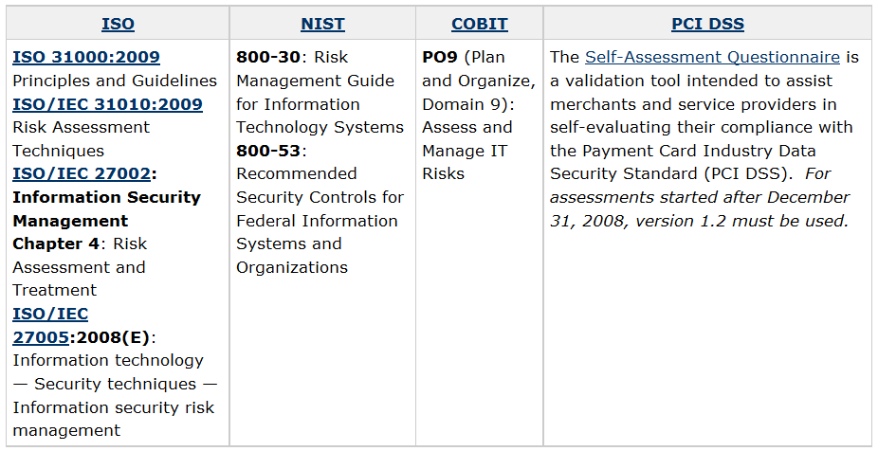
Standards - Example

Slide 12
Structure of the Guide
The navigation pane links to important resources
Home – announcements and featured resource links
Overview to the Guide – similar to this Webinar
Each of the twelve ISO Topics -- Risk Management (ISO 4) through Compliance (ISO 15)
Toolkits – links to specifically developed resources
Hot Topics – resources related to topics of current interest
Contribute a Case Study – instructions and forms
Glossary – list of terms and phrase definitions

Slide 13
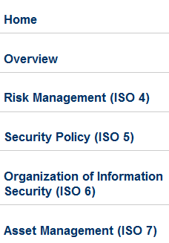
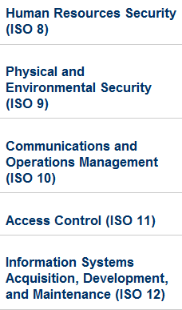
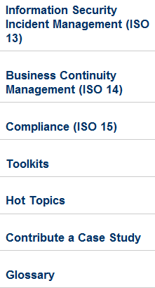
Navigation Pane

Slide 14
Finding information in the Guide
Two ways find information
Link directly to the desired information via the Navigation Pane
Look for the desired information using the Search tool
Navigation Pane is the quickest and easiest
When the topic name makes the location of the desired information obvious, e.g.,
Risk Management (ISO 4)
Security Policy (ISO 5)
Information Security Incident Management (ISO 13)

Slide 15
Finding information in the guide
Navigation pane is not as effective if you don’t know where the desired topic is covered in ISO, e.g.,
Data Classification is in Asset Management (ISO 7)
Awareness and Training is in Human Resources Security (ISO 8)
Cryptographic Controls is in Information Systems Acquisition, Development, and Maintenance (ISO 12)
For these sort of topics, use the Search Tool
Or to ensure you find all information relevant to your interest

Slide 16
Finding information in the guide
Searching is easy but not fully intuitive the first time
Important note: The Guide is one of several “spaces” in a generalized wiki. To search effectively, we must restrict searching to just the Guide.
Start searching by leaving the search box empty and pressing the search button…
(on the bread crumb bar on the top of every page)

Slide 17
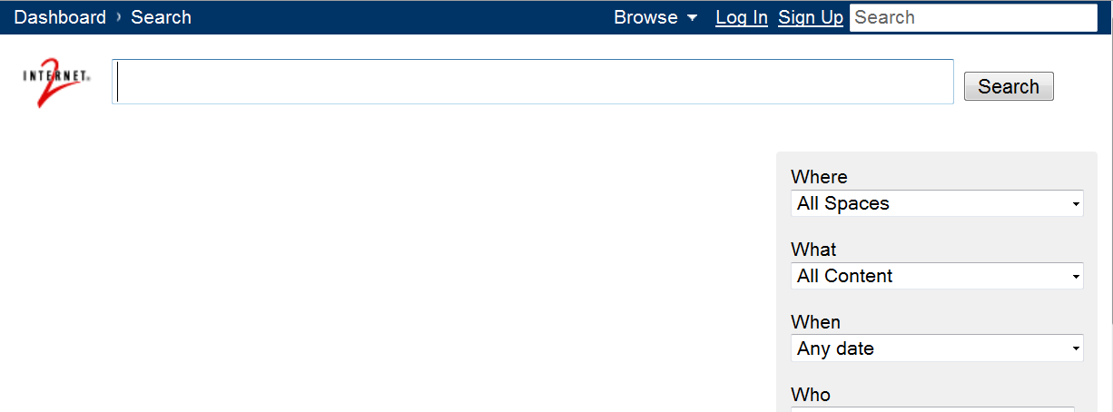
Finding information in the guide
…which brings you to this expanded search page

Slide 18
Finding information in the guide
…which brings you to this expanded search page
where you click on the triangle on the “Where” box and scroll down to “Information Security…”

Slide 19
Finding information in the guide

Slide 20
Finding information in the guide
To end up with…

Slide 21
Finding information in the guide
To end up with…
Note: Be sure to avoid the selection called “Old Security Guide”

Slide 22
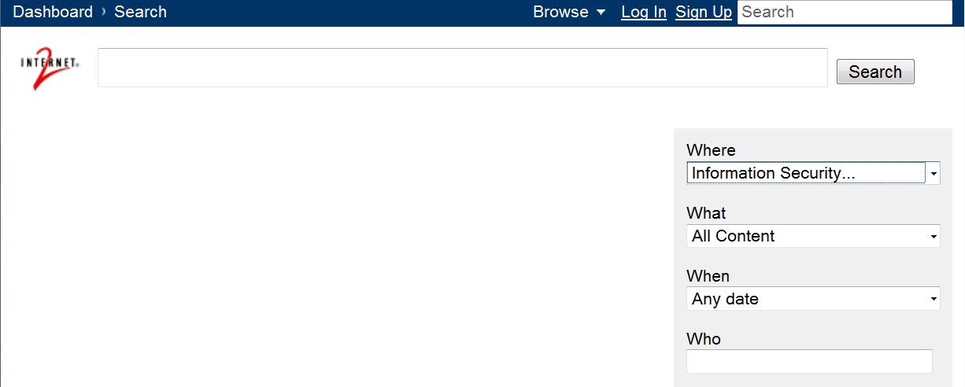
Finding information in the guide
Now enter your search term into the search box on the left side of the page (next to the Internet2 logo)

Slide 23
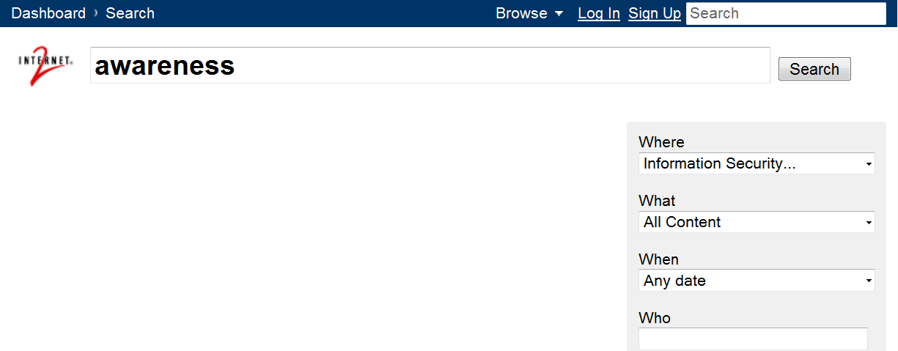
Finding information in the guide
Now enter your search term into the search box on the left side of the page (next to the Internet2 logo)
And ignore the search box on the bread crumb bar

Slide 24
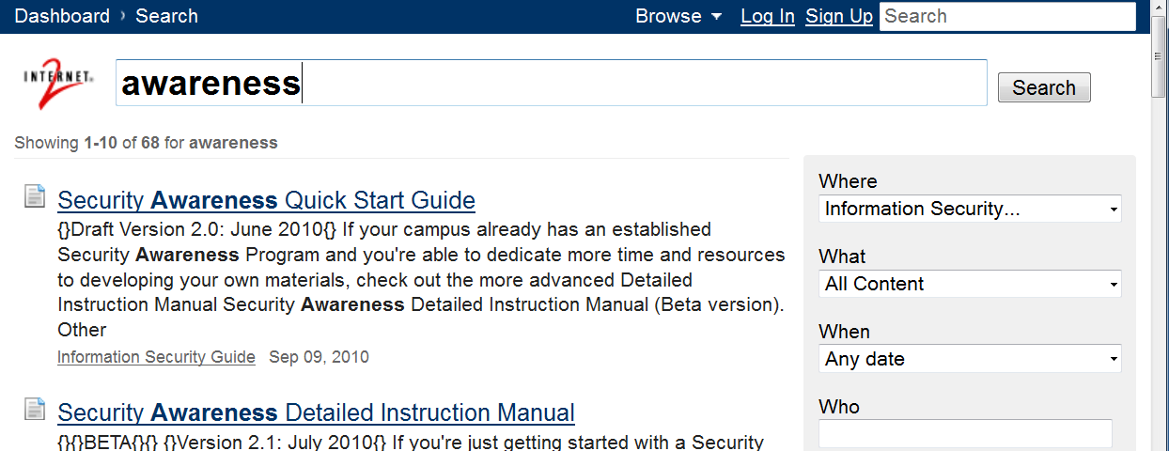
Finding information in the guide
Entering “awareness” returns this result…

Slide 25
Contributing to the guide
The Editorial Board depends upon input from many sources
There are two ways to provide input to the Guide
Make a comment on any page
The underlying platform is a wiki. All comments are monitored and suggestions are acted upon
Submit a case study
The chances are good that your institution is doing something that others will want to know about and possibly emulate

Slide 26
You can also make suggestions or ask questions by sending email to
ced.bennett@stanford.edu
dunker@vt.edu
security-council@educause.edu
Here’s where you can find the Guide
www.educause.edu/security/guide

Slide 27
Questions and answers

Slide 28
Questions and answers
Here are some questions from us…
What do institutions and security officers need from the Guide? What other materials would be useful?
Are there Case Studies (i.e., campus effective practices and solutions) that you would like to see included? Does your institution have an effective practice that you would be willing to share as a Case Study?
What, in addition to the Guide, could HEISC do to support institutional information security?

