Slide 1
STEPS TO A CLOUD READY DATA CENTER
DATA CENTER TO CLOUD INITIATIVE
Debbie Montano, Chief Architect
dmontano@juniper.net
Notes:
1

Slide 2
DISCLAIMER
This statement of direction sets forth Juniper Networks’ current intention and is subject to change at any time without notice. No purchases are contingent upon Juniper Networks delivering any feature or functionality depicted in this presentation.

Slide 3

EXPERIENCE
ECONOMICS
vs
The eternal challenge
Can the Cloud help?
Notes:
3

Slide 4
Cloud Computing
Cloud Services
Cloud Infrastructure
Services delivered over the Network
Dynamically shared resource pools
  Efficiency
  Elasticity
Service production
Service delivery
Application Services
Platform Services
Infrastructure Services

Slide 5


pooling resources – service production
Larger pools are more efficient and elastic
The network interconnects the pool
Resource Pool
Problem: Today’s Data Center Network Limits Scalability
Notes:
5

Slide 6







3 steps to a cloud ready data center
Share
Secure
Policies
Infrastructure
Simplify
Notes:
6

Slide 7



Simplify
Notes:
7

Slide 8







SIMPLIFY
LEGACY NETWORK
ETHERNET
STORAGE
SERVERS
FC SAN
Notes:
8
8

Slide 9
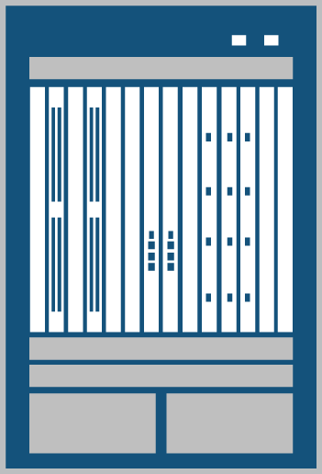
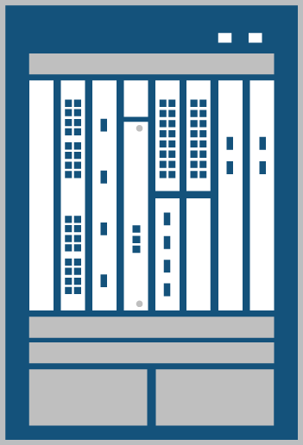


Simplify—Juniper’s Vision
TODAY’S SOLUTION
MX Series
Virtualize & consolidate security appliances
Virtualize access layer
Eliminate aggregation layer
Consistent edge services to connect to other data centers & the Internet
Single management view (and single or few OS versions)
SRX5800
EX8216
STORAGE
SERVERS
FC SAN
Notes:
9
9

Slide 10
Simplify—Juniper’s Vision
DATA CENTER FABRIC
MX Series
SRX5800
EX8216
STORAGE
SERVERS
FC SAN
Notes:
10
10

Slide 11

Simplify—Juniper’s Vision
DATA CENTER FABRIC
MX Series
Virtualized
Security &
Application
Services
The Stratus Project
SRX5800
SERVERS
STORAGE
Notes:
11
11

Slide 12
3 steps to a cloud ready data center
Share
Secure
Policies
Infrastructure
Simplify
Notes:
12

Slide 13


Share
Notes:
13

Slide 14

Share—Virtual Partitioning
VLANs
Physical or virtual server instance

Slide 15
Share—Virtual Partitioning
Zone 1
Zone 2
MPLS - VPN
VPLS - VPN
Zone 4
Zone 3
DATA CENTER
DATA CENTER
VLANs
Zones
VPNs
Physical or virtual server instance

Slide 16
Share
EXPERIENCE
vs
ECONOMICS
Separation of:
  Users communities
  Applications
  Departments
Greater Elasticity
Greater Scalability
More Efficient

Slide 17
3 steps to a cloud ready data center
Share
Secure
Policies
Infrastructure
Simplify
Notes:
17

Slide 18


Secure
Notes:
18

Slide 19
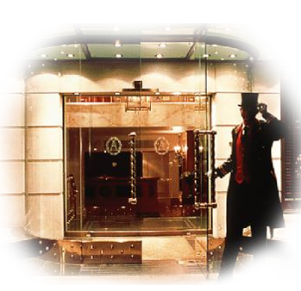

Secure—new model for the cloud
Hotel Model
Castle Model

Slide 20




Secure—Cloud Enabled Security
Clients
Global High-Performance Network
Data Centers
Client to DC
Server to Server
DC to DC
Notes:
20

Slide 21
Secure—the flow in the Cloud
Clients
Global High-Performance Network
Data Centers
Securing flows
between servers
1
Client to DC
Securing flows
between VMs
2
Elastic transport
using VPLS
3
Server to Server
DC to DC
Securing flows
from Clients to DC
4
Coordinated
threat control
5
Notes:
21

Slide 22



Secure—Cloud Enabled Security
User
App
Coordinated Threat Control
IDENTITY
Virtualized
Security
Services
Services
Policies
Reporting
AppSecure DoS Protection
Firewall
Authentication
Encryption
NAT
Intrusion prevention
Real-time visibility
Traffic prioritization
NSM
STRM
Management & Compliance

Slide 23






Secure—Cloud Enabled Security
User
App
VM
1
VM
2
VM
3
VM
4
Altor Virtual FW
Secure VDI
Support
Clients
Hypervisor
IDENTITY
Virtual Machines
Internet
SSL VPN
Virtualized
Security
Services
Hr Zone
DMZ
Finance zone
Policies
Reporting
Services
AppSecure DoS Protection
Firewall
Authentication
Encryption
NAT
Intrusion prevention
Real-time visibility
Traffic prioritization
NSM
STRM
Management & Compliance

Slide 24
3 steps to a cloud ready data center
Share
Secure
Policies
Infrastructure
Simplify
Notes:
24

Slide 25
Experience and Economics
More Scalable
More Elastic
Experience
More Performance
More Secure
More Reliable
Economics
Lowest TCO

Slide 26
EXPERIENCE
vs
ECONOMICS
Can the Cloud help?
Yes

Slide 27
Debbie Montano
dmontano@juniper.net
Notes:
27

