Slide 1
Common Education Data Standards
EDUCAUSE 2011
October 18-21, 2011
Notes:
Introduce myself

Slide 2
America’s education system faces significant challenges
Improve system performance
Improve efficiencies
Improve student outcomes
Increase transparency
Reduce burden
Increasing expectations
Decreasing resources

Slide 3
Tackling those challenges requires clear, consistent data
Interoperability and portability of data across multiple data systems and across projects
Common understanding of what those data mean on both sides of the exchange
Confidence in the comparability of data from different systems, allowing us to draw valid comparisons
Appropriate data must be able to flow efficiently and effectively across data systems
Notes:
…

Slide 4
Students Are Mobile
The U.S. Census found that 15 to 20 percent of
school-aged children moved in the previous year.
Sometimes this mobility is predictable:
Transitions from elementary → middle → high school → postsecondary
Sometimes mobility catches us by surprise:
Families move frequently: receiving schools must know which services to provide and in which courses to place new students
Hurricane Katrina displaced thousands; records were needed – fast

Slide 5
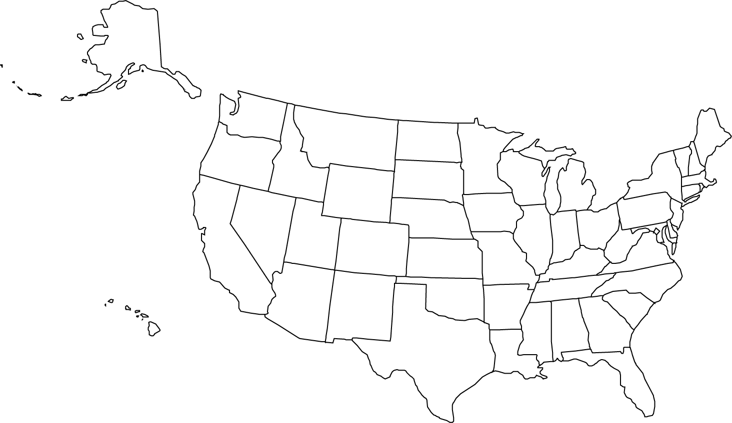
A little more than decade later, HEDS began data
sharing among more than 100 Private institutions
Since then,
hundreds of
decentralized,
independent,
data sharing
agreements
continue to
moved the
inquiry process
forward.
But, each project has to solve the data standards problem all over again…
In the Late ‘60s SREB began sharing data among its members!
Notes:
Click- In the late 60s members of the Southern Regional Education Board began sharing data with each other to evaluate their programs.
Click 2 -About a decade later, the Higher Education Data Sharing consortium brought together over a hundred private institutions together to share there data.
Click 3 – Since then dozens, maybe hundreds, of independent data sharing agreements have been made between institutions, between states, and among numerous constituency organizations.
You get the idea, data sharing focused on improving student results in postsecondary education has a long tradition, it is organic and decentralized, and the issue of data standards has had to be solved fresh every time.
The one thing that all of these projects have in common is that they would have been easier if common education data standards had existed at the time.
Today, we have a unique opportunity.

Slide 6
Who is developing the standards?
The Stakeholder Group convened by NCES is responsible for prioritizing the scope of the CEDS based on community feedback, reviewing existing data definitions and standards, publishing draft CEDS elements for comment, incorporating comments and finalizing each version.
Stakeholder Group Participants
US Department of Education Program Offices: NCES, OPEPD, OET, OUS, OPE, and FSA
Local Education Agencies
State Education Agencies
Institutions of Higher Education (public and private)
State Higher Education Agencies
SHEEO and CCSSO
Interoperability Standards Org: PESC and SIF
Associations: AACC, APLU, AIR, NAICU
Foundations: Gates and MSDF
Other Federal: Department of Labor (invited)
Notes:
NCES – National Center for Educational Statistics
OPEDP – Office of Planning, Evaluation and Policy Development
OET – Office of Educational Technology
OUS- Office of the Under Secretary (Martha Kanter) postsecondary, vocational and adult, federal student aid.
OPE – Office of Postsecondary Education (Edwardo Ochoa)
FSA – Federal Student Aid

Slide 7
CEDS Consortium
The Consortium participates in the development of the standards and is responsible for advocacy, communication, adoption and implementation of the standards.
Advocacy Communication Adoption Implementation
CCSSO ¹
SHEEO ¹
DQC ²
PESC
SIF
The Managing Partners
¹ funded on this project by the Bill and Melinda Gates Foundation
² funded on this project by the Michael and Susan Dell Foundation

Slide 8
What CEDS Is NOT
Required: Adoption of any or all of the CEDS standards is entirely voluntary.
A data collection: CEDS does not collect data.
A Federal unit record system or database: CEDS is a uniform practice for data standardization to enable sharing among education systems.
Solely a U.S. Department of Education under-taking: CEDS is a collaborative effort.
A requirement to recreate your databases: Most offices will probably just use CEDS to create cross walks between institutional databases and extract files for reporting.
Notes:
IR Offices can voluntarily use these data definitions to establish their own IPEDS-related extract databases and/or create “crosswalks” from institutional data collection practices to the standard definitions widely used in external reporting.

Slide 9
Current Status
Version 1.0 was released in September 2010
Only 161 Elements
Mostly K-12
Version 2.0 is in development
Draft 1 for Public Comment (July)
Postsecondary dominated the 5oo+ comments
http://nces.ed.gov/programs/ceds/
www.commoneddatastandards.org
Draft 2 Yet month for public comment
Version 2.0 will be released January 2012

Slide 10
Questions for You
Have you heard about CEDS before today?
How do you think CEDS would be valuable in your context?
What are the questions that come to mind that you need answered to consider whether to adopt CEDS?
Who needs to be involved? How? When?
What do you foresee are the issues that need to be addressed to adopt/implement/support CEDS?
What would implementation look like?

Slide 11
Contact Information
CEDS Consortium Web Site
www.commoneddatastandards.org
NCES CEDS Web Site
http://nces.ed.gov/programs/ceds/
SHEEO CEDS contact
John Blegen, CEDS Project Manager jblegen@sheeo.org cell: 303-589-2328 office: 303-541-1610

