Slide 1
Leading Change —
The Higher Education CIO:
Portrait of Today, Landscape of Tomorrow
Discussion session on The ECAR Workforce Study
Carrie Regenstein, CMU
Susan Grajek, EDUCAUSE
October 20, 2011

Slide 2
Welcome!
Who’s here?
Twitter/blog/wiki tag is #EDU11
Note-taker will help us post the notes

Slide 3

The future ain’t what it used to be

Slide 4
New from the new ECAR…
How was this study done differently?
  Methodology
Why was this study done differently?
  The new mission of EDUCAUSE’s Data, Research, and Analytics group
How can you help ECAR provide meaningful and actionable data and information for you and your institution?

Slide 5
It takes a village
Authors
  Pam Arroway
  Jerrold M. Grochow
  Judith A. Pirani
  Carrie E. Regenstein
Other team members
  Mark Sheehan
  Catherine Yang and Bret Ingerman
  Becky Granger
  Toby Sitko
  Gregory Dobbin

Slide 6
Questions we examined
What is the CIO’s role and how is it changing?
Who are the people in that role: Where did they come from, what degrees do they have, when do they plan on retiring or leaving?
Who are the people who aspire to the CIO role: Where are they now, when will they be ready, what concerns them?
What skills are needed to be a CIO? How will the next generation get those skills? How are potential candidates being nurtured? Who has responsibility for doing that?
What can a person who aspires to be a CIO do to prepare for the job?

Slide 7
Where shall we start?

Slide 8
1. What is the CIO’s role and how is it changing?
45% of leaders responsible for their institution’s primary IT organization have the title of “CIO,” which rises to 70% in doctoral institutions; we often refer to all of these leaders as CIOs even though actual titles differ.
72% of senior IT leaders participate in institutional decision making at the executive level.
Brian Hawkins: “the role of CIO is not about technology itself; rather, it is about the ability of a campus to achieve its goals and objectives through technology.”
CIOs are now spending more time on planning and budgeting.

Slide 9
IT Funding Is among the Top 10 Issues that Consume CIO Time
Issue | Percentage*
Funding IT | 49%
Administrative/ERP/information systems | 39%
Strategic planning | 34%
Governance, portfolio/project management | 30%
Policy development and compliance | 26%
Security | 23%
Infrastructure/cyberinfrastructure | 22%
Collaboration/partnerships/building relationships | 21%
Staffing/HR management/training | 21%
Service and support (formerly service delivery models) | 20%
*n = 320
Notes:
Source: EDUCAUSE Current Issues Survey 2011, Question 3: Which issues are you, as an IT leader or administrator, spending most of your time addressing? Check up to five [5] issues.
To further make the point that the CIO job is not just a technical job, one has only to look at responses to the EDUCAUSE Current Issue Surveys. In 2011, almost half of CIOs reported that funding issues are taking up the majority of their time—and it has been that way for several years. They are spending their time on strategic planning, governance, policies, building relationships, staffing, and service and support, as well as on administrative information systems and infrastructure issues. Even 10 years ago, strategic planning, staffing, and funding made it into the top-five ways in which CIOs spend their time.

Slide 10
The CIO is No longer in the “IT Box”
The CIO position is more strategically oriented.
Half of CIOs selected IT funding as one of the top-five issues they spend time on.
  Responsibility for IT planning and budgeting added by 27% of institutions in the past five years,
    87% of doctoral institutions now reporting this function under the CIO
    only 55% of BA GEN schools doing so
CIOs cited the importance of being able to communicate, think strategically, influence, negotiate, and manage relationships.
CIOs must know how to introduce a new technology as well as which ones to introduce.
Notes:
Source: EDUCAUSE Current Issues Survey 2011, Question 3: Which issues are you, as an IT leader or administrator, spending most of your time addressing? Check up to five [5] issues.
Every CIO respondent (100%) to the 2011 ECAR study indicated that communications skills are important to the job (high or very high), while only 31% put technical proficiency in the same category. Being prepared to take on the job of CIO isn’t just about skills. It is also about broad-based organizational background and understanding.

Slide 11
2. Who are the people in that role?
Where did they come from?
  75% of current CIOs come from within higher education, and one-third held a previous CIO position.
What degrees do they have?
  80% of current CIOs have an advanced degree, and 25% have a PhD; those with PhD’s most commonly work at doctoral institutions.
When do they plan on retiring or leaving?
  31% of current CIOs expect to retire or leave higher education within the next six years.
  52% of current CIOs expect to retire or leave higher education within the next ten years.
Notes:
OF the 75% of current CIOs that come from within higher education, roughly half come from the same institution.

Slide 12
3. Who are the people who aspire to the CIO role?
Where are they now?
  18% of respondents aspire to become a CIO
  61% of respondents do not aspire to become a CIO, an increase of 10% since 2008.
  The rest don’t know.
When will they be ready, what concerns them?
  Of those currently in executive (non-CIO) IT positions, 32% aspire to become a CIO in the next six years.
  48% said politics was a key reason for not wanting to be a CIO
  33% said stress was a key reason for not wanting to be a CIO
  15% were concerned about not having the management or technical skills necessary
  12% were concerned about not having proper leadership skills
Notes:
24% of women are concerned about having the technical skills; only 9% of men. This concern does not align with the required skill set as described by current CIOs.

Slide 13
How many candidates are there per anticipated vacancy?
Among respondents to the 2010 survey, there are 4 higher education candidates for each vacancy:
  113 current CIOs plan to vacate that position within six years
  420 individuals identified themselves as aspirants for the senior-most IT position
    44% of these aspirants (186) are already in executive non-CIO positions
We need to monitor that the number of aspirants increases along with the number of vacancies
  The percentage of interested aspirants in 2010 matched the percentage in 2004, both of which were lower (18-19%) than the percentage in 2008 (23%)

Slide 14
4. What skills are needed to be a CIO in the “age of the cloud”?
Notes:
Source: 2011 ECAR Workforce Survey, Question 2.3: Assess the importance of the following skills for success in your current IT position.
Key Finding: 100% of current CIOs rated communications skills as important for success as a CIO; 31% rated technical proficiency important.
Almost all CIOs noted the importance of strategic thinking and planning and the ability to negotiate, to influence, and to manage other relationships within the institution. The CIO’s job has become a social/political role as well as a technology one, to the point that knowing how to introduce a new technology is as important as knowing which ones to introduce.

Slide 15
What skills are needed to be a CIO?
According to Debra Allison
  Basic competency of excellence in operations and production management
  Ability to focus on the institutional mission & needs and serve as an institutional innovator
  Ability to proactively capture opportunities to advance the institution, rather than merely meeting the requests presented to the IT organization
  Skill in negotiation and contracts as service models to provide new opportunities in the “cloud” and inter-institutionally
  Skills in effective collaboration across the institution and with external partners to reduce duplication of services and associated costs, improve efficiencies, and improve service quality.

Slide 16
5. What can a person who aspires to be a CIO do to prepare for the job?
Aspirants need to take personal responsibility for their own careers
  Seek out formal and informal learning opportunities
36% of people aspiring to be a CIO have a mentor
  These respondents indicate they are more satisfied with their development opportunities by a factor of 2 to 1 over those who do not.

Slide 17
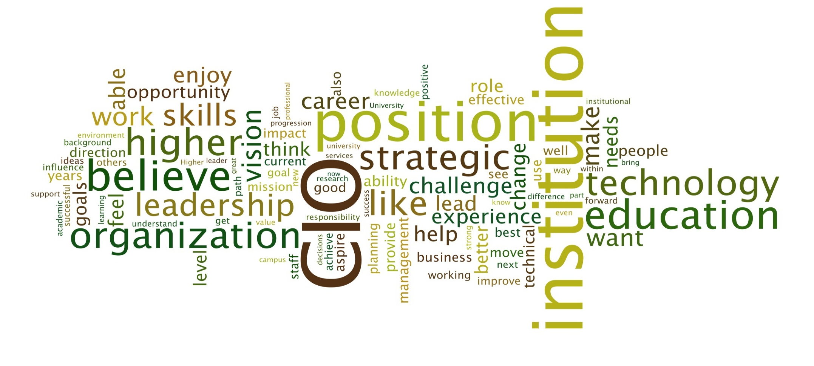
Aspirants are confident and optimistic
Notes:
Source: 2011 ECAR Workforce Survey, Question 5.11: Please elaborate on why you aspire to a CIO position.
This word cloud was created from the free-response answers from 545 respondents. Categorizing their answers, we found that the largest grouping involved a perception of readiness and qualification for the job. A desire to make a difference within their institution was the second most popular category. There were also responses around the same issues but in a broader sense of interest and desire to enhance higher education in general. It is clear that those people who aspire to be a CIO are committed to both IT and to expanding the ways that IT can improve higher education.

Slide 18
Where do we go from here?

Slide 19
The next generation
How will the next generation get those skills? How are potential candidates being nurtured?
  Formal leadership training opportunities
  On-the-job learning opportunities
Who has responsibility for doing that?
  Institutions and current CIOs can help
  Aspirants need to take personal responsibility

Slide 20
A Culture of Succession Planning is Needed Within Higher Education
74% of CIOs come from within higher education. Roughly half of those from within the institution.
Only 31% of CIOs indicated that they are held responsible for identifying a successor.
  However, 64% of CIOs have identified a successor.
Aspirants who are being groomed for the CIO position are more optimistic about job opportunities.
  However, less than one-third of staff selected mentoring as a top factor in their professional growth.
Notes:
Source: 2011 ECAR Workforce Survey
Question 1.15: In what type of organization/institution was your most recent previous position?
Question 5.3: Which of the following describes your role in your previous position?
Question 5.4: Please indicate your level of agreement with the following statements about succession planning for your position. (a) I am held accountable by my supervisor for developing my successor. (b) I have identified one or more individuals within my organization who could succeed me now. (c) My successor is likely to be recruited from within the institution.
Question 5.12: Please indicate your level of agreement with the following statements. (a) I have sufficient opportunities to develop the skills I will need to become a CIO. (b) I believe there will be a sufficient number of CIO job openings in higher education for me to become a CIO within my desired time frame. (c) My manager/supervisor is helping to groom me as a future CIO. (d) To become a CIO, I will need to leave my current institution.
Question 2.3: Which of the following contribute most significantly to your professional growth and development? Select up to three.

Slide 21
Aspirants Who Are Being Groomed Are More Optimistic Than Those Who Are Not
Notes:
Source: 2011 ECAR Workforce Survey, Question 5.12: Please indicate your level of agreement with the following statements. (a) I have sufficient opportunities to develop the skills I will need to become a CIO. (b) I believe there will be a sufficient number of CIO job openings in higher education for me to become a CIO within my desired time frame. (c) My manager/supervisor is helping to groom me as a future CIO. (d) To become a CIO, I will need to leave my current institution.
Key finding: 36% of people aspiring to be a CIO have a mentor, and that makes them more satisfied with their development opportunities by a factor of 2 to 1 over those who do not.
Mentoring has become an important part of personnel development in general, and mentoring IT leaders is no exception. More than one-third of aspirants (36%) are being groomed by a supervisor, a number that is consistent across Carnegie classification and gender. Those who are being mentored are more optimistic about their future and are more likely to agree that they have sufficient opportunities to develop (80% versus 40%), more likely to agree that there will be sufficient jobs (56% versus 36%), and less likely to believe that they would have to leave their institution to become CIO (36% versus 56%). Given the overall increase in satisfaction with the job as a result of mentoring, it is somewhat surprising that only 36% of those under age 30, and 32% of those 30–45, selected mentoring as one of the top-three factors contributing to their professional growth and development (numbers declined significantly after age 45). Members of the executive IT leadership team should be considering this in promoting mentoring as an important—and high-priority—activity.

Slide 22
Take-aways from this session
Major points or findings?
Areas for follow-up?
Please continue the conversation at your institution
The ECAR report, .pptx, and other materials are available at: http://www.educause.edu/ECAR/TheHigherEducationCIOPortraito/236114
The link for the Evaluation Form for this session can be accessed from the session’s abstract page

Slide 23
THANK YOU

