Slide 1
DIY U: Edupunks and the Transformation of Higher Education
Anya Kamenetz
Educause
October 19, 2011

Slide 2
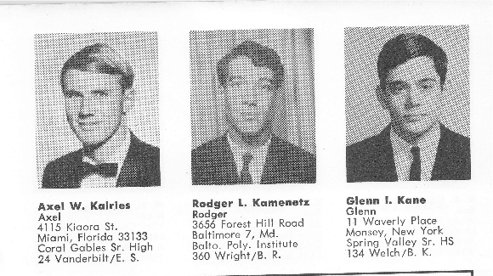
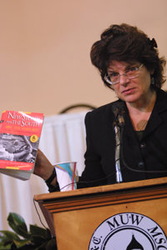
My lenses: Gen Y rep
Faculty brat
media
Journalist

Slide 3
*Two-thirds of BAs have federal student loans. (less than ½ in 1993).
*Average debt: $27,803
*2-year default rate: 8.8% and rising.

Slide 4
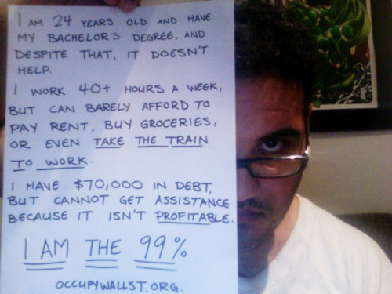
9.6 jobs ages 18-32; workers under 25 are 2x as likely to be freelance, temp, contract. part-time.
As of 2010, 37% of 18- to 29-year-olds are unemployed or out of the workforce, the highest share among this age group in more than three decades.

Slide 5
“I just had a friend who graduated with a French major and is having a panic attack.”
“A lot of us especially in this recession want economic stability.”
“Every year our tuition is getting raised. It makes people weigh out the costs and benefits more.”

Slide 6
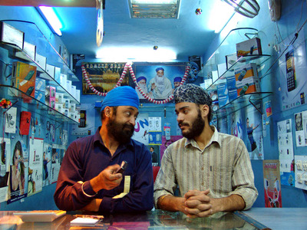
competition is global
“In the school of international studies you’re required to spend a semester abroad. That’s something that really sets you apart.”

Slide 7
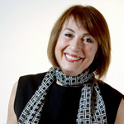
“58 percent of grade school kids will be employed in careers that don’t exist today.” --Cathy Davidson Now You See It

Slide 8
Cost +
Access +
Relevance = The Case for Radical Innovation

Slide 9
From Baumol’s
Disease…

Slide 10
to Moore’s law?

Slide 11
The Future is Open

Slide 12
Content(what to learn)+
Socialization(how to learn)+
Accreditation (why to learn)

Slide 13
OpenContent

Slide 14
Attractive/Accessible
Attractive.Accessible.Unlimited.
“a platform for spreading ideas” – Chris Anderson
“Our professor uses YouTube to show how music therapists interact with different populations.”

Slide 15
Updated Constantly
Continuously updated
“We have apps on
our smartphones
to look up
the drugs and
side effects.”

Slide 16
It’s not *just* about the iStuff

Slide 17
“If this info is out there for free why am I going to school and paying $50K a year ? I want that support network.”

Slide 18
OpenSocialization

Slide 19
Personal Learning Networks

Slide 20
We help each other learn “Alex started us sharing notes on Dropbox.” “We have a Facebook thread with 200 people answering questions”

Slide 21
Stanford University’s Massively Open Online Course
100,000+ students from 175 countries…AI grading
Peter Norvig and Sebastian Thrun.

Slide 22
Wikimedia—45 schools.
Assessment by network

Slide 23
Formalizing peer learning
“Sharing ideas is really enjoyable—it’s just as important as learning from the professors.”

Slide 24
OpenAccreditation

Slide 25
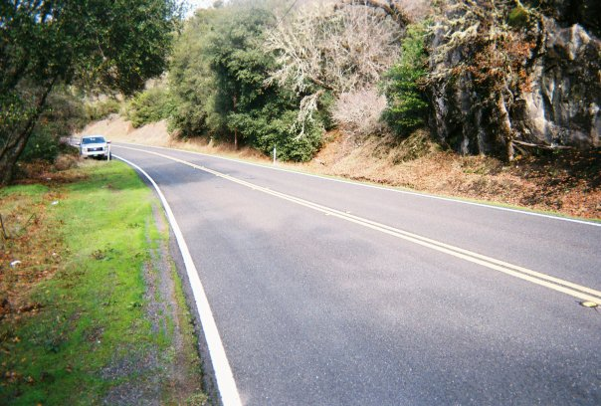
As students follow personal learning paths…
Web
Portfolio

Slide 26
Institutions may specialize in assessment…

Slide 27
…or portability

Slide 28
supplement the need for diplomas
Professional networks:
bypassing diplomas

Slide 29
Reputation+portfolio= credibility

Slide 30
Badges: assessment for real world learning

Slide 31
Pressures-Responses
Access/Demand-Networks & Scalability
Cost-Digital efficiencies& specialization/unbundling
Quality-21st century skills & practices

Slide 32
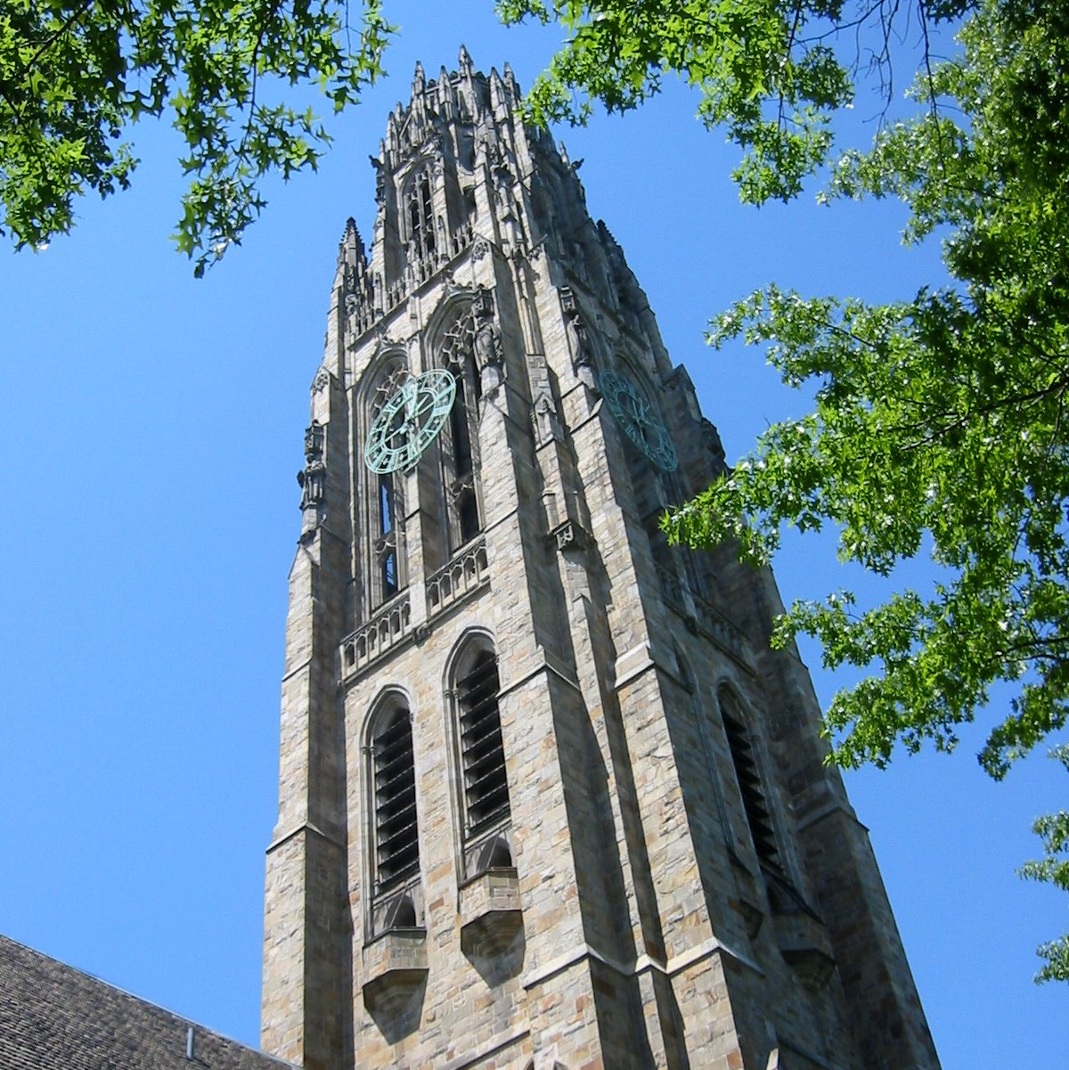
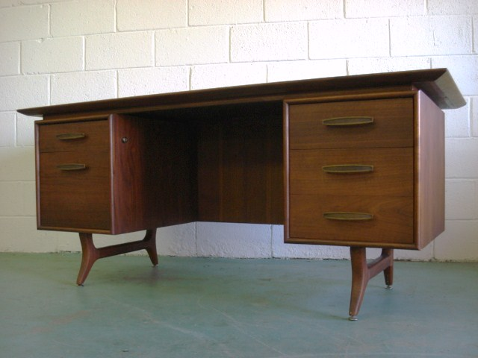
The Old Way

Slide 33
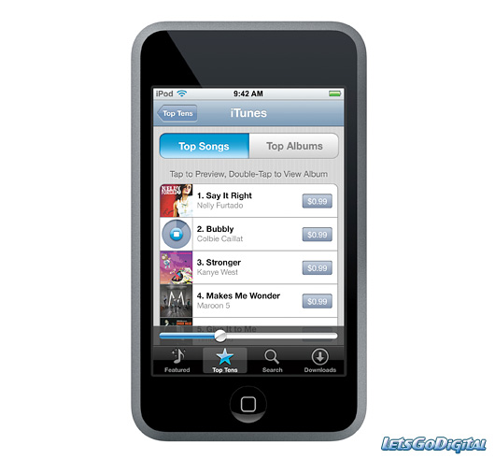
The New Ways
Goals
Web
Networks
Personal
Learning
Networks
Experiences
C
mentors
peers
Internships
Portfolio
Self-discovery

Slide 34
Twitter @anya1anya Edupunksguide.org DIYUBOOK@gmail.com

