Slide 1
Transforming learning through analytics
George Siemens
EDUCAUSE
October 21, 2011
Philadelphia

Slide 2
Questions? Ask here:
http://bit.ly/edu-data

Slide 3
http://www.slideshare.net/gsiemens/analytics-educause

Slide 6
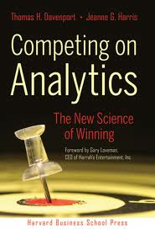
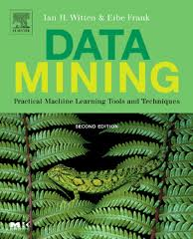

Slide 7
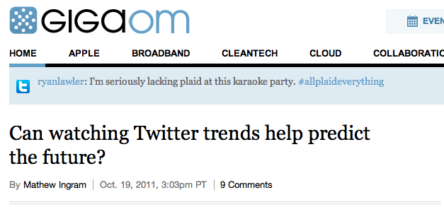

Slide 8
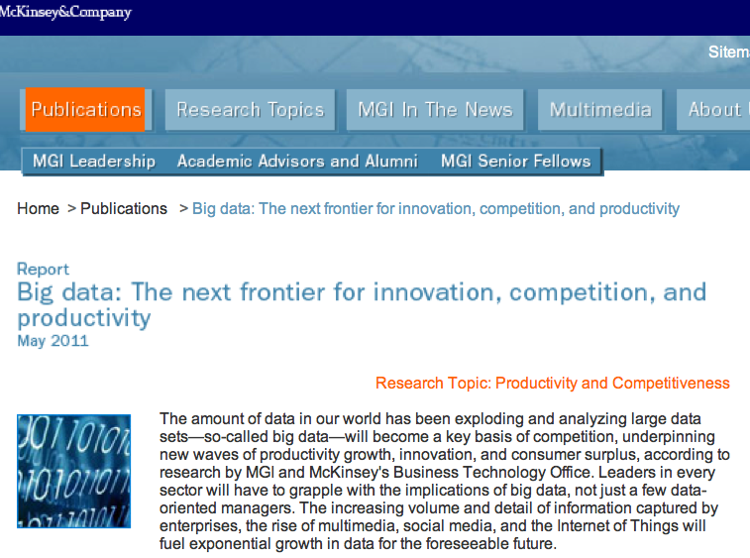

Slide 9
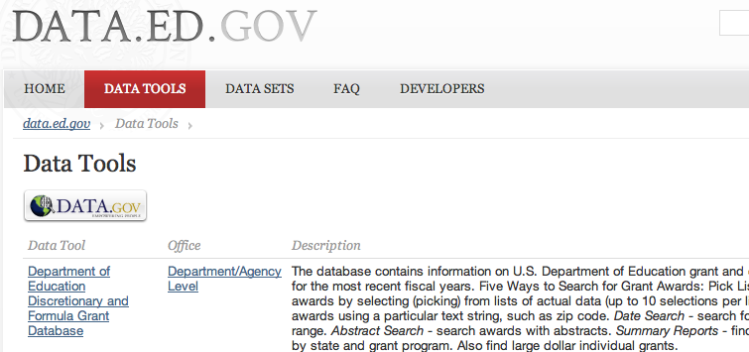

Slide 10
American intelligence communities are interested in your YouTube video, flickr uploads, tweets -- even your online book purchases -- and for over a year they've been laying down some serious cash to get a better look at all of them.
http://www.businessinsider.com/the-cia-just-put-a-ton-of-cash-into-a-software-firm-that-monitors-your-online-activity-2011-7

Slide 11
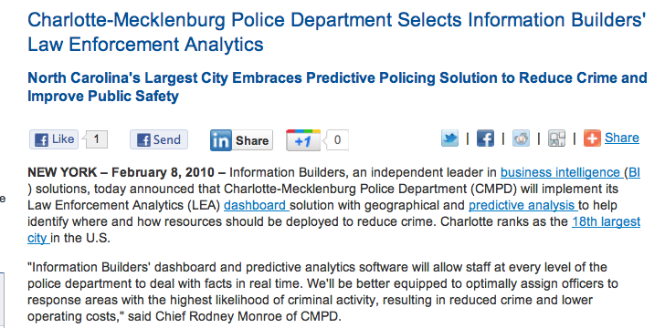
dashboard solution with geographical and predictive analysis to help identify where and how resources should be deployed to reduce crime.
http://www.informationbuilders.com/news/press/release/9483

Slide 12
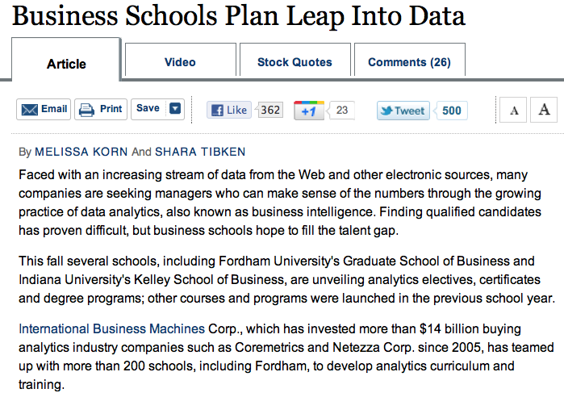
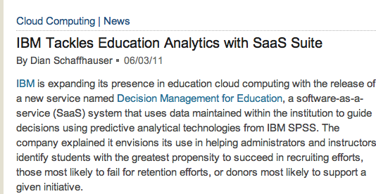
http://online.wsj.com/article/SB10001424053111903885604576486330882679982.html
International Business Machines Corp., which has invested more than $14 billion buying analytics industry companies…since 2005, has teamed up with more than 200 schools…to develop analytics curriculum and training.

Slide 13
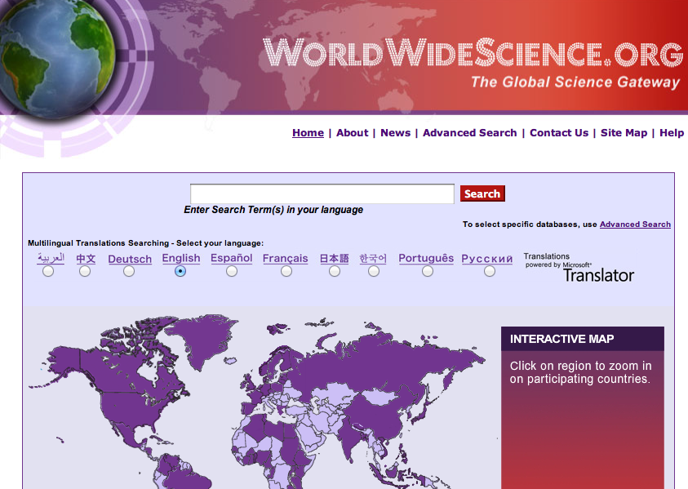

Slide 14
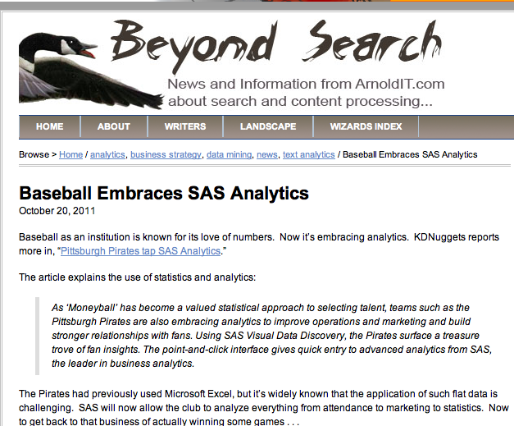

Slide 15
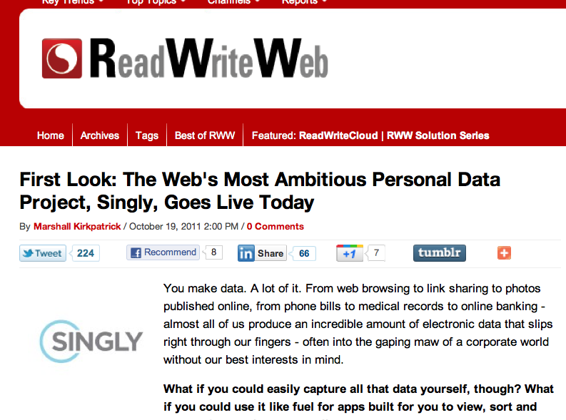

Slide 16
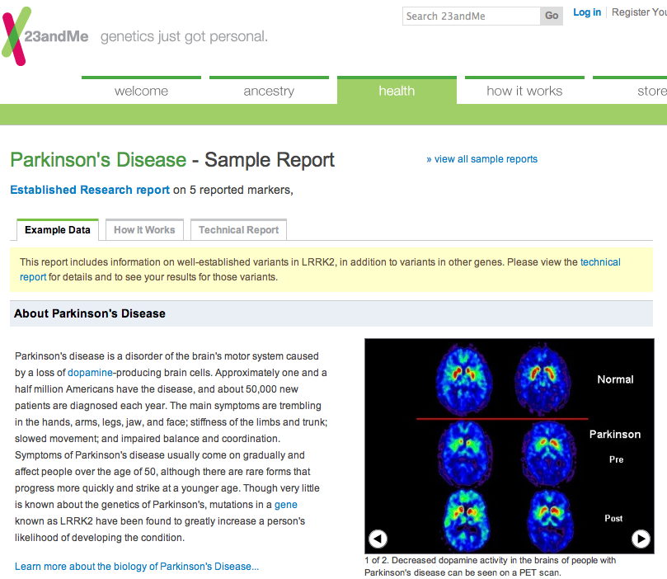

Slide 17
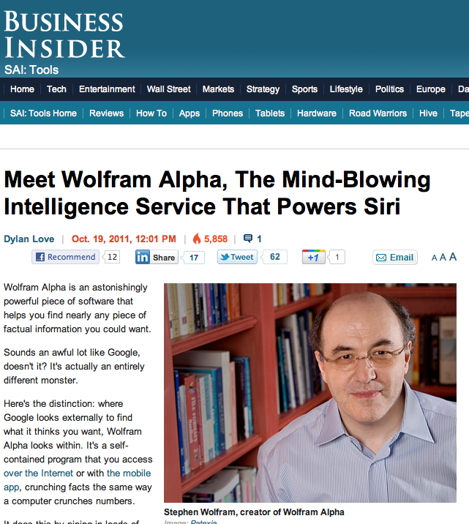

Slide 19
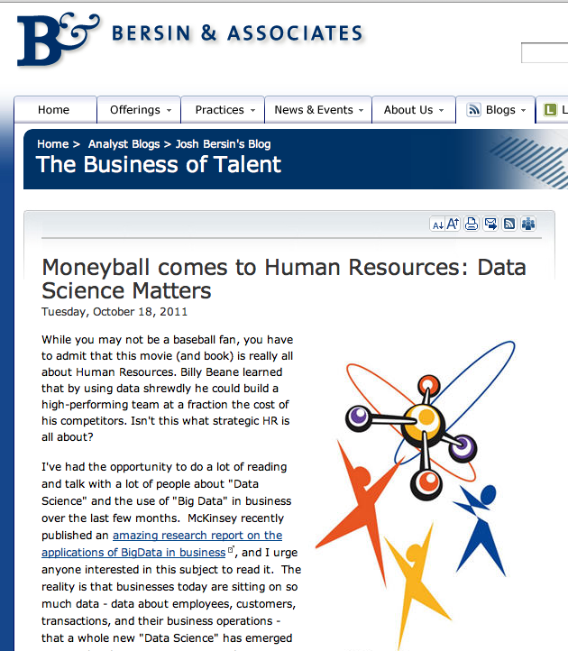

Slide 20
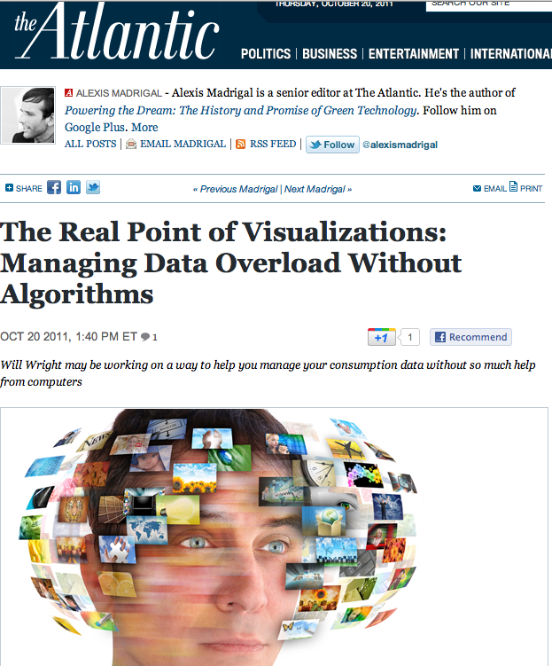

Slide 21
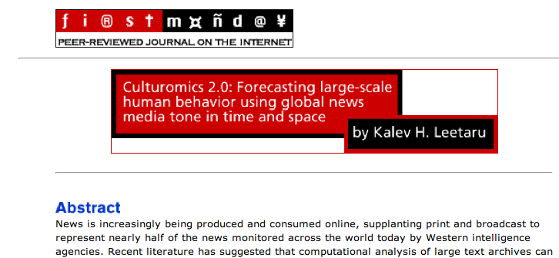

Slide 22
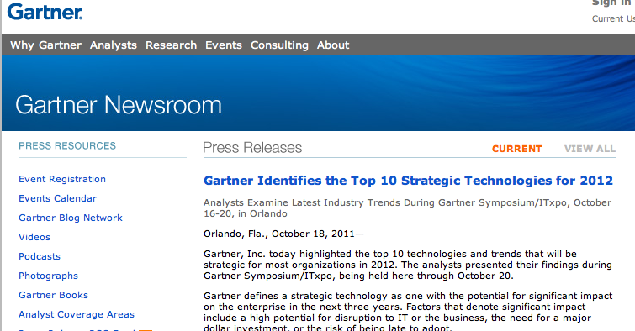
Next-Generation Analytics. Analytics is growing along three key dimensions:
From traditional offline analytics to in-line embedded analytics. This has been the focus for many efforts in the past and will continue to be an important focus for analytics.
From analyzing historical data to explain what happened to analyzing historical and real-time data from multiple systems to simulate and predict the future.
Over the next three years, analytics will mature along a third dimension, from structured and simple data analyzed by individuals to analysis of complex information of many types (text, video, etc…) from many systems supporting a collaborative decision process that brings multiple people together to analyze, brainstorm and make decisions.

Slide 23
Big Data. The size, complexity of formats and speed of delivery exceeds the capabilities of traditional data management technologies; it requires the use of new or exotic technologies simply to manage the volume alone. Many new technologies are emerging, with the potential to be disruptive (e.g., in-memory DBMS). Analytics has become a major driving application for data warehousing, with the use of MapReduce outside and inside the DBMS, and the use of self-service data marts. One major implication of big data is that in the future users will not be able to put all useful information into a single data warehouse.

Slide 24
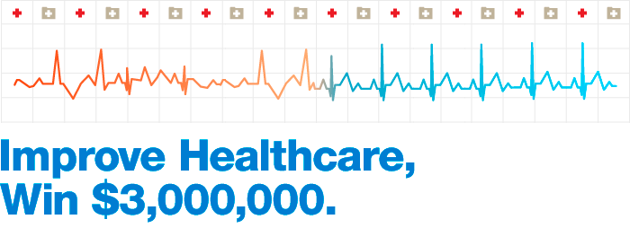
Who is going to get sick?

Slide 25
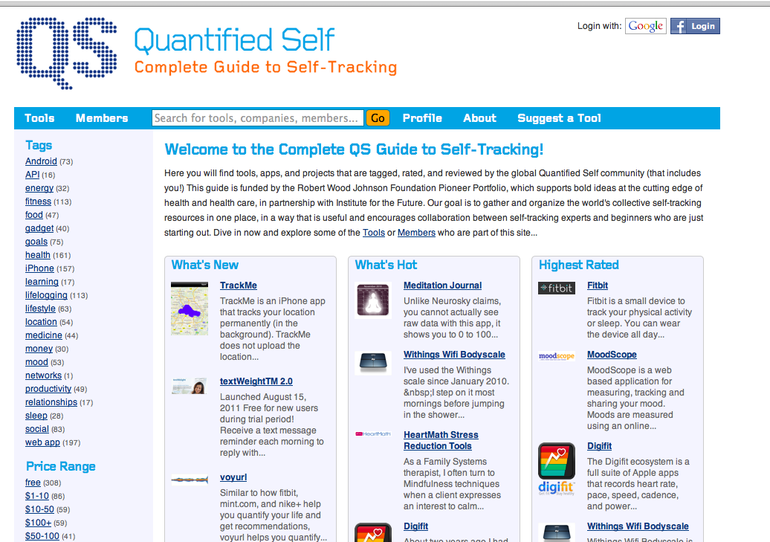

Slide 26
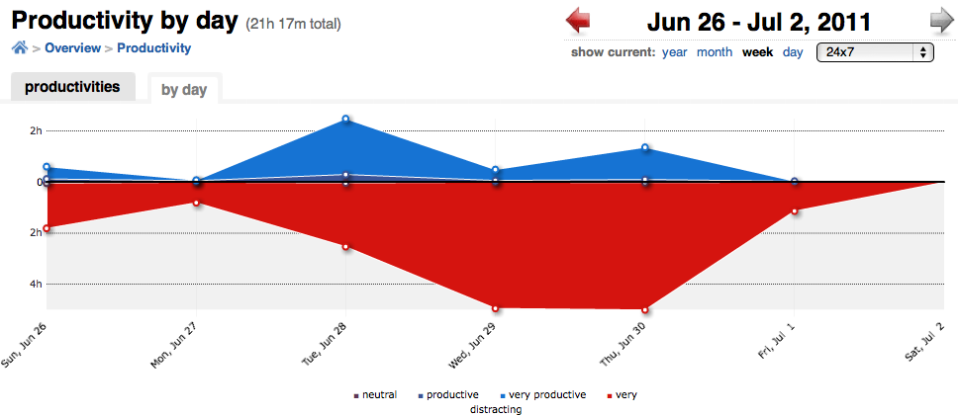

Slide 27
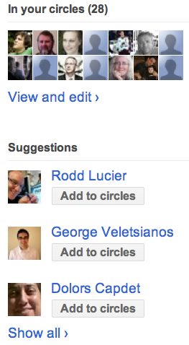

Slide 28
Analytics need corrective capacity

Slide 29
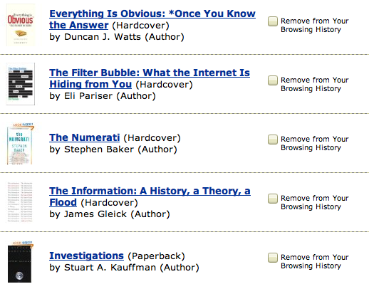

Slide 30
Why?

Slide 31
If your daughter shops on your account…

Slide 32
Yeah, maybe not.

Slide 33
or

Slide 34
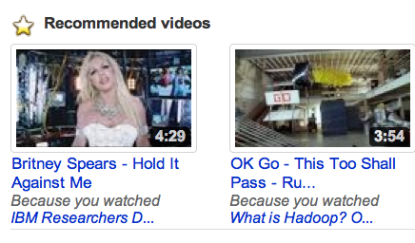
Recommenders gone bad
This
DOES NOT
equal this

Slide 35
Empowering end-users: access to, and means of interrogating, data

Slide 37
Data reveals our sentiments, our attitudes, our social connections, our intentions, and what we might do next.

Slide 38
Learning analytics is the measurement, collection, analysis and reporting of data about learners and their contexts, for purposes of understanding and optimizing learning and the environments in which it occurs.
Society of Learning Analytics Research

Slide 39
Anywhere/time data is produced in education an analytics opportunity exists

Slide 40
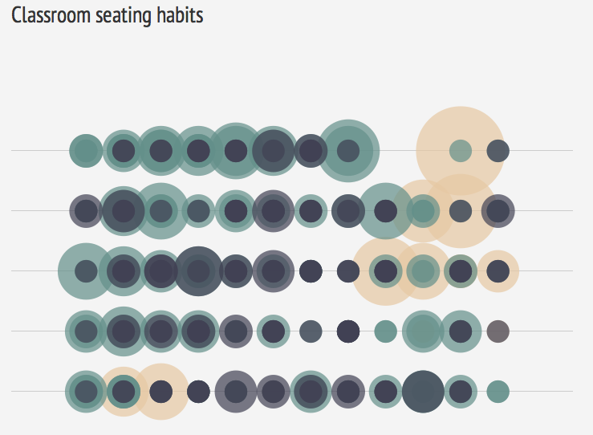
http://www.skyrill.com/seatinghabits/

Slide 41
Learner success
Use of university resources/services
At-risk learners (predictive capacity)
Help-seeking behavior
Alerts
Intervention
Learner dashboard
Path of concept development
Real-time analytics

Slide 42
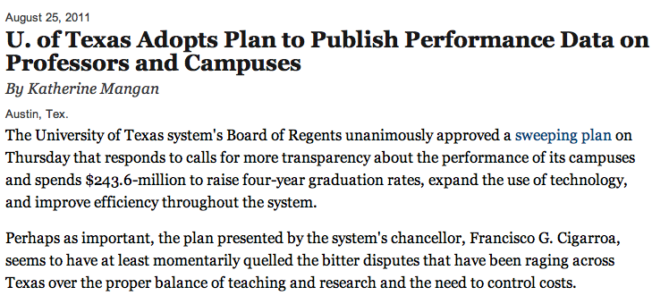
The plan…designates money to create a "dashboard"—an interactive, online database—to give students, parents, and legislators access to detailed measures of departments' and colleges' productivity and efficiency. Data on individual professors will probably also be included
http://chronicle.com/article/U-of-Texas-Adopts-Plan-to/128800

Slide 43
What are NOT learning analytics?
Classroom optimization
Staff allocation
Web analytics
These are important analytics activities for universities, but they are not learning analytics

Slide 44
Analytics must be rooted in learning sciences

Slide 45
Analytics produce patterns, not insight

Slide 46
Analytics should do more than only evaluate what we are doing in our existing system.

Slide 47
They should help to change the system.

Slide 48
An LMS pulls things together by emphasizing one space
Analytics/monitoring tools pull things together by evaluating relatedness outside of a central space
Each new node amplifies value

Slide 49
Let’s avoid the mistakes of previous educational technology adoption.

Slide 50
Let’s start with open. and learners and educators and researchers

Slide 51
Proposal: Open Learning Analytics Architecture
Integrated
Modularized
Extensible

Slide 52
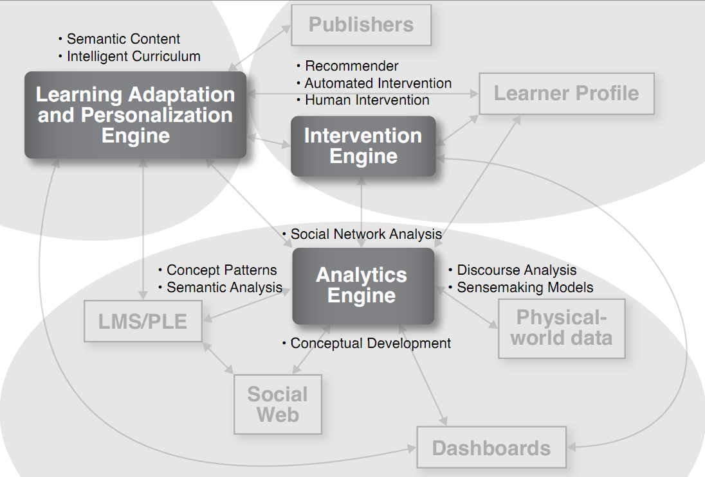

Slide 53
Privacy, security, ethics

Slide 55
http://lak12.sites.olt.ubc.ca/ April 29-May 2, 2012 Vancouver

Slide 56
Open online course: Learning Analytics January 23 - March 17, 2012
http://www.solaresearch.org/

Slide 57
http://www.learninganalytics.net/

Slide 58
change.mooc.ca
Twitter: gsiemens
www.elearnspace.org/blog
Learning Analytics & Knowledge 2012:
Vancouver
http://lak12.sites.olt.ubc.ca/
SoLAResearch.org

