Slide 1
Designing and Delivering a Rich, Cost-Effective Leadership Development Program for IT Leaders Penny Cox Associate Vice President Information Technology, Planning, Administration & Finance University of Kentucky
Penny.cox@uky.edu
(859) 257-3609
EDUCAUSE
October 19, 2011 – 1:30 to 2:30

Slide 2
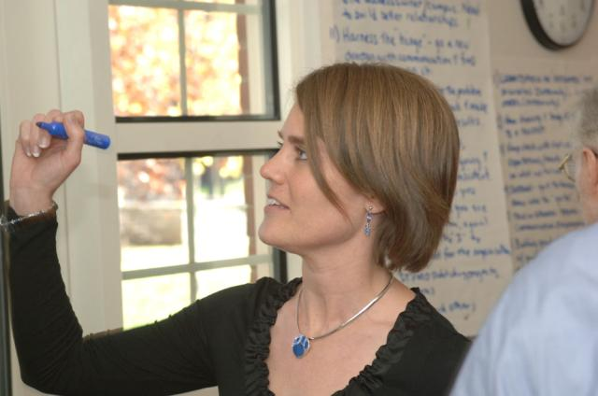
Agenda
Context
Themes
Lessons Learned
Solutions – Year 1, Year 2
Speakers
Books, Year 1, Year 2
Advice
Strategic Impact
Additional Reference Material

Slide 3
University of Kentucky http://www.uky.edu/
Kentucky’s flagship public, land grant university
28,000 students (About 71% undergraduate)
Of that number, 89 percent attend full time
16 colleges
Largest: Arts & Sciences (22 percent)
College of Medicine, College of Law
University hospital
More than 12,000 full-time staff, including more than 3,000 faculty and librarians
Institutional budget of $2.6 billion.
About 300 million in grants, contracts and awards for research.

Slide 4
Context
When IT units have a difficult time planning for the graying workforce, the consequences can be significant. In 2009, the University of Kentucky office of the CIO faced a staggering 23% of the existing IT workforce that was or would be eligible for retirement within three years.
Growing our own leaders, rather than recruiting from outside, was a solution we needed in order to ensure a level of stability in the institutional knowledge base.
Few UKIT Staff members had leadership experience and fewer had collaborative visionary capabilities.
72 IT staff have participated in Leadership Development Program in the past 2 years.
The annual cost for the program is less than $40,000.

Slide 5
Lessons Learned
Identify and hire a facilitator
Develop “Themes” for the leadership program
Create a “Lending Library” for the leadership books.
Solicit internal speakers from on-campus. We paid nothing more than a ‘book’ signed by the LDP participants. Develop a funding model (how much, where from)
External speakers provided helpful perspective/comparison for attendees.
Develop a governance model (who, what, when)
Create and execute IT staff learning plans
Celebrate success
Implement LDP over multiple years

Slide 6
THEMES: UKIT LDP
Collaboration Across Organizational Lines
Leadership Energy & Institutional Risk
Customer Service
Growing Self-sustaining Leadership Processes
Change
Trust
Communication
Mentoring and Learning

Slide 7
Solutions: Year 1 LDP Program
Year 1 – Leadership Development Program
Included 31 UKIT Staff (Intense, active learning, highly interactive, self-generated content, coaches, experts actively engaged)
Who: We had the CIO, his five senior managers, and 25 direct reports from the senior manager’s teams for a total of 31.
Number of Sessions & Themes: Conducted five intense and focused sessions (each one with two five-hour sessions over two adjacent days) bringing forward transportable leadership lessons.
Research/Reading: Every participant had 18 book reading assignments. Most gave oral book reports in presentation style.
Speakers: A blend of Internal University of Kentucky leaders and external executives
Locations: All sessions were held on campus. We provided virtual-style 1 hour sessions around the three key leadership development themes for follow-up and reflection with facilitator, Dick Dooley
Essay Bio’s written by every participant and posted on SharePoint.

Slide 8
Solutions: Year 2 LDP Program
Blue Track, Growth continuation of LDP#1: Included about ½ of original 2009-10 group of 31 (Intense, active learning, highly interactive, self-generated conduct, coaches, experts actively engaged)
Who: We reviewed candidates and selected a total of 20 people to divide among three teams. Those 20 participants were chosen from the 31 that participated in LDP Year 1.
Number of Sessions & Themes: We conducted three intense and focused sessions (each one with two five-hour sessions over two adjacent days) reaching into Kentucky history, or more specifically Kentucky Civil War history, bringing forward transportable leadership lessons.
Research/Reading: Each team of 6 people did the research, presented the book report assignments, and helped to lead sessions. A total of 8 books were covered.
Locations: The sessions were held on campus except for one field trip. We also provided three virtual-style 1.5 hour sessions around the three intense sessions for follow-up, reflection with our facilitator Dick Dooley.
White Track, UKIT Outreach: (less intense, a bit more conference-style)
Who: The track will be open to all Blue Track members for a total of 60 UKIT staff partnering with 12 IT staff from other campus IT units (including UK HealthCare, Arts & Sciences, Engineering, and Nursing).
Number of Sessions: Three 6-hour symposiums. These sessions were a combination of lecture and active participation.
Leaders: These sessions were facilitated by members from the Blue Track and other campus executive leaders.
Research/Reading: All members of this track had the same 8 books in their reading lists in preparation of the sessions
Locations: At Alumni House and Campus Faculty Center. A total of 50 participated in the field trip to Perryville. Battlefield.
Essay Bio’s written by every participant and posted on SharePoint.

Slide 9
Speaker Instructions
The talk is their personal leadership journey. Each speaker was given 1 hour. They responded to these four questions:
Personal Story – Who am I? How did I get to be me?
What are the key challenges of my job?
What are you reading? What are your reading recommendations for our team?
What are your personal recommendations for “aspiring leaders?”

Slide 10
Speakers
Internal
Executive VP for Finance & Administration, Frank Butler
VP for Development, Mike Richey
VP for Diversity, J.J. Jackson*
Associate Provost for Undergraduate Education, Michael Mullen
President, Student Government Association, Ryan Smith
Chief External Affairs Officer, UK HealthCare, Mark Birdwhistel
CIO UK, Vince Kellen*
CIO UK HealthCare, Tim Tarnowski
Dean, UK Law School, David Brennen
Associate Dean, College of Business & Economics & Board Chair, UK Federal Credit Union, Scott Kelley
Athletic Director, Mitch Barnhart
Emeritus Chancellor, UK Medical Center, James Holsinger*
Emeritus History Professor, Charles Roland*
*spoke both years of LDP
External
Greg Martis, CIO Honeywell
Connie Shoemake, VP, IBM, Smarter City/ Economic Stimulus Sales, North America,
Jim Dowling, Retired Executive
Ron Morgan & Markel Snyder, Franklin University
David Van De Voort, Mercer, Inc.
Harold Nelson, Retired Army General
Dick Dooley, The Dooley Group, LDP Facilitator
Alumni
Neal Starkey; (Former IBM Vice President)
Kris Kimel, Director KY Science & Technology Program
Renee Jackson, President, Downtown Lexington Corporation

Slide 11
Books 2009-10
Stress for Success, James E Leohr and Mark H. McCormack
The No Asshole Rule, Robert I. Sutton
Principle Centered Leadership, Steven R. Covey
The Management of Time, James T. McCay
The Pearl, John Steinbeck
Two Old Women, An Alaska Legend of Betrayal, Courage and Survival, Velma Wallis
The Leadership Moment, Michael Useem
The Wisdom of Teams, Katzenback and Smith
Seven Ways of Knowing – Teaching for Multiples Intelligences, David Lazear
Emotional Intelligence, Daniel Goleman
The Prince, Machiavelli
The Little Book of Juggling, Richard Dingman
The Leaders Companion, Insights on Leadership Through the Ages, J. Thomas Wren
Getting to Yes, Roger Fisher, William Dry and Bruce Patton
Managing Transitions: Making the Most of Change, William Bridges
Deep Change - Discovering the Leader Within, Robert E Quinn
Building the Bridge As You Walk On It: A Guide for Leading Change, Robert E. Quinn
Today Matters: 12 Daily Practices to Guarantee Tomorrow's Success, John C. Maxwell

Slide 12
Books 2010-11
Lincoln on Leadership Donald T. Phillips
Team of Rivals - The Political Genius of Abraham Lincoln Goodwin, Doris Kearns;
The Power of Full Engagement Loehr &Schwartz
The Civil War at Perryville (KY): Battling for the Bluegrass [Civil War Sesquicentennial] Christopher L. Kolakowski
Thank You for Arguing Jay Heinrichs
The Leadership Moment Michael Useem
Building The Bridge as You Walk On It Robert E. Quinn
The Prince Niccolo Machiavelli

Slide 13
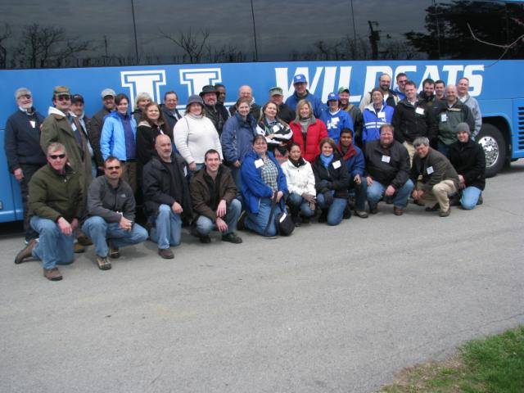
Perryville Battlefield Trip, March 2011
http://www.battleofperryville.com/
http://www.perryvillebattlefield.org
http://www.civilwar.org/battlefield.org

Slide 14
Advice
Focus on providing inexpensive and convenient professional development counsel to the participants.
Respond to the current intense organizational focus on minimum travel, and less time away from job and home.
Structure continued engagement and involvement in self-sustaining internal UK speaker lead sessions
Make available all session materials on SharePoint.
Record and archive speaker presentations as much as possible. We captured speakers through existing Echo 360 system for later on-demand viewing
Offer virtual sessions monthly to provide continuity between face-to-face sessions
Have participants give oral book reports to practice their public speaking skills.

Slide 15
Advice
Require completion of Essay Bio for every participant.
Partner Mentor and Mentee’s to provide continuity between sessions.
Develop personalized learning plans to meet the needs of individual employees, and link initiatives to strategic plan
Celebrate success – hold graduation/commencement ceremony.
Take a day-long field trip.
We went to Perryville Battlefield by bus to experience “risk and teamwork.”

Slide 16
Strategic Impact
Significant collaboration across organizational lines,
Higher leadership energy,
Increased focus on developing strategies to mitigate institutional risk,
Improvements in operational performance of IT, including metric management,
Enhanced delivery of meeting service level commitments to customers, and
Greater trust among team members.

Slide 17
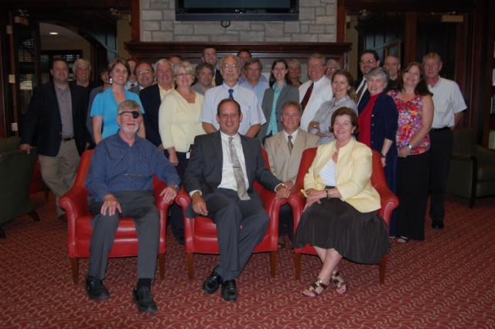
Team Graduation Photo’s
UKIT Leadership Development Program 2009-10

Slide 18
Closing Remarks
“Excellence is what you and your people create on your turf.
It can be done and it is done.
There is no excuse for not getting on with it among your people.”
- Tom Peters

Slide 19
ADDITIONAL
REFERENCE MATERIALS

Slide 20
Facilitator - Leader
Richard E. Dick Dooley
http://www.thedooleygroup.com
Email: dick@thedooleygroup.com
Phone: 508-771-0534
Address: 41 Babbling Brook Rd, Centerville, MA 02632

Slide 21
Essay Bio – What is it?
A personal story of your life/dreams/memories. How you got to be "you."
Maybe two pages (can be less, or a bit more), in narrative/prose style, usually chronological. Much more intimate/detailed than a résumé.
A sharing of self, to enable a group of session participants to get to know you as an individual, more quickly, and in ways which facilitate the engagement process.
It’s another signal that each LDP session is a different, likely a unique experience, and gift. Be ready for that. Capitalize on it.
An example of how rich, deep and "broadly lived" the people are, with whom we work/attend meetings etc., but often don't really know well enough. Such insight helps teamwork, helps productivity, helps relationship building. And it really helps learning. It’s essential for leadership.
The speakers' Essay Bios provide a good role model. We post them to SharePoint for sharing with each other.

Slide 22
Ground Rules
Please turn your cell phone/pager off. These devices are not to be used during our sessions. “If you are here, be here!”
Please respect the time of others. Be on-time for the start of the session and return from breaks promptly.
Don’t speak mainly to the facilitator. Share with each other. That’s most important.
Capitalize on all the speakers, on each other, the facilitator, guests, and above all on yourself. Engage.
The UKIT-LDP process is an heuristic puzzle, different for each cycle, for each meeting, for each person. You put the mosaic together.
You agree to “give back,” to “pass it on,” in a responsible, committed way.
Equals while in the process. The mix is for all attendees, i.e., balanced, e.g., dominators and quiets switch. Harness our diversity. Practice in each session.
Use the feedback form frequently – not just for speakers, but for other participants. Handwritten notes are worth the attention and make people feel special.
We will use the business action list (parking lot).
Use the lending library – but remember you are sharing these books with 70 other people.

Slide 23
Mentor Assignments
Sit with the mentee and introduce them around,
Explain the use/value of the feedback forms,
Cover the lessons that stuck with you from the UKIT-LDP1,
Explain the process of the LDP
Specifically address all learning platforms, diversity of & new perspectives, self-reflection, getting to know each other much better, personally incorporating learning processes & leadership characteristics for the future.
Review all themes, and point out how they show up in books/speakers/activities.

Slide 24
Sample Certificate

