Slide 1
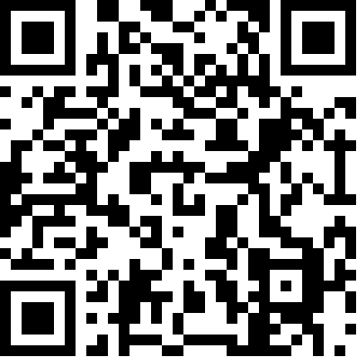
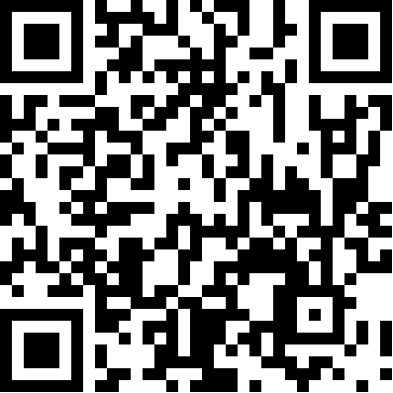
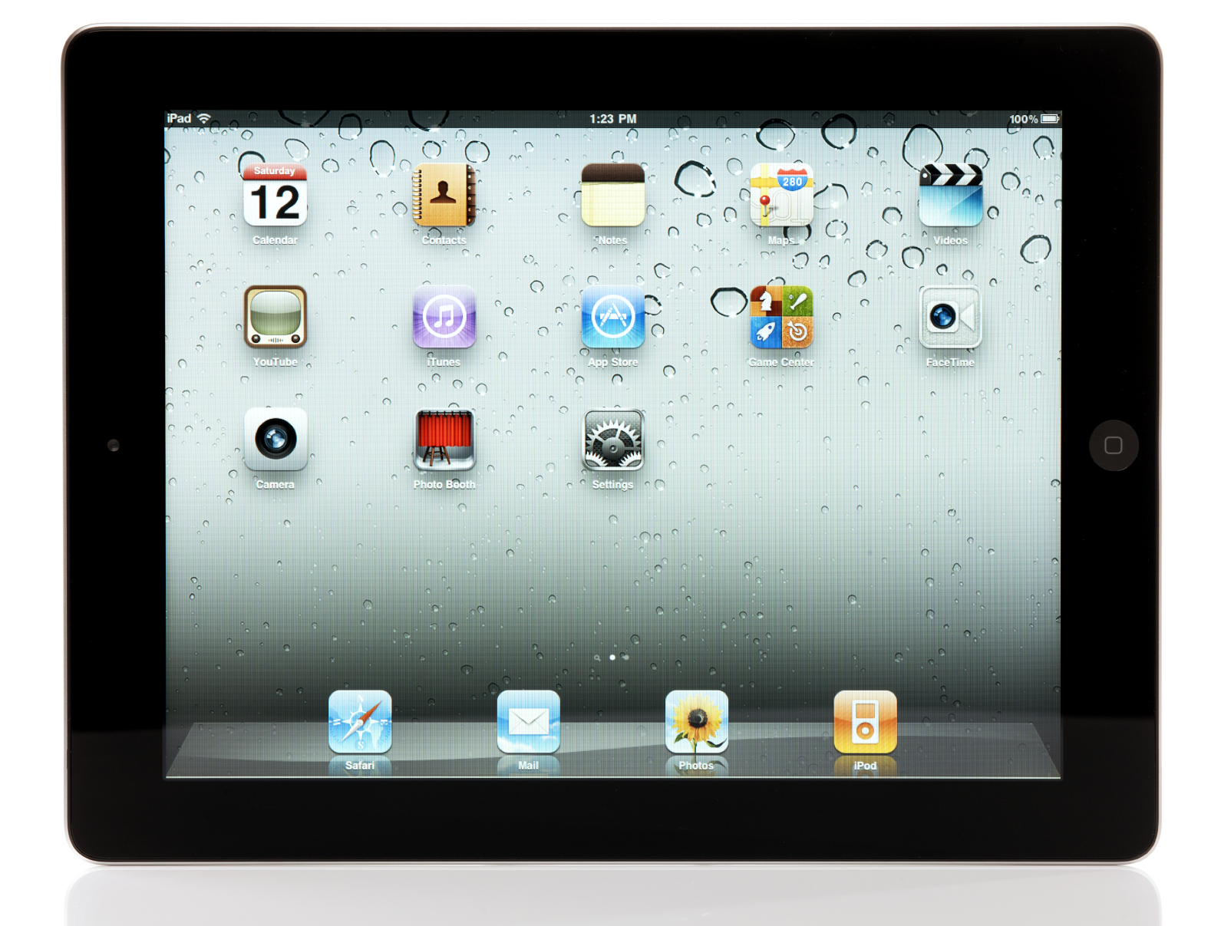
From Plan to Pedagogy: Lessons from an iPad Lending Program
Heather Beattey Johnston and Carolyn J. Stoll
7. Publish & Assess
Report available to the public on our website
Quantitative data (in the form of charts and graphs) and select qualitative data reported
Close assessment loop: adjust program elements
1. Call for Applications
Announced on Blackboard and faculty listserv
Applications processed in SurveyMonkey
Application designed to be open-ended in an effort
to attract faculty with purpose and vision
Program website
2. Select Participants
Grant from Faculty Development Council limits program to full-time faculty
Applications reviewed using scored rubric and are then ranked by each reviewer
Distribution across college, discipline and gender is taken into account in final selections
eLearn Magazine
article
6. Check in Devices
Exit survey completed by borrowers prior to return
Devices are checked for damage in presence of borrower
Later, they are re-set to factory settings and re-synched to master image
3. Manage Apps
Using iTunes to manage this program is challenging, especially navigating Apple’s Volume Purchasing Program
We provide a package of free and paid apps
Borrowers can buy additional apps on their own iTunes account on the iPad; they do not sync devices on a PC or Mac, and cannot update our apps
5. Host Mini Camp
Four-hour event between “practice term” and “implementation term” of the two-term loan period
Discussions on strengths, weaknesses and solutions
Problem based learning activity including an app hunt
Demonstration on connecting iPad in classroom
Building a lesson plan using iPad
4. Check out Devices
Group appointments
Participants sign legal agreement
Brief training on basic operation
Provide brochures describing installed apps
No technical, desktop-type support
Set up group return appointments

