Slide 1
The Lean and Green by Design
Link Alander, Mario Berry
Delivering quality services at 99.999% availability at the enterprise level while focusing on cost reduction, innovation, and sustainability is proving challenging for many higher education institutions today. Hear representatives from Lone Star College detail how they are using virtualization and a new high-density green data center to address these challenges.

Slide 2
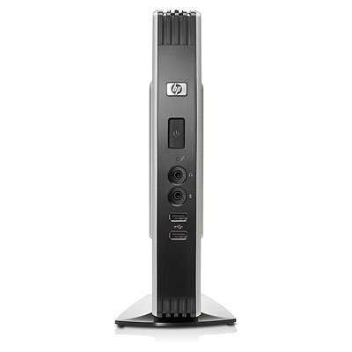
Presentation Overview
Introduction to Lone Star
Why Green?
Customer Focus - Pilots
It’s in the Design
Virtualize Everything!
Availability and Performance
Datacenter Redesign
Savings and Quality
What’s Next
Questions

Slide 3
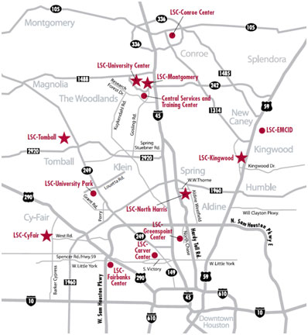
Who is Lone star
16 Locations across 1,400 square miles
6 Colleges
2 University Centers
8 Instructional Centers
Growth
78,000 Credit Students
25,000 non credit
Our Quality
Top 100 AA Degree Producers in the Nation
70% transfer rate
Texas A&M, UT, Rice, Harvard, Stanford, UCLA
Top 100 places to work - 3 years in a row (Chronicle of Higher Education)

Slide 4
Why green?
Strategic Initiative defined in 2008
Our Green-IT definition
As an institution of higher education, we have a social responsibility to address this issue and be a leader in our community.
As stewards of tax payers’ dollars we have a fiscal responsibility to manage costs and improve efficiencies.
LSCS Green IT Initiatives
Advanced Power Management Computers
eWaste Program
Texas Educational Sustainable Technology Consortium
Desktop Virtualization
Datacenter Virtualization
Datacenter Innovation

Slide 5
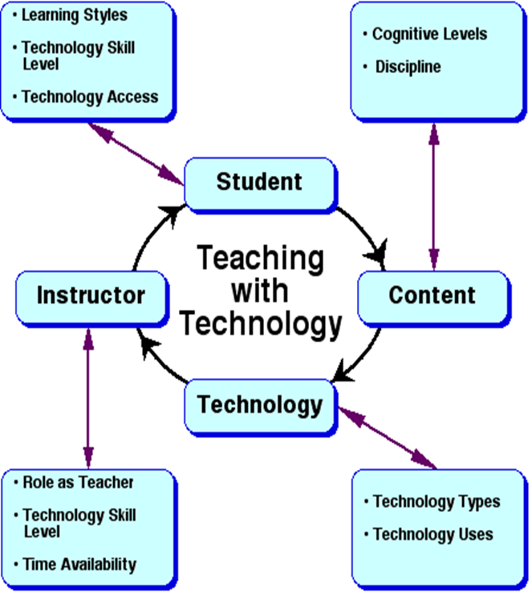
Customer Focus pilot
Chancellor Technology Innovation Grant
Project Goals
Increase access to technology resources
Increase Mobility
Instant Access anywhere
Improve Service delivery
Reduce Power Consumption
High Availability

Slide 6
Customer Focus - Pilot
Citrix XenApp
FEATURES:
Dynamic App Delivery - Optimal method for delivering applications to users.
Single Instance Management - Application are updated once and delivered on-demand.
Any Device, Anywhere - Users can simply and securely access apps with a consistent experience regardless of location or device.
Secure by Design - Centralized application management is the most secure architecture for delivering applications.
Enterprise-class Infrastructure - Proven to support more than 50,000 users, scale beyond 1,000 servers.

Slide 7
Customer Focus – Pilot
VMware View, Thin App and VSS
FEATURES:
Lower your IT operational expenses by up to 60%
Increase security by moving data from devices to the datacenter
Simplify, automate, manage, update and provision 1000’s of desktops from a single console in minutes
Application Virtualization:
Symantec - VSS
Vmware – ThinApp
AppSense – Profile Virtualization

Slide 8
Customer Focus - Pilot
Keys To Success
Define Customer(s)
Engage End-User(s)
Determine Measures
Communicate, Communicate
Know Thy Infrastructure!!!

Slide 9
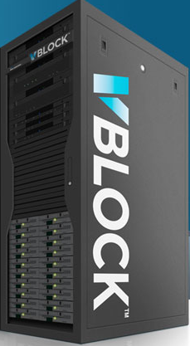
It’s in the design
Infrastructure is key to your success
Converged VDI backend solutions
Simplified Management
Flexibility
70 to 80% reduction in space requirements
60 to 75% reduction in power
Evaluating
VCE – vBlock
HP P4000 VDI

Slide 10
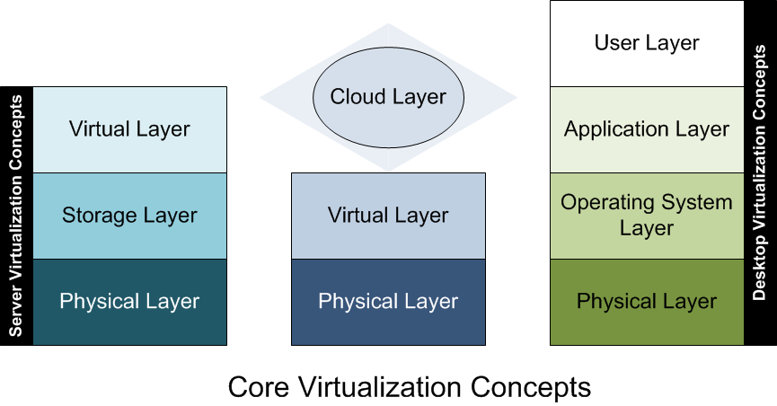
It’s in the design
New Green Datacenter
Virtualization First!
Data Center Innovation

Slide 11
Virtualization First
Virtualization First practice adopted Dec 2008
Moved from 5% utility virtualization to 85% in year 1
Moved to 95% in year 2
Currently virtualizing our Voice and Video to close the gap
Benefits
High availability – 5-nines architecture
66% reduction in power consumption
Enterprise Agility and Elasticity
LSCS – Private Cloud
2.1 THz Processing Power
5.2 TB RAM
172 Physical CPUs
1,349 CPU Cores
19 Virtual Data Centers
218 Resource pools
700 TB of Virtualized Storage

Slide 12
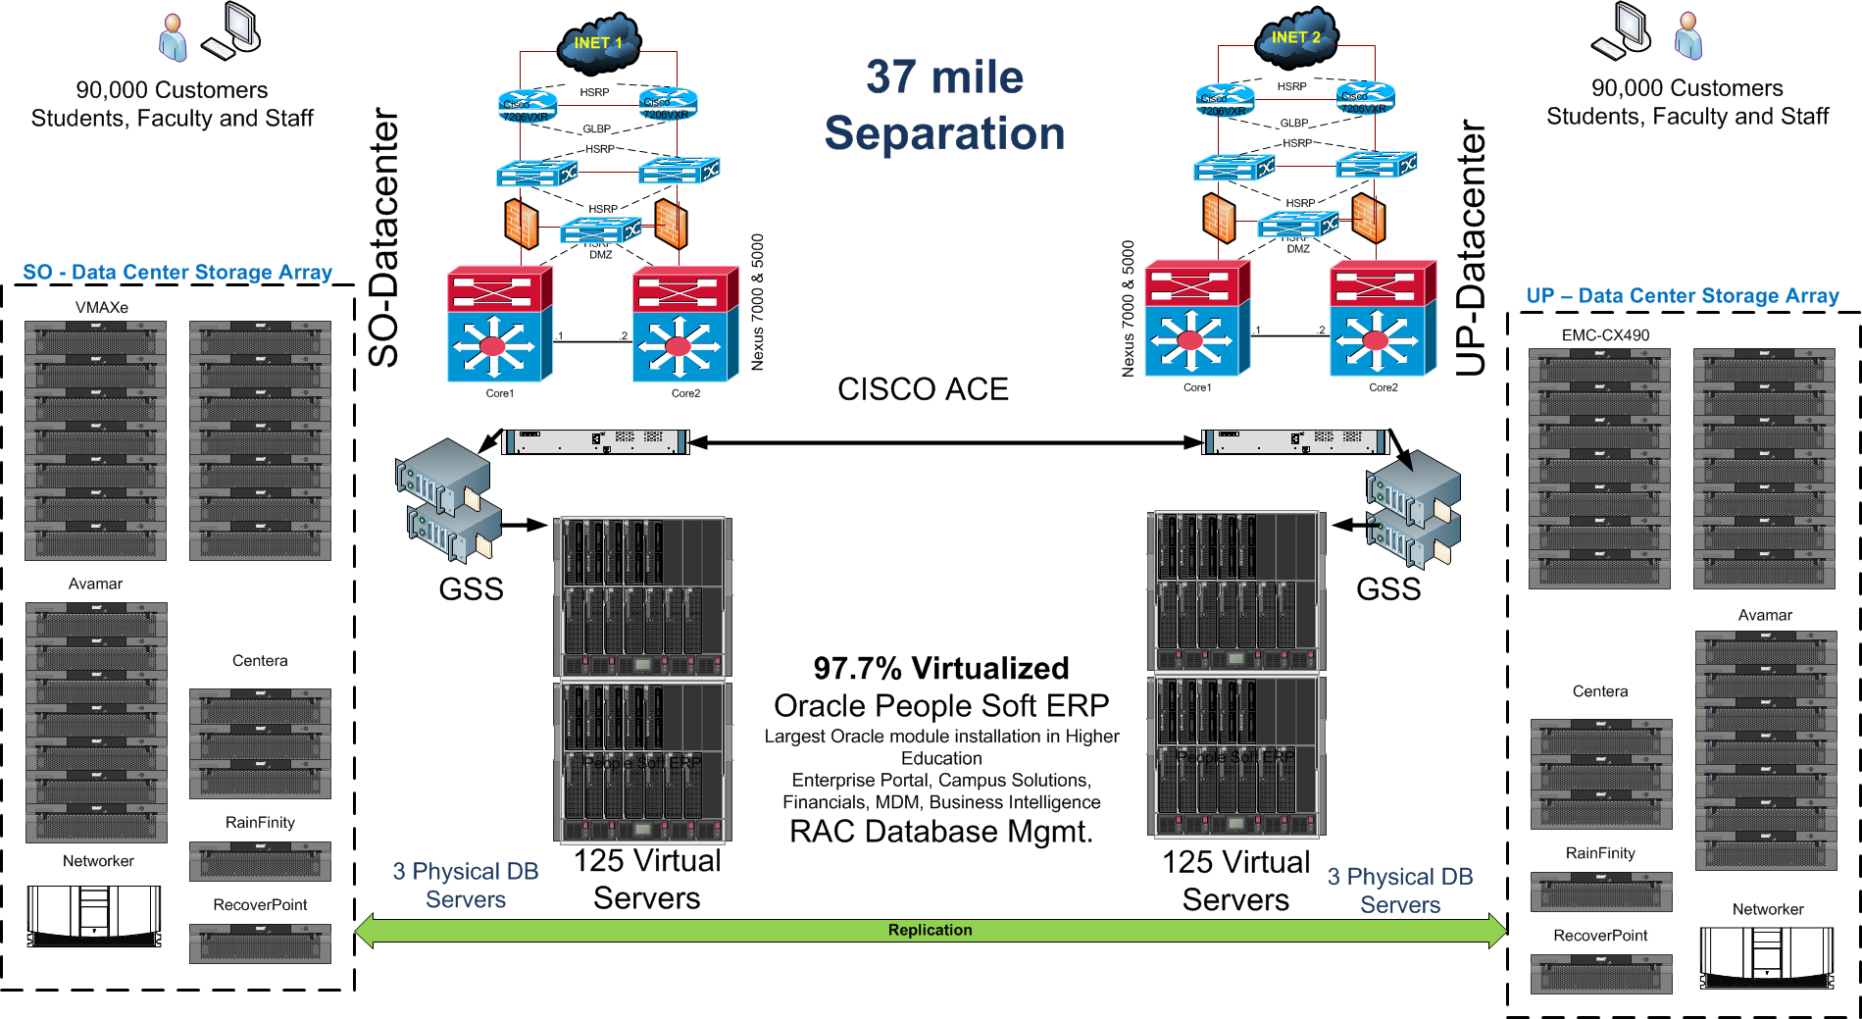
ERP Availability - 5-nines

Slide 13
ERP Availability - 5-nines

Slide 14
ERP Availability - 5-nines

Slide 15
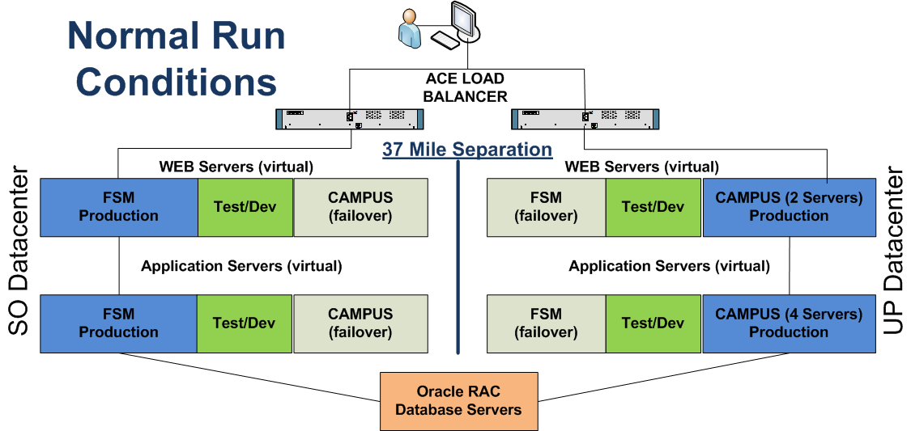
ERP - Elasticity
Example – Elasticity – Normal Operations

Slide 16
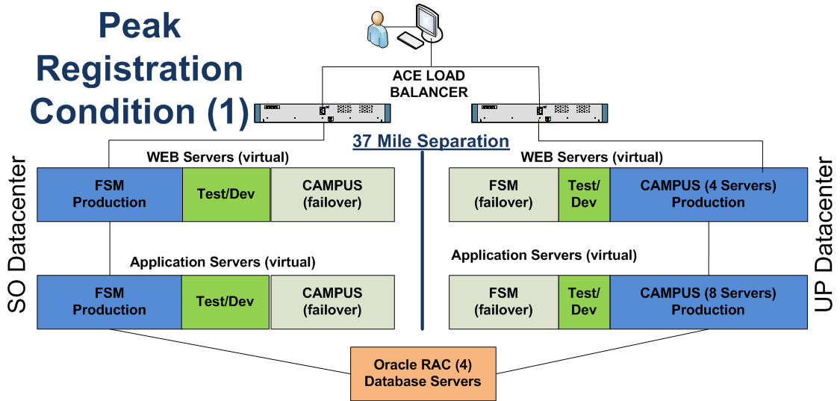
ERP - Elasticity
Example – Elasticity – Peak Registration

Slide 17
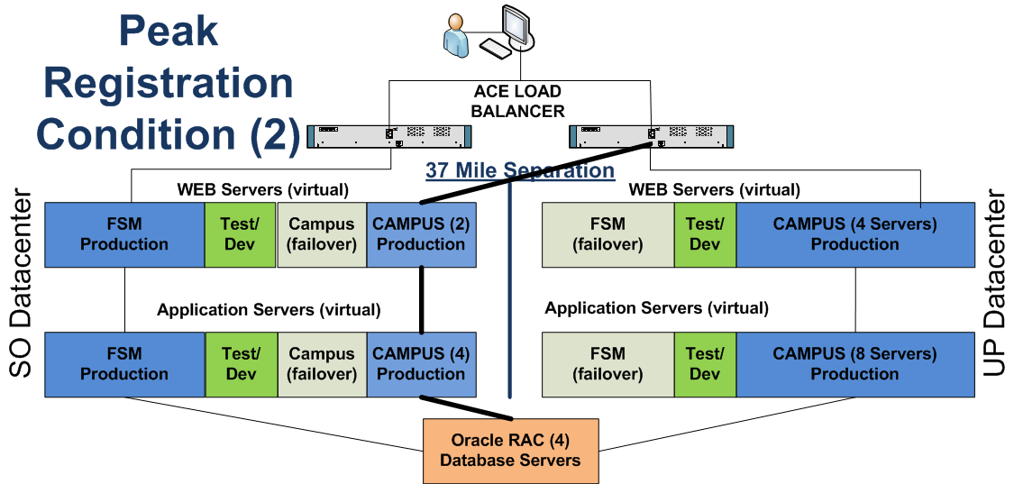
ERP - Elasticity
Example – Elasticity – Peak Registration - extended

Slide 18
Value & Cost Avoidance
Dynamic reallocation of computing resources
No downtime or performance loss during peak system demands
IT is addressing the business and customers needs
COST AVOIDANCE
Physical server ERP - Cost
250 Physical Servers
$ 3.5 million
Virtual ERP - Cost
246 vm servers
4 physical DB servers
$ 722,000
Power Requirements
Physical – 12.3 KW
Virtual – 7.2 KW

Slide 19
DataCenter Redesign
Power Utilization Efficiency (PUE)
Simple term – how much does it cost to distribute power and cooling to the data center
Simple Calculation
Total Power used by equipment to provide services
Total Power used by the data center
Example - PUE
A room with a PUE of 2.6 means that for every kilowatt used to deliver a service 1.6 kilowatts are needed.
http://searchdatacenter.techtarget.com/definition/power-usage-effectiveness-PUE

Slide 20
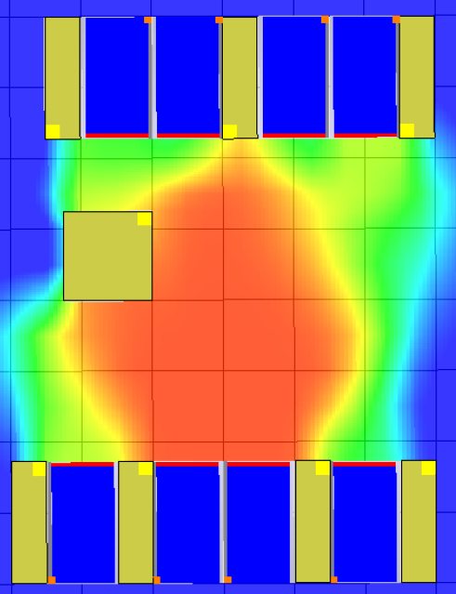
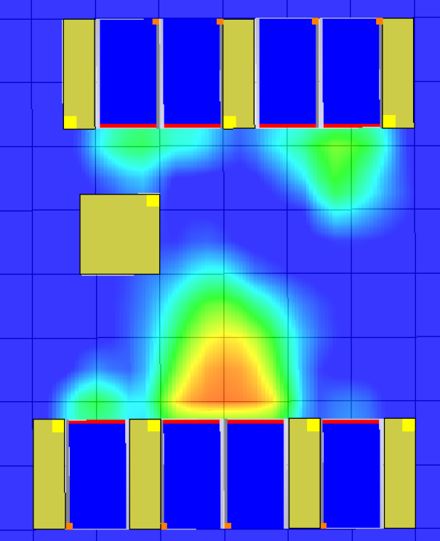
DataCenter Redesign
LSCS – System DC 1 - Traditional Forced Air Data Center
DEFFICENCY ASSESMENT – 10 years old – No efficiency reviews
In-line UPS was 85% efficient
Power line loss of 4.7%
Loss of heat containment
Inefficient CRAC units
REDESIGN
Upgraded power distribution
Upgraded UPS
Pending upgrade of CRAC units
Load distribution – Hot isle containment
PUE
Initial 3.8 – Current 3.1 - Projected – 2.7

Slide 21
Design Green – New Datacenter
Efficiency by Design – New LSCS DC 2
Tier IV data center
European design standards
Water cooled racks
In-direct UPS 99.9%
480 volt power distribution
In rack fire suppression
Two commercial power feeds
Two 500 KW generators
Two backup CRAC units
Hyper-Density
½ a megawatt power and cooling capacity packed into 950 square feet

Slide 22
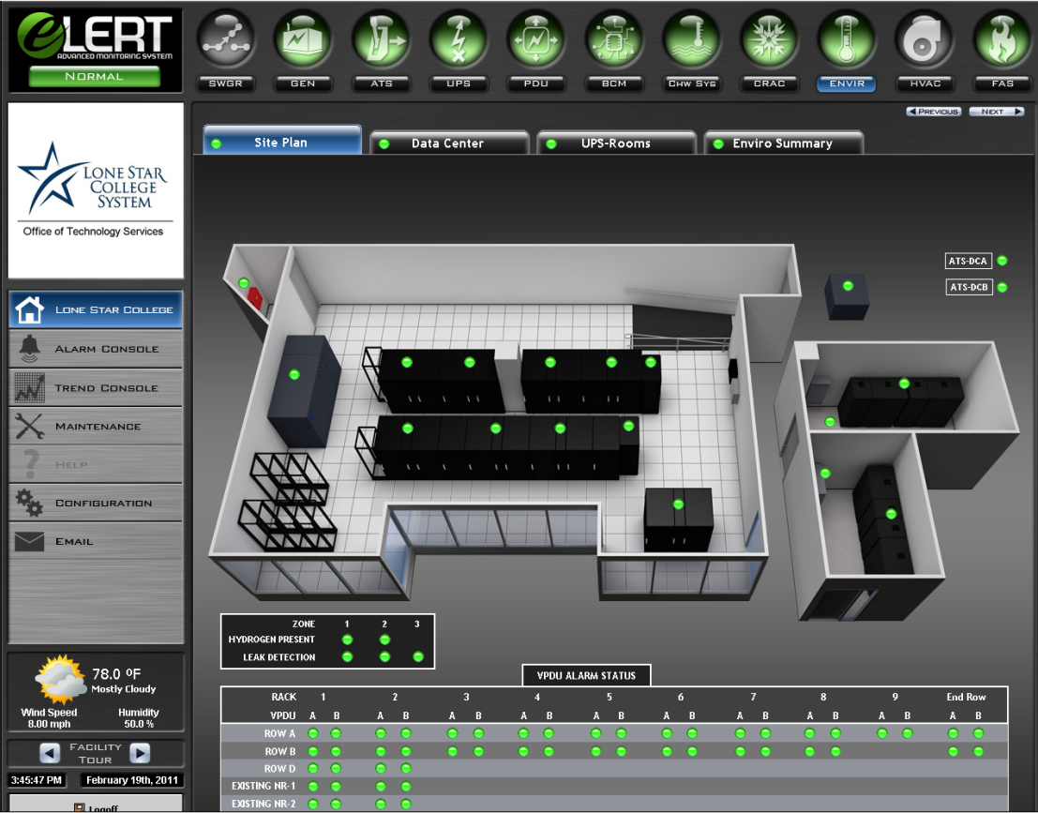
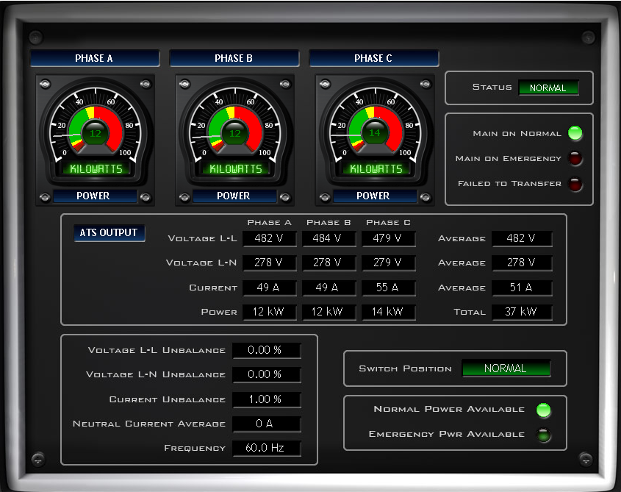
Design Green – New Datacenter
State of the Art
Infrastructure Management
Power Distribution
Monitoring

Slide 23
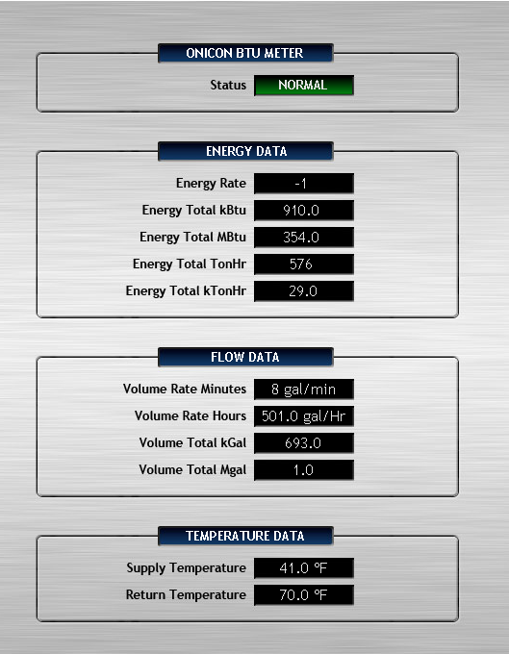
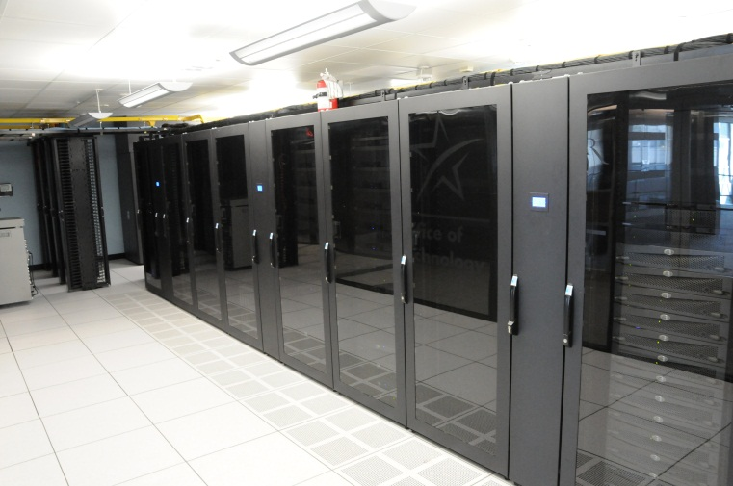
Design Green – New Datacenter
Side-by-Side Comparison
Both of our main datacenters have identical equipment loads
PUE – New Datacenter 1.37
PUE – Existing Datacenter
2009 – PUE 3.8
2010 – PUE 3.1
2011 – Est. 2.7

Slide 24
Savings and quality Wrap up
Server Virtualization
$600,000 in CAPX savings
$428,978 per year savings in power and cooling
Cost Avoidance - $2.7 million
Datacenters
New Datacenter requires half the power and cooling
Thin Client Projects
Projected ROI in 2.5 years
Improved service delivery
anytime, anywhere, and any device

Slide 25
What’s next
Private Cloud Desktop Computing
Ability for students to access all IT resources from anywhere, anytime, any device!
Application virtualization based on students class load available via our My LoneStar portal

Slide 26
THANK YOU
Delivering quality services at 99.999% availability at the enterprise level while focusing on cost reduction, innovation, and sustainability is proving challenging for many higher education institutions today. Hear representatives from Lone Star College detail how they are using virtualization and a new high-density green data center to address these challenges.
Link Alander,
Associate Vice Chancellor,
Technology Services
Mario Berry,
Interim Associate Vice Chancellor,
Technology Services

