Slide 1
Georgia State University IS&T
A Principled and Participative Process for Organizational Realignment
JL Albert, Associate Provost, CIO
James M. Amann, IT Business Planning Coordinator
Georgia State University
Copyright Georgia State University 2009. This work is the intellectual property of the author. Permission is granted for this material to be shared for non-commercial, educational purposes, provided that this copyright statement appears on the reproduced materials and notice is given that the copying is by permission of the author. To disseminate otherwise or to republish requires written permission from the author.

Slide 2
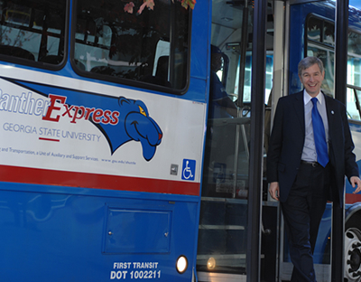
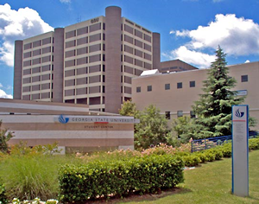
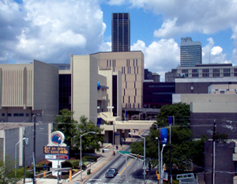
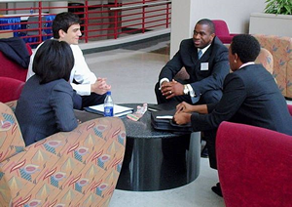
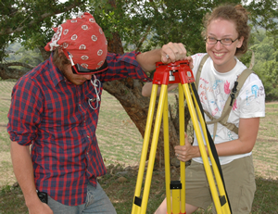
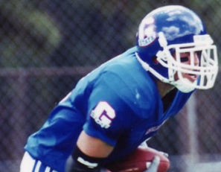
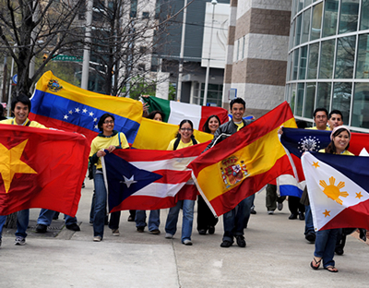
Georgia State University
Georgia State University
Founded in 1913
Urban research institution in the heart of downtown Atlanta
Mission of excellence in teaching, research and service
Enrollment of 32,022 Students and ~40,000 headcount
2nd largest university in Georgia
Students from every county in Georgia, every state in the nation and from over 145 countries
GSU Panther Football now in it’s second season! GO PANTHERS!
JL Albert

Slide 3
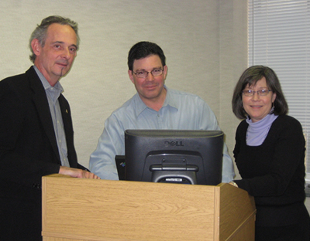
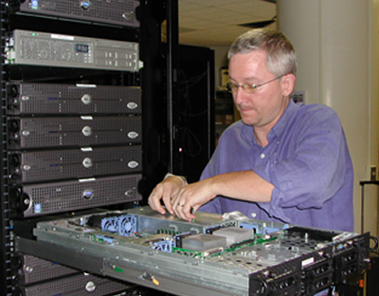
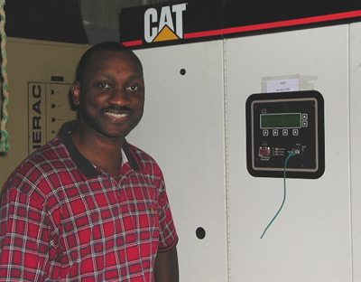
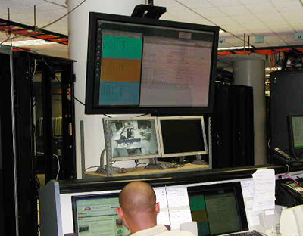
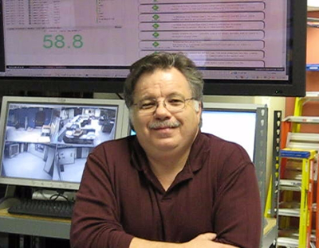
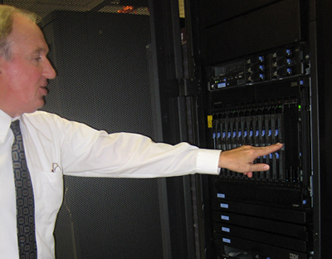
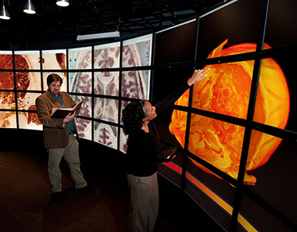
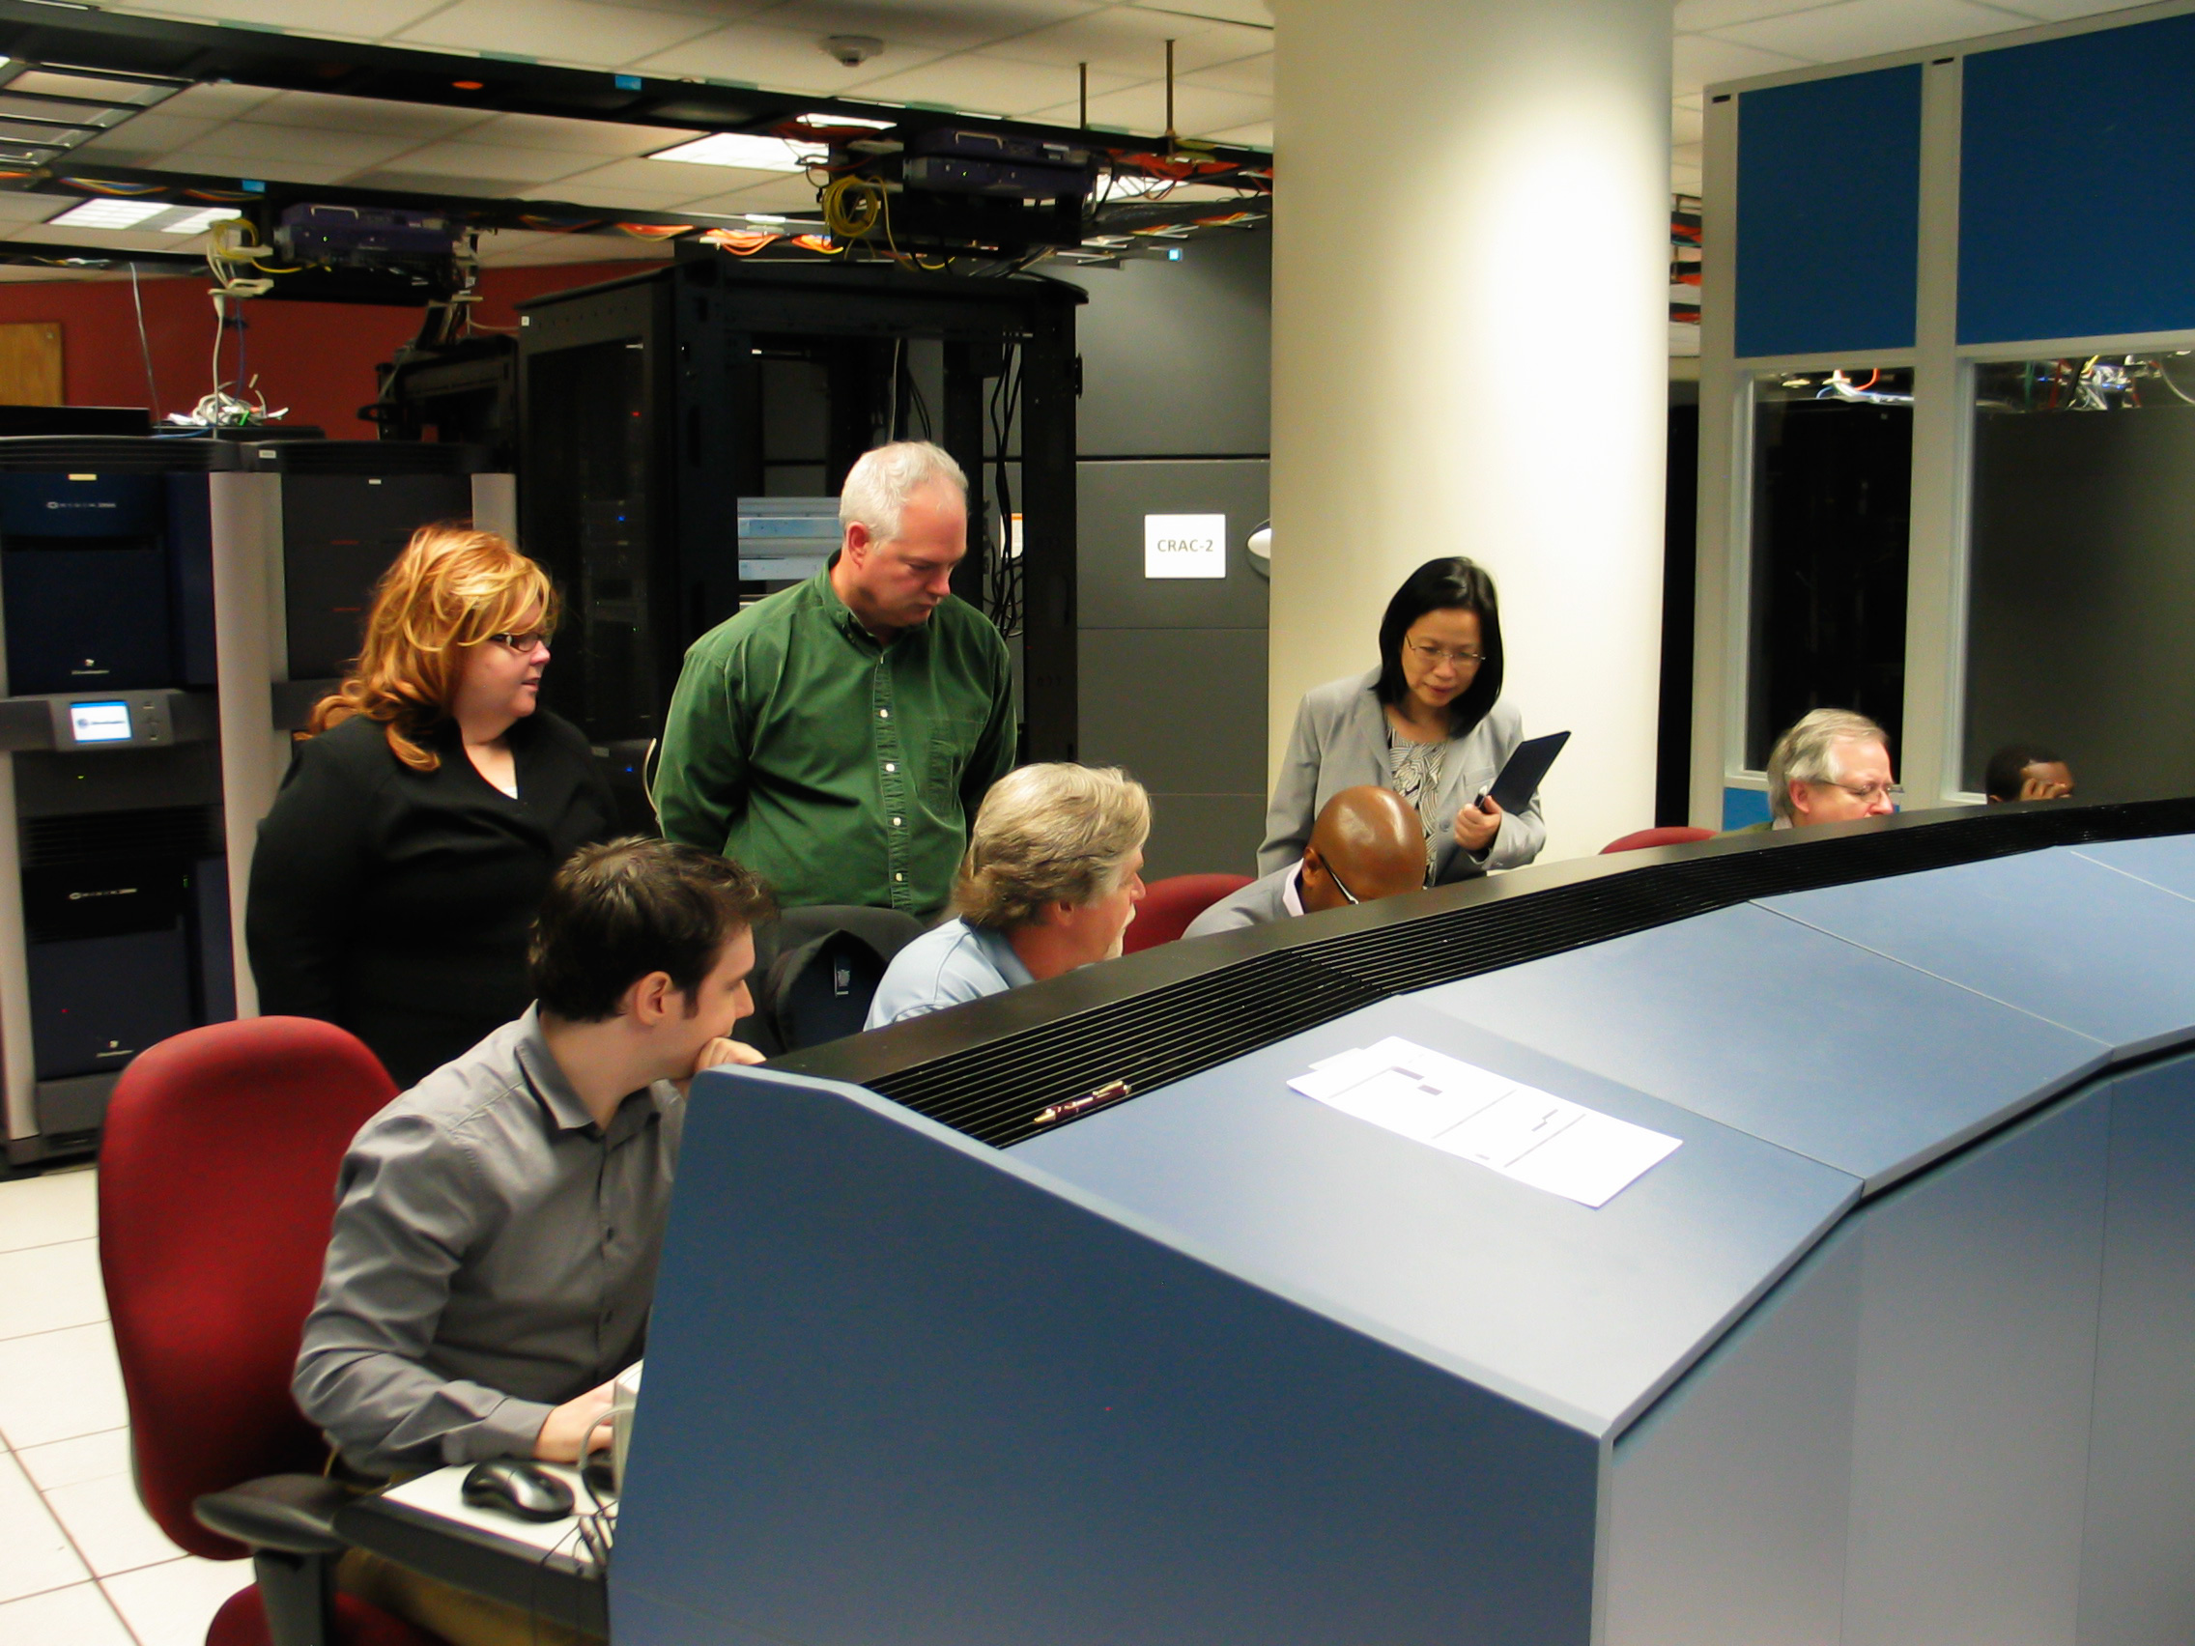
Information Systems & Technology
Information Systems and Technology (IS&T)
Full-service technology provider
Offering networks, telephones, business applications, research computing, desktops, IT Security, instructional technology and classrooms
Roster of 170 staff
Budget of $21.5M
JL Albert

Slide 4
What I Found in 2004
The Predicament:
Inconsistent customer focus
Internal stovepipes, duplicated services
Conflict among leaders and staff due to overlaps
Gaps in services with no accountability
No distinction between engineering and operations
Lack of distinct corporate culture with focus on innovation
The Vision:
Consistently and predictably keep our focus on our customers needs and expand services as requested
Eliminate internal redundancies due to stovepipes
Create a foundation for teamwork
Eliminate gaps in service
Establish world-class engineering and operations teams
Develop a culture that encourages innovation
JL Albert

Slide 5
Internal Budgeting Improvements
Recent financial management project helped us all clearly see the duplication of products and services
Four groups within IS&T offering application hosting under widely varied cost and service models
At least four groups within IS&T offering platform and storage services
Nearly all groups offering some form of application service provision
Read More: http://net.educause.edu/SERC09/Program/1020814?PRODUCT_CODE=SERC09/SESS16
JL Albert

Slide 6
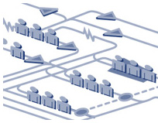
Solution Search
We wanted
Elimination of all gaps and overlaps in service delivery
Clearly defined domains
An informed and empowered Leadership Team
A principled and participative process of transformation
Answer – Outside expertise and facilitation
Building blocks of structure based on systematic approach
A defined language of organizational design for use by the Design Team
A documented project plan for organizational transformation
JL Albert

Slide 7
Realignment Announced
Ground Rules
No employees would lose employment due to the restructure
Performance issues and budget cuts exempted
No pay reduced (due to movement from director to manager, manager to staff) for one year
JL Albert

Slide 8
Formation of the Design Team
The Design Team would be tasked with creation of the new organization
All IS&T staff invited to join
To be a part of the team, staff had to illustrate basic qualifications set by HR
Supervisory experience or related education
Budget management experience
To apply for management positions yet to be created, had to be on the Design Team
Our Human Resources team assessed qualifications for Design Team selections
JL Albert

Slide 9
The Process
James Amann

Slide 10
Design Team First Steps
For two days the team was coached in the rational process of organizational design by a facilitator with outside expertise
The Golden Rule of Organizational Design:
Assigned accountability must be matched with an equal amount of authority
James Amann

Slide 11
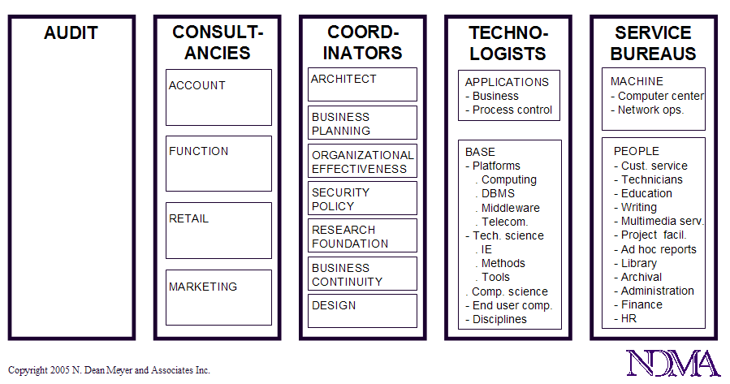
Design Team Training
The team was introduced to the Structural Cybernetics Functional Building Blocks

Slide 12
The Old IS&T

Slide 13
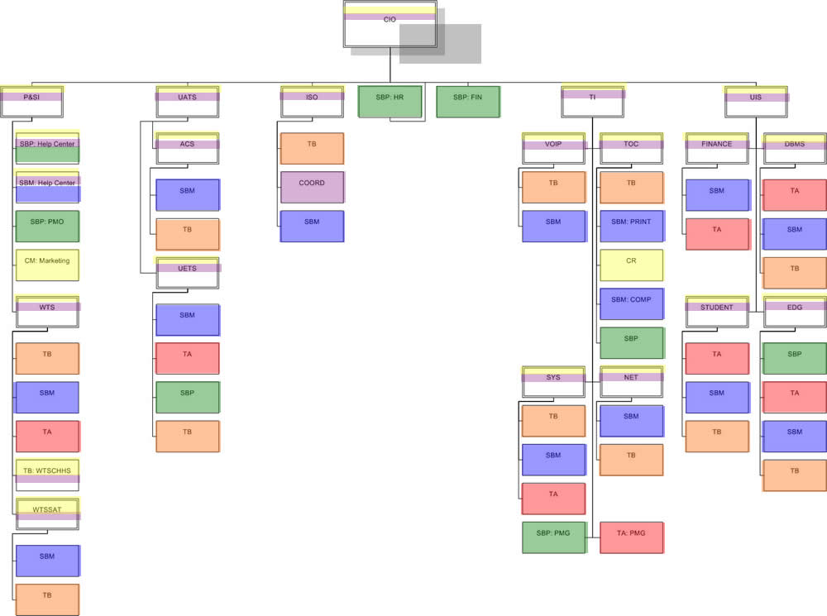
Service Gaps and Overlaps (Rainbows)
NDMA’s “Rainbow Exercise”
James Amann

Slide 14
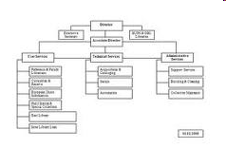
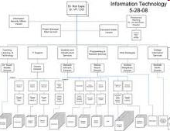
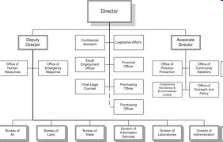
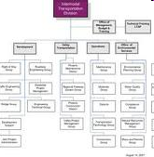
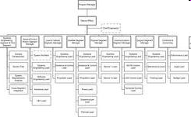
Team Homework
The team disbursed and was asked to individually produce one or more org charts using the principles and building blocks they had just learned
James Amann

Slide 15
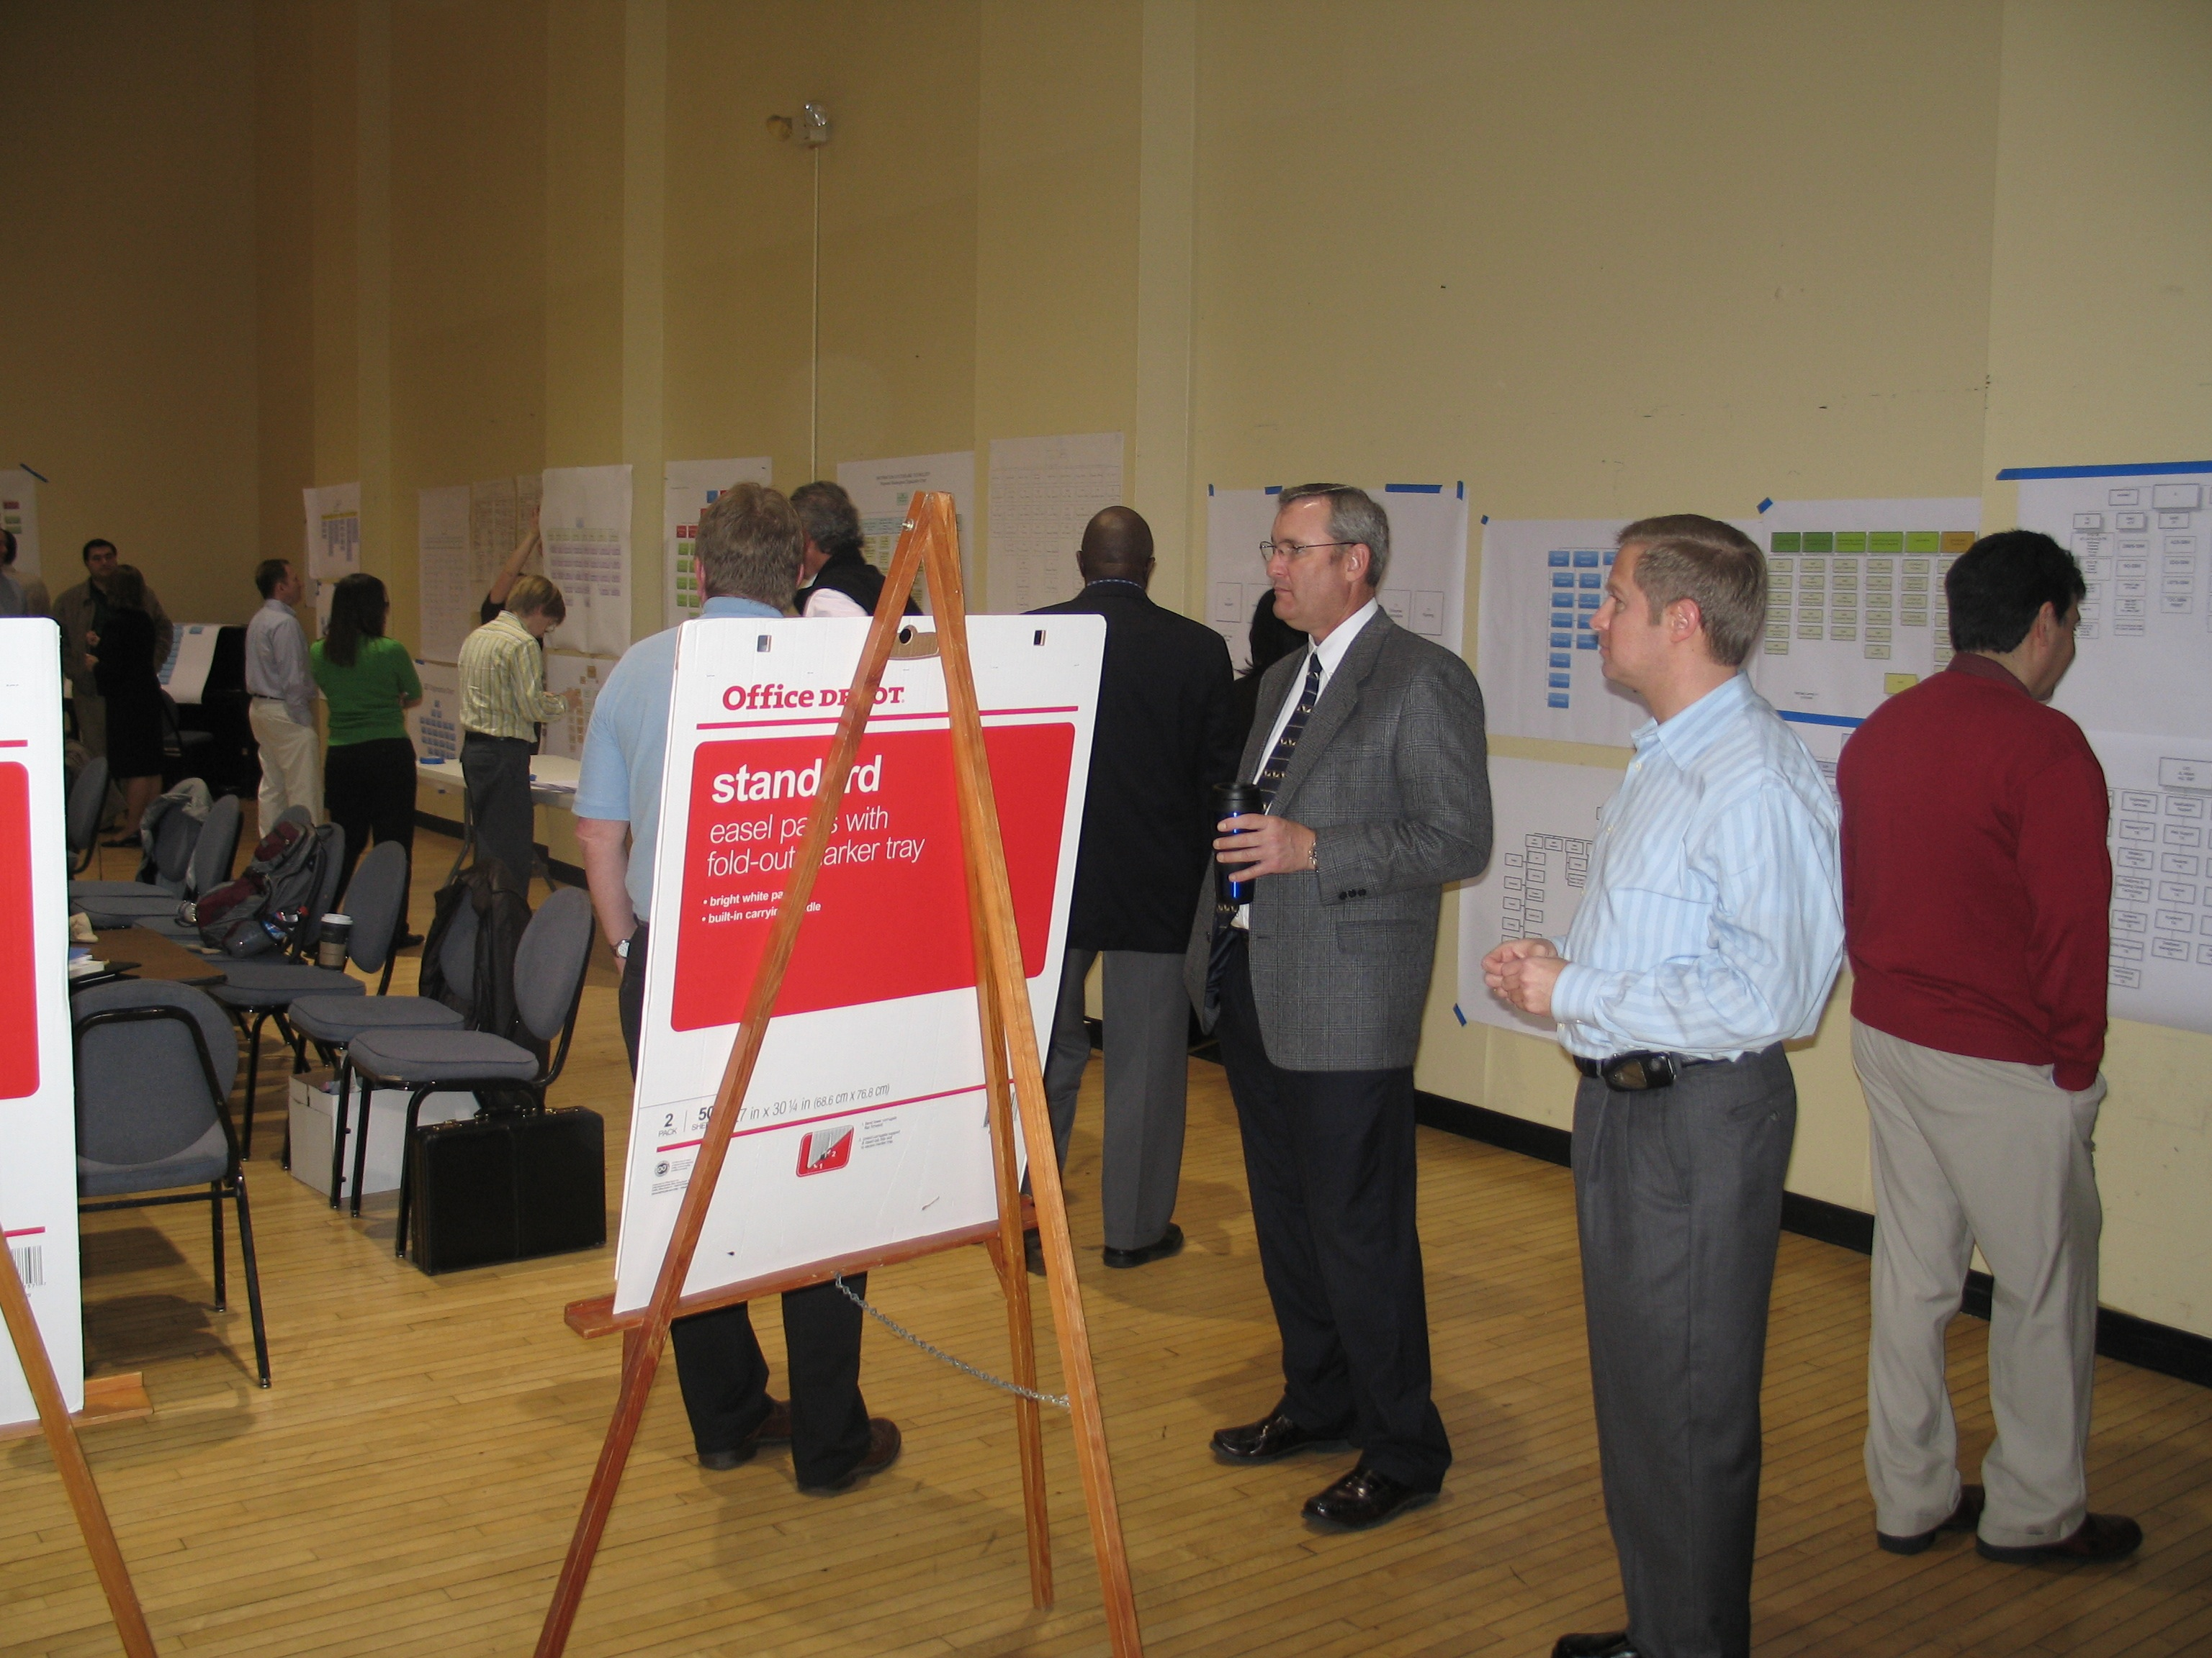
Creating the Organization
Design team re-convened
Org charts mined for ideas and proposed lines of business
Each line of business discussed, dissected, clarified and evaluated for possible inclusion in the new organization
Day one, all lines of business identified for the new organization
James Amann

Slide 16
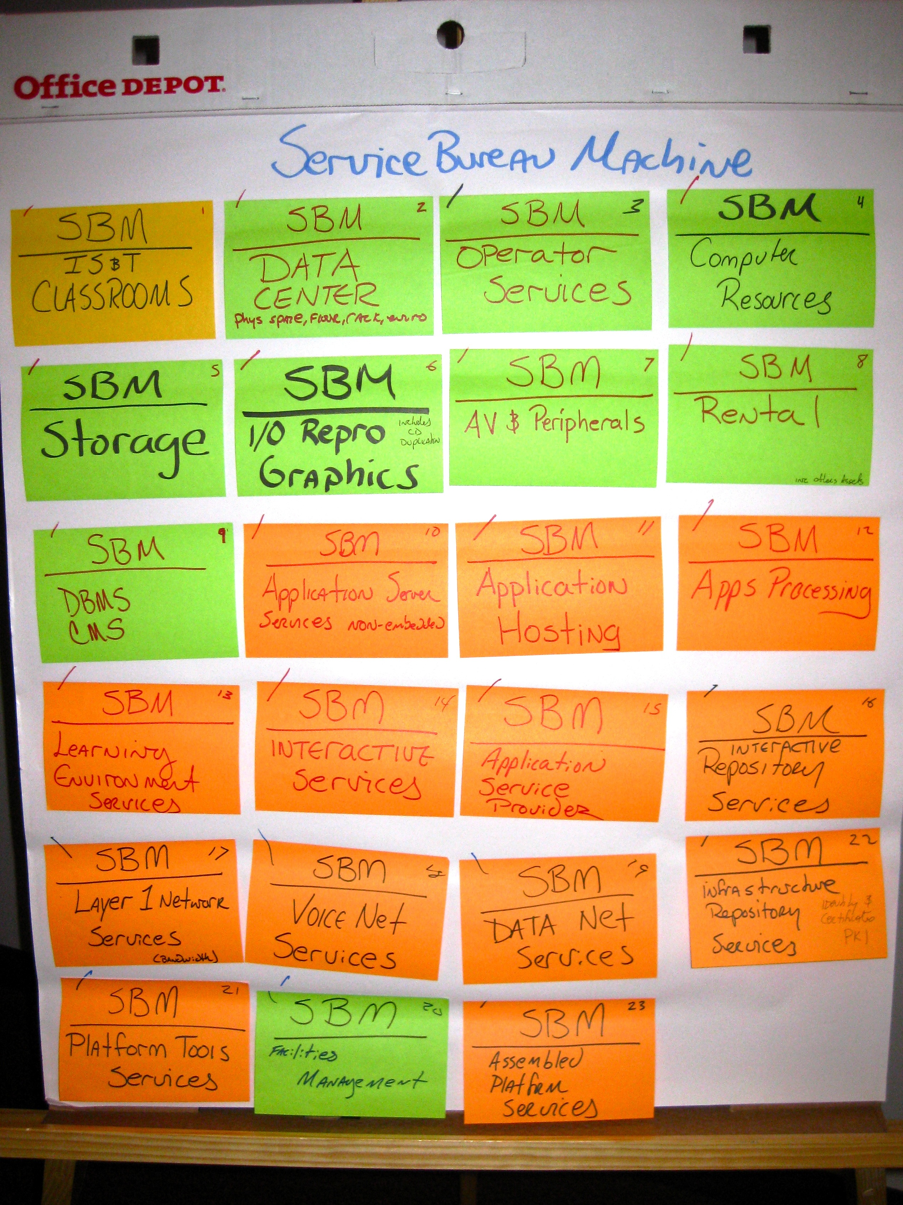
Creating the Organization
Day two and three
Grouped “boxes” into whole businesses
Grouped businesses into the tiers of the new organization
Long days and late nights ... “Welcome to management.”
James Amann

Slide 17
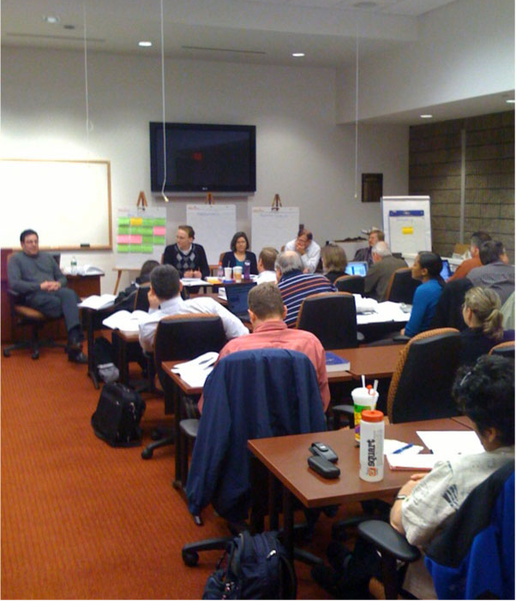
Creating the Organization
All decisions were made by the team as equals
If anyone voted against a proposal, they were asked, “Are you passionate?”
If so, they were given the floor to make their case, try to sway the crowd; many times it worked
If we decided we disagreed but were not passionate, we then agreed to “teach and support” the decision made by the group
James Amann

Slide 18
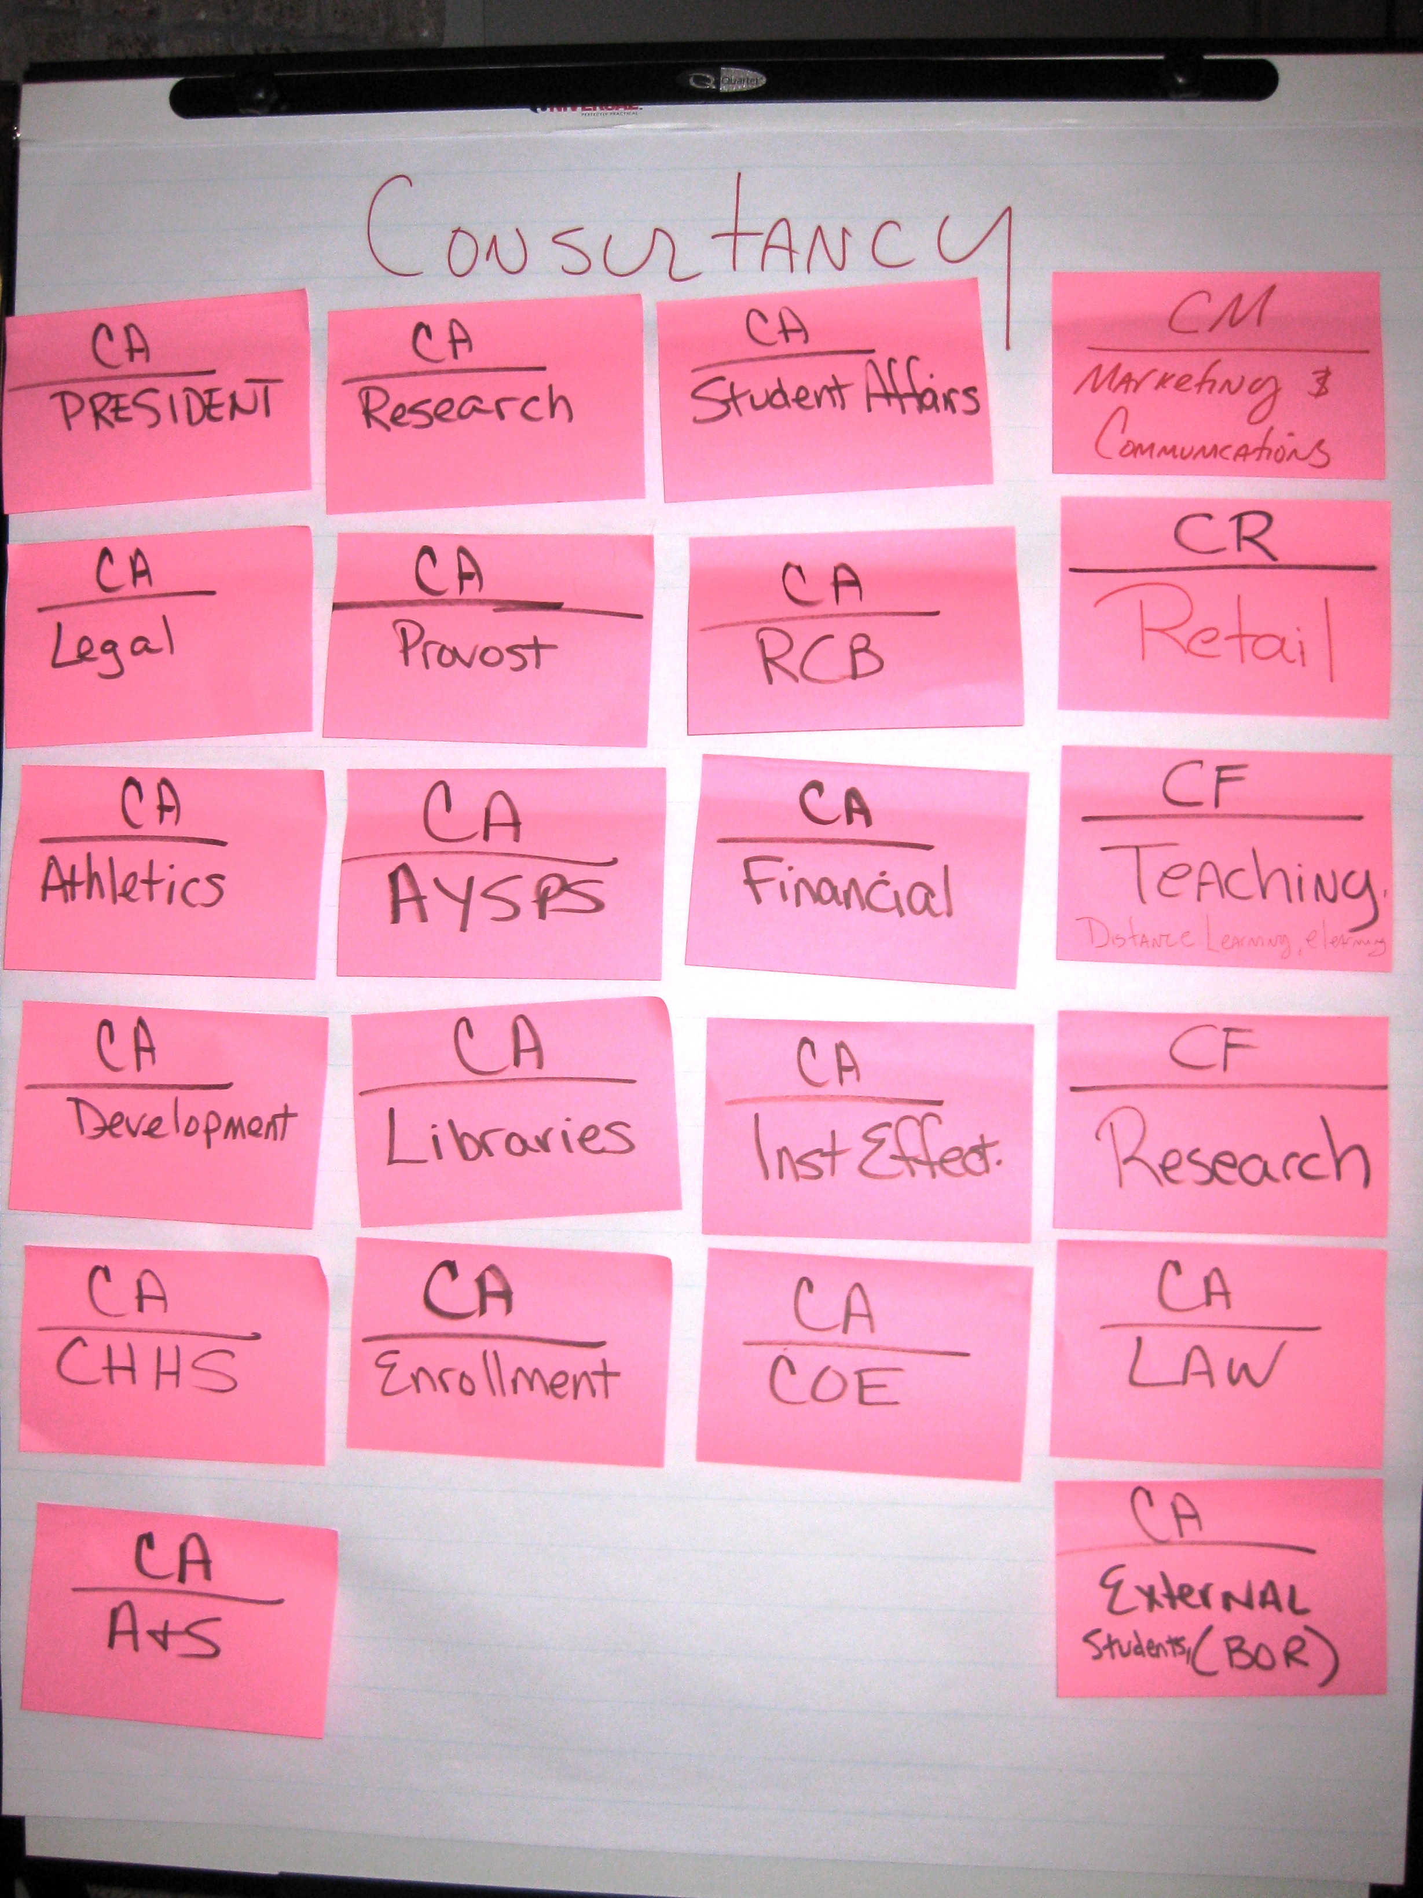
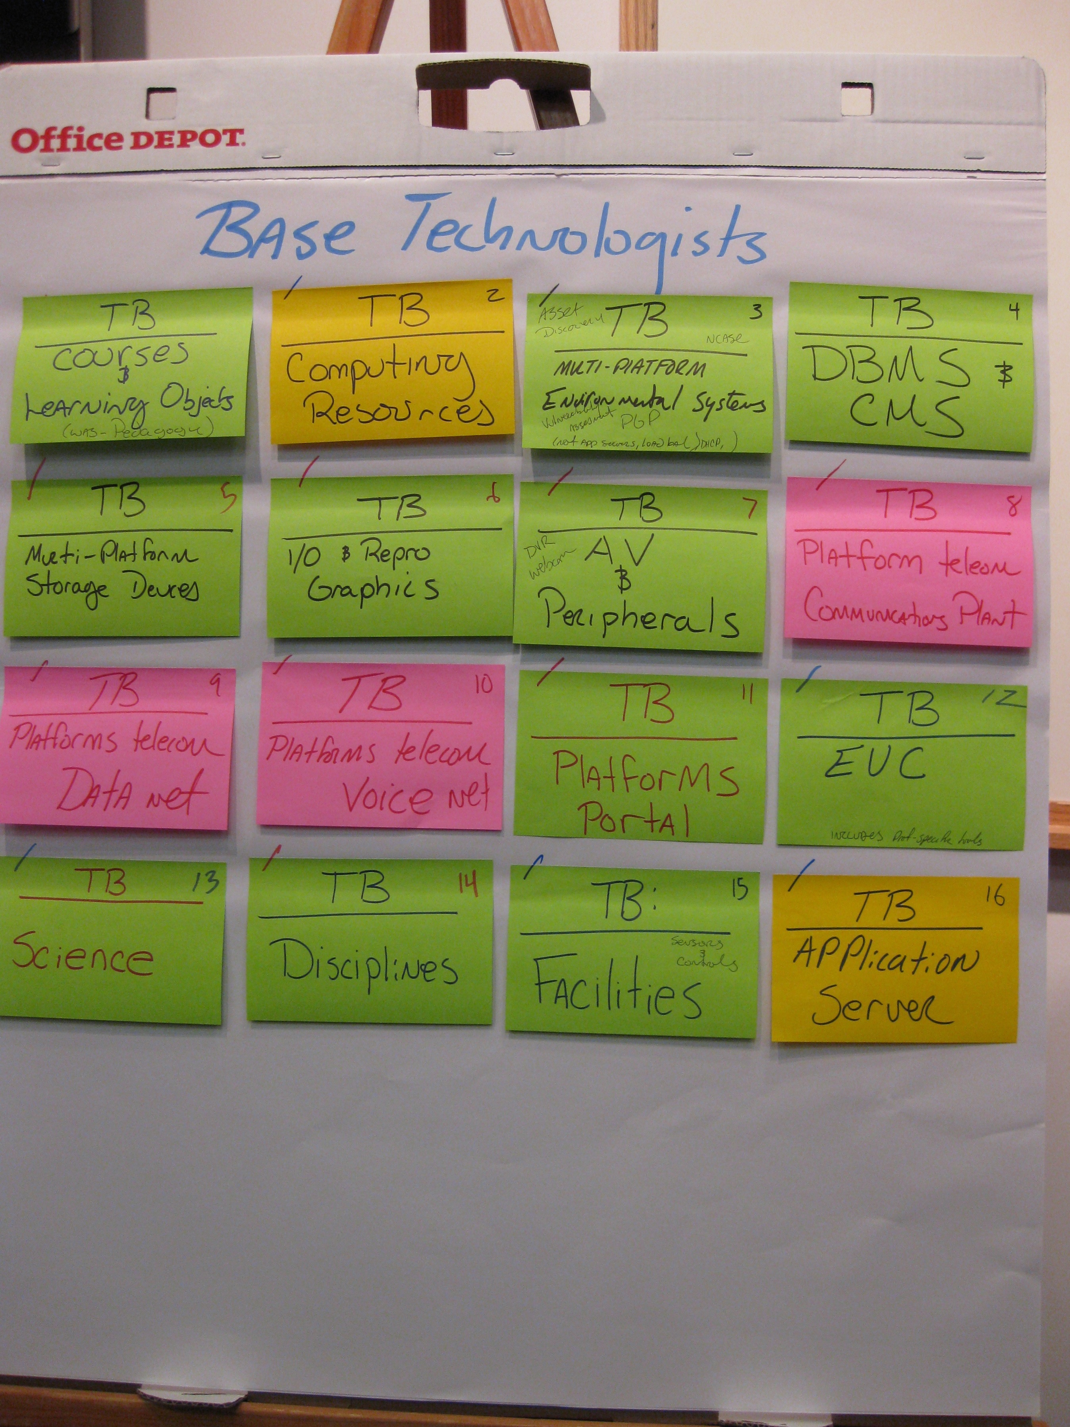
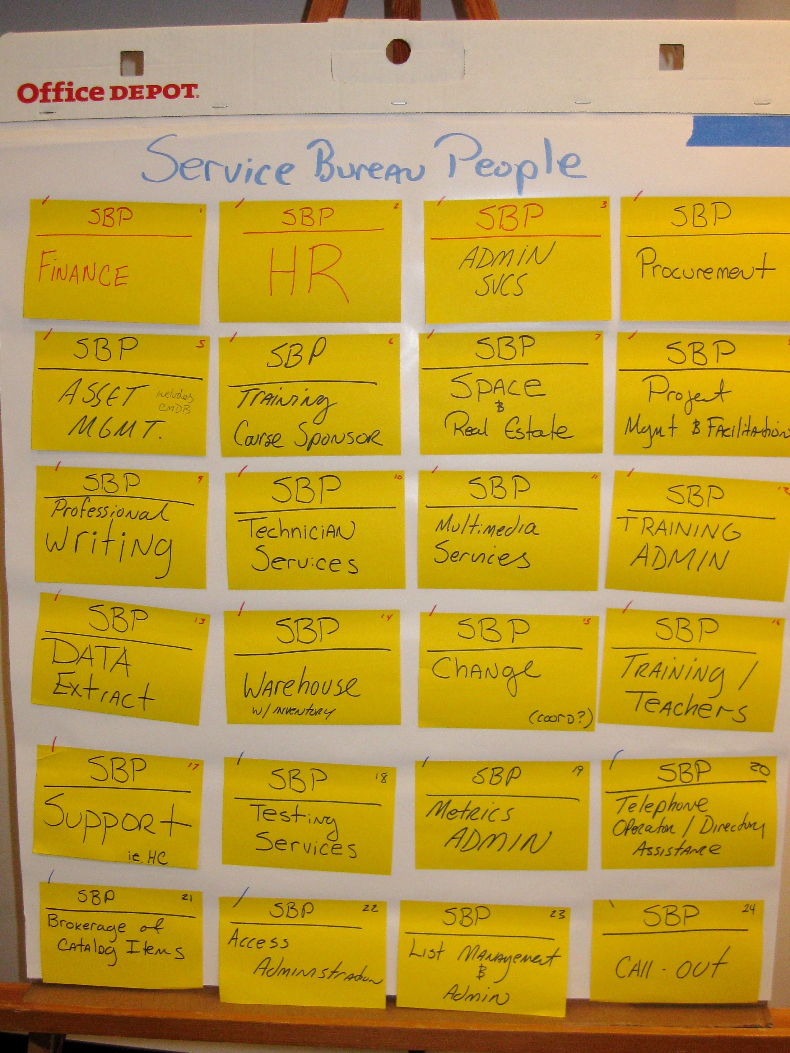
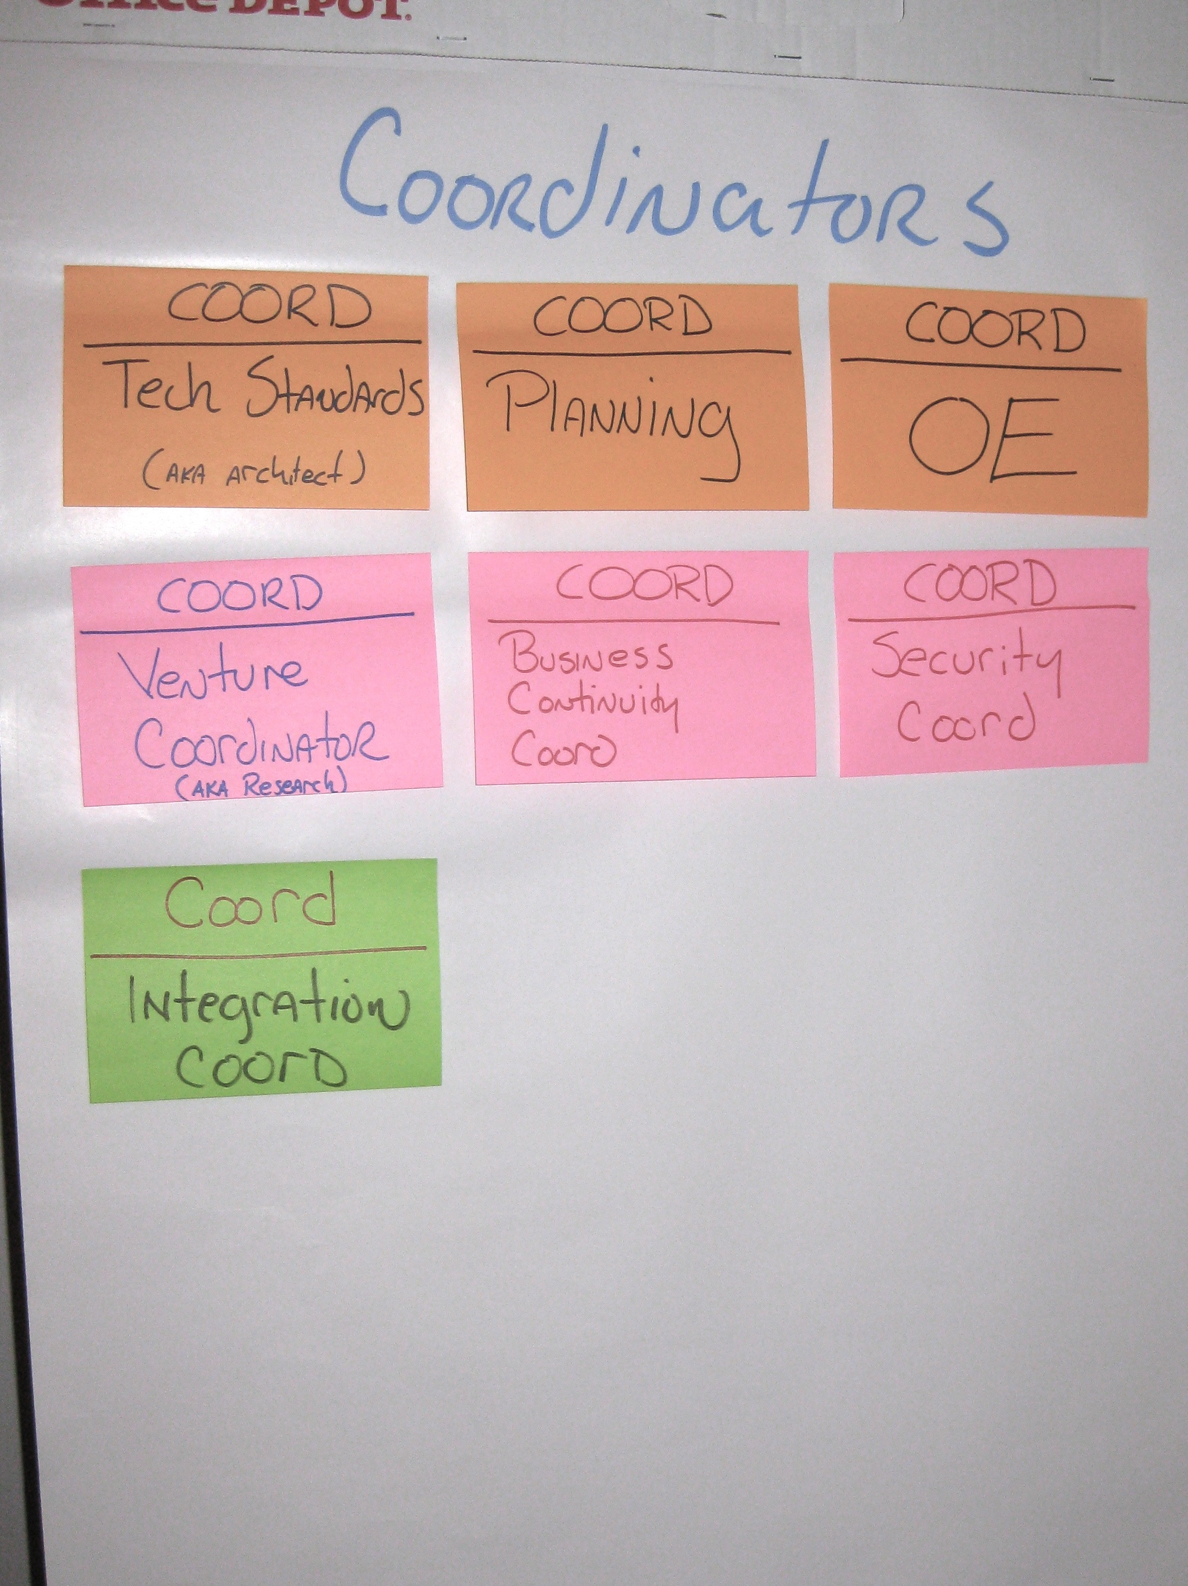
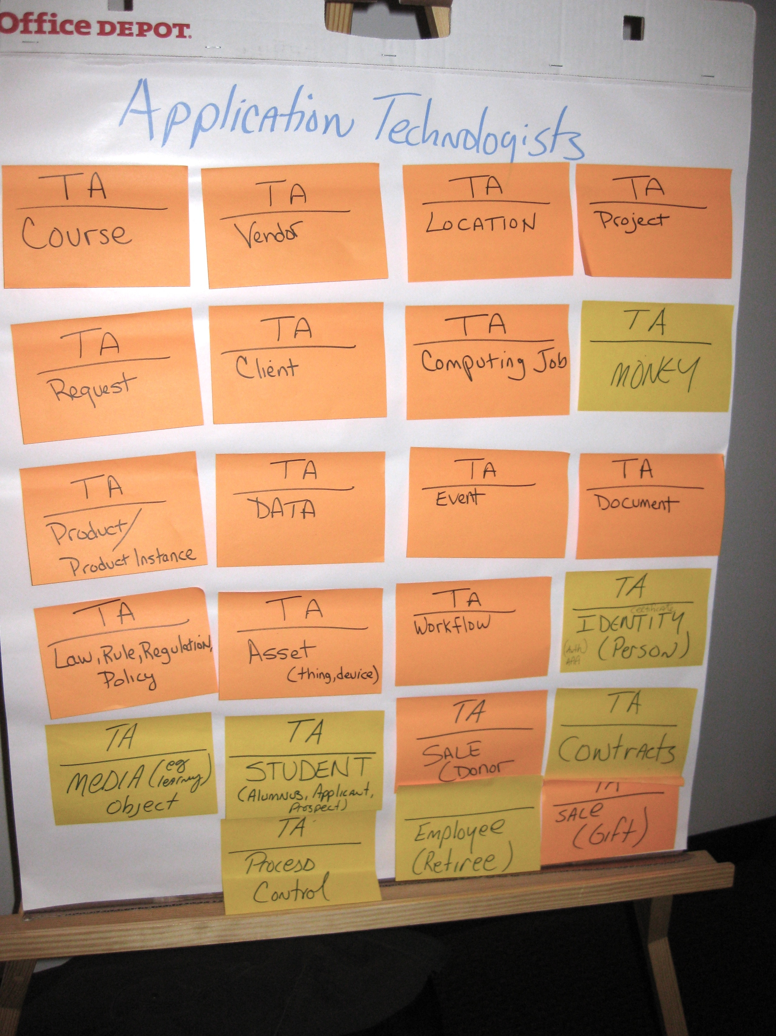
Creating the Organization
By the end of day three, we had created the new IS&T organization!
Design Team disbanded
(and there was much rejoicing)
James Amann

Slide 19
Selecting the New Leadership
All former Design Team members supplied the CIO with their top five preferences within the new organization
The CIO, JL Albert met with each and every member of the Design Team to discuss these preferences (around 44 interviews)
The CIO then selected the first-tier (directors) of the new Leadership Team, matching qualifications and preferences with the needs of the organization
James Amann

Slide 20
Selecting the New Leadership
The newly selected tier-one leaders and the CIO met as a team to select the tier-two leaders, according to voiced preferences and the needs of the organization
The new structure is highly specialized; each director understood that in order to be successful, their peers must also be successful
Teamwork already evident
James Amann

Slide 21
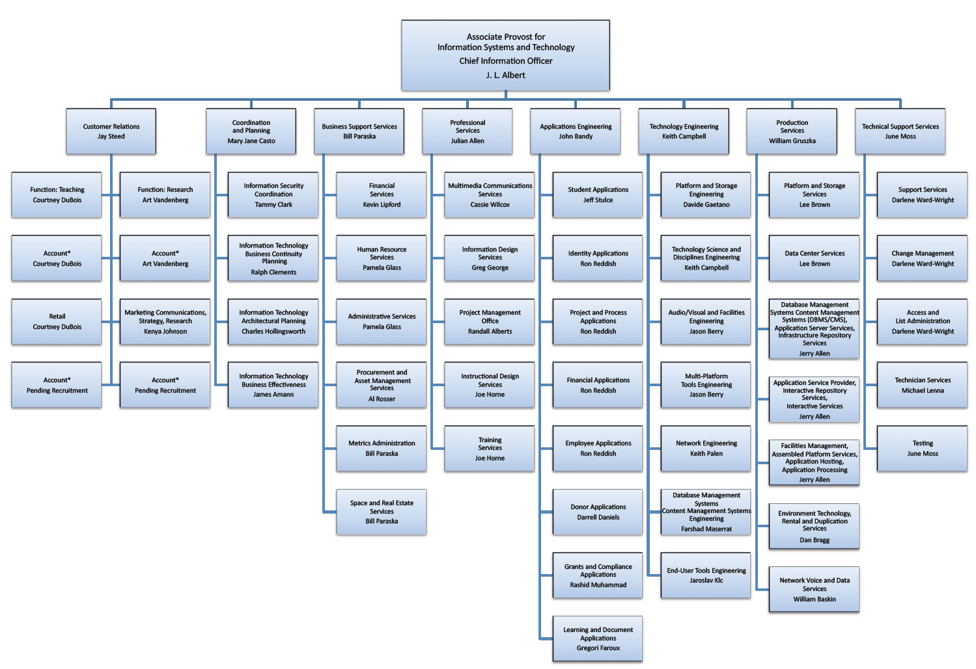
Current IS&T Structure
Previous IS&T Structure
James Amann

Slide 22
Defining Domains
The new Leadership Team, tier-ones and tier-twos, met again with our facilitator to create clearly defined domains
Using consensus, each line of business was again evaluated and defined
New leaders created the organization, then defined their business
What each line of business is accountable to produce and provide
James Amann

Slide 23
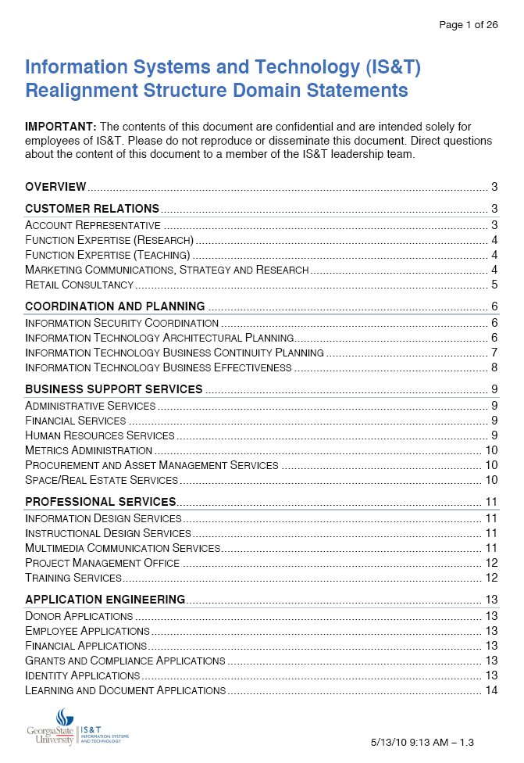
Defining the Domains
The product was a twenty-six page document, which clearly defined the boundaries of each line of business
Domain document referred to often to clarify misunderstandings, determine accountability for new technology offerings
James Amann

Slide 24
Staff Assignments
With domains created, staff were assigned to groups in the new organization
The entire Leadership Team met to perform this task
Again, all decisions made by consensus
Leaders ensured their peers could be successful by making reasoned assignments
James Amann

Slide 25
Announcement Day
A four-hour staff meeting in which the new structure was explained
Presentations were made by a majority of the new Leadership Team
The day after this session, all staff reported to their new supervisors in the new organization
University’s executive management attended announcement event
James Amann

Slide 26
Results
JL Albert

Slide 27
Internal Results
Clearly defined domains eliminate ongoing conflict – “Good fences make good neighbors”
Domain statements allow continuous clarity in regard to our structure
Team members developed a sense of entrepreneurship, ownership and accountability
Stronger leaders with focus on teamwork and general excitement about the future
Team members have insight into organizational effectiveness and efficiency
Accountabilities clearly defined
Innovation encouraged and rewarded
JL Albert

Slide 28
Challenges
Renewed focus on accountability
Migration of existing tasks to new teams
New customer account representatives increasing new business beyond capacity
Funding model (fee-for-service in addition to core budget)
Balancing resource allocation between engineering and operations staff in tight economic conditions
JL Albert

Slide 29
Next Steps
Culture process
Refinement of domains
Complete migration
Enhance governance process (internal and external)
Re-allocation of staff to align with demand
JL Albert

Slide 30
Questions
?
JL Albert

Slide 31
Would you like to know more?
IS&T’s CIO
JL Albert: jlalbert@gsu.edu
Manager, IT Business Planning
James Amann: jamann@gsu.edu
Our Facilitator
Dean Meyer: dean@ndma.com

