Slide 1
e-Portfolios in Online Learning:
Student and Faculty Perspectives
EDUCAUSE
October 19, 2011
Michelle Holschuh Simmons
Beth Wrenn-Estes
Alejandra Saldana-Nann

Slide 2
SJSU School of Library and Information Science (SLIS) Profile
Students in 48 states and 18 countries
Faculty on 3 continents
First fully online web-based course offered in 2001
e-Portfolio added as a culminating project in 2006
All courses delivered online in 2009
Ranked #1 by U.S. News and World Report for LIS e-learning
Notes:
keep

Slide 3
Goals for the e-Portfolio
The process of developing the portfolio enhances the learning process.
The resulting portfolio demonstrates your understanding of professional competencies.
Both faculty and students can measure individual and group progress toward learning objectives.
Students can reflect on their MLIS experience to identify individual strengths and develop a professional growth plan.
http://slisweb.sjsu.edu/courses/289/organizing_presenting.html
Notes:
keep

Slide 4
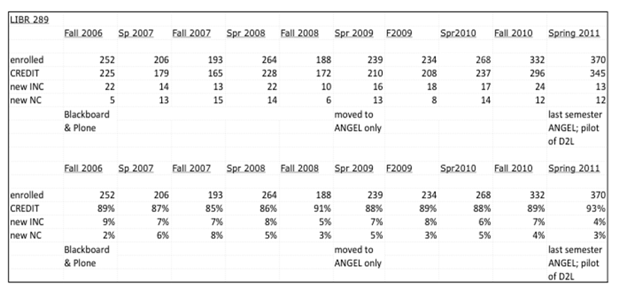
e-Portfolio by the numbers
Notes:
Keep--update

Slide 5
Session outcomes
Review SLIS history in how the e-Portfolio developed as a culminating student experience
Compare sample e-Portfolios in multiple platforms including ANGEL, D2L, and Google Sites
Understand the development of a culminating e-Portfolio experience as an evaluation tool to assess a student's mastering of the core competency areas.
Identify the challenges and successes inherent in developing a culminating experience using the e-Portfolio format from both the faculty and student perspective.
Notes:
keep

Slide 6
Professional competencies Program competencies
Notes:
keep

Slide 7
Organization of a submission
Explication of competency statement (around 2-3 pages)
Three artifact sections proving that the student is competent (2-3 pages)
Conclusion—application to other settings
Artifacts are attached (typically 3 artifacts per competency)
Notes:
keep

Slide 8
Criteria for non-D2L site
Navigation
Attachments
Security

Slide 10
Collapsible Menu

Slide 11
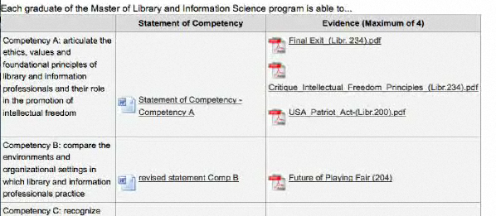
e-Portfolio in ANGEL
Competency statement along left
Attached artifact files (pdf, Word, mp3, html, etc. along right
Attached Word files for competency essays in middle
Notes:
keep

Slide 12
Advantages of ANGEL
Straight-forward publication interface
Students and advisors can take advantage of Word features such as spell-check.
Students feel a sense of accomplishment as they populate the matrix with artifacts and competency essays.
Notes:
keep

Slide 13
Disadvantages of ANGEL
Limited customizability
Complicated process to create the publication
Publications do not resemble websites
Finicky, e.g. inability to put artifacts in an intentional order
Cannot be exported/saved as a publication outside of ANGEL
Notes:
Keep

Slide 14
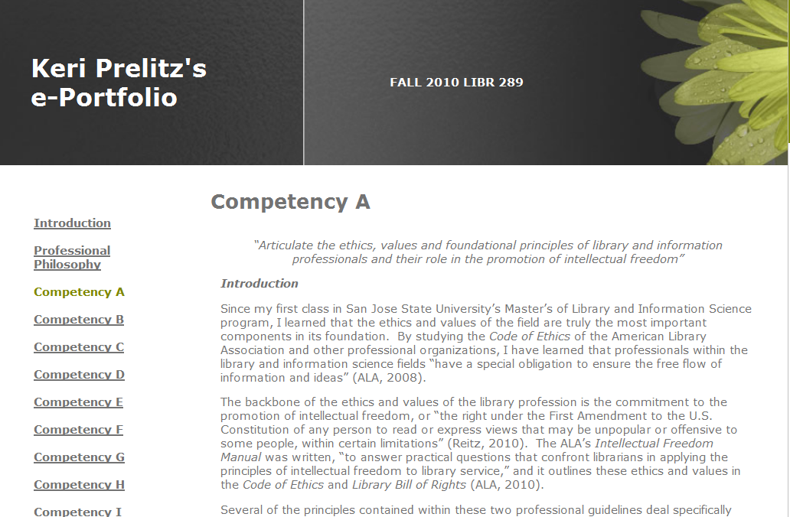
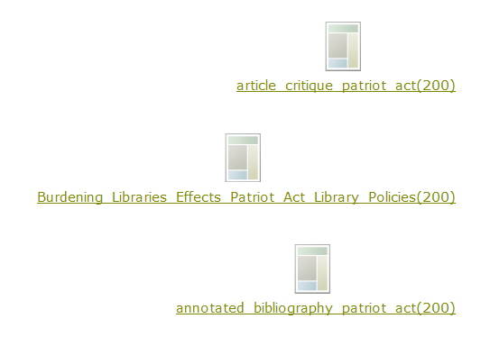
e-Portfolio in D2L
Competency statement on top of each page
Navigation bar of all competencies on left
Attached artifacts on bottom of each page
Explication and demonstration in the middle
Notes:
Keep

Slide 15
Advantages of D2L
Publication appears and functions like a website
Appearance is somewhat customizable
Process of creating a publication is straight-forward
Integrated plagiarism-detection tool
Students can deposit artifacts in their e-Portfolio folder throughout the program
Notes:
Keep

Slide 16
Disadvantages of D2L
Publication cannot be easily exported/saved outside of D2L
Students must choose among a limited number of designs
Advisors read from a webpage instead of from a Word doc (as in ANGEL), and so cannot take advantage of Word features.
Notes:
Keep

Slide 17
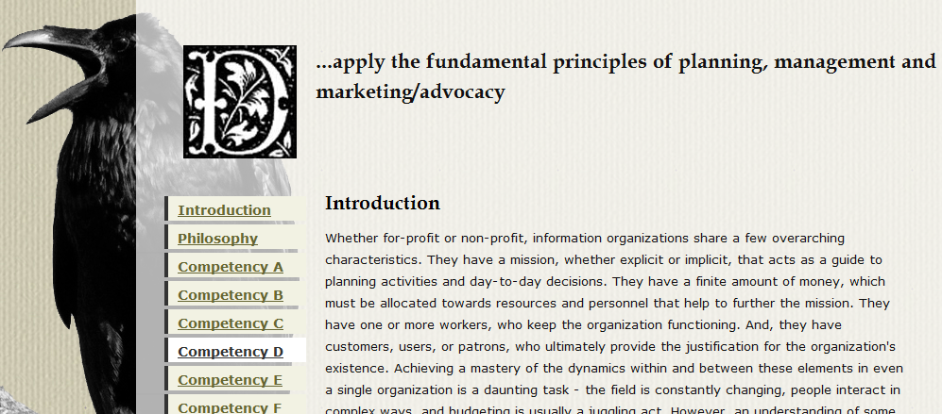
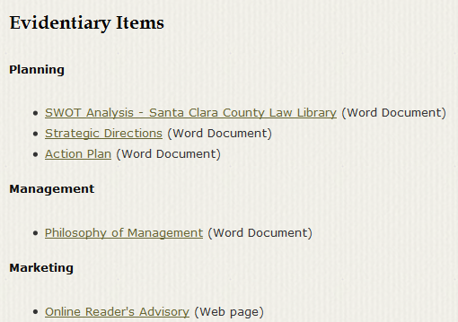
e-Portfolio as a website
Most students place competency statement on top of each page
Most students put site navigation on left, on top, or in a dropdown menu.
Most students link artifacts at bottom of each page
Notes:
Keep

Slide 18
Advantages of a website
Potential for unique design
Student maintains access and ownership of the site
Learning to build a website is a transferable skill
Notes:
Keep

Slide 19
Disadvantages of a website
SLIS does not provide tech support
Designing the website takes time
Student must secure server space on which to house site
Notes:
Keep

Slide 20
Challenges
Privacy
Academic integrity
Digital storage
Consistency in assessment
Notes:
Keep

Slide 21
Successes
Program assessment
Curricular cohesion
Meaningful and valuable to students (see quotations on the handout)
Rewarding to see students’ reflections about their progress throughout the program.
Notes:
Keep

Slide 22
D2L dashboard

Slide 24
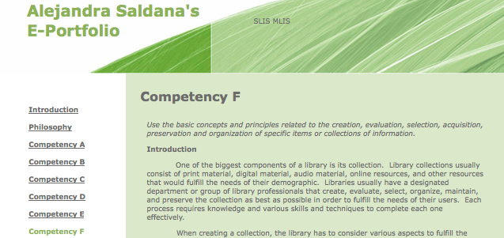
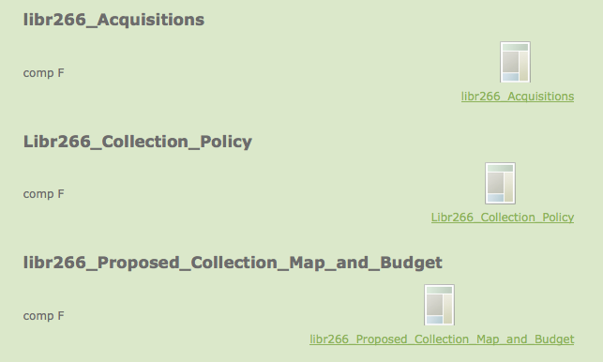

Slide 25
Artifact example

Slide 26
e-Portfolio challenges
12 week time limit to articulate everything learned from the MLIS program.
Finding assignments based on personal organizational skills throughout the entire program.

Slide 27
e-Portfolio successes
A way to regain the passion for librarianship.
A refresher of everything learned and experienced.
An innovative way to showcase accomplishments and achievements from coursework and experience.

Slide 28
Questions?
Thank you!

