Slide 1
Research Data Management
A View from Penn State University
Patricia Hswe, Digital Collections Curator
- - - - - - - - -
EDUCAUSE 2011 | October 20
Panel: Access to Data Tomorrow Means Good Data Management Today

Slide 2
The data management landscape at Penn State (& elsewhere, very likely)
Where is the data? Who has data? What types of data are there?

Slide 3
Penn State’s “enterprise” of response
Data Curation Services Working Group (DCSWG)
Collaboration between Libraries, Information Technology Services (ITS), Office of Sponsored Programs, and faculty (research institutes)
Activities: survey of NSF PIs and pending PIs; future – benchmarking services with peer institutions
Research Data Management Services Team (RDMST)
Based in libraries, diverse membership
Activities: website, consultations on data management planning, information session in spring 2011, brochure for distribution in the Libraries and beyond (i.e., to faculty and students), data management planning workshop for graduate students

Slide 4
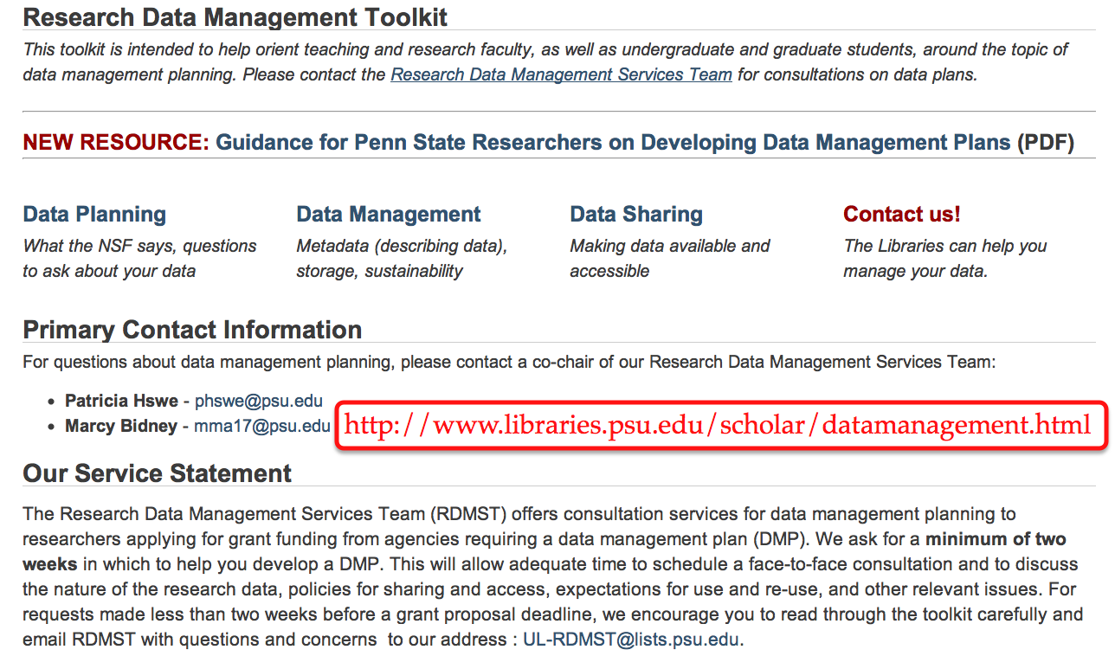

Slide 6
Data Management Planning Guidance
Faculty sought a template or guidance based on Penn State conditions (e.g., research administration policies/guidelines)
The Libraries and ITS partnered with the Strategic Interdisciplinary Research Office (within the OVPR office) to develop this guidance

Slide 7
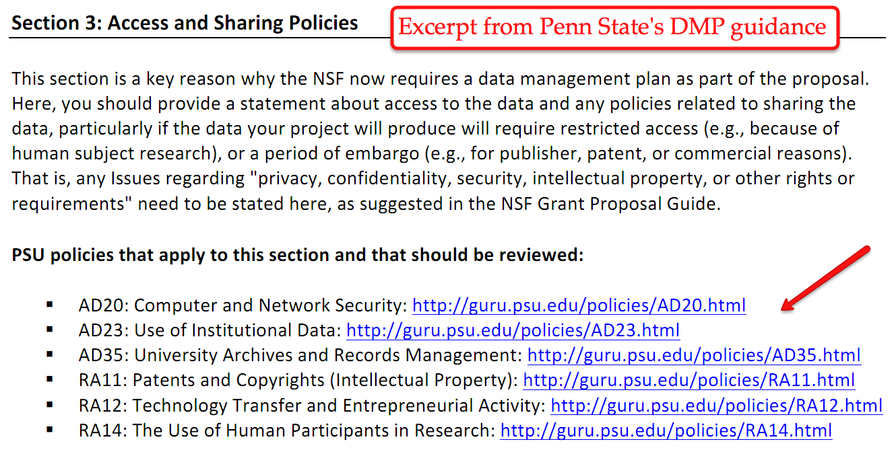

Slide 8
Services (Infrastructure) Development
Spring 2011: Libraries and ITS piloted an ingest tool using curation microservices architecture (cf. California Digital Library, http://www.cdlib.org/services/uc3/)
Since summer 2011:
ITS (specifically, Digital Library Technologies) has been working with Hydra community (cf. http://projecthydra.org/) on a framework for repository-based services
ITS is also planning new, tiered storage services for research data, consulting w/ Research Data Management Services Team
Goal: new suite of publishing and curation services in production in fall 2012

Slide 9
Challenges (Opportunities)
Engaging more subject librarians in data curation efforts
ARL/DLF E-Science Institute
Taking entrepreneurial approach (following up with new NSF/NIH/NEH PIs)
“Data literacy” for graduate students
Meeting other commitments, including but not limited to:
Addressing commercial, born-digital data sets
Publishing (ingesting) student-based work
Developing e-records management program
Satisfying faculty requests for help in starting peer-reviewed, online journals

Slide 10
Thank you!
Questions? Comments?
Email me: phswe@psu.edu
Picture credit:
http://www.flickr.com/photos/jmd41280/2975460863/ • CC-BY-ND by jmd41280

