Slide 1
Collaborative Community Engagements
A Recipe for Growing Networks, Managing Change, and Leveraging Resources

Slide 2
Outcomes
Consider opportunities for new and alternative relationships beyond your campus that may provide means to save costs, reduce risks, and provide mutual benefits.
Be inspired to form communities of interest and new partnerships in your geographical area.
Think inventively about building foundations upon which other opportunities can be pursued
Create a thought lab about how to balance expansion with reduced budget through collaboration
Warning … May make you hungry

Slide 3
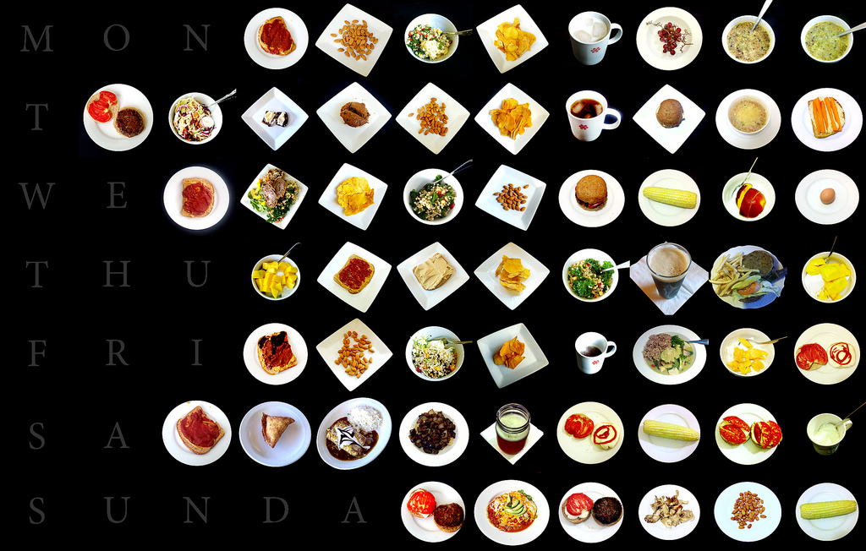
Creative Commons, Flikr "Every Food Week 19" Mike Mccaffrey

Slide 4
Why use a "recipe" as a metaphor?
Recipes allow for collaborative relationships between unlikely partners
Allows for a vast amount of creativity while still conforming to a heuristic framework
Allows for derivative product
Sometimes leads to unexpected successes

Slide 5
MiS En Place
A Recipe for Growing Networks, Managing Change, and Leveraging Resources

Slide 6
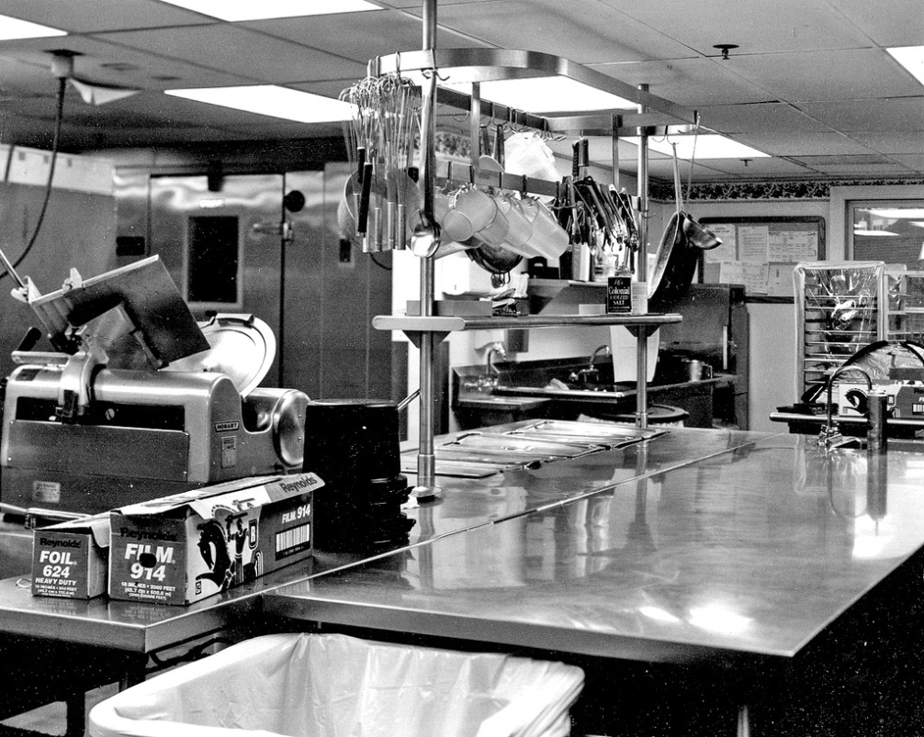
Mis en place
French phrase defined by the Culinary Institute of America as "everything in place", as in set up. It is used in professional kitchens to refer to organizing and arranging the ingredients

Slide 7
Three elements for a successful recipe:
The Chef – Willing to experiment, take calculated risks, work long hours, expect the unexpected
The Kitchen – Must be capable of producing the recipe.
The Ingredients - High quality, of the local variety, palatable to the taste of the consumer

Slide 8
Our Chefs
We are a representative sampling of our "Kitchen Staff” , but there are many line chefs. To note is our differences:
Elwood Downing - Vice President of Member Relations for Merit Network, The high speed regional research and educational network in Michigan
Pete Hoffswell - Network Manager for Davenport University in Grand Rapids Michigan
Brian Paige - Director of Networking and Technology for Oakland University

Slide 9
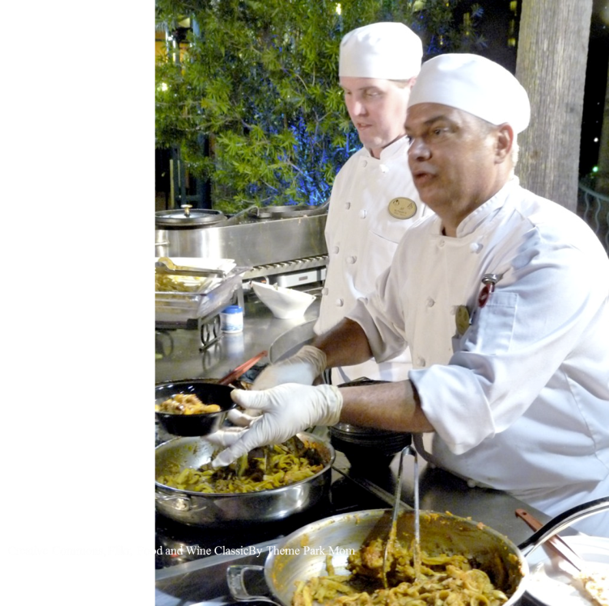
Characteristics of a Chef
Knowledge of local cuisine
Skill
Synergy
Commitment to shared vision
Acceptance of differences
Collaboration
Cooperation
Communication
C³

Slide 10
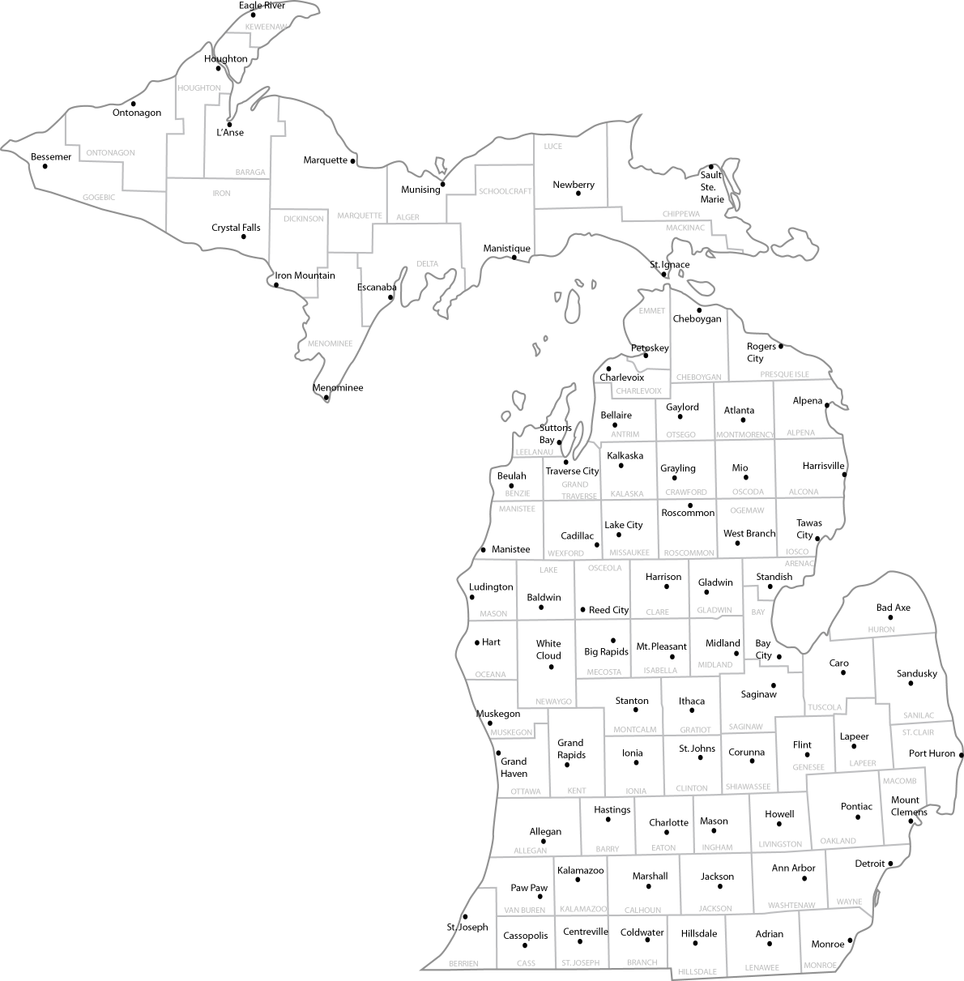
Our Kitchen: State of Michigan
Only state that consists of two peninsulas
Joined by 5-mile Mackinac Bridge
83 Counties in Michigan
70% of the counties are rural
Creates challenges with middle-mile and last-mile
State – Decentralized Educational Network

Slide 11
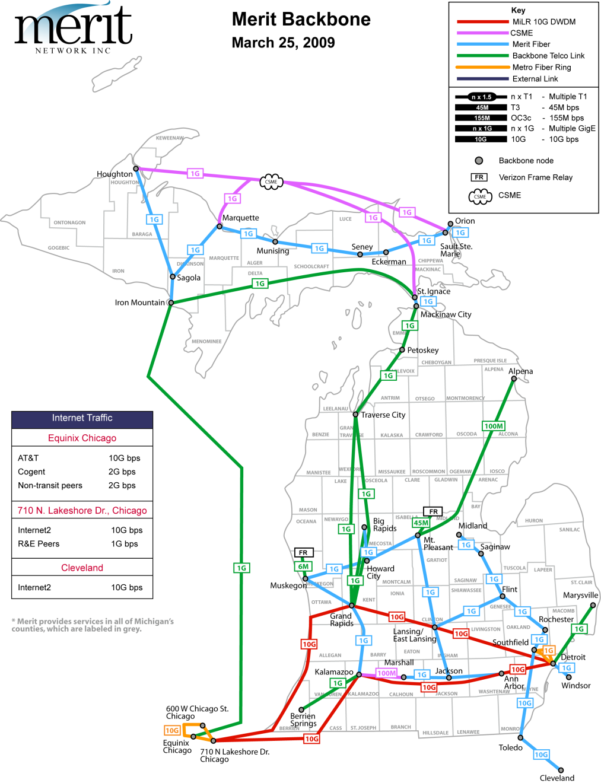
Our Kitchen: State of Michigan
Limited Resources and Quality of Life created an appetite for Hungry Collaborators.
They were willing to come to the table together as a community and share what they have in their cupboards.
Merit Network, operates and manages Michigan’s statewide Education and Research network.
Governed by 12 of the Public Universities.
45yrs in November, 501(c) 3

Slide 12
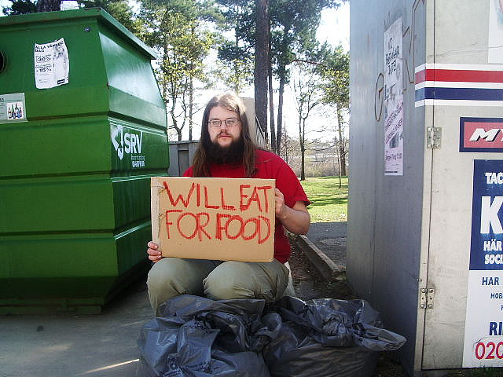
Creative Commons, Flikr ”Will Eat for Food" mikael altemark

Slide 13
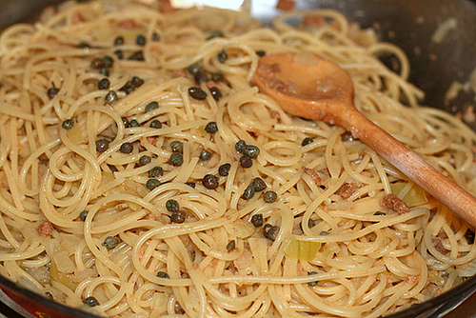
Ingredients
The Chefs supply their local ingredients – The resources available to cook our spaghetti
Staff
Knowledge
Time
Money
Infrastructure

Slide 14
The mixing bowls
In our case state network operators are the relationship, but the relationship happens at multiple levels. The circles are unique but often overlap. MOST Meetings - Public state technical folks MAC Meetings - Private and Not-for profit advisors to Merit Board Meetings - Executives, Administrators, MJTS Meetings - The whole community Ad Hoc Meetings - Little groups.
Community Meetings – Local get-togethers

Slide 15
Early Attempts – Fun in the Kitchen
A Recipe for Growing Networks, Managing Change, and Leveraging Resources

Slide 16
Example … OU and Merit
Oakland Expands to a shared university center, 18 miles East.
Two Options: Private Leased Lines
Collaborative Engagement: The community college who hosted the University Center is a Merit affiliate, and is willing to negotiate transit for a fraction of bandwidth over their Merit Connection. Merit charges only a small administrative fee, thereby saving leased line fee

Slide 17
Examples
Oakland + Merit + Community College creates momentum for a broader initiative.
Now that Oakland (and other Merit Partners) are in place at the University Center, there is critical mass for a shared fiber build project. The CC benefits with the University Presence with a fiber build into one of their campuses.

Slide 18
Examples
University Center Location Now provides a viable point of presence for new networking.
Oakland University announces a Medical School partnership with William Beaumont Hospital – the OUWBH Medical School. IT Staff is charged with connecting the two institutions.

Slide 19
OU-WBH Medical School
WBH is located approximately 7 miles south of Oakland University and has a private MAN to all of its facilities.
OU has no network presence close to the hospital which would traditionally require another expensive leased line, difficult wireless installation, or expensive VPN tunnel.
WBH has a significant clinic building immediately across the highway from the University Center.

Slide 20
A New Partnership Begins
Oakland University Network and WBH Hospital network can now be connected and certain services shared over the long term through a simple fiber build, less than 1/6th of a mile.
Merit and WBH now have an opportunity to bridge other common community interests.

Slide 21
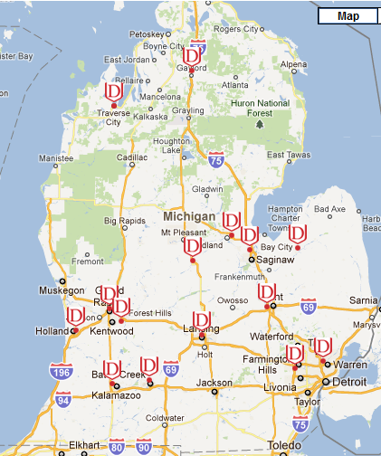
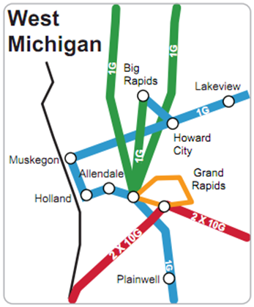
Davenport University
Good network neighbors make great connectivity
Grand Rapids to Holland via GRCC/GVSU/OAISD/BPW
Grand Rapids to Merit via GRCC
Collaborative fiber builds

Slide 22
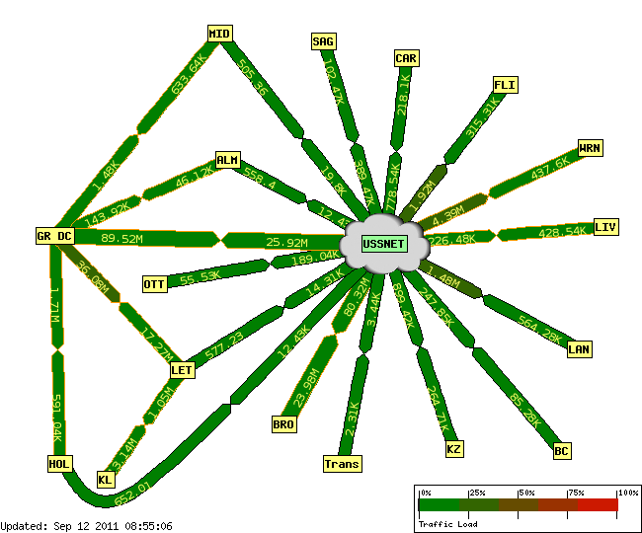
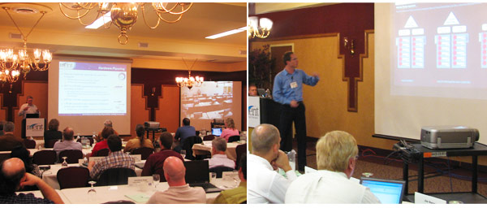
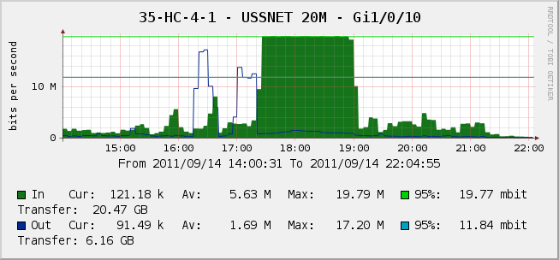
Davenport University
Opportunities to regularly meet with Peers to share knowledge and experience
http://www.merit.edu/events/mjts/

Slide 23
Turning Up The Heat
A Recipe for Growing Networks, Managing Change, and Leveraging Resources

Slide 24
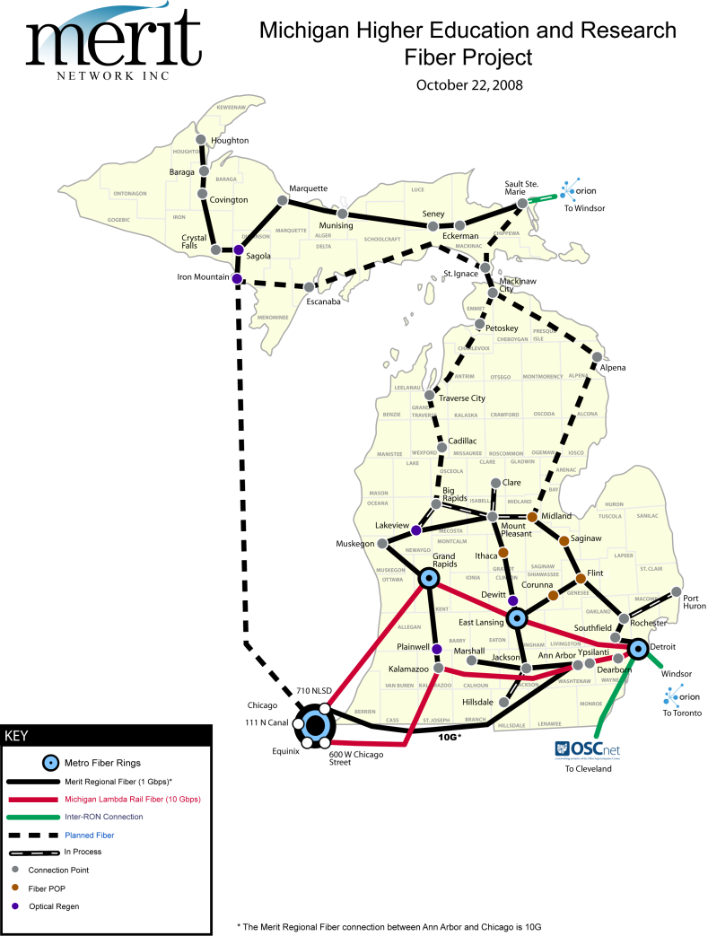
Our Kitchen: State of Michigan
The dinner conversation begins….
Leaders at the table are individuals that want to create a solution that is a winning combination with a smorgasbord of options.
“A Geographical Community Partnership is a regional section of Michigan that is comprised of Leaders interested in the Quality of Life within their Community. Downing”
Note: Date Oct. 2008

Slide 25
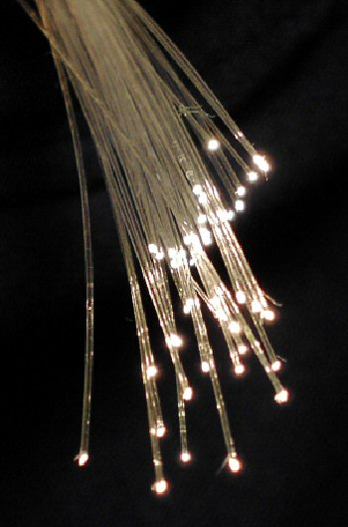
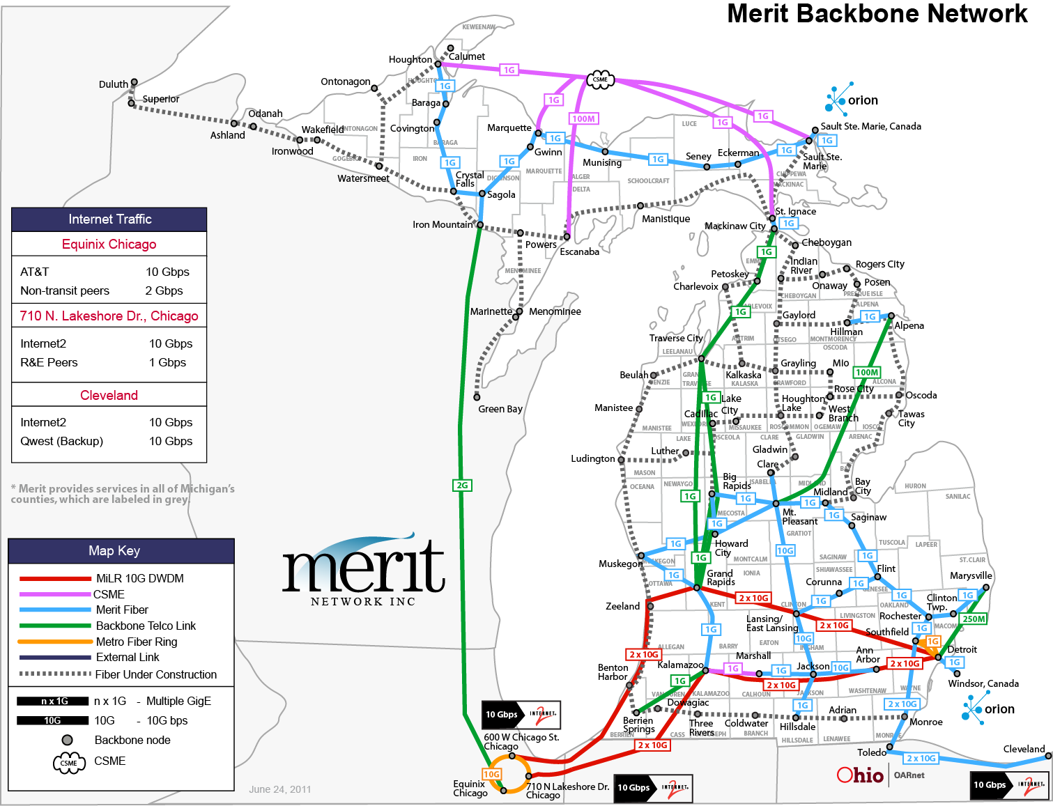
Our Kitchen: State of Michigan
Received two ARRA/BTOP awards to build middle-mile fiber-optic infrastructure in Northern Michigan.
Project Name: REACH-3MC
Total funding is $103M for $129M investment in Michigan
Private – Public Partnership
7 for-profit sub-recipients
Up to 168 fiber-strands
40 – 10Gig waves with 1Gig local handoffs
Creates a recipe for statewide collaborations

Slide 26
Turning up the heat ...
Higher Stakes - More to Lose
Timelines
Visibility and consultation with other groups – unanticipated celebrity

Slide 27
What is An Award Winning Recipe?
A Recipe for Growing Networks, Managing Change, and Leveraging Resources

Slide 28
Components
Have a common vision
Share the Kitchen
Mix ingredients
Cooperate

Slide 29
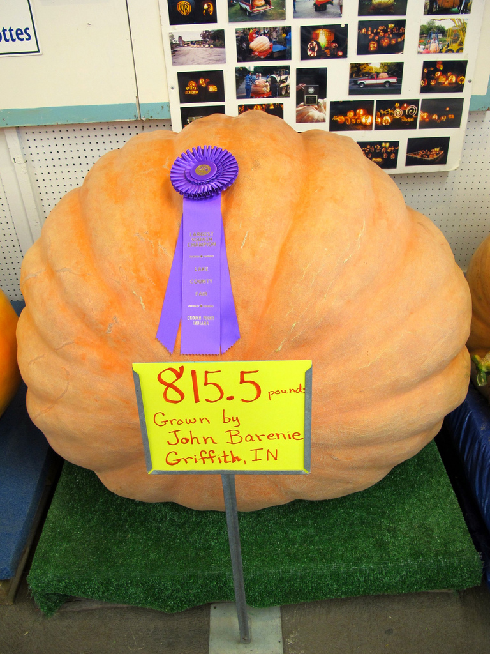
Creative CommonsAttribution Some rights reserved by JOE MARINARO

Slide 30
Remember what it’s all for
What did we cook this all up for anyway?

Slide 31
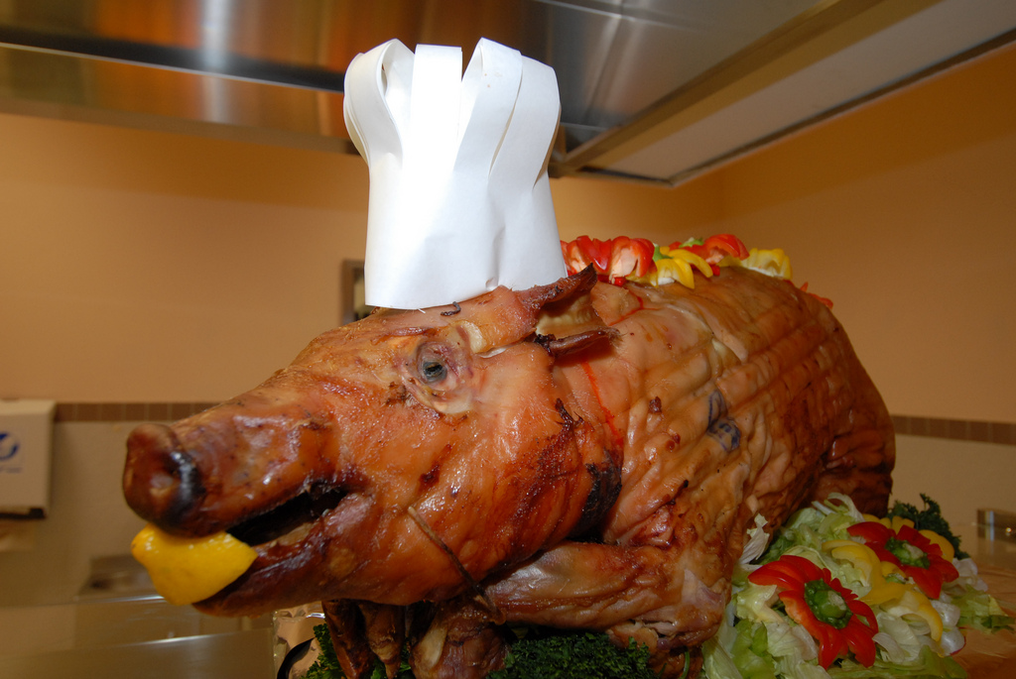
Creative Commons, Flikr 2009 Thanksgiving meal at the South of the Alps Dining Facility U.S. Army photo by Edward N. Johnson

