Slide 1
Taking Change Management To A Higher(Ed) Level
Dr. Linda Shatzer
Jim Russell
John Ray
Adante Harvey
| October 20, 2011
City University of New York

Slide 2
AGENDA
Communications and Student Marketing – John Ray
Academic Integration – Jim Russell
Training for Higher Ed – Adante Harvey
Measuring Change Readiness – Dr. Linda Shatzer

Slide 3
OVERVIEW
CUNY is undertaking a massive ERP implementation. This session will identify common issues for large scale implementations in higher education and the methods used to address those issues. Examples include user readiness assesments, constituent group development including the academic community, student marketing teams and training models.

Slide 4
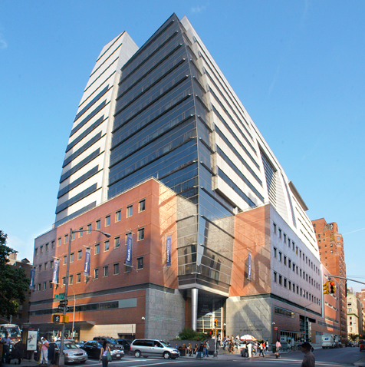
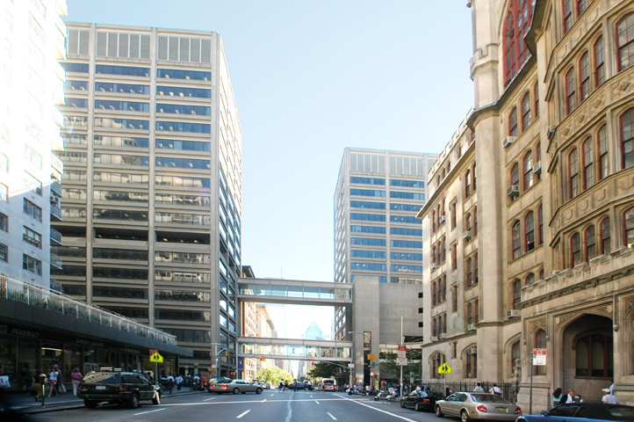

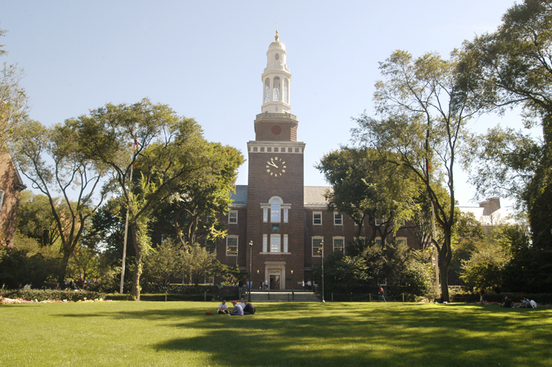
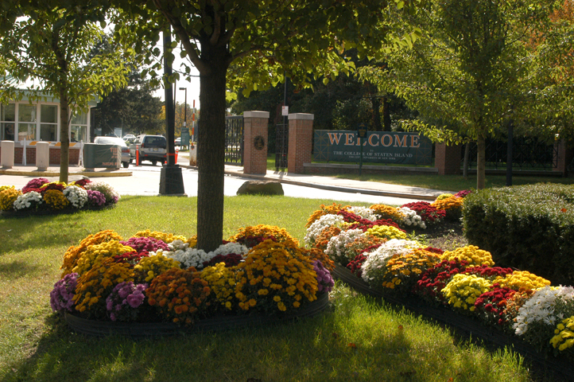
WHAT IS CUNY?

Slide 5
WHAT IS CUNY
CUNY is the largest urban public university in the United States:
23 24 Institutions
>262,000 degree-seeking students
>257,000 continuing education students
>7,000 full-time faculty
>10,000 part-time faculty
1,000 continuing education teachers
>35,000 total employees
1,400 academic programs
200+ associate and baccalaureate degree majors
100+ graduate degree programs
280+ buildings on 23 million square feet of space
641+ acres

Slide 6
ERP IMPLEMENTATION – “CUNYfirst”
PeopleSoft (Oracle) 9.0
Ongoing implementation and unification of Finance, Human Capital Management (HR) and Campus Solutions (SIS)
Replacing 35 year old home grown legacy systems
Union environment
Both city and state oversight

Slide 7
What Makes CUNYfirst Unique
Splintered Change Management
  Large scope made it clear that we needed more resources
  Existing University models in communications and training did not support massive change effort
  Wave approach
    By module
    Campus Solutions (Student Information) by schools
    No “big bangs”

Slide 8
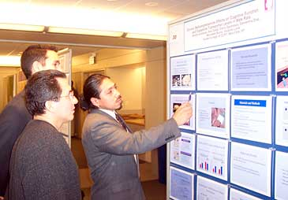
Creating Liaison Groups

Slide 9
Organizing for change
CUNY was a “loose federation of colleges”
  While leadership could be assessed, “followship” had a mixed history
  Diversity of mission led to diversity of procedures
  Some colleges believe that their processes are integral to their unique identities
Each college needs to be guided toward “ownership” through engagement
CUNY adopted a model of liaisons to bring key community members into the project

Slide 10
Campus Team Coordination for Organizational Readiness Execution
Communication
Liaison
Organizational Readiness focuses on the coordination and execution of various campus-based activities
Additional
Campus
Resources
Technical
Readiness
Liaison
Project
Management
Liaison/
Campus
Executive
Change
Management
Liaison
Training
Liaison
Help Desk
Manager
Security
Liaison
Functional
Pillar
SMEs

Slide 11
Campus Team Roles and Responsibilities
Campus Team Member | Roles & Responsibilities
Campus Executive | Maintains overall accountability for campus organizational readiness activities Assigns Campus Team member resources to complete organizational readiness activities as needed Communicates to and involve other top-level campus leaders
Project Management Liaison | Coordinates and tracks execution of project plan tasks Communicates campus organizational readiness activity (through use of Organizational Readiness Checklist) progress to Campus Executive Identifies issues and risks associated with completion of activities; facilitates resolution to resolve the issues/risks
Change Management Liaison | Monitors activities of Campus Team resources and reports progress to the CUNYfirst Organizational Readiness Managers Updates the Campus Risk Identification and Mitigation Log to document campus-based issues and risks associated with the organizational readiness activities Works with Project Management Liaison to address identified campus-specific issues and risks related to organizational readiness

Slide 12
Campus Team Roles and Responsibilities
Campus Team Member | Roles & Responsibilities
Communications Liaison | Tailors campus-specific communications pertaining to system module rollouts Disseminates system module rollout information and promotional materials to campus Works with the Project Management Liaison to coordinate system module rollout awareness activities to various campus audiences
Training Liaison | Assists with training logistics and support that includes scheduling and registration Identifies and supports subject matter expert trainers from campus
Functional Pillar Subject Matter Experts (SMEs) | Gains and maintains knowledge of To-Be processes Participates with system module design, acceptance testing, validation of system module role mapping for campus end users, and data conversion Provide system module functional guidance to the Campus Team and affected end users during the system module rollouts

Slide 13
Campus Team Roles and Responsibilities
Campus Team Member | Roles & Responsibilities
Technical Readiness Liaison | Identifies and coordinates technical requirements with CUNYfirst Project Technical Readiness Team Validates cutover tasks including data conversion and interfaces as needed for the campus
Security Liaison | Coordinates and sets up campus security activities, working with the designated campus data owner(s)
Help Desk Manager | Ensures help desk facility is ready at the campus Coordinates help desk training at the campus (including policies and procedures) Monitors help desk customer assistance after the system module rollouts

Slide 14
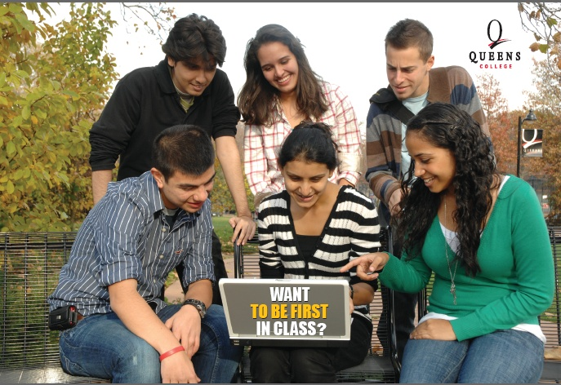
COMMUNICATIONS

Slide 15

Communications in Higher Ed
Challenging, as most of the existing focus is external
Messages often don’t reach their targets
Messaging must be delivered to specific individuals
Faculty and staff want transparency, not spin
College leaders too often assume they know best avenues to communicate
Do an assessment!

Slide 16
Communications Assessment in Higher Ed
Assess your history on large-scale projects and communication
Who is the audience?
How do you get to them?
What do you want to say?
When?
How can students help?

Slide 17
Communications in Higher Ed
How do you communicate well at your college?
Who is the most influential communicator to students? Staff? Faculty?
Can you send a communication directly to your entire staff? How? Students? Faculty?
Do you know where you can reach students with a sign or poster? Where are your high traffic areas?
What is your approval/send message process?

Slide 18
Communications in Higher Ed
Do you know where you can reach students with a sign or poster? Where are your high traffic areas?
Who is the most influential communicator to students? Staff? Faculty?
Have you started explaining the change to your community? Do you know what’s in it for them?
Do you want to change how you communicate internally?

Slide 19
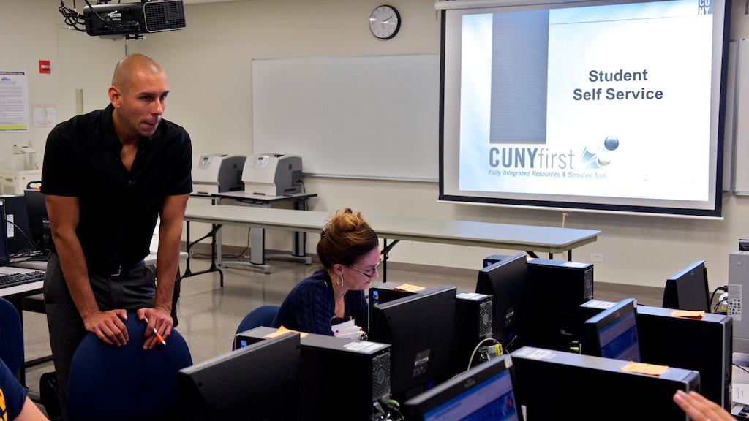



Student Marketing Teams

Slide 20
Student Marketing Teams
“Who better to talk to students than students.”
Recruit leaders – be as diverse as student body
Let them see the system, play in “sandbox”
Use sandbox experience to drive messaging
  Tout features
  Acknowledge differences
  Emphasize support – “We’ll be with you every step.”
Grow team to train – hold orientation sessions
Support center with student leads at hand

Slide 21

Academic Integration

Slide 22
Faculty Communities
Keep in mind that faculty members often play multiple roles (advisors, admissions, transcript review, placement, and more…)
Faculty want to focus on teaching and the core of their job
  Just in time training
  Minimal short updates with links for more details
  Any marketing pieces must be closely aligned to faculty reality

Slide 23
Academic Leadership Communities
Faculty chairpersons – key role but diverse activities and capabilities
  Departmental support staff usually keep the school afloat!
  Think about delegation from the beginning
Deans and Division heads seek data and approval flow
Provosts and Chief Academic Officers need to be kept informed and be consulted

Slide 24
Academic Integration Experiences @CUNYfirst
Avoid the mistake of not including more space for the academic community in scope development
Introduce project results to the academic community with relevant “low hanging fruit”
Avoid Initial High Stakes Risks:
TAMfail (Talent Acquisition Management)
  Be aware of actual work flow of faculty searches
  Watch your language (HR “processes” the search result, the Provost “approves” the search no matter what the software says)

Slide 25
Faculty Chair Liaison Lessons @CUNYfirst
They can provide expert guidance and local advocacy
Seek thought leaders even if they are not “easy”
Listen! (i.e. - ability of chairperson to delegate functionality and approvals is essential)
For reporting, get the data out first, develop the formatting later
Provide concierge-like levels of service – it pays off in the end

Slide 26

Training

Slide 27
Purpose
Purpose
The CUNYfirst End-user Training Strategy describes the overall approach for training and end-user support for CUNY.
Outlines a CUNY university-wide training methodology as well as a process to develop training curriculum and course materials
Provide the basis for the development of a Training and Support Plan

Slide 28
Goals
Goals
The goals and objectives of the training and end-user support are designed to articulate a clear and consistent understanding regarding the expectations, scope, and application of end-user learning.
Continuous learning opportunities beyond the initial or go-live training
On-demand/Self-Help support materials organized by business process with multiple delivery methods
Provide training that will allow users to gradually build and sustain their skills

Slide 29
Planning
Learning and Support Strategy
Learning Plan
  Needs Analysis (Roles)
  Content Standards and Templates
Content Materials
Delivery
Support Network
Knowledge Base
Communication Messages

Slide 30
Planning: Needs Assessment
Inputs
  Interview Questions
  Survey
  Role Definition Review
  Workshops
  Data Gathering and Prep Activities
Outputs
  Business Process Documentation
  Fit Gap Documents
  Role Based Matrix

Slide 31
Planning (T – 6 Months)
Goals and Objectives:
  Create clear and consistent end-user documentation and support materials for trainer and end-user delivery.
  Finalize Train the Trainer Resources
  Train the Trainer: Design & Structure Development
  Content Development (System Functionality)
  Instructor Development (Presentation/Facilitation)
  Develop “Prototype” Course
  Develop End-User Matrix
  …

Slide 32
Planning (T – 6 Months)
  On-demand/Self-Help support materials organized by business process with multiple delivery methods
  Create borough learning centers with university instructors that will allow user to gradually build and sustain skills
  Outlines a CUNY university-wide training methodology as well as a process to develop training curriculum and course materials

Slide 33
Planning (T – 6 Months)
  Provide the basis for the development of a Training and Support Plan
  Create Support Network: Peer Network, Center of Excellence, Help Center

Slide 34
Planning (T – 4 months)
Planning
  Create borough learning centers with university instructors that will allow user to gradually build and sustain skills
  Outlines a CUNY university-wide training methodology as well as a process to develop training curriculum and course materials
  Provide the basis for the development of a Training and Support Plan
  Create Support Network: Peer Network, Center of Excellence, Help Center

Slide 35
Planning (T – 4 months)
Planning
  Comprehensive Business Analysis: End-User Matrix
  End-User Matrix: Security Certification
  Conduct “Prototype” Course
  Incorporate Feedback and Suggestions
  Train the Trainer: Design & Structure Development
  Content Development (System Functionality)
  Instructor Development (Presentation/Facilitation)
…

Slide 36
Planning (T – 4 months)
Planning
  Complete Course Structure
  Develop Course Content: CRM
  Develop Course Content: General Ledger
  Includes all supporting learning documentation
  On-demand/Self-Help support materials organized by business process with multiple delivery methods

Slide 37
Content and Management
Learning documentation
  Job Aid – quick reference guide
  Testing Document – testing scenarios
  Training Guide – manuals for instructor lead training
  Instructor Manual – Training Guide with additional topic properties
  FAQ – Frequently Asked Questions
  Self-Study – Simulated environment for self-help

Slide 38
Content and Management
Enterprise Learning Management (ELM) is used to manage the data and processes associated with administering, delivering, and tracking learning initiatives
  Manage courses in the course catalog
  Enrollments in courses
  Track and manage course completion
This helps the organization proactively manage learning initiatives, ensuring that employees acquire knowledge and skills consistent with organizational objectives

Slide 39
ELM
ELM
Enterprise Learning Management (ELM) is used to manage the data and business processes associated with administering, delivering, and tracking learning initiatives throughout the enterprise:
  Administrators can manage courses in the course catalog, enrollment in courses, and the costs and resources associated with courses
  Learners can browse and search the course catalog, enroll in learning activities, and track their progress in those activities
  Managers can track the progress of their team members, as well as assign learning activities and objectives

Slide 40
ELM
ELM
ELM helps the organization proactively manage learning initiatives, ensuring that employees acquire needed knowledge and skills consistent with the vision of the CUNY FIRST project

Slide 41
Content Development Tool
User Productivity Kit (UPK)
  Enables creation and maintenance of business processes
  Testing, Training and Support documentation
  Uses object recognition technology to capture screen content, keystrokes and mouse actions
  UPK supports classroom and web based training scenarios

Slide 42
UPK
See It
  Watch an animated demonstration of action steps
  All activities, such as moving the mouse and entering data, are completed automatically
Try It
  Learn interactively in a simulated environment
  The learners is prompted for mouse clicks and keystrokes to complete the transaction

Slide 43
UPK
  Do It
  Learn interactively using live data. The is presented with a small window in the live application that displays instructions to complete a particular transaction
  With Do it, the learner sets his/her own pace
Know It
  Learner completes a task without step-by-step instructions
  This mode is used for learners assessment

Slide 44
Learning Preparation

Slide 45
Train the trainer
  See previous diagram for details:
  Selection Criteria
  Instructor Presentation Workshops
  Instructor Content Workshops

Slide 46
Support and Help

Slide 47
Help Desk Support
  Help Desk Training
  It will be necessary to appropriately train Help Desk personnel on the ways to recognize, capture, categorize and resolve potential issues that are likely to be encountered using each new CUNYfirst process
  CUNYfirst will train representatives from each campus who will train help desk staff members from their home campuses

Slide 48
Help Desk Support
  A collection of articles, references to available UPKs (User Productivity Kit – a PeopleSoft training tool), technical solutions, and FAQs. CUNY personnel will analyze to maintain the knowledge base content and ensure that it is updated with useful material
  The Knowledge Base will serve as a repository of application knowledge, primarily mined initially by Help Desk, and then later by the users themselves

Slide 49
Help Desk Support
Training
Support
Network
Knowledge
Base
Help
Desks

Slide 50
Delivery
The appropriate mode for course delivery is:
  the audience
  the specific training event
  Instructor-led training
  Instructor-led training, or classroom training
  Distance Learning
  Self-paced, web-based training
  Facilitated Workshop Sessions
  Written Materials

Slide 51
Delivery Strategy

Slide 52
On-Going Support
Follow-up Study | Multiple Opportunities for Learning and Retention
Job Aids | Training support material and documentation
User Support Network | Peer Network for Support and Communication
Self Tutorials | Multi-Media Course processes and procedures
Help Desk | The Help Desk will also provide a level of support for training.
New Media | CUNYfirst Website Peer User Groups PeopleSoft Network Groups

Slide 53
Learning is FIRST
Prepare
Deliver
Support
Course Catalog
  Certification Program
  Learner Enrollment
Delivery
  Instructor Lead
  Distance Learning
  Facilitation/ Workshop
User Productivity Kit (UPK)
  See It, Try it, Do it, Know it
  Self-Help Learning
End-User Peer Network
  Super Users
  Power Users
  End-User
  SME
Central Support
  Center of Excellence
  Support Center
Help Desk
Vendor Support
Content Documentation
  Job Aid
  Learning Guides
  FAQ
Train The Trainer Activities
  Subject Matter
  Presentation
Certification Program
  Needs Assessment
  Learning Courses
“I hear, and I forget. I see, and I remember. I do, and I understand.”

Slide 54

Measuring Change Readiness

Slide 55
Tools for Measuring Change
CUNY conducted a community survey in 2008 and 2010 to measure staff attitudes/reactions to CUNYfirst. Key Metrics were in leadership, communications and training
  Recommendations were to share the data, ramp up communications, and share best practices
A Change Index focusing on qualitative and quantitative metrics provided indicators for a decision “to go” or “not to go” to launch and sequencing
  Mitigation strategies strengthened organizational readiness

Slide 56
Tools for Measuring Change (cont.)
Campus Readiness Checklists provided directions to manage at the local level and to coordinate with the project team
  Self-reporting of the data did not always provide accurate project status
Monthly project evaluation gave recommendations of what was going well and what needed to be improved
  Decisions were made to delay some features and to take others out of the project scope

Slide 57
Community Survey

Slide 58
Community Survey Results
CUNY conducted a community survey in 2008 and 2010
Population included key staff and faculty likely to be impacted by ERP
The following slides are select results from second survey with changes as a result of change management efforts

Slide 59
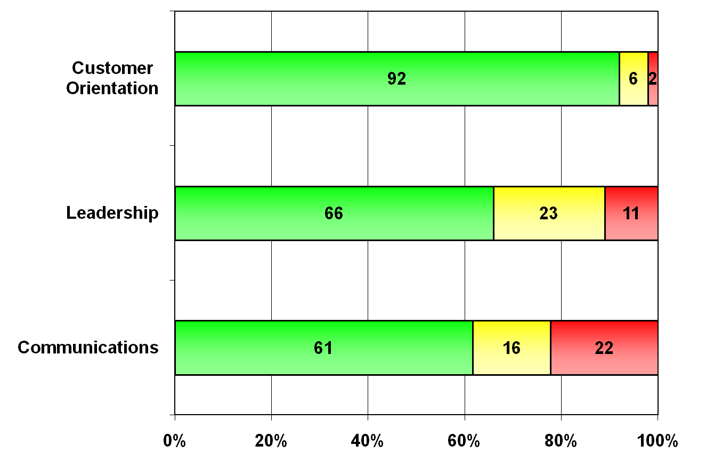
Input - Major Dimensions
Overall Agreement, Neutral, and Disagreement
*Note: Taken from CUNY campus community survey
Change from 2008, % Agree
+2
+10
+9

Slide 60
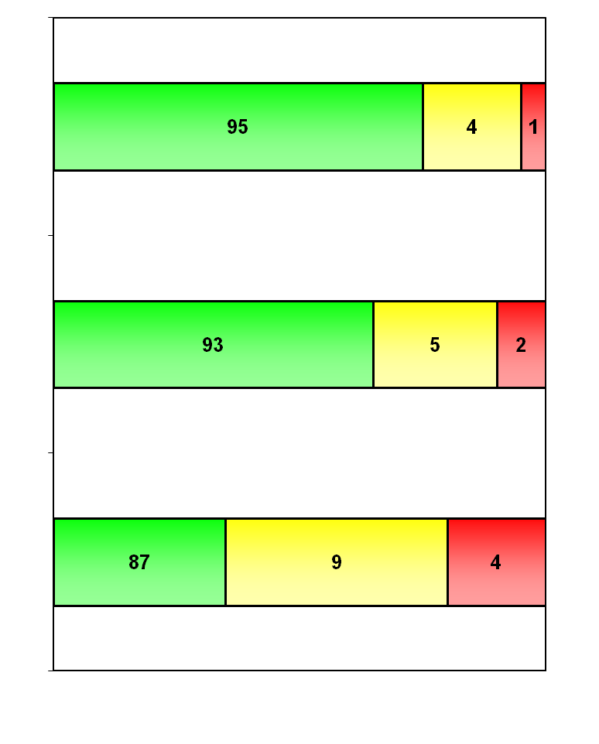
Customer Orientation
Team Tries to Satisfy
Change from 2008, % Agree
5b. In my work group, we try hard to satisfy our customers
+1
5a. In my work group, we have a good idea of how to satisfy our customers
0
7b. My colleagues and I often work as a team
+5

Slide 61
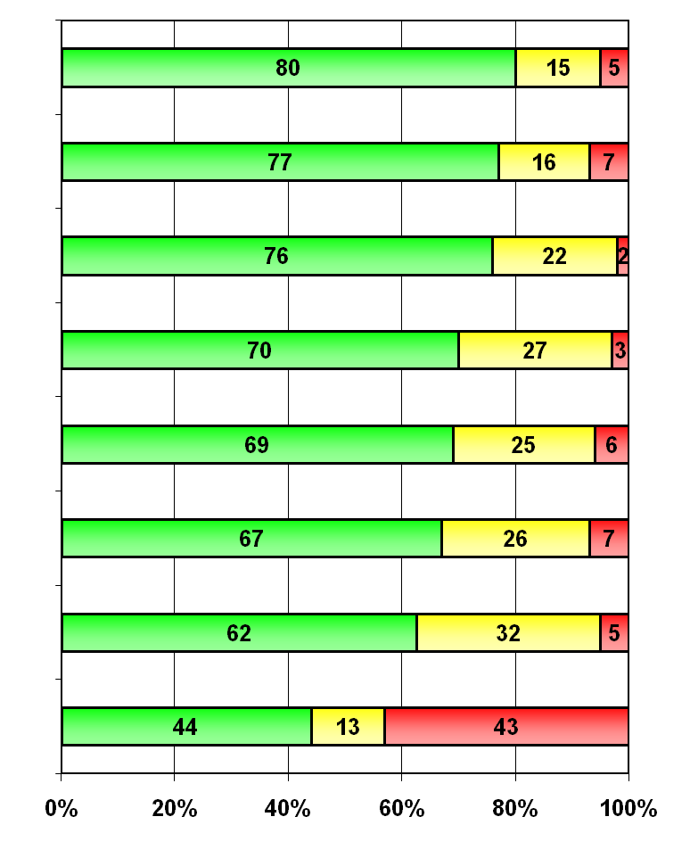
Community Survey - Leadership
Growing Majority are Positive
Change from 2008, % Agree
3h. I believe my immediate supervisor/manager has been (or will be) willing to allow me to take part in CUNYfirst planning and training activities.
n/a
Subhead here
  Next subhead here
    Next subhead here
      Next subhead here
        Next subhead here
3g. I believe my immediate supervisor/manager will commit the time and energy to make CUNYfirst succeed.
+9
3b. My Senior Campus Leadership is committed to the success of this project.
+13
3a. My Senior Campus Leadership is eager to move forward with CUNYfirst.
+11
3d. I am confident that my Senior Campus Leadership can guide us to success.
+7
3e. My Senior Campus Leadership understands the effects CUNYfirst will have on our organization.
+10
3c. My Senior Campus Leadership will remove any campus barriers which could cause project failure.
+7
3f. I have attended staff meetings or planning sessions about the CUNYfirst implementation in my work unit.
+16

Slide 62
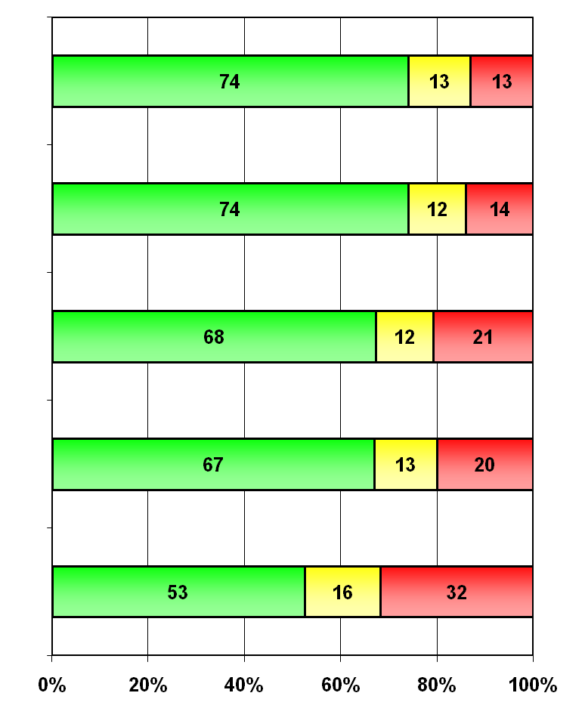
Communication
Improved Understanding of Program
Change from 2007, % Agree
1a. I have a good understanding of what CUNYfirst is trying to achieve.
+10
1f. My information on CUNYfirst comes mostly from management or official sources, not from gossip or the informal “grapevine”.
+4
1e. I know whom to contact if I want more information about the CUNYfirst on my campus.
+8
1b. I have received information from my campus CUNYfirst team for my campus.
+8
1g. I have looked at the CUNYfirst website (http://first.cuny.edu).
+18

Slide 63
Change Readiness Index

Slide 64
CHANGE READINESS INDEX
CUNY’s needs developed for a tactical assessment tool
  Measured critical success areas
  Developed meta questions and survey questions informed by initial wave (vanguard) experience
  Measured multiple levels of organization
  Quantitative, qualitative and staffing ratios included
Results shared first with campuses, later with project
By making it tactical, mitigations plans easily suggested

Slide 65
CRI - AREAS
Business Ownership - Is everyone prepared to do their part to support CUNYfirst with as little resistance as possible? More importantly is it understood that the success or failure of the implementation is the campus’ responsibility and that they own the outcome?
Coordination - Are cross-functional teams cooperating to redesign processes or are people siloed and turf conscious? Is BARFIT coordinating with one another and leveraging common resources?

Slide 66
CRI - AREAS
IT Ownership - Is the campus owning their part in ensuring that data, reports, and systems are fully integrated and prepared for CUNYfirst? Are end-user support mechanisms in place and has the data landscape been prepared for launch?
Knowledge Management - Is the campus preparing their processes, training, and knowledge sharing to support the CUNYfirst launch? Do they know how their organization currently functions, how it will function with the CUNYfirst system, and what the differences will be?

Slide 67
CRI - Areas
Leadership - Does the VP level understand the urgency for change and fully support it? Are managers empowered to make decisions? Is behavior in support of the change rewarded?

Slide 68

Change Readiness Index - Dashboard
Staff Measurement:
BARFIT (Bursar, Admissions,
Registrar, Fin Aid and IT) to
student ratio Z scores.

Slide 69
Less Effective Tools for Monitoring Change
Organizational Readiness Checklists (for each individual campus to use)
  Self reported
  Not all task tied directly to change success
Project plan based organizational readiness dashboards (aggregate of campus status)
  Also not always tied to change success
  Did not allow for nuances between schools
  Not culturally effective – Higher Ed is seldom PMBOK or PMP oriented

Slide 70
Organizational Readiness Checklist - Sample

Slide 71
CUNYfirst Project Status Update - Sample
Pillar Project Indicators
Campus Solutions
HCM
Financials
Technology
Hosting
Help Desk
Overall Program Assessment
Overall Program assessment summary
See pages xx for Plan Delayed and 30-Day Deliverable Status Section
Pillar Status Overview (Critical Points Driving Indicators)
Campus Solutions:
Technology:
Portal
Long-term identity management solution
Conversion
Development
Integration
Help Desk (Phase 1b):
Hosting:
Human Capital Management (HCM):
HR
Base Benefits
Payroll Integration
Financials:
General Ledger
Planning and Budgeting

Slide 72
Lessons Learned:
Expectations / Culture Change
Enhanced communications on what to expect on Go-Live
Enhanced communications on post Go-Live status
Communication regarding “No Training – No Access”
Communication regarding “Hosted vs. Home Environment”

Slide 73
Ongoing Transformational Change Considerations for CUNYfirst
Transformational Change activities are needed to enable CUNY to successfully move from its current structure and processes to the future CUNYfirst-enabled processes and structure by:
Addressing project risks, not changing CUNY’s culture
Identifying ongoing people risks and addressing them early
Driving CUNY leadership to consensus on key issues
Emphasizing stakeholder communication events to drive understanding and acceptance
Assessing organizational acceptance of the CUNYfirst system
Anticipating and addressing organizational implications

Slide 74
Upcoming Transformational Change Activities To Address Challenges
Assist CUNYfirst system users in understanding what will change for them and how they will be supported before and after go-live:
    Impact assessment
    Role mapping
    Policy changes
    Training
    Post-implementation support – includes support from help desk, campus super users, campus-specific transition centers, and ongoing communications
Work with CUNY leadership collectively to address ongoing considerations during the ERP implementation

Slide 75
Lessons Learned: Communications
Evaluate internal communication
  Barriers?
  Who has clout?
  Channels?
Avoid Spin
Engage front line staff
Let students tell you how to communicate with students

Slide 76
Lessons Learned: Academic Integration
Truly engage the Academic side of the house from the beginning
Even if the process is owned administratively, review with the Academic community (and listen)
Provide regular timely updates at multiple levels
Plan time for any changes that involve governance (course numbers, grade policy, etc.)
Make sure the initial elements add value and work well – or you will pay the price

Slide 77
Lessons Learned: Training
Make business decisions earlier so training material is ready
Provide refresher training
Define training “audience” early in the cycle
Reporting tools may require customized training
Provide multiple delivery modes

Slide 78
Lessons Learned: Managing Change
Survey instruments can measure “the pulse” of a large organization’s strengths and weaknesses
A more focused tool, a change index, can be an effective intervention to foster change in targeted populations
Not all measurements yield actionable intervention
“anyone who has never made a mistake has never tried anything new” (Albert Einstein)

Slide 79
Final Thoughts
ERP implementations in higher education require understanding and engagement of the academic community
“It’s about improving the student experience” is a key communication and planning mantra to gain support
To achieve a learning organization, training needs to be continuous
A vision of academic excellence supported by updated technologies can bring about transformation in higher education

Slide 80
Questions & Answers twitter hash - #E11_SESS063
Dr. Linda Shatzer
  Change Management Manager
  E-mail: linda.shatzer@cuny.edu
Jim Russell
  Academic Integration Manager
  E-mail: jim.russell@cuny.edu
Adante Harvey
  Training Manager
  E-mail: adante.harvey@cuny.edu
John Ray
  Communications Manager
  E-mail: john.ray@cuny.edu

Slide 81
THANK YOU

