Slide 1
EDUCAUSE 2011
Three Paths, One Goal: Three Institutions’ Journey with Providing and Supporting Mobile Technology
Emporia State University
The Faculty & Staff Support Perspective
Cory Falldine (Director, User Support Services)

Slide 2
Copyright Christopher Falldine 2011. This work is the intellectual property of the author. Permission is granted for this material to be shared for non-commercial, educational purposes, provided that this copyright statement appears on the reproduced materials and notice is given that the copying is by permission of the author. To disseminate otherwise or to republish requires written permission from the author.

Slide 3
Background & Overview
Around 6,000 Students
1,000 Employees (FTE & PTE)
Mostly Centralized IT

Slide 4
Centralized IT
(…but with Decentralized IT Asset Mgmt.)
IT included in Acquisition Oversight
Manage through Guidelines, Device Configuration, and Training
Primarily a PC Campus (90/10)
Before iPads, mobile devices consisted of Blackberries

Slide 5
Existing Support Strategy
University-Owned vs. Personally-Owned
Full Support (and acquisition requirements) for University-Owned
Limited Support for Personally-Owned

Slide 6
Mobile Support Strategy
Mobile Access to Primary Systems/ Services
Building Support Structure Around Most Popular Mobile OS
Mobile Device Guidelines Framework to Fit New Devices (Template)

Slide 7
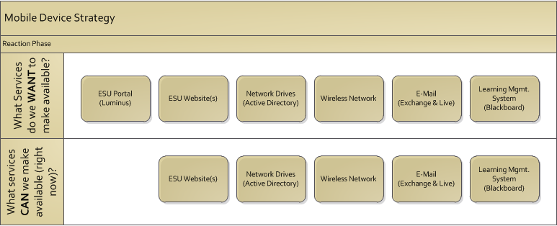
Mobile Support Strategy
Starting from Scratch:
First thing’s first, we’ve got to get it written down.
Which services need to be available from a mobile device?
What services can we make available right now?

Slide 8
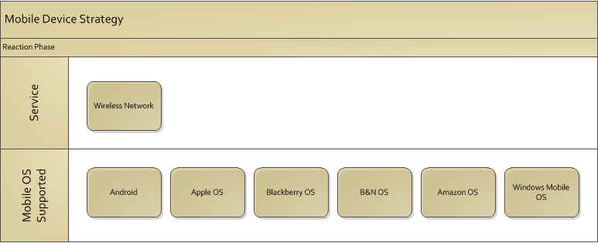
Mobile Support Strategy
Starting from Scratch:
Which OS’s can be supported for each service right now?
Example above for ESU Wireless Network service

Slide 9
Mobile Device Guidelines
Overview Includes –
What Constitutes a Mobile Device
Contracts (3G, etc.)
Security & Encryption (incl. Lost/Stolen Devices)
Purchasing the Device
Configuring the Device
Personal v. Business Use
Classroom & Checkout Use

Slide 10
Apple OS Device Guidelines
Choosing Your Device
Mobile Contracts
Setting up an iTunes Account
Downloading/Purchasing Apps (VPP or Unreimbursed)
Configuring Device (including Lab, Classroom, and Checkout Use)
Syncing/Backing Up Device

Slide 11
Mobile Device Support
1. Mobile Device Support Guidelines
2. Mobile Device Support Website(s)
3. Mobile Device Support Training
4. Mobile Device Configuration & Support

Slide 12
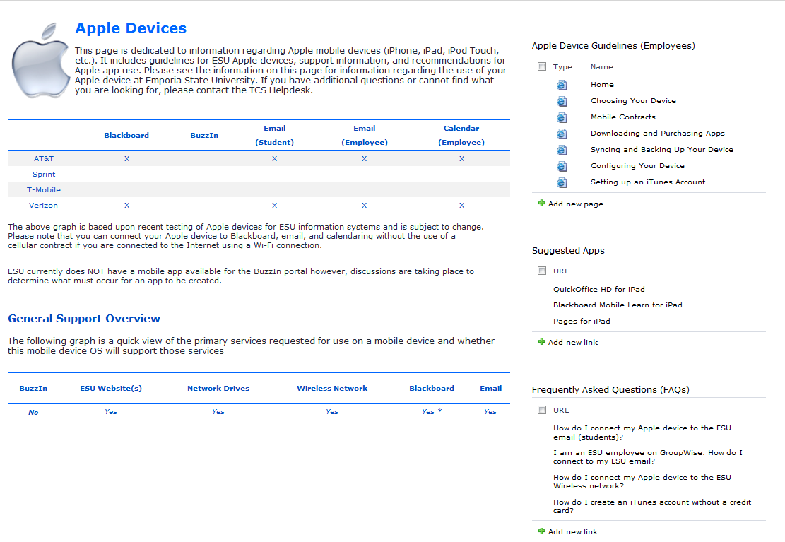
Mobile Device Support
Example of Mobile Device Support page for Apple Devices

Slide 13
Moving Forward
Assist the ‘other sides of the IT house’
Continue to leverage framework for new mobile devices
Engage Colleges & Departments
Continued evaluation of potential MDM solution(s)

Slide 14
Questions?
Cory Falldine
Emporia State University, Emporia, KS
Don Silvius
Shenandoah University, Winchester, VA
Mike Davis
Bentley University, Waltham, MA

