Slide 1
Updating the Value Proposition:
Using Services to Define Your IT Organization
Mark Askren – CIO, University of Nebraska – Lincoln
Kimberly Harper – Director of Portfolio Management, University of Nebraska – Central Administration

Slide 2
Higher Ed IT in Crisis?

Slide 3
Change or Fade Away…
Short-term…
Long-term…
education
research
outreach
budget cuts
SERVICES ORIENTED

Slide 4
Choosing Change
Understanding
Alignment
Efficiency
Collaborative
Strategic planning
Decision-making
Relevant
Improvement

Slide 5
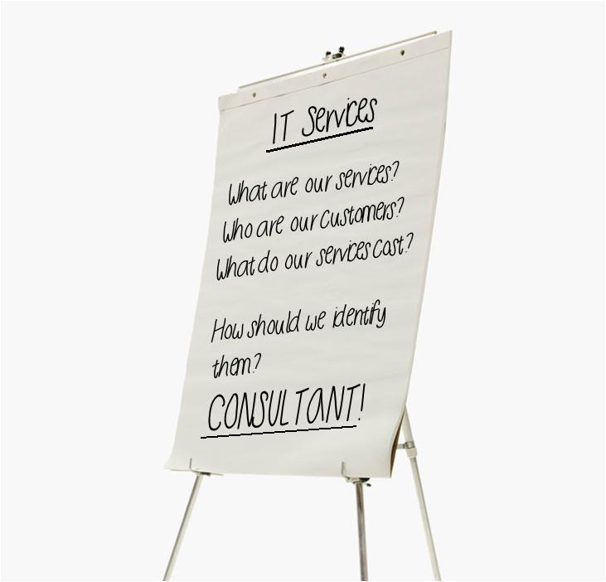
An Approach: Services Inventory

Slide 6
An Approach: Services Inventory
CSN
UNL
Data Management & Analytics
E-Mail, Communication & Collaboration
Hardware & Software Support
Data Management & Analytics
E-Mail, Communication & Collaboration
Hardware, Hosting & Storage
Internet & Network Connectivity
IT Governance & Service Management
User Access & Security
Internet, Phone & Network Communications
IT Governance & Service Management
User Access & Security
User Training & Community
User Training & Community
Enterprise Information Systems
Printing, Forms & Output Management
Web Development Support
Classroom, Lab & Instructional Resources
Consulting & Project Management
Development, Integration & Support
Infrastructure Hosting
Technology Innovation Support
Technology Sales & Repairs

Slide 7
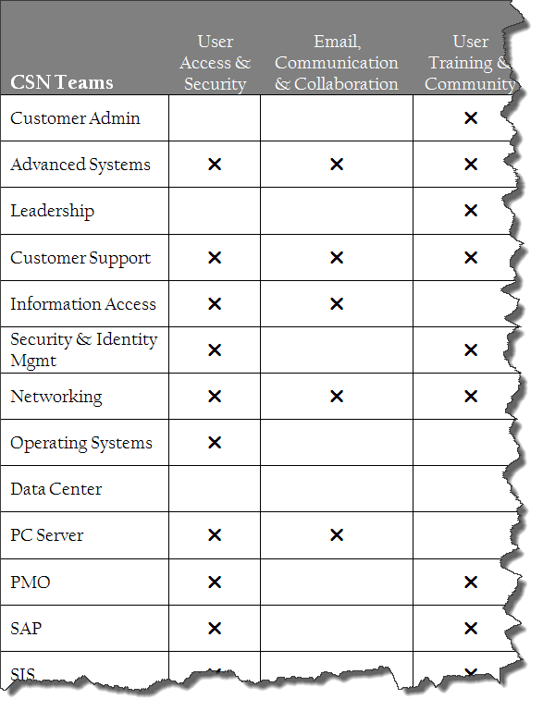
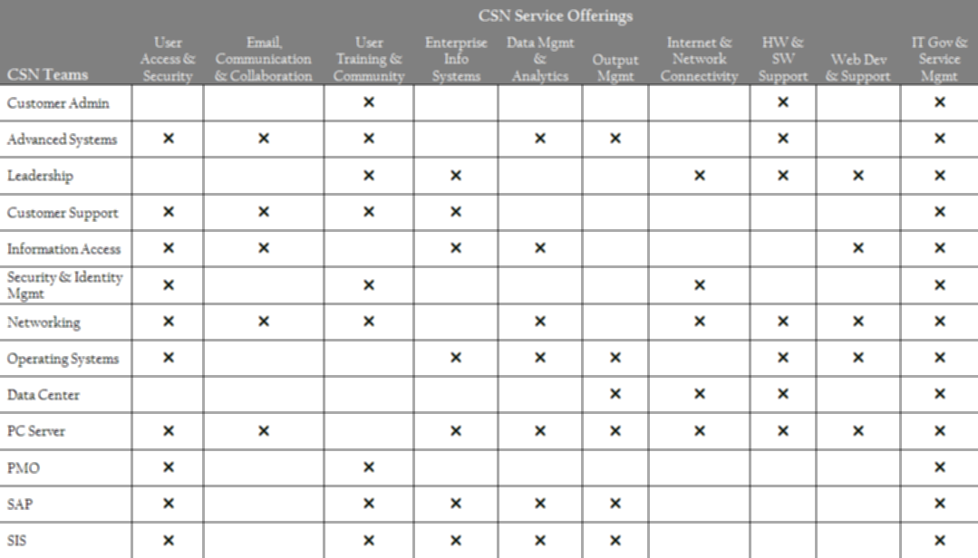
An Approach: Services Inventory
Different Perspective
Cross-functional contributions vs. “Silo” thinking

Slide 8
The Key Lessons Learned
Services-orientation is a more effective value definition
Service inventorying & management is a long-term commitment
And then there are the….
Service decisions have wide-spread implications
CHALLENGES

Slide 9
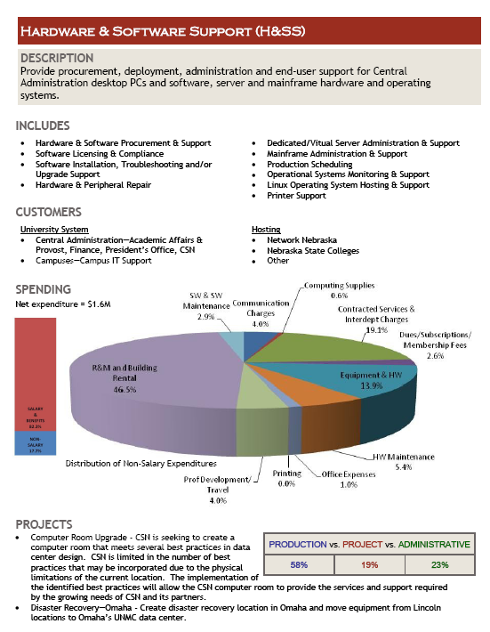
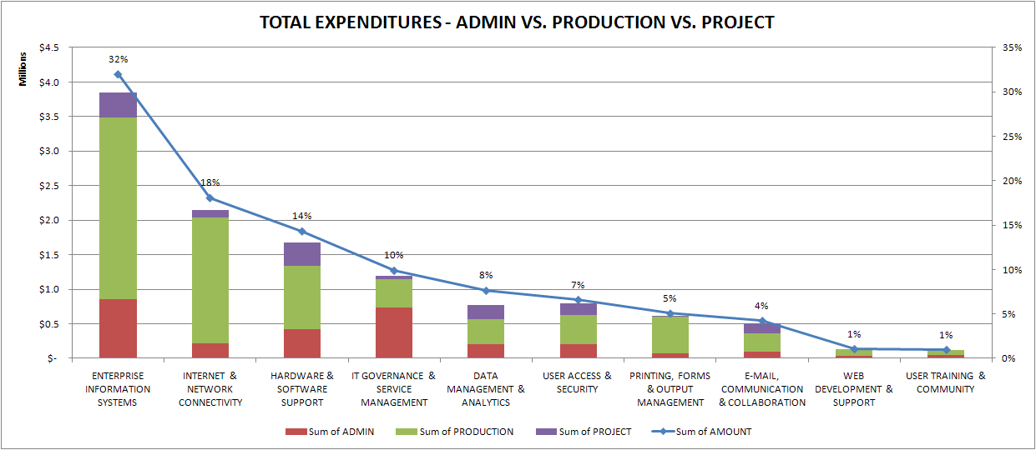
Positive Outcomes
Communication with Leadership

Slide 10
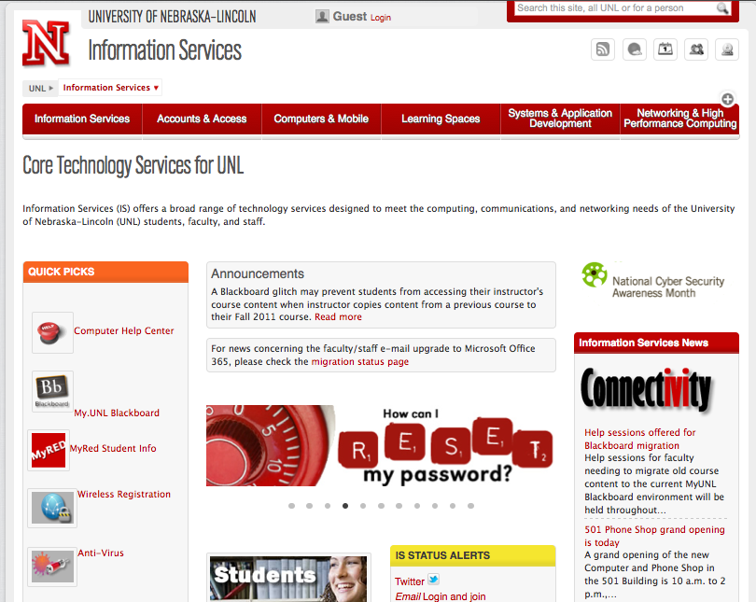
Positive Outcomes
Communication with Customers

Slide 11
Positive Outcomes
Collaboration
Efficiency

Slide 12
Positive Outcomes
Decision Making
Strategic Planning

Slide 13
Going Forward
Commodity services costs
Change Agent
Explain value
Align resources
Customer feedback
Service catalogs & request processes

Slide 14
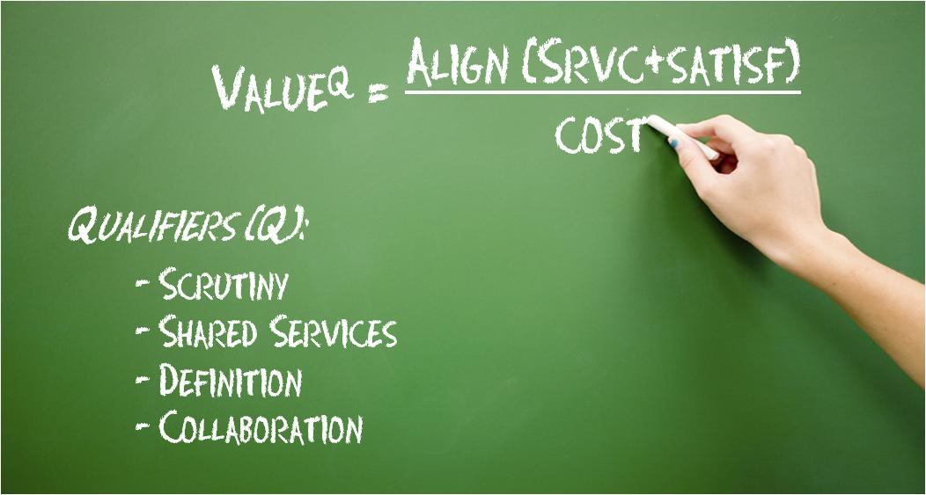
The Updated Value Equation

Slide 15
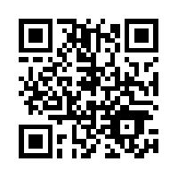
Contact Information
Mark Askren
maskren2@unl.edu
Kimberly Harper
kkharper@nebraska.edu

