Slide 1
Data Security:
It’s All About the Desktop
EDUCAUSE 2011
Philadelphia, PA
October 20, 2011

Slide 2
Bret Ingerman
Vice President for Computing and Information Services
Vassar College
Poughkeepsie, NY
ingerman@vassar.edu

Slide 3
Agenda
A little about Vassar
Why are we talking about this?
Our experiences
Definitions
Legal considerations
Policy development
Technologies
Questions / Comments

Slide 4
A LITTLE ABOUT VASSAR

Slide 5
Vassar College
Founded in 1861
  Sesquicentennial year
Highly selective, residential, coeducational liberal arts college
  Poughkeepsie, New York
  Hudson Valley
2,450 students
947 employees
  290 faculty
1,000 acres
100+ buildings

Slide 6
Computing and Information Services (CIS)
All technology:
  Academic Computing Services
  Administrative Information Services
  Networks, Systems and Telecommunications
  User Services
    Media Resources
    Card Office (ID card, door access, dining, video security, off-campus merchants)
    Computer Store
44 staff
  No formal information security position

Slide 7
WHY?

Slide 8
Data Security
Data Breach

Slide 9
Government Accountability Office
Although there is no commonly agreed-upon definition, the term “data breach” generally refers to an organization’s unauthorized or unintentional exposure, disclosure, or loss of sensitive personal information, which can include personally identifiable information such as Social Security numbers (SSN) or financial information such as credit card numbers.
– http://www.gao.gov/new.items/d07737.pdf

Slide 10
Data breaches at educational institutions
http://www.adamdodge.com/esi/

Slide 11
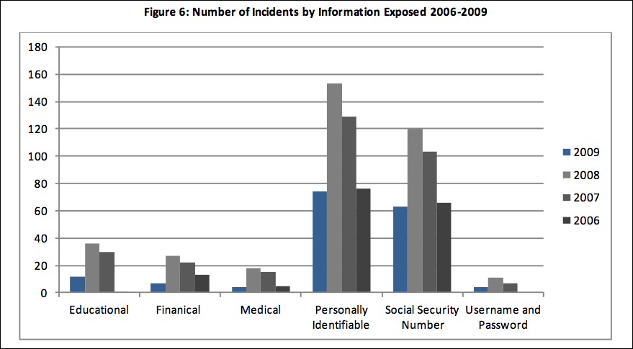
Data breaches at educational institutions
[Financial]
http://www.adamdodge.com/esi/

Slide 12
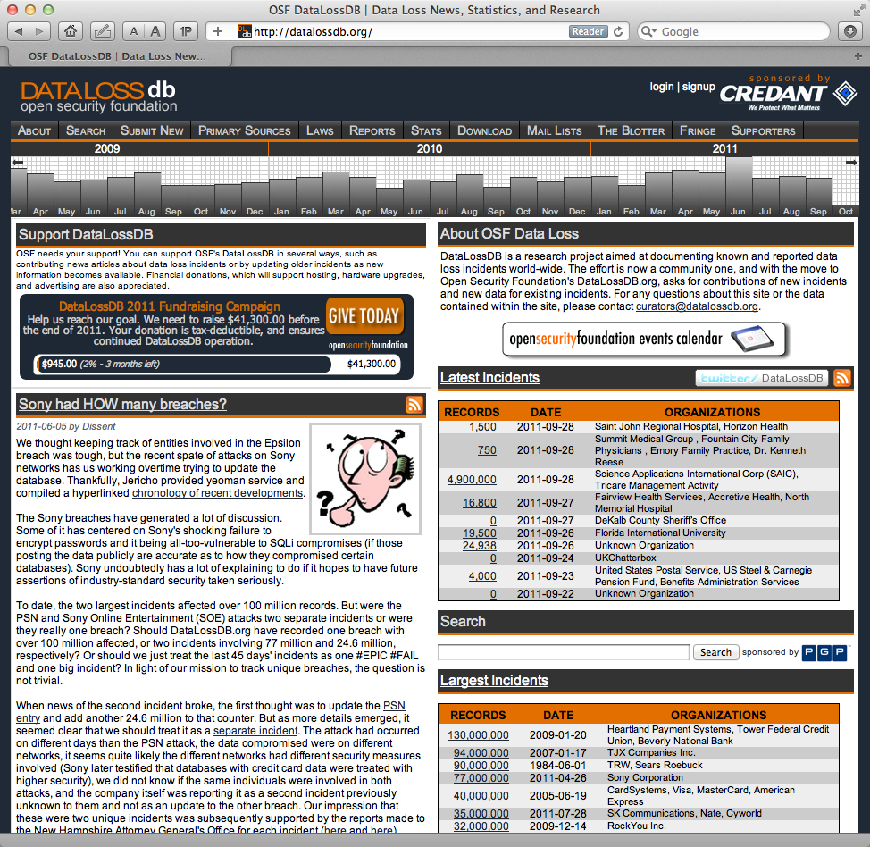
http://datalossdb.org/

Slide 13
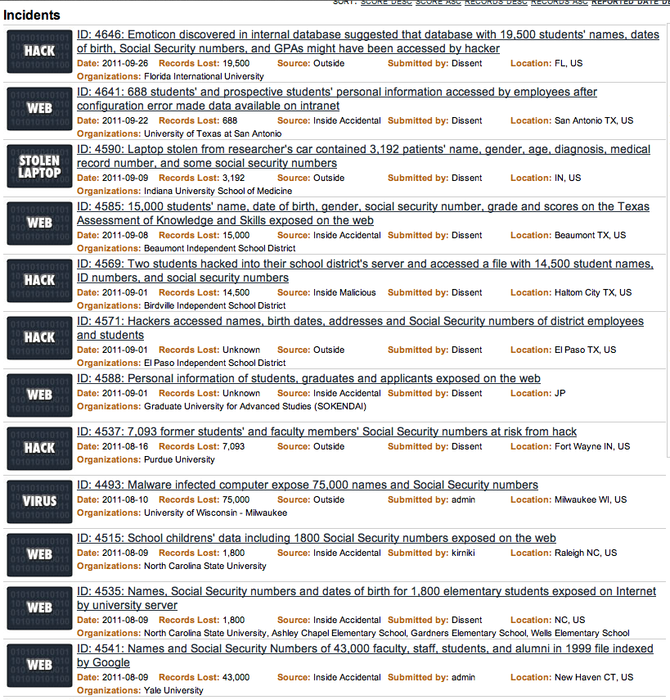

Slide 14
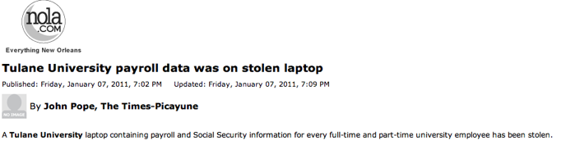

Slide 15
The computer was inside a briefcase in the locked automobile of a Tulane employee who was travelling outside New Orleans…
The employee had been processing tax records during the holiday break…

Slide 16
Our experiences

Slide 17
DEFINITIONS

Slide 18
Definitions
PII
  Personally Identifiable Information
  Defined by law (more in a minute)
CI
  Confidential Information
  Defined by local custom / practice
Data Custodian
  The specific person responsible for collecting, maintaining and safeguarding specific pieces of PII or CI
  Specific duties
    Who
    Why
    What

Slide 19
United States Government Accountability Office :
PII is: “…information that can be used to locate or identify an individual, such as names, aliases, Social Security numbers, biometric records, and other personal information that is linked or linkable to an individual. Loss of such information may lead to identity theft (the wrongful obtaining and using of another person’s identifying information in some way that involves fraud or deception, typically for economic gain) or other fraudulent use of the information, resulting in substantial harm, embarrassment, and inconvenience to individuals.”
http://www.gao.gov/new.items/d08343.pdf

Slide 20
LEGAL CONSIDERATIONS

Slide 21
Breach laws
Define PII and…
  your responsibilities to safeguard PII
  your requirements after a breach
Need to understand existing breach laws
  Federal
  State

Slide 22
Breach laws
Federal data breach law
There is none!

Slide 23
Breach laws
State data breach law
  Forty-six states, the District of Columbia, Puerto Rico
  and the Virgin Islands
    Alabama, Kentucky, New Mexico, and South Dakota have no such laws (as of 10/12/2010)
      National Conference of State Legislatures : http://www.ncsl.org/default.aspx?tabid=13489
  Differ on
    Definition of PII
    Encryption
    Safe haven
    Deletion
    Threshold for notification for breach
  Each applies to their residents

Slide 24
Breach laws
A real nightmare
  For the Class of 2011 at Vassar…
40 different state laws could apply

Slide 25
New York State Breach Law
An individual’s unencrypted personal information* + 1 or more of the following:
- Social security #
- Driver’s license number or non-driver ID
- Account number, credit or debit card # + security code, access code or password which permits access to an individual’s financial account
* any information concerning a natural person which, because of name, number, personal mark, or other identifier, can be used to identify such natural person
http://www.cscic.state.ny.us/lib/laws/faq.cfm

Slide 26
POLICY DEVELOPMENT

Slide 27
Policy development
Define what you consider PII
  Federal guidelines
  State guidelines
Vassar’s definition
  From NYS definition
    Social Security Number
    Drivers License Number or other non-driver ID
    Account number, credit or debit card number + security code, access code or password which permits access to an individual’s financial account
  From other states
    Date of birth
    Mother’s maiden name

Slide 28
Policy development
Define what you consider CI
  Institutionally specific
Vassar’s definition
  “…information that, while not defined as PII, nevertheless should not be shared with others without a specific academic or businesses reason to do so.”
  Examples
    gift and donor information
    salaries
    performance appraisals
    tenure/promotion review materials
Protect at same level as PII?

Slide 29
Policy development
Develop a policy to manage and safeguard PII / CI
Engage senior administrators
  Explain to them the risks of a breach
  Remind them about the newspaper headlines
Board of Trustees
  Technology Committee Audit Committee
Create a Data Custodian Group
  HR Dean of Faculty
  Registrar Alum. Affairs & Development
  Admissions Financial Aid
  Health Services Security and Safety
  Nursery School Faculty Housing
  Controller CIS
This is a team effort

Slide 30
Over
Simplified PII / CI policy
If you’re not the data custodian don’t collect it
If you need it ask for it
If you don’t need it you shouldn’t have it
If you do use it don’t store it (ask again)
If you must store it encrypt it / password protect it
If you do have it don’t share it
When you’re done with it securely delete it

Slide 31
Policy development
Surveyed custodians
  PII / CI that they collect & store
  Why they collect / store it
  How they collect / store it
Analyzing custodian data
Vassar policy in draft form
  Crafted with data custodians
  Shared with Senior Officers
  Discussed with Board of Trustees Technology Committee
  To be vetted by Counsel
Finalize policy (2011-12)

Slide 32
Policy development
Survey campus offices
  Determine what they store and why
  Determine what they need and why
Eliminate non-authoritative collection of PII / CI, and…
Limit number of offices that store PII / CI
  Dramatic culture shock
Protect what is stored
  Password
  Encryption
Two additional PII policies
  FTC “Red Flag” rules
  PCI DSS

Slide 33
TECHNOLOGIES

Slide 36
Secure administrator access
CIS needs to troubleshoot, repair, install, etc.
1,800 desktop computers
Administrator account
  Need password that is strong
  Need password that can be remembered by CIS staff
Same password
  Lose the password → compromise up to 1,800 computers
Different passwords
  1,800??
2-factor authentication

Slide 37
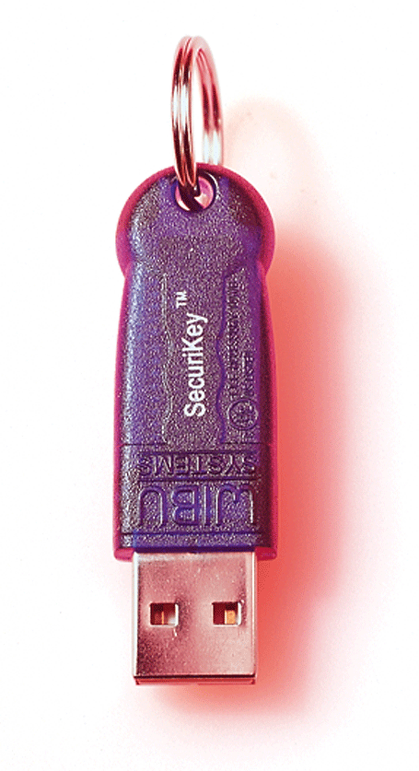
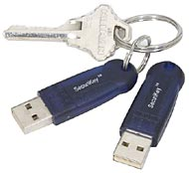
SecuriKey

Slide 38
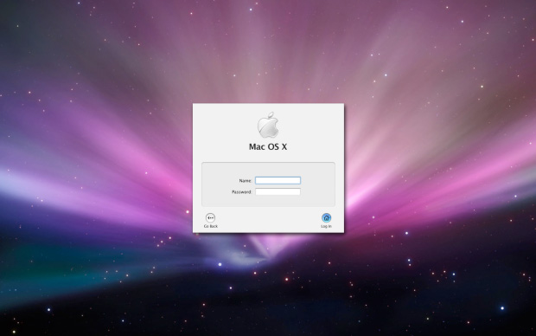
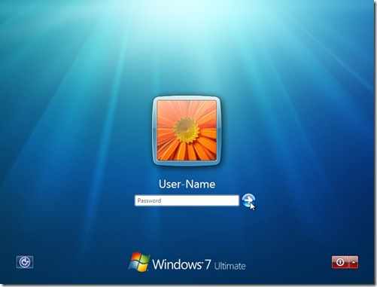
SecuriKey

Slide 39


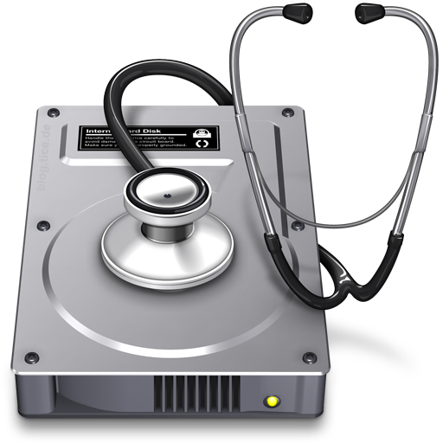
Redeploying computers
DeployStudio
7-Pass Erase
Disk Utility
DoD 5220.22-M
NATIONAL INDUSTRIAL SECURITY PROGRAM OPERATING MANUAL

Slide 40
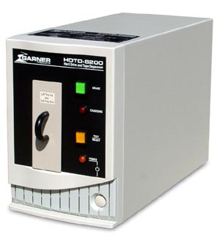
Redeploying computers

Slide 43
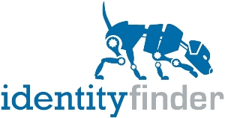
Identifying PII

Slide 44
IdentityFinder
Cross-platform
Searches local drives for
  Social Security Numbers
  Credit/Debit cards
  Passwords/PINs
  Bank account numbers
  Driver Licenses
  Dates of Birth
  Passport Numbers
  Mother’s Maiden Names
  …and much more

Slide 45
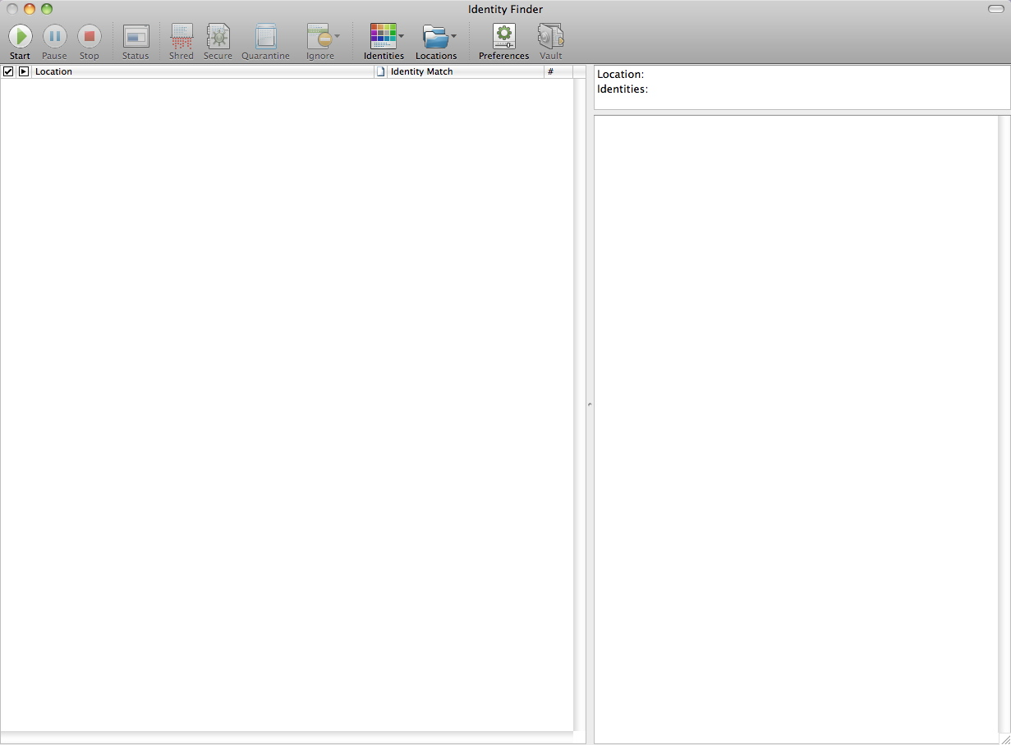

Slide 46
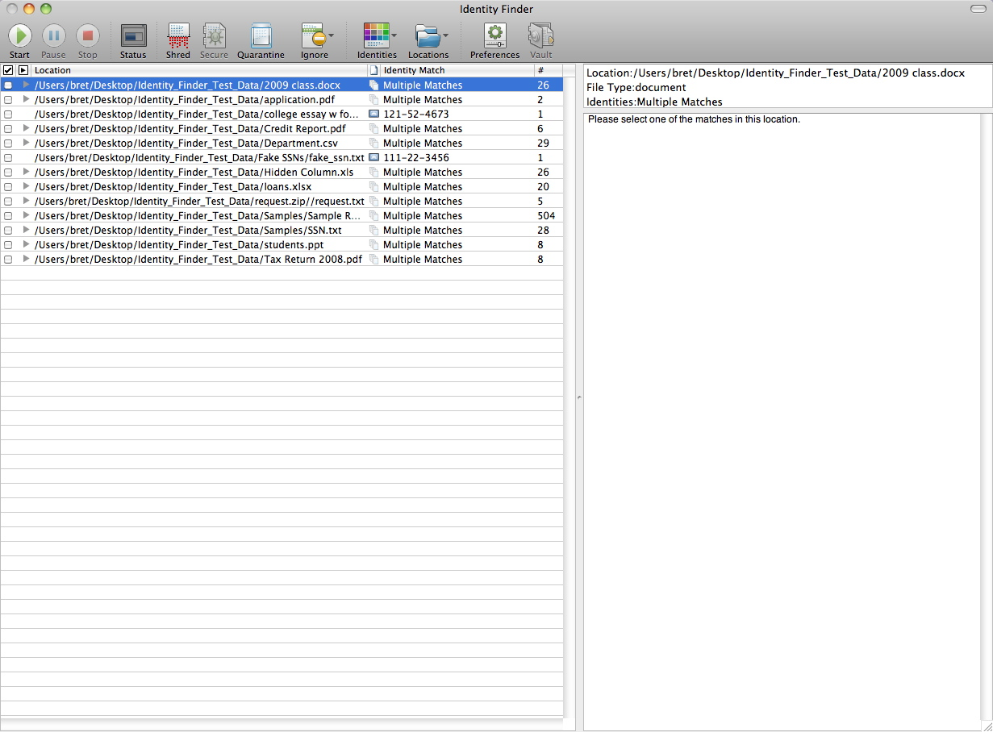
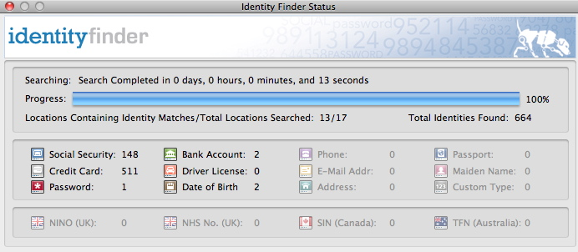

Slide 47
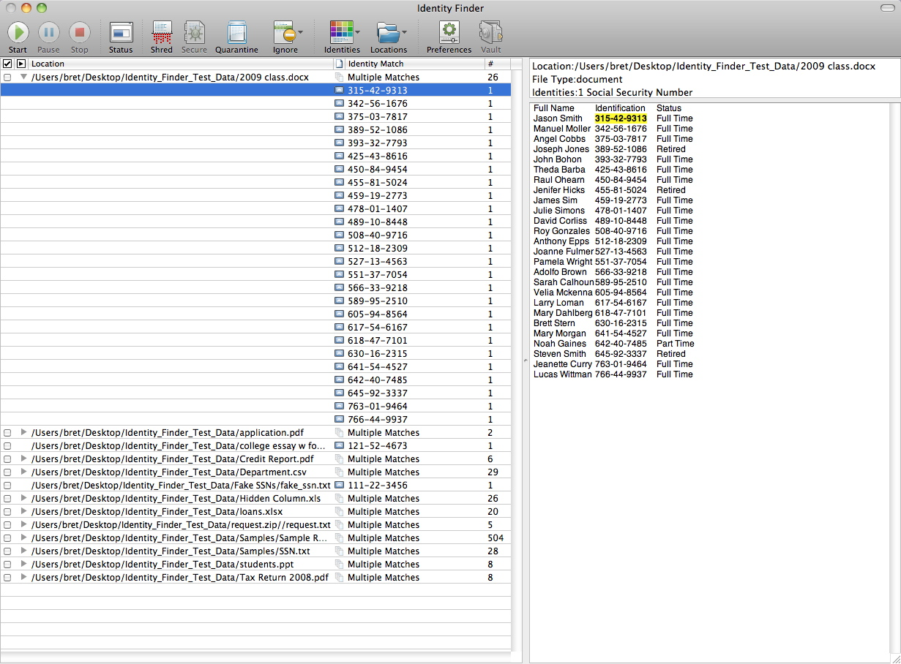

Slide 48
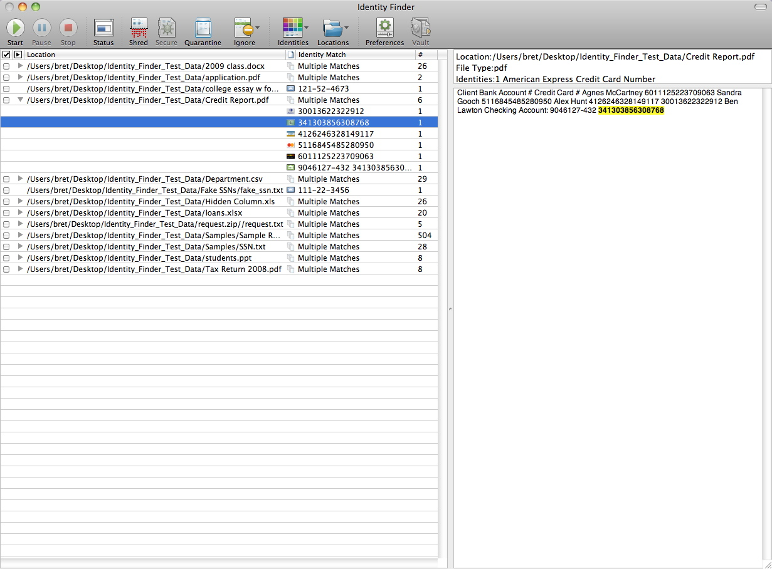

Slide 49
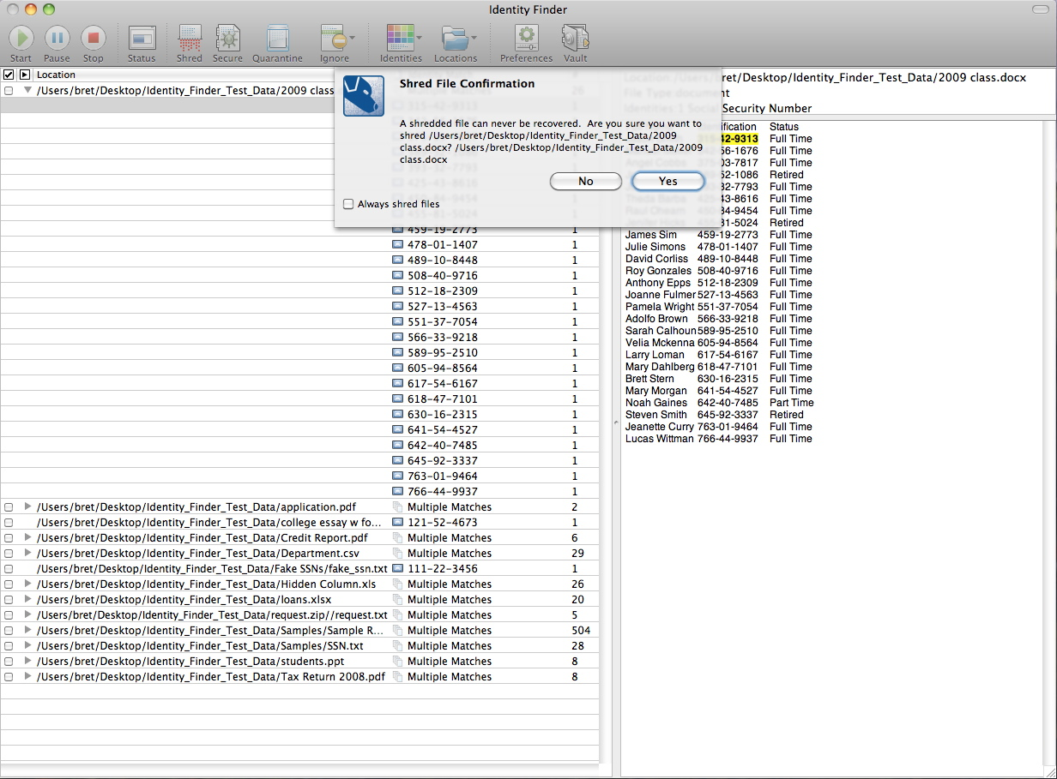

Slide 50
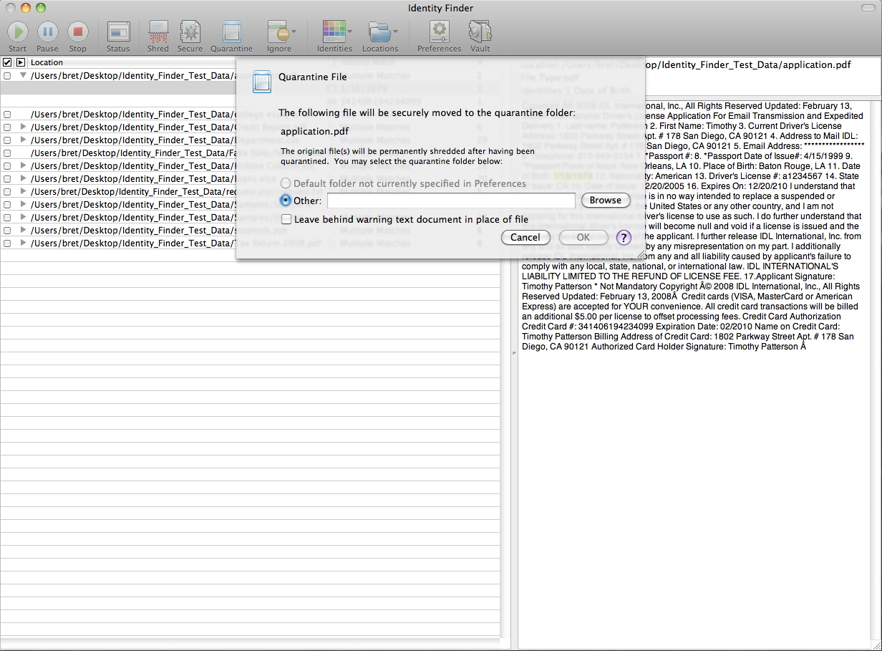

Slide 51
IdentityFinder
Test deployment: over 300 computers
Already removed…
  11,647 SSN
  2,176 Bank account numbers
  235 Passwords
  114 Credit card numbers
Campus-wide availability in November
Enterprise Console
  Reports that PII was found, not what was found
  Help clients eradicate PII
  “Teachable moment”

Slide 54

PII

Slide 55

Encryption
Whole Disk Encryption

Slide 57
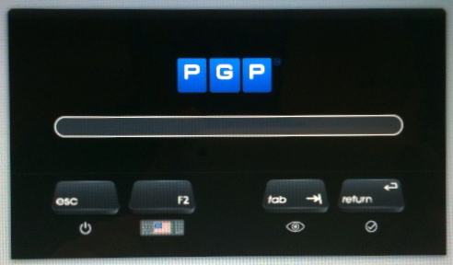

Slide 58


Problems

Slide 59
Problems
Pre-boot
  Does not work when in “sleep”
  Software failure = unable to boot
Lag behind OS updates
  Auto update
  OS X Lion (10.7) shipped: July 20, 2011
  Support for OS X Lion (10.7): September 23, 2011
Windows & Mac OS (x2) problems
  Needed to be visited by technician

Slide 60


New Solution (we believe)

Slide 61
Dell Data Protection
Cross-platform
Pre-boot if desired
Post-boot
  Works when in “sleep”
  Not affected by OS updates
Mobile devices
Cloud
  Dropbox
Enterprise Console
  This is critical!

Slide 62
New York State Breach Law
An individual’s unencrypted personal information* + 1 or more of the following:
- Social security #
- Driver’s license number or non-driver ID
- Account number, credit or debit card # + security code, access code or password which permits access to an individual’s financial account
* any information concerning a natural person which, because of name, number, personal mark, or other identifier, can be used to identify such natural person
http://www.cscic.state.ny.us/lib/laws/faq.cfm

Slide 65
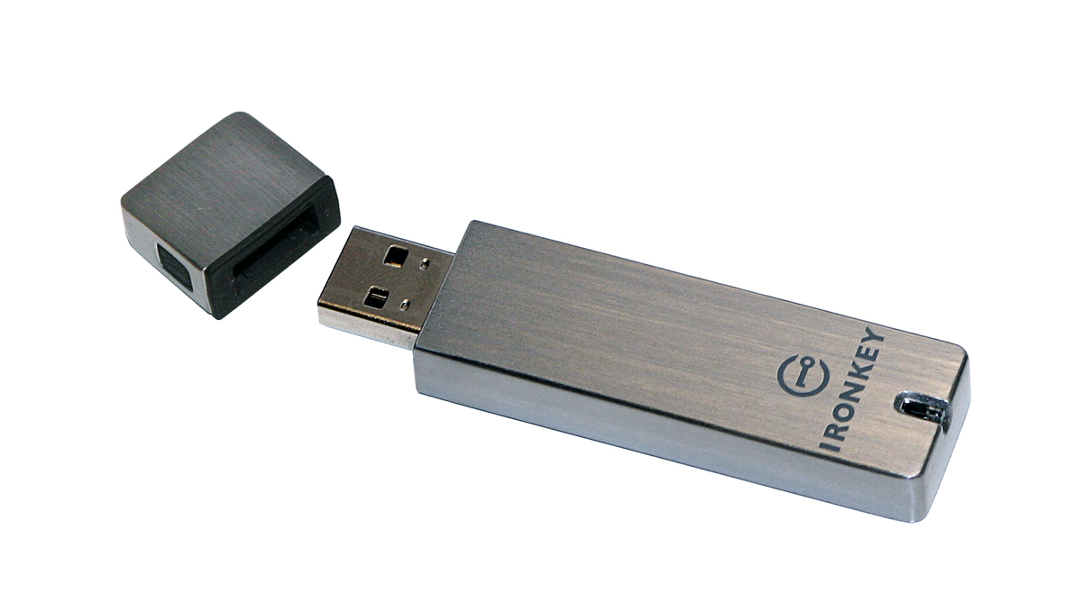
Secure mobile storage

Slide 66
IronKey
Department of Defense specs for Flash Media
  Encrypted
  Password counter
  Built-in control software
  Remote management
  Malware defense
  Tamper resistant
  Water proof

Slide 67
IronKey
Based on “best practices”
  Union College and Hamilton College
Initial deployment
  Crisis Response Planning Group
  Senior Officers
Contains
  Employee contact information
  Student contact information
  Student course schedules
  Teaching schedules by building, day of week, time of day
  Maps of each building
  Room for additional data (such as MSDS, aerial maps, etc.)

Slide 68
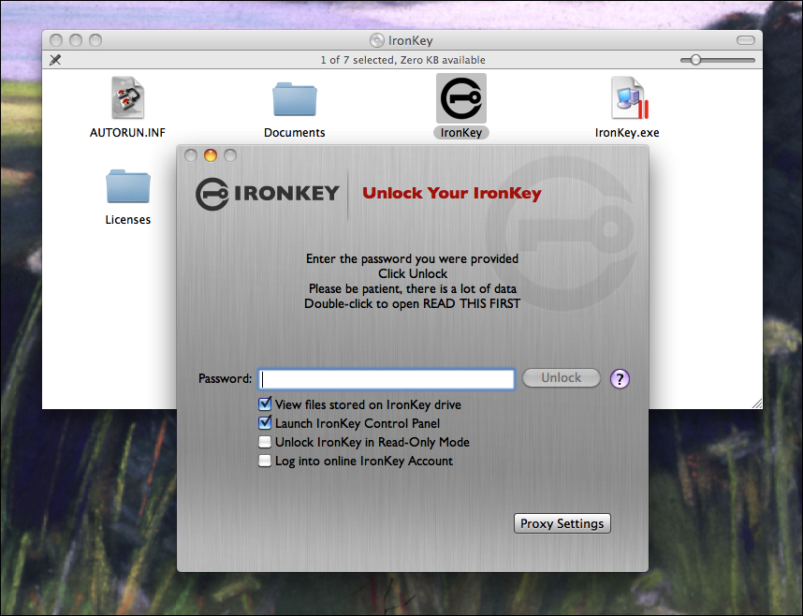

Slide 69
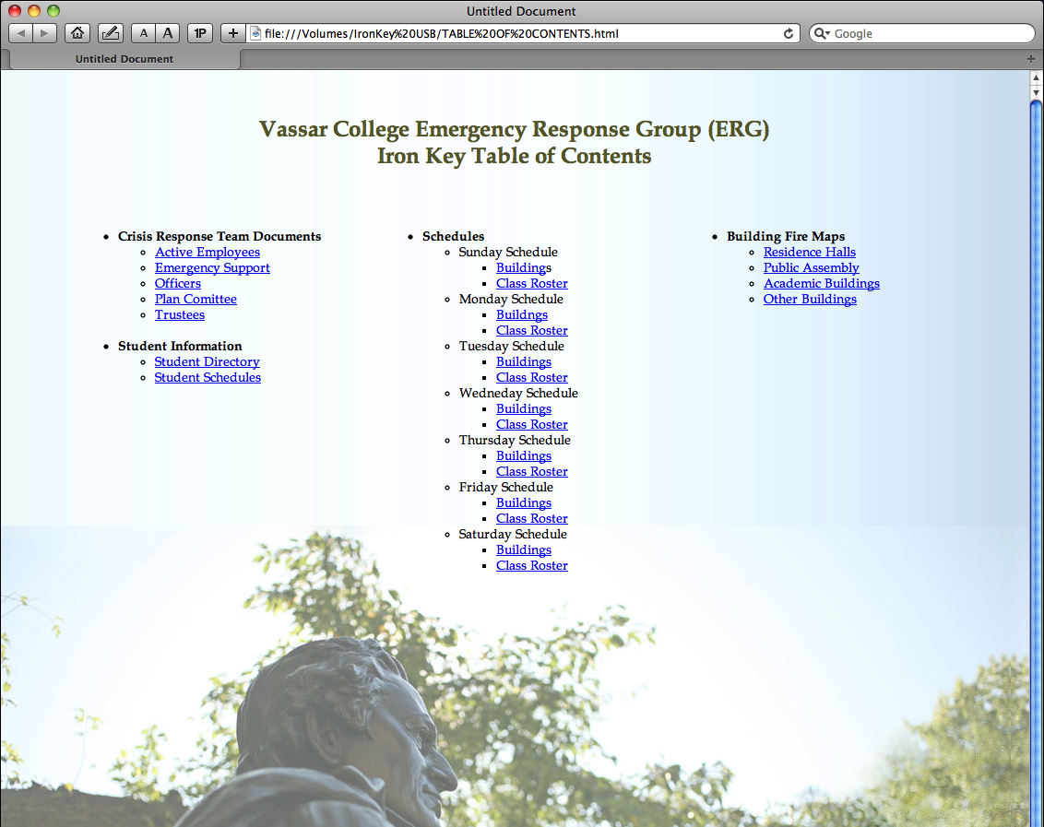

Slide 70
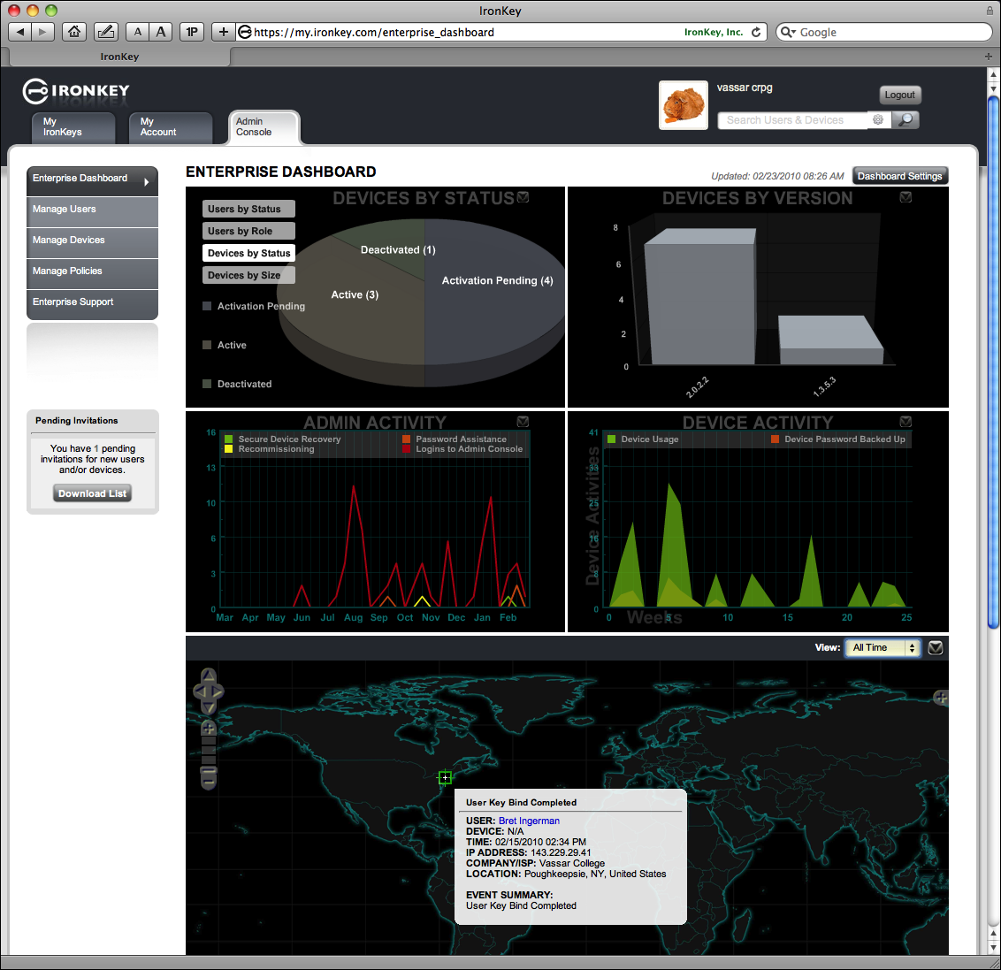

Slide 73

Cloud backup
X

Slide 74

Cloud backup

Slide 75
CrashPlan Pro-e
Cross-platform
Encrypted
Cloud and on-premises
  Multiple backup sets
Scheduled and real-time
Enterprise console
Local or web restore
It works
  251 users
  259 computers
  32 TB array on premises, monitored (8 TB used)

Slide 77
QUESTIONS? COMMENTS?

Slide 78
Thank You!
Bret Ingerman
ingerman@vassar.edu

