Slide 1
There’s a Party in Security and Everyone’s Invited!
Geoff Wilson
IT Security
University of Oklahoma

Slide 2
About OU
Located in Norman, Oklahoma
Public research institution
Founded in 1890
30,315 enrollment
  26,490 Norman
  3,854 OU HSC
  1,464 OU Tulsa
17,959 employees

Slide 3
Party Plan
Know if you are missing the party
Party foul example: malware infections
Making time for the party
Be the life of the party
Party favors

Slide 4
Security Incident Lifecycle
Proactive
Reactive
Detection
Triage
Analysis or other Response
Fix /
Resolution
Lessons Learned Feed
Proactive Processes & Strategy
Feeds
Communication & Outreach Strategy

Slide 5
Why balance is necessary
Reactive
Detection
Triage
Analysis or other Response
Fix /
Resolution
Incidents will happen. Are you able to react?
We must fix the problem this time around. We cannot leave problems lingering.

Slide 6
Why balance is necessary
Proactive
Lessons Learned Feed
Tough financial times require smart resource utilization.
Proactive measures often cost less than the incidents.
Free up time to work on bigger problems
Community effort can often ease your workload.
Proactive Processes & Strategy
Feeds
Communication & Outreach Strategy

Slide 7
Party Theme
Establish a healthy reactive-proactive balance so that you can build community.
Proactive
Reactive
Lessons Learned Feed
Detection
Triage
Analysis or other Response
Fix /
Resolution
Proactive Processes & Strategy
Feeds
Communication & Outreach Strategy

Slide 8
Party Plan
Know if you are missing the party
Party foul example: malware infections
Making time for the party
Be the life of the party
Party favors

Slide 9
Stuck in a reactive cycle?
Are you unable to invest time in community building or in staying up on the current trends in the industry?
Are you continually surprised by the incidents that face you?

Slide 10
Stuck in a reactive cycle?
Is the expected cost difference between continuing to react and implementing preventative measures unacceptable?
Is this type of event going to continue to be a problem?
Is not having a proactive process in place hurting how your team or department is perceived?

Slide 11
Party Plan
Know if you are missing the party
Party foul example: malware infections
Making time for the party
Be the life of the party
Party favors

Slide 12
Lifecycle of malware infection
Detection
Triage
Analysis or other Response
Fix /
Resolution
Malware infection alert
Examples
Hey Geoff, we’ve got a machine that looks like it’s infected. Can you take a look?
Symantec AV alert,
“W32.Waledac.B
2011-01-20 09:55:58
c:\windows\temp\_ex-08.exe”
REN-ISAC alert

Slide 13
Lifecycle of malware infection
Detection
Triage
Analysis or other Response
Fix /
Resolution
Determine if escalation is required
Examples:
Look in security logs to see if machine has generated other alerts
Look up the virus common name (e.g. Waledac.B) in Microsoft Malware Encyclopedia and other knowledge bases to see if it is a known data stealer, rootkit, or backdoor Trojan.
Ask field tech to perform a secondary scan of machine and email results back

Slide 14
Lifecycle of malware infection
Detection
Triage
Analysis or other Response
Fix /
Resolution
Costly analysis

Slide 15
Lifecycle of malware infection
Detection
Triage
Analysis or other Response
Fix /
Resolution
Rebuild (usually) or clean

Slide 16
Increase in Malware-Related Incidents
In late 2010 we saw a significant spike in malware-related incidents
Were we stuck in a reaction cycle?
Is the expected cost difference between continuing to react and implementing preventative measures unacceptable?
Yes, time lost in reaction cycle and
cost of negative impacts is high

Slide 17
Increase in Malware-Related Incidents
In late 2010 we saw a significant spike in malware-related incidents
Were we stuck in a reaction cycle?
Is this type of event going to continue to be a problem?
Yes, because root causes haven’t been addressed

Slide 18
Increase in Malware-Related Incidents
In late 2010 we saw a significant spike in malware-related incidents
Were we stuck in a reaction cycle?
Is not having a proactive process in place hurting how your team or department is perceived?
It will eventually if it hasn’t already

Slide 19
Increase in Malware-Related Incidents
In late 2010 we saw a significant spike in malware-related incidents
Were we stuck in a reaction cycle?
Are you unable to invest time in community building or in staying up on the current trends in the industry?
Yes, this is often the case

Slide 20
Increase in Malware-Related Incidents
In late 2010 we saw a significant spike in malware-related incidents
Were we stuck in a reaction cycle?
Are you continually surprised by the incidents that face you?
No, because of root-cause analysis understanding

Slide 21
Increase in Malware-Related Incidents
In late 2010 we saw a significant spike in malware-related incidents
Were we in a reaction cycle?
4/5 answers were, “yes,” so we were out of balance in a reaction cycle.

Slide 22
Party Plan
Know if you are missing the party
Party foul example: malware infections
Making time for the party
Be the life of the party
Party favors

Slide 23
Getting out of a reaction cycle
Reduce the time cost of reaction
Perform root cause analysis
Measure and analyze
Focus on lessons learned
Build community

Slide 24
Time Cost of Reaction
$$cost=cycles\left(d+t+e_{rate}\left(a+r\right)\right)$$
Detection
Triage
Analysis or other Response
Fix /
Resolution
Incoming Incidents

Slide 25
Time Cost of Reaction
$$cost=cycles\left(d+t+e_{rate}\left(a+r\right)\right)$$
Detection
Triage
Analysis or other Response
Fix /
Resolution
Incoming Incidents
Preventative measures can lower number of incoming incidents
However, they often take a while to
implement.

Slide 26
Time Cost of Reaction
$$cost=cycles\left(d+t+e_{rate}\left(a+r\right)\right)$$
Detection
Triage
Analysis or other Response
Fix /
Resolution
Making triage a defined process and automating where possible
Incoming Incidents
Reduce number of incidents escalated

Slide 27
Reducing triage time
Give front-line IT Pros more ownership of malicious software remediation
  Before: Field techs would always defer to us on infections to determine what was worthy of being escalated to IT Security.
  After: We are teaching field techs how to self-assess infections to determine if they are worthy of escalation
Minimize time of infection
  Multi-stage attacks are cut off before they become a threat to data

Slide 28
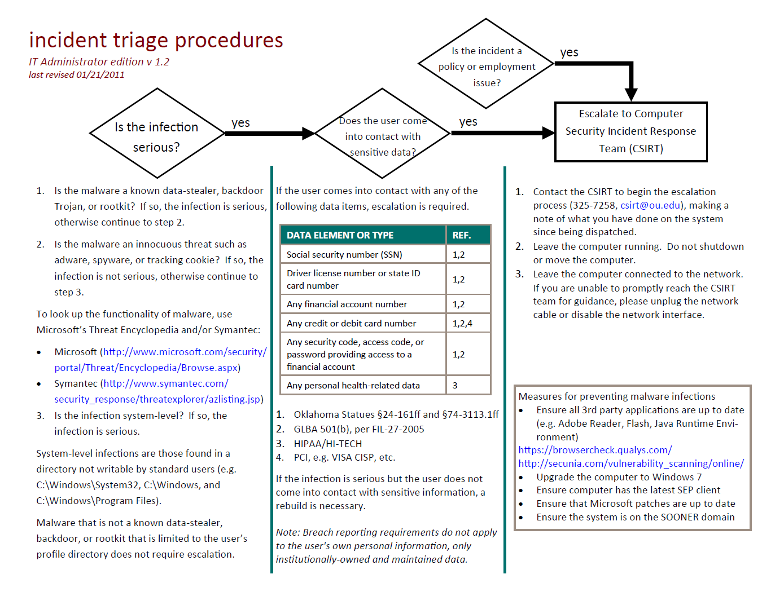


Slide 29
Time Cost of Reaction
$$cost=cycles\left(d+t+e_{rate}\left(a+r\right)\right)$$
Detection
Triage
Analysis or other Response
Fix /
Resolution
Incoming Incidents
This is often the most costly step

Slide 30
Reduce the time needed for analysis
Refrain from performing full analysis when:
  The system definitely does not come into contact with sensitive data
  The time of infection was minimal and network logs show no suspect flows
Train and empower others to perform the analysis
Automate the analysis where possible

Slide 31
Getting out of a reaction cycle
Reduce the time cost of reaction
Perform root cause analysis
Measure and analyze
Focus on lessons learned
Build community

Slide 32
Revealing the Root Cause
Five Whys
  Developed by Sakichi Toyoda and developed as part of the Toyota Production System
  “…by repeating why five times, the nature of the problem as well as its solution becomes clear.”^{[1]}
  For certain reactive incidents, ask “Why?” until the underlying problem surfaces.
  Most effective when done as a team
[1] Taiichi Ohno Toyota Production System: Beyond Large-Scale Production. (Productivity Press, 1988)

Slide 33
Five Whys
A sensitive machine became infected with a key logger.
WHY?
The computer became infected when the user was browsing Facebook
WHY did the computer become infected?
The user was running as admin
The computer didn’t have the latest Java patch
WHY?
WHY?
The IT administrator configured the user to run as administrator
WHY?
The user isn’t aware of the risk of not applying security patches
There is no centralized patch management solution
The IT administrator is not aware of the dangers of users browsing as administrator.

Slide 34
OU Initiatives from Root Cause Analysis
Generate buy-in (easier to do with a community)
Security awareness and training
Patch Management
Increased security controls for systems that handle sensitive data
Storing sensitive data in a centralized and controlled place
Targeted monitoring of systems

Slide 35
Getting out of a reaction cycle
Reduce the time cost of reaction
Perform root cause analysis
Measure and analyze
Focus on lessons learned
Build community

Slide 36
Measure and Analyze
Quantify your reaction cycle
  Why do we have a high number of incidents?
  What’s the trend?
  What’s the time lost on responding?
Make the business case for more resources/support
Understand the impact of your efforts
You don’t have to be exact, but be accurate

Slide 37
Copyright Complaints Received
216 complaints
TippingPoint & copyright
tutorial/quiz introduced
33 complaints

Slide 38
Getting out of a reaction cycle
Reduce the time cost of reaction
Perform root cause analysis
Measure and analyze
Focus on lessons learned
Build community

Slide 39
Throughout security lifecycle, ask yourself two questions.
Detection
Triage
Analysis or other Response
Fix /
Resolution
What did I learn here?
Can I create a proactive process?

Slide 40
Getting out of a reaction cycle
Reduce the time cost of reaction
Perform root cause analysis
Measure and analyze
Focus on lessons learned
Build community

Slide 41
Community Discussion
Is there a part of your organization that is stuck in a reaction cycle?
Some examples could be:
  Service outages
  Copyright complaints
  Access or account creation requests
  IDS alerts
What’s one thing that your organization could do to get out of a reaction cycle?

Slide 42
Party Plan
Know if you are missing the party
Party foul example: malware infections
Making time for the party
Be the life of the party
Party favors

Slide 43
What is a Community?
Community is the Party!
A group of people who communicate regularly and who have something in common (e.g. a belief, experience, or goal)
Transcends boundaries such as physical location, organization chart, and other silos

Slide 44
Why Community?
Security needs to be everyone’s job. We cannot do this alone
Community building is a proactive measure
Community helps with generating advocacy of the security program and buy-in
Reaction becomes easier with established relationships

Slide 45
How to Plan for Community?
Visualize potential relationships to help with planning
Access to
Sensitive
Data
Org 2
Org 3
Org 1
Political
Power
Org 5
Org 4

Slide 46
How to Plan for Community?
Visualize potential relationships to help with planning
Access to
Sensitive
Data
Org 3
Org 2
Org 1
Strength of Relationship
Org 5
Org 4

Slide 47
How to Build Community?
Hold awareness talks or training sessions
Date Given | Presentation | Audience
10/11/2011 | Introduction to Security Awareness Campaign | Campus IT Leaders
8/5/2011 | Lessons Learned from Incident Response | Incident Response Team
3/9/2011 | Information Security Awareness Training | Various
3/2/2011 | Information Security Update | Legal Counsel
1/11/2011 | Sandboxing and 3rd Party Patching Utilities | Campus IT Leaders
12/8/2010 | Malware Guest Lecture | CS Students
10/12/2010 | Removable Media Viruses | Campus IT Leaders
9/27/2010 | Security Incident Response | IT Field Services & Reps
9/14/2010 | Securing the University: Challenges and Opportunities, Incident Triage Procedures | Campus IT Leaders
8/14/2010 | Securing the University: Challenges and Opportunities | Deans & VPs
8/4/2010 | Security Awareness for Developers | IT Developers
7/13/2010 | Security Awareness for Developers | IT Developers
5/19/2010 | Emerging Threat Briefing | Various IT (workshop)

Slide 48
How to Build Community?
Generate buy-in by involving distributed IT Pros in the security processes
  Open up security projects to distributed IT Pros
  Give distributed IT Pros a greater stake in security

Slide 49
How to Build Community?
Be Available
Give others something in return
  Access to a SME
  Access to a technology
  Help with their needs and challenges
Be involved in more than just security
Give user-friendly, relevant information

Slide 50
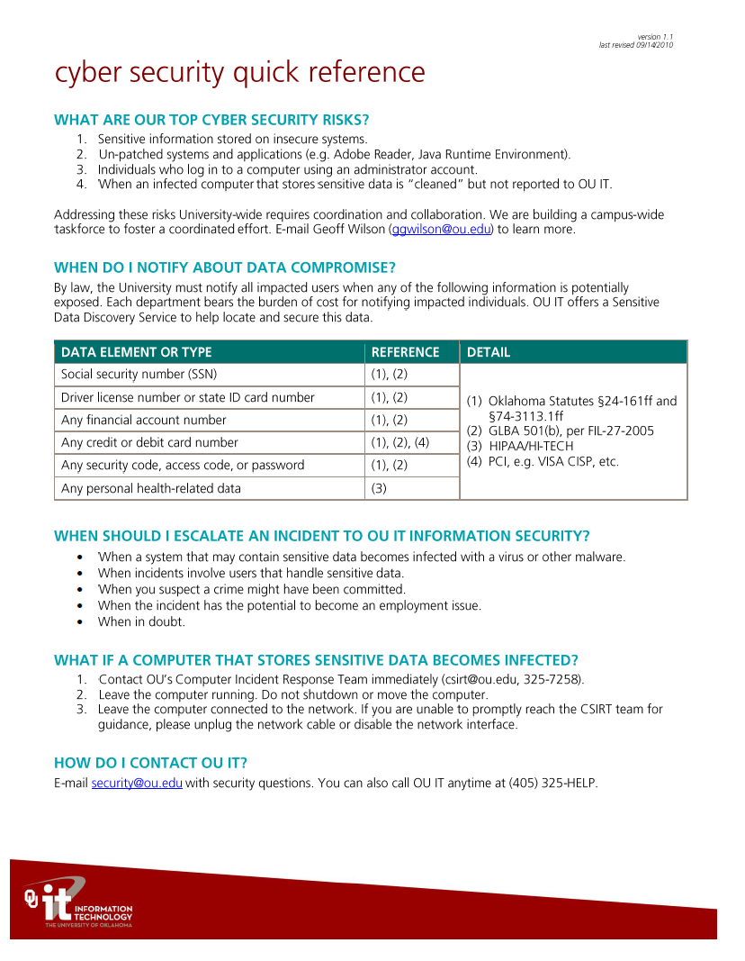

Slide 51
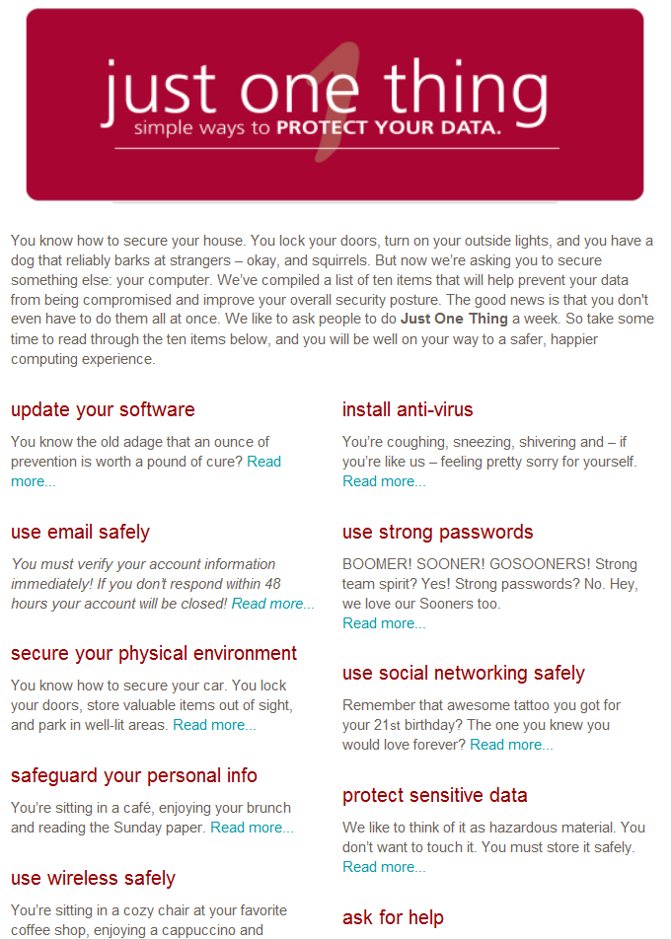

Slide 52
Party Plan
Know if you are missing the party
Party foul example: malware infections
Making time for the party
Be the life of the party
Party favors

Slide 53
What can you do on Monday?
Identify your institution’s top 5 reaction cycles
Schedule your first 5 whys session to discuss incident root causes
Begin collecting statistics on your reactive cycles to help you measure actual cost
Pick the relevant criteria for your planning community building efforts. Plot 10 organizations on a graph to visualize your community building strategy

Slide 54
Don’t forget your party favor!
Geoff Wilson
ggwilson@ou.edu

Slide 55

Questions?
www.educause.edu/E2011/Program/SESS133

