Slide 1
Demand Aggregation: The Higher Ed IT Chessboard
Brad Wheeler
Vice President for IT, CIO, & Professor
Indiana University
© 2011 Brad Wheeler, Creative Commons Attribution 3.0
http://www.spoki.lv/upload/articles/34/349681/images/_origin_Daudz-bildites-4.jpg

Slide 2
“In recent weeks and months, this list has assessed our buy-side concerns for higher education IT regarding:
Costs of Internet bandwidth (wildly varying prices, situations vary)
Costs of ERP maintenance (ouch)
Structure of sell-side vendors/products following various actions of the capital markets”

Slide 3
“We would all like to buy in (near) perfect markets where lots of buyers and lots of sellers match offers to buy/sell for rapidly improving products with low switching costs to guard against egregious cost escalation.
But….that is not our world,
…and it will be less so as the sell-side aggregates/consolidates and the buy-side (us) remains highly fragmented. The economic trends regarding pricing (what we call cost) are perfectly predictable, and the last decade provides much empirical evidence of those economics.”

Slide 4
“Thus… it is time for a productive conversation among the buy-side regarding how our collective behaviors and $$ can re-balance the economic chessboard for this decade.”

Slide 5
Chessboard Questions:
If we assess the last 20 years of buying, what are the macro lessons? What do we wish to make different?
What approaches are available and effective for the buy-side of the chessboard?
To what extent is Demand Aggregation a solution to rebalance interests of buy/sell? If so, how?

Slide 6
Discussion

Slide 7
Above-Campus Services Shaping the Promise of Cloud Computing for Higher Education by Brad Wheeler and Shelton Waggener
Illustration by Randy Lyhus ©2009
EDUCAUSE Review, Nov/Dec 2009

Slide 8
4 October 2011

Slide 9
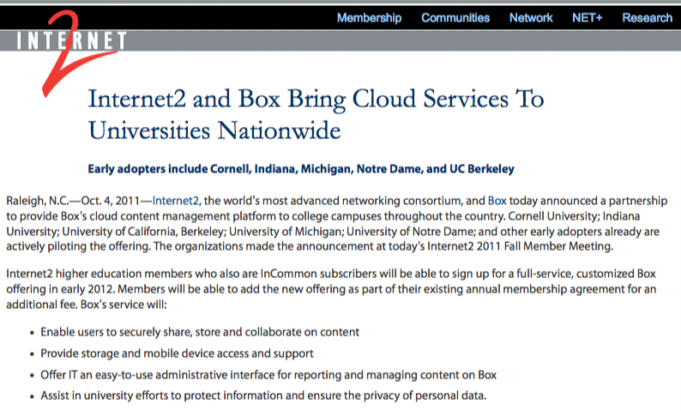
4 October 2011

Slide 11
Continuing the Chessboard Dialogue…Options?

Slide 12
Demand Aggregation: The Higher Ed IT Chessboard
Brad Wheeler
Vice President for IT, CIO, & Professor
Indiana University
© 2011 Brad Wheeler, Creative Commons Attribution 3.0

